Slide 1
Steps 1a: Creating Common App Account / Signing the FERPA Release Waiver
Student Process
Students should follow the steps in this video to learn how to setup their Common App account & how to sign the FERPA Release Waiver.

Slide 2
Step 1b: Matching the Common App Account in Naviance
Student Process
Students should follow the steps in this video to learn how to match their Common App Account in Naviance.
Go to Colleges I’m Applying To List
Select the hot pink bar to Match Accounts
Enter the email address used for the Common App account
Confirm that the birthdate is correct
Select Match Accounts
Once a student has matched their account, schools from their application list in Common App will feed into their Colleges I’m Applying To list in Naviance

Slide 3
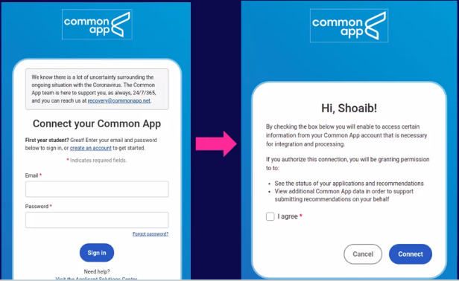
Match your Common App Account (Video: 2021 Common App Account Matching)
Select Match Accounts.
Students will be redirected to log into their Common App account
Enter the email address that you used in Common App account
5. Select I agree option and Connect button
4. Enter password
All your Common Applications will automatically feed into your Colleges I’m Applying to list in Naviance. Now, you should request transcripts & Letters of Recommendation in Naviance!

