Slide 1


Argyle Kindergarten
C
Mensaje de la Directora
Spanish.
Principal’s message English.

Slide 2
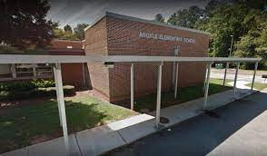
Welcome to kindergarten!

Slide 3

Contact Information
Address: 2420 Spring Road
Smyrna, Ga. 30080
Phone: 678-842-6800
FAX: 678-842-6802
School Website: https://www.cobbk12.org/argyle

Slide 4
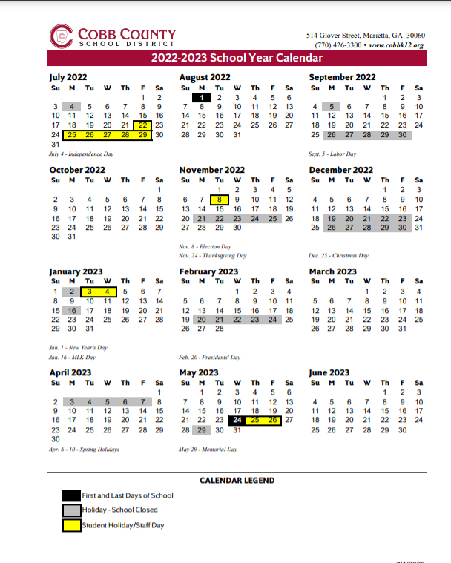
2022-2023 School Calendar

Slide 5

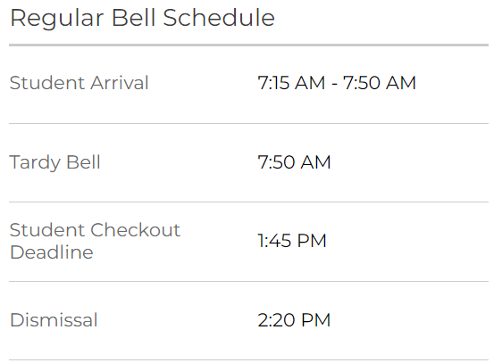
School Hours

Slide 6
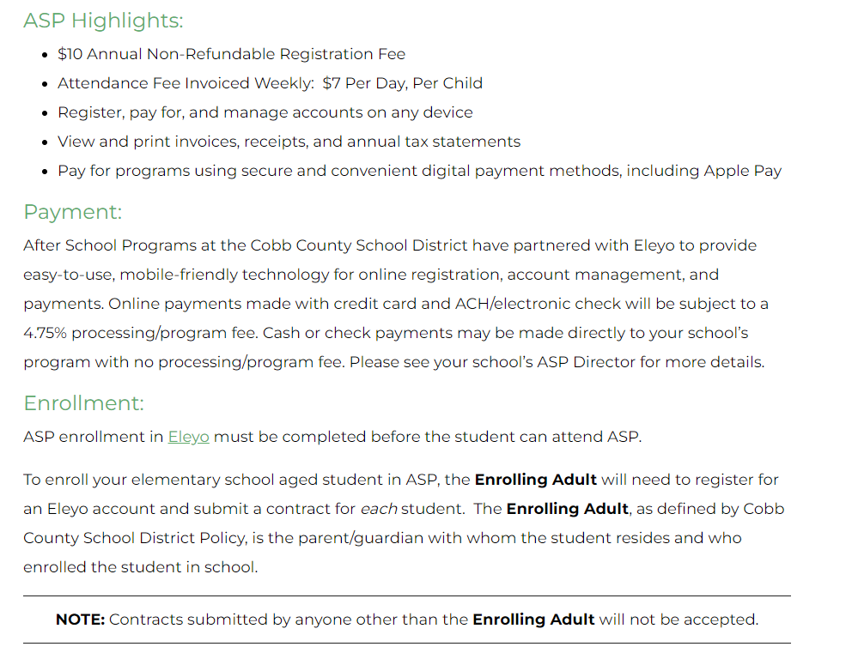

After School Program (ASP)
Hours- 2:45p.m.-6:00p.m.
ASP Registration Link: You must Register Here through Eleyo

Slide 7
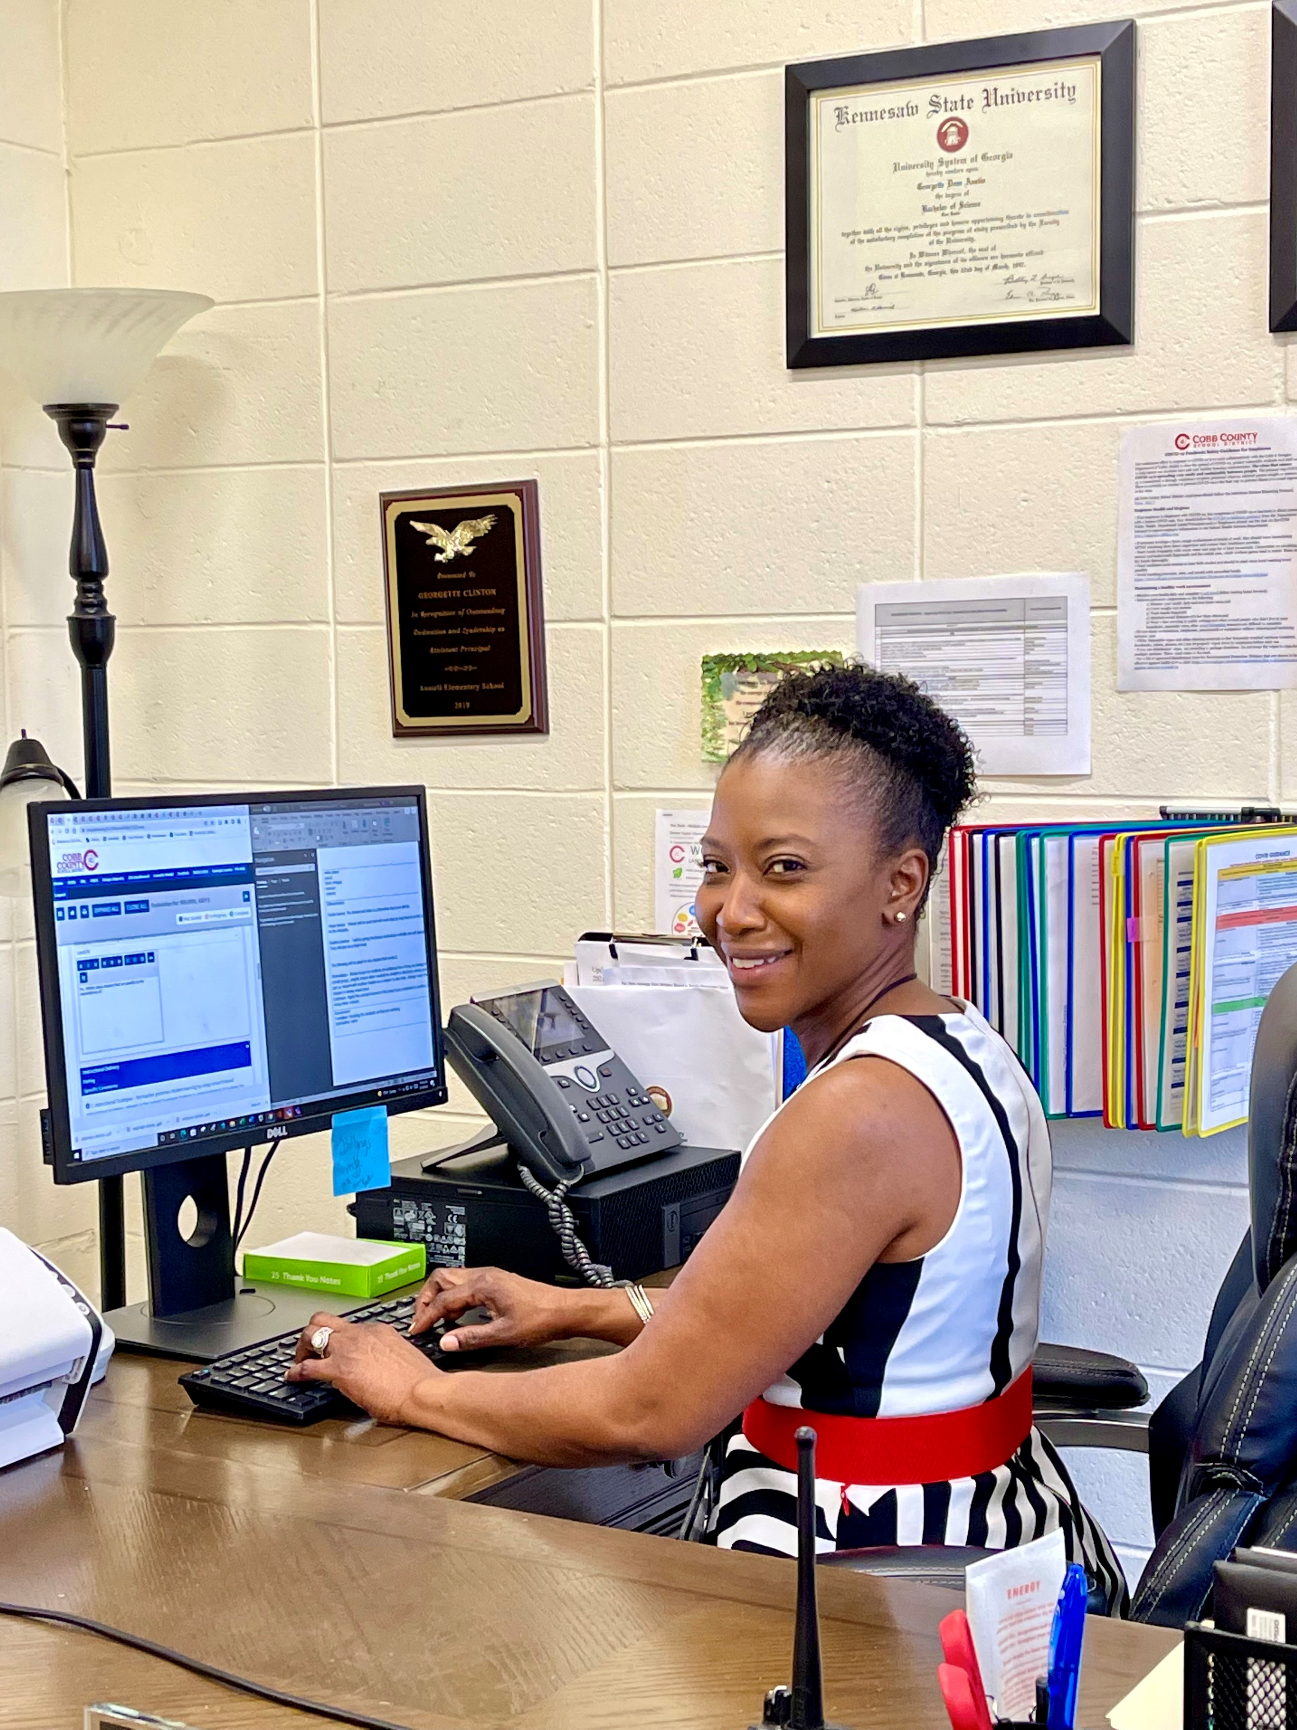
Meet Argyle’s Principal: Georgette Clinton

Slide 8
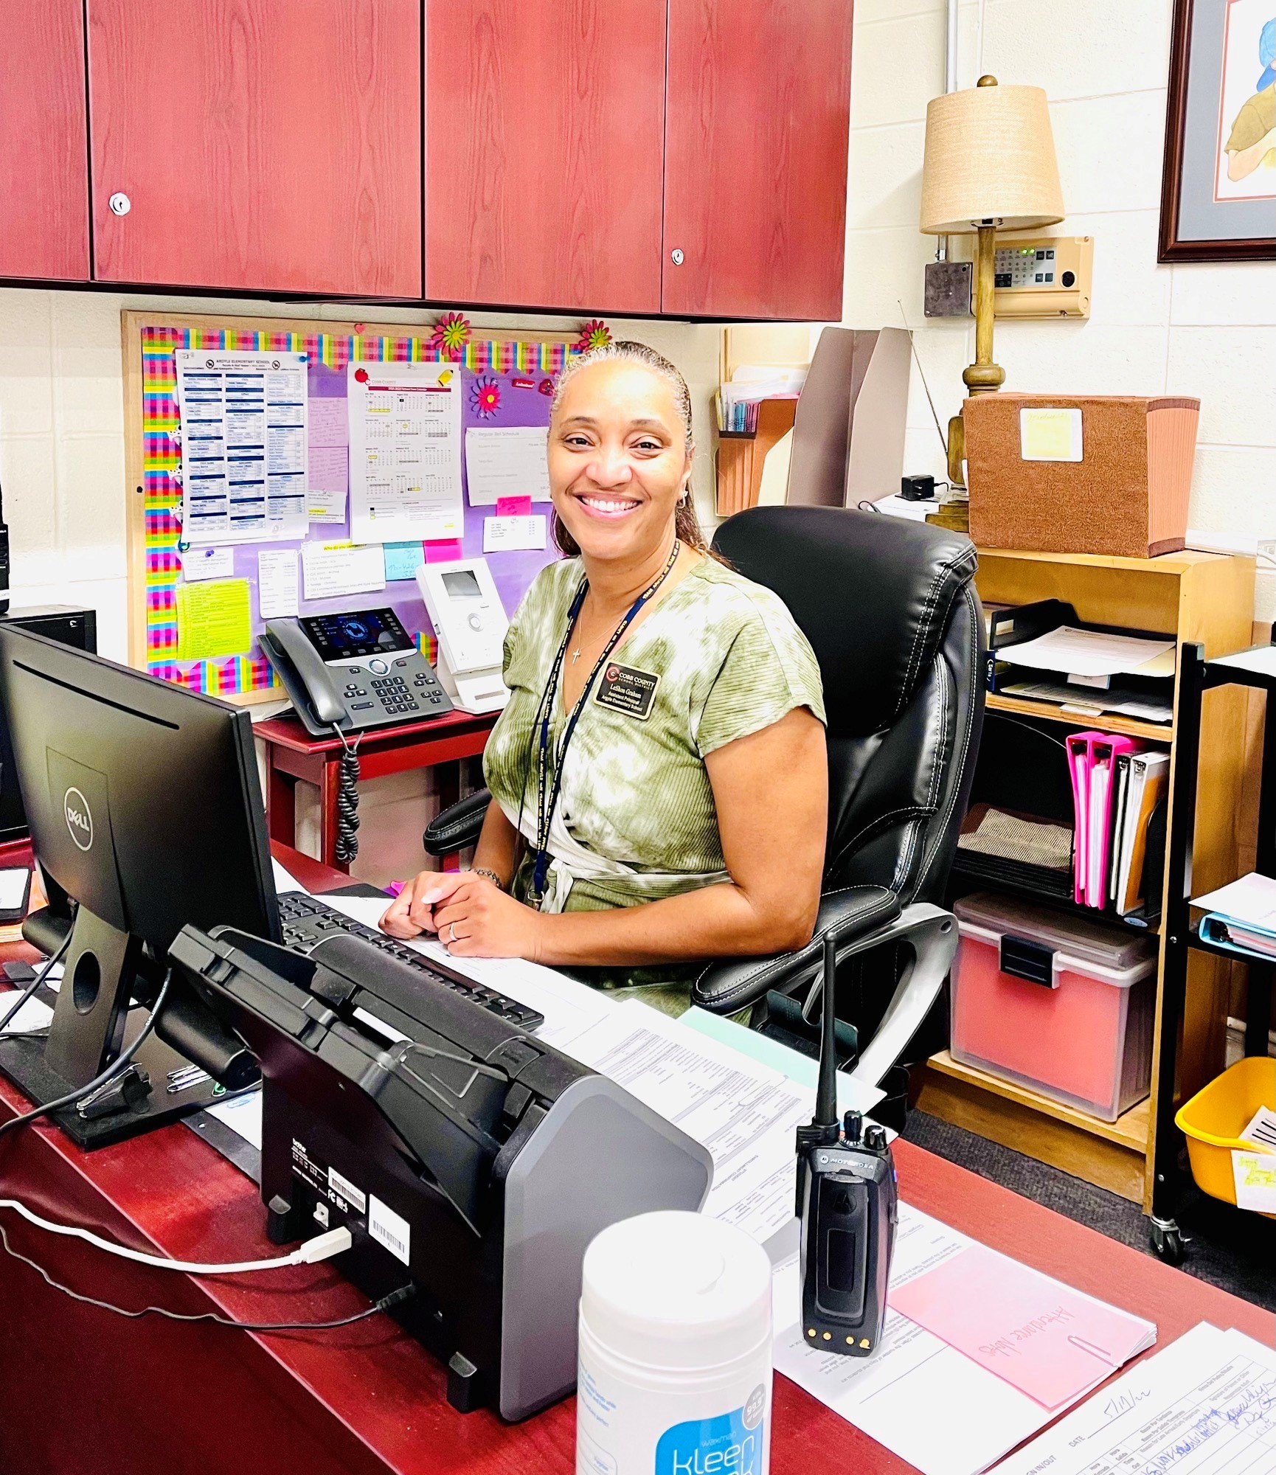
Meet Argyle’s Assistant Principal: Leshon Graham

Slide 9
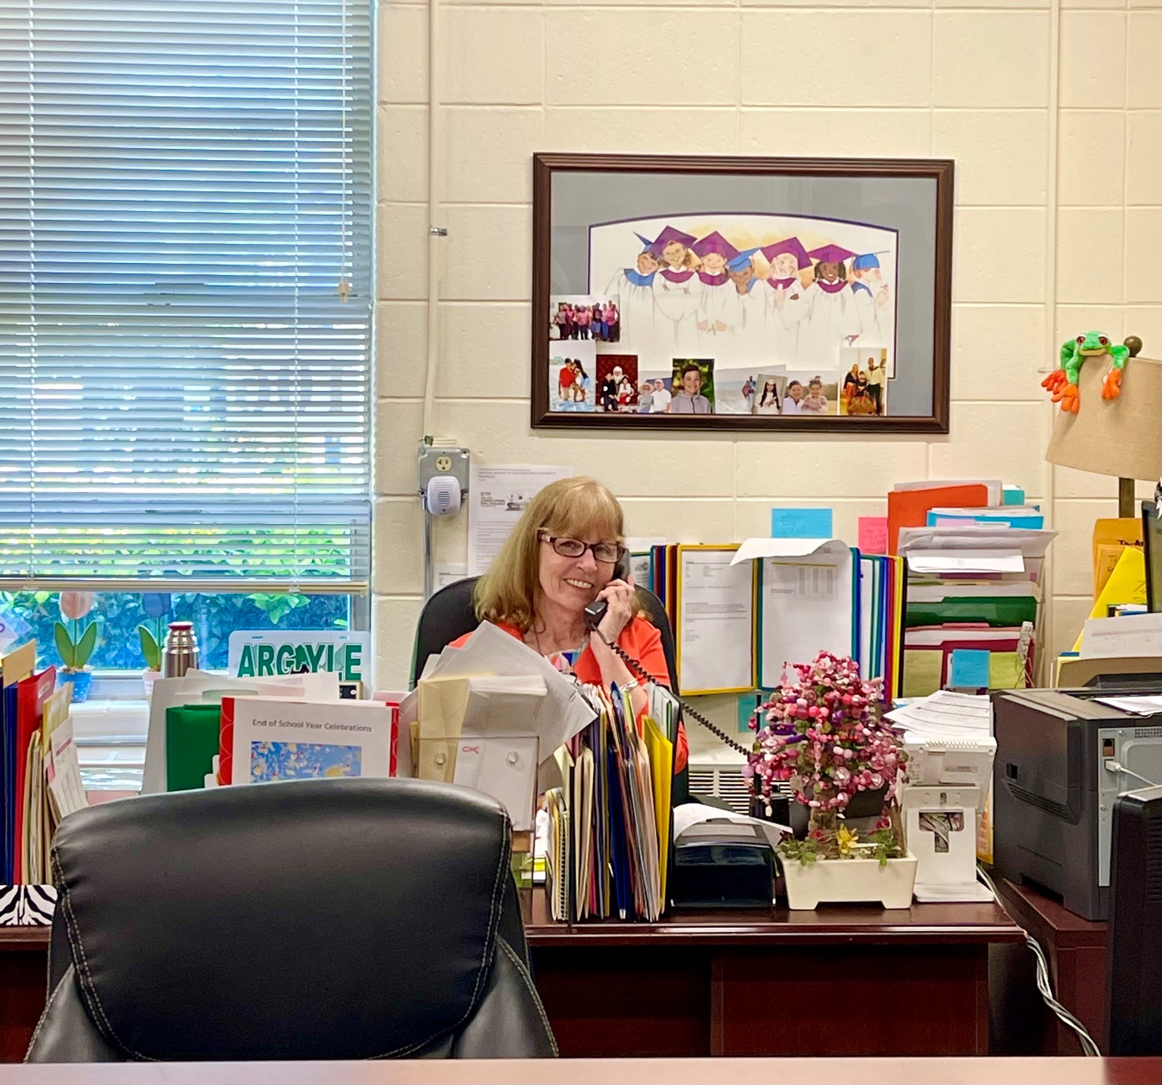
Meet Argyle’s secretary: Donna Ellis

Slide 10
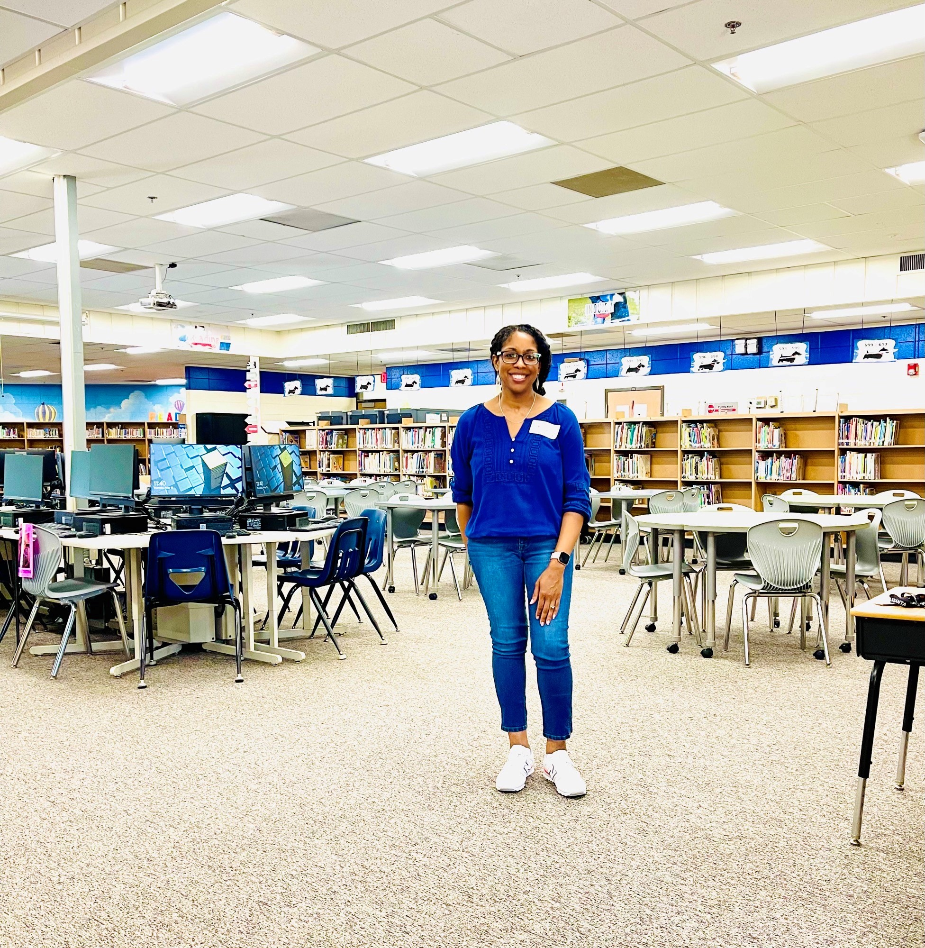
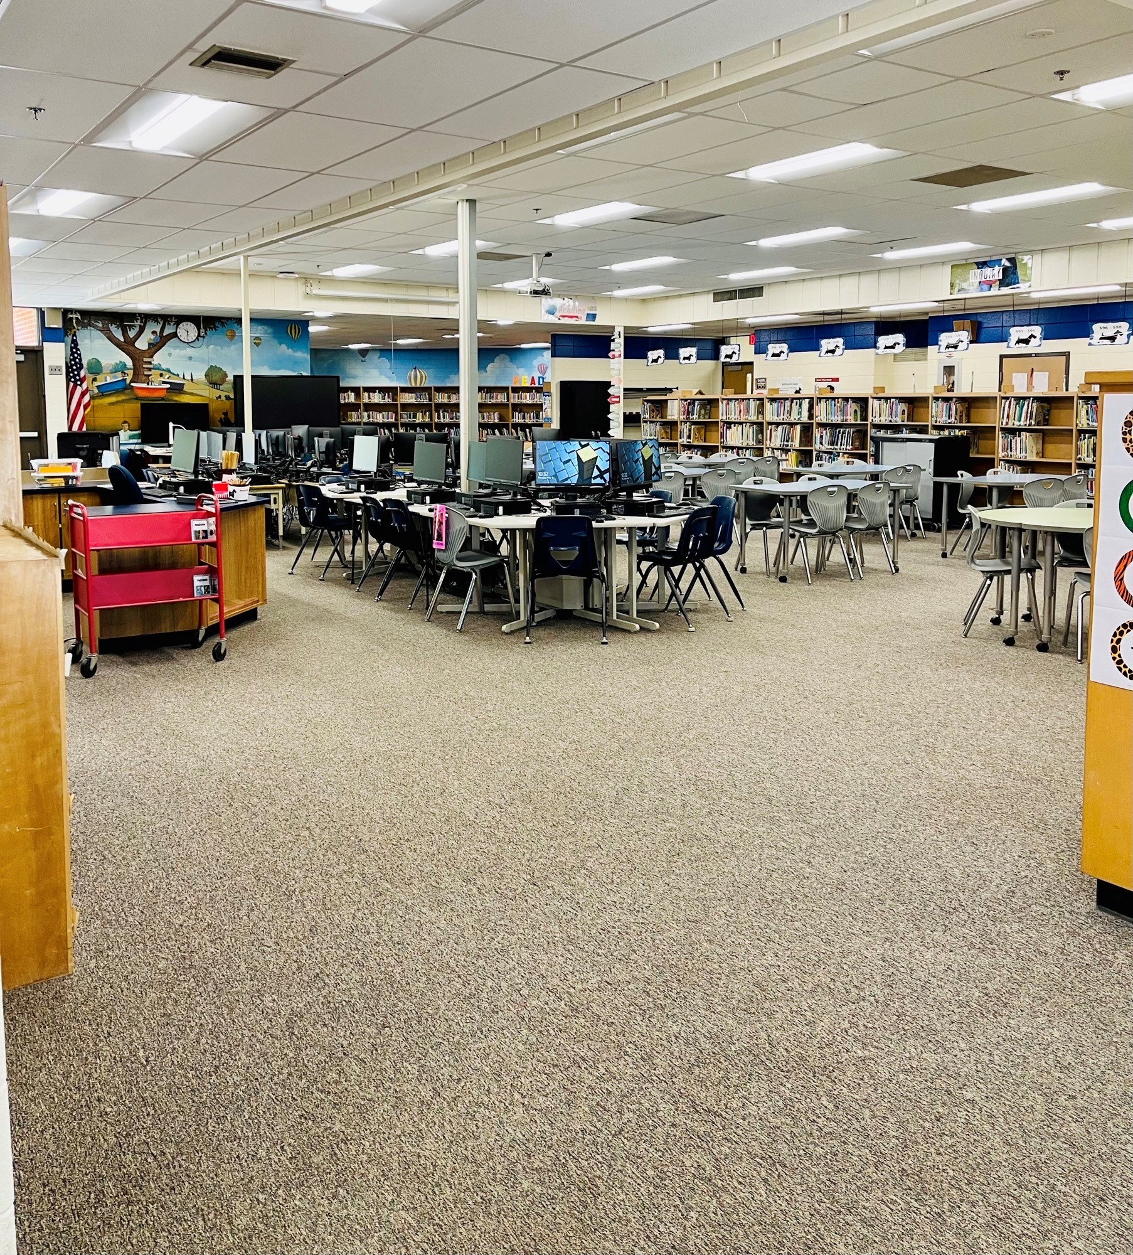
Meet Argyle’s Media Specialist: Roshanda Wilson

Slide 11
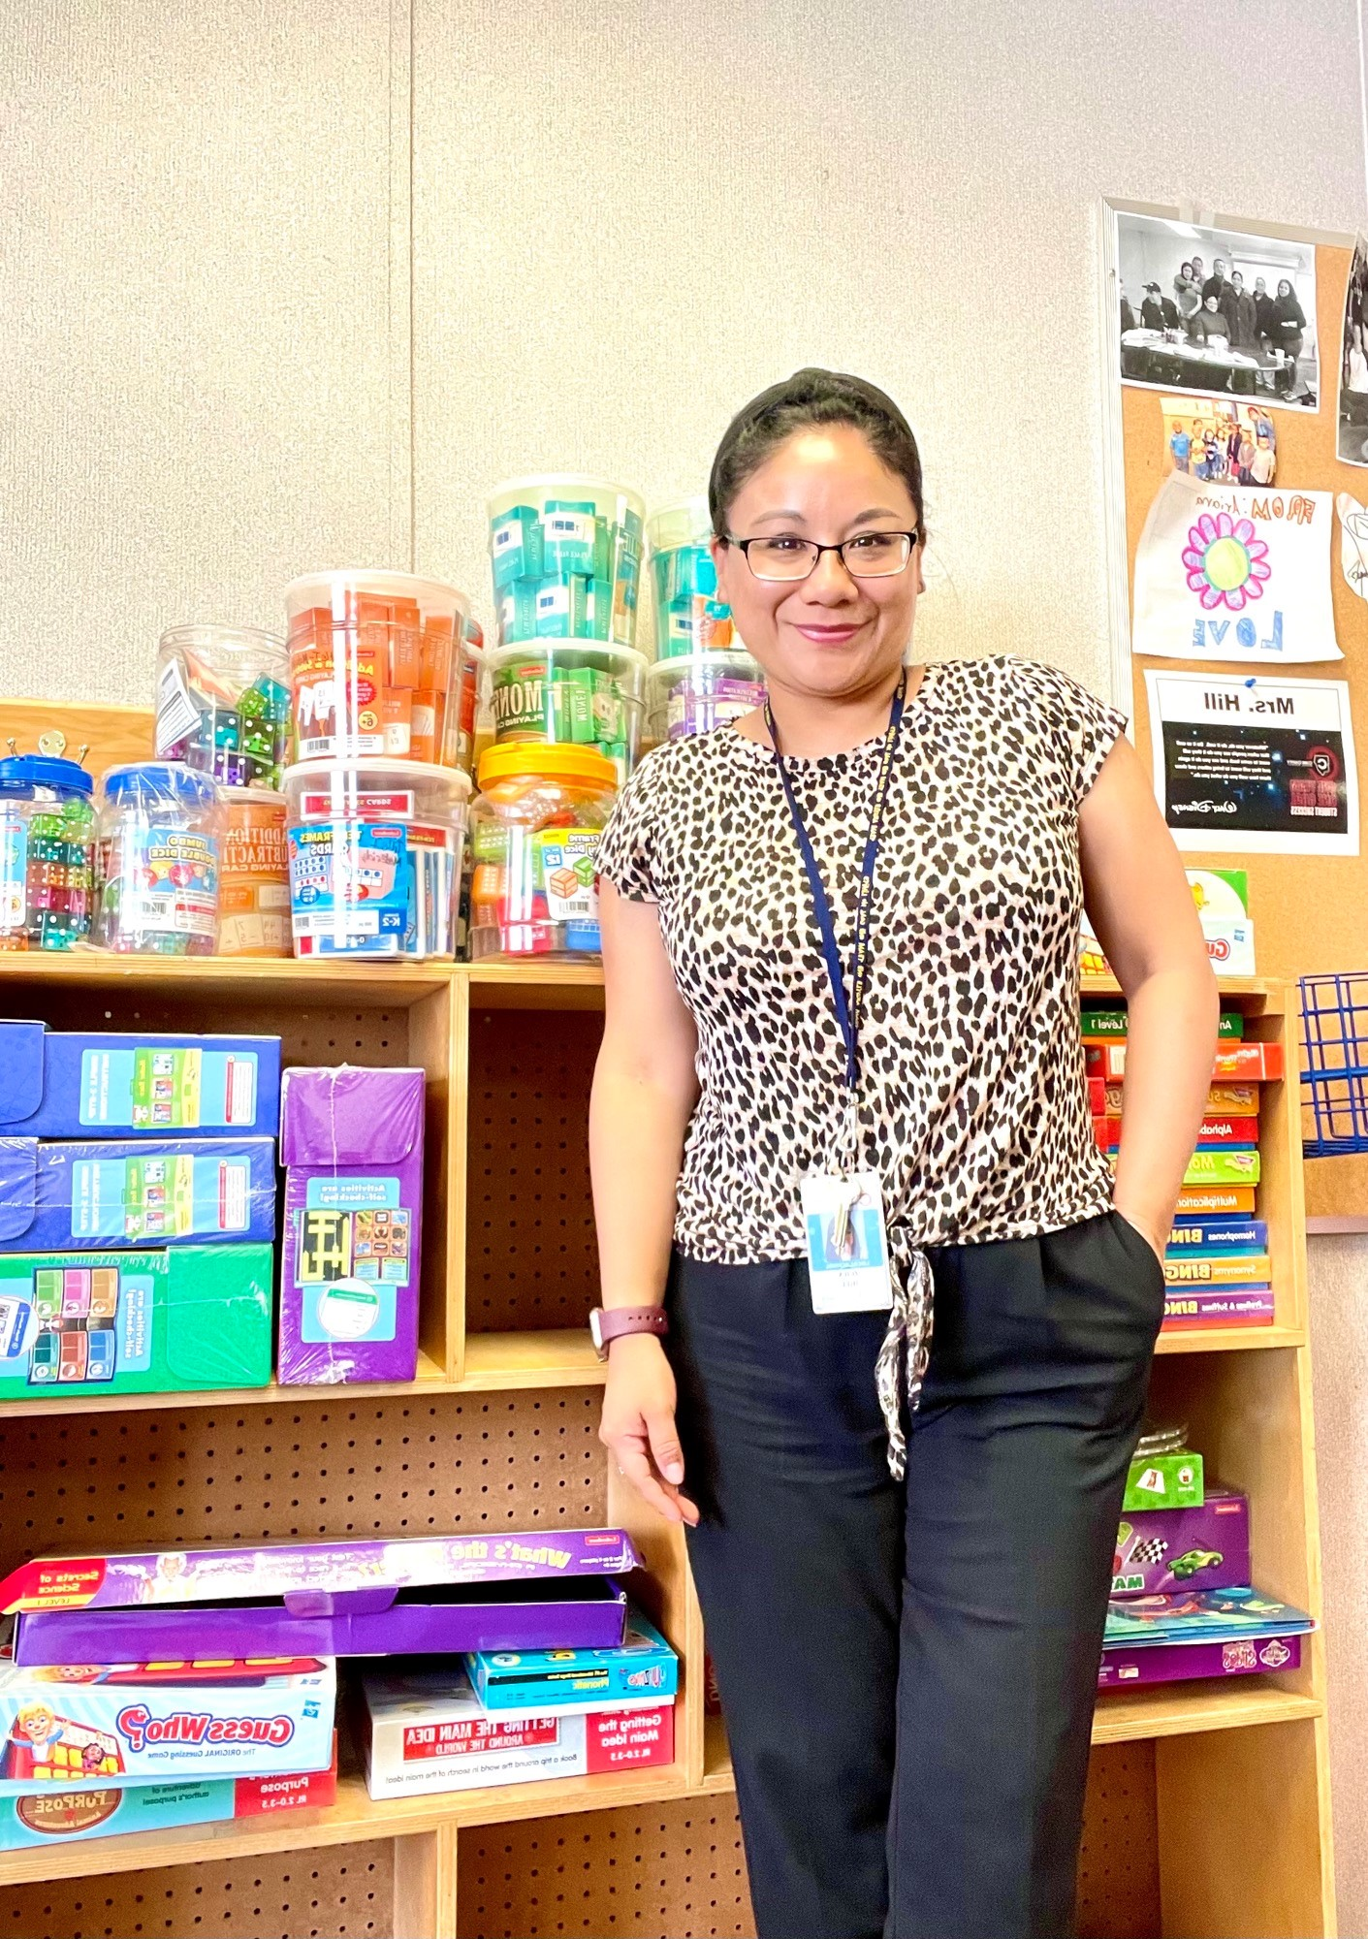
Meet Argyle’s Parent Facilitator: ZoilA Hill

Slide 12
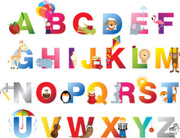
Sample Kindergarten Schedule
7:50-8:10 – Morning Meeting/ Social Emotional Learning
8:10-9:10 – Math
9:10-9:40 – AIB (Intervention Block)
9:45-10:30 – Specials (Art, P.E., or Music)
10:35- 11:35 -Reading
11:35-11:50 - Recess
12:05-12:35 – Lunch
12:40-1:35 – ELA
1:35-2:10 – Social Studies/Science
2:15 - Dismissal

Slide 13
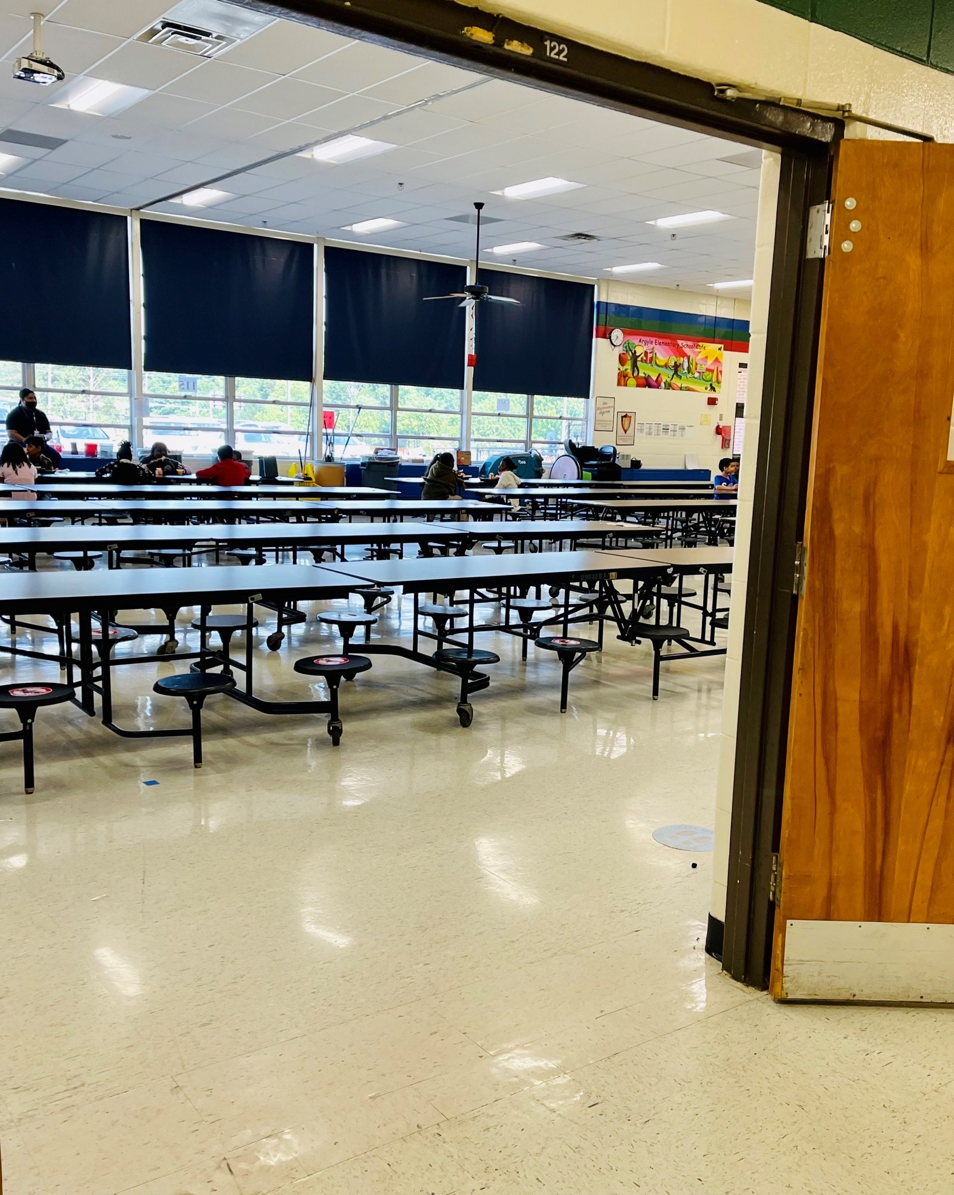
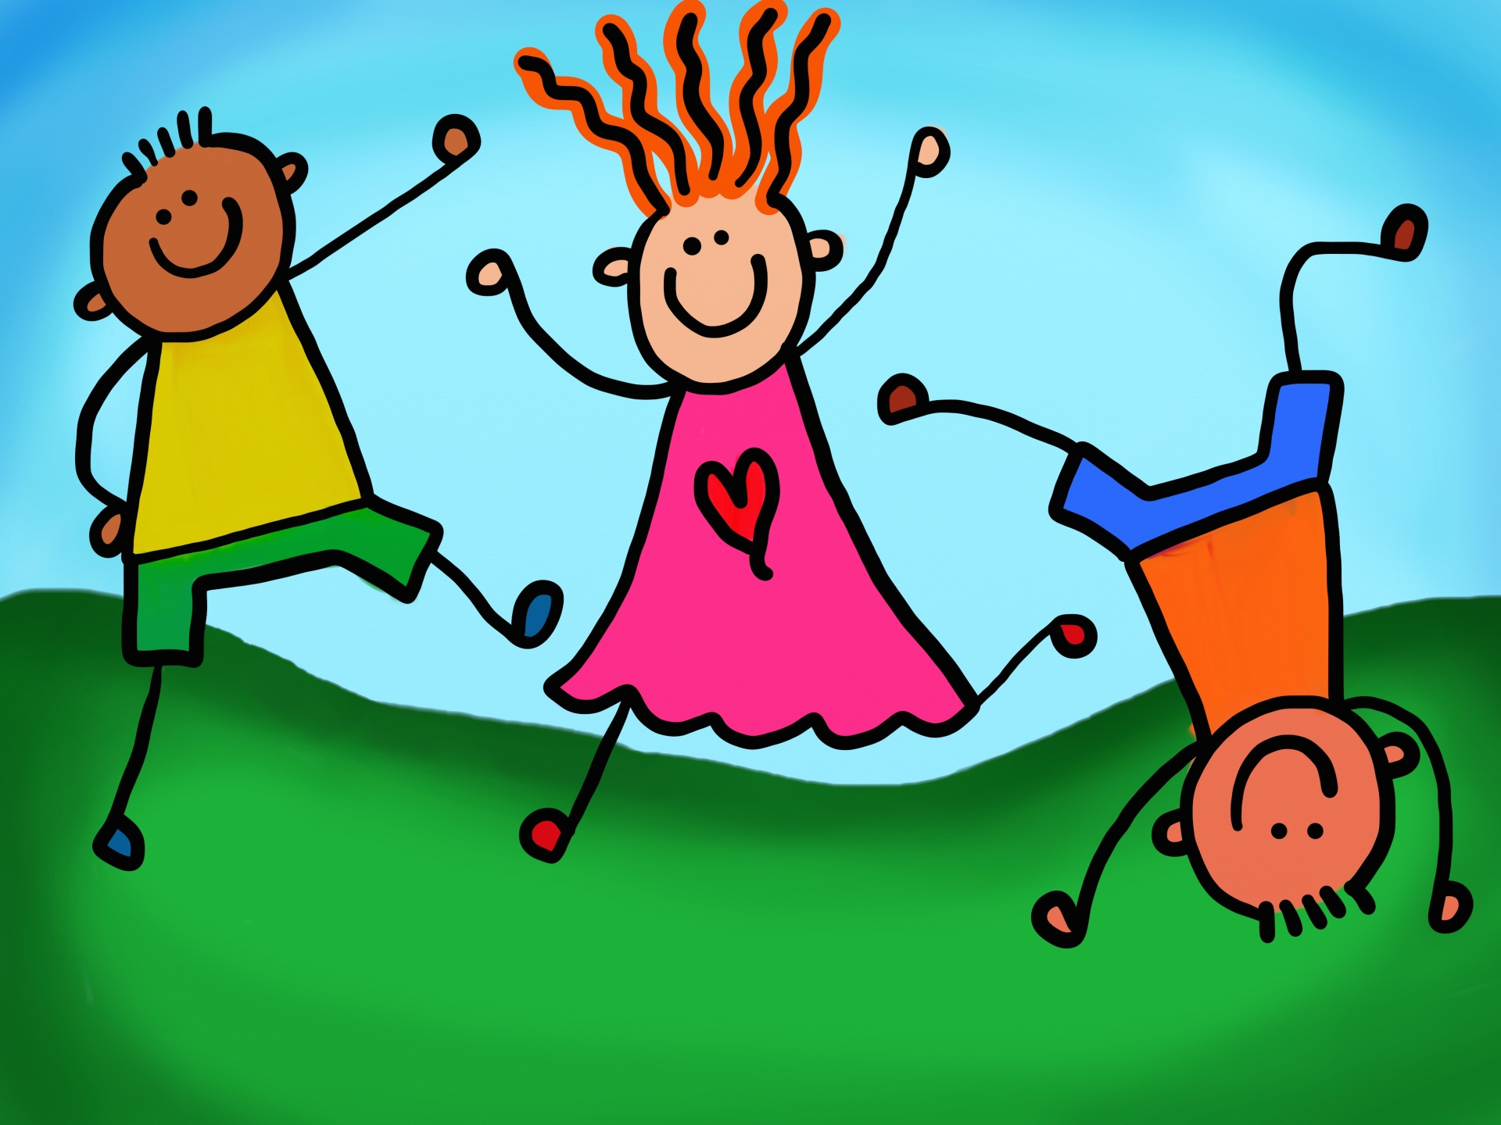
Lunch/ Recess
Breakfast is served each day until 7:50 a.m.
Kindergarteners eat lunch in the cafeteria with their class. Lunch lasts for 30 minutes each day.
Kindergarten students have recess for 15 minutes each day.

Slide 14
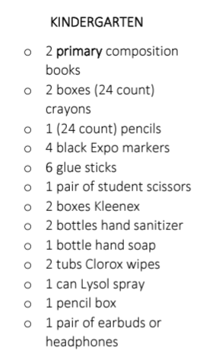

Suggested Kindergarten School Supply List

Slide 15
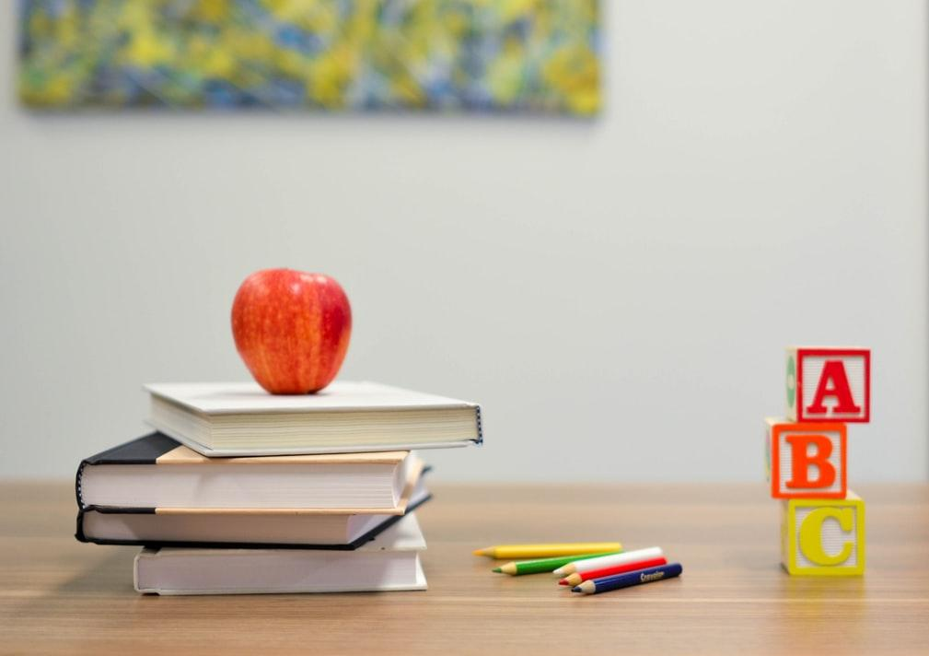
Classroom Expectations
Each Kindergarten class consists of a teacher and a paraprofessional for additional support.
What do students learn in Kindergarten?
Link: https://www.cobbk12.org/page/42502/kindergarten-learning

Slide 16

Quarter 1 Learning Standards
Reading, Writing, Words | Math | Science | Social Studies
Argyle participates in Cobb County’s Early Literacy Fluency Initiative Students will be taught 2-3 new letters and letter sounds each week Students are expected to identify the letter, letter sound, and be able to write both the uppercase and lowercase letter Students will learn 3 sight words a week. The expectation is to identify at least 75 sight words by the end of Kindergarten. | Students should be able to identify 2-D shapes (circle, square, rectangle, square) Identify 3-D Shapes (sphere, cube, cylinder, cone) Explain how these shapes are alike and different Count objects up to 10 in different arrangements (Circle, straight line, scattered) Write numbers correctly (0-10) Use positional words to describe relative location (above, below, beside, next to, under) Count to 50 by ones | Compares and sorts objects made of different materials (paper, plastic, wood, paper, metal) Classify objects according to physical attributes (color, size, shape, weight, and texture) Predicts and observes whether objects sink or float | Identify the United States and Georgia Flag Describe the work that people do Explain why we make and follow rules Identify land and water on a map and globe Distinguish goods and services

Slide 17
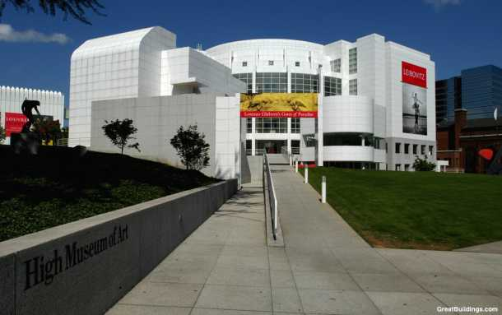
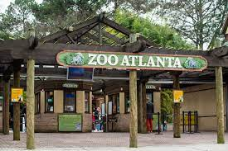
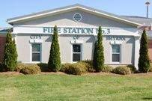
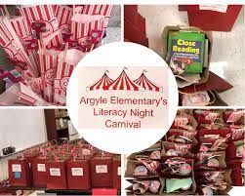
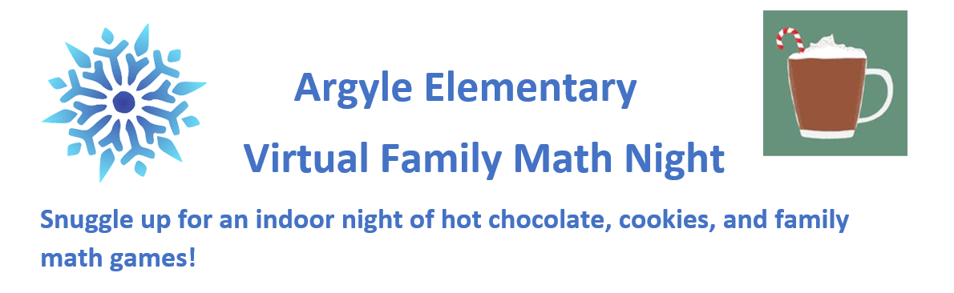
Field Trips/ Family Events
High Museum of Art
Zoo Atlanta
Smyrna Fire Station

Slide 18
We LOOK FORWARD TO SEEING YOU IN THE FALL!
Any questions?
Contact: 678-842- 6800

