Slide 1
Parent Communication
CCSD School Health Services
COVID Re-entry Team

Slide 2
Clinic goals
Create an environment where children and staff can return to school F2F
Minimize potential exposure
Communicate with parents and staff as needed

Slide 3
What will the clinic look like this year?
Only one child will be allowed in the clinic at a time
All minor complaints, accidents and injuries will be handled in the classroom
Each classroom will have a First Aid Station
Each child must have a change of clothes in their backpack for unforeseen accidents (bathroom, lunch, playground, etc.)
The clinic will NOT have any clothes to offer
A parent will be called to handle the situation if clothes are not in their bag.

Slide 4
How can you help?
Be Patient
Please do a daily screen of your child every morning before school
Use the Decision tree provided
https://secureservercdn.net/45.40.150.136/2hf.82a.myftpupload.com/wp-content/uploads/2020/09/Health-Checklist_Digital.pdf
Send your child to school every day in a mask
Complete the clinic card and make sure all contacts and emergency contacts are correct and working numbers
If you are contacted to pick up a sick child, please pick up ASAP (1hr window)
Frequently asked questions regarding COVID
https://www.cobblearningeverywhere.com/faqs/
Give all once a day medication at home before school if possible
If a scheduled medication is needed at school, please contact your school nurse to discuss a plan.

Slide 5
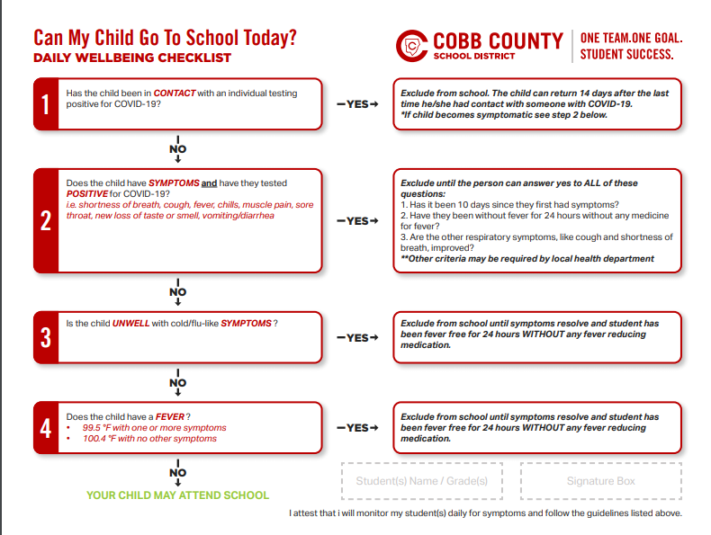

Slide 6
Medication drop off
Medication drop off will be by appointment only the week before Fall Break
Be prepared for drop off
Check expiration dates
Print and complete all forms before drop off
https://www.cobbk12.org/page/11005/medical-forms-and-care-plans
Authorization to give medication
Asthma Action Plan
Food Allergy Action Plan
Anaphylaxis Action Plan
Seizure Action Plan and Doctor orders for Emergency Seizure medication
Place all forms and medication in gallon size Ziploc bag

Slide 7
Things to keep in mind…
Flu season is happening now
Flu and COVID symptoms are similar
Students with COVID like symptoms will be monitored by staff in a separate waiting room until picked up by parents
The health and safety of our students and staff is a priority
We are in this together
Please contact your School Nurse if you have any questions or concerns

