Slide 1


Programs & Placement
Shallowford Falls

Slide 2
Mission and Vision
Shallowford Falls:
Mission: Relationships, Rigor and Relevance for All
Vision: A school of excellence where learners reach their full potential

Slide 3
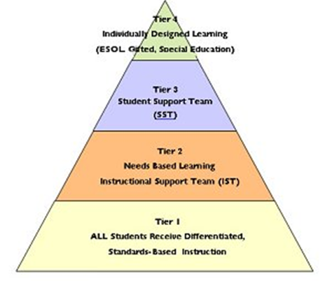
RTI – Response to intervention

Slide 4
Programs
General Education
  EIP (15%)
  ESOL ( 2%)
  AC You do NOT have to be gifted identified (Target) to qualify
Special Education/Focus/DHH ( 18.2)
Gifted Education – Target ( 34%)

Slide 5
EIP or Early Intervention Program
Governed by district and local criteria
Looks different from school to school
3 Models: Pull Out, Push In, Reduced Class
Could be reading or math or both (deficits in ELA/Math)
Assess in August and May
Rising K are screened in summer for EIP

Slide 6
ESOL
Governed by the state
Looks different from school to school
2 Models: Pull Out or Push In
Identified through the Home Language Survey (Questions) on the registration form.
Screen new students in August
Assess progress in January

Slide 7
Special Education
Governed by National laws
Student needs vary greatly as do services- based on IEP
Services include consult, additional support, co-teaching, small group, units
Assessment through RTI Tier 4
Students can be twice exceptional (gifted and special education)

Slide 8
Advanced Content (AC)
Governed by the state and district
District established criteria include Ability, Achievement, and Motivation
Offered only in 4th & 5th Grades
ELA/Reading or Math
Coursework is advanced and faster paced
Can be AC without being gifted identified

Slide 9
Gifted Education –
Referred to as Target/ALP in elementary school
Governed by State Laws
Criteria includes Ability, Achievement, Motivation and Creativity
Assessment through RTI Tier 4
  Automatically assessed in 1, 3, and 5 grades
  All Kindergarten students are screened using reading and math inventories
Pull out model for 1 full day
Can be in Target and not in Advanced Content

Slide 10
General Education
Innovative curriculum options such as
  Talent Development
  Curriculum specific focus with flexible grouping for students
  Tutoring- Extensions
  WIN time
Guided Reading and math groups
K – 2nd grades: IRead
3rd – 5th grades: Read 180 & System 44
4th & 5th Grades: Advanced Content

Slide 11
Anticipated # of classes at each grade level
& class sizes
Kindergarten – 5
1st Grade – 5
2nd Grade – 4
3rd Grade – 4
4th Grade – 4
5th Grade – 5
18 – 25 (23)
18 – 26 (24)
18 – 26 (24)
18 – 26 (24)
25 – 33 (30)
25 – 33 (30)

Slide 12
Classroom placement
Administration and current teacher place students based on student achievement data, social/emotional needs and classroom environment
Students are cluster grouped (AC is the exception)
Teacher assignment will be communicated in July via CTLS
Parent input – not required, but may send a letter to Mrs. Long if you feel you have valuable information- do not list specific teacher
Notes:
Cluster grouping is a placement of students with similar needs and abilities in order to have like peers and a large enough group for teachers to meet their needs.

Slide 13
Cluster Grouped classrooms vary for every classroom – Examples include but are not limited to the following
1/3 SpEd
1/3 Gifted
1/3 General
1/3 EIP or ESOL
1/3 Highly Able
1/3 General
1/3 General
1/3 Gifted
1/3 Low Av
1/3 EIP or ESOL
1/3 Gifted
1/3 General
1/3 SpEd
1/3 Highly Able
1/3 General
1/3 Low Av
1/3 Highly Able
1/3 General
1/3 High Av
1/3 EIP
1/3 General
1/3 General
1/3 SpEd
1/3 Highly Able

Slide 14
2022-23 School Year
New Orientation
Flyer and CTLS message – Wednesday

Slide 15
Q & A

