Slide 1

9th Grade Elective Registration
“Reaching Out and Moving Forward Toward Student Success!”

Slide 2
SCHS Course Catalog
Your school website will post the South Cobb High School
9th Grade Course Catalog.
Students and parents should read about all the courses that we offer and get an idea of what ELECTIVES we offer at South Cobb HS.

Slide 3
High School Credit
8th grade students who have
TAKEN and PASSED
the 1st level of Spanish, French, HS Art, Audio/Video I or Healthcare should select the 2nd level of those courses since HS credit for Level I will already be earned.

Slide 4




Core Classes - Registration
9th Grade CORE classes are based on 8th Grade
TEACHER RECOMMENDATION.
Teachers are basing their placement into core classes based on a Recommendation Guideline sheet. South Cobb HS does NOT make core placements.

Slide 5

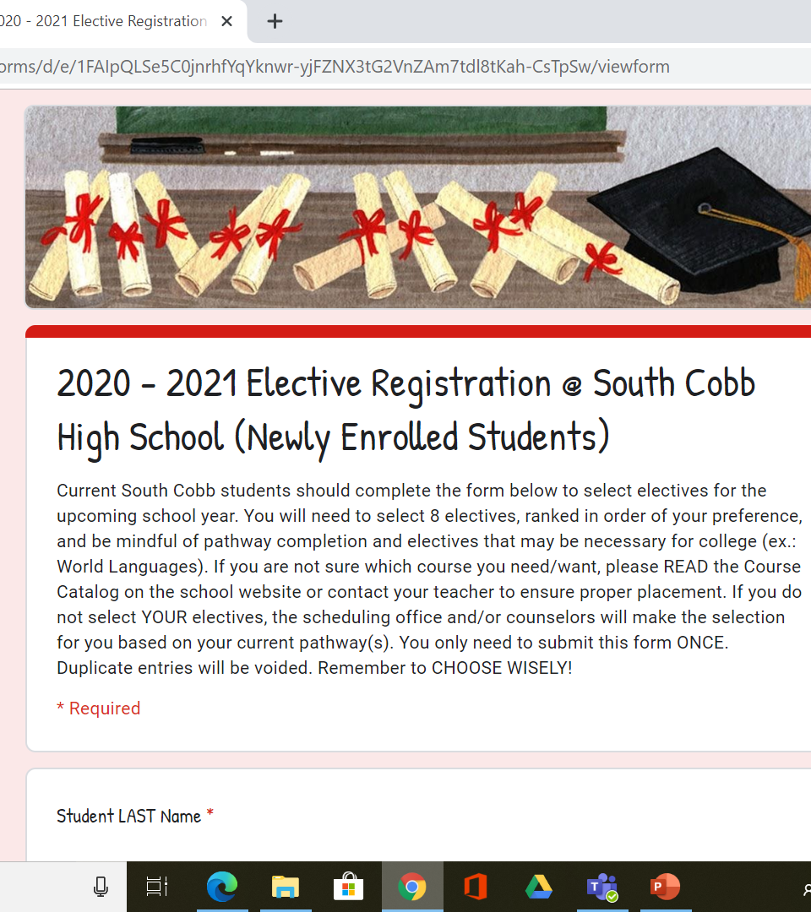
On-Line Elective Registration

Slide 6

On-Line Elective Registration
Students will receive an on-line registration link to select their electives for the coming year.
Students will select 8 electives.
Students get 4 of the 8 classes they request. There is NO DROP/ADD for electives!
Choose Wisely!

Slide 7
On-Line Elective Registration
If you do NOT make your 8 elective choices during the one week of elective registration…..
1. The counselors at SCHS will select the electives for you
AND
2. You CANNOT request a schedule change
Choose Wisely!

Slide 8



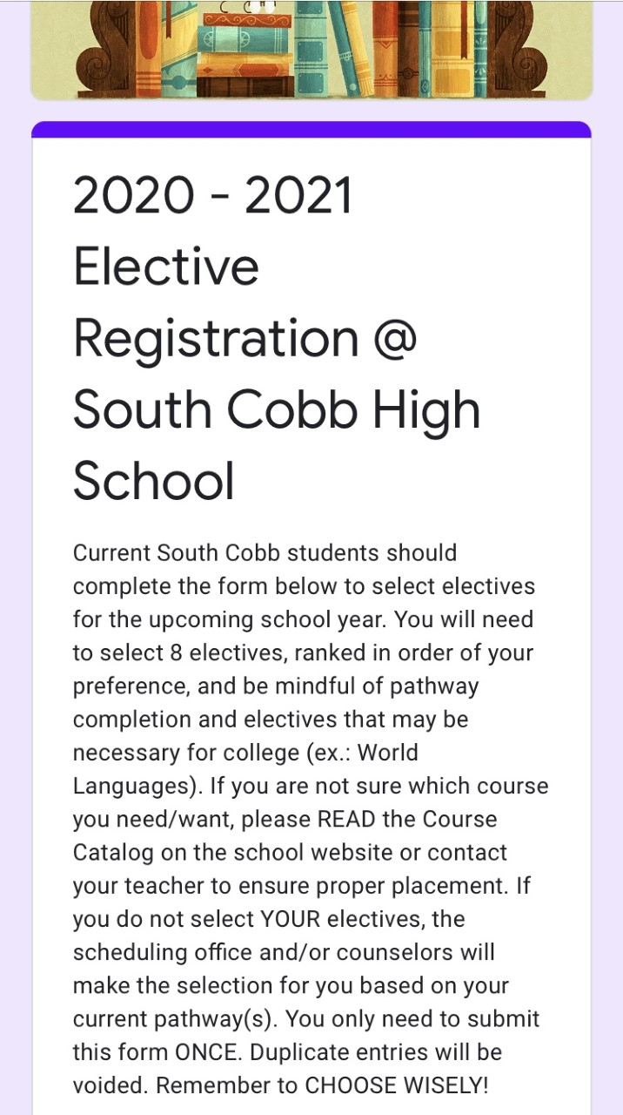

Elective Registration is Online!
February 7 -11, 2022
Registration CLOSES at 3:30 p.m. on February 11th
Students and Parents should discuss the electives and make decisions TOGETHER.
Choose Wisely!
8

Slide 9

READ the course catalog to learn about the course you are selecting.
Students should remember to focus on PATHWAY COMPLETION and seek out those electives that will help with this goal. Once you start, we help you finish.
Students should remember that there are ACADEMIC pathways as well as CAREER & FINE ARTS pathways.
Students should make WISE SELECTIONS since you CANNOT do drop/add for electives YOU selected.

Slide 10

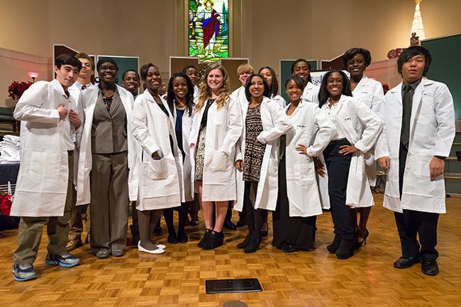

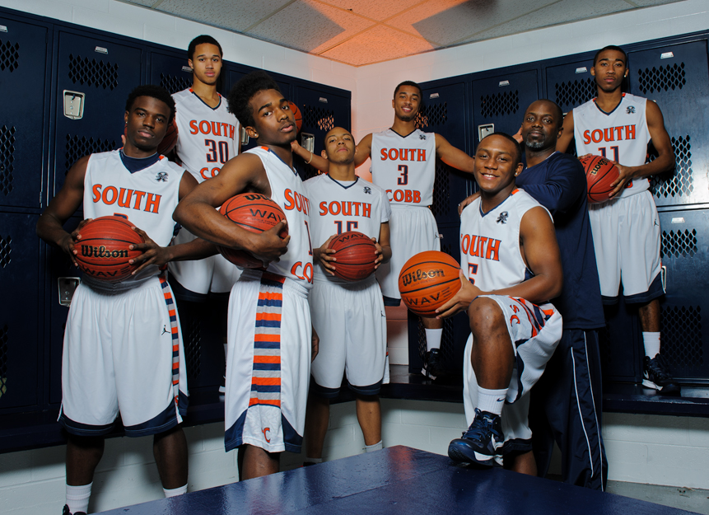
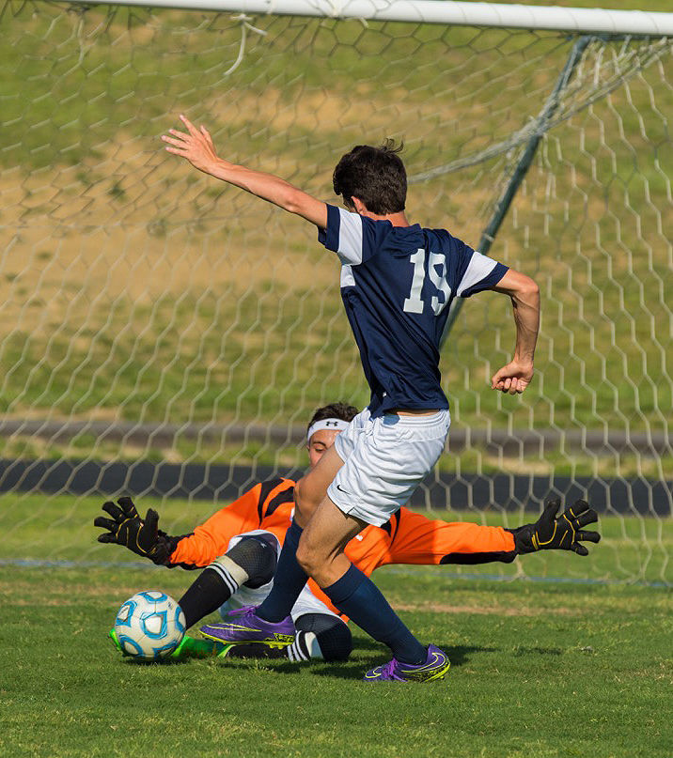
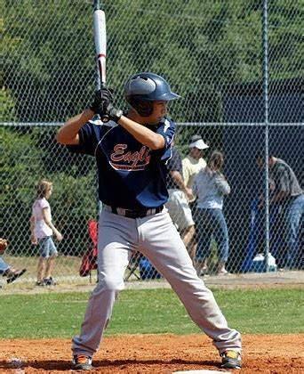
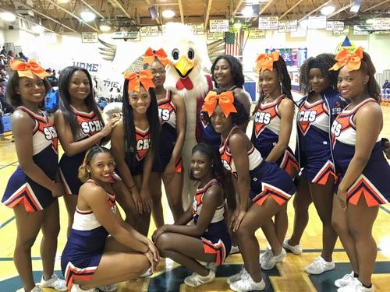

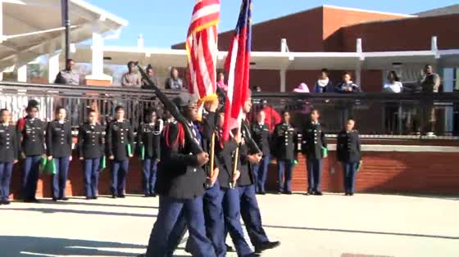




Welcome to South Cobb!

