Slide 1
Class of 2021 Commencement Meeting

Slide 2
Welcome
Valencia Andrews, Assistant Principal
Graduation Administrator

Slide 3
Meeting Purpose
To share information with graduating students and parents about remaining activities and responsibilities prior to commencement on
June 1, 2021

Slide 4
How To Stay Informed
Graduation information is posted on the Campbell website. Please check frequently for information and updates.
The Cobb County School District also maintains a website with graduation information (www.cobbk12.org/graduation)

Slide 5
Senior Activities and Responsibilities

Slide 6
Caps and Gowns
All graduates must wear the approved cap and gown for commencement provided by Herff Jones
www.herffatlanta.com
March 31 distribution of caps and gowns (10:00 a.m.-11:30 a.m./ Last Names A-L) (11:30 a.m.-1:00 p.m./Last Names M-Z)
Orders placed after March 29th will be shipped directly to your home

Slide 7
College Signing Day
Thursday, April 22nd
Students must complete the form located on the CHS website and upload a video less than one minute announcing the college that they will be attending.
Students must have proof of acceptance in Naviance.
Self-recording Guidelines
Please record all videos 1080P or higher.
The Frame Rate should be 30 frames per second.
While recording be sure you hold your phone horizontal.
Make sure you have good lighting.

Slide 8
Senior Exam Dates
Senior Exams will be administered:
Monday, May 10, 2021 - 3rd Block A Day and 4th Block A Day
Tuesday, May 11, 2021 - 1st Block B Day and 2nd Block B Day
Thursday, May 13, 2021 - 1st Block Y and 1st Block A Day / 2nd Block Y and 2nd Block A Day
Friday, May 14, 2021 - 3rd Block Y and 3rd Block B Day / 4th Block Y and 4th Block B Day

Slide 9
Monday May 17- Wednesday May 26 Graduating seniors do not report to school

Slide 10
Requirements and Paperwork

Slide 11
Meeting Graduation Requirements
The Georgia Department of Education has identified the requirements to be met for students to be eligible to graduate
Any senior who does not meet the established requirements cannot participate in the June commencement ceremony
Because senior grades are due earlier, the final grading period will end earlier than other grade levels
It is important for seniors to monitor their grades and to maintain the momentum to the end

Slide 12
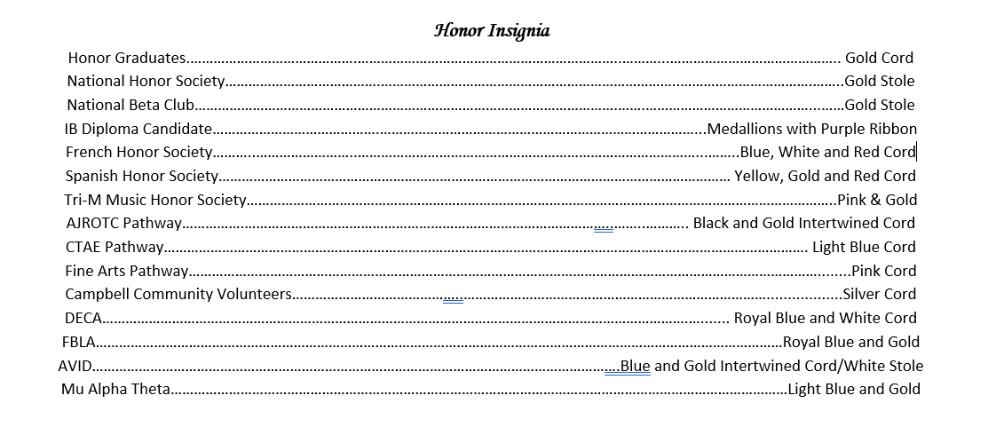
Senior Clearance
Wednesday May 19 & Wednesday May 26
Last Names A-L 9:00 a.m.-11:30 a.m.
Last Names M-Z- 11:30 a.m.-2:00 p.m.
Fines and Fees Clearance Form (orange)
- Students who owe fines or fees due to textbooks, athletics, extracurricular activities, parking, or any other fees/fines assigned by school personnel must have them paid prior to receiving Commencement Ceremony tickets.

Slide 13
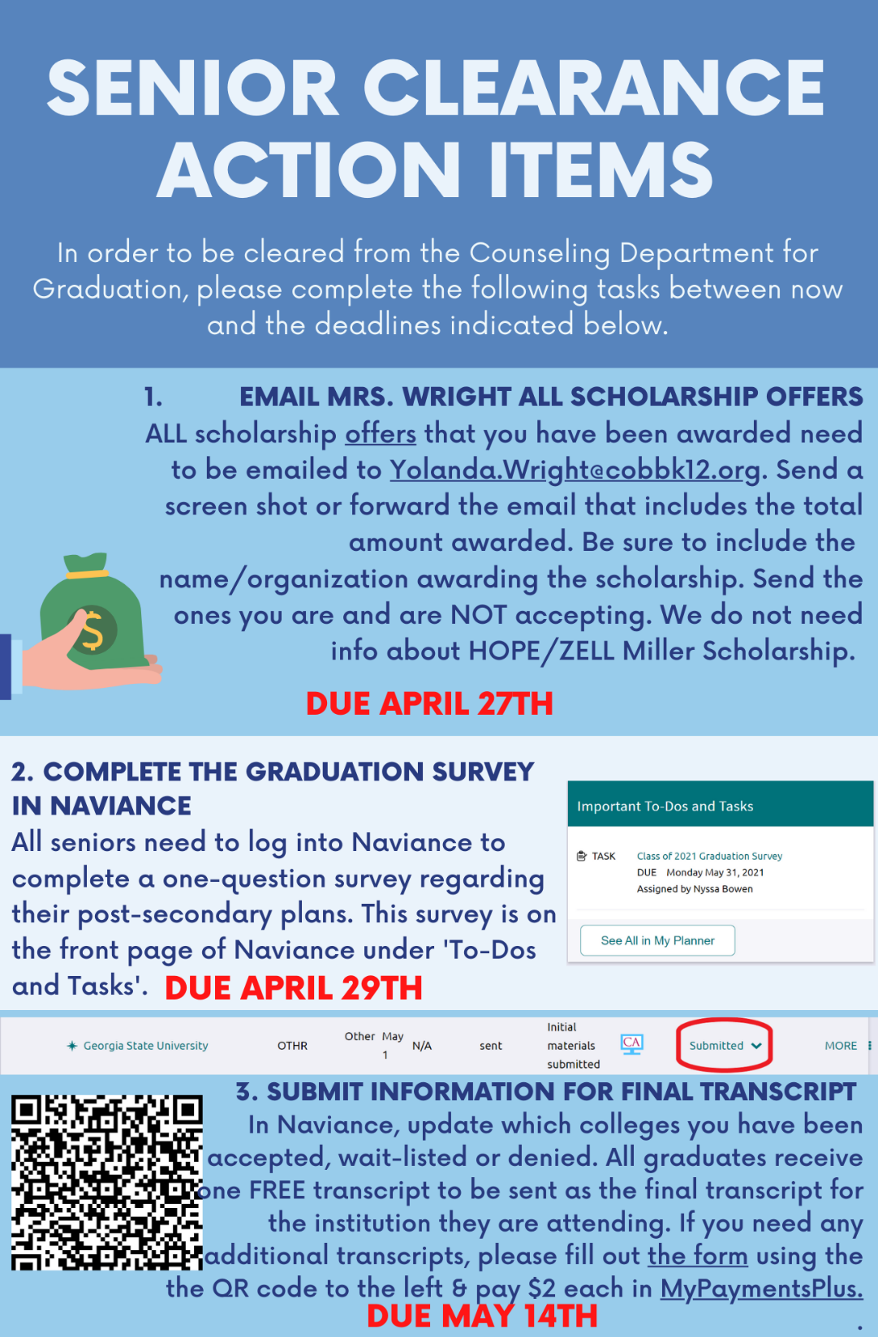

Slide 14
Assistance to Guests with Disabilities & Elderly
School staff members will be available to assist with the entrance, conveyance, and seating of guests with disabilities and elderly guest requiring individualized assistance.
Guests with disabilities who require a wheelchair must provide their own. Wheelchairs are not provided at the venue.

Slide 15
Graduation Information Packet
Emailed to senior families on March 15th
Posted on CHS Website
Summary of important graduation information including:
- exam schedule
- practice information
- required paperwork and deadlines
- important dates
- information for graduates about the expectations for the ceremony including attire, tickets and behavior

Slide 16
Commencement Information and Related Activities

Slide 17
Graduation Practice
Mandatory Virtual Practice
Thursday, May 27 at 10:00 a.m.

Slide 18
2021 Commencement
Walter H. Cantrell Stadium
McEachern High School

Slide 19
Bag Checks
Bag Checks may be conducted by the CCSD Police Department at any venue, as warranted.
Graduates are strongly encouraged not to bring any bags or purses with them to the commencement ceremony.

Slide 20
McEachern Parking
Guests with disabilities and elderly guests needing individualized assistance should enter the campus of McEachern High School at either the north entrance on New Macland Road or the northwest entrance on Gaydon Road. Accessible parking will be available in front of the Performing Arts Center.
Guests will park in any available lot using entrances on New Macland Road and Gaydon Road. Overflow parking will be available off-site. Directions will be available on the district website (www.cobb12.org/graduation)

Slide 21
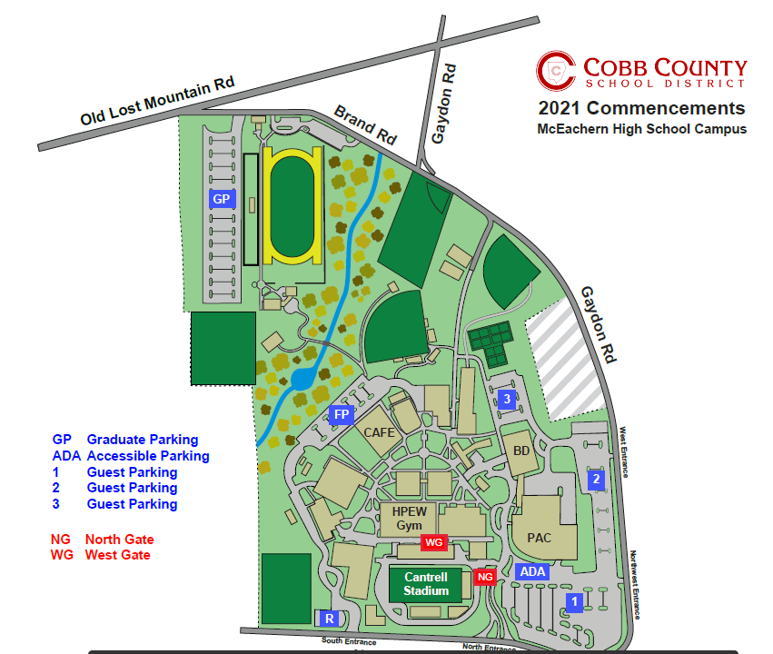

Slide 22
2021 Commencement Ceremony
Graduates must report to the HPEW Gym at 7:00 a.m. with their caps and gowns (and nothing else – including cell phones) for attendance verification and line up -- late graduates will not be permitted to join the line
The ceremony will begin promptly at 9:00 a.m. – it is very important all guests arrive promptly.
No monopods, tripods, selfie-sticks or other camera stabilizing devices are not permitted inside the venue.
No horns/noisemakers, balloons, signs or posters are permitted in the venue.

Slide 23
Decorum of the Commencement Program
Commencement is a dignified event and should be treated as such.
Graduates during the processional, ceremony, walking on stage, and during the recessional are expected to demonstrate mature behavior (no cell phones or inappropriate behavior when walking across the stage)
It is requested that calling out and clapping when graduate names are called be held until the conclusion of the program. When this occurs, it disrupts the program and interferes with the ability of other families to hear the names of their graduates when they are called.

Slide 24
Graduate Attire
Students may NOT alter/decorate cap & gowns
Gentlemen:
White or dark dress shirt
Black pants
Black shoes
Black socks
Ladies:
Solid colored dark dresses (length no longer than the gown) or black dress slacks
Simple small jewelry (no necklaces)
Dark dress shoes (no white hosiery and no silver/gold on shoes)
Low heels or flats are strongly recommended because graduates will be walking and standing for long periods of time
NO FLIP FLOPS, tennis shoes, house shoes, slippers or shoes with sparkles/bling are to be worn

Slide 25
Pictures, Filming and Live Streaming
Cady Studios will have photographers present to photograph graduates during the ceremony for purchase at a later date.
The ceremony will be video recorded, and DVDs will be available for purchase by accessing the link on the Cobb County School District website.
The Cobb County School will stream the ceremony live on the district’s website – www.cobbk12.org

Slide 26
Diploma Pick-up

Slide 27
Diploma Pick-up
Students may keep their cap & gowns.
Seniors not participating in the ceremony or unable to remain after can pick-up diplomas from 1:00 p.m.-3:00 p.m. in the 2000 building on Friday, June 4

Slide 28
Graduation Tickets
Each graduate will receive four (4) tickets to the Commencement Ceremony.
Tickets will be distributed to seniors during senior clearance once the Clearance of Fines and Form is submitted.
Every guest entering the Walter H. Cantrell Stadium must present an individual ticket at the gate.
No extra tickets are available.
Tickets cannot be purchased from graduates or from their families

Slide 29
Graduation Announcement Update
Due to the ongoing impacts of the COVID-19 pandemic, the Cobb County School District was not able to finalize a commencement schedule prior to the printing deadline for graduation announcements for the Class of 2021. Therefore, the announcements were printed without a specific date. Herff Jones is printing and providing insert cards for graduates that would like to add the date and location of the ceremony with their graduation announcements. The insert cards will be made available at the school the week after Spring Break.

Slide 30
Senior Activity Information
Class Remind: to 81010 @classof21g
Class Website: https://campbellclassof202.wixsite.com/mysite
Class Instagram: @campbellco21
PTSA Member in charge of Parent sponsored Senior events Ms. Ford.
IMPORTANT: Please email her and request to be added to contact list.
elaina.l.ford@gmail.com

Slide 31
Senior Class Dues
Optional- not required
This year, dues have just been for apparel, due to COVID restrictions
$25-Package 1: Class Shirt, mask & lanyard
$50-Package 1 + 2: Class Hoodie and blanket
$75-Package 1 + 2 +3: Sweatpants and tumbler
Students had until the end of February to order packages.
Students who have already paid for packages, please pickup will by football field 9:30-1:30pm on tomorrow, 3/31.

Slide 32
Extra Senior Merchandise
There are a few extra senior merchandise items. These items will be first come, first serve and will be available beginning April 16th.
The prices are:
Masks & Lanyards $5 each
Class shirts $15
Hoodie $20
Blanket $20
Sweatpants $10
Tumbler $18

Slide 33
Closing
We look forward to seeing you at graduation on
June 1st

