Slide 1
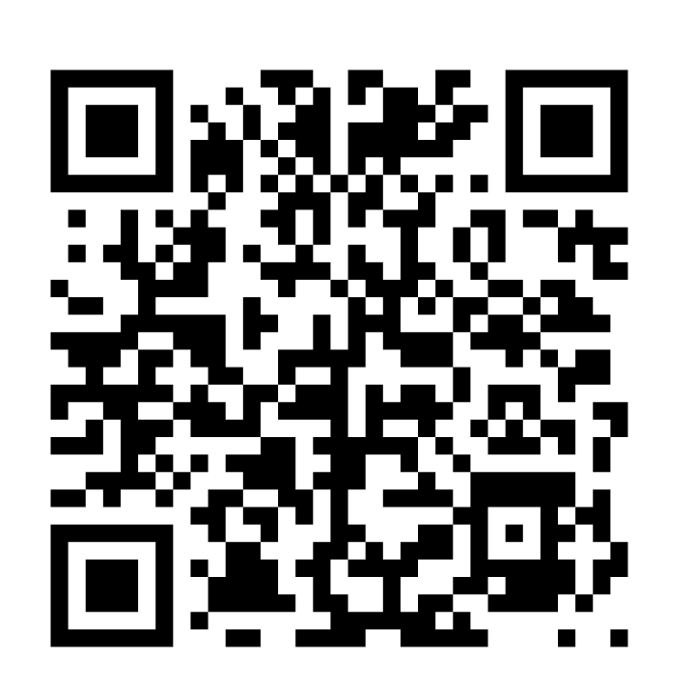

GEORGIA
SCHOOL CLIMATE
SURVEY

Slide 2
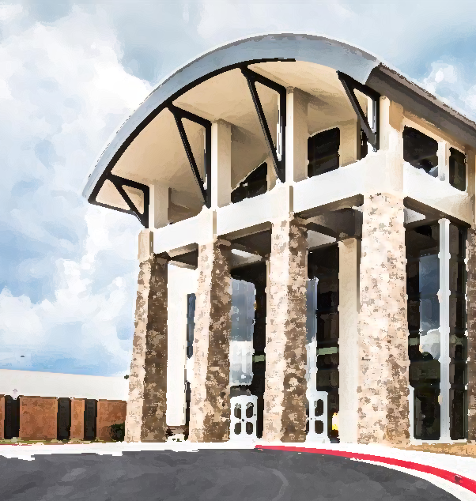
Educate.
Walton
High School
Inspire.
Empower.
Class of 2030
High School Transition

Slide 3
Academic Program
7 period day 6 classes and lunch
Each class earns .5 unit of credit
3 units per semester
6 units per year
total of 24 units possible over 4 years
Two semester system
grades are posted to the transcript at the end of each semester
Opportunities to earn more units of credit exist through
Morning tuition
Online learning
Summer programs

Slide 4

Promotion Rules
10th grade
5 units, including one full credit in English, math, and science
11th grade
10 units, including two full credits in English, math, and science
12th grade
16 units

Slide 5
Subjects | Diploma
English | 4 units of English Language Arts required for all students including 1 unit of Literature/Composition 1 and 1 unit of Literature/Composition 2
Mathematics | 4 units of Mathematics required for all students
Science | 4 units of Science required for all students, to include 1 unit of Biology, 1 unit of Physical Science or Physics, 1 unit of Chemistry, Earth Science, Environmental Science, or an AP Science, and 1 additional unit of science
Social Studies | 3 units of Social Studies required for all students, to include 1 unit of World History, 1 unit of United States History, 1/2 unit of American Government, and 1/2 unit of Economics
Health & Physical Education | 1 unit of Health (semester) and Personal Fitness (semester) are required for all students
Career Technical Education and/or Modern Language/Latin and/or Fine Arts | A total of 3 units are required from Career Technical Education, Modern Language, Latin and/or Fine Arts. Students planning to enter or transfer into a University System of Georgia institution or other post-secondary institution must take 2 units of the same modern language or Latin.
Electives | 4 additional elective units for all students
Total Units Minimum | 23 units
23 Units

Slide 6

Eligibility
First-year students are eligible first semester. Must earn 2.5 units the first semester in order to be eligible for the spring semester.
Second-year students must have accumulated 5 total units in the first year and have earned 2.5 units the previous semester.

Slide 7
English Options
Literature/Composition I
1 summer reading novel
3 parallel readings per semester
Vocabulary book
Fundamentals of argumentative, expository and narrative writing
Homework: 30-45 minutes per week
Most reading assignments completed in class
Literature/Composition I Honors
1 summer reading novel
3 parallel readings per semester
Accelerated vocabulary book
Develop voice and sophistication in writing through narrative, analytical, and argumentative essays
Homework: 2–2.5 hours per week
Independent reading is expected
Notes:
Students are recommended for honors if they have an A average or based on teacher recommendation and highly motivated. Must enjoy reading!! 47% of current 9th graders are taking honors

Slide 8
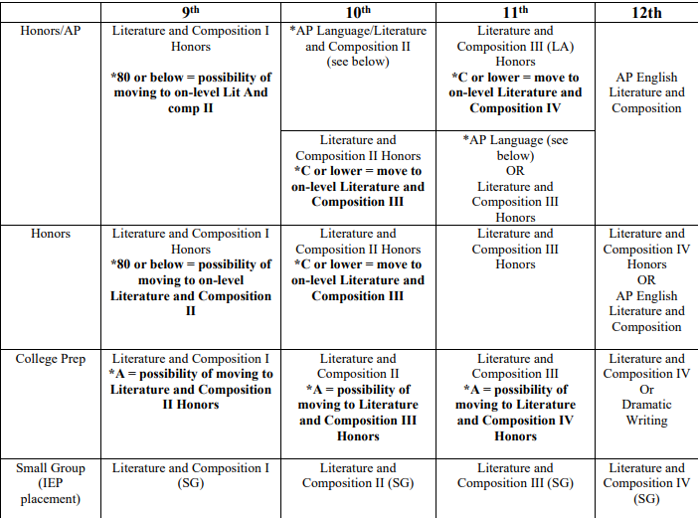

Slide 9
Mathematics
Enhanced Courses
go at a faster pace
include 2 years of curriculum in one year
very little calculator usage
Accelerated courses earn ½ EQP for BOTH courses
Embedded credit (grade counts twice!)
Honors Courses
more rigorous
higher-order thinking questions
can take two math courses during sophomore year to reach Calculus
less calculator usage
Honors courses earn ½ EQP
All Algebra courses take the same GA Milestones EOC
Notes:
Students are recommended for honors if they have an A average or based on teacher recommendation and highly motivated. Must enjoy reading!! 47% of current 9th graders are taking honors

Slide 10
GSE Algebra with support
No state curriculum for support
2 classes per day allows for more practice and processing time
Math support is an academic elective
Students can waive out of support with parent permission

Slide 11
Foundations of Algebra A&B (Fall) Algebra 93 A&B (Spring)
Set state curriculum to review, revisit, and expand understanding of foundational algebra concepts
2 Math classes per day allowing more practice & processing time
CORE Math credit
Students who take Foundations of Algebra must take the course the entire year and cannot waive midway through the year

Slide 12
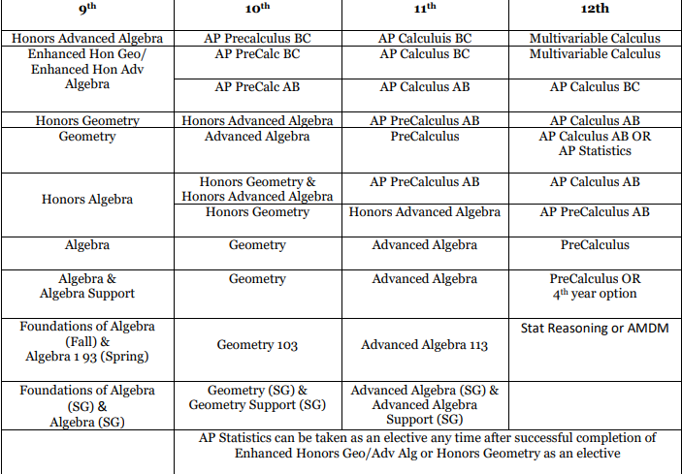
Notes:
All based on test average not overall grade.

Slide 13
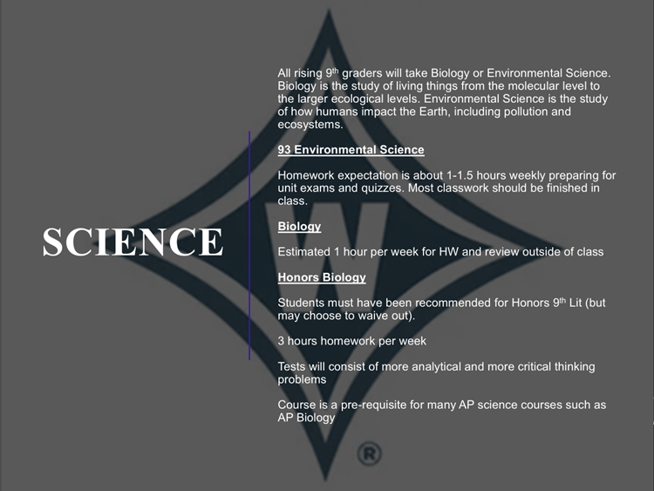

Slide 14
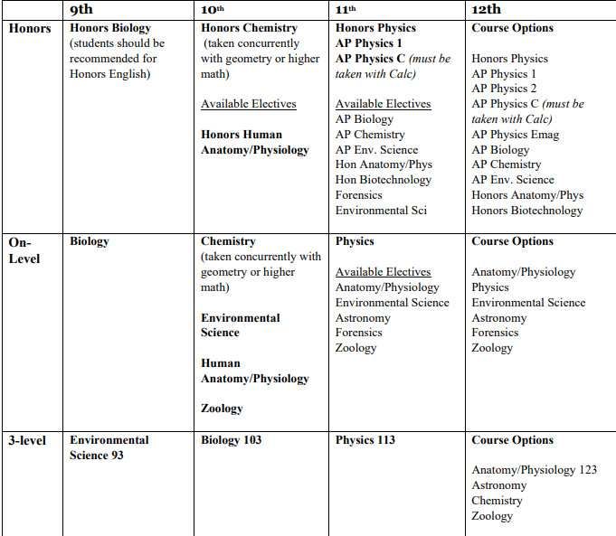


Slide 15
9th Grade Social Studies
AP Human Geography
Summer Packet–will be posted on Walton website at the end of the semester
Know the relative location of most of the countries in the world, plus several sub-national regions
Theme:
Catch Up Unit: Physical Geo. and History; general geographical concepts; Demography and Migration; Cultural Geography (language & religion); Political Geography; Agriculture and Rural Land Use; Industrialization; Urbanization
World Geography
Summer Packet – will be posted on Walton Website at the end of the semester
Theme:
Semester 1: Physical Geography, Cultural Geography, and Demography & Migration
Semester 2: Political, Environmental and Economic Geography

Slide 16
World Geography
AP Human Geography
Homework per day
15-25 minutes
30-45 minutes
3- or4-part free response questions (FRQs) throughout the semester (20% of unit assessments)
One formal DBQ essay
Writing component
7-part free response questions (FRQs) which account for 50% of unit assessment
Textbook is written at the 11-12th grade level (used sparingly)
Most parallel readings are written at the college level and are assessed through reading quizzes and Socratic seminars
Various articles/book chapters/ PSAT-style readings given
Reading Quizzes used to assess reading per chapter
Reading component
Tests 40%
Reading Assessments 15%
Daily/HW 20%
Projects/DBQ 20%
Final Exam 10%
Homework 15%
Reading Assessments 20%
Tests 40%
Student Enrichment Grades 10%
Final Exam 15%
Grading Scale
Notes:
57% of current 9th graders are taking APHG. 94% of last year’s 352 students earned a 3 or higher on the test.

Slide 17
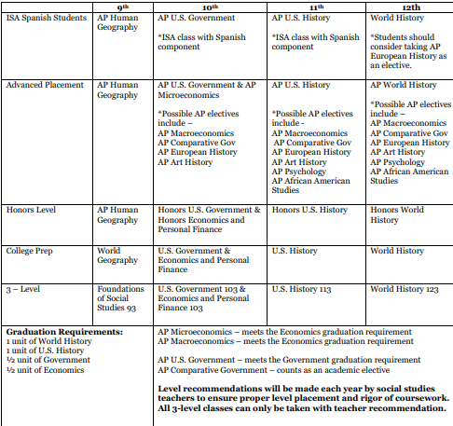

Slide 18
World Languages
Freshman | Sophomore | Junior | Senior
Chinese I | Chinese II | H Chinese III | H Chinese IV
Chinese II | H Chinese III | H Chinese IV | H Chinese V
Latin I | Latin II | H Latin III | AP Latin
Latin II | H Latin III | AP Latin | H Latin V
French I | French II | H French III | H French IVH
French II | H French III | H French IV | AP French Lang

Slide 19
World Languages
 | Freshman (Fall) | Freshman (Spring) | Sophomore | Junior | Senior
Language Track | Spanish IIA | Spanish IIB | Spanish III Honors | Spanish IV Honors | AP Spanish Language or Spanish V Honors
Advanced Track | Spanish IIA | Spanish IIB Honors | Spanish III/IV Honors (Pre-AP Spanish) | AP Spanish Language | AP Spanish Literature
 |  |  |  | Spanish V Honors | AP Spanish Language
Language Track for entering freshmen | Spanish IA | Spanish IB | Fall Semester: Spanish IIA Spring Semester Spanish IIB or Spanish IIB Honors | Spanish III Honors or Pre-AP (for students from Honors Spanish II) | Spanish IV Honors or AP Spanish Language (for students who completed Pre-AP)

Slide 20
Rigorous Course Work
Challenging course work directly relates to standardized test scores
Challenge yourself in areas of strength
COGAT/IOWA scores
College admissions—progression in your rigor over the four years
Prepared for post-secondary work

Slide 21
GPA and Extra Quality Points
ALL honors courses earn .5 Extra Quality Point
AP earns 1.0 Extra Quality Point
A in a college prep course is 4.0
B in a college prep course is 3.0
A in an honors course is 4.5
B in an honors course is 3.5
A in an AP course is 5.0
B in an AP course is 4.0

Slide 22
High School Hints
Students are not allowed to retake assessments to improve their grade. Be well prepared for every assessment!
Regular homework is expected. Missing homework will result in a grade of zero. Stay on top of all assignments!
Teachers are available before and after school as well as WEBs for extra help and make up work.
Use WEB time wisely!
Take a course load that is right for your student. We want BALANCE!

Slide 23
High School Course Registration
List of courses generated from MS teacher recommendations made on criteria set by Walton
Every list of courses should include English, Math, and Science. Any other classes listed are considered electives for 9th graders
Walton has a traditional bell schedule with a 7-period day. This means a full-time student should have 6 courses and a lunch.
Elective registration opens Friday, March 4th at 5 PM and will close at 11:45 PM on Sunday, March 22nd.

Slide 24
Why is registration important?
We build our master schedule and hire staff according to student course requests.
There is not an option to "sample" a course and then change your decision.
Our goal is to ensure that every student is appropriately challenged and advancing toward meeting high school graduation standards.

Slide 25
Elective Course Registration
ALL students must complete elective course registration!!
Elective course registration can be accessed through the student's CTLS Homeroom tile.
Prepare ahead of time and read carefully— can only submit elective registration ONE TIME!
What you will find in the CTLS homeroom:
Link to elective course registration
Link to electronic waiver form
Information about registering and paying for zero period
Link to online course form

Slide 26
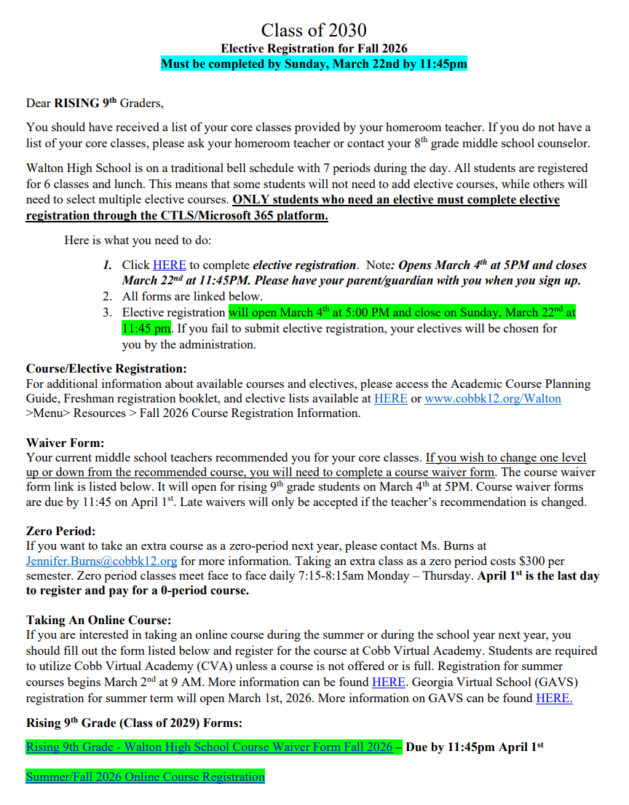

Slide 27
Zero Period
NOT required and NOT for everyone
Zero period classes meet Monday–Thursday, 7:10–8:10am
Parent/guardian is responsible for transportation
Who takes zero period?
Course 8 (extra course)
Example: student wants to take English, math, science, social studies, orchestra, Spanish, and Latin or a STEM student is taking English, math, science, social studies, orchestra, Spanish, and a STEM elective
Interested? Express interest and pay for the course NOW. If no zero-period class works in your schedule; you will receive a refund.
Cost is $300. Email Ms. Burns: Jennifer.Burns@cobbk12.org for more information. Deadline to register and pay for zero period is April 1st.

Slide 28
Waivers
What is a waiver?
A form you submit to request a course one academic level different from the teacher recommendation.
How do I submit a waiver?
Electronic form will be distributed; waivers are due April 1st at 11:45PM
What does this mean for my child?
Your child will be required to stay in the course for the semester even if the teacher decides he/she is misplaced

Slide 29
FAQs
What if my child is taking a course over the summer?
You can find information about the process in the CTLS homeroom. There is an online form linked in CTLS. You are responsible for registering your child through CVA or GAVS and should also reach out to your student’s 8th grade counselor.
Who should I direct questions to?
For now, your 8th-grade middle school counselors:
Dickerson–Ms. Charrette (Kirsten.Charrette@cobbk12.org)
Dodgen–Ms. Hammonds (Kaley.Hammonds@cobbk12.org)
What if my child is in STEM or ISA?
Once your child commits to the STEM or ISA program, the school will automatically update course lists.
What if I want to drop a class on my student’s course list?
You will do this through the elective registration form found in the CTLS homeroom.

Slide 30

Walton 101
PTSA Sponsored
Learn the nuts and bolts
April 21st 6:00 p.m.
Lecture Hall (inside the library)

Slide 31

Notes:
The Walton Foundation is Walton's parent-led nonprofit raising funds to support teacher hires and other needs at Walton. Each spring the Foundation invites incoming families to donate to the capital campaign. Funds raised are used in the 2026-2027 calendar year for Walton. Check out the Foundation home page to learn more. Also, the Foundation is hosting an online auction March 26-29 with fun items like picking a lunch buddy for your student in the fall semester. All details on the Foundation website!

Slide 32

Next Steps
Q & A with
Department chairs
STEM
Special Education
Counselors
Select clubs and organizations will be showcased along your route
Registrar Mrs. Melissa Schrenk is available in the library to answer questions for families outside the Walton feeder pattern

