Slide 1


Registration Information
For Fall semester 2026

Slide 2
Course Lists
List of courses were received in Homeroom, February 25th.
Share your course list with parent/guardian. Take a picture of it for good measure!
Want to change the level of a course or an elective class that you were recommended for?
  Level change (up or down 1 level only) = course waiver – link found on your CTLS HR tile
  Drop elective = talk to the teacher of the elective you are currently signed up for by noon Thursday, March 5th. If dropping the elective is agreed upon then the teacher will let Dr. Brown know of the change and that elective will fall off your course list.

Slide 3
CTLS Announcement in Student Homeroom
More information about registration
Link to waiver form
  Waiver deadline is 11:45pm April 1, 2025
Information for taking an online course
Applications for mentorship (11th-12th), work-based learning (12th), teacher apprenticeship (11th-12th), and minimum day (12th).
  Deadline for these applications is 11:45pm March 20, 2026

Slide 4
Resources for Elective Registration
Elective fair during WEB on 2/25 (TODAY) during Q block and A block. Held in the cafeteria.
Counselors will be available during all lunches on Thursday 3/5 and Friday 3/3. No appointment necessary, just stop by the counseling suite during lunch.
Review the academic planning guide, flow charts, elective lists and so much more on the Walton website. Go to Resources tab and select “Fall 2026 Course Registration” or there is a direct link to the course registration page in the CTLS announcement.

Slide 5
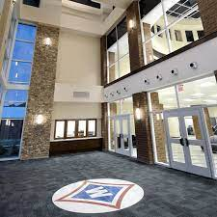
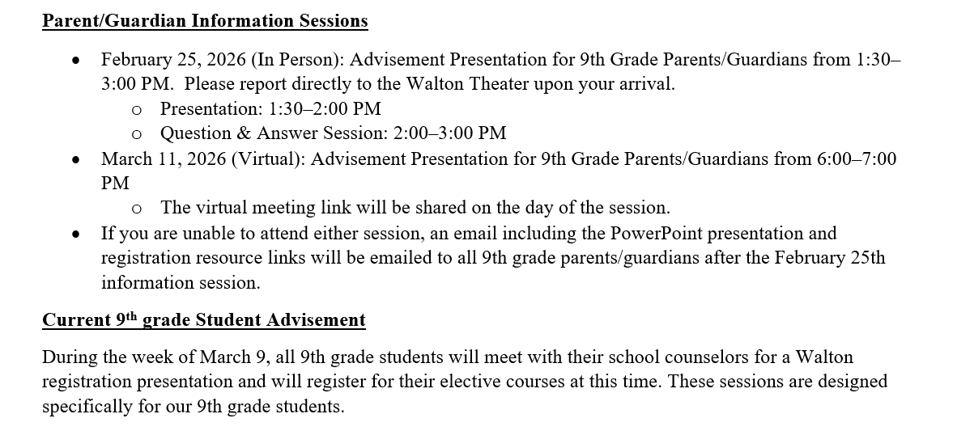
Elective Registration for current 9th graders (rising 10th)
Elective registration will be completed during your freshman advisement. Information about freshman advisement is on your CTLS HR announcement.
In the meantime, research your elective choices!

Slide 6
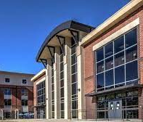
Elective Registration
Current 10th and 11th grade students
Elective registration will be completed during homeroom on March 6th. Will be completed on paper (not electronic)!
Students will choose electives as if they will be spending a full day at Walton (6 classes and a lunch).
Elective choices are binding
In the meantime, again, research elective choices!

Slide 7


