Slide 1
12th Grade BRIDGE Law
COUNSELING LESSON
CLASS 2025

Slide 2
Who’s Your School Counselor?
Last Names A - D
Del Green
Last Names
E - K
Holly Von Lanken
Last Names
L - Rh
Taran Smith
Last Names
Li - Z
Kendra DeGruy
CLASS 2025

Slide 3
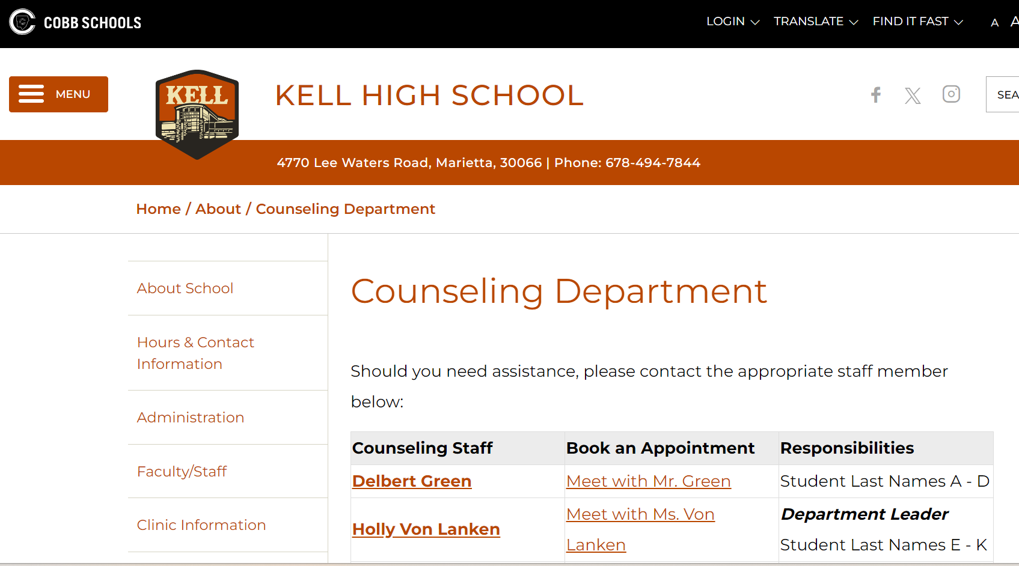
Stay Connected!
https://www.cobbk12.org/kell/page/47041/counseling-department
@kellcounseling
CLASS 2025

Slide 4
Lesson Overview
PART I
PART II
Post-Secondary Options:
4-year College/University
2-year College/Technical College & Trade School
Military/Armed Forces
Workforce/Apprenticeship
Naviance
Common App Matching
Colleges I’m Applying To
Letters of Recommendation
Official Transcript Request
Sending SAT/ACT Scores
College Visits
College Basics
Application Types
Application Process
Paying for College (Financial Aid)
Scholarships, Grants, & Loans
Local + State Funding
Federal Funding
CLASS 2025

Slide 5
Post-Secondary Options

Slide 6
4-Year College/University
Typically have more stringent admission requirements than other post-secondary options
- Factors for college admission consideration:
Rigor of classes, final grades/GPA, test scores (SAT/ACT), extracurricular activities, essays, letters of recommendation, demonstrated interest
On average, it takes a student four years to complete after matriculation from high school
Best to build a college list, with recommendations to include 1-2 “reach schools”, 2-3 “match schools” and at least 1 “safety school”.
- Reach: Your academic credentials fall below the school’s middle 50% range for the freshman class
- Match: Your academic credentials fall within or perhaps slightly exceed the school’s middle 50% range for the freshman class
-Safety: Your academic credentials exceed the school’s middle 50% range for the freshman class, nearly guaranteeing admission
Check the school’s admission requirements by visiting the school’s website, as requirements vary from school to school and year to year
CLASS 2025

Slide 7
4-Year College/University
SAT/ACT test scores are usually required, with explicit score minimums
- The University System of Georgia (USG) will continue its temporary waiver of test score requirements meaning no test scores will be required for admission at 23 of USG’s 26 public colleges and universities during the Academic Year 2025-2026 (Fall 2025, Spring 2026 and Summer 2026).
- The temporary test waiver does not apply to the Georgia Tech., UGA, and Georgia College & State University.
- Test-optional: Colleges/universities can use the student’s grade point average on the required high school curriculum without a standardized test score at the following minimum grade point averages (GPA):
3.4 GPA for research universities
3.2 GPA for comprehensive universities
3.0 GPA for state universities
Test scores will continue to be required to apply for Zell Miller scholarships in accordance with state of Georgia requirements.
CLASS of 2025

Slide 8
2-year College/Technical College & Trade School
Proof of high school graduation/GED is required – providing your final high school transcript will satisfy this. Follow the transcript request process to accomplish this.
SAT/ACT exams are accepted, however the Accuplacer is accepted and often offered directly from the school.
-Less expensive than taking the SAT/ACT and serves as a placement exam vs. admissions exam.
Programs are typically career focused and completed in 2-years or less
- Trains students for a specific job in a career field, immediately ready to work
Technical/Trade careers can include ones related to: Aviation, Criminal Justice, Welding, Cosmetology, Carpentry, Drafting, Automotive Technician, Medical & Dental Assisting, Graphic Design, HVAC Technician, Electrician, Paralegal, Early Childhood Care, Horticulture, Accounting, Cybersecurity & Networking, Film & Video Production, EMT/AEMT (Paramedic), Supply Chain Management, and more!
CLASS 2025

Slide 9
Military/Armed Forces
The six branches are: Air Force, Army, Coast Guard, Marine Corps, Navy, Space Force
- Reserve & National Guard are various options within
Every branch of the military sets its own standards for enlisting, so learn about the specific requirements for each, i.e.:
- Citizenship & Residency
- Age limits
- Education: You must have a high school or general equivalency diploma (GED); must have a degree from a four-year college to join as an officer
-Testing Requirements: Armed Services Vocational Aptitude Battery (ASVAB)
-Physical & Medical Requirements
In general: (1) Make contact with a branch recruiter, (2) take the ASVAB, (3) graduate, and (4) request your final high school transcript
Additional information can be found online at: https://www.usa.gov/military-requirements
CLASS 2025

Slide 10
Workforce/Apprenticeship
On-the-job short-term or long-term training is provided by an employer at the beginning of a new job.
Training can last 1 - 5 years, often paid.
The completion of an apprenticeship is generally associated with skilled labor.
These kinds of programs can lead to secure and well-paying jobs without the need for any college expenses.
CLASS 2025

Slide 11
Naviance
Naviance is a delivery system and college/career search engine and also how we communicate with YOU and your parents throughout the school year.

Slide 12
Multiple Uses for Naviance
Available to you online, 24/7!
College Planning
College Search, College Visits, Colleges Applying To, Letters of Recommendation
Scholarship Searches
College-specific, National Search, CCSD-specific
Communicating with your School Counselor
E-Mail Capabilities
Career Planning & Resume Building
Explore Careers, Clusters & Pathways
Self-Discovery
Personality, Skills, and Strengths Assessments

Slide 13
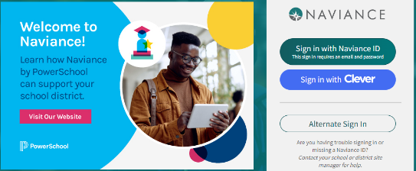
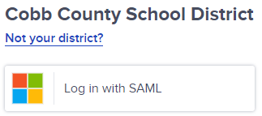
Logging into Naviance
Navigate to Naviance using your device’s internet browser https://id.naviance.com/
Click the Sign in with Clever blue button.
Click the Sign in with SAML top button.
Enter you Cobb County School District student email address first.last@students.cobbk12.org and enter your password.

Slide 14
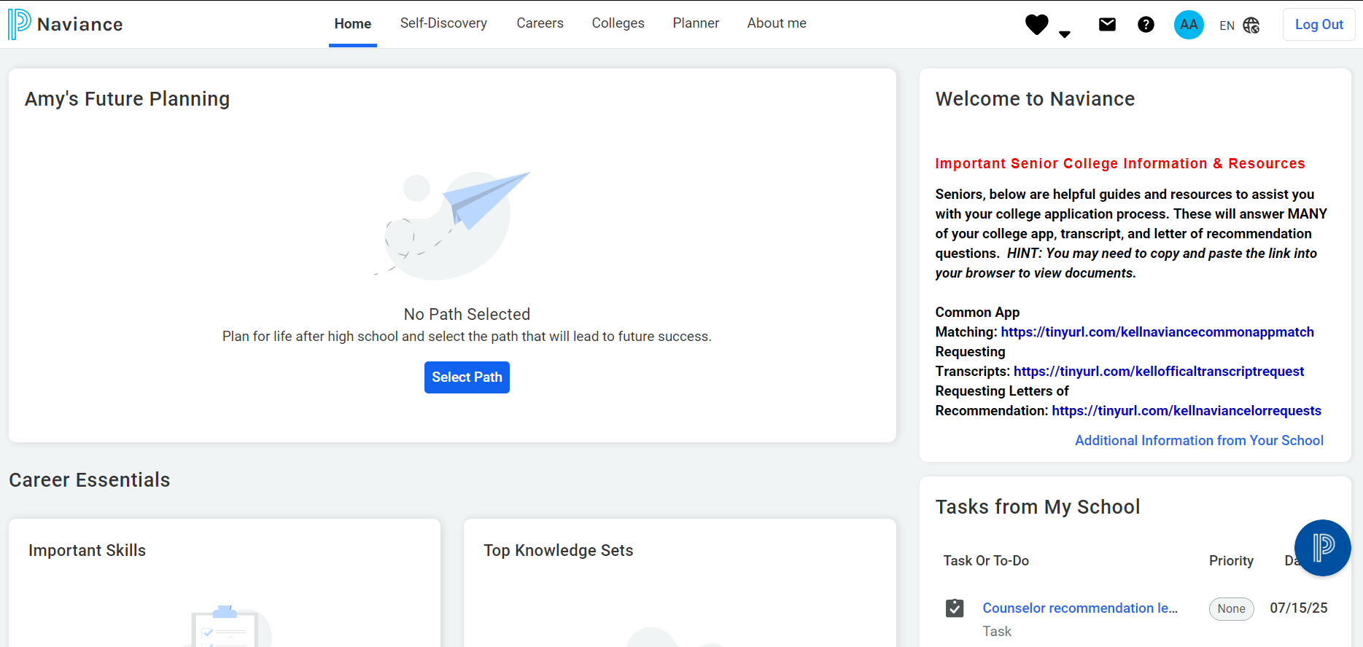
Your Naviance Homepage
Notes:
If any senior has not yet selected a path, have them do so now.

Slide 15
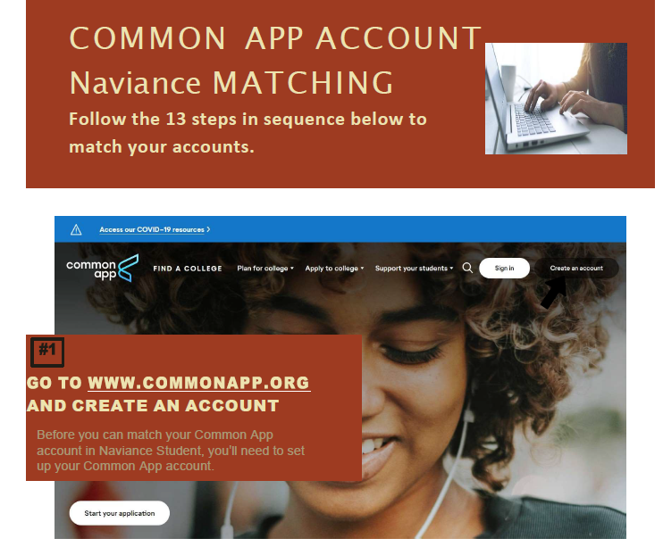
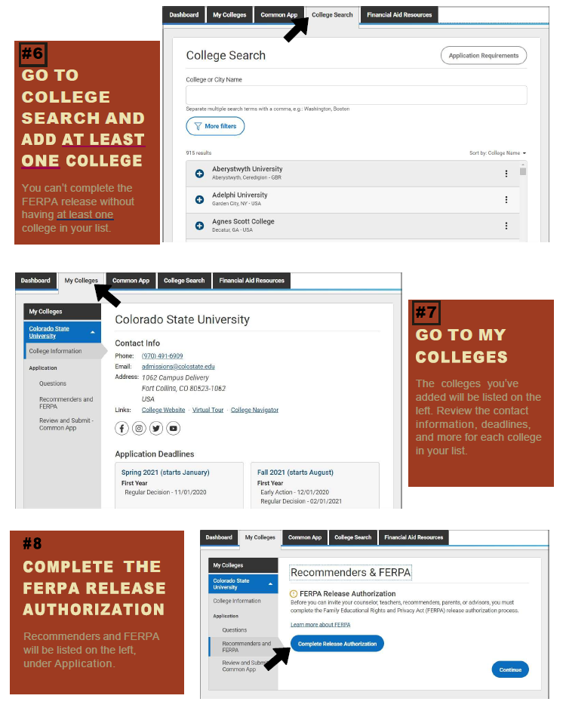
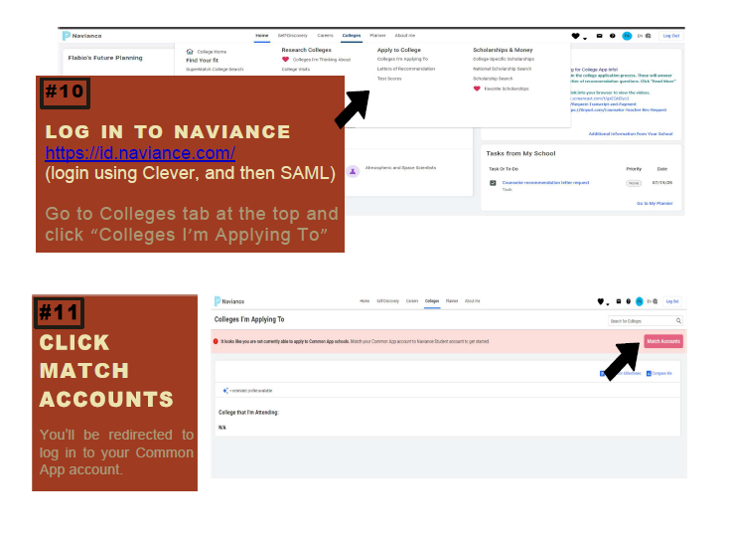
Common App Matching
The Common App is an undergraduate college admission application that applicants may use to apply to any of the 1,000+ member colleges and universities.
For Common App schools, students are required to match their Common App and Naviance Student accounts.
Need more help matching your Common App to Naviance? More information and details for requests can be found using the Student Guide for Matching Common App Account and Naviance Account https://tinyurl.com/kellnaviancecommonappmatch
NOTE: Not all colleges and universities are on the Common App and have their own, individual applications that, in most cases, are web-based and can be found via the school’s undergraduate admissions website.

Slide 16
“Colleges I’m Applying To”
Many seniors spend most of their time in this section.
After matching your Common App account, your colleges/universities listed there will auto populate here.
Just because a school is not on the Common App, does not mean that they do not accept the transmission of important documents, like letters of recommendation and official transcripts, through Naviance.
- Be sure to indicate “Direct to Institution” for these non-Common App schools.
This is also where you will request Teacher Letters of Recommendation.

Slide 17
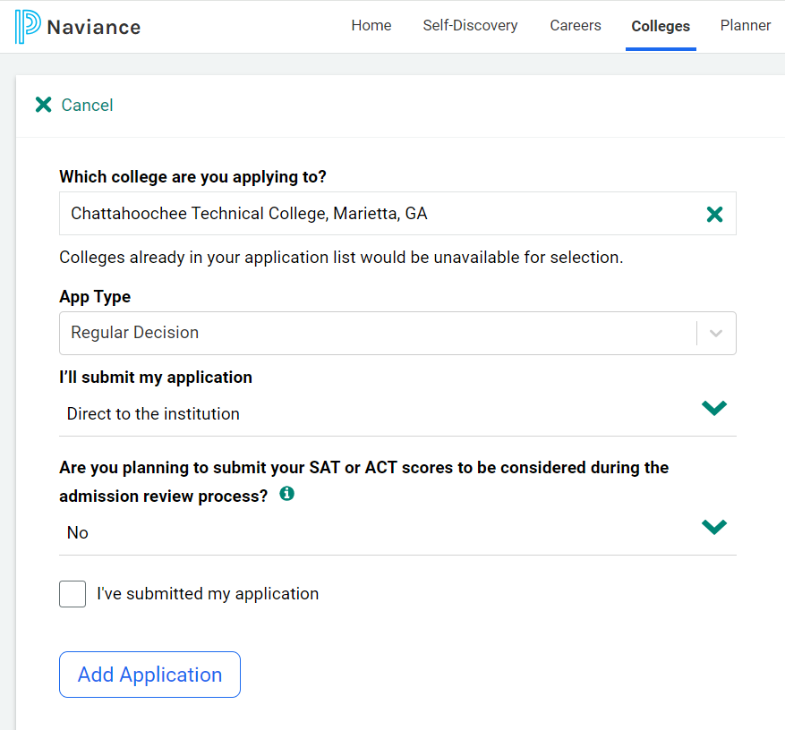
“Colleges I’m Applying To”
This is how to “manually” add colleges/universities to your Naviance account, should the college/university not be a Common App school or not auto populate from your Common App account.

Slide 18
Letters of Recommendation
Allow at least 3-4 school weeks for your teachers to complete their recommendation portion of your application!​​
Students “invite” their teachers to upload and send letters of recommendation in two steps: ​
(1) Provide your teachers with a copy of your senior brag sheet/academic resume (if not already completed in Naviance) to include a list of colleges/universities to which you are asking the teacher to write.​
(2) Add the request under your “Colleges I’m Applying To” tab from Naviance.
IMPORTANT: ASSIGN YOUR TEACHERS TO INDIVIDUAL SCHOOLS – NOT “All Applications”.
-If the school does not require a teacher letter of recommendation, they do not use it in the admissions process.
DO NOT ASK YOUR TEACHER FOR ONE IF THIS IS THE CASE!
It is the student’s responsibility to research/know which schools require a letter of recommendation.
CLASS 2025

Slide 19
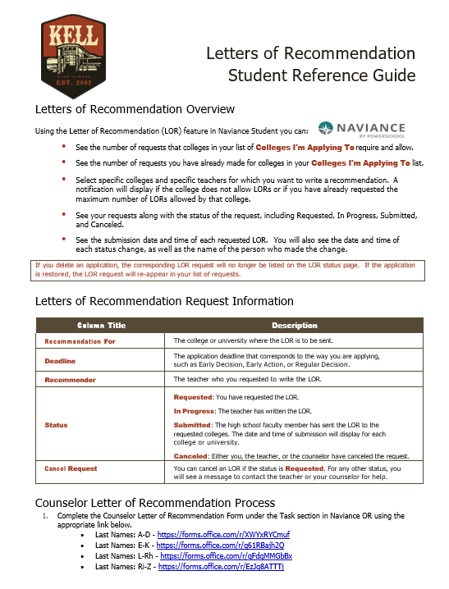
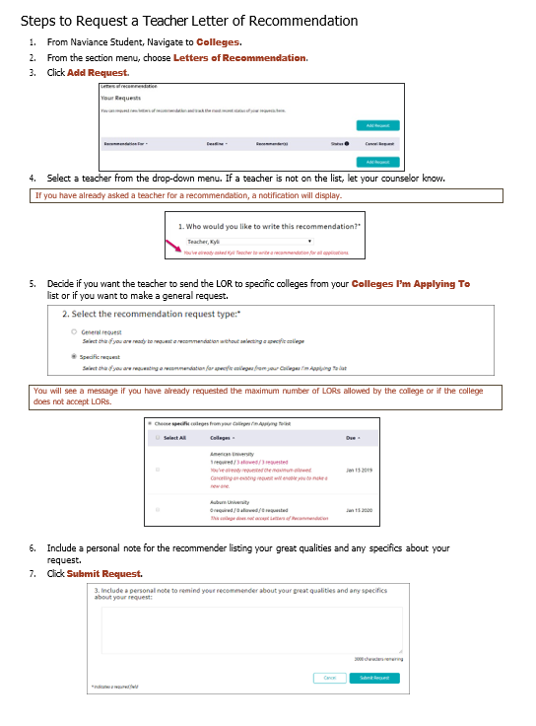
Adding Teacher Recommendation Requests in Naviance
How to: ‘Colleges’ header → ‘Letters of Recommendation’ from under the ‘Apply to College’ tab.
More information and details for requests can be found using the Letters of Recommendation Student Reference Guide: https://tinyurl.com/kellnaviancelorrequests

Slide 20
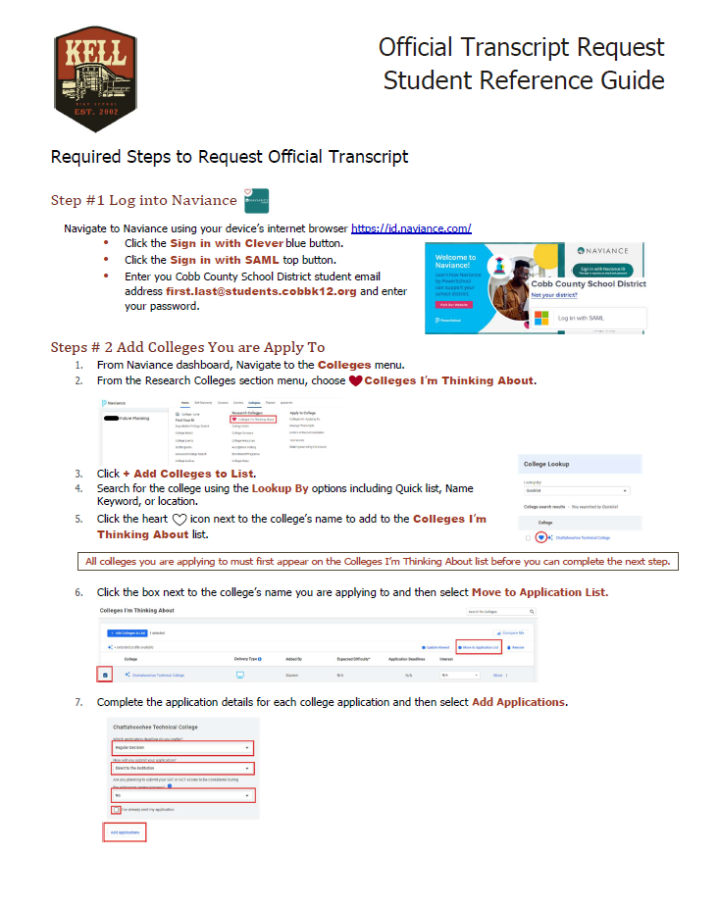
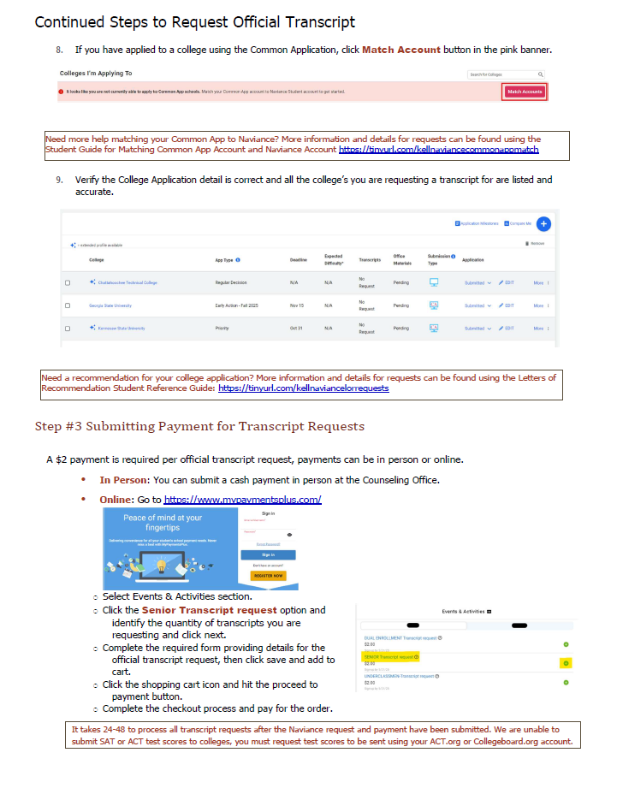
Official Transcript Requests*
More information and details for official transcript requests can be found using the Official Transcript Request Student Reference Guide: https://tinyurl.com/kelltranscriptrequest
*Students are responsible for completing ALL parts of the above process, or transcripts will not be sent.

Slide 21
Sending Official Test Scores
ACT/SAT scores can only be sent directly from the testing agencies websites.
-SAT: https://satsuite.collegeboard.org/
- ACT: www.actstudent.org
Our School’s CEEB code:
111992
CLASS 2025

Slide 22
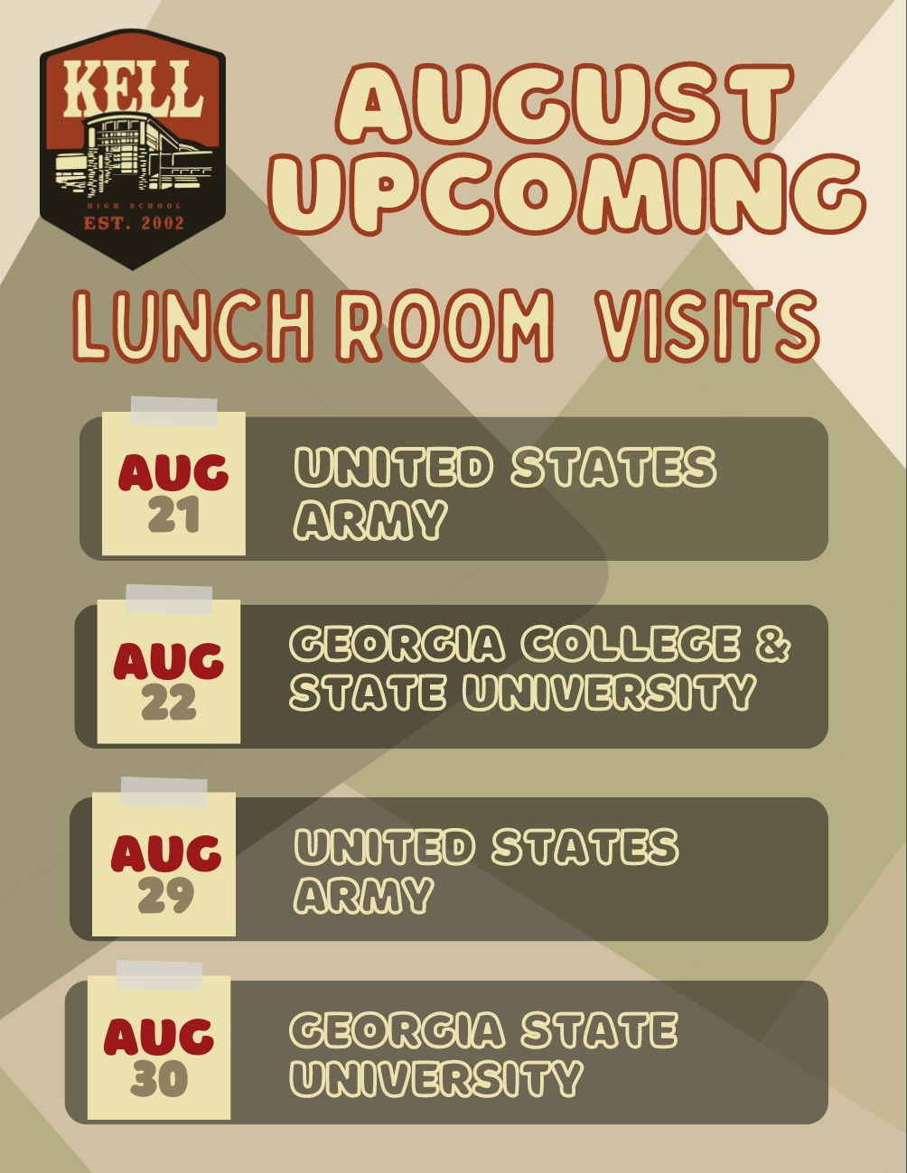
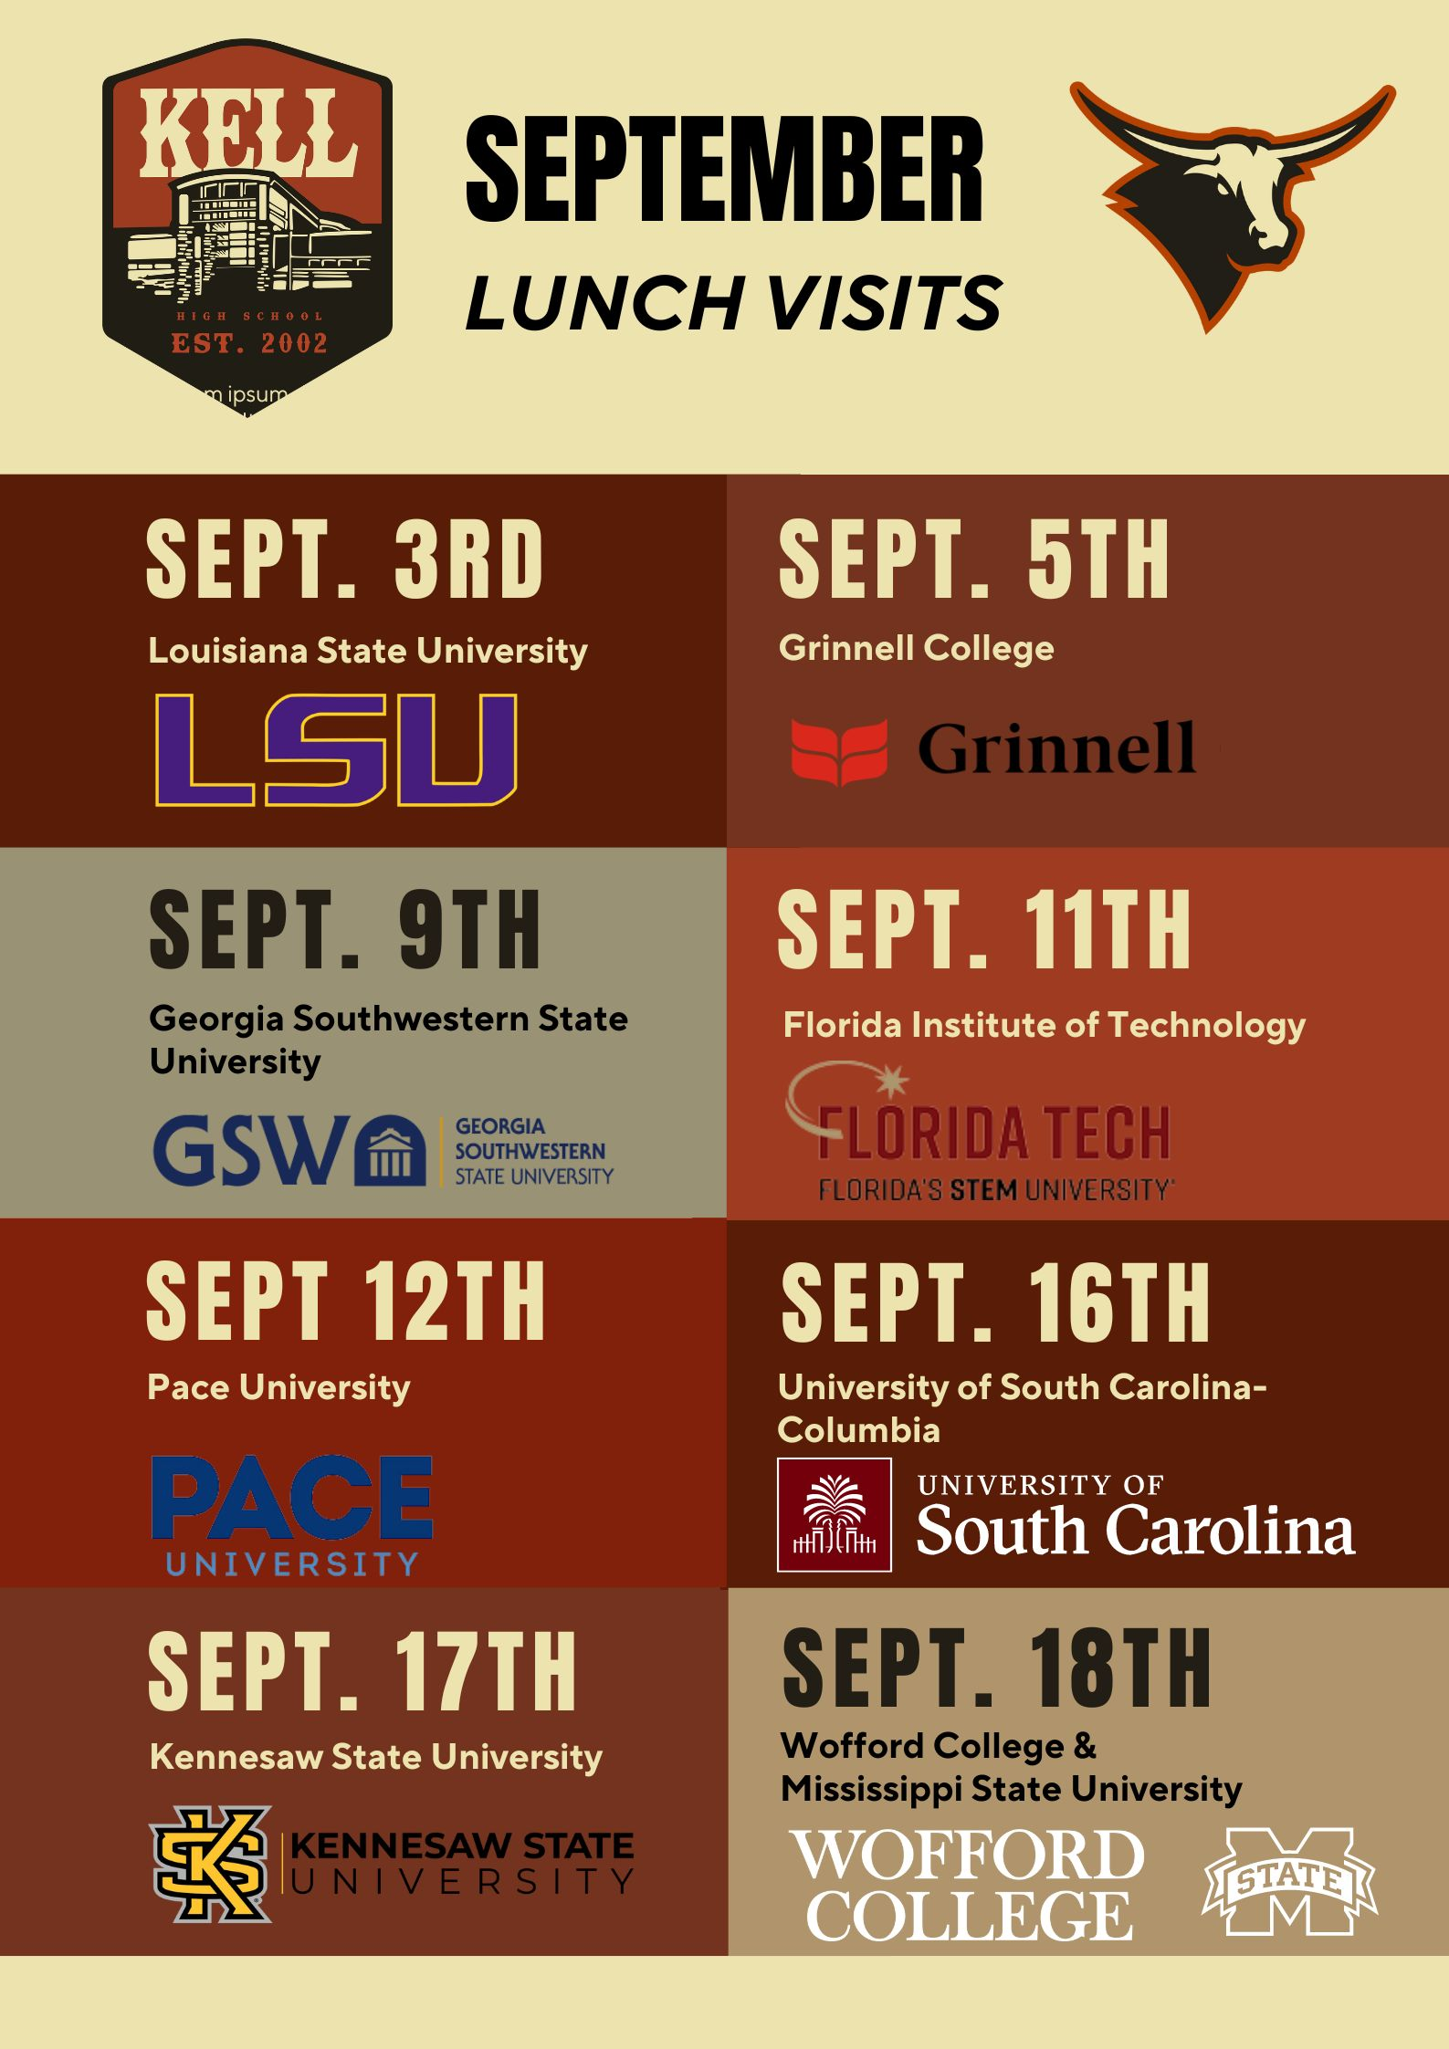
College Visits
This is your opportunity to hear from various college admission representatives who visit our school to share about their college/university and its respective admissions process.

Slide 23
College
Basics

Slide 24
Understanding Application Types
Early Decision I & II (Binding) – Cannot apply early decision to other colleges, but can apply regular decision. If accepted for early decision, must attend.
Early Action (Non-Binding) – Can apply early to other colleges and can apply regular decision. Will receive admission decision before regular decision deadlines.
Rolling Admission – Open admission, decisions given throughout the year as applicants are received and until limit set by intuition met.
Regular Decision – Standard deadline date established by the institution, with no priority or early
Priority Deadline –Similar to rolling admissions, but priority consideration around financial aid, housing, etc. is typically offered to these applicants
CLASS 2025

Slide 25
6 Steps to the College Process
*Determine what college(s) you’re applying to & know their deadline(s)
Determine the application type(s) – i.e., Common App, Common Black College App, Direct to Institution
Complete your online profile/submit your application(s)
Pay application fee(s)
Send your test scores directly from the sites (Collegeboard/ACT) – this cannot be done by HS!
Use Naviance – our “delivery system” – to: (1) Send your official transcript and/or (2) Obtain teacher letter of recommendations
Remember – as the student/applicant, be sure to track your admissions status directly from the institutions’ websites.
*It is highly recommended that you take college campus tours!
Most (if not all) are free of charge and can easily be scheduled online directly from the college/university's websites.

Slide 26
GEORGIA MATCH
GEORGIA MATCH is a simple way for you to know where you are eligible for admission (to be admitted to college), based on your high school calculated HOPE grade point average (GPA) through 11th grade.
Note: GEORGIA MATCH works with public and private accredited high schools in Georgia only.
A senior’s GEORGIA MATCH colleges are found on one’s GAfutures Student Dashboard.

Slide 27
Helpful Websites for Senior Year
ACT: https://www.act.org/
Big Future: https://bigfuture.collegeboard.org/
Cobb County School District: https://www.cobbk12.org/
Common App: https://www.commonapp.org/
Common Black College App: https://commonblackcollegeapp.com/
FAFSA: https://studentaid.gov/h/apply-for-aid/fafsa
GAFutures: https://www.gafutures.org/
SAT (Collegeboard): https://www.collegeboard.org/
US Dept of Education College Scorecard: https://collegescorecard.ed.gov/
CLASS 2025

Slide 28
Paying for College (Financial Aid)

Slide 29
Paying for College (Financial Aid)
Financial Aid is said to be the overarching umbrella to paying for college.
There are various types of financial aid/ways to pay for college at the local and federal levels, to include:
-Scholarships
-Loans (Federal & Private)
-Federal Student Grants Pell Grants are awarded to undergraduate students who have exceptional financial need and who have not earned a bachelor’s or graduate degree.
-Federal Work-study The Federal Work-Study (FWS) Program provides part-time jobs for undergraduate and graduate students with financial need, allowing them to earn money to help pay some of their education expenses. The program encourages community service work and work related to the student’s course of study.
Scholarships and grants do not have to be repaid.
Loans do have to be repaid and typically include the amount borrowed plus interest.
CLASS 2025

Slide 30
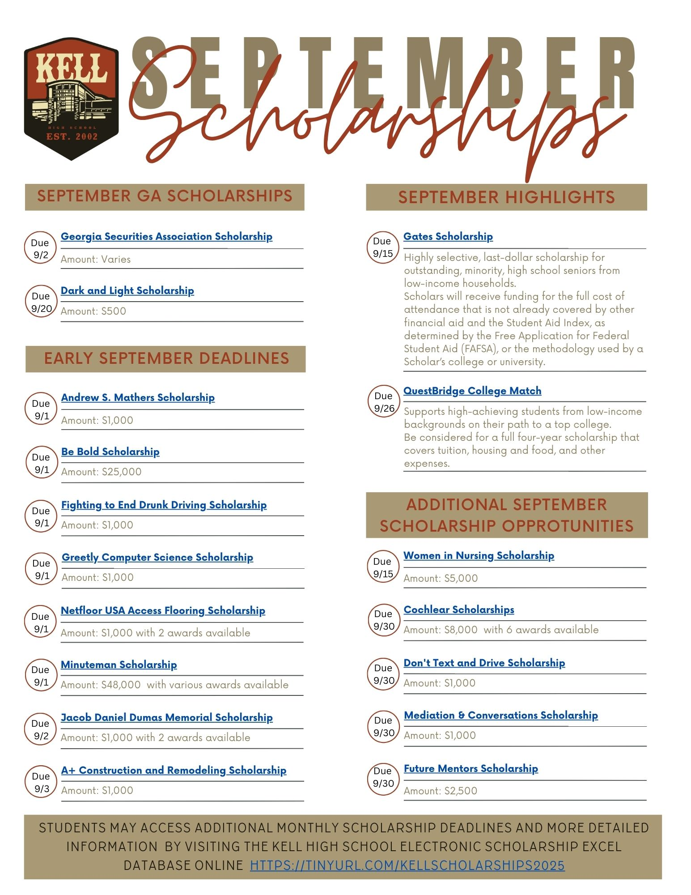
Paying for College - Scholarships
There are a number of different types of scholarships: Academic, Community, Athletic, Extracurricular/Hobby, Employer, Military, Need-based, etc.
Remember, these (scholarship) funds do not have to be repaid.
There are varying scholarship deadlines, so pay attention to when they are and apply by deadline.
Where to find scholarships for college?
- Kell Excel Database https://tinyurl.com/kellscholarships2025
- Naviance (Colleges → Scholarships & Money)
- GA Futures (Federal Aid & Scholarships → Scholarship Search)
- Scholly (App. Store & Google Play)
- College/University Financial Aid Office websites
- Online search engines, i.e.
Going Merry, FastWeb, BigFuture/Collegeboard
NOTE: A scholarship and a sweepstakes are not the same thing.
CLASS 2025

Slide 31
Paying for College - FAFSA
FAFSA – Free Application for Federal Student Aid
Available October 1st
It is an online application that is completed by students who want the opportunity to receive federal funding to pay for college
-Pell Grant (Need based)
-Student Loans
Must be completed on an annual basis and determines how much money one’s family would be able to contribute to the student’s cost of attending college
Requires federal tax information from student’s family for application completion/submission
This application can be used to also satisfy the request to receive state funding for the HOPE program as well – HOPE/Zell Miller Scholarship, HOPE/Zell Miller Grant, and HOPE Career Grant
CLASS 2025

Slide 32
Paying for College – HOPE/Zell Miller Scholarship
HOPE Scholarship – Basic eligibility requirements:
- Graduate high school with a minimum 3.0 calculated HOPE GPA
- Earn a minimum of four (4) full rigor credits from the Academic Rigor Course List
- Meet U.S. citizenship or eligible non-citizen requirements
Zell Miller Scholarship– Basic eligibility requirements:
- Graduate with a minimum 3.7 calculated HOPE GPA
- Earn a minimum of four (4) full rigor credits from the Academic Rigor Course List
- Earn a qualifying test score on a single administration of the ACT or SAT prior to high school graduation.
Current Test Score Requirements: A minimum score of 1200 is required for the SAT or 25 composite score for the ACT.
NOTE: The equivalent ACT composite score (as of the most recent concordance guide published by the College Board and ACT each January 1). The ACT score requirement can change each year. The equivalent is posted by January 15 each year for the upcoming/award school year.

Slide 33
Paying for College – HOPE/Zell Miller Grants
HOPE Grant: Available to Georgia residents who are working towards a certificate or diploma at an eligible college or university in Georgia.
- Basic eligibility requirements:
(1) No high school GPA minimum/requirement
(2) Meet U.S. citizenship or eligible non-citizen requirements
HOPE Career Grant: Available to HOPE Grant-qualified students who enroll in select majors specifically aligned with industries in which there are more jobs available in Georgia than there are skilled workers to fill them. These industries have been identified as strategically important to the state’s economic growth.
Zell Miller Grant: Available to Georgia residents who are working towards a certificate or diploma at a Technical College System of Georgia (TCSG) or University System of Georgia (USG) institution.
- Basic eligibility requirements:
(1) No high school GPA minimum/requirement
(2) Meet U.S. citizenship or eligible non-citizen requirements
- A minimum 3.5 postsecondary Calculated HOPE GPA, at the end of each term, is required in order to maintain eligibility.

Slide 34
Paying for College – HOPE Program FAQ
How to apply for the HOPE/Zell Miller Scholarship or Grant?
-Complete the FAFSA (Annually)
or
-Complete the GSFAPP (Valid for 10 years)
HOPE Program Application Deadlines: The last day of the school term or a student's withdrawal date, whichever occurs first.
Note: Additional college-specific application and deadline requirements may be required, so check with your postsecondary institution.
What’s my HOPE GPA?
-Viewable from the Your HOPE GPA tab from logging in to your GA Futures profile
-Not the same as your CCSD weighted or unweighted GPA
It is recommended to frequent the GAFutures website for the most up-to-date and official information about the HOPE program.
Your Social Security Number (SSN) must be on file in the Cobb County student record system in order to receive any HOPE/Zell Miller funds!

Slide 35
Save the Date!
November 20th
^{1st & 2nd Blocks}
March 11th KSU Admitted Student Celebration
CLASS 2025

Slide 36
BRIDGE Law
December Graduates:
May Graduates:
This survey will be made available to you in November.
This survey will be made available to you in March 2025.
NOTE:
This survey is required to be completed by every senior before graduation, so be sure to complete it when available.
Thanks in advance!

Slide 37
BRIDGE Law Survey Instructions
Log into Naviance.
On Naviance homepage, scroll down to Important To-Dos and Tasks.
Click "Class of 2025 Graduation Survey".
Click on the blue words "take this survey".
Answer all questions on Page 1, Page 2, and Page 3 by clicking "NEXT PAGE >".
Add all scholarship names & amounts that you've been awarded. New fields will populate after each entry, if necessary.
6. On Page 3, press "SUBMIT RESPONSES".
CLASS 2025

Slide 38
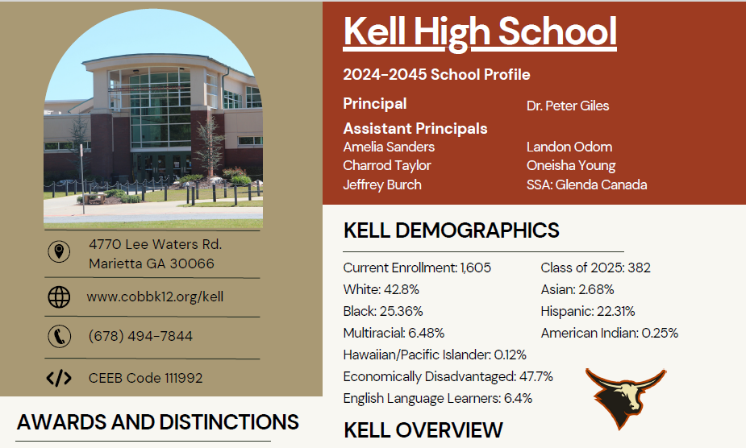
Stay Connected!
https://www.cobbk12.org/kell/page/47041/counseling-department
@kellcounseling
CLASS 2025

Slide 39
Have a Great Senior Year!
“Do not go where the path may lead, go instead where there is no path and leave a trail.”
— Ralph Waldo Emerson
CLASS 2025

