Slide 1
COMMENCEMENT 2023
CAMPBELL HIGH SCHOOL
Graduation Parent Meeting
March 21, 2023

Slide 2
Welcome
Dr. Vanessa C. Watkins, Principal
Dr. Lisa Moore Sparks, Assistant Principal
Dr. Antwane Nelson, Assistant Principal
Ms. Dawn Holmgren, Lead Counselor
2023 Graduation Administrators

Slide 3
Meeting Purpose
To share information with graduating students and parents about remaining activities and responsibilities prior to commencement on
Wednesday, May 24, 2023

Slide 4
How To Stay Informed
Graduation information is posted on the Campbell High School website. Please check frequently for information and updates. Graduation and Graduate Information (cobbk12.org)
The Cobb County School District also maintains a website with graduation information www.cobbk12.org/graduation

Slide 5
Senior Activities and Responsibilities

Slide 6
Cap and Gown
All graduates must wear the approved cap and gown for commencement provided by Herff Jones/ATLGrad
Orders placed after March 7th will be shipped directly to your home

Slide 7
Senior Exam Dates
Wednesday, May 10 – 1st and 2nd Block B Day Finals
Thursday, May 11 – 3rd and 4th Block A Day Finals
Friday, May 12 – 3rd and 4th Block B Day/(All)
Monday, May 15 – 1st and 2nd Block A Day/(All)
Seniors will be dismissed after their last exam on 5/15.

Slide 8
^{Tuesday, May 16}
^{Wednesday, May 17}
^{Thursday, May 18}
^{Monday, May 22}
Graduating seniors do not report to school

Slide 9
Requirements and Paperwork

Slide 10
Meeting Graduation Requirements
The Georgia Department of Education has identified the requirements to be met for students to be eligible to graduate
Any senior who does not meet the established requirements cannot participate in the May commencement ceremony
Because senior grades are due early, the final grading period will end earlier than other grade levels
It is important for seniors to monitor their grades and to maintain momentum to the end

Slide 11
Senior Clearance
Wednesday, April 26 &
Thursday April 27
3rd Block ONLY (Cafeteria)
Fines and Fees Clearance Form (orange)
Students who owe fines or fees due to textbooks, athletics, extracurricular activities, parking, or any other fees/fines assigned by school personnel must have them paid prior to receiving Commencement Ceremony tickets.

Slide 12
Senior Clearance ACTION ITEMS for Counseling
In order to be cleared from the Counseling Department for Graduation, please complete the following tasks
By April 27.
1. Email ALL scholarship offers to Mrs. Wright. ALL scholarship offers that you have been awarded need to be emailed to Yolanda.Wright@cobbk12.org. Send a screen shot or forward the email that includes the total amount awarded. Be sure to include the name/organization awarding the scholarship. Send the ones you are & are NOT accepting. We do NOT need info about HOPE/ZELL Miller Scholarship.
2. Complete the CLASS OF 2023 GRADUATION SURVEY in Naviance ALL SENIORS are required to complete the survey prior to graduation. Students attending college after graduation will also request their FINAL Transcript in this survey.
Directions can be found on the Campbell High School website: www.cobbk12.org/campbellhs > FIND IT FAST > SENIOR CLASS INFORMATION

Slide 13
Assistance to Guests with Disabilities & Elderly
School staff members will be available to assist with the entrance, conveyance, and seating of guests with disabilities and elderly guest requiring individualized assistance.
Guests with disabilities who require a wheelchair must provide their own. Wheelchairs are not provided at the venue.

Slide 14
Graduation Information Packet
Emailed to senior families
Posted on CHS Website
Summary of important graduation information including:
- exam schedule
- practice information
- required paperwork and deadlines
- important dates
- information for graduates about the expectations for the ceremony including attire, tickets and behavior

Slide 15
Commencement Information and Related Activities

Slide 16
2023 Commencement
Kennesaw State University
Convocation Center

Slide 17
Bag Checks/Clear Bag Policy
In accordance with KSU requirements, all persons entering the Convocation Center MUST submit all bags and packages for inspection by public safety personnel. Please do not bring any packages that cannot be opened or inspected. Also, please allow extra time for entry as there may be delays.
Clear Totes | Clutch Bag or Small Purse
Size may not exceed 12”x 6”x 12” Logo may only be on one side of the bag Items in the tote must be loose All bags are subject to search | Size may not exceed 6.5”x 4.5” May include a handle or strap Does NOT need to be clear All bags are subject to search

Slide 18
KSU Parking
Parking will cost $10 for each car parked for commencement. This fee applies to graduates and to guests.
Credit/Debit card ONLY.
Graduates are to park in the Central Parking Deck.
Guests are to park in the East Parking Deck and the East Economy Lot (across Frey Road from the East Parking Deck). Overflow parking will be available in the Central Parking Deck.
Guests with disabilities and elderly guests who require assistance should park in either Lot A or Lot B. Golf carts will run continuously to transport guests to and from the Convocation Center.

Slide 19
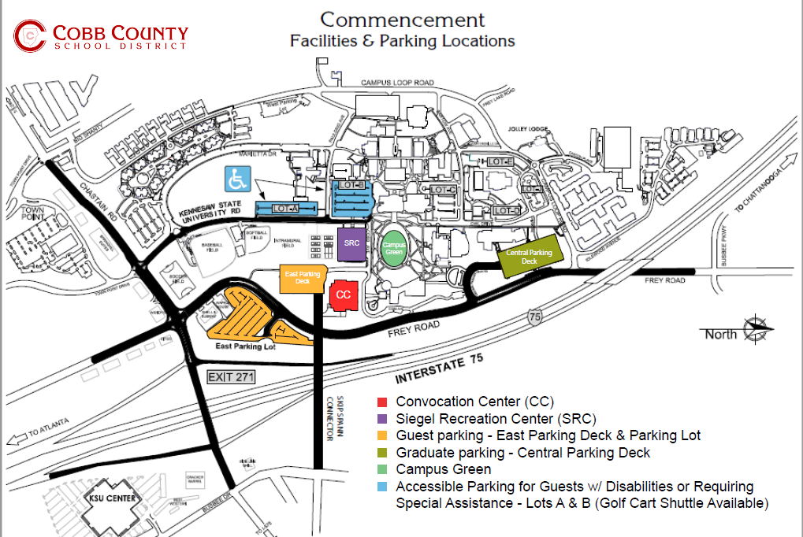

Slide 20
2023 Commencement Ceremony
Graduates arrive at the Siegel Student Center by 1:30 p.m. with cap and gown for attendance verification and line-up for the processional.
The ceremony will begin promptly at 3:30 p.m. – it is very important all guests arrive promptly. Doors will close for the processional.
Any object which obscures the view or impacts the safety of others is not allowed in any district-manage venue. A complete list of prohibited items is available on the district graduation web page (www.cobbk12.org/graduation).

Slide 21
Commencement Practice
Mandatory Practices
Friday, May 19 8:30 a.m. - 11:30 a.m.
Tuesday, May 23 8:30 a.m. - 11:30 a.m.
Location- Gwyn-McClure Gymnasium
Must attend to participate in Commencement.

Slide 22
Decorum of the Commencement Program
Commencement is a dignified event and should be treated as such.
Graduates during the processional, ceremony, walking on stage, and during the recessional are expected to demonstrate mature behavior (no cell phones or inappropriate behavior when walking across the stage)

Slide 23
Graduate Attire
Students may NOT alter/decorate cap & gowns
Gentlemen:
White dress shirt
Tie
Black pants
Black shoes
Black socks
Ladies:
Solid colored dark dresses (length no longer than the gown and collars should not show) or black dress slacks
Simple small jewelry (no necklaces)
Dark dress shoes (no white hosiery and no silver/gold on the shoes
If you decide to wear high heeled shoes, please wear a comfortable pair for walking and standing for long periods of time.
NO FLIP FLOPS, tennis shoes, house shoes, slippers or shoes with sparkles/bling are to be worn.
Graduates may only wear stoles, cords and other honor insignia authorized by the school.

Slide 24
Honor Insignia
Students may qualify for cords or stoles based on their academic performance, pathway completion, or participation in community service, extracurricular clubs and honor societies.
You may submit payment for cords/stoles on MyPaymentsPlus. Be advised, any associated cost, paperwork, or requirements are specific to each cord and stole.
It is the responsibility of the student to contact the necessary staff member to determine eligibility and for additional information.
Graduates may only wear stoles, cords, and other insignia authorized by the school during the graduation ceremony.

Slide 25
Graduation Cords/Honor Insignias
MyPaymentsPlus: Single Cords ($5), Double Cords ($10) and Intertwined Cords ($13) Honor Graduates (Double Gold Cord)
A minimum GPA of 3.500. Honor cords will be distributed to qualifying seniors during mandatory graduation practice.
IB Diploma Certificate (Medallions with Purple Ribbon)
Completion of the IB Diploma Programme or IB Course Programme
CTAE Pathway (Light Blue Cord)-$5
Earn credit for all 3 classes in a career pathway and pass the EOPA to qualify for a cord. Students are able to earn a cord from each career pathway where the aforementioned criteria are met.
Fine Arts Pathway (Pink Cord)-$5
Visual Arts – These students have completed the pathway by successfully completing 3 or more sequential visual arts courses.
Performing Arts – These students have completed the performing arts pathway by successfully completing 6 or more sequential performing arts courses.
Campbell Community Volunteers (Silver Cord)-$5
120 Community Service hours, due by April 28, 2023, to Dr. Dorrough

Slide 26
Honor Insignia (Clubs/Organizations) Distributed by teachers/sponsors
National Honor Society (Gold Stole) National Beta Club (Gold Stole)
French Honor Society (Blue, White and Red Cord) Spanish Honor Society (Yellow, Gold and Red Cord) Tri-M Music Honor Society (Pink and Gold Cord) AJROTC Pathway (Back and Gold Intertwined Cord)-$13 MyPaymentsPlus
DECA (Royal Blue and White Cord) FBLA (Royal Blue and Gold Cord)-$10 MyPaymentsPlus AVID (Blue and Gold Intertwined Cord/White Stole)-$13 MyPaymentsPlus Mu Alpha Theta (Light Blue and Gold Cord)
National Japanese Honor Society

Slide 27
Pictures, Filming and Live Streaming
Cady Studios will have photographers present to photograph graduates during the ceremony for purchase at a later date.
The ceremony will be video recorded, and DVDs will be available for purchase by accessing the link on the Cobb County School District website.
The Cobb County School will stream the ceremony live on the district’s website – www.cobbk12.org

Slide 28
Cap and Gown Photos
Campbell High School Class of ‘23: Cap & Gown Portraits Are Here!
Parents and Seniors, Cap & Gown portraits are now available to view and purchase through CADY! Celebrate this special achievement. Click below to order now!
cady.com/capgown23

Slide 29
Graduate Diploma Pick-up May 25th and 26th

Slide 30
Diploma Pick-up
Students may keep their cap and gown.
Diplomas will not be distributed after the commencement ceremony at KSU. Graduates may pick-up their diplomas on Thursday, May 25 or Friday, May 26, from 9:00 a.m. - 12:00 p.m. in the CHS PAC.

Slide 31
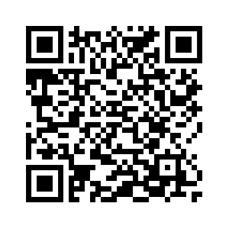
Class of 2023 Yard Signs
Order by Friday, March 31st!
Signs will be ready for pickup at CHS around April 15.
Send questions to
campbellptsapresident@gmail.com
Use this link to order yours today!
$15

Slide 32
Graduation Tickets
Graduates participating in commencement must complete the Graduation Ticket Request. Graduates who fail to complete the request will receive two (2) tickets. Deadline to request tickets is March 24th.
Tickets will be distributed to seniors during graduation practice. All seniors must be cleared of Fines and Fees prior to receiving tickets.
Every guest entering the KSU Convocation center must present an individual ticket at the door. All guests attending commencement, including babies and small children who will be seated in the laps of adult family members, will require a ticket.
No extra tickets are available. No tickets will be provided in advance.
Tickets cannot be purchased from graduates or from their families.

Slide 33
COMMENCEMENT 2023
CAMPBELL HIGH SCHOOL
Kennesaw State University
May 24th, 2023
3:30 PM

