Slide 1


Welcome to Wheeler
Wildcat Day
July 29, 2026

Slide 2
Social Media
Facebook
  www.facebook.com/wheelerhighwildcatnation/
  www.facebook.com/principalsarafetterman/
  www.facebook.com/WheelerHighSchoolPTSA
  www.facebook.com/WheelerABCFoundation/
  www.facebook.com/people/Wheeler-Athletic-Association/61560365672354/
  www.facebook.com/wheelermagnetfoundation/
Instagram
  @Wheeler_High
  @whsfetterman
  @Wheelerathletics
  @wheelerptsa
  @wheelerabcfoundation
  @wheelerathleticassociation
  @wheelermagnetfoundation
X
  @Wheeler_High
  @whsfetterman
  @WHSCatSports
  @wildcatabc

Slide 3
Introductions
Dr. Sara Fetterman
  24th Year in Education with Cobb County Schools
  9th Year as Principal
PTSA
  Home
Wheeler Academic Booster Club (ABC) Foundation
  Wheeler ABC Foundation
Wheeler Athletic Association (WAA)
  Wheeler Athletic Association, Inc > Home
Wheeler Magnet Foundation
  Home
Parent Resource Specialist for Latino Parents and Students
  Vani Arcuragi
  Vani.Arcuragi@cobbk12.org

Slide 4
EdSPLOST Update
Lipscomb Gym Painted
New roof over portion of the main building

Slide 5
Wheeler Brag Sheet
2nd Most Diverse High School in Georgia
  Last year’s graduating class had students who were born in 24 different countries, speaking 23 different languages
Named in FIVE different AP Honor Categories
  AP STEM, AP STEM Achievement, AP School of Distinction, AP Humanities, AP Humanities Achievement
Work Based Learning (WBL)
  Total Student Hours Worked: 33,174
  Total amount paid to students: $464,000
Highest ACT Score in Cobb (ACT Composite of 28.5)
20 Students qualified for Governor’s Honor Program
14 National Merit Semifinalists
One senior was named a 2026 Georgia Scholar through the GADOE Georgia Scholar Program
State runner-up in Helen Ruffin Reading Bowl
State Championship Mens Basketball Team (5th in 7 years)
State Championship Mens Water Polo Team
We had 8 Athletic Teams and 3 individuals qualify for state
Fifteen graduates continued athletic careers at the collegiate level

Slide 6
Wheeler Brag Sheet
CTAE Competitions
  FFA Floriculture team qualified for state in their first year and Senior Vet Science Team qualified for state
  FBLA had 4 state qualifiers and 4 national qualifiers
  DECA had 5 state qualifiers
  SkillsUSA had two Region Champions and 9 state qualifiers
  AVTF took first place at the Cobb County Film Festival
Two students qualified for 4-H National Competition – placing first and fourth (one earning perfect scores in two areas)
Two Congressional App Challenge Winners (1st and 3rd place)
Circuitrunners Robotics Teams ALL qualified for Worlds in Texas in 2026
One Act Play Region Runner-Up, won Best Set, Best Actress, Best Supporting Actor and All Star Cast Award
Air Force JROTC achieved 5th place nationally in All-Service JROTC Raider Championships and 3rd place nationally in AFJROTC Orienteering Competition
Two students qualified for the Georgia State Science Fair

Slide 7
Wheeler General Information
Safety
  All doors locked during the school day – only open for drop-off in the morning and pickups in the afternoon
  Three police officers on campus
Dress Code and Cell Phones
  No colored bandanas, no visible undergarments, no inappropriate content on clothing
  During class time, cell phones should be in bookbags or purses
    Cell phones are permitted in the cafeteria and in the halls
    No music or speakers in the halls
Technology
  Bring laptops daily - CCSD
ParentVue and StudentVue accounts
  Check attendance and grades

Slide 8
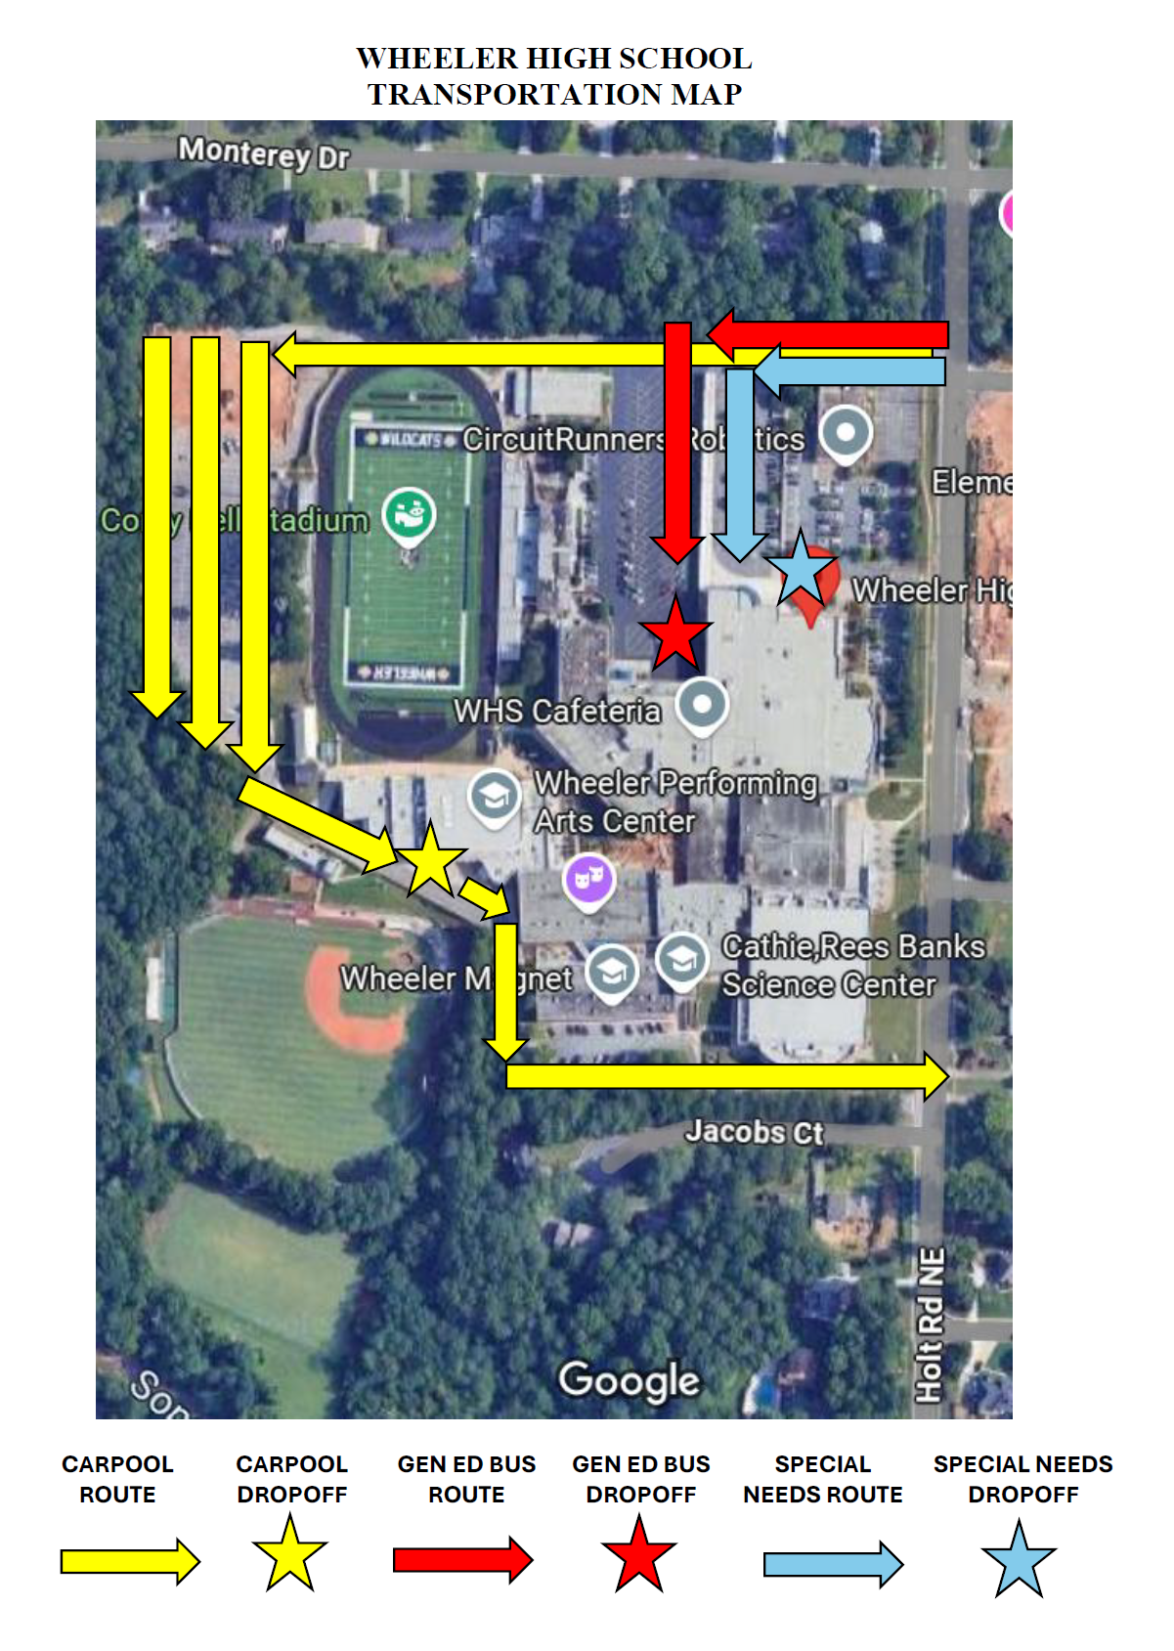
Wheeler Transportation Information
ONLY ENTRANCE ON CAMPUS

Slide 9
Academics
Academic time will be protected
AVID
  Organization
  Literacy through WICOR strategies
PBIS
  Positive Behavior Intervention and Supports
  Wildcat Four
    Respectful
    Engaged
    Accountable
    Positive
School Strategic Plan
  Math
    Algebra: Increase percentage mastery on EOC
  Literacy
    Lit 2: Increase percentage students reading on grade level

Slide 10
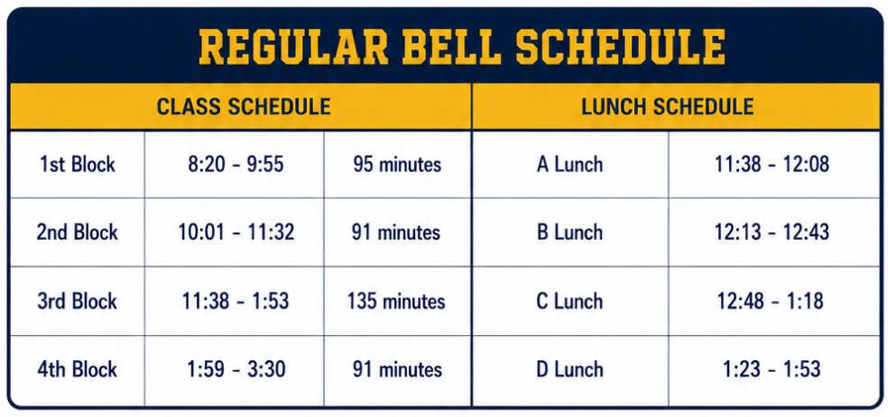
Bell Schedules
General Bell Schedule
Den Time is built into EVERY class once weekly
  This time will be flexible based on when formative and summative assessments are given that week

Slide 11
Social Media and Communication
Any concerns – please reach out to the teachers first
  The superintendent is not your best point of contact if you are upset about something that occurred in the classroom
  24-hour turnaround on communication, excluding weekends and holidays
CTLS will be the primary method of communication
  Make sure that your information is updated and accurate
Calendar
  www.calendarwiz.com/wheelerhs
  Mobile
  You can view it by monthly calendar or list view (top left corner of the page)
Social Media
  Updated website
  Updates via Facebook, Instagram, Twitter
  #OneWheeler

Slide 12
Wheeler Honors
Student of the Month
Athlete of the Month
Student Spotlight in Newsletter

Slide 13
Weekly Newsletter
Principal’s Weekly Message
Week at a Glance – always subject to change (check Calendar Wiz for most up-to-date information)
This Week in Pictures
Important Announcements
Student Spotlight
Student Opportunities
Counseling Newsletter
Community Events
Message from Support Organizations
Sponsor Spotlight
Partners in Education

Slide 14
Important Dates (subject to change)
Check our calendar for the most up-to-date information
August
  3: First Day of School
  17: Tutoring start date
September
  8: Picture Day
October
  14: Homecoming Parade
  16: Homecoming Game
  17: Homecoming Dance
  19: PSAT Day
December
  3-11: EOCs
  13: SWAW
  16 – 18: Final Exams
January
  14: MLK Ceremony
  20: Open House (Virtual)
March
  11: International Night
  20: Prom
April
  13: Honors Night
  16: Yearbook Day
  26: EOCs begin
May
  7: EOCs end
  3 - 14: AP Exams
  17 – 19: Final Exams

Slide 15
This Afternoon and Evening
View it in ParentVue or StudentVue
Tables
  PTSA, ABC Foundation, WAA, Magnet Foundation, Yearbook, Class Dues
Club and activities fair
  Clubs, Athletics, Extracurriculars, Programs, Organizations
Counselors outside Media Center
Walk your schedule
Sign up for ParentVue account if you haven’t already done so
Wildcat Warehouse is open
Cafeteria will be open if you would like to put any money on your child’s MySchoolBucks.com account
This will be our Open House for this semester

