Slide 1

2026
AP NIGHT
Harrison High School
A link to this presentation will be posted on the HHS website by 2/1/26

Slide 2


ASSISTANT PRINCIPAL/
AP COORDINATOR
Matt Staruch
Matthew.Staruch@cobbk12.org
678-594-8104 Ex: 011

Slide 3
WELCOME
HHS PRINCIPAL
Dr. Jeff Milton

Slide 4

Agenda
I. What is Advanced Placement (AP)?
II. Harrison’s AP Data
III. AP Courses & Benefits of Taking Them
IV. AP vs Dual Enrollment
V. AP Testing
VI. AP and GPA, HOPE/Zell Miller, Cost Comparison
VII. AP Capstone Diploma
VIII. The Student Experience
IX. VISIT TEACHERS AND STUDENTS AT AP COURSE TABLES

Slide 5
AP Courses
What are they?
1
Rigorous high school classes equivalent to intro-level college course aiming to challenge students
2
Taught at the college level by AP Certified Instructors
3
Possibility of college course exemptions and/or college credits by passing a year-end exam (varies by college)

Slide 6

887
752
STUDENTS REGISTERED(2025)
STUDENTS TESTED (2025)
1574
87%
EXAMS GIVEN (2025)
CUMULATIVE PASS RATE (2025)

Slide 7
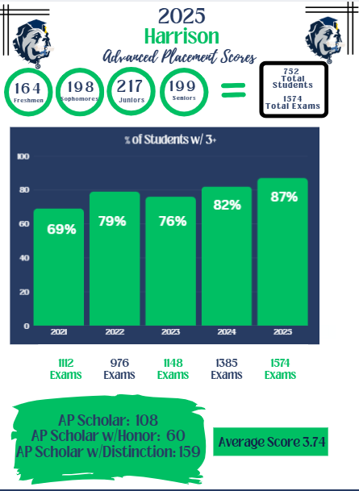

Slide 8
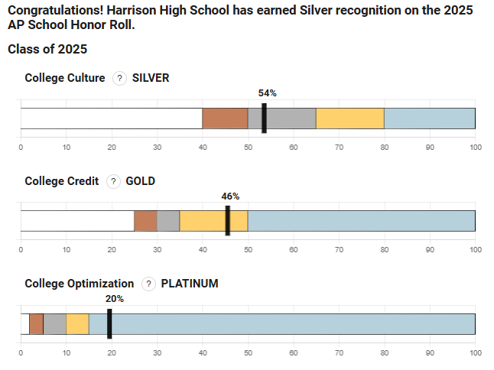

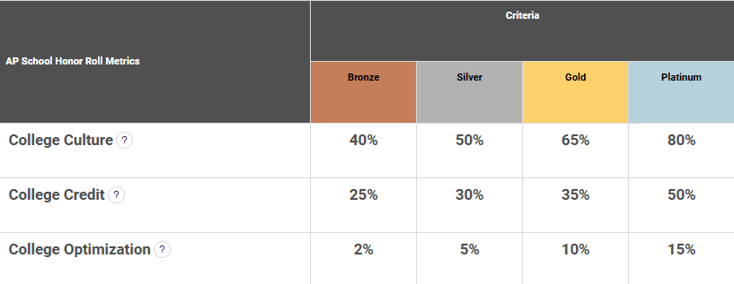
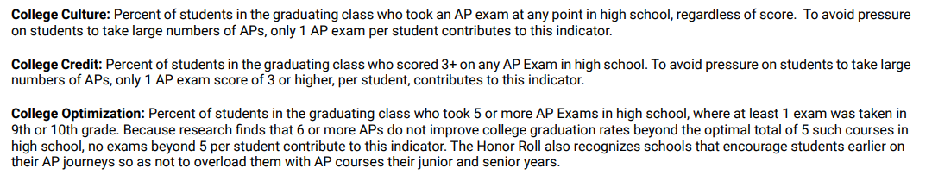
Notes:
• College Culture: 50% or more of the graduating cohort took at least 1 AP Exam during high school.
• College Credit: 38% or more of the graduating cohort scored a 3 or higher on at least 1 AP Exam during high school.
• College Optimization: 17% of the graduating cohort took 5 or more AP Exams during high school. At least 1 of those exams was taken in 9th or 10th grade, so that students are spreading their AP experience across grades rather than feeling disproportionate pressure in any single year.

Slide 9

AP AWARDS
AP Scholar
AP Scholar
with Honor
AP Scholar
with distinction
Granted to students who receive an average score of at least 3.25 on all AP Exams taken, and scores of 3 or higher on four or more of these exams.
Granted to students who receive an average score of at least 3.5 on all AP Exams taken, and scores of 3 or higher on five or more of these exams.
Granted to students who receive scores of 3 or higher on three or more AP Exams.
108 HHS Students in 2025
60 HHS Students in 2025
159 HHS Students in 2025

Slide 10
OFFERED AP COURSES
English:
AP English Language & Comp
AP English Literature & Comp
Capstone:
AP Seminar
AP Research
Math & Computer Science:
AP Pre-Calculus
AP Calculus AB
AP Calculus BC
AP Statistics
AP Computer Science A
AP Computer Science Principles
World Languages & Culture:
AP French Language and Culture
AP Spanish Language and Culture
History & Social Studies:
AP Human Geography
AP World History
AP US History
AP US Gov’t & Politics
AP Microeconomics
AP African American Studies
AP European History
AP Comparative Gov’t & Politics
AP Psychology
Science:
AP Biology
AP Environmental Science
AP Chemistry
AP Physics I
AP Physics II
AP Physics C: Mechanics
Arts:
AP 2D Art & Design
AP 3D Art & Design
AP Drawing
AP Music Theory
*31 AP Courses offered
*Courses accessible to the most students

Slide 11


REGISTRATION PROCESS
Teachers make recommendations in November/January
Parents/Students complete Core & Elective Drop/Add process in February (also in November)
Schedules Confirmed by end of April/early May
Please discuss recommendations w/ teachers
DENM RK HIGH SCHOOL
A
P
EST.
Advanced Placement
2018
EXCELLENCE
In Pursuit of:

Slide 12
ARE THERE ANY PREREQUISITES?
Varies by content area → teacher recommendation process in each subject
Certain AP courses require prerequisite courses
All CTAE AP classes are part of “pathways” → specific course sequencing
DENM RK HIGH SCHOOL
A
P
EST.
Advanced Placement
2018
EXCELLENCE
In Pursuit of:

Slide 13


AP STUDENTS:
Characteristics of Successful AP Students
Average and above reading, writing, computational skills
Motivated
Effective time management
Attends school regularly
Completes assignments
Positive attitude
Perseverance

Slide 14

AP COURSES:
BENEFITS (regardless of your score)
Better prepared for success in college
More attractive to selective college admissions offices
Opens more doors for scholarships, work opportunities, summer programs
Explore advanced topics and/or topics of interest in more depth
Develop advanced skills e.g., writing, critical thinking, reading, analytical, argumentation, computational, etc.
Exposure to academic rigor while having more parental/teacher support
Surrounded by other motivated learners
Quality point added to GPA (more to come)

Slide 15
BENEFITS OF PASSING AP EXAMS & EARNING COLLEGE CREDIT:
REDUCE COSTS
Graduate in less time
Graduate while taking fewer courses & buying fewer books
Change majors w/o extra years
FLEXIBILITY
Easier to manage a job
Easier to double major
Easier to add minors
Pathways to advanced degree
FREE TIME!
Take less classes than your friends
Sleep in!
Participate in more intramural sports and/or extracurricular activities
Reap the benefits of outworking your peers now!
Notes:
Although, parents, you’ve seen in this presentation a potential downside of having too much free time ☺

Slide 16

AP COURSES:
Colleges Prefer AP Courses - Why?
Common curriculum across the nation – equal playing field
Standardized assessments each year - all students must perform to the same standard
Students typically better prepared for academic rigor of college

Slide 17

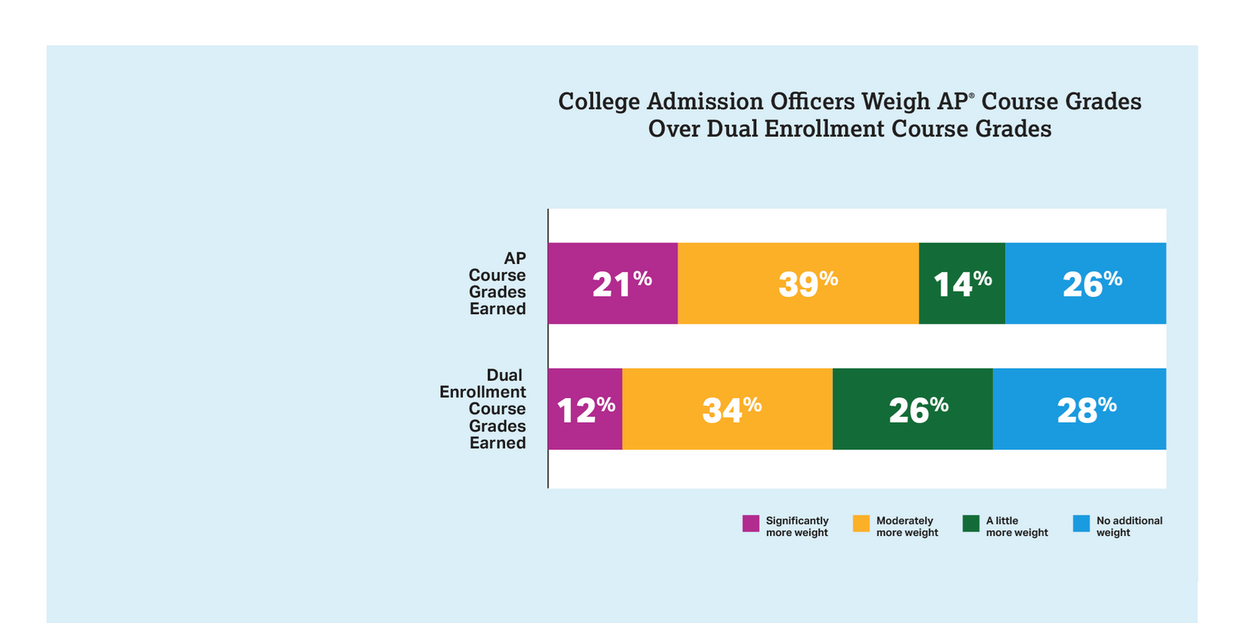
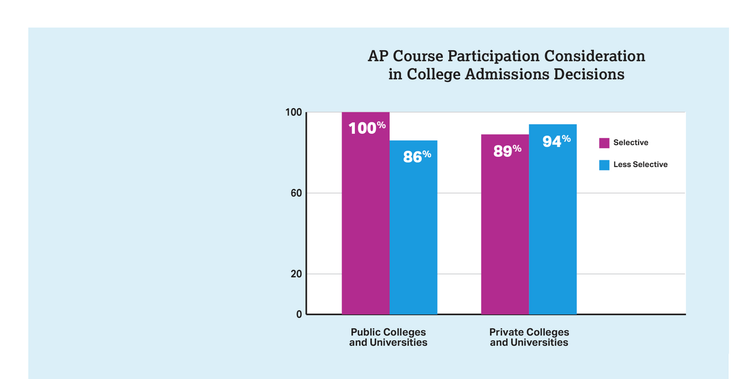
AP COURSES:
Comparing AP and Dual Enrollment
COLLEGE ADMISSION OFFICERS ARE ALMOST TWICE AS LIKELY TO REPORT GIVING “SIGNIFICANTLY MORE WEIGHT” TO AP COURSE GRADES AS THEY ARE DE COURSE GRADES
COLLEGE ADMISSION OFFICERS RECOGNIZE AP QUALITY

Slide 18
DUAL ENROLLMENT
AP COURSES
Grade in course determines credit given (most credits transfer)
Course content varies by institution & teacher
Tuition is free
Dual enrollment courses will remain on college transcript (start your college GPA)
AP test determines possible credit awarded by colleges
Course content is consistent across the nation
Cost associated with AP exams ($99 per exam)
AP classes do not show up on college transcript
(https://apstudents.collegeboard.org/help-center/difference-ap-dual-enrollment)

Slide 19

AP Testing
Basic info
Exams administered in May (both fall & spring courses)
Globally, all students take AP exams for each subject on same date
Students earn scores of 1 through 5
Students who earn a 3, 4, or 5 can receive college credit
Each university has its own requirements
Check AP Credit Policy Search on the CB website
Students MUST apply for accommodations through College Board

Slide 20

AP COURSES:
How are AP Classes calculated in GPA?
Students receive 1.0 added weight to their GPA for an AP class **
Ex.: Student makes an A in AP Human Geography = 5.0 for that class
Ex.: Student makes a B in AP Government = 4.0
** Only half a point for HOPE purposes

Slide 21


HOPE / Zell Miller
Why Hope & Zell Miller Matter?
AP COURSES ADD TO COURSE RIGOR FOR HOPE/ZELL MILLER
OFFERS STUDENTS SCHOLARSHIP TO COVER TUITION COSTS
MUST TAKE FOUR RIGOR COURSES TO EARN HOPE
UGA COST COMPARISON - 15 CREDIT HOURS
COST OF CLASS WITH HOPE & ZELL MILLER SCHOLARSHIP
COST OF CLASS WITHOUT HOPE & ZELL MILLER SCHOLARSHIP
$122.00
$5,017.00
FOR HOPE, STUDENTS RECEIVE +.5, except students earning an A.
A = 4.0 B = 3.5 C = 2.5
LINK
LINK

Slide 22
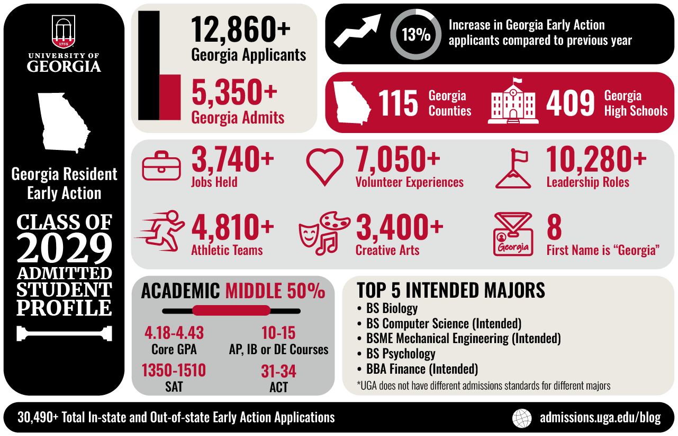


Slide 23
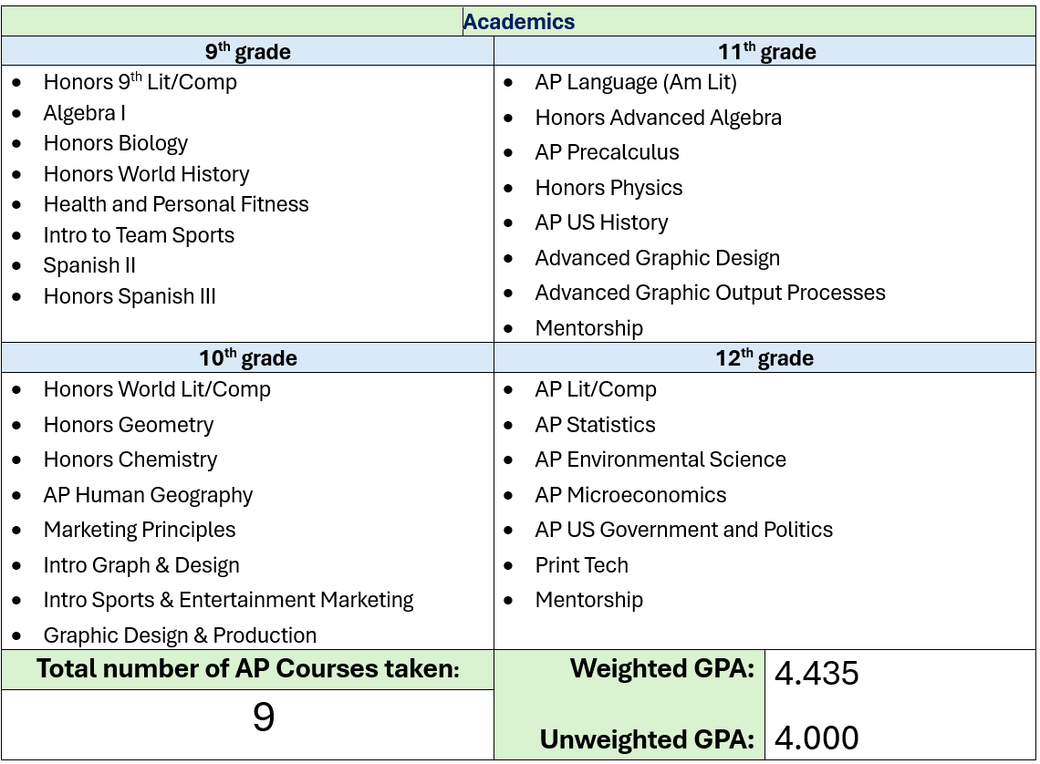
Profile of an HHS Grad - UGA

Slide 24
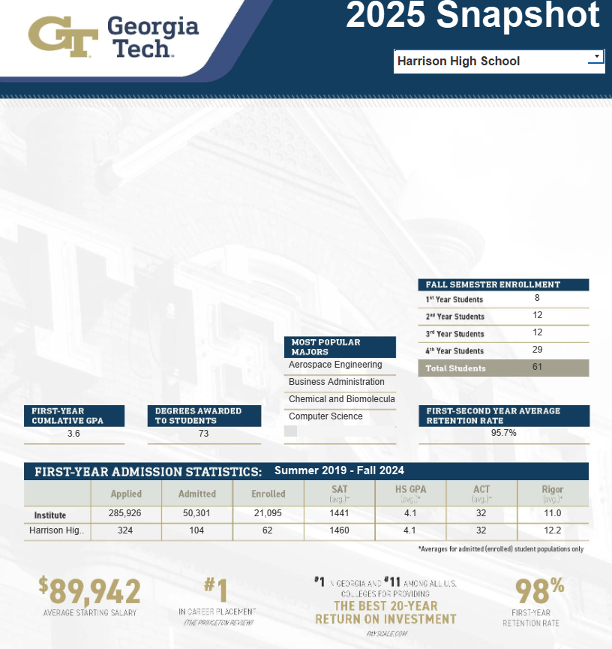
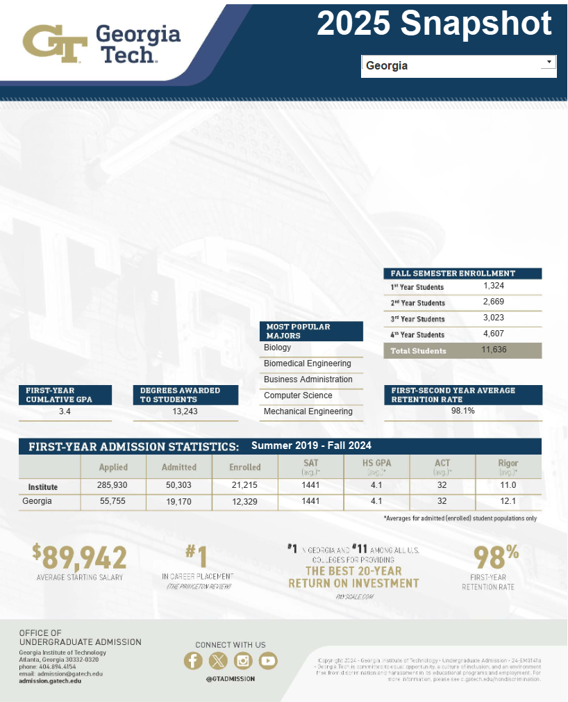

https://admission.gatech.edu/admission-snapshot

Slide 25
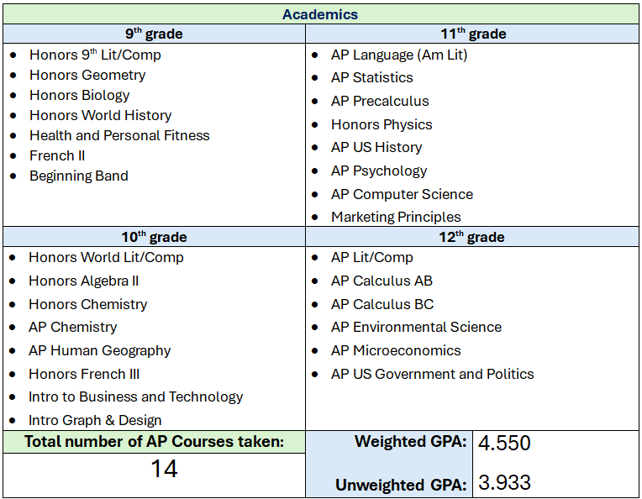
Profile of an HHS Grad - Ga Tech

Slide 26

Introducing - AP Capstone
is an innovative program that helps students develop critical skills as well as a broader perspective on the world. It also deepens their passion for learning and builds confidence.
Emphasizes Critical Skills Needed for College & Beyond
Complements the in-depth subject-matter study in AP
AP Seminar and AP Research allow students to immerse themselves in topics that matter to them, while they develop analytic, research, problem-solving, and communication skills that colleges seek in their applicants.

Slide 27

AP Capstone: The Benefits
Earn Distinction – Stand out in the college admission process
Acquire Critical Skills – Students acquire challenging analysis, writing, & research skills that are increasingly valued by colleges
Choose what to study – Students choose their own research topic and study issues and topics of interest and importance to them

Slide 28
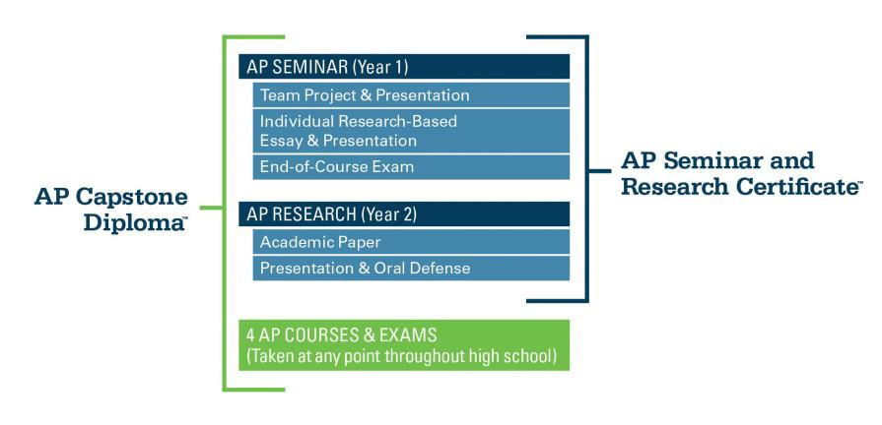
AP Capstone Diploma
2025
2 HHS Students
2025
9 HHS Students
Students who earn scores of 3 or higher in both Capstone courses will receive the AP Seminar and Research Certificate™
Students who earn scores of 3 or higher in both Capstone courses and four additional AP Exams will receive the AP Capstone Diploma.

Slide 29


Meet the AP Ambassadors
What do we do?
Grow AP Program
Support Improved Performance
Design Swag!
Assist with Parent/Student AP-Related Questions

Slide 30



The Student Experience
Claire Howerton HHS Junior
Joey Belden
HHS Junior
Kayla Darden HHS Senior

Slide 31

Claire Howerton’s Student Experience
1st year AP Ambassador
AP classes offered at Harrison are for every student; there is an excellent AP class that will fit most of our students
The level of rigor at Harrison prepares students for college level success
AP classes will open the door for future opportunities/ careers

Slide 32

Joey Belden’s Student Experience
1st year AP Ambassador
AP classes are a challenge, but our teachers are here to help you.
Even with taking these classes it is easy to stay in sports.
AP classes do not take away from a student’s ability to have an amazing social life.

Slide 33

Kayla Darden’s Student Experience
2nd year AP Ambassador
AP classes can change your trajectory
Possible to manage time constraints
Essential for preparation for college and career goals

Slide 34
QUESTIONS?
OUR STUDENTS & TEACHERS HAVE THE ANSWERS!
PLEASE RETURN TO “MAIN STREET” AND STOP BY THE TABLES FOR EACH SUBJECT YOU WISH TO LEARN MORE ABOUT

Slide 35


Helpful Resources
Visit Harrison’s website:
Click “Menu”
Click “Curricular”
Click “Advanced Placement
AP Exam Schedule 2026
Link for HHS Advanced Placement

Slide 36


QUESTIONS ABOUT TESTING ACCOMMODATIONS?
SSD COORDINATORS:
Mrs. Gillian Moody - 504s
Mr. Zach Thompson - IEPs

Slide 37

AP Courses
What are they? (click picture to learn more)

Slide 38
Thank you !
We look forward to meeting you!

