Slide 1





Welcome to Kindergarten
Pirate Preview

Slide 2

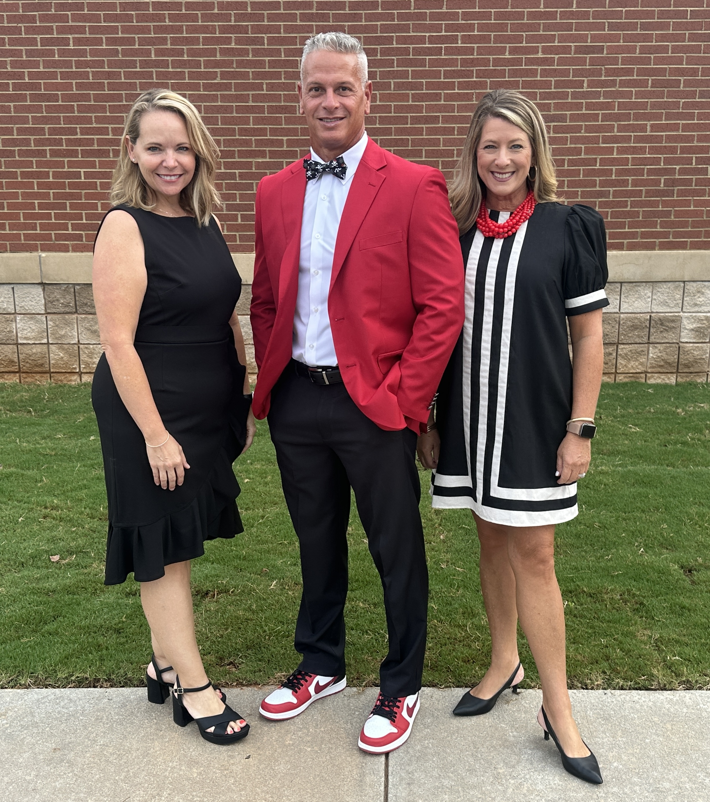
Principal-Dr. Benji Morrell
Assistant Principal-Mrs. Blair Ivey
SSA-Katie Greene

Slide 3

WELCOME

Slide 4
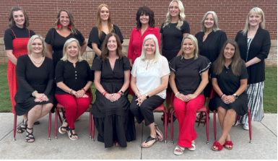
Kindergarten Team
Kate Cordell, Robin Rann, Lynn Hahn, Ashlee Green, Beth Fountain

Slide 5

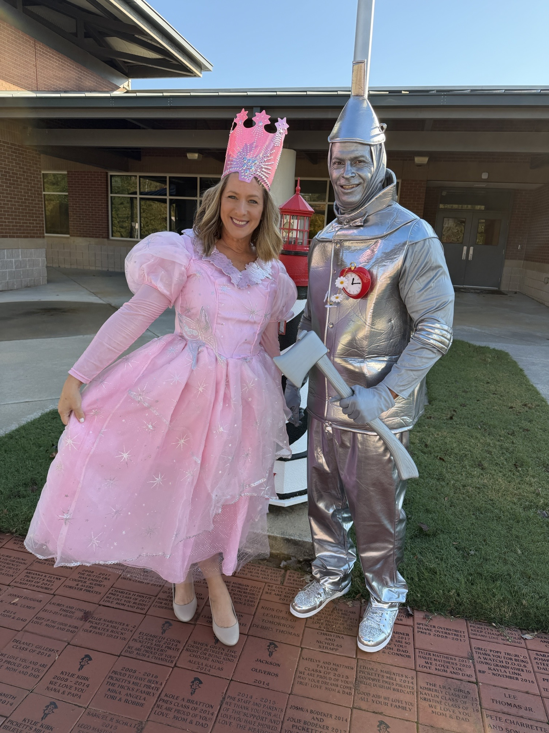
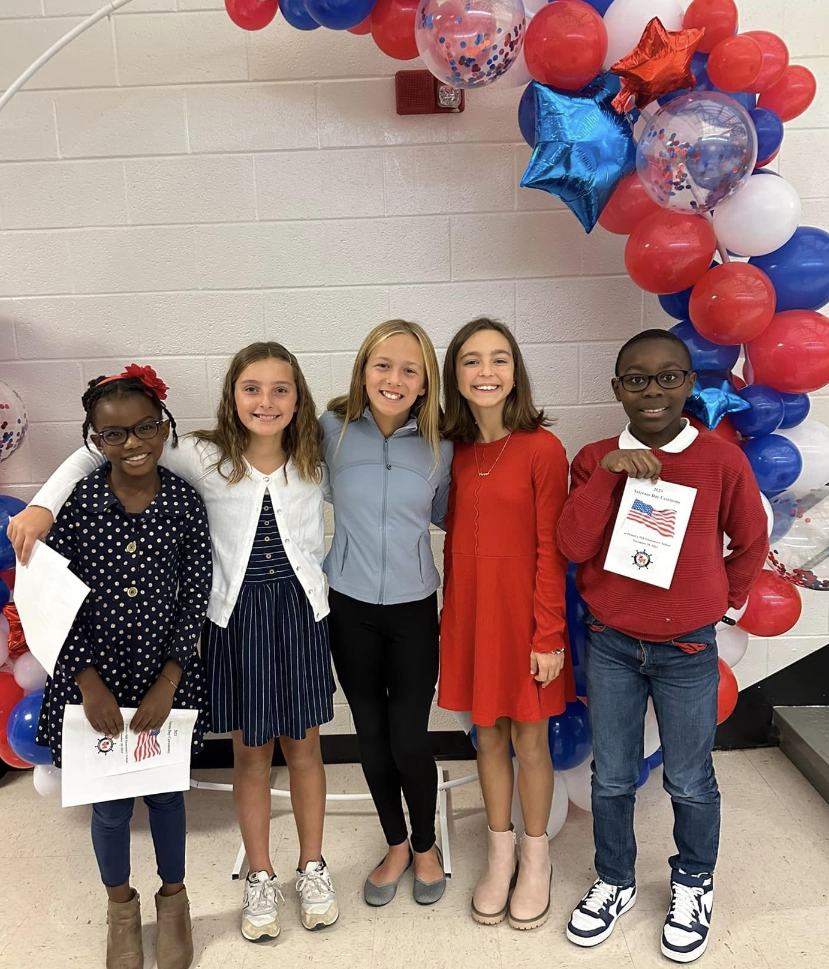
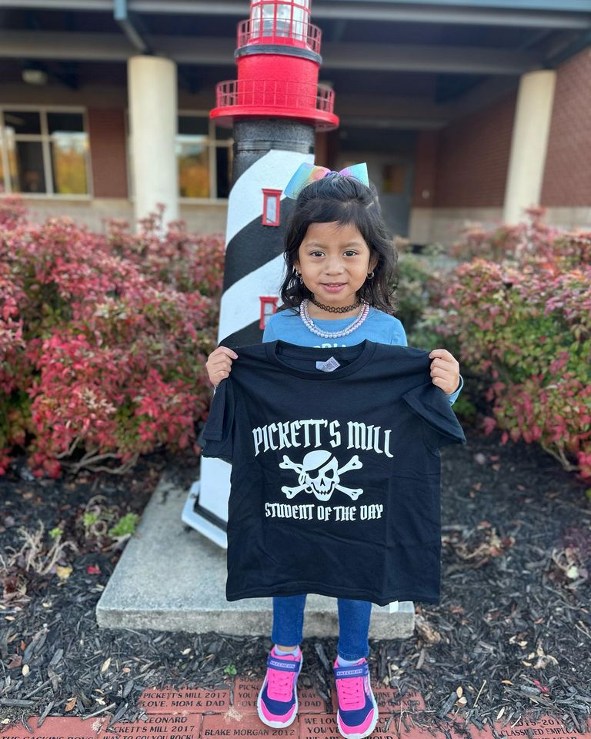

Slide 6
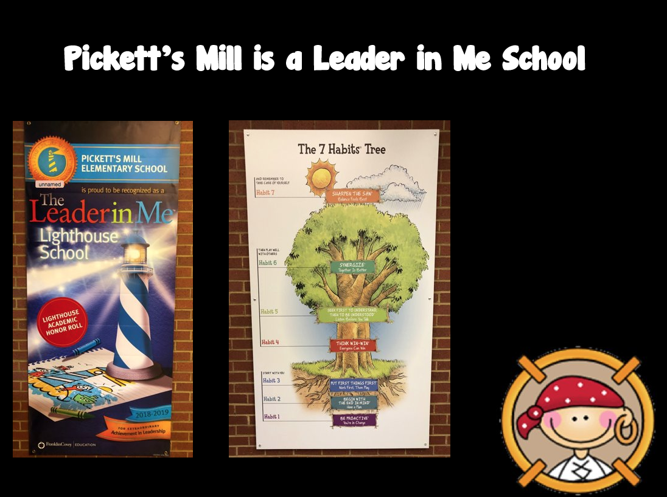
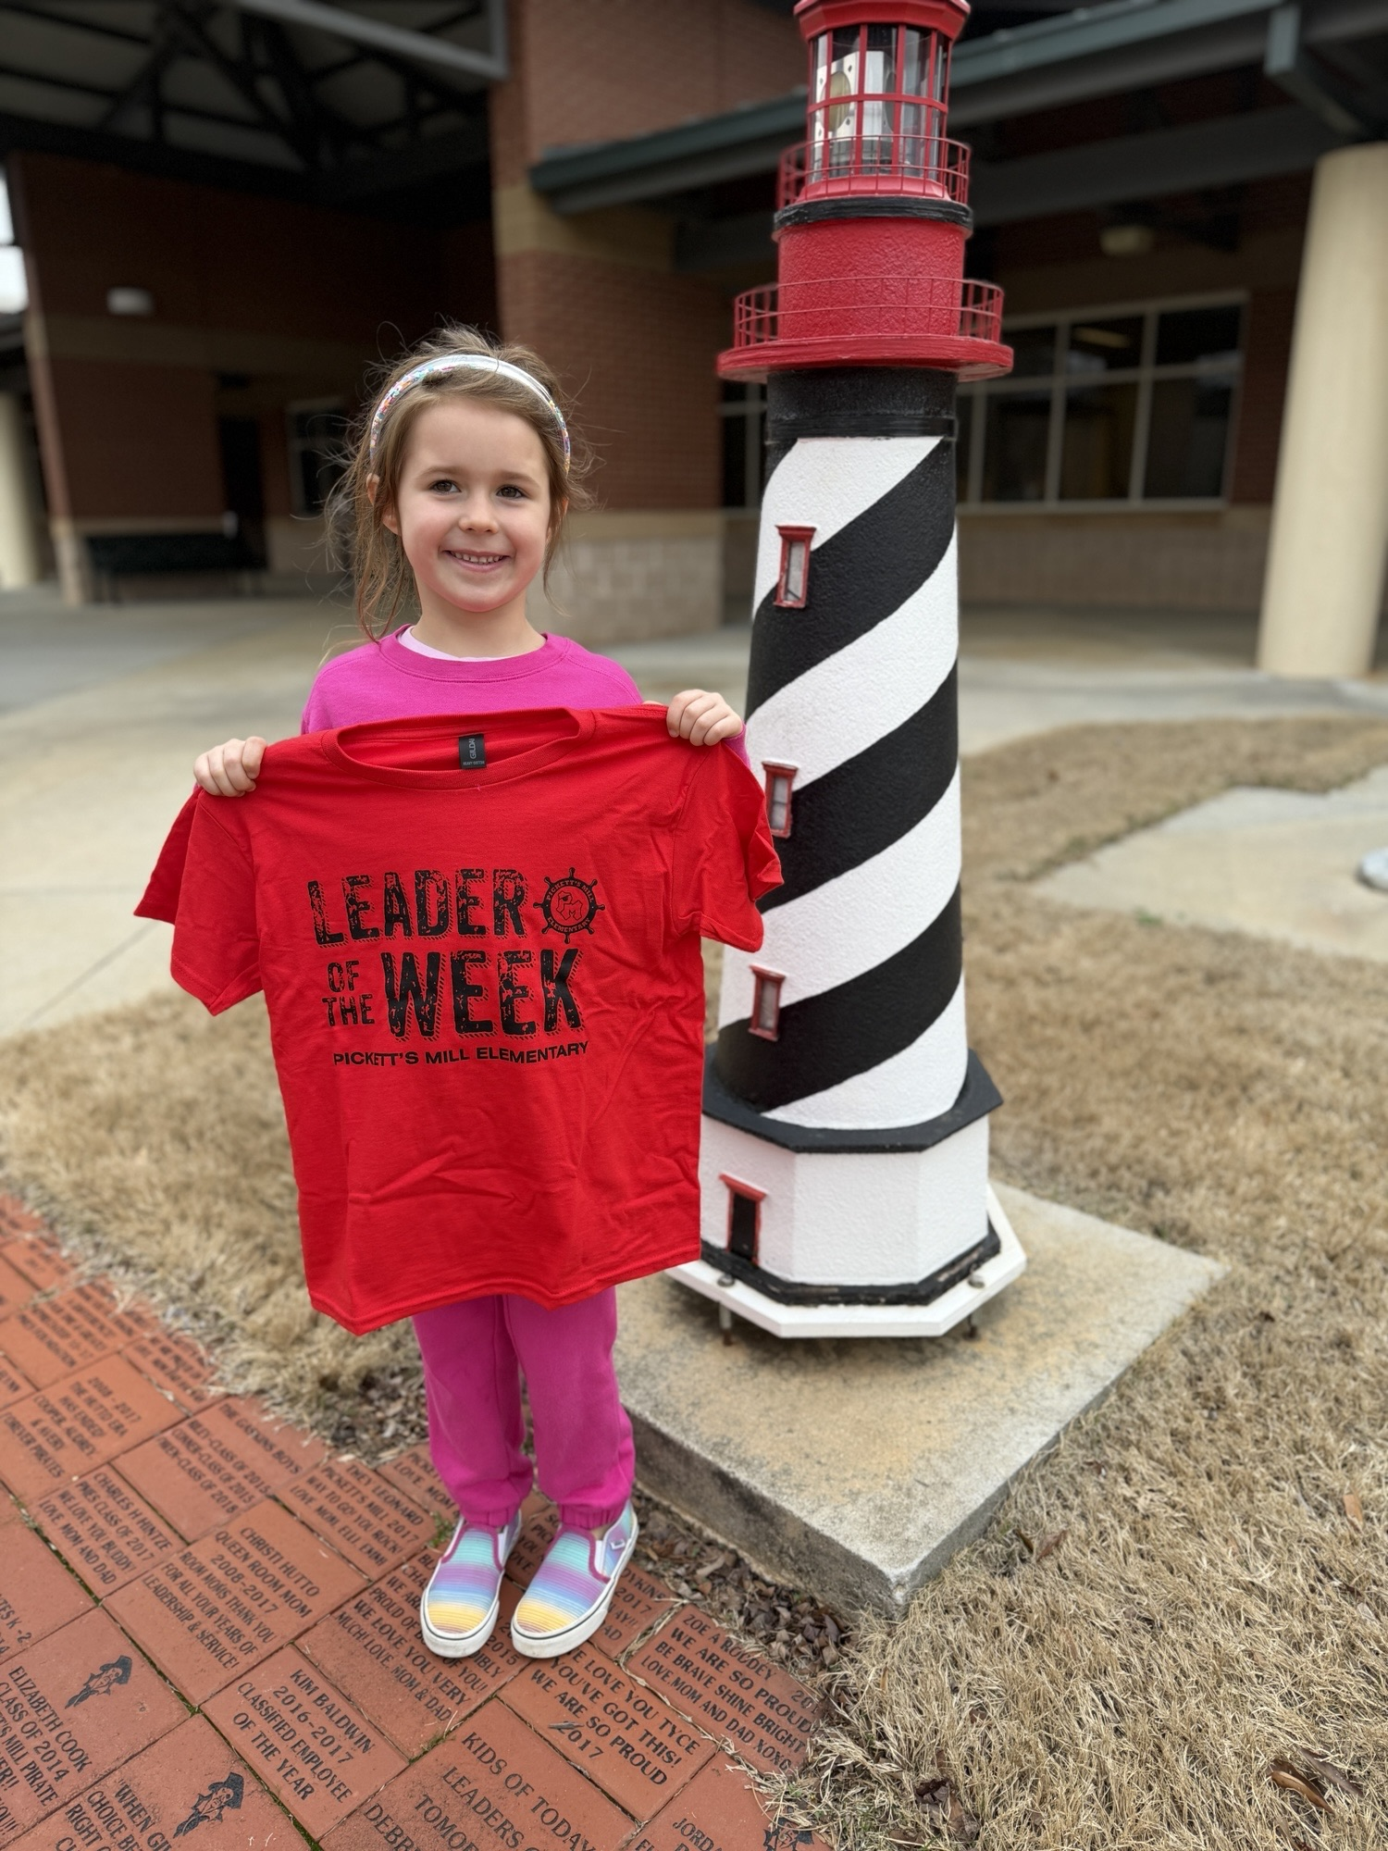
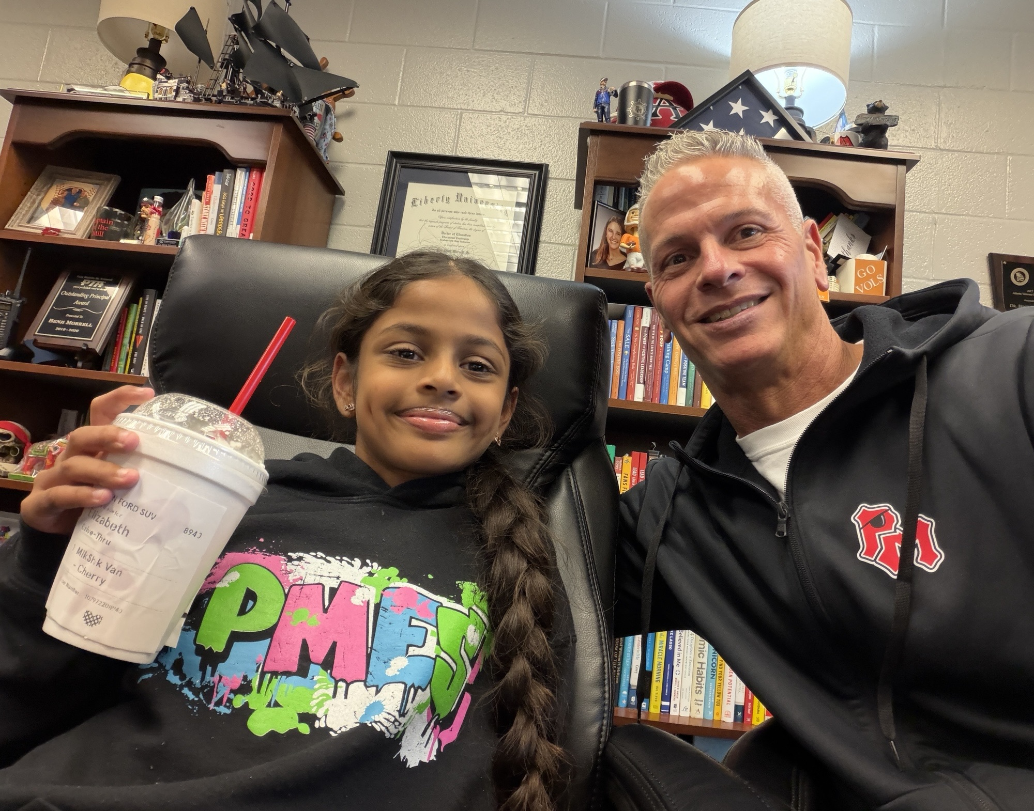

Slide 7
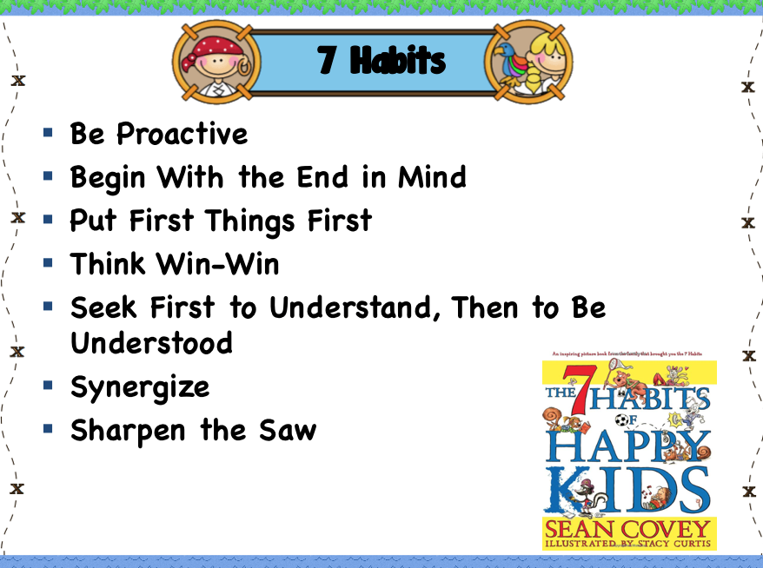

Slide 8
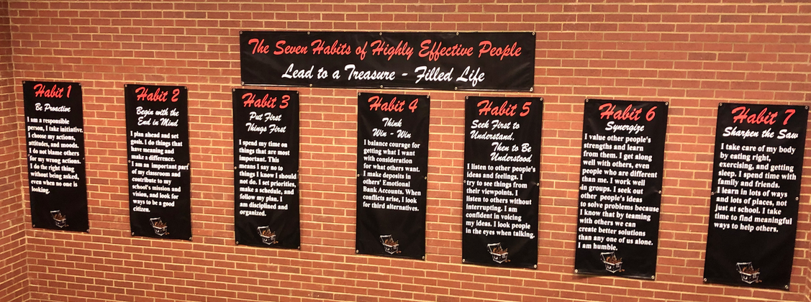
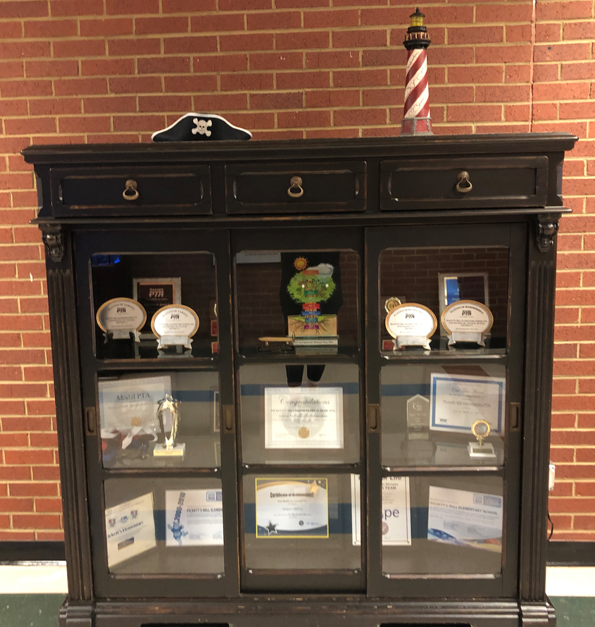
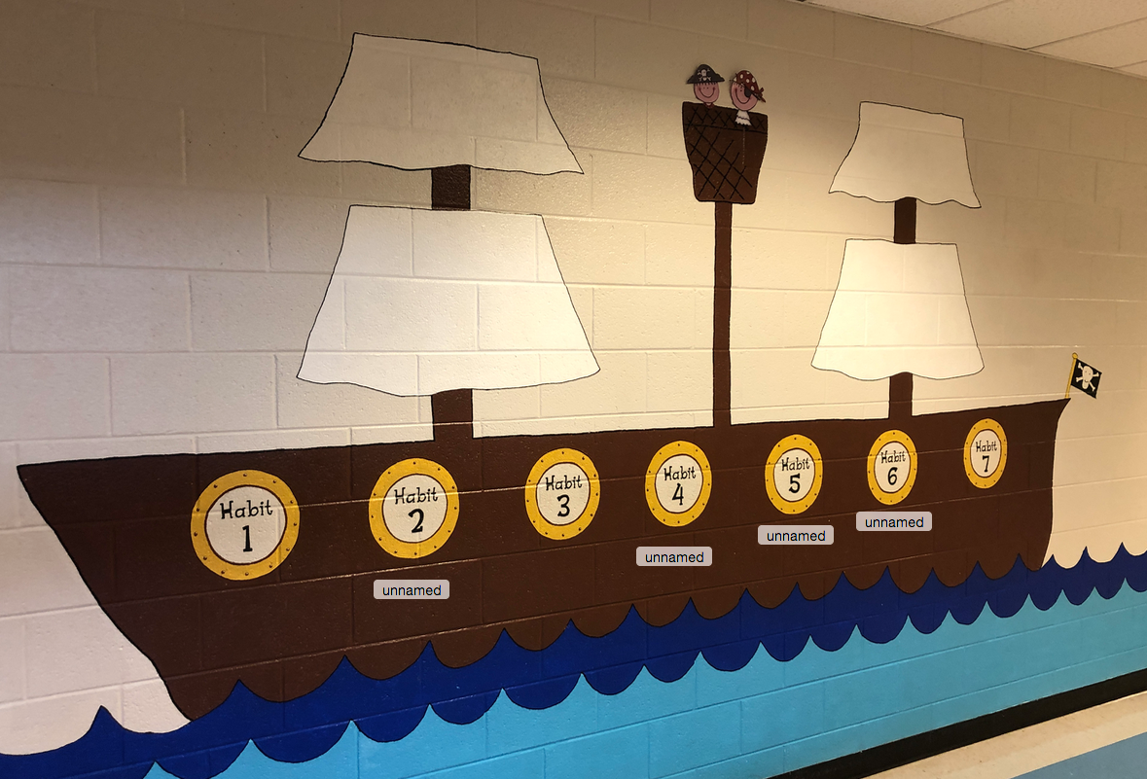

Slide 9
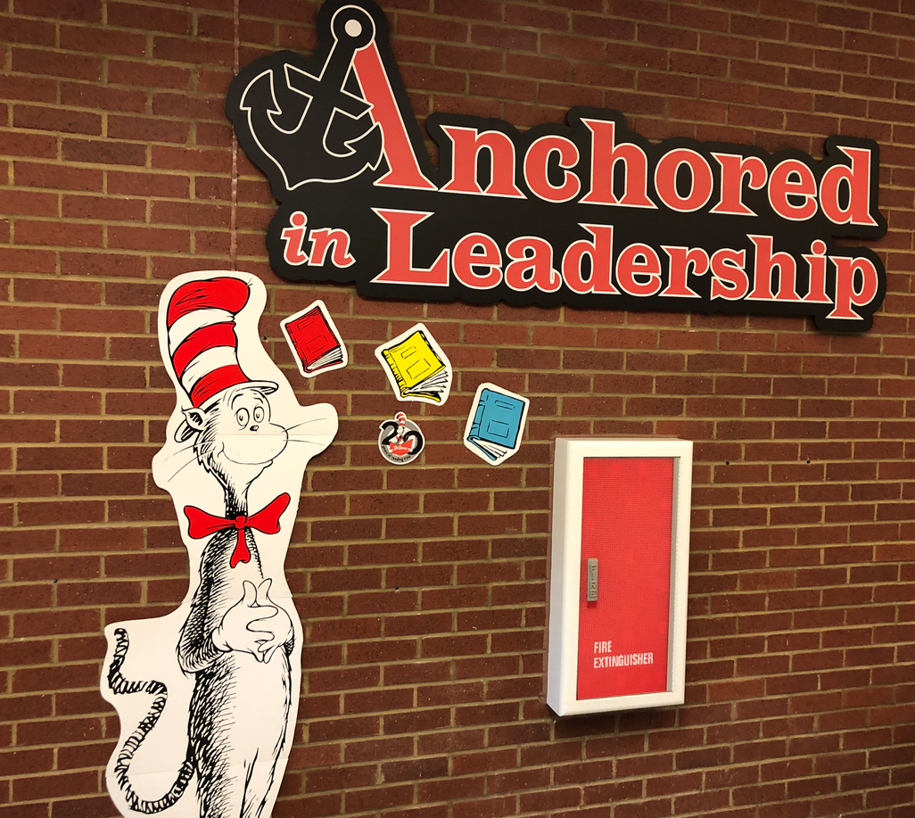
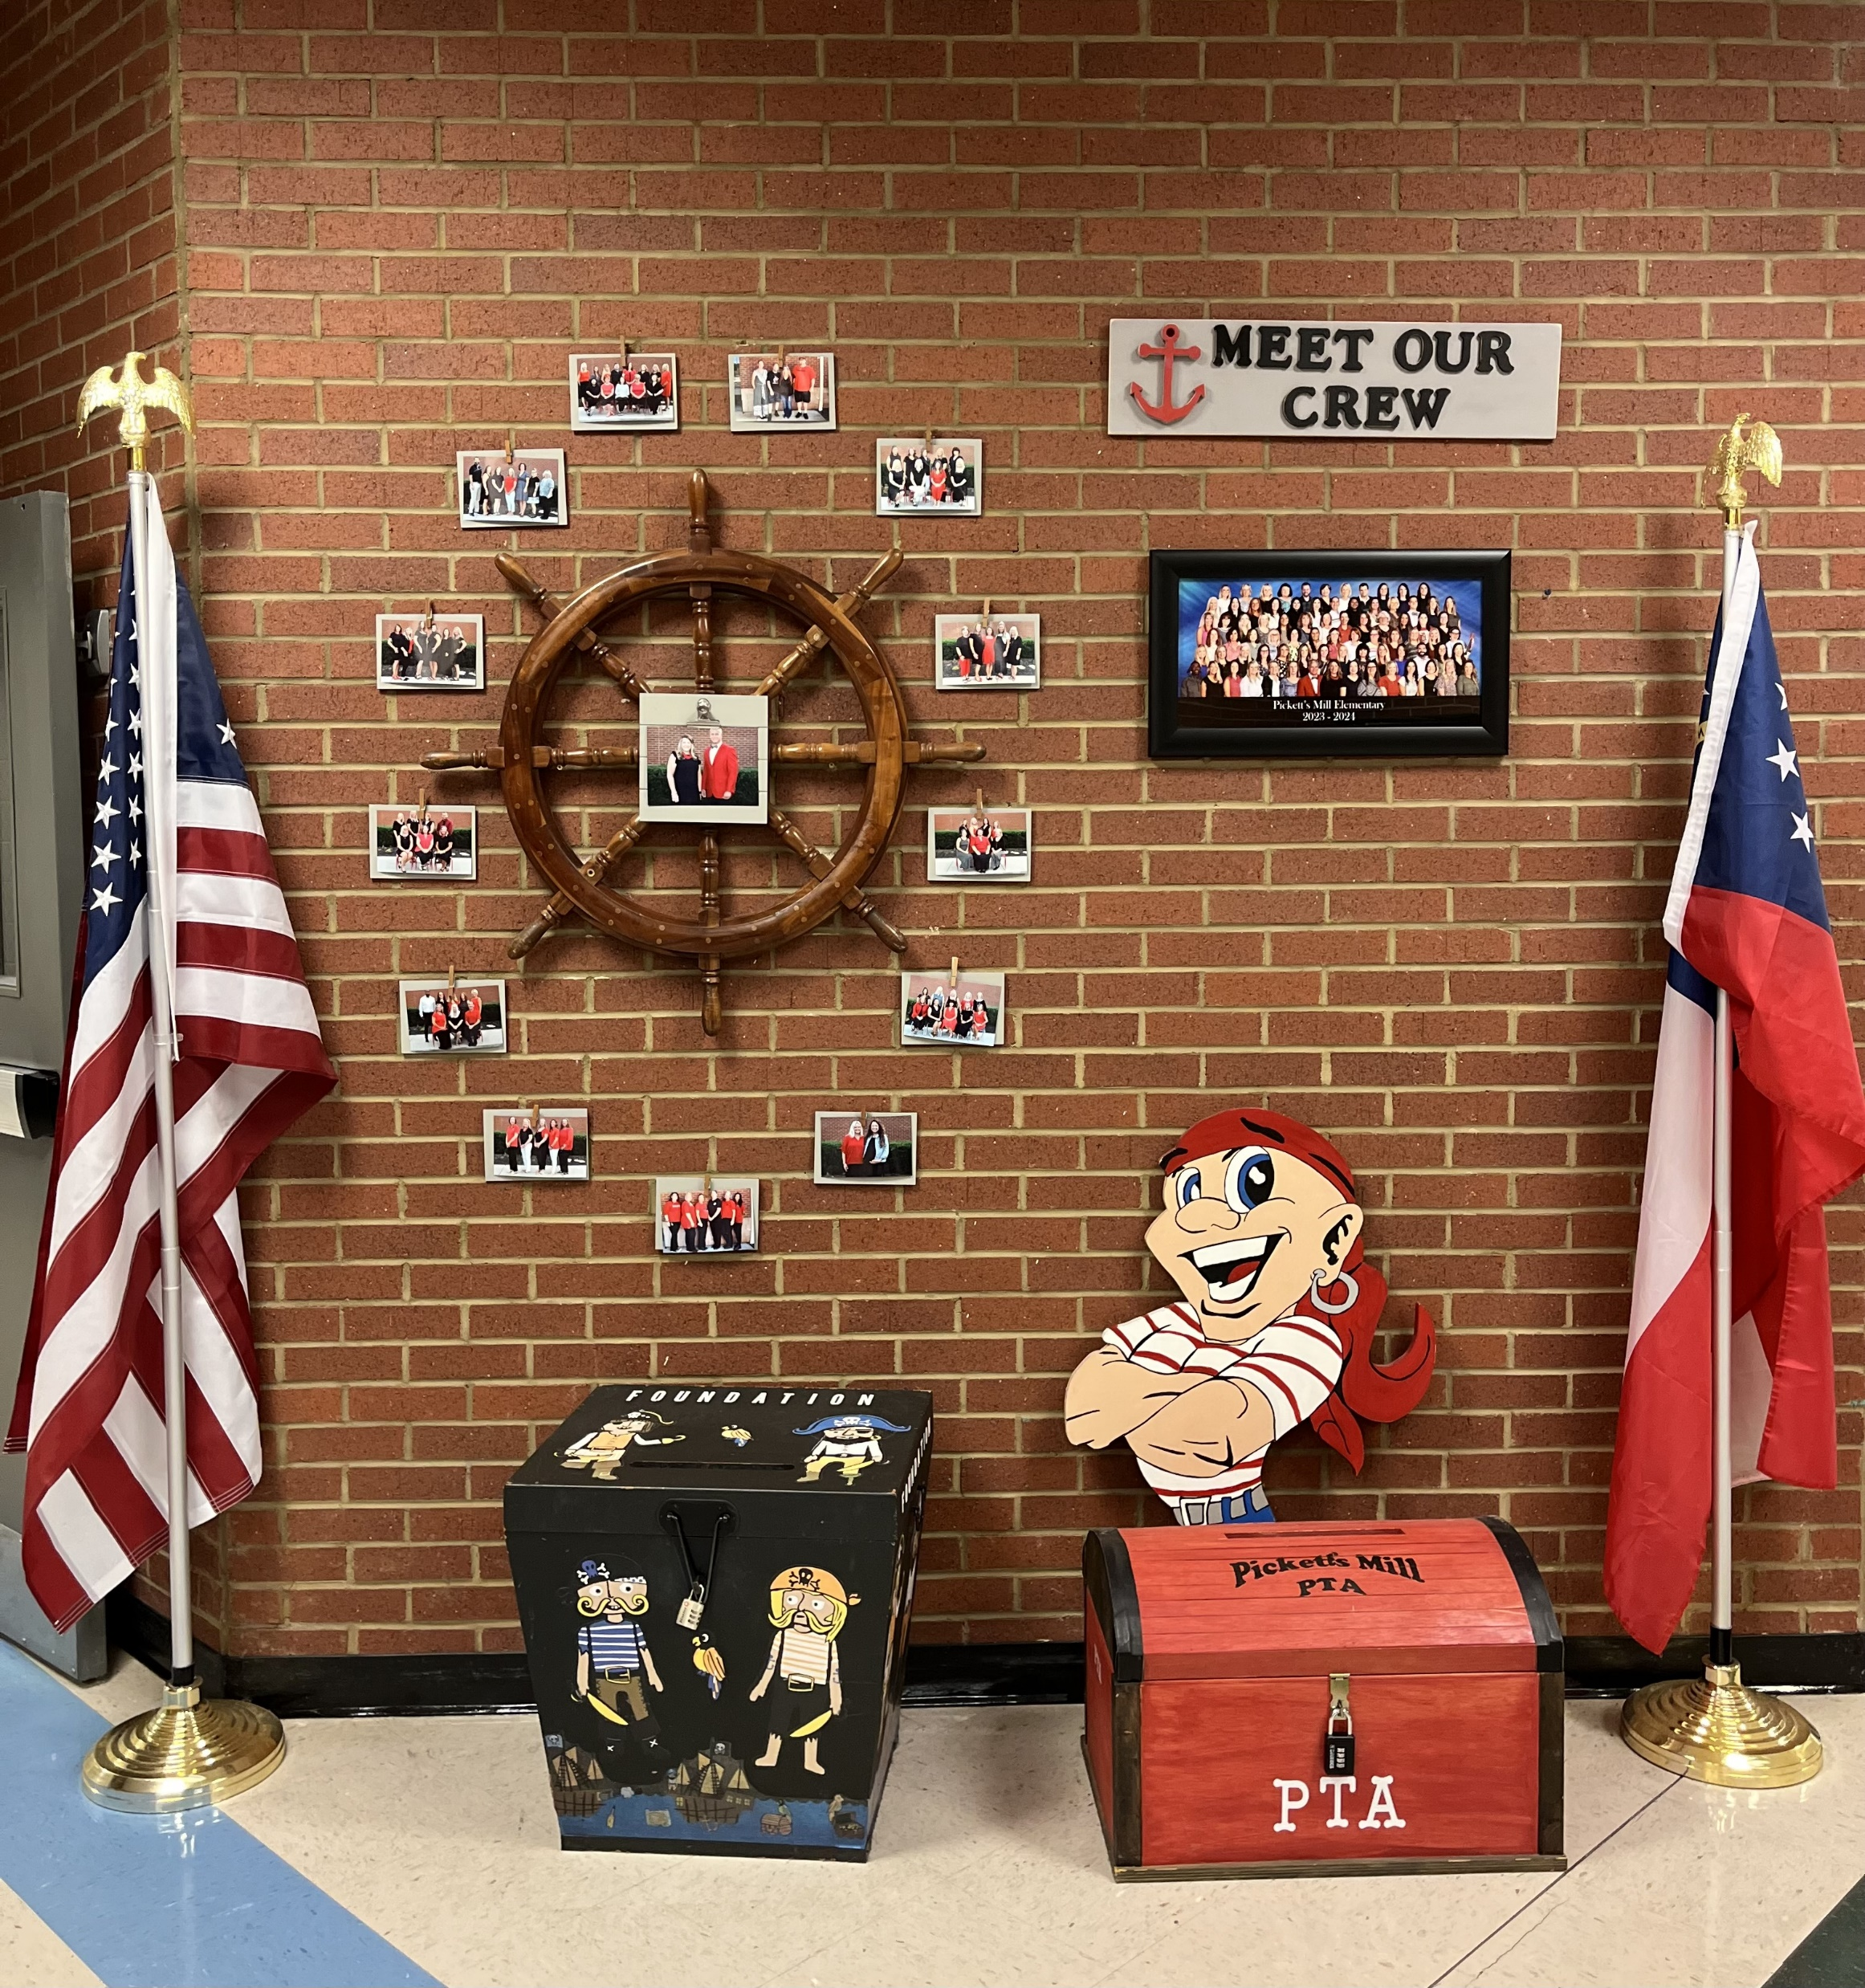
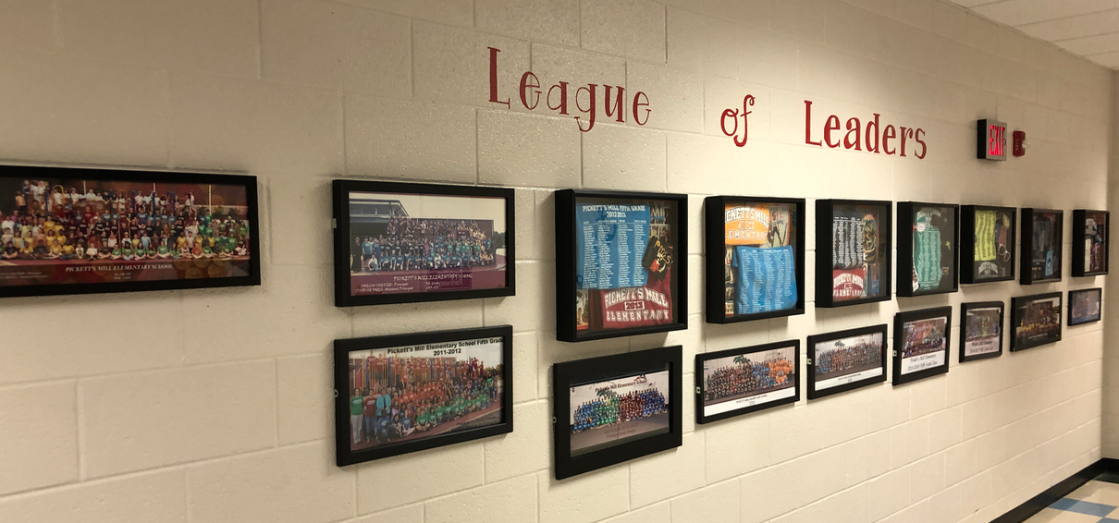

Slide 10
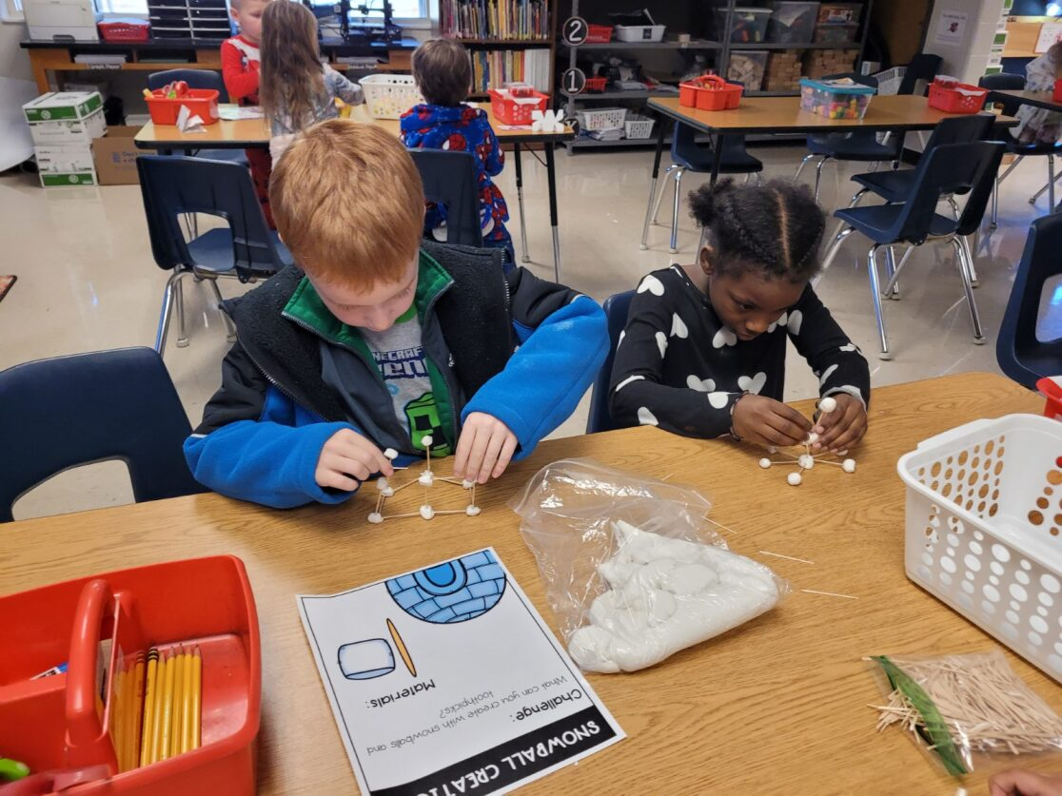

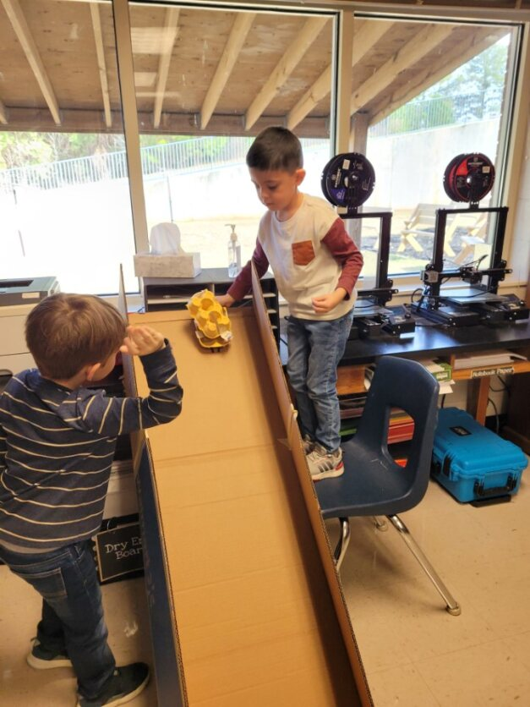
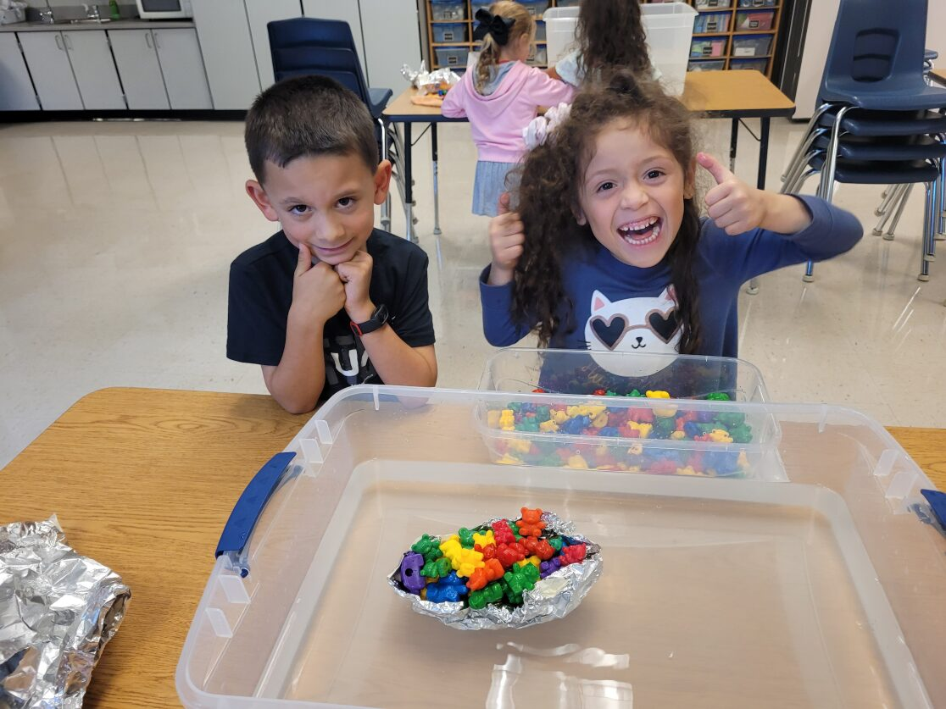
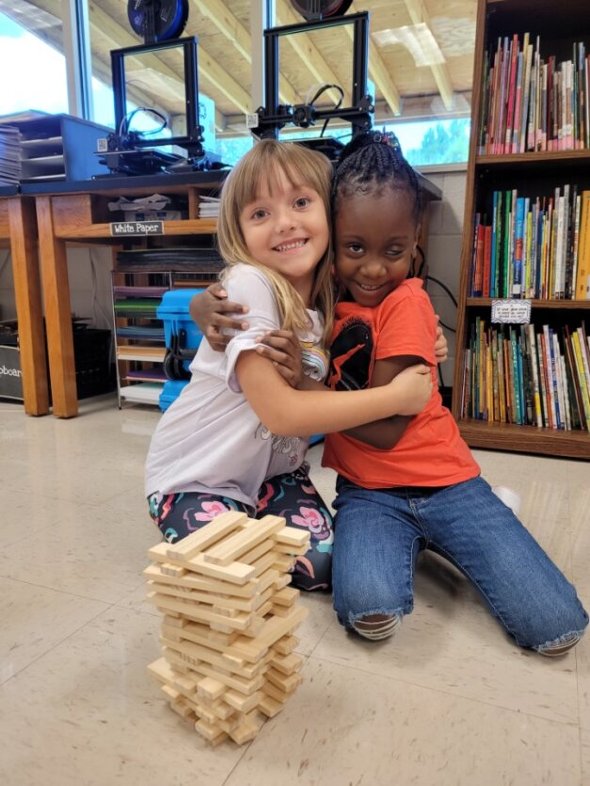
Hands on STEM activities in the classroom and STEM Lab

Slide 11













Pickett’s Mill Elementary
Essential Skills for Entering Kindergarten

Slide 12
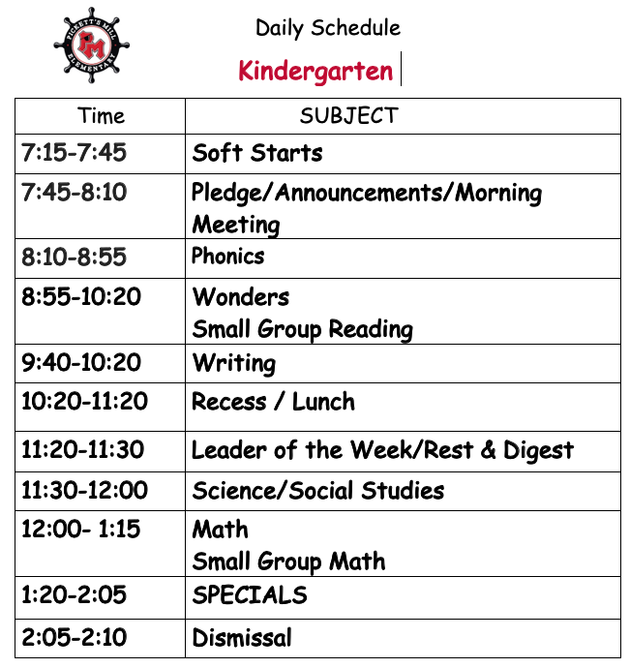

Slide 13
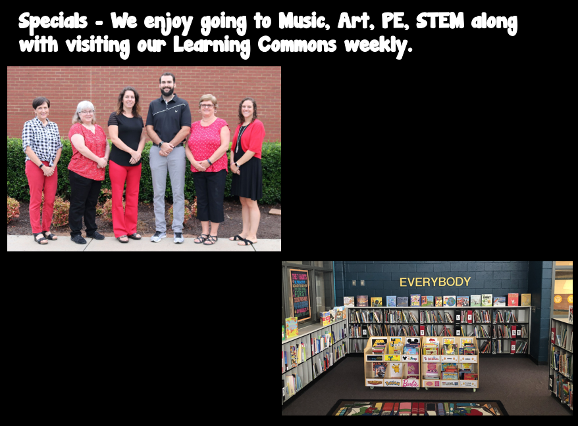
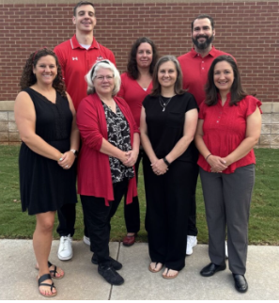

Slide 14
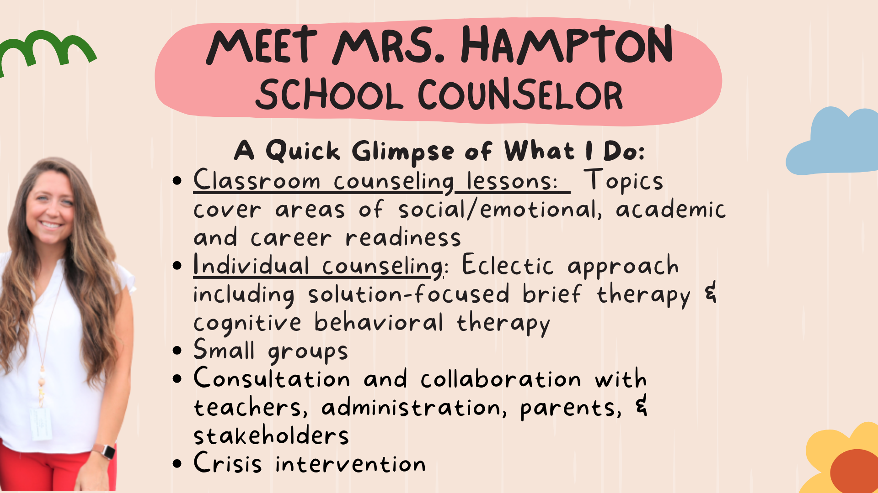

Slide 15
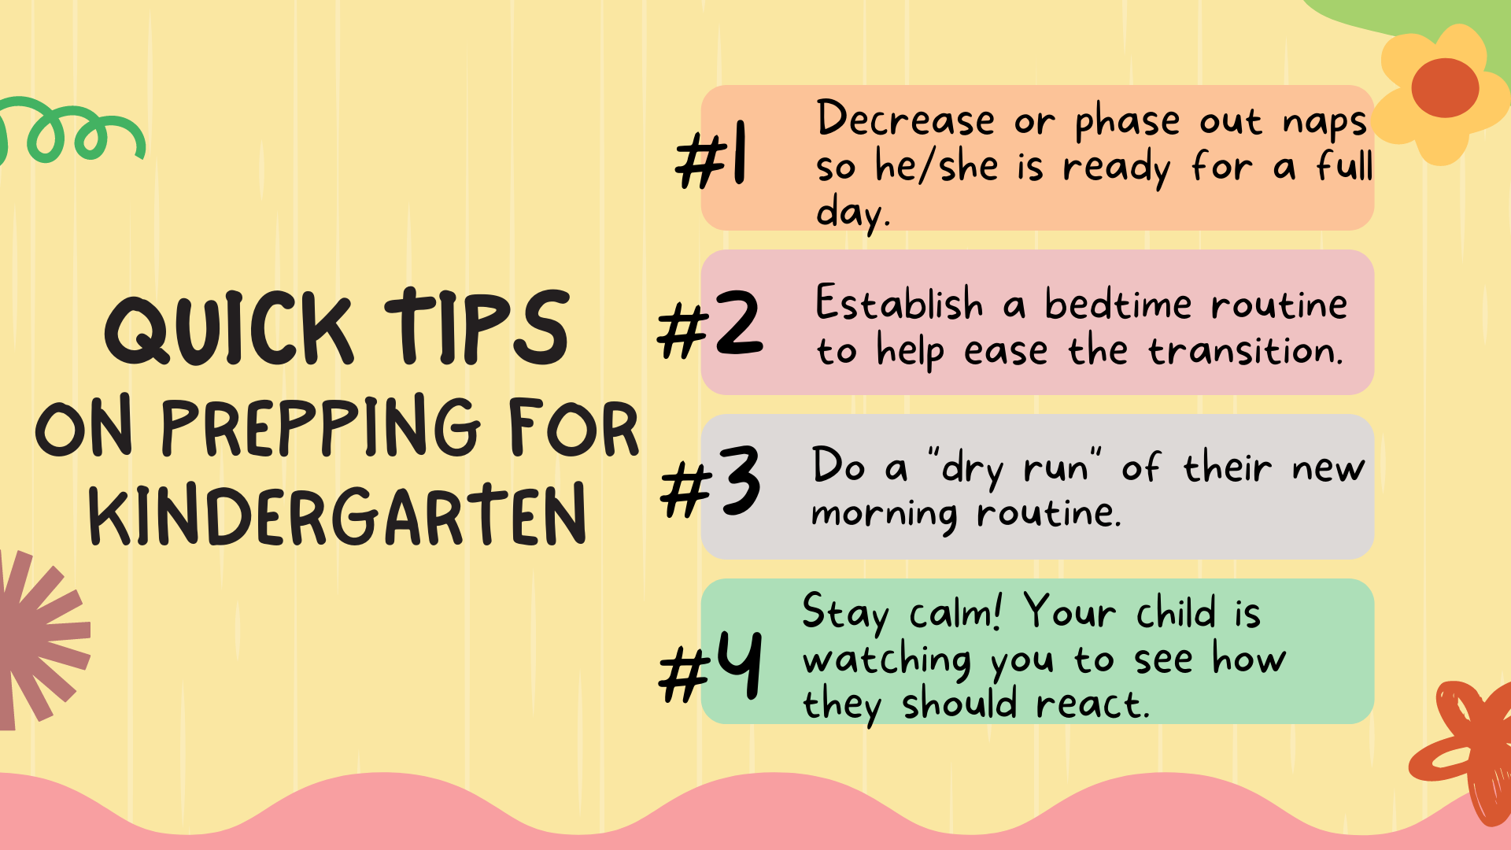

Slide 16


Slide 17

PTA
Why Join the PTA? PTA provides opportunities to meet and collaborate with other parents, teachers, and school administrators. Working together to share ideas and support that benefit children. There is no better way to know what's happening in your child's school and community.

Slide 18
Foundation
“Our goal is to promote student participation, leadership, learning, curiosity, and creativity. We partner with families, the community, administration, faculty, and PTA to empower educators and support student success. We strive always for positive involvement, respect and transparency and pledge good stewardship of the financial resources entrusted to us for the benefit of all Pickett’s Mill Elementary School students.”
Kate Zimmer, Foundation President 2023-2024

Slide 19
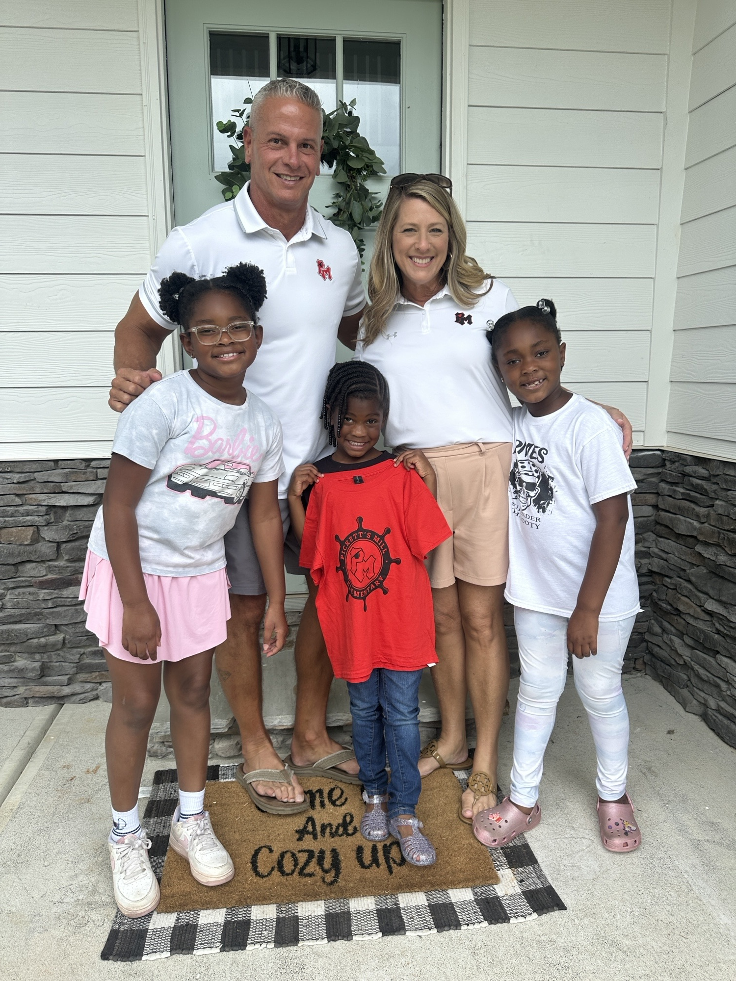
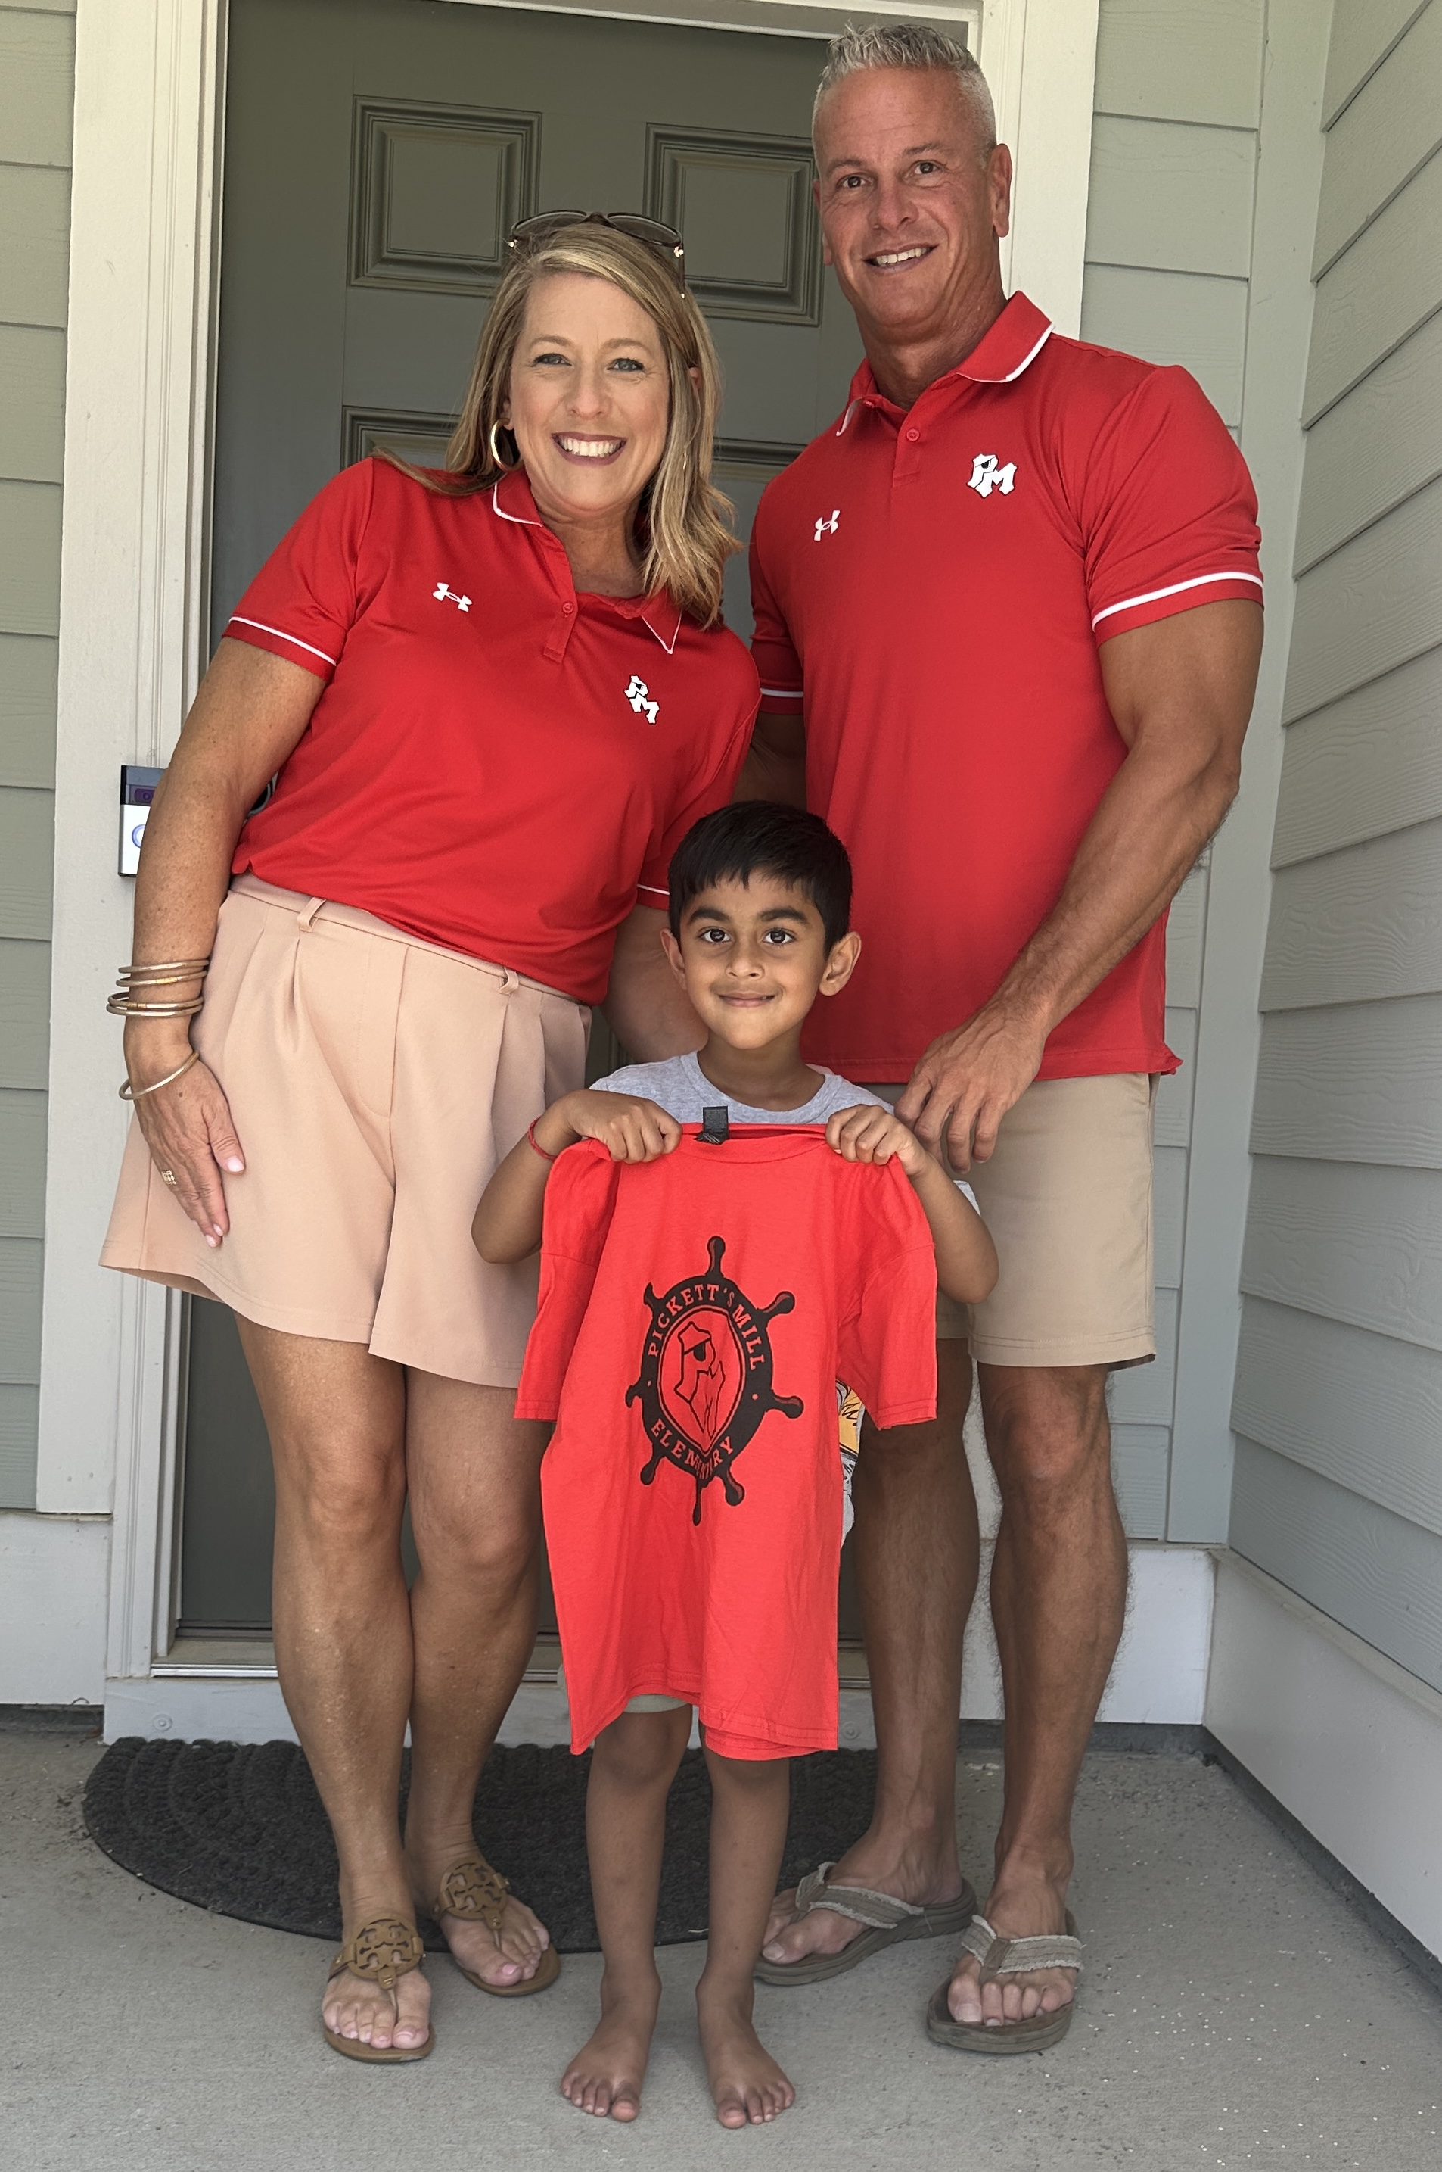
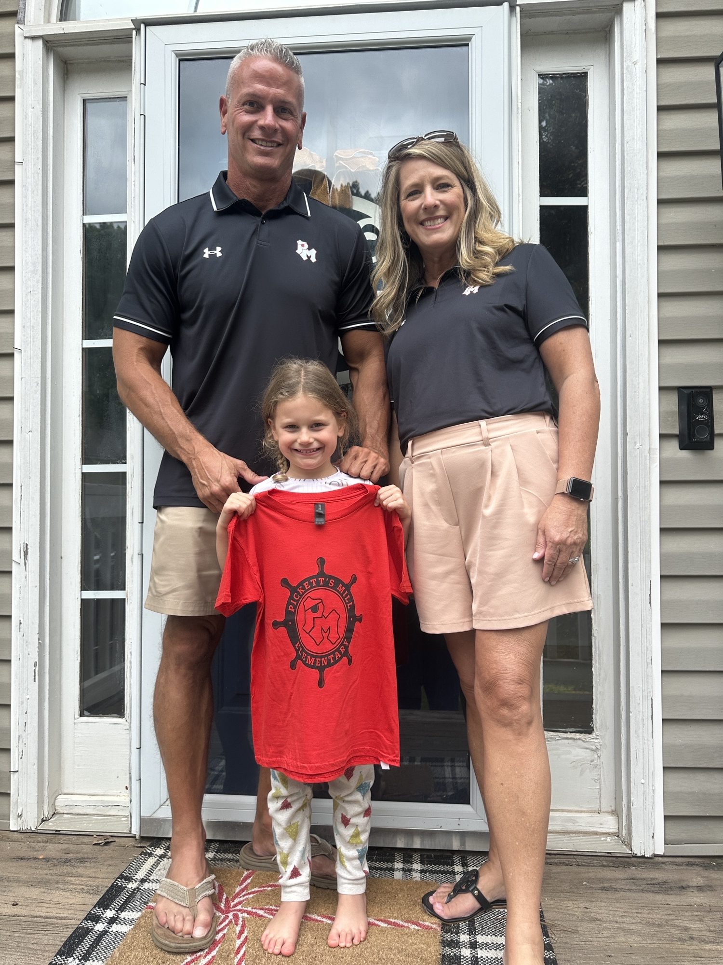
We looksforward to greeting our new pirates over the summer with during our locally famous, Kindergarten Home Visits!

Slide 20
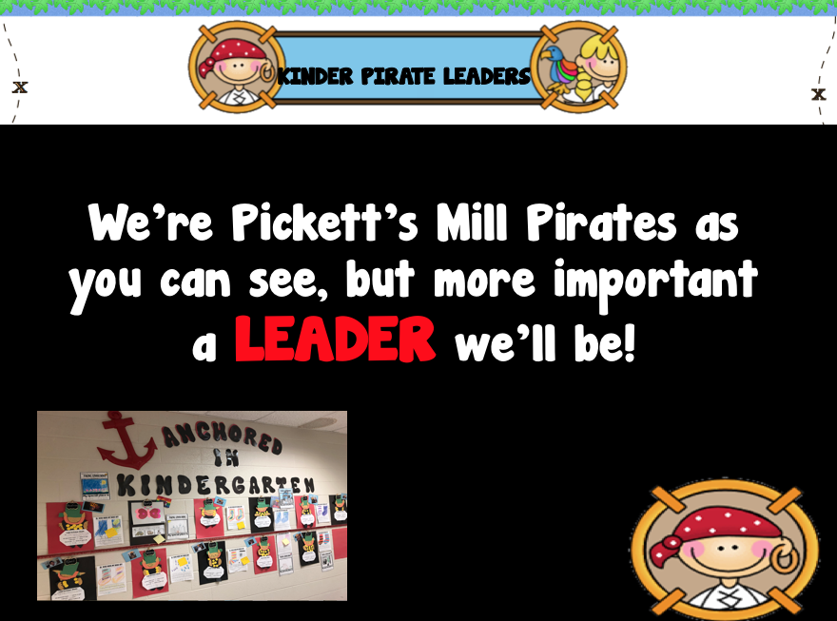

Slide 21


Slide 22

Thanks for attending Pickett’s Mill Pirate Preview. We look forward to seeing our new Pirate leaders in August!

