Slide 1








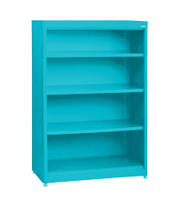









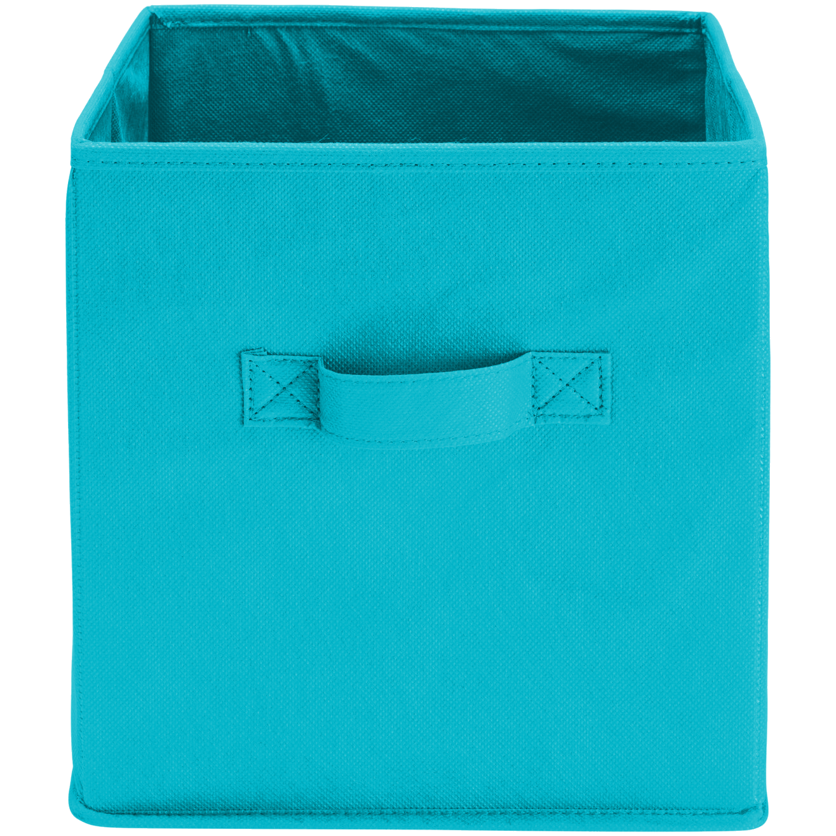







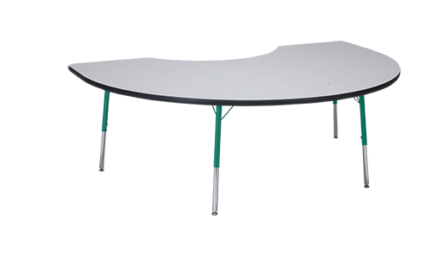



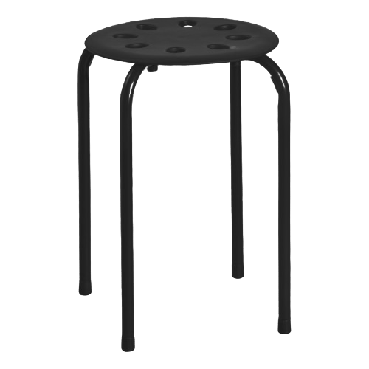

Welcome to
3rd Grade!

Slide 2

3rd grade
2022-2023
mrs.brown, Mrs.gibbs, mrs.Greco, Ms. King, Ms. Lambie, Mrs. Lee, Mrs.Montejo, Ms. Ragoo, Mrs. Simpson

Slide 3
Our Schedule
3rd grade

Slide 4
3rd grade schedule:
8:00 – 8:45 – W.I.N. Time
8:45 - 9:45 – Reading
9:45 – 11:00 – Writing/ELA
10:51 – 11:36 – Lunch (Each class will have a 30 minute block inside this time frame)
11:40 – 12:25 – Specials
12:30 – 2:00 – Math
2:10 - Dismissal
*Recess times vary per class

Slide 5
3rd grade schedule - FRIDAY
8:00 – 8:45 – W.I.N. Time
8:45 – 9:55 – Content Block #1
10:51 – 11:36 – Lunch (Each class will have a 30 minute block inside this time frame)
11:40 – 12:25 – Specials
12:30 – 1:55 – Content Block #2
1:55 – Return to homeroom, pack up
2:10 – Dismissal
*Note: If your child is absent on a Friday, they will be responsible for completing any missed work prior to the next Friday.

Slide 6
Our homework policy
3rd grade

Slide 7
Subject Areas
Reading – 20 minutes a night plus additional response activities
Math – Focus on Fact Fluency for Multiplication – this is a key skill this year! Practice every week!
There may be additional assignments throughout the year from individual teachers.
We are working hard to make sure that homework is differentiated and meets the needs of your individual student.
Students are responsible for turning in their homework on the due date.

Slide 8
Behavior management
3rd grade

Slide 9
What does it look like
Earning and Losing Funny Money – during the first few weeks of school, each class will determine what behaviors earn/lose money and how much money the behavior will earn/lose them.

Slide 10
How you can contribute to our behavior management
End of Quarter Stores – we will ask for volunteers and donated items at the end of each quarter. We will hold a day where the students will get to spend their hard-earned Funny Money.
Economic Standards – 3rd graders have to learn some basic economic ideas. They will get to apply this learning to the Funny Money stores in the later quarters.

Slide 11
Student responsibilities
3rd grade

Slide 12
Binders & Notebooks
Per the supply list, your child will use a binder and two five-star five-subject notebooks to organize their learning materials.
Teachers will help students organize materials during the first week of school.
Daily communication folder will come home each day. Students will be responsible for this folder and its contents.

Slide 13

general
Third grade is a big transition year.
We want students to understand that learning means problem-solving, using their resources, and trying their best – even if that means failing. Failure is how we learn.

Slide 14
CTLs
3rd grade

Slide 15
Ctls parent
Make sure you can access CTLS Parent so that you will receive communication from teachers, school, and county.
Please ensure that your contact information is accurate in ParentVUE so that you will receive all communications.
You will need to download the CTLS Parent App on your mobile device to receive and respond to communication.
You will also receive notifications in email but must respond through CTLS Parent.

Slide 16
Ctls learn
Students are able to access CTLS Digital Classrooms for resources as needed from home.
Announcements and assignments will be available through the CTLS Learn platform for student access.

Slide 17
curriculum
3rd grade

Slide 18
reading
RI will be given at the beginning of the year to determine the Lexile level. They will be reassessed two other times during the year.
End of Year Lexile Range: 520L – 824L
Resources to find books on your child’s Lexile level:
* lexile.com
* http://www.the-best-childrens-books.org/books-by-lexile.html
On Grade Level for report card are levels M, N, O, P (by quarter)

Slide 19
writing
In the beginning of the year, we will review foundational skills such as handwriting, capitalization, punctuation, sentence and paragraph structure. Then we will move into the genre units listed below:
Narrative
Informational
Opinion
Creative Writing will be included throughout the year.
Other - Constructed Response/Response to Reading

Slide 20
math
The third-grade team’s goal is that all students will engage in mathematical concepts with a growth mindset. We will focus on the process more so than the product. Below are some concepts we will cover:
Multi-digit addition and subtraction – students should have mastered this in 2nd grade!!
Your students will need to have multiplication facts to 100 memorized by the end of the school year. START NOW –
  By December, they should master their 0, 1, 2, 5, 10 facts
Division strategies
One and two - Step Word Problems all year!!
Fractions
Elapsed Time

Slide 21
Science Social studies
Rocks and Soil
Weathering, Erosion, Fossils
Pollution
Animal Adaptations
Heat
3 Branches of Government
U.S. Geography
American Indian Cultures
Explorers
Colonization
Economics

Slide 22
Information from Admin
All visitors and volunteers must sign in with the front office and wear their visitor badges visibly for the entirety of the visit. Be prepared to show identification upon arrival.
Parent Volunteer Requirements
  Volunteer Video: https://studentprivacy.ed.gov/training/school-volunteers-and-ferpa
  Complete the form and return to homeroom teacher
Morning Drop Off begins at 7:20am
Afternoon early checkouts must be prior to 1:45
Hand-written notes are required for transportation changes
All Students must be registered for ASP
Attendance Policy
Lunch visitors are allowed beginning August 15th

Slide 23
Information from Admin
Car Rider Procedures
  The car line will take longer the first week of school.
  Be sure students know their grade level and last name.
  Students will not be dismissed to parents without a car tag.
  Parents without tags must park and come into the office with their identification.
  Walkers will be dismissed around 2:30, once most cars have gone.
  Students that are not picked up by 2:35pm will be sent to ASP.
  Initial car tags will be available at the Car Rider Table, located in the upper mezzanine, across from the Learning Commons. At this time, as supplies are limited, we are creating one car tag, per family. If your family needs a second tag, please fill out the pink forms, located in our classrooms, and turn into the Car Rider Table, the front office, or to your student’s teacher.

Slide 24
Mountain View Elementary PTA
PTA’s mission is to make every child’s potential a reality. How do we do that?
Provide online learning tools for most subject areas
Provide support for Art, Music and PE
Consumables for labs
Enrichment Materials for Special Education, Target, Speech and Guidance
Provide Funding for Professional Development Opportunities for Our Staff
Family Engagement Events (Fall Festival, Winter Dance, International Night)
Please visit our website for more information:
www.mountainviewpta.org
Thank You!
Together We Make A Difference!

Slide 25


Slide 26


Slide 27










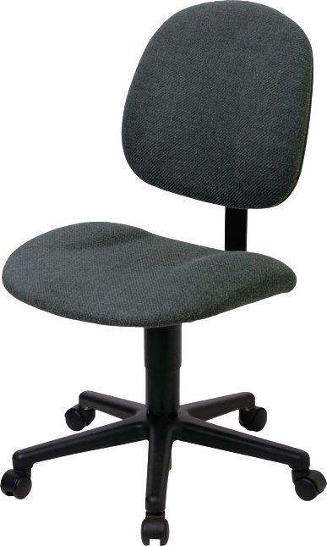
This Photo by Unknown Author is licensed under CC BY-NC

