Slide 1
Class of 2029
High school 101
Parent Hot Topic
Presented by Your Amazing Counseling Team

Slide 2
Let’s talk about…
Schedules (4X4)
Graduation Requirements
AP and Honors Courses
CTAE, Fine Arts and elective courses
GPA (Calculating/Importance/Types)
AP v. Dual Enrollment
Elective Registration
Notes:
This is your agenda for the lesson.

Slide 3
4x4 Block Schedule
Students complete a year’s worth of curriculum, the entire course, in 18 weeks. Semesters 1 and 2
Homeroom does NOT meet everyday, students go directly to 1st Block except for the first few days of the semester and other days as scheduled by the school
Every class taken and passed earns 1 unit of credit. Students can earn as many as 32 course credits in the 4 years of high school (only need 23 to graduate)
Most often, each semester will consist of 2 academic courses and 2 Elective courses (CTAE, Fine Arts, World Languages)

Slide 4
Sample High School Schedule
 |  |  | Fall |  |  |  | Spring
Warning Bell |  | 8:15 |  |  | Warning Bell | 8:15
Block 1 |  | 8:20 - 10:01 | 9th Lit |  | Block 1 | 8:20 - 10:01 | H/PF
Block 2 |  | 10:06 - 11:43 | Spanish II |  | Block 2 | 10:06 - 11:43 | World Geography
Block 3 |  | 11:48 - 1:48 | Intro to Marketing |  | Block 3 | 11:48 - 1:48 | Visual Art I
Lunch A |  | 11:48 - 12:18 |  |  | Lunch A | 11:48 - 12:18
Lunch B |  | 12:18 - 12:48 |  |  | Lunch B | 12:18 - 12:48
Lunch C |  | 12:48 - 1:18 |  |  | Lunch C | 12:48 - 1:18
Lunch D |  | 1:18 - 1:48 |  |  | Lunch D | 1:18 - 1:48
Block 4 |  | 1:53 - 3:30 | Algebra I |  | Block 4 | 1:53 - 3:30 | Biology
***Each teacher/class is assigned a lunch period for their student to attend.

Slide 5
PROMOTION/RETENTION
10th grade: 5 units including one unit each of required English, Math, and Science.
11th grade: 10 units including two units each of required English, Math, and Science.
12th grade: 16 units including two units each of English, Math and Science
Students who are retained will remain in the same grade-level homeroom the entire year and must retake the failed classes needed for promotion.
Important: Participation in homecoming court or purchasing prom tickets is based on your enrolled grade, not your ninth-grade entry date. Only students in 11th and 12th grade homerooms may purchase prom tickets.
Also parking and yearbook picture placement are also determined by promotion/retention too

Slide 6
What’s a GPA
https://www.youtube.com/watch?v=28JWeft_WAc
Grade Point Average (GPA)
A = 4.0 90-100
B = 3.0 80-89
C = 2.0 74-79
D = 1.0 70-73
F = 0.0 69 and ↓
Advanced Placement
Grade Point Average (GPA):
A = 5.0 90-100
B = 4.0 80-89
C = 3.0 74-79
D = 2.0 70-73
F = 0.0 69 and ↓

Slide 7
Hope and Zell Miller Scholarship Program
Rigor Courses are most AP Courses and World Language year 3 and up. For a full list contact the High School Counseling office
HOPE – covers part of in-state tuition
ZELL- covers 100% of in-state tuition
A half point (.5) is added for AP, IB and Dual Enrollment classes that receive a B, C, D, or F. No point added for an A.
Requirements | HOPE | ZELL MILLER
GPA | 3.0 (unweighted) in all Math, English, Science, Social Studies and World Languages | 3.7 (unweighted) in all Math, English, Science, Social Studies and World Languages
Test Scores | No Test Score Requirement | 1200 SAT or 25 ACT score
Rigor Requirement | 4 Credits | 4 Credits

Slide 8
Dual Enrollment
Dual Enrollment is a program that provides funding for students at eligible high schools that are enrolled to take approved college-level coursework for credit towards both high school and college graduation requirements.
Dual Enrollment/Dual Credit courses are primarily available for any eligible 11th or 12th grade high school students (some 10th grade students if meet specific requirements)
The Dual Enrollment program covers tuition, mandatory fees and required textbooks.
Students may enroll full-time or part-time
Courses can be taken before, during or after regular school hours, on the college campus, on-line, or at the high school during the regular school calendar year. Dual Enrollment courses can also be taken during the summer.
Students must meet certain eligibility requirements (SAT or ACT score, and enroll in approved courses)

Slide 9
Graduation Requirements
ELA
MATH
SCIENCE
SOCIAL STUDIES
4 Units
9th Literature (Lit & Comp)
American Literature (Lit & Comp II)
+2 More Classes (Pick 2)
AP Language
AP seminar
AP Literature
AP Research
Lit and Comp III
Lit and Comp IV
Comp & Dramatic Wtg
4 Units
Algebra
Geometry
Advanced Algebra II
+ 1 More Class:
Foundations of Algebra
AP Calc AB
AP Calc BC
AP Stat
Calculus
Pre-Cal
Adv Mathematical Decision Making
4 Units
Physical Science or Physics
Biology
Chemistry or Environmental Science,
4th Science Class
3 Units
World History
US History
Economics
US Government

Slide 10
Graduation Requirements, Pt. 2
1 Unit - Health/ Personal Fitness
3 Units – Pathways
CTAE, Fine Arts, Foreign Language
4 Additional Electives
23 Units total required for graduation
Notes:
** 4-Year colleges require at least two credits of the same foreign language**
Don’t need foreign language to graduate

Slide 11
Pathways
Students must complete at least one pathway while in High School to be eligible for graduation. This means they must pass 3 out of 4 classes in a particular pathway.
Hillgrove Pathways
Architecture Drawing & Design / Engineering
Drafting and Design
Business Management and Administration
Culinary Arts
Engineering
Visual Arts
Audio & Video Technology and Film
Graphics Design / Graphic Communication
Government & Public Administration /
JR ROTC Navy
Sports and Entertainment Marketing
Computer Science and Programming
Fine Arts
World Languages
Harrison Pathways
Audio Visual Technology and Film
Business and Technology
Computer Science
Teaching as a Profession
Graphic Design
Sports and Entertainment marketing
Therapeutic Services/Sports Medicine
World Languages
Fine Arts

Slide 12
Transfers and Magnet Programs
Students are registered for the high School they currently reside in
Students who plan to apply for school choice or employee transfer– parent needs to email a counselor or Ms. Biolsi . We will still register the student for their districted high school, but we will also do an unofficial registration form for the school applied for In case the transfer is approved..
For students who applied to Magnet Programs or CITA – we will still register, the student for their districted High School. the Magnet school will send us a registration forms for accepted students later in the year
Once Parents are notified transfer is approved, they need to contact the approved school about registration. The school may request the parent and student come in for an in-person registration appointment or they maybe able to use the unofficial registration form we completed

Slide 13
High School Registration - Electives
8th graders will register for their 9th grade electives by selecting their choices given by their high school
Health/BPE is required in 9th grade so it will be an automatic choice for one semester
Foreign Language will also take the place of an elective choice for one semester
Hillgrove will use an orange paper elective sheet for students to list their elective choices
Harrison students will use their Student Vue account to choose their electives

Slide 14
High School Registration - Core
High School Department Chairs meet with 8th grade teachers to share their requirements for core placement. 8th grade teachers use the criteria set by the high school in recommending core classes
8TH grade teachers will evaluate your student’s achievement level, work habits and current grades to recommend the academic core classes for the subject they teach
For Students/Parents who disagree with a core recommendation: Each High School will have a process for addressing this.
Harrison will use online drop/adds submissions from April 18-25 for this.
For Hillgrove, Registration Verification Forms to drop/add will be used April 14-28. Forms must be turned into Hillgrove Front Office

Slide 15
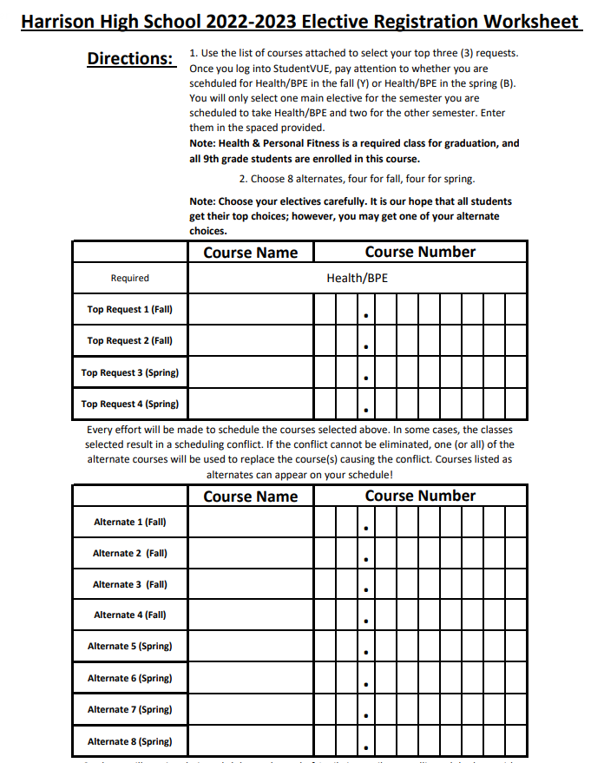
Harrison Elective Registration
You will use your Elective Registration Worksheet Numbers to enter your Elective courses.

Slide 16
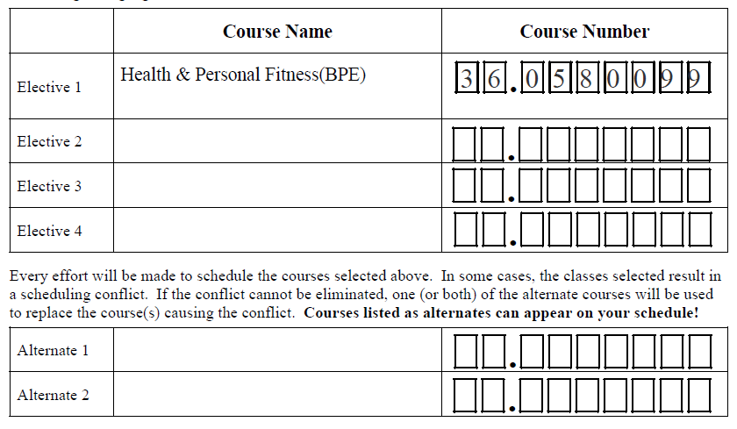
Sample Worksheet for Hillgrove Elective Registration – Year Long

Slide 17
Hillgrove High School
Mid January Hillgrove students receive Registration materials in homeroom (from now until Feb. 6 students will fill out their forms with selected electives and turn into homeroom teacher)
Jan. 23 at 7-8:15PM Rising 9th Parent Night/Open House at Hillgrove
Jan. 24 LMMS 8th grade Field trip to Hillgrove (for districted Hillgrove students with parent permission)
Jan. 30 from 11:00AM-1:00PM Virtual Q&A for parents with Hillgrove counselors (link will be sent via CTLS)

Slide 18
Hillgrove High School
Feb. 4 LIME GREEN Elective Registration forms due to homeroom teachers
Feb. 5 Hillgrove picks up Registrations from LMMS
Feb. 12 from 6-7:30PM Advanced Academic Night at Hillgrove
April 4 Course Registration Verification Forms mailed to parents
April 14-April 28 Parents/Students may use Registration Verification Forms to drop/add course. Forms must be turned into Hillgrove Front Office

Slide 19
Harrison High School
January 24 LMMS 8th grade Field trip to Harrison (for districted Harrison students with parent permission)
February-March 8:30 AM- 9:30 AM - Virtual Transition Talks Every Friday with HHS Counselors (link will be sent via CTLS)
Feb. 6th @ 6 PM at Harrison 8th Grade Open House (Club exhibits @5 PM)
Feb. 7 LMMS Students Receive Elective Registration Materials in Homeroom
Feb. 10 Online Elective Registration for Students via Student VUE Opens

Slide 20
Harrison High School
Feb. 25 8:30 am LMMS Media Center – Registration Help Session for Students (HHS Counselors will be present)
Feb. 28 Online Elective Registration Closes
April 17 @ 6 PM at Harrison - Hoya Challenge
April 18 Students Schedules Distributed via Enrolling Adult Email
April 18-25 Students may request to drop/add online
April 25 Drop/Add Closes (all requests for schedule changes must be made during drop/add)

Slide 21
THANK YOU!
Do you have any questions for us?

