Slide 1
Campbell Middle State of the School Title 1 Meeting September 21, 2023
AGENDA
What is Title I
Who is Funded
ESEA Parents Right-to-Know
Parental Involvement
The Budget
Sample Title 1 Survey Items
3 GOALS of the Title 1 PLAN
Dr. Camille Havis
Principal
Ms. Dalia Saldierna
Parent Facilitator
Join Zoom Meeting https://cobbk12-org.zoom.us/j/91542328856
Meeting ID: 915 4232 8856

Slide 2
AGENDA ITEM #1
Title I, Part A is one of many programs governed by the Elementary and Secondary Education Act or ESEA.
The program makes it possible to expand the basic educational programs that schools offer with services and interventions that support struggling learners.
What is Title 1?
Additional money for teachers, coaches, supplies

Slide 3
AGENDA ITEM #2
There are two kinds of programs that schools can fund through Title I, Part A
School wide means that all students - based on academic need - are eligible to receive the additional instruction this federal program will fund.
EX: Morning Tutoring/ Reading Support
Targeted assistance makes it possible to provide the same benefits but only to selected students based on academic need.
Who is being funded?

Slide 4
AGENDA ITEM #3
ESEA directs schools to notify parents of four requirements of a Title I - Part A program.
Professional qualifications of teachers and paraprofessionals
All CMS Teachers AND Paraprofessionals are certified by the state of Georgia
Notification if your child’s teacher is not highly qualified
1 CMS IRR Teacher is not HQ (he is on a provisional)
Individual report card that lets you know how your child is progressing
Synergy Parent Vue Accounts
Notification if the school has entered a need improvement status.
CMS is not on any state list for academic improvement
ESEA Parents Right-to-Know
4 Requirements

Slide 5
AGENDA ITEM #4
Why is parental involvement important?
Families have a major influence on their children’s achievement in school and through life. When schools, families, and community groups work together to support learning, children tend to do better in school, stay in school longer, and like school more.
How does parental involvement affect student achievement?
Earn high grades and test scores, and enroll in higher-level programs;
Pass their classes, earn credits, and are promoted;
Attend school regularly; and
Graduate on time!
Parental Involvement

Slide 6
AGENDA ITEM #5
The CMS Title 1 Budget is as follows:
1 Math Teacher
1 ELA Teacher
1 Parent Facilitator
= 85% of the Budget (includes BENEFITS)
The remaining 15% of the budget goes towards instruction:
Moby Max
IB Workshops
IXL
PBIS Rewards App
Morning Study Hall
Student Agendas
Usage of Title 1 Funds

Slide 7
THE TITLE 1 BUDGET

Slide 8
FROM THE BUDGET
PROFESSIONAL LEARNING | Budgeted
 | $39,500
Title 1 Conference
Georgia Council for Teachers of Social Studies
Georgia Council for Teachers of English
Georgia Council for Teachers of Math
Georgia Council for Teachers of Science
STEM Conference
Foreign Language Association of Georgia
IB Workshops / IB Conference

Slide 9
AGENDA ITEM #6
Do you have a clear understanding of how the school qualifies for Title I assistance?
Do you have a clear understanding of how the funding is being used?
Did you attend Title I Parent Night?
Sample
Survey
Items

Slide 10
AGENDA ITEM #7
GOAL #1
Increase the number of students moving up one band level on the Reading Inventory for grades 6-8 by 250 students.
School wide writing strategy for ELA
CTLS Assess for common summative assessments
Read 180 Training for support teachers
Monitoring Student Data via CTLS
Reading Inventory Scores
Reading Inventory Incentives
Monitoring of IB Unit Plans
Highlights of 2023-2024 Title 1 Plan

Slide 11
AGENDA ITEM #8
GOAL #2
Increase the number of students moving up one band level on the Math Inventory for grades 6-8 by 250 students.
School wide writing strategy for Math
CTLS Assess for common summative assessments
Math Dream Box Training for support teachers
Monitoring Student Data via CTLS
MATH Inventory Scores
MATH Inventory Incentives
Monitoring of IB Unit Plans
Highlights of 2023-2024 Title 1 Plan

Slide 12
AGENDA ITEM #9
GOAL #3
Decrease the number of student offenses / incidents for grades 6-8 by 50 students through explicit instruction.
Social Emotional Learning via Restorative Circles
Restorative Conferences for Discipline
IB Learning Traits
IB Approaches to Learning Skills
PBIS Traits
Monthly Admin Talks
Awards / Incentives for Proper Behavior
Highlights of 2023-2024 Title 1 Plan

Slide 13
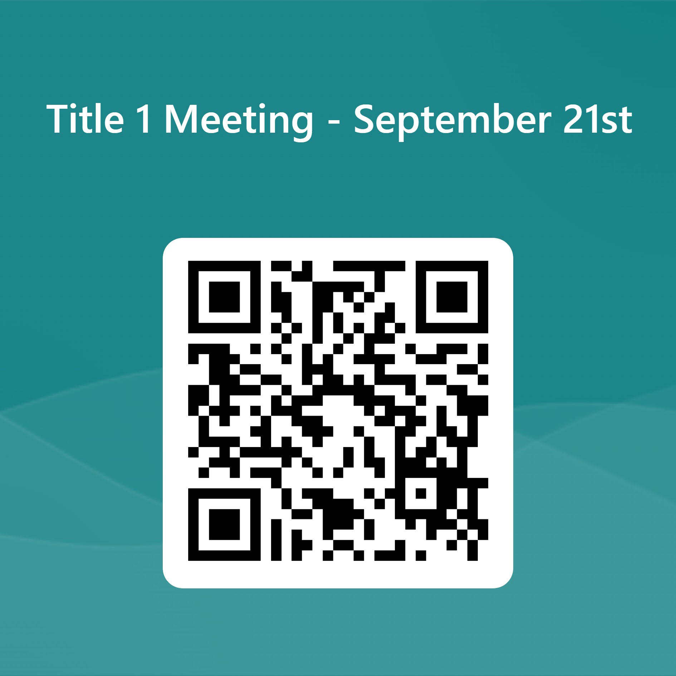
Your Input is Needed
Please provide feedback here or QR code
https://forms.office.com/r/QCq62SPsBU

Slide 14
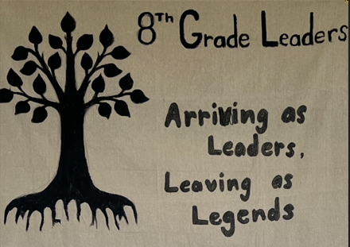
8th Grade Parent Night Campbell Middle School 2023-2024
Mrs. Parrish
8th Grade Assistant Principal
Ms. Burress
8th Grade Lead Teacher

Slide 15
WELCOME
AGENDA
Testing
Reality U
Field Trip
IB Showcase / 8th Grade Project
Field Day
Dance
Fun Day
Yearbooks
End of the Year Awards Ceremony
Celebration Drive Thru Ceremony

Slide 16
TESTING
FALL TESTING
August
Reading Inventory
Math Inventory
October
PSAT 8/9
December
Reading Inventory
Math Inventory
SPRING TESTING
APRIL to MAY
Reading
Math
End of Grade
-ELA / MA / SCI /SS
End of Course Assessments
H.S. Algebra
H.S. Physical Science

Slide 17
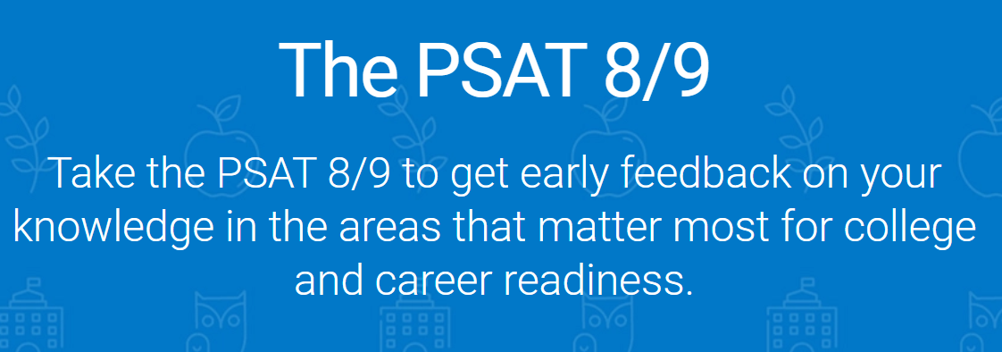
WHEN: WEDNESDAY - OCTOBER 25th WHERE: Homeroom Teacher TIME: 9:30 to 11:55 (2hrs & 25 min.) WHAT: Reading, Writing & Language, and Math

Slide 18
PSAT
Online
Students must use their own school device (not compatible with Mac books.
Students must bring their laptops and their chargers on Monday 10/23.
Laptops will stay with their homeroom teachers each afternoon so that they can charge for 2 full nights.
Please make sure your student brings their laptops and charger.
Once students register with Bluebook, they will have access to a practice PSAT test and other resources.

Slide 19
Tentative Dates – District Will Release Final Dates April 22 & 23 ELA EOG April 24 Science EOG or HS Physical Science (EOC) April 25 Math EOG April 26 GA Studies EOG April 29 & 30 HS Algebra EOC *Note they take 8th grade Math EOG as well

Slide 20
Date: Friday October 13th - We need volunteers to work booths (like the bank, or the apartment manager, or the water company, etc.) Link to sign up Click Here The goals of Reality U are - Teach teens that their performance in school today can affect their future. - Provide students with the opportunity to learn and practice personal finance skills. - Mobilize the community to become involved stakeholders in education (hence why we need volunteers) Meet several Standards for Financial Literacy: - Students will use rational decision-making and planning to set and implement financial goals - Students will understand sources of income and the relationship between income and career preparation - Students will understand principles of money management - Students will understand credit uses and costs.

Slide 21
8th Grade Field Trips (TENTATIVE)
MONDAY - NOVEMBER 6th
THE PHYSICS OF SKATING “FORCE & MOTION”
STEM CURRICULUM DAY AT ANDRETTI OR MAIN EVENT
WEDNESDAY - MARCH 27TH
BATTLE OF ATLANTA CYLCORAMA
"GEORGIA IN 50 OBJECTS"

Slide 22
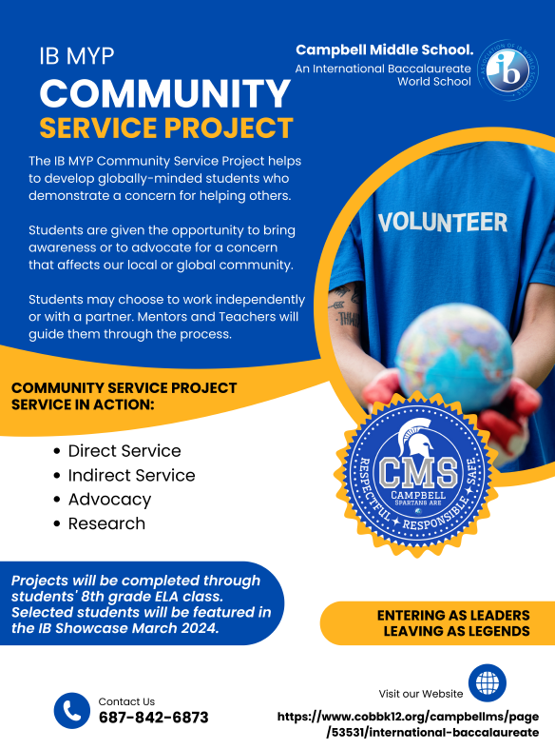
3/21
CMS 5th Annual
IB Showcase
6pm in the theater
Visit our website
https://www.cobbk12.org/campbellms/page/53531/international-baccalaureate

Slide 23
8th GRADE FIELD DAY
DATE: Friday - May 3rd
TIME: ALL DAY ☺
WHAT: Gives students the chance to celebrate the school year coming to an end, show some class pride and spend a day being active.
HOW: Rotation 1: (Lower Soccer Field) Tug of War, Relays
Rotation 2: (Football Field) SPARTAN Run w/Obstacle course
Kona Ice AFTER you have completed the SPARTAN Run
Rotation 3: (Tennis Court): 9 Square in the Air; BATTLESHIP
Rotation 4: (Baseball Field) Kickball
T-Shirt Cost: $10.00 Included in 8th Grade Dues

Slide 24
8th GRADE DANCE
DATE: Friday - May 17th
TIME: 7:00 to 10:00
WHERE: CMS Lower Gym
ATTIRE: Semi Formal
WHO: Only 8th graders attending CMS
THEME: Rolling Out the Red Carpet
Cost: $25.00 (Music w/DJ+ Food & Drinks)
Payment: Pay VIA My Payment Plus for PTSA

Slide 25
8th GRADE FUN DAY
DATE: MONDAY May 20th
TIME: 9:30 to 1:00 (CCSD Early Dismissal)
WHAT: PE Games on the Field / Lower Gym
Game Truck
Signing of Yearbooks
Lunch from Zaxby’s
Payment: $15.00

Slide 26
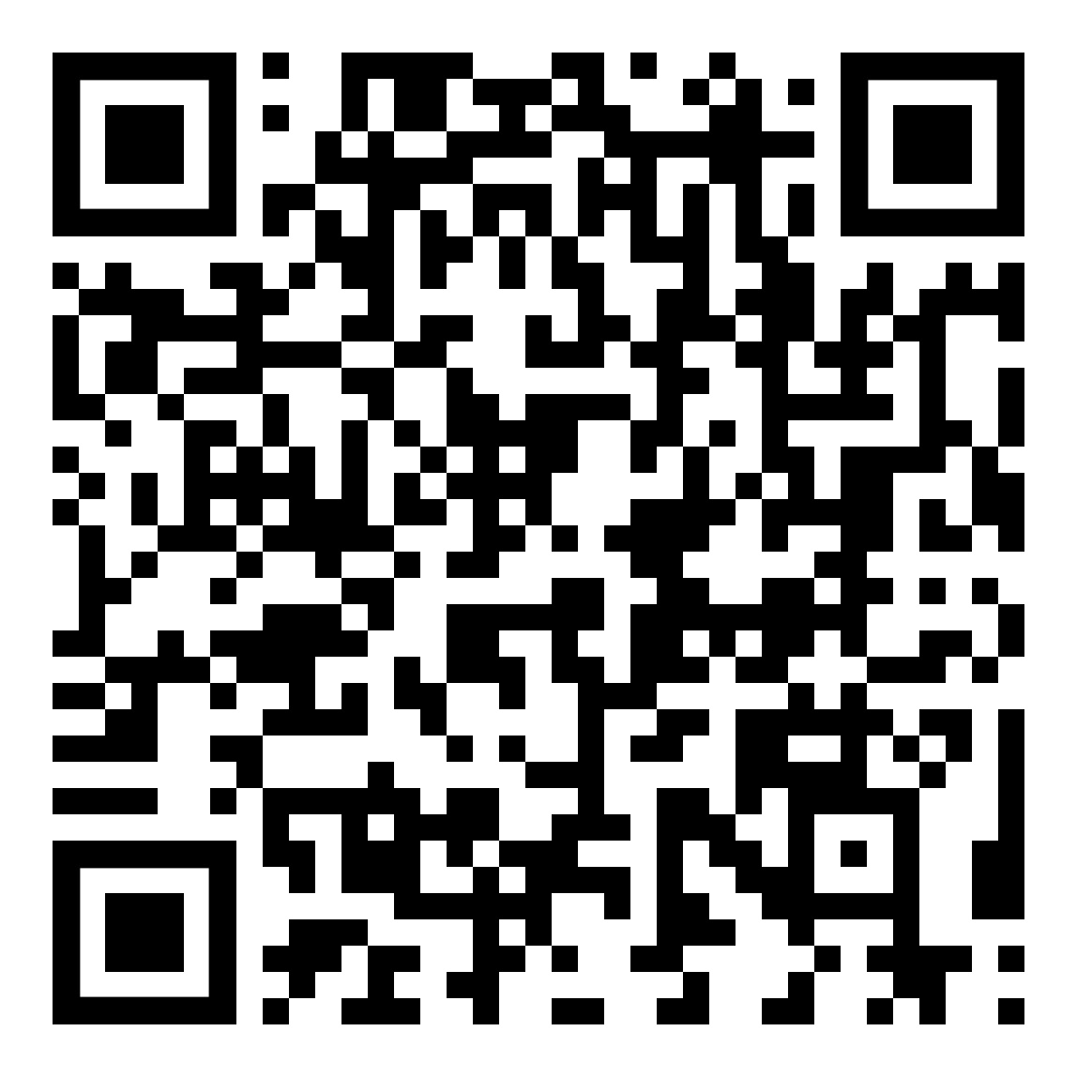

Slide 28
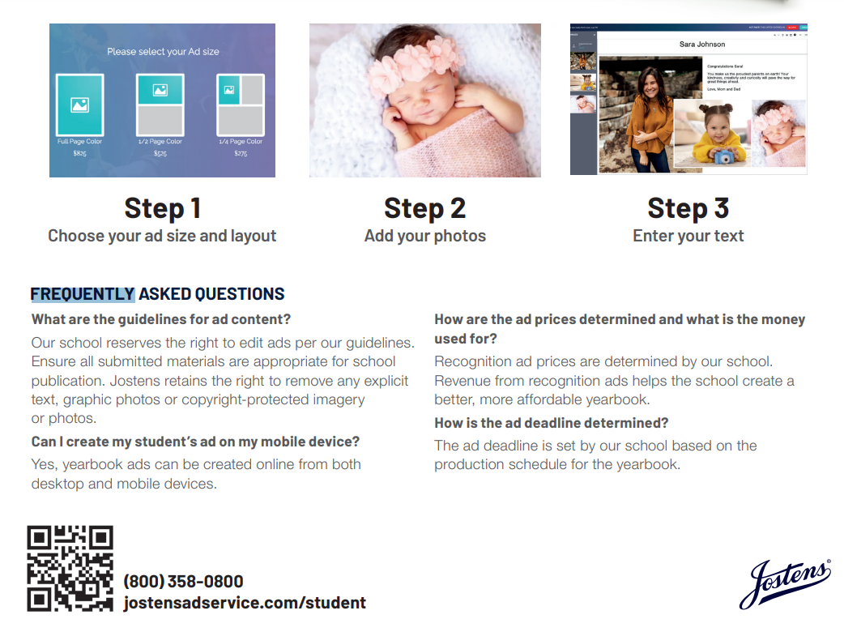

Slide 29
8th GRADE AWARDS DAY
THIS EVENT IS BY INVITE ONLY
DATE: TUESDAY - MAY 21st
INCLUDES:
ALL A’s FOR 8th GRADE YEAR
EACH 8th GRADE TEACHER’S STUDENT OF THE YEAR
RECOGNITION OF STUDENTS HEADED TO A CCCD HS MAGNET & CITA
WALL OF HONOR – ALL As ALL 3 YEARS
AFTER THE CEREMONY
8th GRADE VIDEO
8th GRADE FINAL WALK THRU HALLS
MEAL $10.00
Hot dogs, chips, and drink
PAYMENT: My Payment Plus

Slide 30
8th GRADE DRIVE THRU CEREMONY
DATE: WEDNESDAY – MAY 22nd
TIME: 9:30AM to 11:00AM
WHAT: Station 1: Entrance to Line
Station 2: Welcome Signs
Station 3: Name & Homeroom Teacher
Station 4: Name Announcement
Station 5: Student Certificates
Station 6: Bubble machine / confetti
Station 7: 8th Grade Teacher Pic
Station 8: PTSA High Schooler Sign

Slide 31
CONTACT INFORMATION
Ms. Parrish Tanika.Parrish@cobbk12.org
Assistant Principal
Ms. Valencia Cinde.Valencia@cobbk12.org
8th Grade Counselor
Ms. Burress Stephanie.Burress@cobbk12.org
8th Grade Lead Teacher
Ms. Hales alesha.hales@cobbk12.org
8th Grade Field Trip Coordinator
Dr. Whipple dawn.whipple@cobbk12.org
8th Grade IB Project Coordinator
Ms. Ellis candace.ellis@cobbk12.org
Testing Administrator
Yearbook Coordinator

Slide 32
High School Info

Slide 33
Cobb County Magnet and special Programs
International Baccalaureate Diploma Program at Campbell HS
Academy of Math, Science & Technology at Kennesaw Mountain HS
The School for International Studies at North Cobb HS
The Center for Excellence in the Performing Arts at Pebblebrook HS
The Academy of Research and Medical Sciences at South Cobb HS
The Center for Advanced Studies in Science, Math, & Technology at Wheeler HS
The Cobb Innovation and Technology academy next to Osborne high school
Notes:
You're going to hear more about these on October 8th when we host a virtual magnet informational session. You 8th grade counselor has the link to our 12:00 PM virtual information session.

Slide 34
What is a Magnet Program?
A four-year program for Cobb County’s highest-achieving students
You have to apply!
Fall of 8th grade is the only opportunity to apply
Competitive
Over 2300 applications last year
Over 500 accepted to one or more programs
Exciting, high-level courses you can’t take at a non-magnet school
Magnet buses take you to any magnet program
Notes:
A four-year program designed for Cobb County’s highest-achieving students
competitive application process
Provides rigorous and advanced coursework in specific fields
Offers outstanding preparation for university and beyond
Guarantees transportation at local pickup areas throughout the county
Collegiate and professional training program

Slide 35
Advantages of a Magnet Program
Personalized Experience
Choice of Courses
Cohort group
Dedicated teachers/classes
Individualized advisement
Appeals to Colleges/Universities
Rigor of Coursework Matters Most
Real World Experience
Internships, Advanced Research, and International Travel Programs
Notes:
Magnet programs have academic advisors,

Slide 36
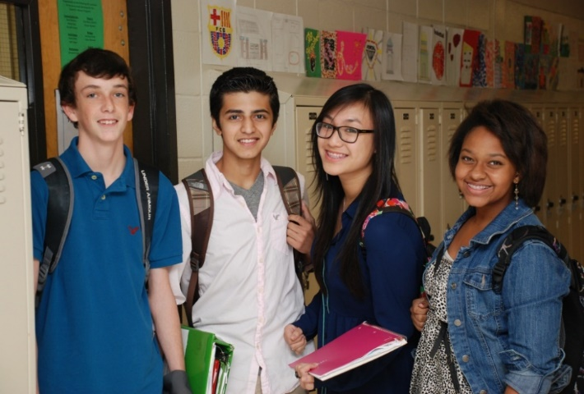
Who are Magnet Students?
Motivated, focused, and committed
Involved in sports, clubs, activities, and everything else!
Interested in a variety of experiences beyond a regular high school

Slide 38
Admissions
Eighth grade students residing in the Cobb County School District are eligible to apply for freshman admission into any magnet program BEFORE December 1, 2023.
There is ONE application website for all five academic magnet programs: www.magnet.cobbk12.org
Applicants will be evaluated on demonstrated strengths in the following areas:
Middle school grades
Teacher recommendations
Standardized test scores (Iowa)
PSAT (alternative) or audition scores (based on program)
Written communication skills

Slide 39
Important Dates to Remember
August/September Middle School Visits
October 1, 2023 Application Opens (magnet.cobbk12.org)
Pebblebrook's Audition Schedule Published
October 2023 Magnet Open Houses (Oct 8th = CHSIB)
December 1, 2023 Application Deadline
February 2, 2024 Magnet Decisions in Portal
March 1, 2024 Student Decisions Due in the Portal
Note: this timeline does NOT apply to Pebblebrook or CITA
Notes:
Cambell IB's Open House is on October 18th @ 1:30

Slide 40
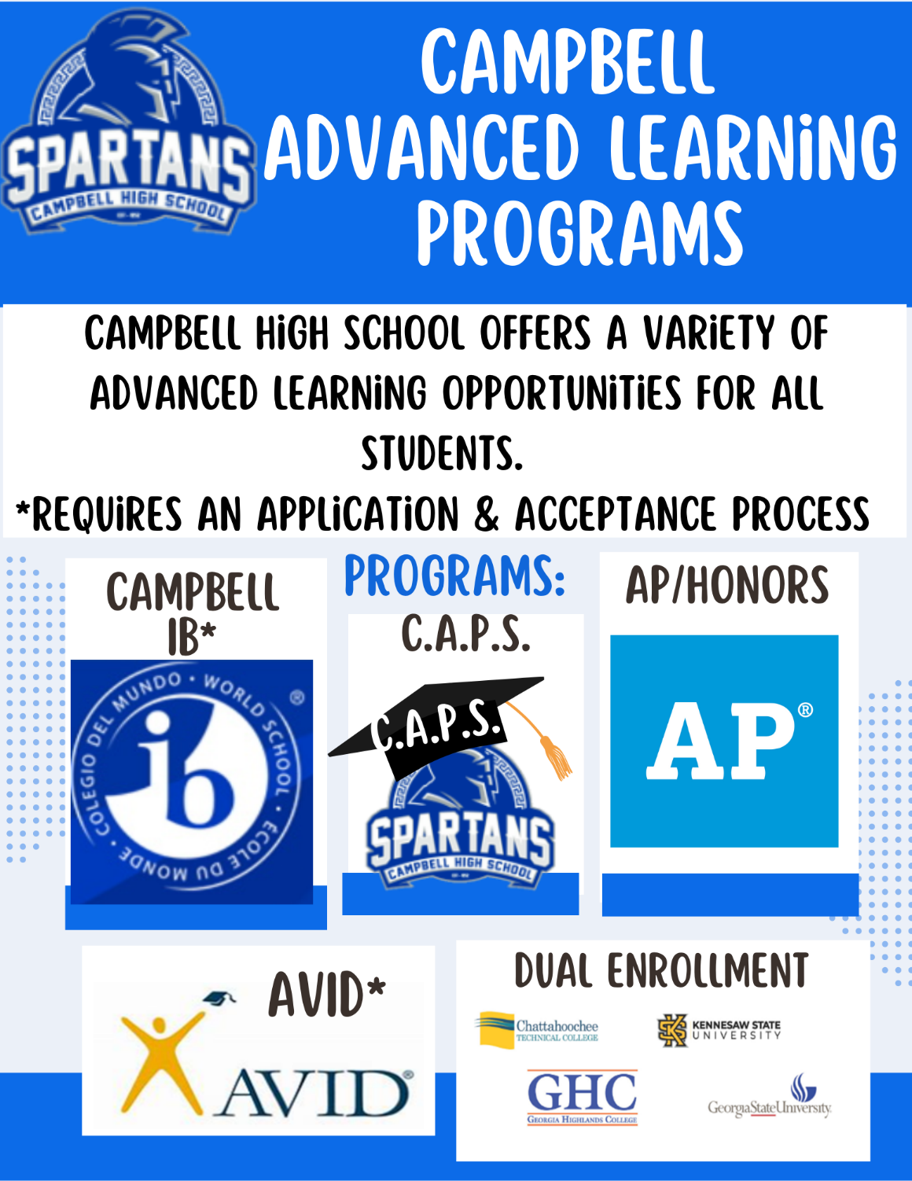
Advanced Learning at CHS

Slide 41
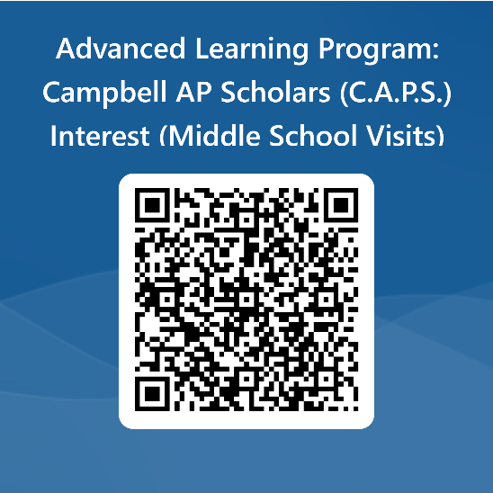
Advanced Learning at CHS CAPS (Campbell AP Scholars)
Beginning the 2023-2024 School Year, Campbell launched the Campbell AP Scholars Program (CAPS)
WHO: Campbell students NOT in the IB program that want the challenge of rigorous Honors and AP classes.
Benefits: Students will meet with an advisor to assist in selecting their CORE and Elective classes to ensure they take the most rigorous courses each year.
Requirements: Honors/AP Core classes, foreign language classes, Career Pathway and/or Fine Arts during their 4 years in HS
**Must maintain a 3.5 Weighted GPA, take 5 AP classes, & 5 AP exams during their high school career
The Outcome: Eligible students will receive a STOLE at Graduation during their Senior Year.

Slide 42
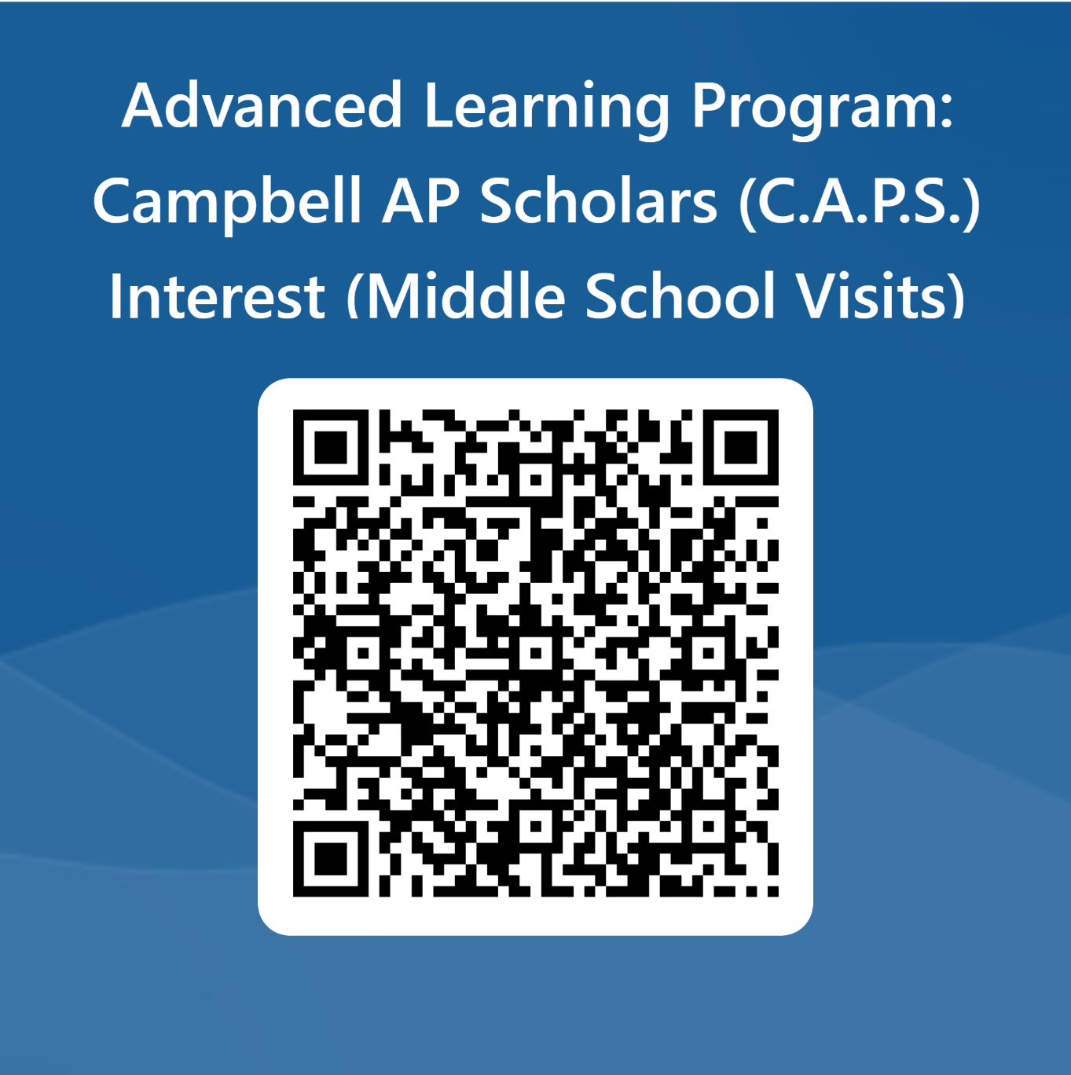
CAPS Interest Form

Slide 43
Advanced Learning at CHS
Advanced options at your local high school:
Honors Courses (English, Math, Science, Social Studies and Foreign Language)
20+ Advanced Placement (AP) Courses
English, Calculus, Statistics, Biology, Physics, Env Sci, Computer Sci, Human Geography, World Hist, US Hist, European Hist, Psych, Government, Economics, French, Spanish, Studio Art, Music Theory, Seminar/Research
AP STEM School; AP STEM Achievement School; AP Humanities School; AP Access and Support School.
76% Pass Rate on AP Exams in May 2023
191 AP Scholars

Slide 44
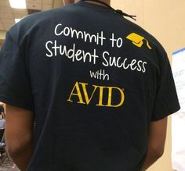
AVID AVID Advancement via individual determination
The mission of AVID is to close the opportunity gap by preparing all students
for college and career readiness and success in a global society.
Hone your skills in:
Writing
Inquiry
Collaboration
Organization
Reading
Learn to Maintain:
Growth Mindset
Confidence
Perseverance
Commitment
Grit
Experience:
College Visits
College and Career Prep
Direction about next steps in your life
Speakers from all walks of life
Obtain:
Meaningful Direction in your Life
Forever bond with fellow AVID students
Good grades and opportunity to do what you dream.
For people who want it; not for those who need it.

Slide 45
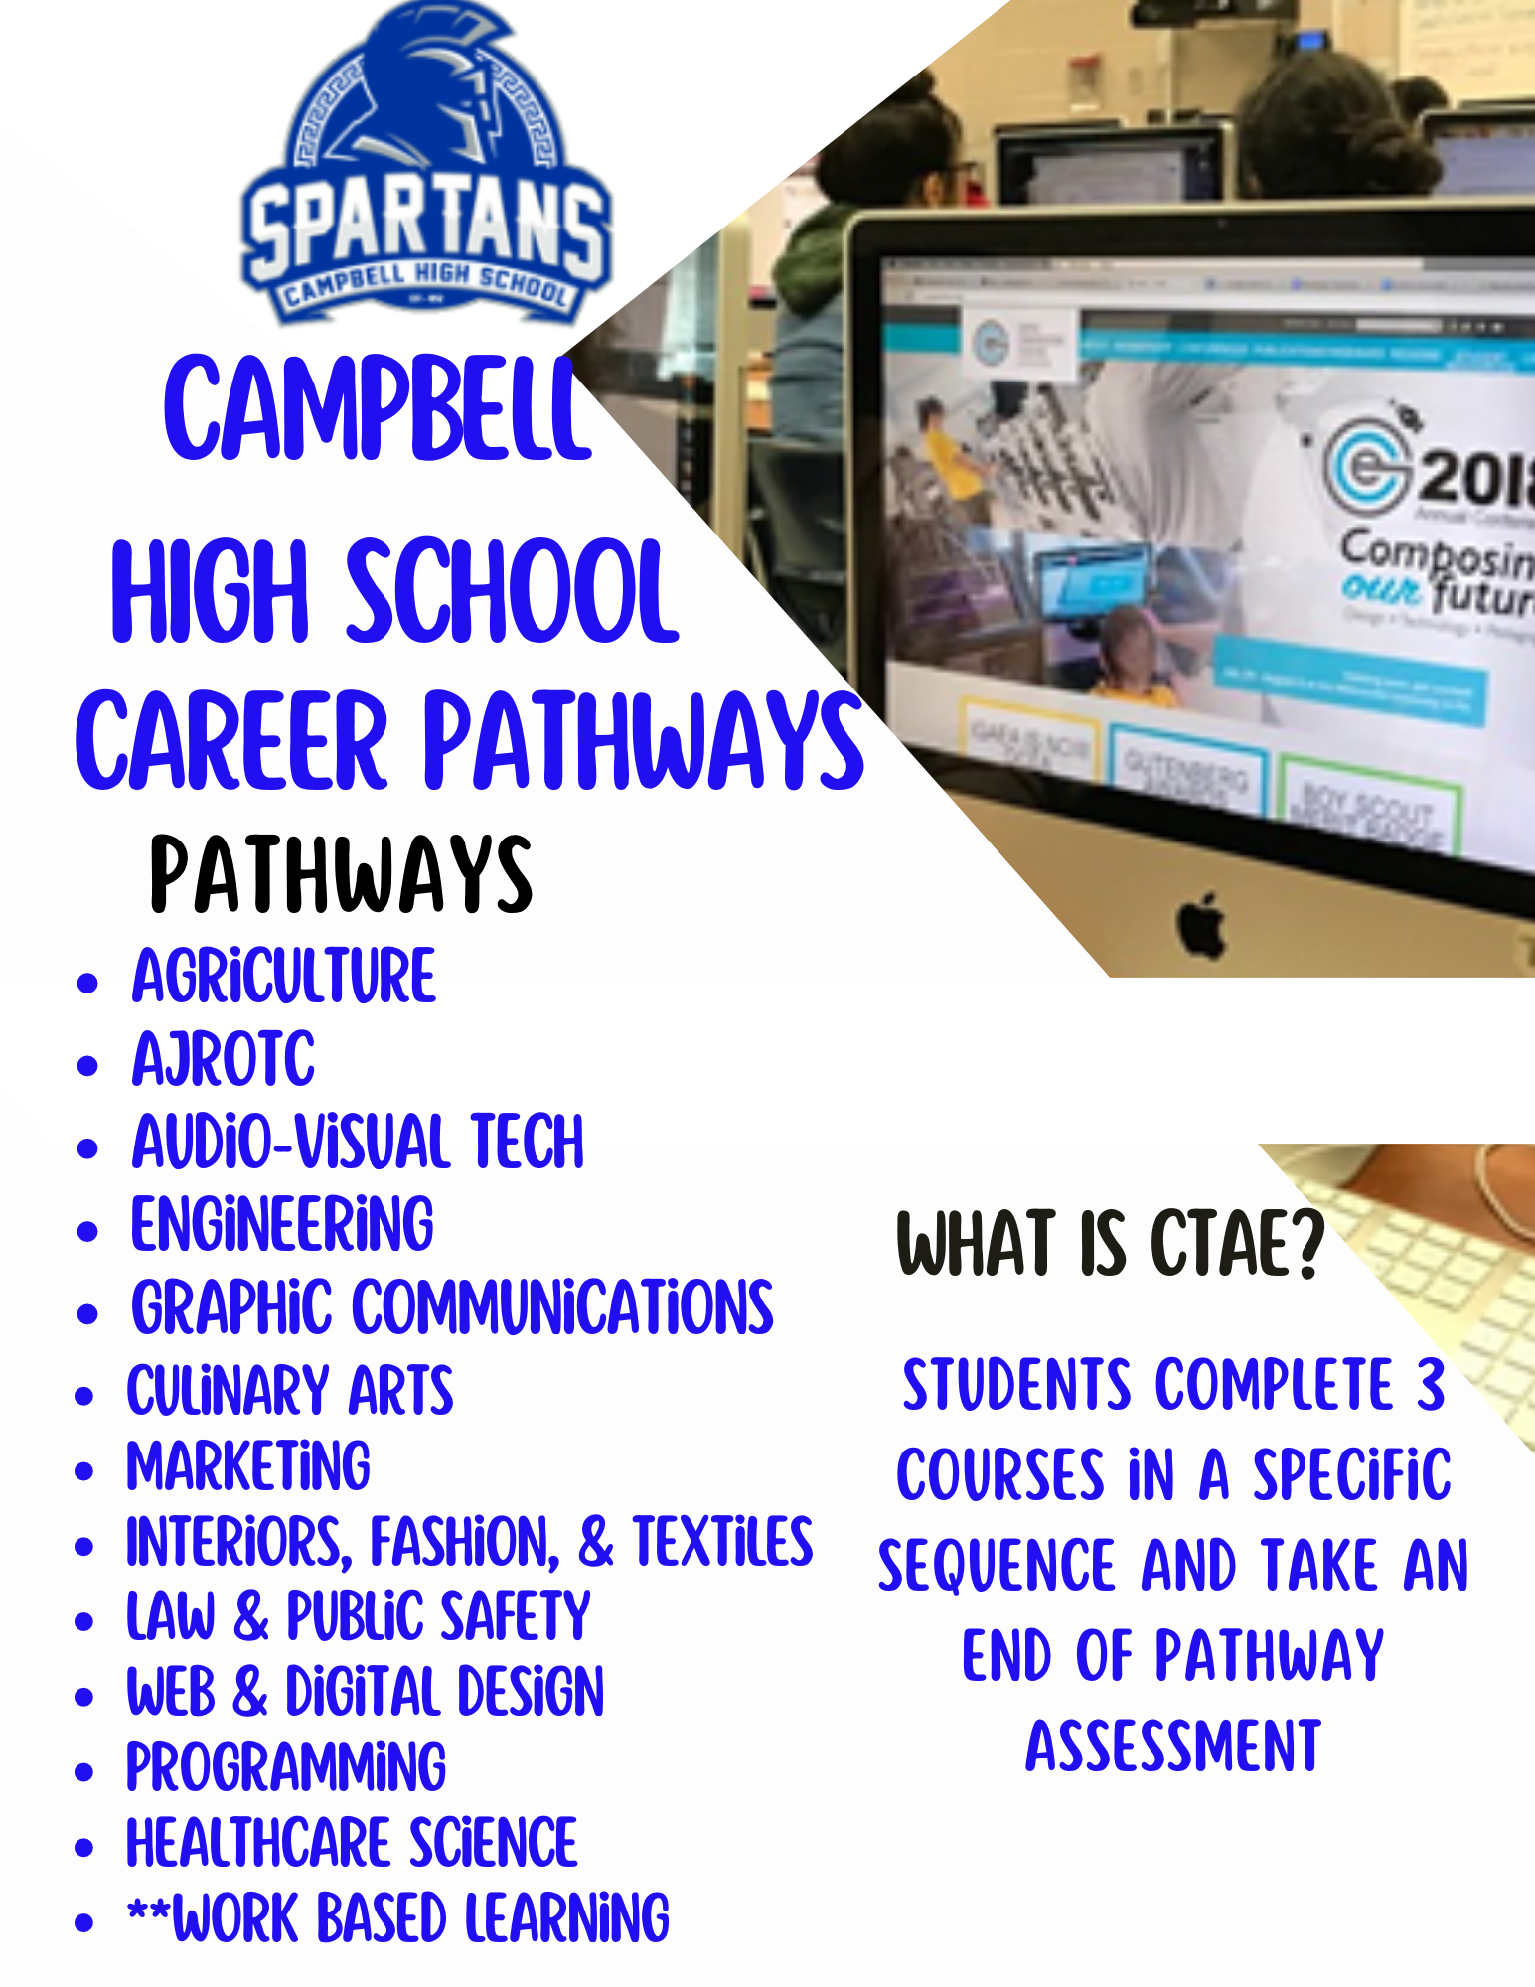
Career Pathways (CTAE)

Slide 46
What else?
Athletics
Football, basketball, baseball, soccer, track (STATE CHAMPS!), softball, tennis, golf, swim/dive, cross country, lacrosse, volleyball, fencing, etc.
Academic Competition Teams
Academic Bowl, Chess Club, Debate Team, Math Team, Model UN, Robotics, Science Olympiad
Interest/Service/Leadership Clubs
Beta Club, NHS, Desi/MSA, Earth, Interact, Habitat for Humanity, HOPE, Medical, Newspaper, Photography, Relay for Life, Rocketry, Science Club, Scream Team, SGA, Water Project, Yoga, and so many more!

Slide 47
What Can Your Student Do NOW?
Work hard at school and at home
Good Grades and Test Scores
Read, Read, Read
Get involved in areas of interest—sports, service, music, leadership, careers, etc.
ASK FOR HELP
Come see us, reach out to us, and join us at every event!

Slide 48
Reach out!
Jennifer.Dorrough@cobbk12.org (AP Advanced Learning)
Lisha.Wood@cobbk12.org (IB Coordinator)
Janie.Bell@cobbk12.org (IB Clerk)
Cobb Advanced Learning website

