Slide 1
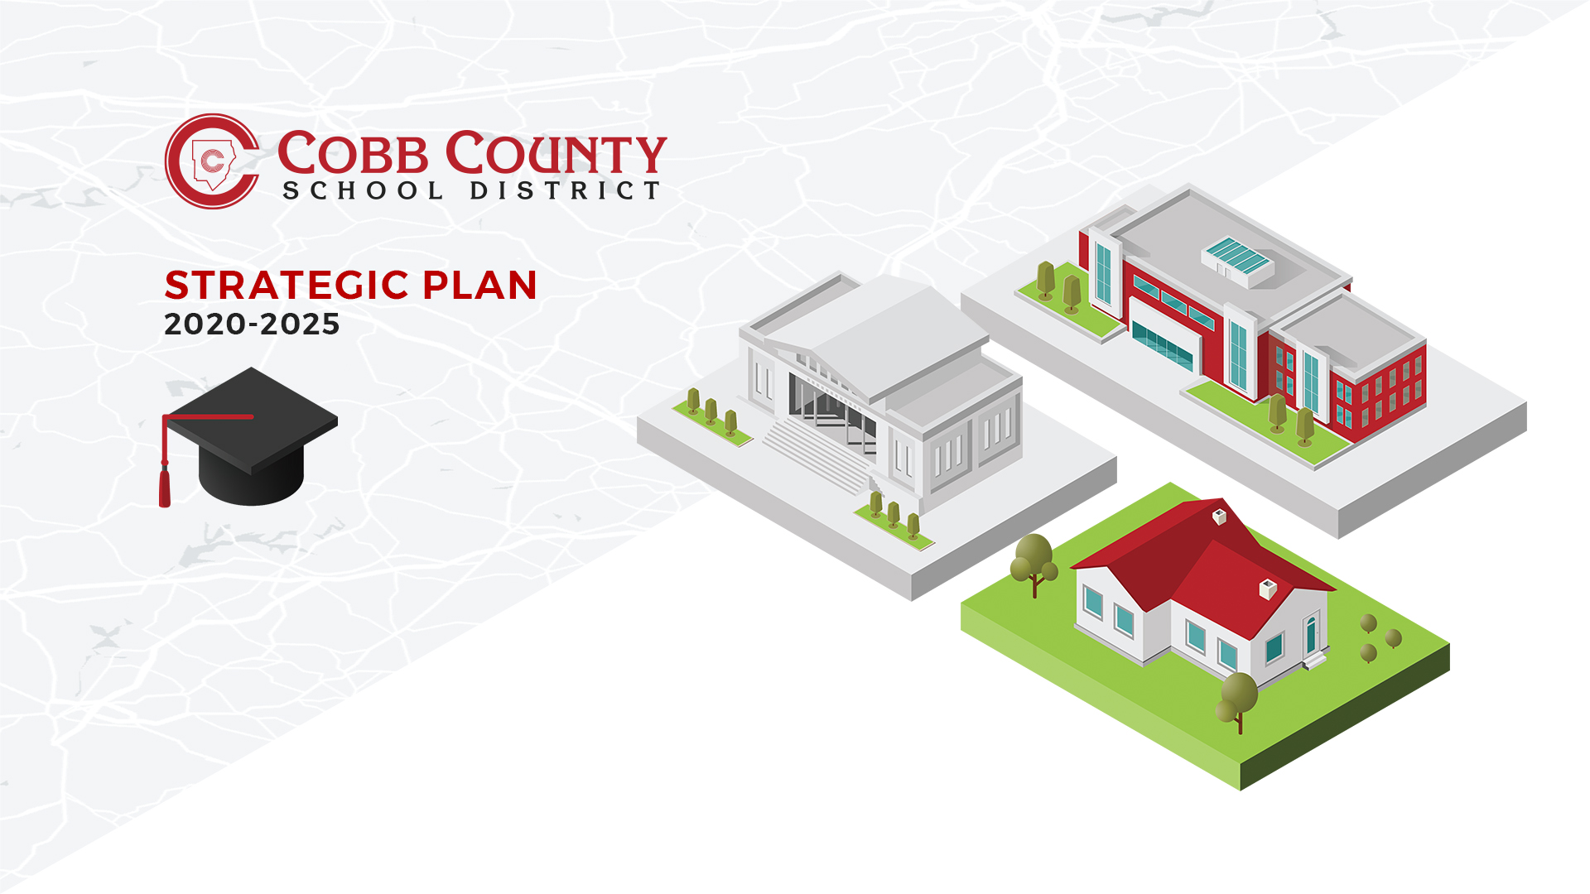

Slide 2
Why: The Cobb County School District Strategic Plan 2020-2025
Define student success
Reflection of what our community believes
Simplify
Streamline
Align
Notes:
Presenting this draft of our District strategic plan is an opportunity to frame why we exist to the parents and community which we serve. Communicated well, your audience should walk away with a better understanding of why we do what we do and, to a lesser extent, what and how.
What is student success? (Profile a graduate as defined in this strategic plan draft)
Who should define student success? (The audience! Their input matters!)
Why do we need to define student success? Multiple definitions of success mean our time, people, and resources go in multiple directions and no one feels like the District is being successful.

Slide 3
What: Profile of a Graduate and Profiles of Support
Task Force
Profile of a Graduate
Profiles of Support will be dynamic, nimble, and adjustable
Research Plans Compared to Districts of a Similar Size
Guiding Coalition - Team of 40
Survey – We have currently received over 9,000 responses
9 competencies which define a Cobb Graduate
Notes:
Strategic Plan Task Force assembled in November 2018
Task Force comprised of principals and assistant principals representing all three levels and all geographic areas of the county
Met monthly with the goal of developing a final product by spring 2020

Slide 4
How: Profiles of Support
Profiles of Support – How we support a Cobb County graduate:
  Academics
  Culture of Care
  Safety
  Personnel
  Community
  Technology
  Finance
  Communication
Notes:
How do we best support the graduate Cobb County is asking the school district to produce? They aren’t departments, they aren’t programs, they aren’t initiatives. They are the best way we know to support the knowledge and skills Cobb county is asking for it’s graduates to possess when they walk across graduation stages.

Slide 5
The Cobb County School District Strategic Plan 2020-2025 (Draft)
The Cobb County School District Strategic Plan 2020-2025
  Revisions based on your input
  Micro-sites are being created to provide further detail for each profile of support. Ex. Safety has an active micro-site
Notes:
The visual will be present on District and local school websites. The graduate is at the center of everything we do. This site will continue to be built (based on their input) between now and January 30th. *Note a brief pdf version is available (bottom right-hand corner).

Slide 6
Your Voice
Cobb County School District Strategic Plan Feedback
Your voice matters!
This draft has been built based on the input of over 7,000 community, staff, and students!
Complete the survey at your convenience from your phone, tablet, or computer.
                Thank you!
Notes:
Ask each audience member to provide input through the digital link at their convenience. We have currently received over 7,000 responses from our community and we

Slide 7
