Slide 1
9th & 10th Grade Parent Night
2024 – 2025 Allatoona School Counseling

Slide 5
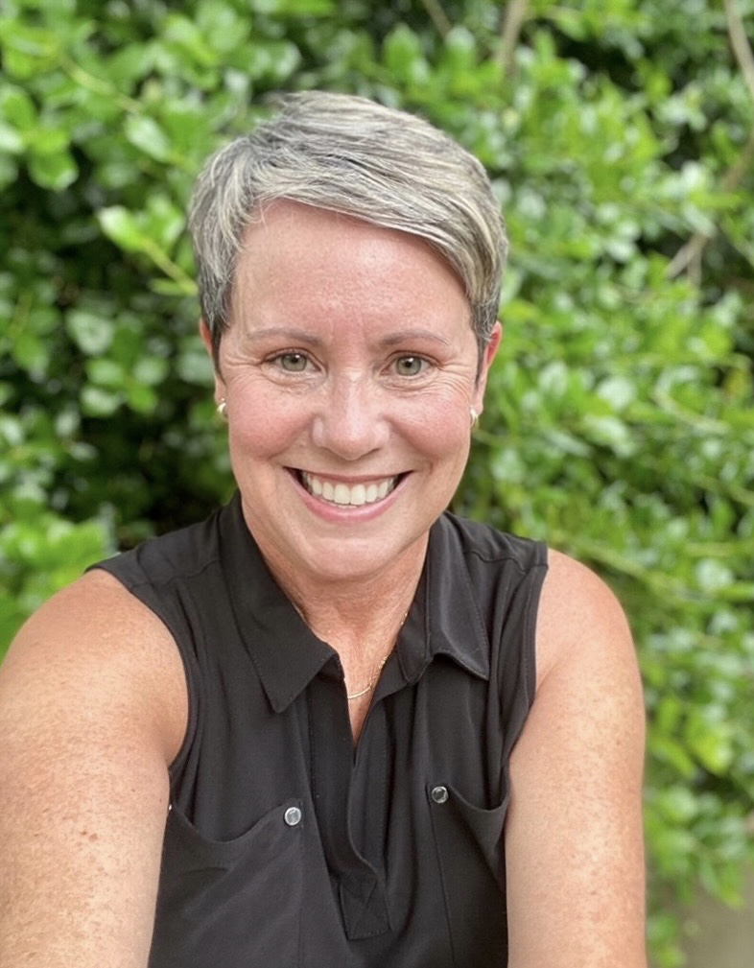
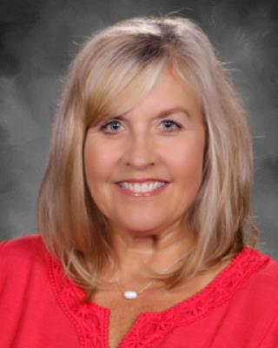
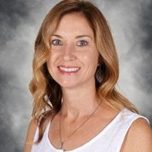
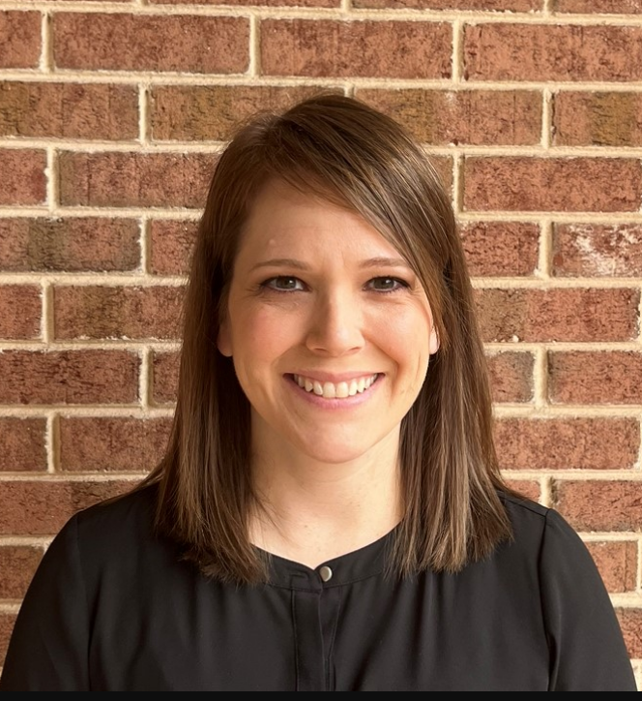
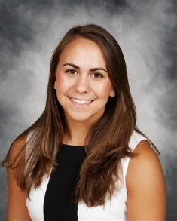
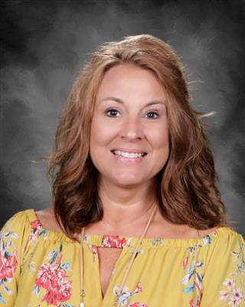
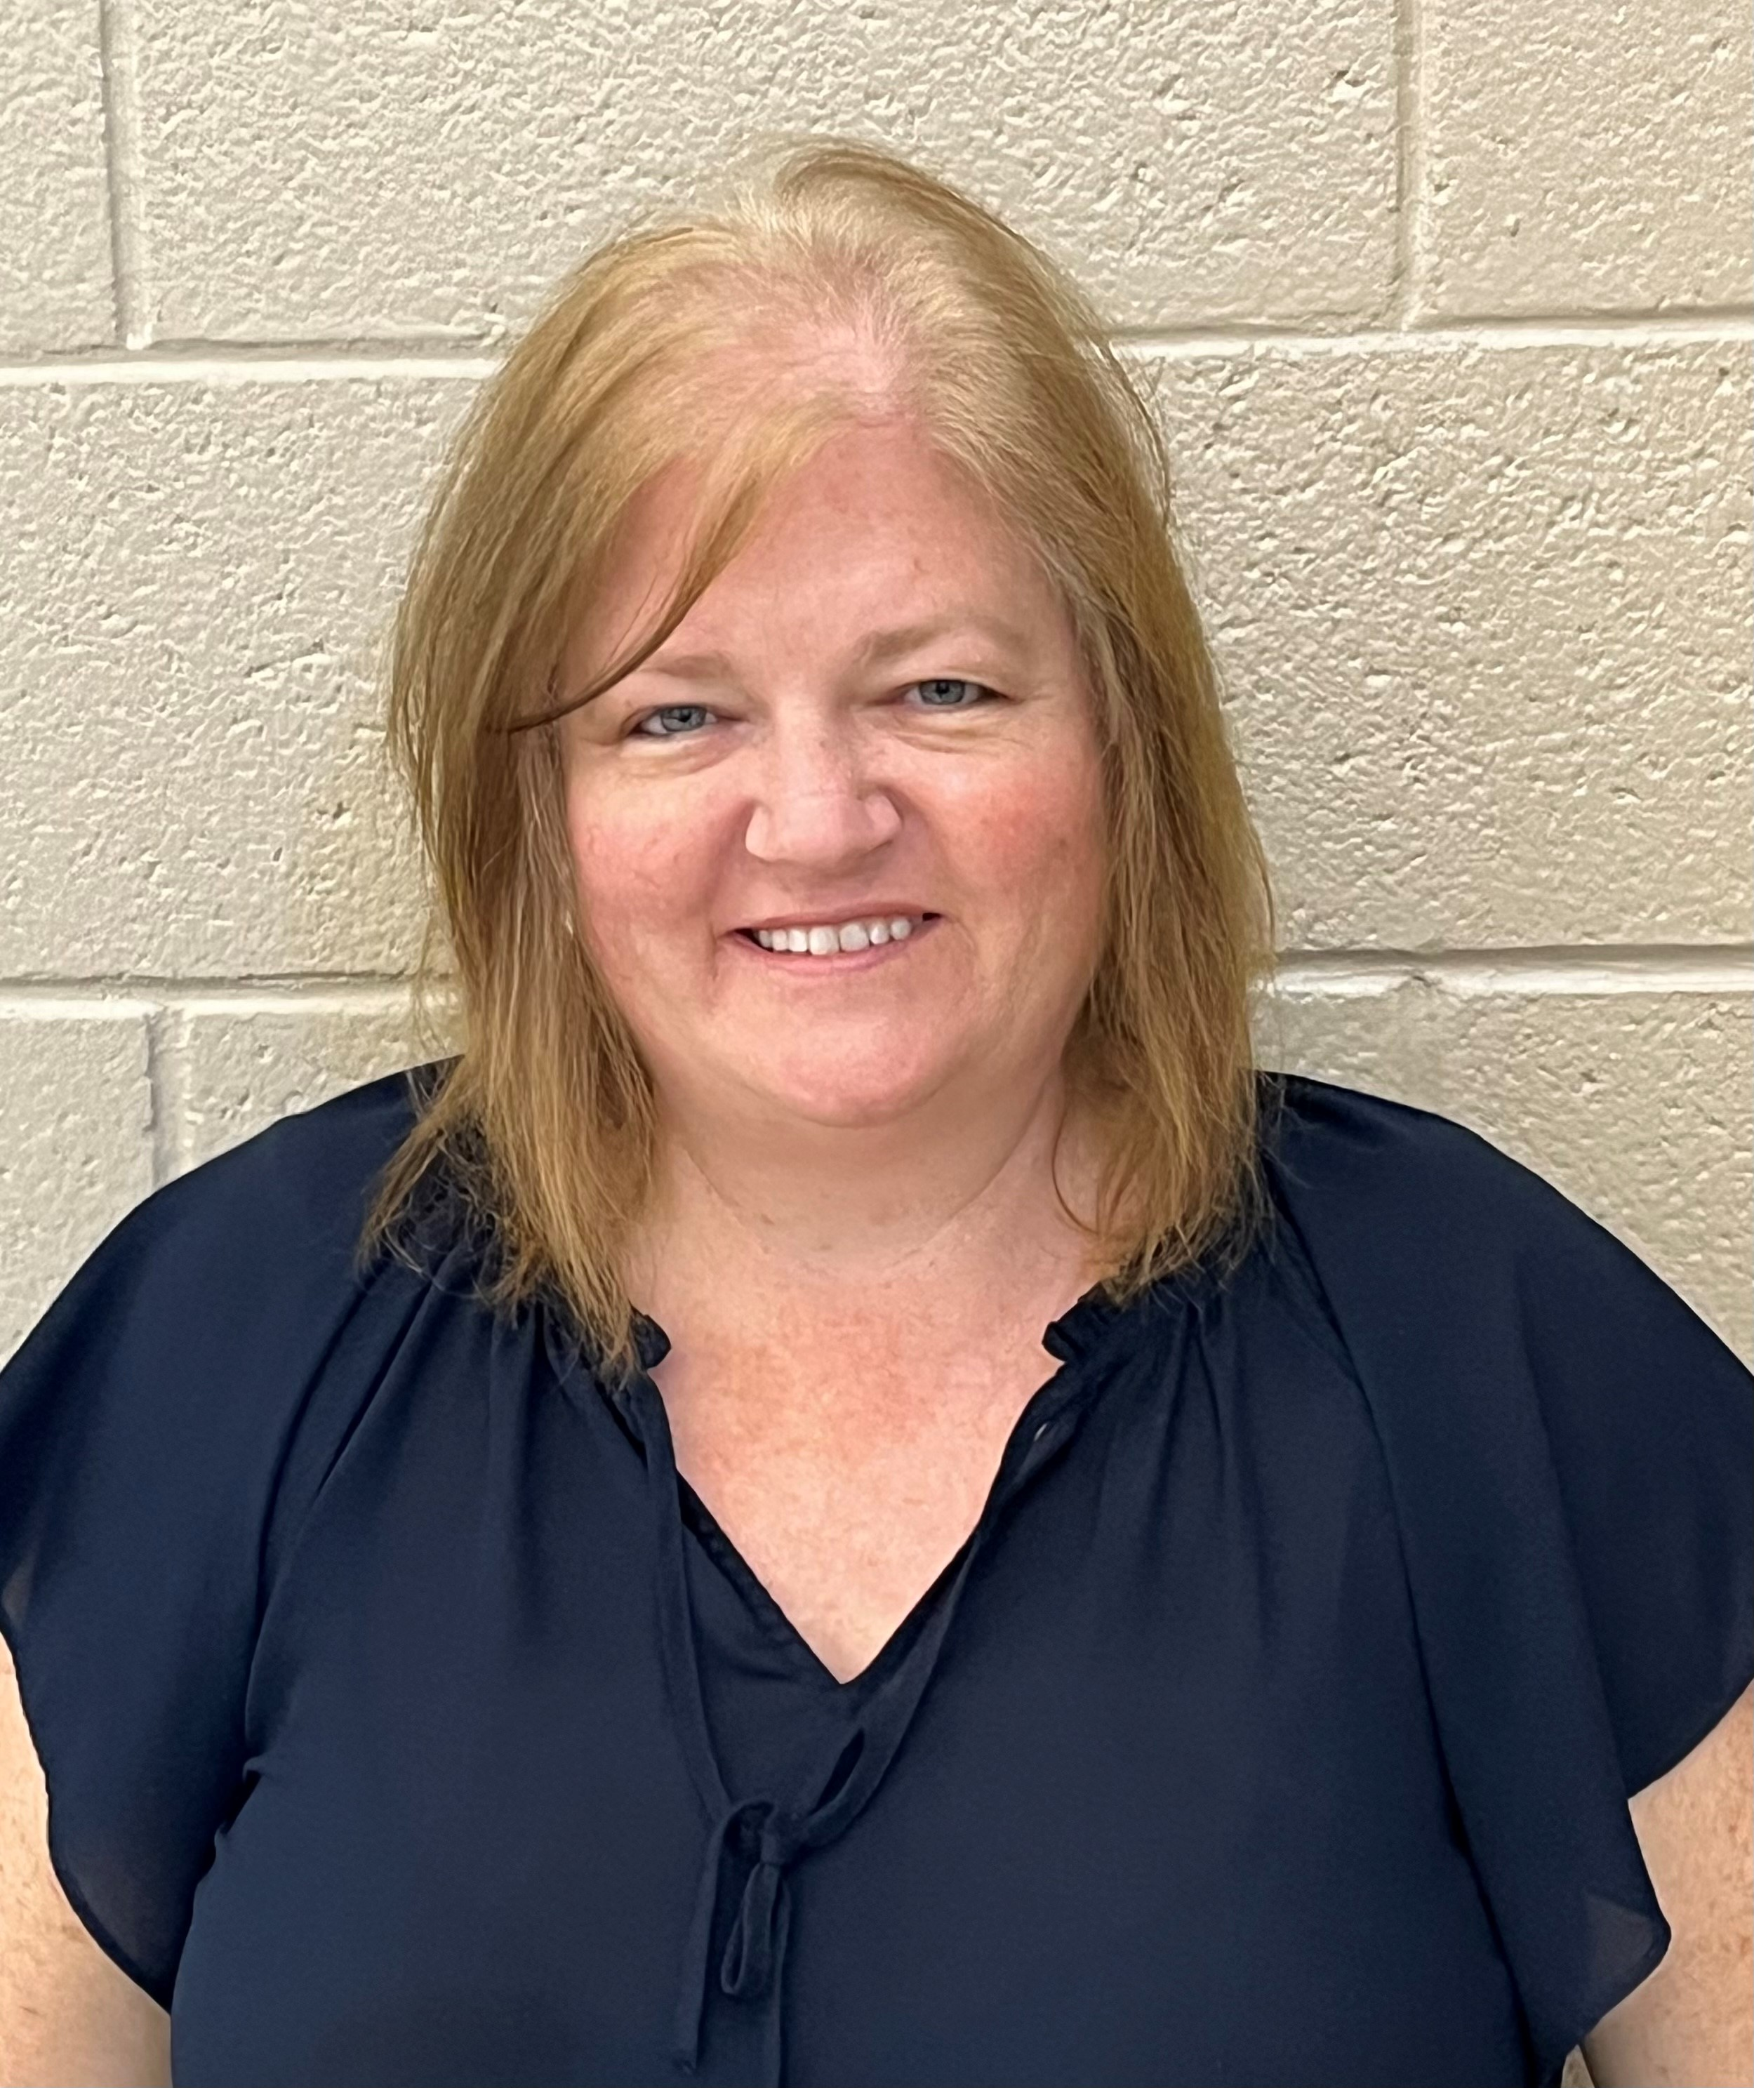
The Counseling Team
Mrs. Weeks
A – D
Mrs. Rohrbach
E - K
Mrs. Turner
L - Re
Mrs. Mastrangelo
Rf - St
Mrs. Michael
Academic/Personal Development Counselor/504 Coordinator
Mrs. Welch
Academic/Personal Development Counselor/504 Coordinator
Mrs. Rich
Counseling Clerk
Mrs. Ridenour
Counseling Clerk

Slide 6
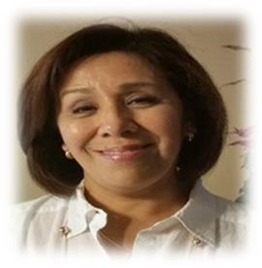
Ms. Martha D'Arcy-Guzman
Parent Resource Specialist
English Learner Programs Cobb County Schools

Slide 7
Role of the High School Counselor
Academic
Career/College
Personal Development
Schedule Questions
Registration Decisions
Academic Success Skills
Career Options
Post-secondary Planning
Problem Solving Skills
Conflict Resolution

Slide 8
High School Classes/Credits
CORE classes: English, Math, Science, Social Studies
Elective classes: World Language, Career Tech, Fine Arts, PE and some academic areas
Block Schedule:
4 classes each semester
Credit awarded in December & May
1 credit per class (except for Economics/Government – 0.5 credits)
High school credit earned in middle school will be on transcript but NOT calculated into GPA

Slide 9
Graduation Requirements
23 Required Credits
4 English
4 Math
4 Science
3 Social Studies
Health/Personal Fitness
4 Electives
3 from Career Tech/Fine Arts/World Language*
World Language credits are not required for graduation; however, 2 credits of the same language are required for acceptance to 4-year colleges

Slide 10
9th –> 10th
11th -> 12th
10th -> 11th
Promotion Requirements
5 total credits:
1 must be in English, Math and Science
16 total credits:
Must have also met all other promotion requirements
10 total credits:
2 must be in English, Math and Science

Slide 11
Credit System
If a student fails an academic course needed for graduation, they will repeat that course before receiving credit
If a student fails a course needed for promotion, the student will be retained and placed in the appropriate homeroom
Failing grades will:
Appear on the transcript forever
Will not be removed even after the course is repeated and passed

Slide 12
—What Does a Transcript Say About a Student?
Cumulative GPA
Rigor of Courses
Elective Choices
Attendance
Grades
Credits Earned & Attempted
EOC Scores

Slide 13
Why Take Honors and AP Classes?
Provides opportunities to improve study skills
Familiarizes students with college level work
Can boost GPA
Prepares students for big test (SAT, ACT, Accuplacer)
Gives advantage in college admissions
May be eligible for college credit (AP Exam)
Improves work ethic & critical thinking skills

Slide 14
All About Cumulative GPA
Numerical Grade | Letter Grade | On-level Points | Honors Points | AP Points
90 - 100 | A | 4 | 4.5 | 5
80 - 89 | B | 3 | 3.5 | 4
74 - 79 | C | 2 | 2.5 | 3
70 - 73 | D | 1 | 1.5 | 2
69 & below | F | 0 | 0 | 0
Cobb County does NOT report class rank.
Often shows effort not necessarily intelligence
Average of ALL grades
Weighted vs. Unweighted
For Unweighted:
A = 4 B = 3
C = 2 D = 1
F = 0

Slide 15
Core & College GPAs
CORE: average of 17 core required classes
4 English, 4 Math, 4 Science, 3 SS, 2 World Lang.
Many colleges use the core GPA for admission
EVERY COLLEGE CALCULATES GPA DIFFERENTLY!

Slide 16
HOPE GPA
Numerical Grade | Letter Grade | On-level Points | Honors Points | AP Points
90 - 100 | A | 4 | 4 | 4
80 - 89 | B | 3 | 3 | 3.5
74 - 79 | C | 2 | 2 | 2.5
70 - 73 | D | 1 | 1 | 1.5
69 & below | F | 0 | 0 | 0
The average of ALL CORE classes
ALL attempted math, English, science, SS & World Language courses.
This includes electives like World Geography, Psychology, etc.

Slide 17
HOPE Rigor Requirements
In order to be HOPE eligible, students must earn at least 4 credits in the following categories:
Advanced Math
Advanced Science
Advanced Placement
Chemistry
Physics
Zoology
Astronomy
Human Anatomy
In core subject areas
Advanced Algebra
Advanced Financial Algebra
Pre-Calculus
University System of Georgia
World Language
In core subjects
Dual Enrollment
Level 2 and higher

Slide 18
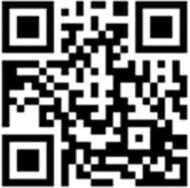
HOPE Scholarship
For the most up-to-date information visit http://bit.ly/AHSHOPEinfo
A lot of changes to the program as of May 2023

Slide 19
Hope Grant & Hope Career Grant
HOPE Grants are awarded to Georgia residents who have demonstrated specific academic achievements. These scholarships assist students with paying for their tuition at any TCSG colleges in Georgia. The criteria varies for each grant; however, this is a great way for students to get help with paying for their post-secondary education!
HOPE Career Grant
The HOPE Career Grant is available to HOPE Grant-qualified students who enroll in select majors specifically aligned with industries in which there are more jobs available in Georgia than there are skilled workers to fill them. These industries have been identified as strategically important to the state’s economic growth.
More information at www.GAFutures.org

Slide 20
Dual Enrollment
Overview:
Take college classes while in high school
Earn high school credit AND college credit at the same time
Application process differs between colleges!
See Counseling Website AND district website for up-to-date information!
*District Dual Enrollment Summit: 9/18 from 6-8pm at Cobb Civic Center
Who Can Apply?
9th Grade: NOT eligible
10th Grade: in CTAE at participating TCSG only OR with 1200 SAT/26 ACT prior to the term at TCSG, USG, or eligible private post-secondary institute
11th & 12th Grade: may take approved DE courses at eligible, participating post-secondary institutions
Cost:
Funding up to 30 semester & 45 quarter hours
Does not count against HOPE Cap Hours but does calculate into HOPE GPA
DE Info Night Tuesday Jan. 28th VIRTUAL 6:30-7:30 more details to follow

Slide 21
Parent Responsibilities
01.
02.
03.
Communicate
Encourage child to advocate for themselves
Be respectful of teachers & staff
Start with the teacher
If not resolved, schedule a conference with teacher & counselor*
This is an important step in post-secondary preparation
They want what is best for your child
Note: Conferences are held before school (7:45 – 815am) & the student MUST be present for the conference!

Slide 22
FAQs
Community Service
PSAT
11th Grade
Keep a list of school & community. Use AHS form for school.
Digital this year! All 10th graders will take it. 9th and 11th can pay to take it
Need proof of meningococcal booster (MCV4). Upload to ParentVUe or send to counselor
ParentVue
Absences
Check regularly. Personal Info. Changes. Athletic Eligibilty.
Excused notes submitted within 3 days. Check CTLS for work.
Follow counseling on instagram @buc_counselors

Slide 23
Graduation will be here soon! Please reach out if you need any help!

Slide 24
Questions
?

