Slide 1

Welcome
9TH & 10TH GRADE
PARENT NIGHT

Slide 2
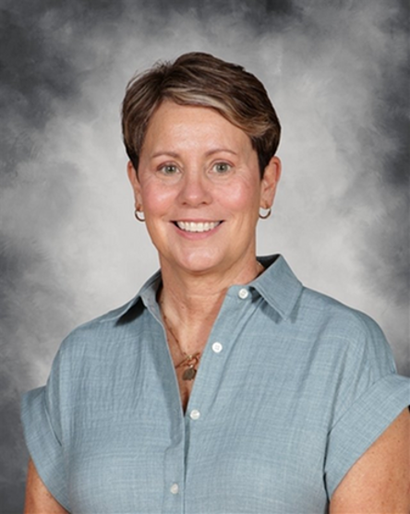
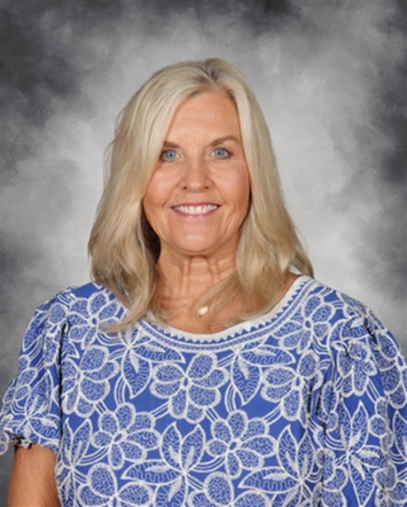
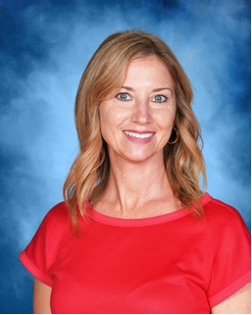
ALLATOONA COUNSELORS
MRS. WEEKS
A-D
MRS. ROHRBACH
E-K
MRS. TURNER
L-RE

Slide 3
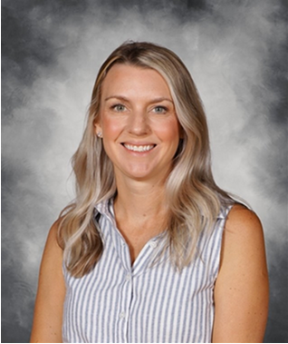
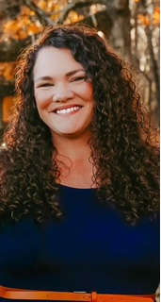
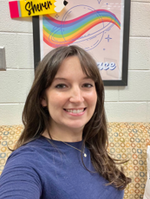
ALLATOONA COUNSELORS
MRS. MASTRANGELO
RF-Z
MRS. CORTOLANO
STUDENT SUPPORT
MRS. SHERER
CITA

Slide 4
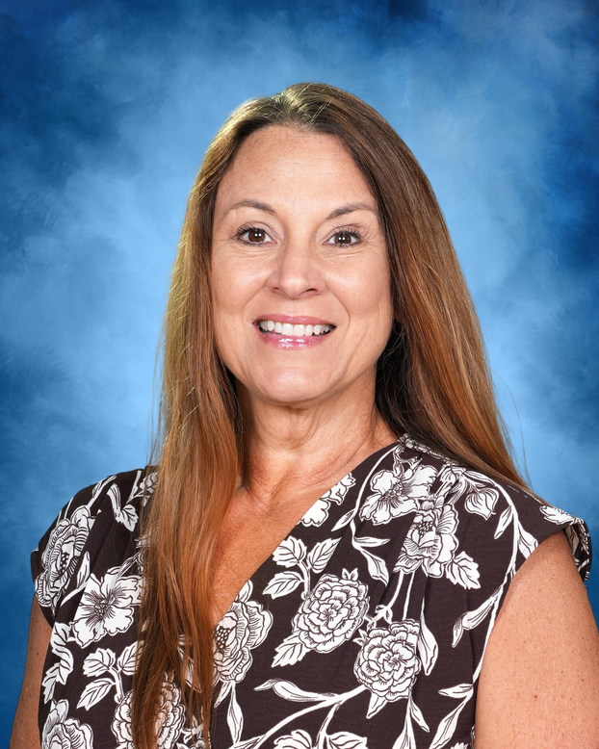
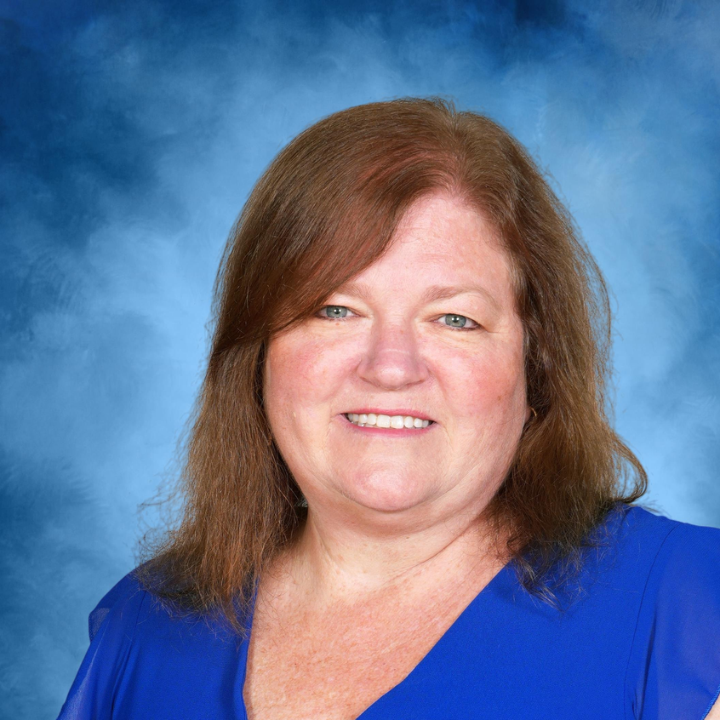
COUNSELING CLERKS
MRS. RICH
MRS. RIDENOUR

Slide 5


Slide 6


Slide 7
ROLE OF THE HIGH SCHOOL COUNSELOR
ACADEMIC
CAREER/COLLEGE
PERSONAL
DEVELOPMENT
Schedule Questions
Registration Decisions
Academic Success Skills
Career Options
Post- Secondary
Planning
Problem Solving Skills
Conflict Resolution

Slide 8
HIGH SCHOOL CLASSES
Elective classes: World Language, Career Tech, Fine Arts, PE & some academic areas
CORE classes: English, Math, Science & Social Studies
Block Schedule:
*4 classes each semester
*Credit awarded in December & May
Credits: 1 credit per class (except for
Economics /Government .5 credits
  HS credit earned in middle school will be on transcript but NOT calculated in GPA.

Slide 9
CREDIT SYSTEM
  If a student fails an academic course needed for graduation, they will repeat that class before receiving credit.
  If a student fails a course needed for promotion, the student
will be retained and place in the appropriate homeroom.
  Failing grades will:
- Appear on the transcript forever.
- Will not be removed even after the course is repeated
and passed.

Slide 10
PROMOTION REQUIREMENTS
9TH TO 10TH
GRADE
11TH TO 12TH
GRADE
5 total credits:
1 must be in English,
Math and Science
10TH TO 11TH
GRADE
16 total credits:
Must have also met
all other promotion requirements
10 total credits:
2 must be in English,
Math and Science

Slide 11
4 English
Health & Personal Fitness
GRADUATION
REQUIREMENTS
4 Math
4 General Electives
3 from Career Tech/Fine Arts/World Language
23 Required Credits
4 Science
World Language credits are NOT required
for graduation; however, 2 credits of same l
language are required for acceptance
to 4-year colleges
3 Social Studies

Slide 12
WHAT DOES A TRANSCRIPT SAY ABOUT A STUDENT?
  Cumulative GPA
  Rigor of Courses
  Elective Choices
  Attendance
  Grades
  Credits Earned & Attempted
  EOC Scores

Slide 13
Provides opportunities to improve study skills
Prepares students for big test (SAT, ACT)
Familiarizes students with college level work
Gives advantage in college admissions
WHY TAKE HONORS AND AP CLASSES?
Can boost GPA
May be eligible for college credit (AP Exam)
Improves work ethic and critical thinking skills

Slide 14
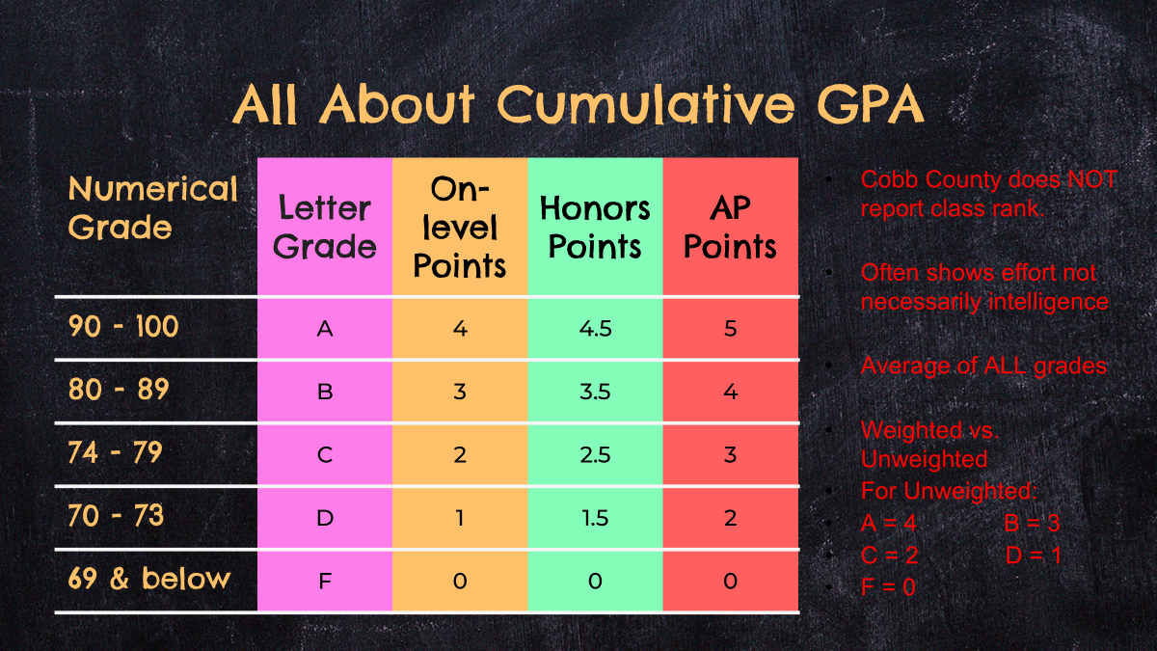

Slide 15


Slide 16
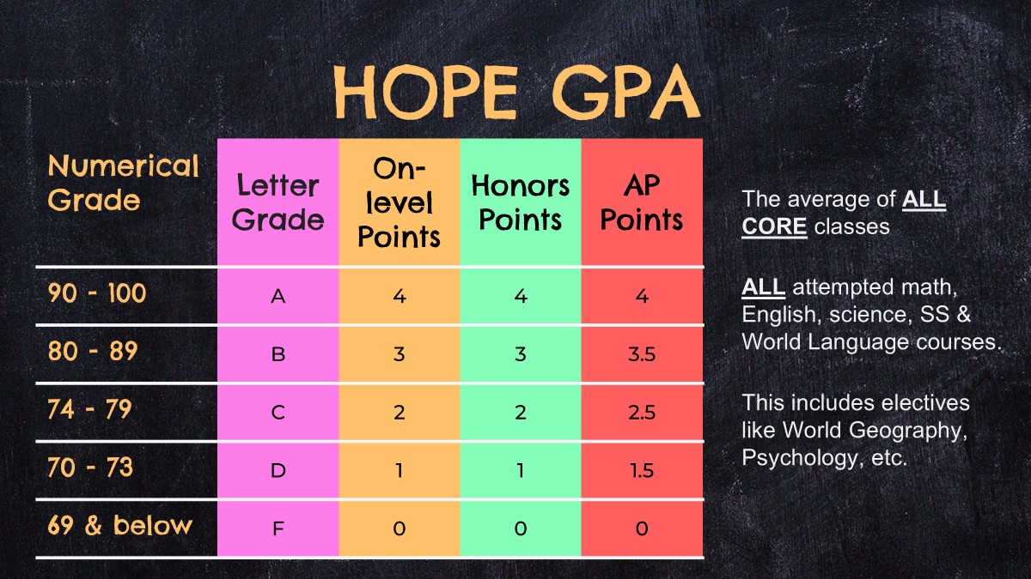

Slide 17
HOPE RIGOR REQUIREMENTS
In order to be HOPE eligible, students must earn
at least 4 credits in the following categories:
ADVANCED MATH
WORLD LANGUAGE
ADVANCED PLACEMENT
Advanced Algebra
Advanced Finacial Algebra
Pre-Calculus
Level 2 and higher
In core subject areas
ADVANCED SCIENCE
DUAL ENROLLMENT
Chemistry
Physics
Zoology
Astronomy
Human Anatomy
In core subject areas

Slide 18
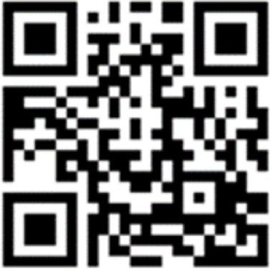
HOPE SCHOLARSHIP
For the most
up-to-date information
visit:
GAFUTURES.org

Slide 19
DUAL ENROLLMENT
  Take college classes while in highschool
  Earn HS credit AND college credit at same time
  Application process differs between colleges!
  See counseling website and district website for specific information
  9th Grade: NOT eligible
  10th Grade: ONLY CTAE classes at Tech school or with 1200 SAT/26 ACT prior to applying
  11th & 12th Grade: may take arpproved DE courses at eligible colleges
DE Summit NEXT week 8/25/26 Cobb County Civic Center
AHS DE Info Night VIRTUAL 12/8/26 6:30 pm

Slide 20
PARENT RESPONSIBILITIES
Encourage child
to advocate for themselves
Be respectful of teachers and staff
Communicate
  Start with the teacher by emailing directly
  If not resolved, ask to schedule a conference with teacher and counselor
This is such an important skill for them to practice.
They want your child to be successful

Slide 21
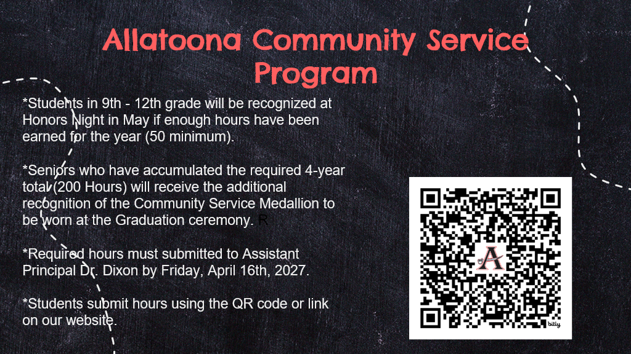

Slide 22
FAQ’s
Follow counseling on Instagram: @buc_counselors
PSAT
BY 11TH GRADE
PARENT VUE
This is digital and all 9th and 10th graders will take here
school. 11th can pay
to take it.
Need proof of meningococcal booster (MCV4). Upload to ParentVue or send to our clerk Allyson Rich.
Check regularly. Update contacts since info. changes. Theresa Bennett can help troubleshoot.
ABSENCES
COMMUNITY SERVICE
Excused notes submitted within 3 days. Can email Theresa Bennett notes. Check CTLS for work.
Students will need to upload their service hours each school year.

Slide 23
Additional
Questions?
We look forward to partnering
with you this school year!

