Slide 1

9th Grade Elective Registration
“Reaching Out and Moving Forward Toward Student Success!”

Slide 2
SCHS Course Catalog
Your school website will post the South Cobb High School
9th Grade Course Catalog.
Students and parents should read about all the courses that we offer and get an idea of what ELECTIVES we offer at South Cobb HS.

Slide 3
High School Credit
8th grade students who have
TAKEN and PASSED
the 1st level of Spanish, French, HS Art, Audio/Video I or Healthcare should select the 2nd level of those courses since HS credit for Level I will already be earned.

Slide 4




Core Classes - Registration
9th Grade CORE classes are based on 8th Grade
TEACHER RECOMMENDATION.
Teachers are basing their placement into core classes based on a Recommendation Guideline sheet. South Cobb HS does NOT make core placements.

Slide 5

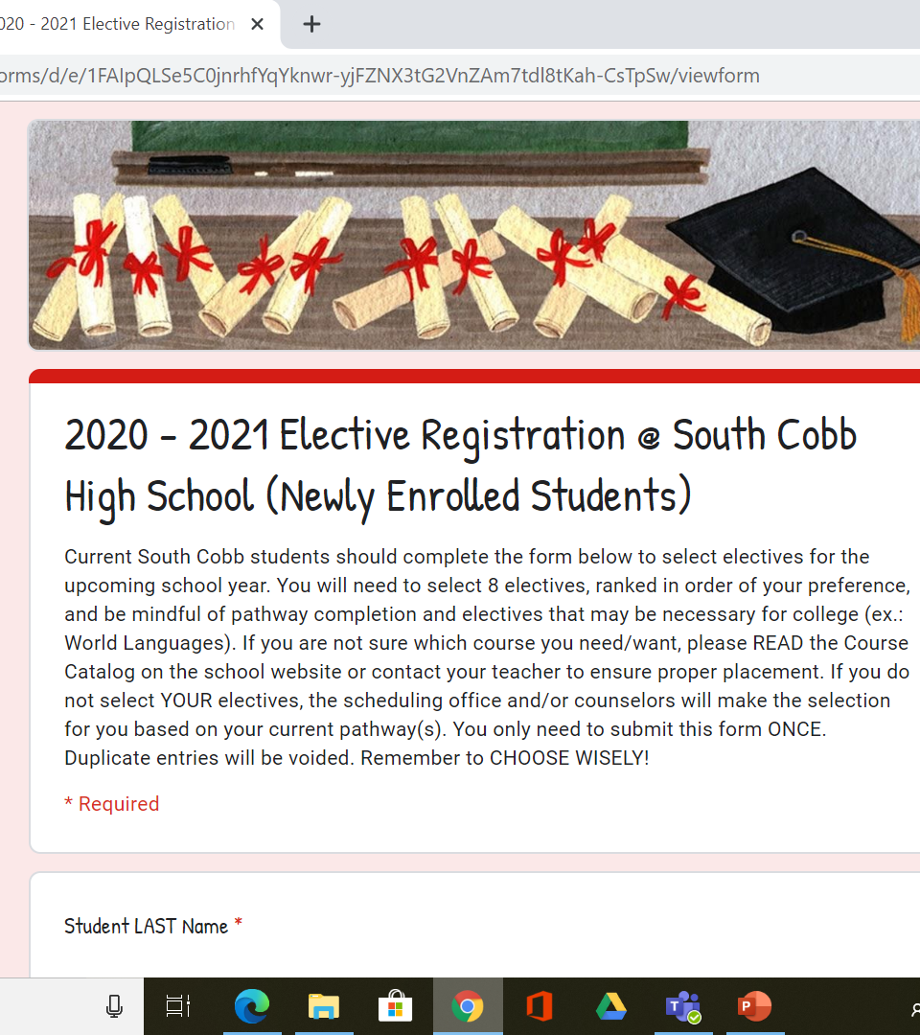
On-Line Elective Registration
2024-2025

Slide 6

On-Line Elective Registration
Students will receive an on-line registration link to select their electives for the coming year.
Students will select 8 electives.
Students get 4 of the 8 classes they request. There is NO DROP/ADD for electives!
Choose Wisely!

Slide 7
On-Line Elective Registration
If you do NOT make your 8 elective choices during the one week of elective registration…..
1. The counselors at SCHS will select the electives for you
AND
2. You CANNOT request a schedule change
Choose Wisely!

Slide 8
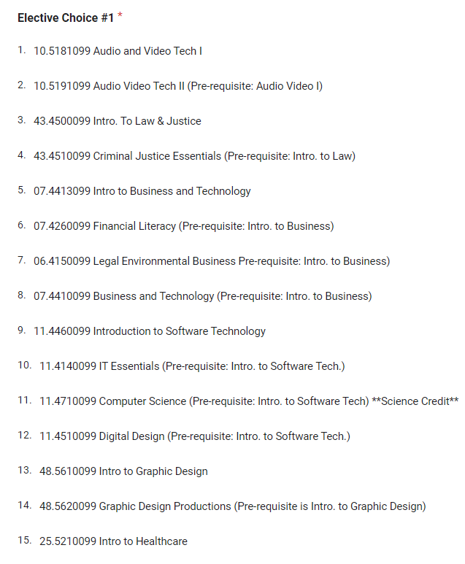
ALL students should READ the elective name and the PRE-REQUISITE (if applicable).
You may want “Financial Literacy”, but you MUST take Intro. To Business 1st.
Pre-req. is listed.
If you select Financial Literacy without selecting Intro. To Business, you will NOT get Financial Literacy, you will get Intro. To Business.
This will allow SCHS to help you reach your goal of taking the Financial Literacy class.
Pre-requisites are listed next to electives where applicable.
1
1
What you want.

Slide 9

What’s New?
ALL incoming FRESHMAN are REQUIRED to complete this graduation requirement as 9th graders; therefore, it MUST be the 1st elective choice.

Slide 10

Students Should…
Read the Rising 9th Course Catalog
Select 8 electives that interest you
Read
Choose Wisely
Understand
Learn
Some Elective Courses have
Pre-requisites
Learn something NEW in all classes

Slide 11

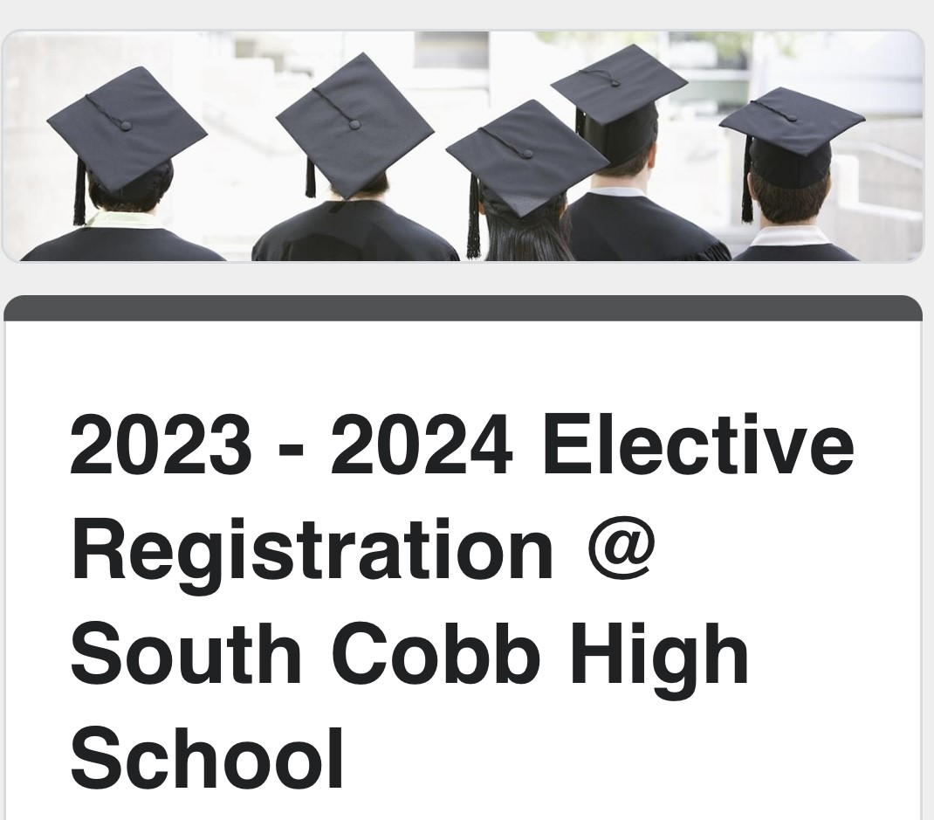
Use the Technology
Rising 9th Grade Elective Registration
Rising 9th grade SCHS students should complete the form below to select electives for the upcoming school year……
Student LAST Name:
Student FIRST Name:
Student ID Number:
Current Middle School:
Students can select their 8 electives, via their phone or laptop, 24 hours a day during the elective registration window.
February 5 – 12, 2024
Elective

Slide 12
If you do NOT make your own selections, the counselors at South Cobb HS will make the selection for you and it CANNOT be changed.
Health/PF should be #1 Choice!
Students Should Exercise Their Right to Choose!
Rising 9th Grade Elective Registration
Rising 9th grade SCHS students should complete the form below to select electives for the upcoming school year……
Student LAST Name:
Student FIRST Name:
Student ID Number:
Current Middle School:
Elective

Slide 13


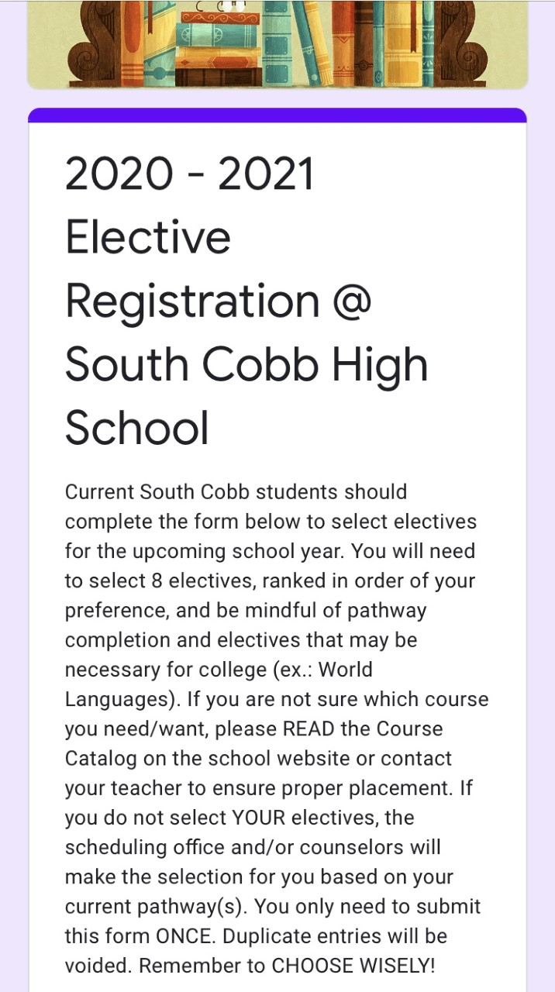

February 5 – 12, 2024
Remember to
CHOOSE ELECTIVES WISELY!
There is NO drop/add for electives that a student selected.
13

Slide 14
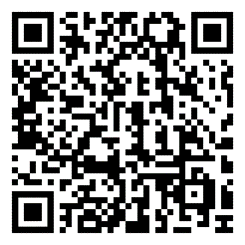
Elective Registration Begins February 5, 2024 @ 8:00 a.m.
Students will access the elective registration form via a QR code this year.
It will be recommended that when the flyer is sent to 8th grade teachers, it is placed in CTLS, the school website, and projected each day of registration for students to do during a specific time in class.
Registration Closes on February 12th @ 3:30 PM
Choose Wisely!

Slide 15

REMEMBER! Health/Personal Fitness MUST be your 1st choice (graduation requirement).
Students should remember to focus on PATHWAY COMPLETION and seek out those electives that will help with this goal. Once you start, we help you finish.
Students should remember that there are ACADEMIC pathways as well as CAREER & FINE ARTS pathways.
Students should make WISE SELECTIONS since you CANNOT do drop/add for electives YOU selected.

Slide 16

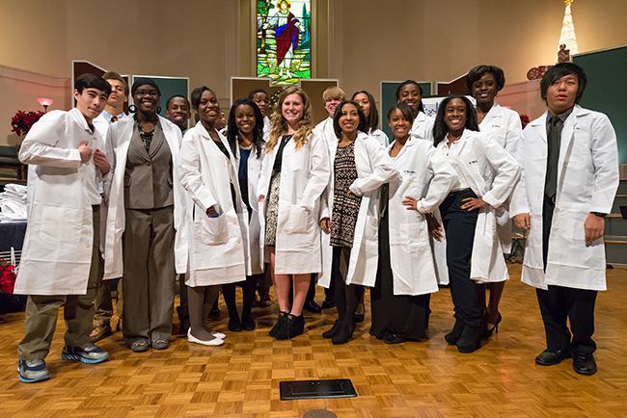
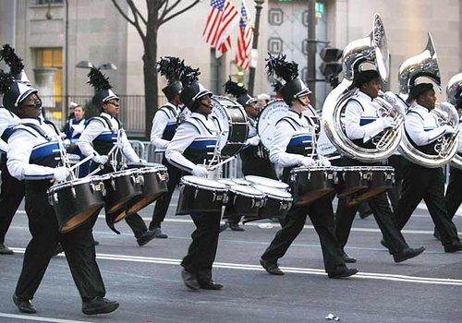
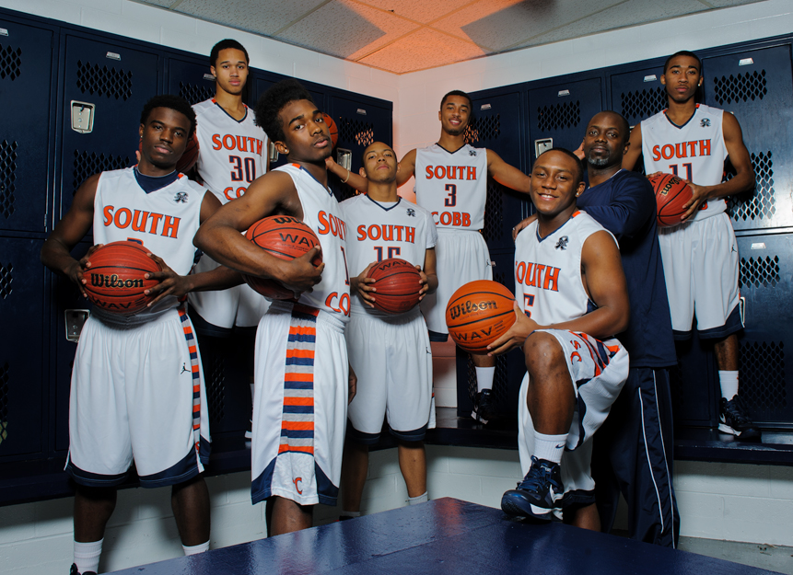
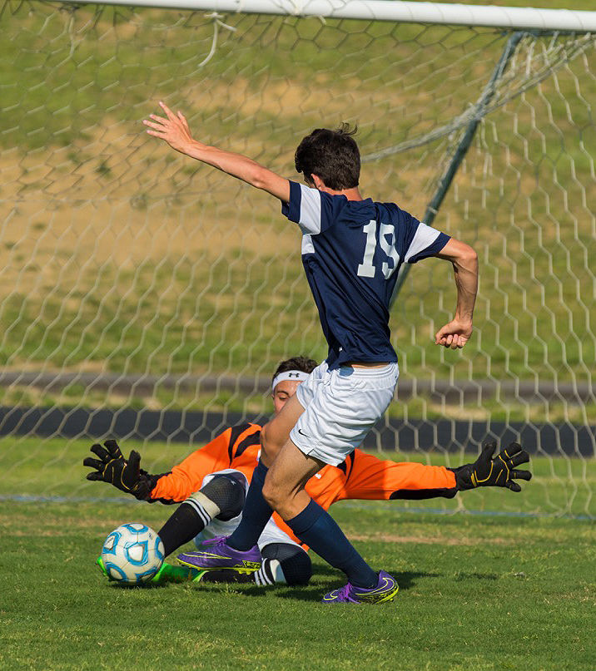
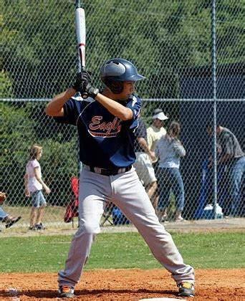
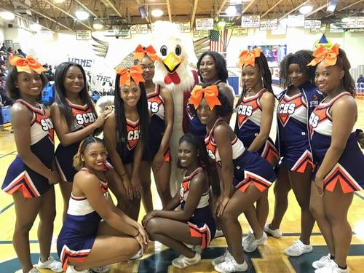
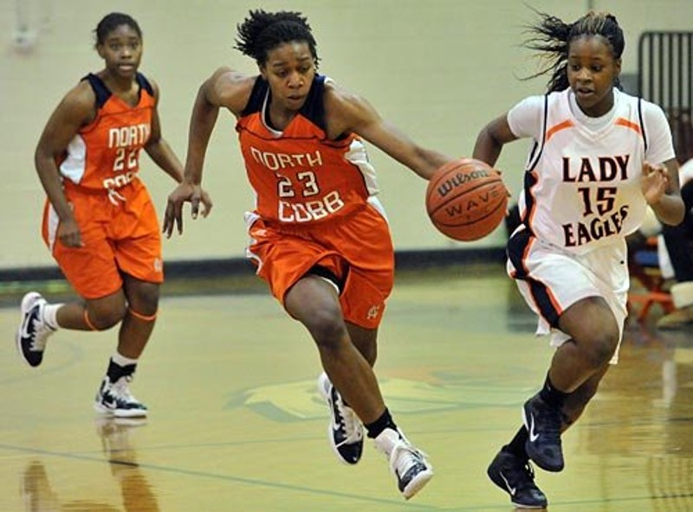
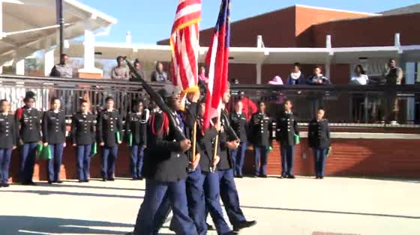




Welcome to South Cobb!

