Slide 1
Notes:
Welcome…. Introductions…. 4 part transition

Slide 2
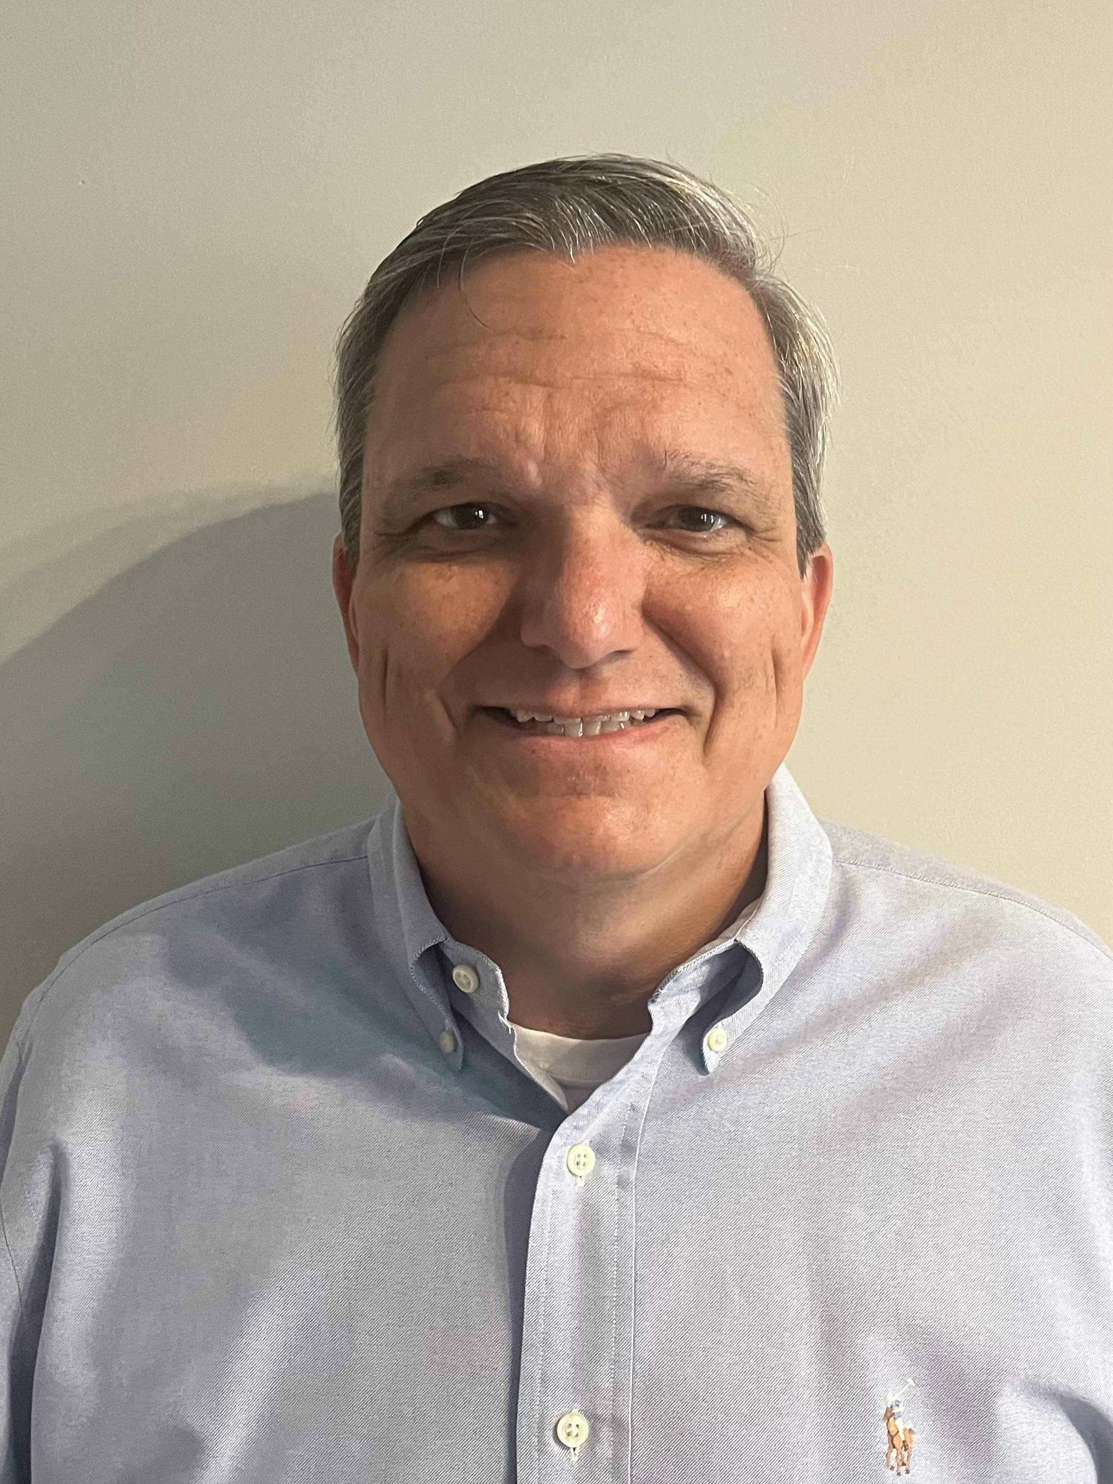
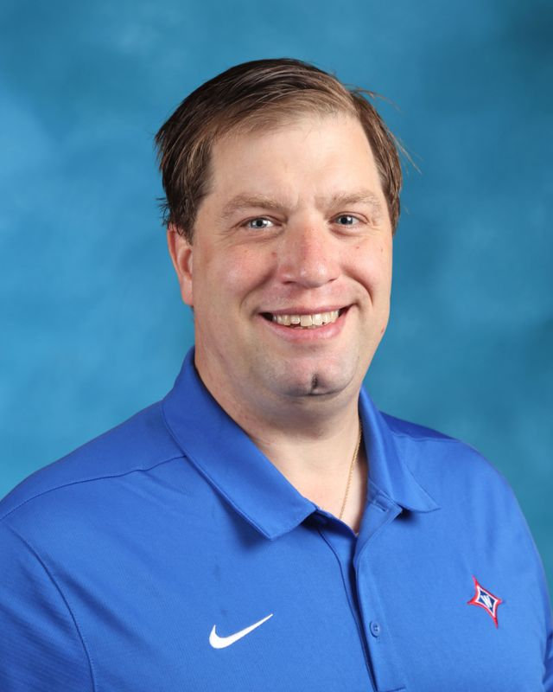
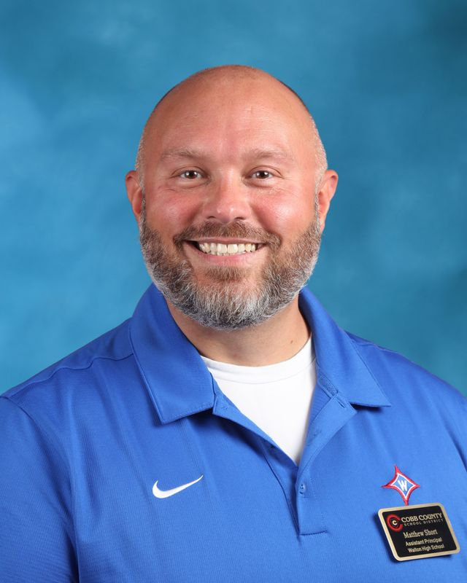
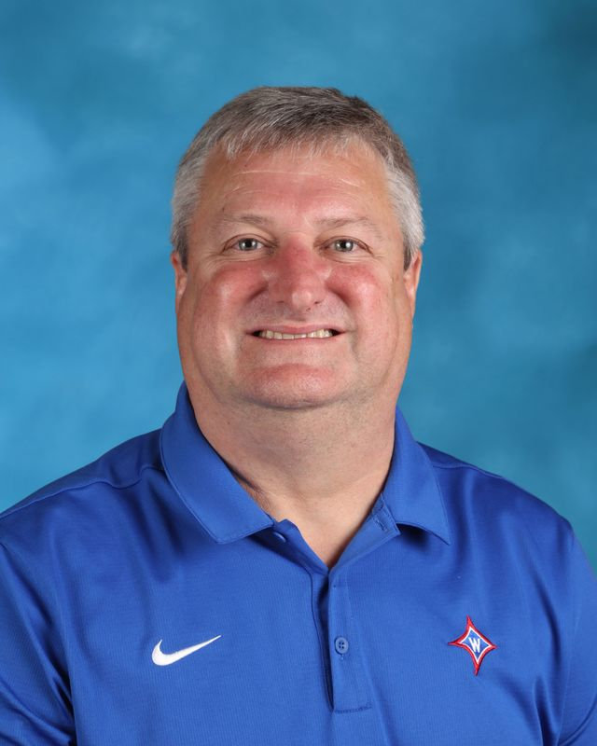
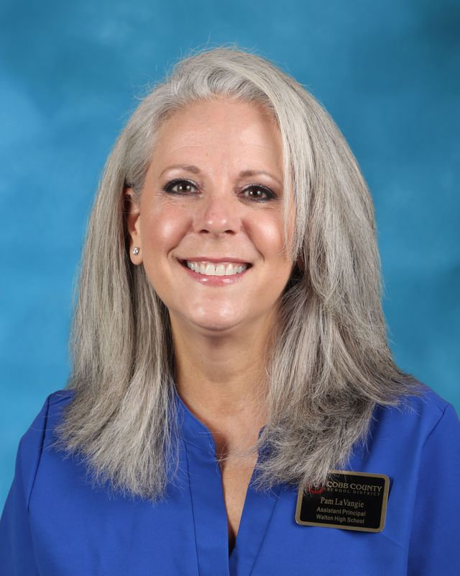
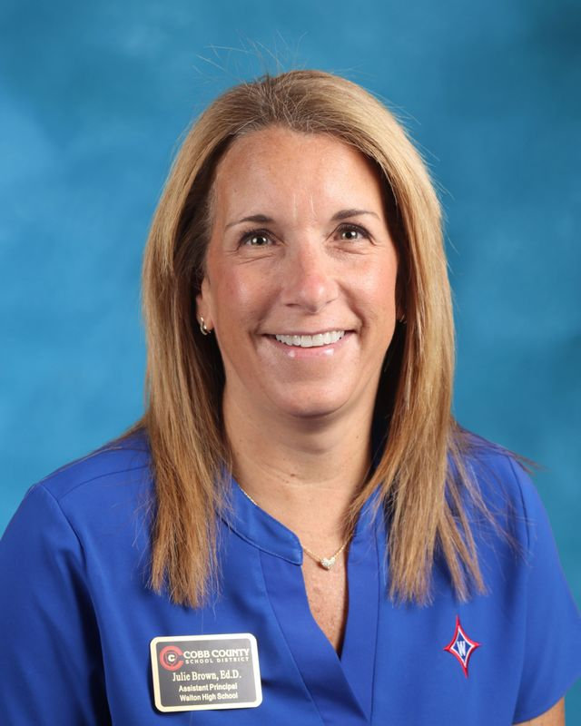
Administration
Mr. Pirkle
9th grade
Dr. Jones
10th grade
Mr. Short
12th grade
Dr. Williams
10th grade
Ms.LaVangie
9th grade
Dr. Brown
11th grade

Slide 3
Supporting Walton

Slide 4
Walton Foundation
Our mission is to raise funds to enrich the Walton experience by:
reducing class size
increase class offerings
enhance the campus
Donate to join the Foundation in our mission and receive Walton perks!
Signup to receive biweekly eNewsletter emails

Slide 5
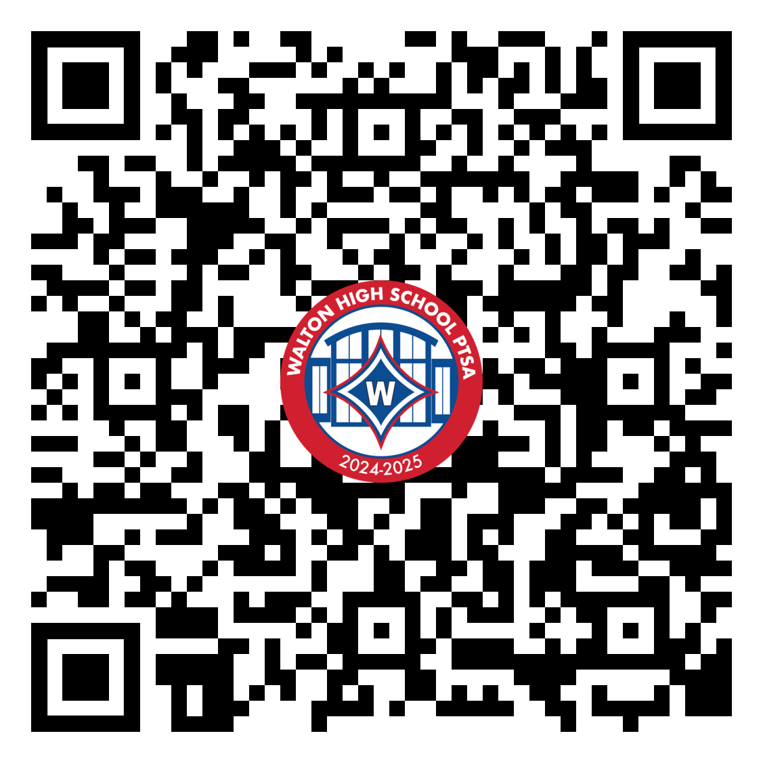
The Parent Teacher Student Association (PTSA) is an organization whose mission is to connect parents, students, and teachers to promote the welfare of students. We are committed to improving the lives of our children through programs that address education, health, and social concerns. With your help, we can strengthen the home-to-school connection, uniting parents, faculty, and students.
Join Walton PTSA
Waltonptsa.org

Slide 6
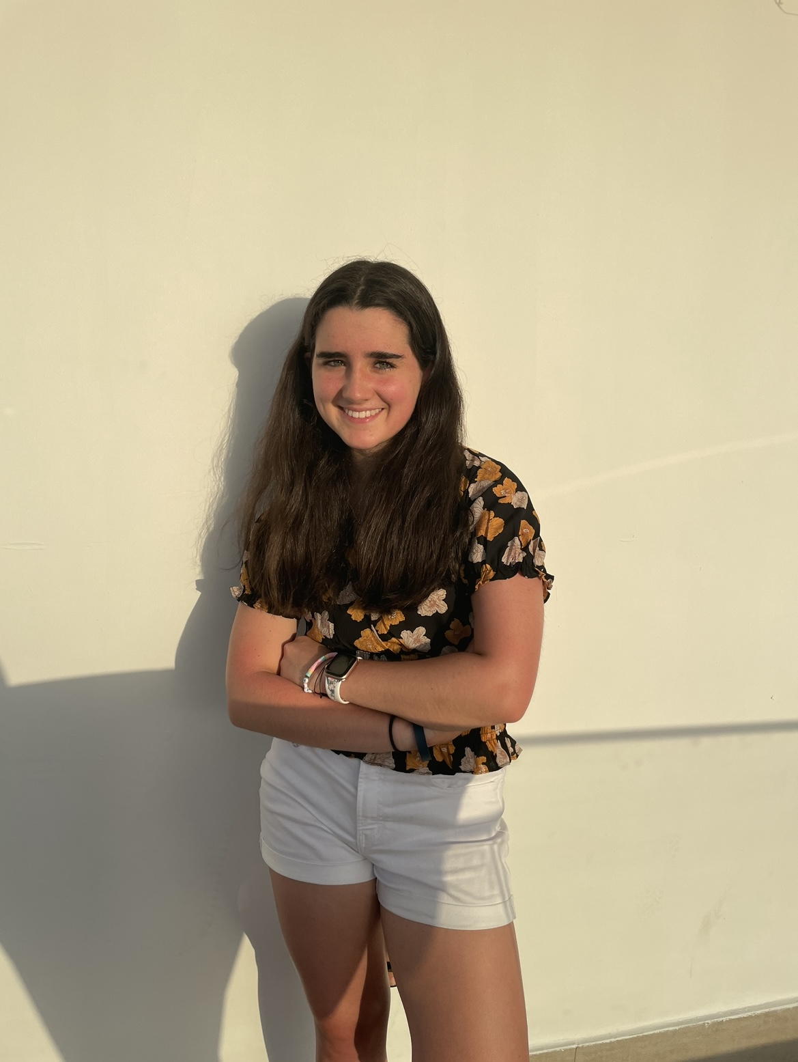
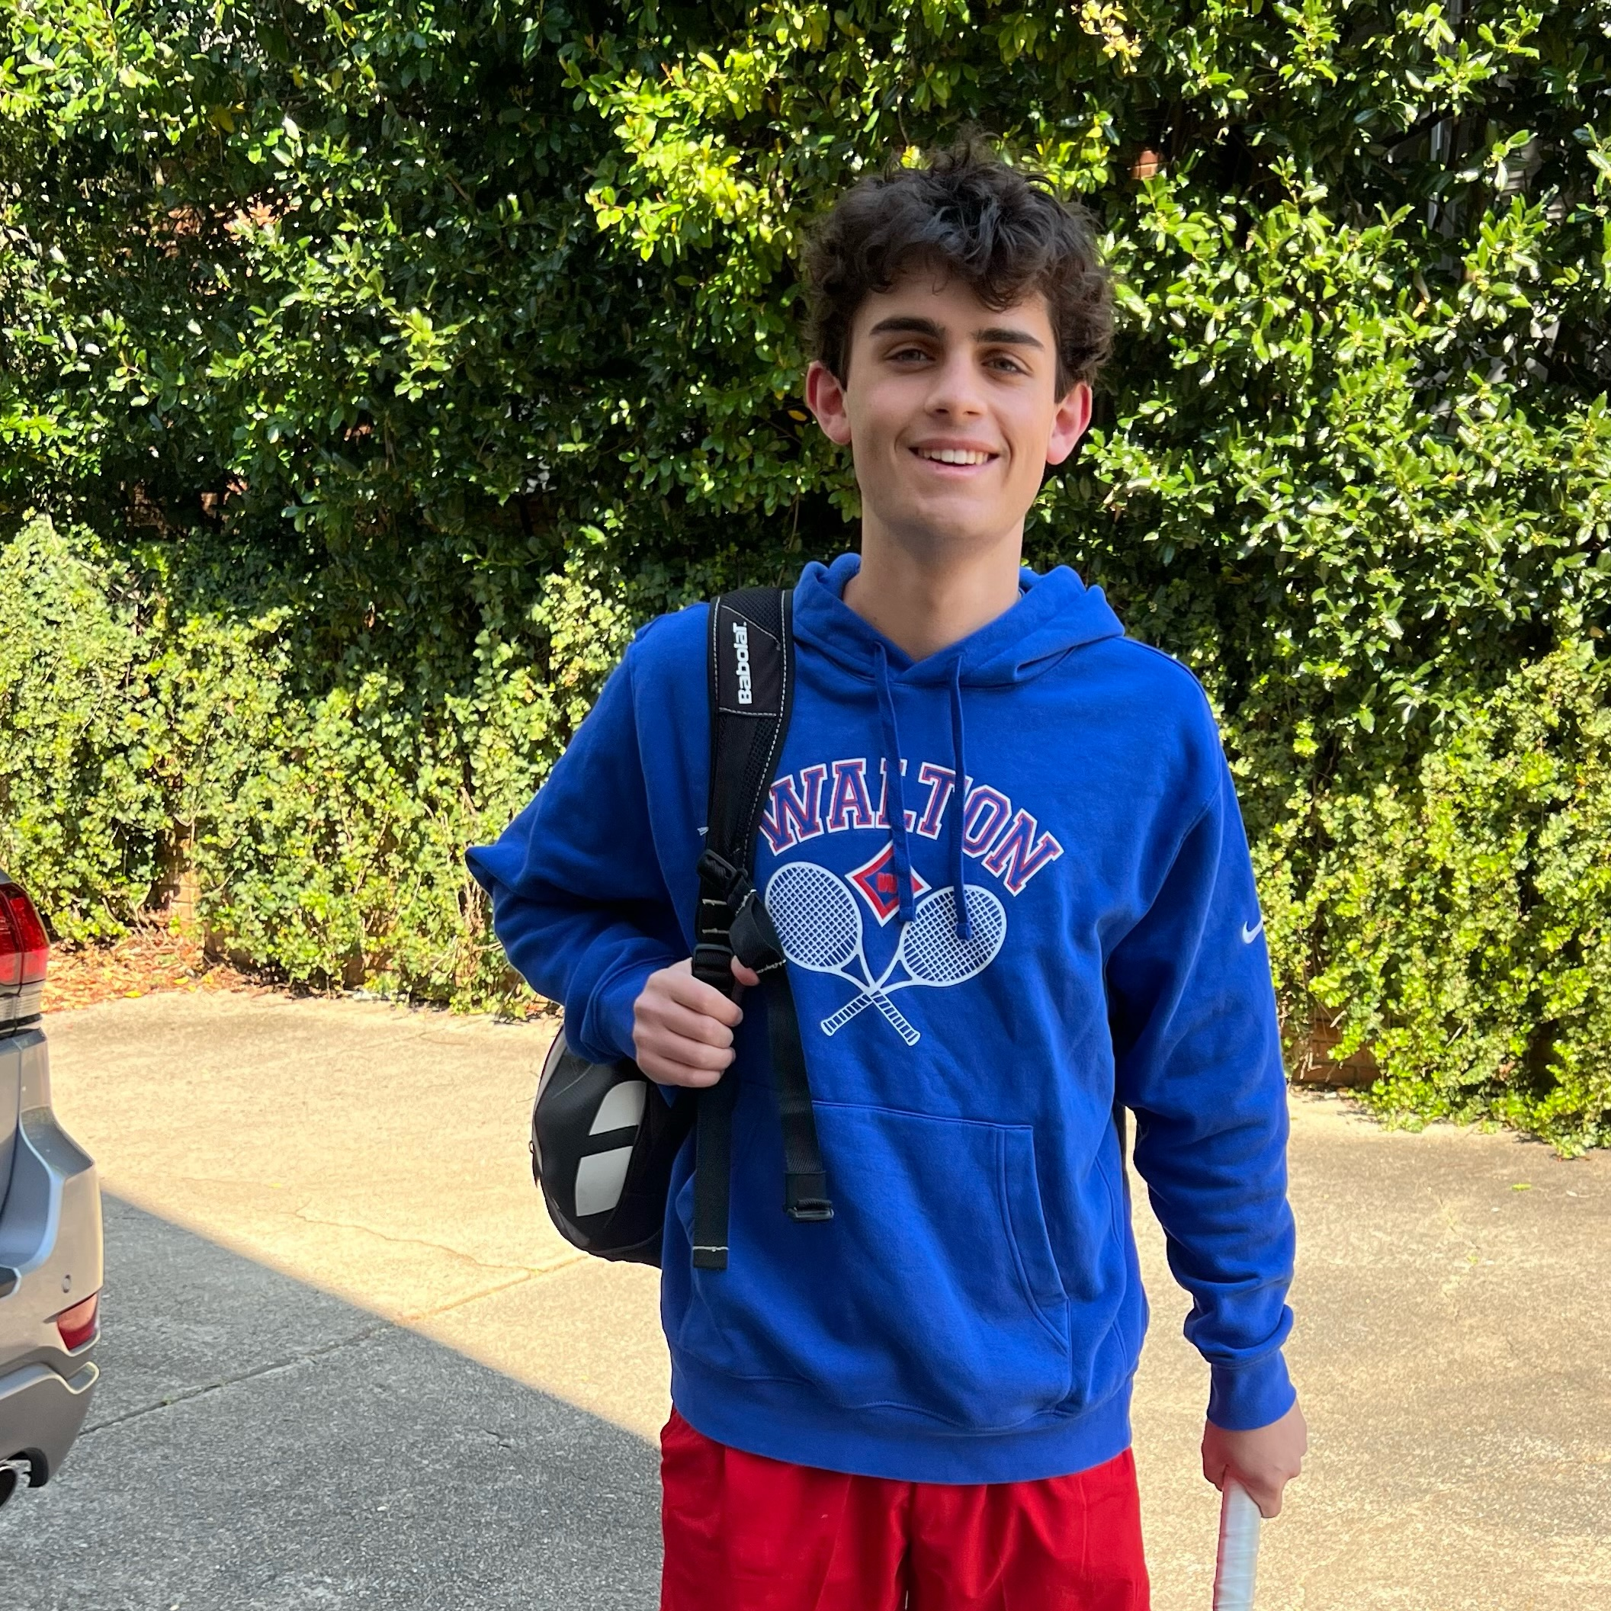
Student body
President:
Maddie Halloran
Vice president:
Lawson rhea

Slide 7
Where is my kid & what are they doing?
Meeting with homeroom teacher & Walton Ambassadors
Ice Breakers
School Trivia
Top 10 things I wish I knew
School tour
Meet up in the cafeteria at 2pm
Case manager meeting in library at 2pm
Spirit Shop
Walk their Schedule
Get out before the teenage drivers come!!

Slide 8
9th Grade Fees
No PSAT fee this year!

Slide 9
What about their schedule?
Full Schedule
Wrong Schedule
Process for corrections
Elective Choices

Slide 10
What in the world is WEB?
Walton Charter
Extra Help
Make Up Work
Time for a Break?
Bell Schedule
Buses run at 3:30
Parent Choice

Slide 11
New WEB Bell Schedule
WEB Bell Schedule
0 pd | 7:10 | 8:13 | (63 min)
1st | 8:20 | 8:50 | (30 min)
HR | 8:56 | 9:05 | (9 min)
2nd | 9:11 | 9:40 | (29 min)
3rd | 9:46 | 10:15 | (29 min)
4th | 10:21 | 10:50 | (29 min)
5th | 10:56 | 11:25 | (29 min)
6th | 11:31 | 12:00 | (29 min)
7th | 12:06 | 12:35 | (29 min)
Q Block | 12:35 | 12:55 | (20 min)
A Block | 1:00 | 1:25 | (25 min)
B Block | 1:30 | 1:55 | (25 min)
C Block | 2:00 | 2:25 | (25 min)
D Block | 2:30 | 2:55 | (25 min)
Dept Meetings | 3:00 | 3:30 | (30 min)

Slide 12
WEB- How does it work?
May Leave List
“May Leave” means a student, with parental guidance, is individually responsible for his/her own choices as to remaining or leaving school. The student will be responsible for his/her time management choices. STUDENTS ARE ALWAYS WELCOME TO STAY!
Must Stay List
“Must Stay” means a student must sign up and attend WEB blocks. During homeroom each WEB, students on the “Must Stay” list will receive a WEB verification form that they are required to stay for WEB. Students must complete this form in its entirety and turn it in to the WEB table before leaving school. Failure to complete the WEB verification form correctly will result in discipline consequences.
Notes:
General WEB (Walton Enrichment Block) Information
At Walton High School, we believe that finding innovative ways to educate students should be an endless journey. On most five-day school weeks, students are dismissed for WEB at 12:42 pm from their regular schedule (see WEB Schedule below). Students determine, based on a variety of available activities, how they will spend the remainder of the day. The afternoon consists of four 35-minute blocks that students can sign up to attend. Enrichment activities may include tutoring time with teachers, community service, research in the media center, make-up work, SAT prep, guest speakers, and other opportunities that will benefit students.

Slide 13
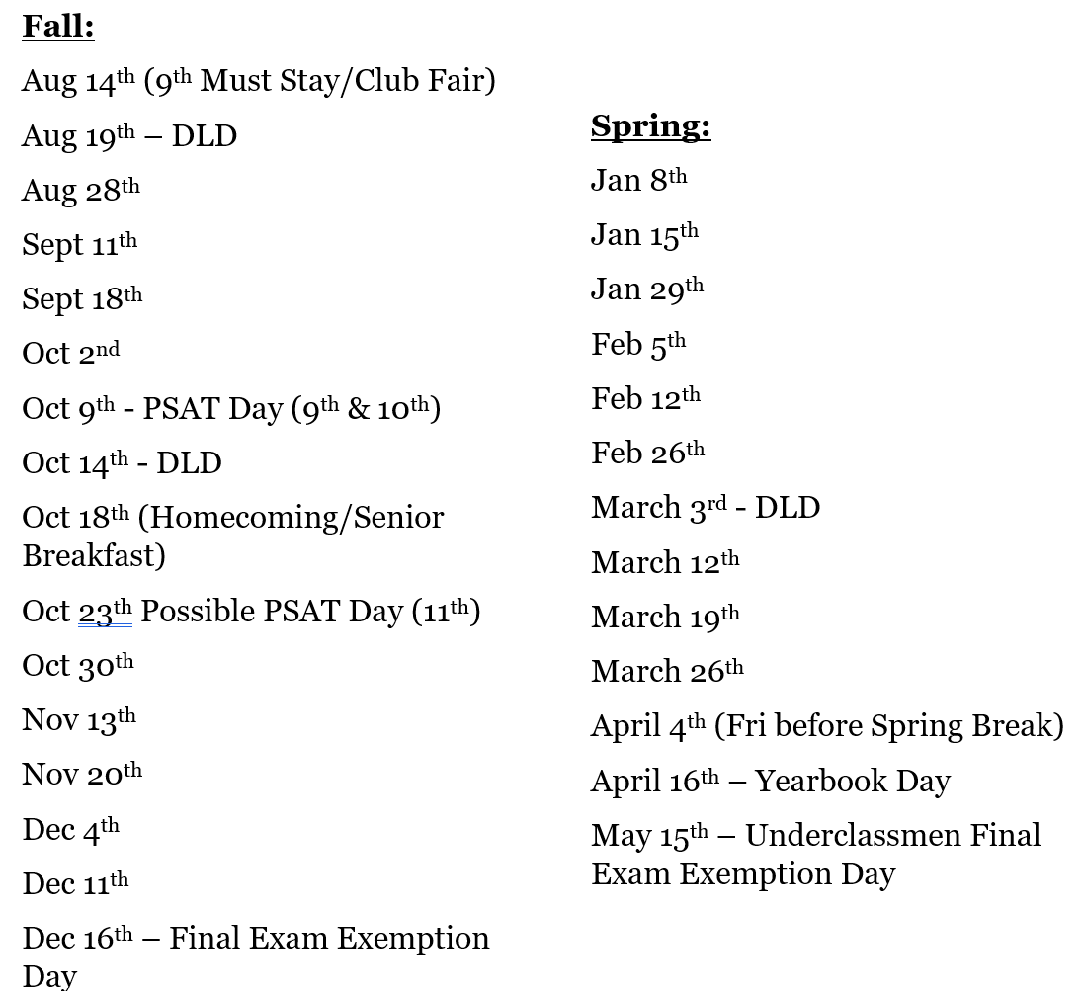
2024 – 2025 WEB Dates DLD = digital learning day

Slide 14
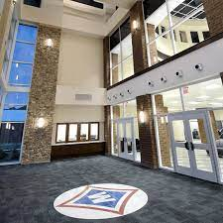
Schoolwide Expectations
Dress Code (no baseball caps, no hoods)
Academic integrity
Code of Conduct
More than one in a bathroom stall
Possession of vape – 3 days oss
Food deliveries from UberEats, GrubHub, etc.
Fighting
Attendance
skipping
Phones/Social Media
New-found freedom!

Slide 15
Attendance
Students coming to school after 8:30 must check in with the attendance office before going to class.
Anyone needing to leave campus must have parental permission to do so.
Send an email to as early as possible the attendance office (Kim Gibson or Lauren Seckman) with the student's first and last name, cobb id(lunch number), time leaving, and reason for leaving.
We will send a dismissal to the student’s cobb county email address.
If returning, simply stop by the attendance office and reply to our email and let us know you are back on campus.
For an absence, the parent/guardian must send an email within three days. The absence will remain unexcused if we do not receive an email or the reason is not an excusable one. (See agenda with state-approved reasons).
Please feel free to stop by if you have any questions about attendance or obtaining a certificate of enrollment for your driving permit. When you enter the building, we are the office on the left.
Kim.Gibson@cobbk12.org
Lauren.Seckman@cobbk12.org

Slide 16
transportation
Bus riders
Can never be tardy!
Know bus number
Carpool
Tardies count
All drop-offs must occur in the front of the building, not in the parking lots or on the street

Slide 17
Staying Informed
PTSA Eblast
CTLS Parent
Walton Website
ParentVue

Slide 18
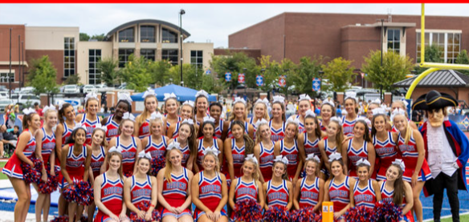
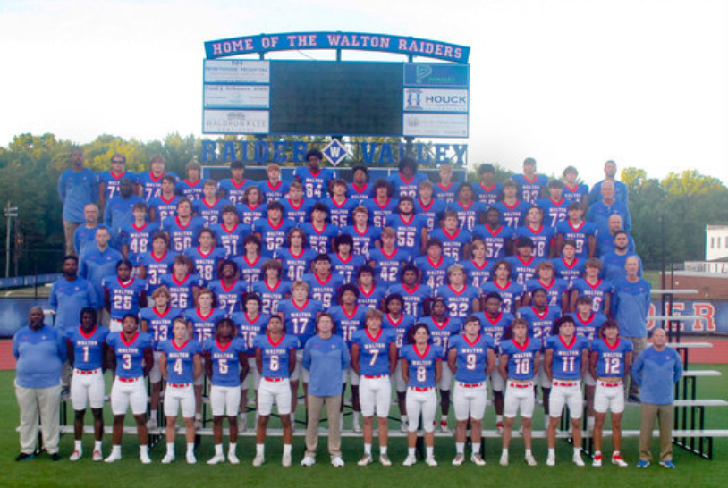
Athletics
Eligibility
Athletic Registration/Physical
Walton Sports Medicine and peachtree orthopedics
Getting started!

Slide 19
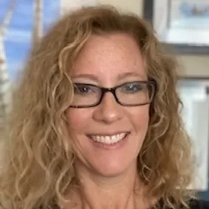
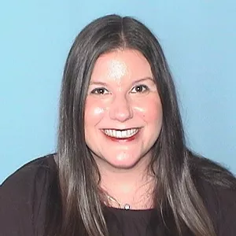
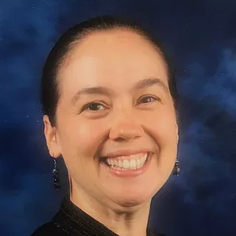
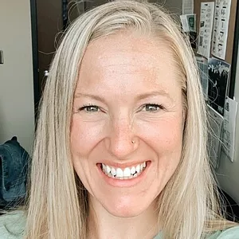
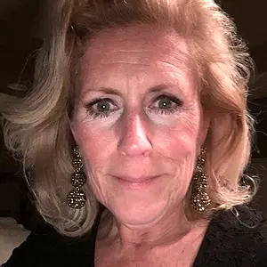
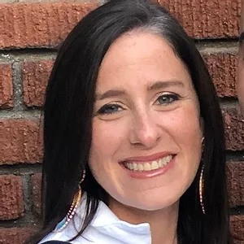
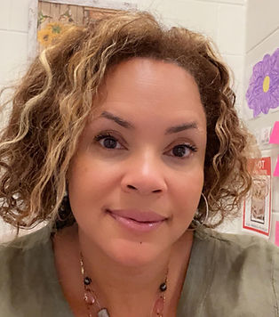
Walton’s Counselors www.waltonhighcounseling.com
Mrs. Clary
A - Ch
Mrs. Alpert
Ci - G
Mrs. Dunham
H - K
Mrs. Watford
L - N
Mrs. Harwood
O - Sl
Mrs. Fay
Sm - Z
Mrs. Ambles
504 Counselor

Slide 20
We Are Here to Help YOU!
Counseling Services Offered:
Classroom Lessons for all students
Academic Advisement in 9th grade (spring) and 11th grade (fall)
Social, Emotional, and Academic support
Parent, Teacher, and Student Conference coordination
Referrals to local therapists/resources
Senior Year College and Career process advisement and support
Dual Enrollment Information
504 and RTI Coordination
Naviance Introduction
So much more! Please visit our website, https://www.waltonhighcounseling.com and our Social Media accounts regularly for Counseling news!

Slide 21
Tips from your School Counselor
Grades are IMPORTANT-understanding GPA calculation and impact
Plan with the end in mind-monitoring graduation and promotion requirements and planning for future
Be active/involved—remembering quality vs. quantity (balance important)
Using Naviance to keep plans organized and to help with career/college exploration
Much help available—using available tutoring and teachers’ help times efficiently and effectively
Attend parent nights and advisement

Slide 22
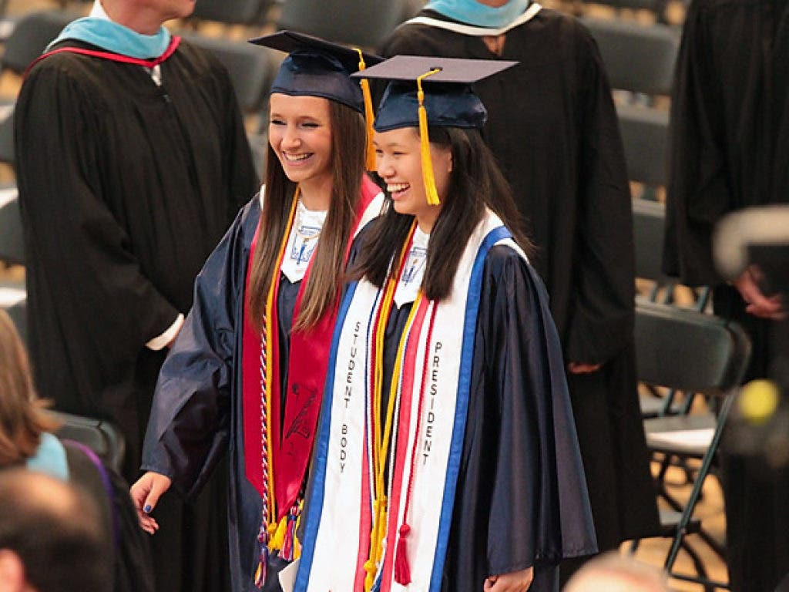
Enjoy the Ride!

