Slide 1

Spanish Academy
Sra. Karina Alarcon
STEM Academy
Ms. Marianna Foxwell
Leadership and Law Academy
Mr. Jordan Johnson

Slide 2
All Academies
Capstone Projects
All academy students will participate in projects that help cultivate skills for their future.
Volunteer Hours
20 volunteer hours
10 in school hours
  Spooky STEM Night
  Tutoring
10 out of school hours
Field Trips/Activities
STEM Under the Stars Movie Night
Spooky STEM Night
Sparkles Skating Rink
iFly
Piedmont Park Conservancy
Medieval Times Dinner Theater
Garner-Holt Production Studio Virtual
PPE Making for Atlanta Beats COVID
NASCAR Virtual Field Trip
All 3 look great on magnet applications
Academies should be chosen based on your interest and future career plans

Slide 3

How to Sign Up (online)
Fill out the application form (form will be posted on the JJ Daniell website starting Friday, 2/13)
2. Mark the correct teachers for recommendations.
3. Post a video in the Academy Canva about why
you are interested in the desired academy.
(MUST be at least 1 minute long)
4. Apply to only one academy.
Recommendations:
  Spanish: Language Arts and 1 other core class
  STEM: Science and Math
  Leadership and Law: Social Studies and Language Arts

Slide 4
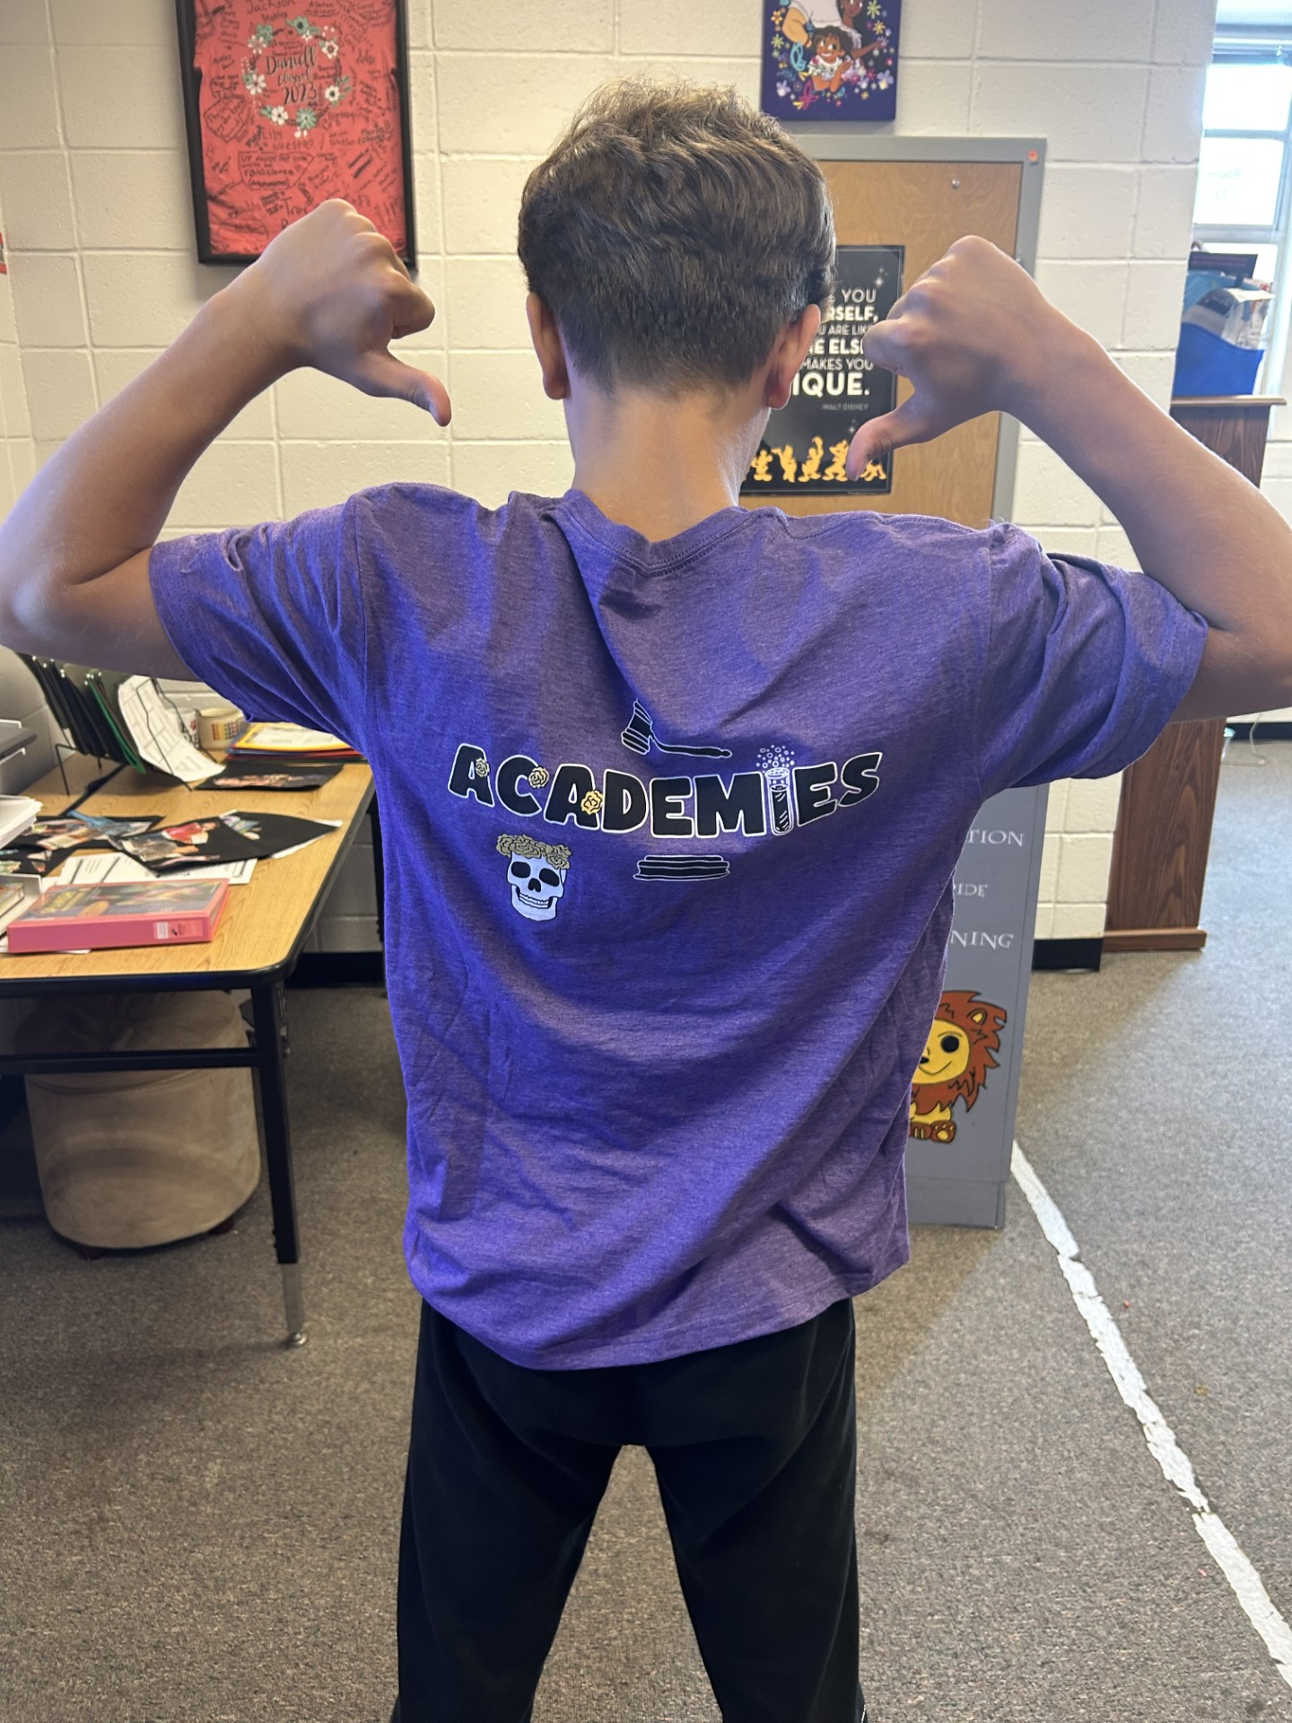
Spanish Academy
Sra. Karina Alarcon

Slide 5

What does the Spanish Academy do?
Capstone project – Our capstone project is mainly about helping Native students, making them feel welcome, and help them learn about our culture.
The Bracelet Project – Every year the Spanish Academy sells Bracelets to help families in Nicaragua and charities. This is the biggest project that the Spanish Academy has!
Baila Viernes – Every Friday the Spanish Academy dances to songs or sings songs that we all enjoy (dancing is optional)
Hispanic Heritage Month – This is one of the most fun things we get to do in the Spanish Academy. During the month we decorate doors, put of posters, and many other activates that help represent the Hispanic cultures!

Slide 6
Why choose the Spanish Academy?
The Spanish academy is not all work.
Fun activities and field trips
Spanish I High School credit continue with the ISLA
Academy at Sprayberry
We do food projects, projects around the school, and much more!

Slide 7
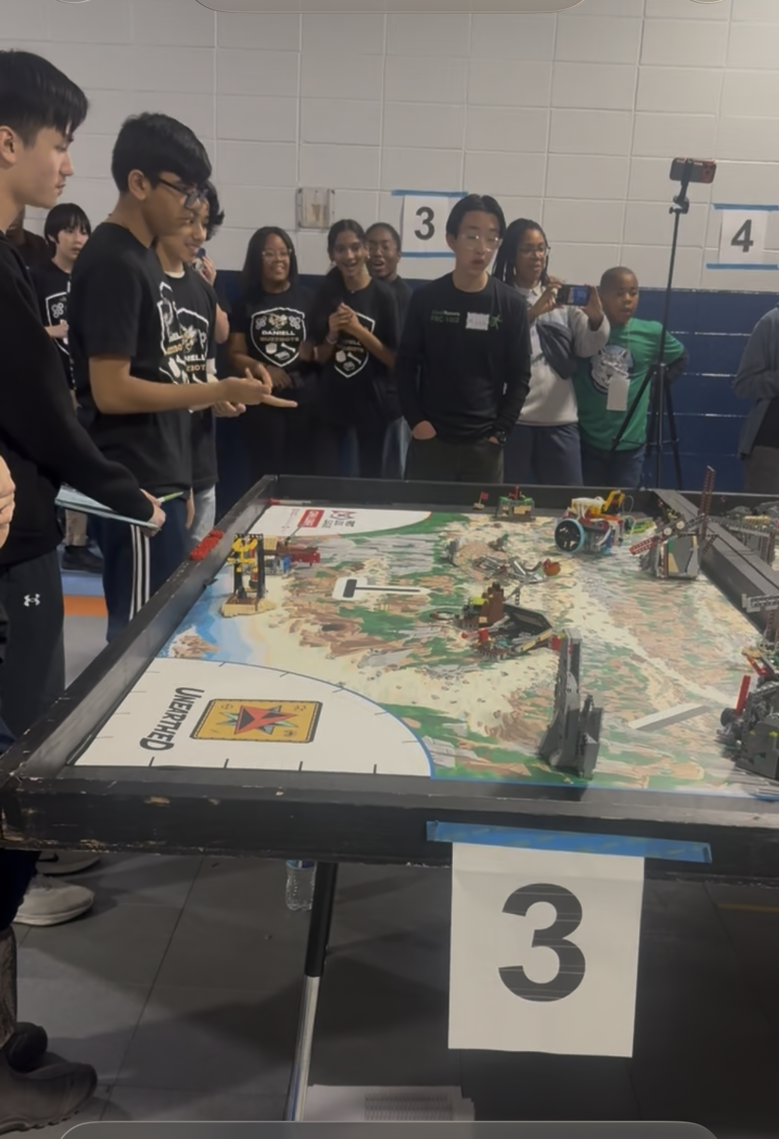
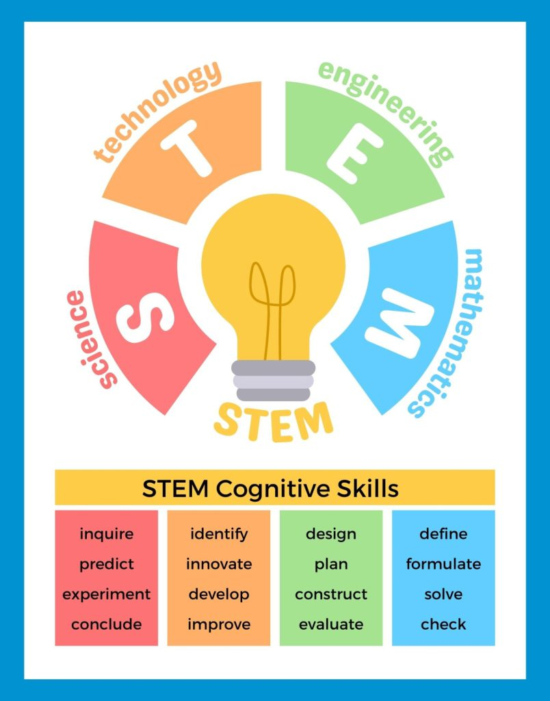
STEM Academy
Ms. Marianna Foxwell

Slide 8
Why choose the STEM Academy?
The STEM academy is not all work.
Fun activities, Field trips, and Spooky Stem night
Can increase the opportunity to go into Sprayberry’s STEM Program and Cobb Magnet programs.
Possible opportunities to earn recognition in a national competition

Slide 9

Capstone Projects
Each semester, there is a project with choices such as, Science Fair, Robotics, and a Chemistry/STEM National Challenge.
There are also fun PBL activities to help solve real-world issues

Slide 10
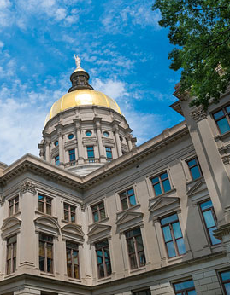
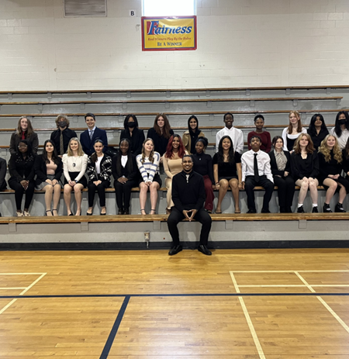
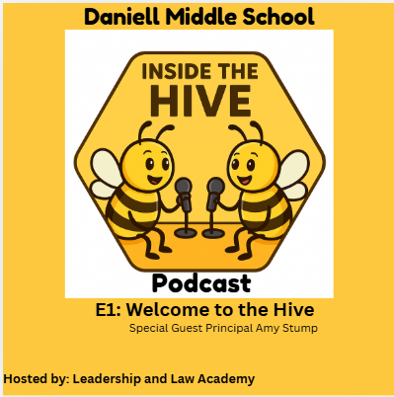
Leadership and
Law Academy
Mr. Jordan Johnson

Slide 11
Why choose the Leadership and Law Academy?
Leadership and Law focuses on building presentation skills, public speaking, volunteer service, and government.
Field Trips, School Service (5th Grade Big Visit, rising 6th grade night, Spooky Stem night)
HS Credit Local Area Studies counts toward the Civics Diploma Seal at any GA HS

Slide 12
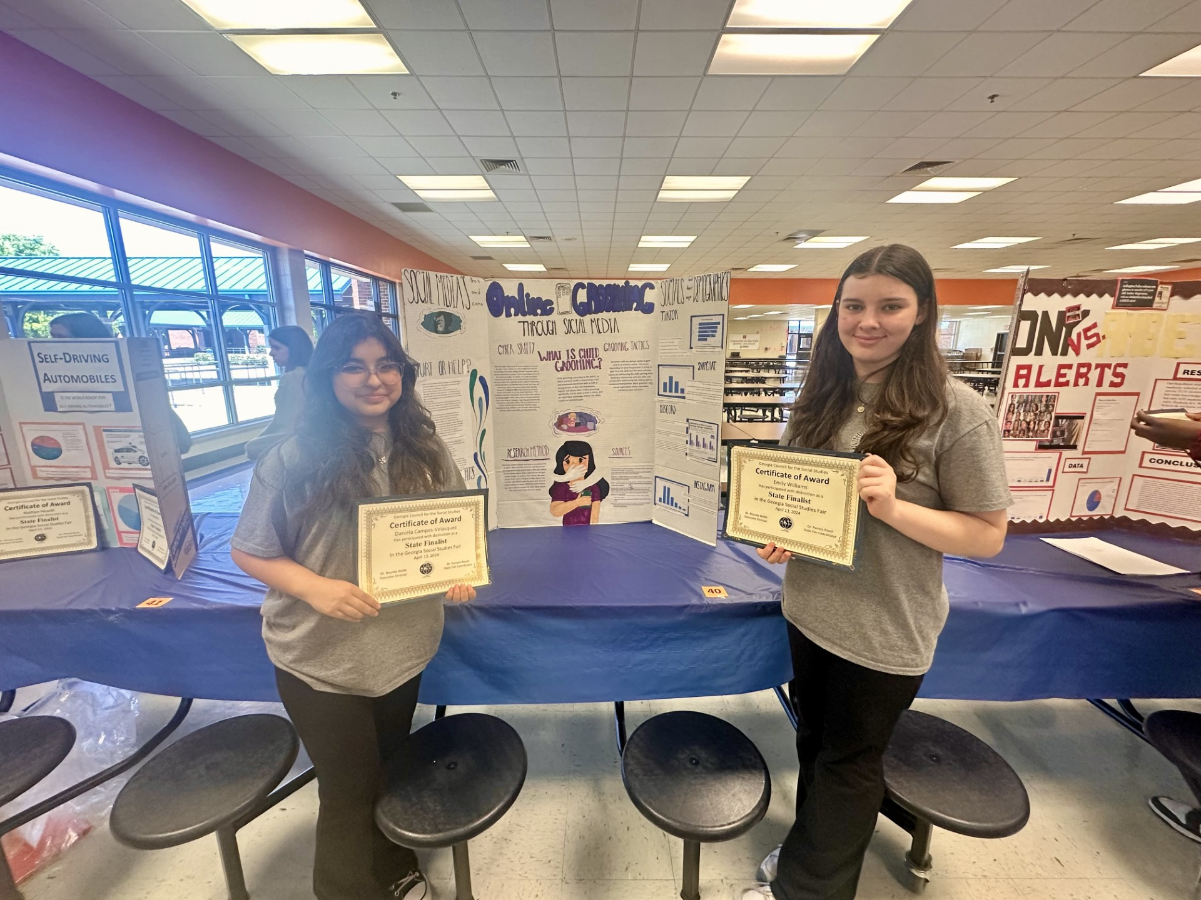
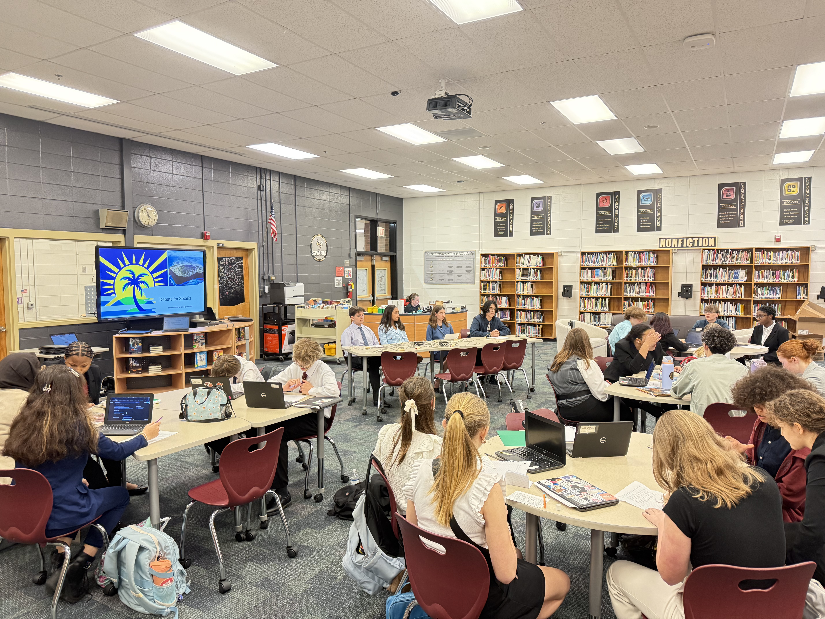
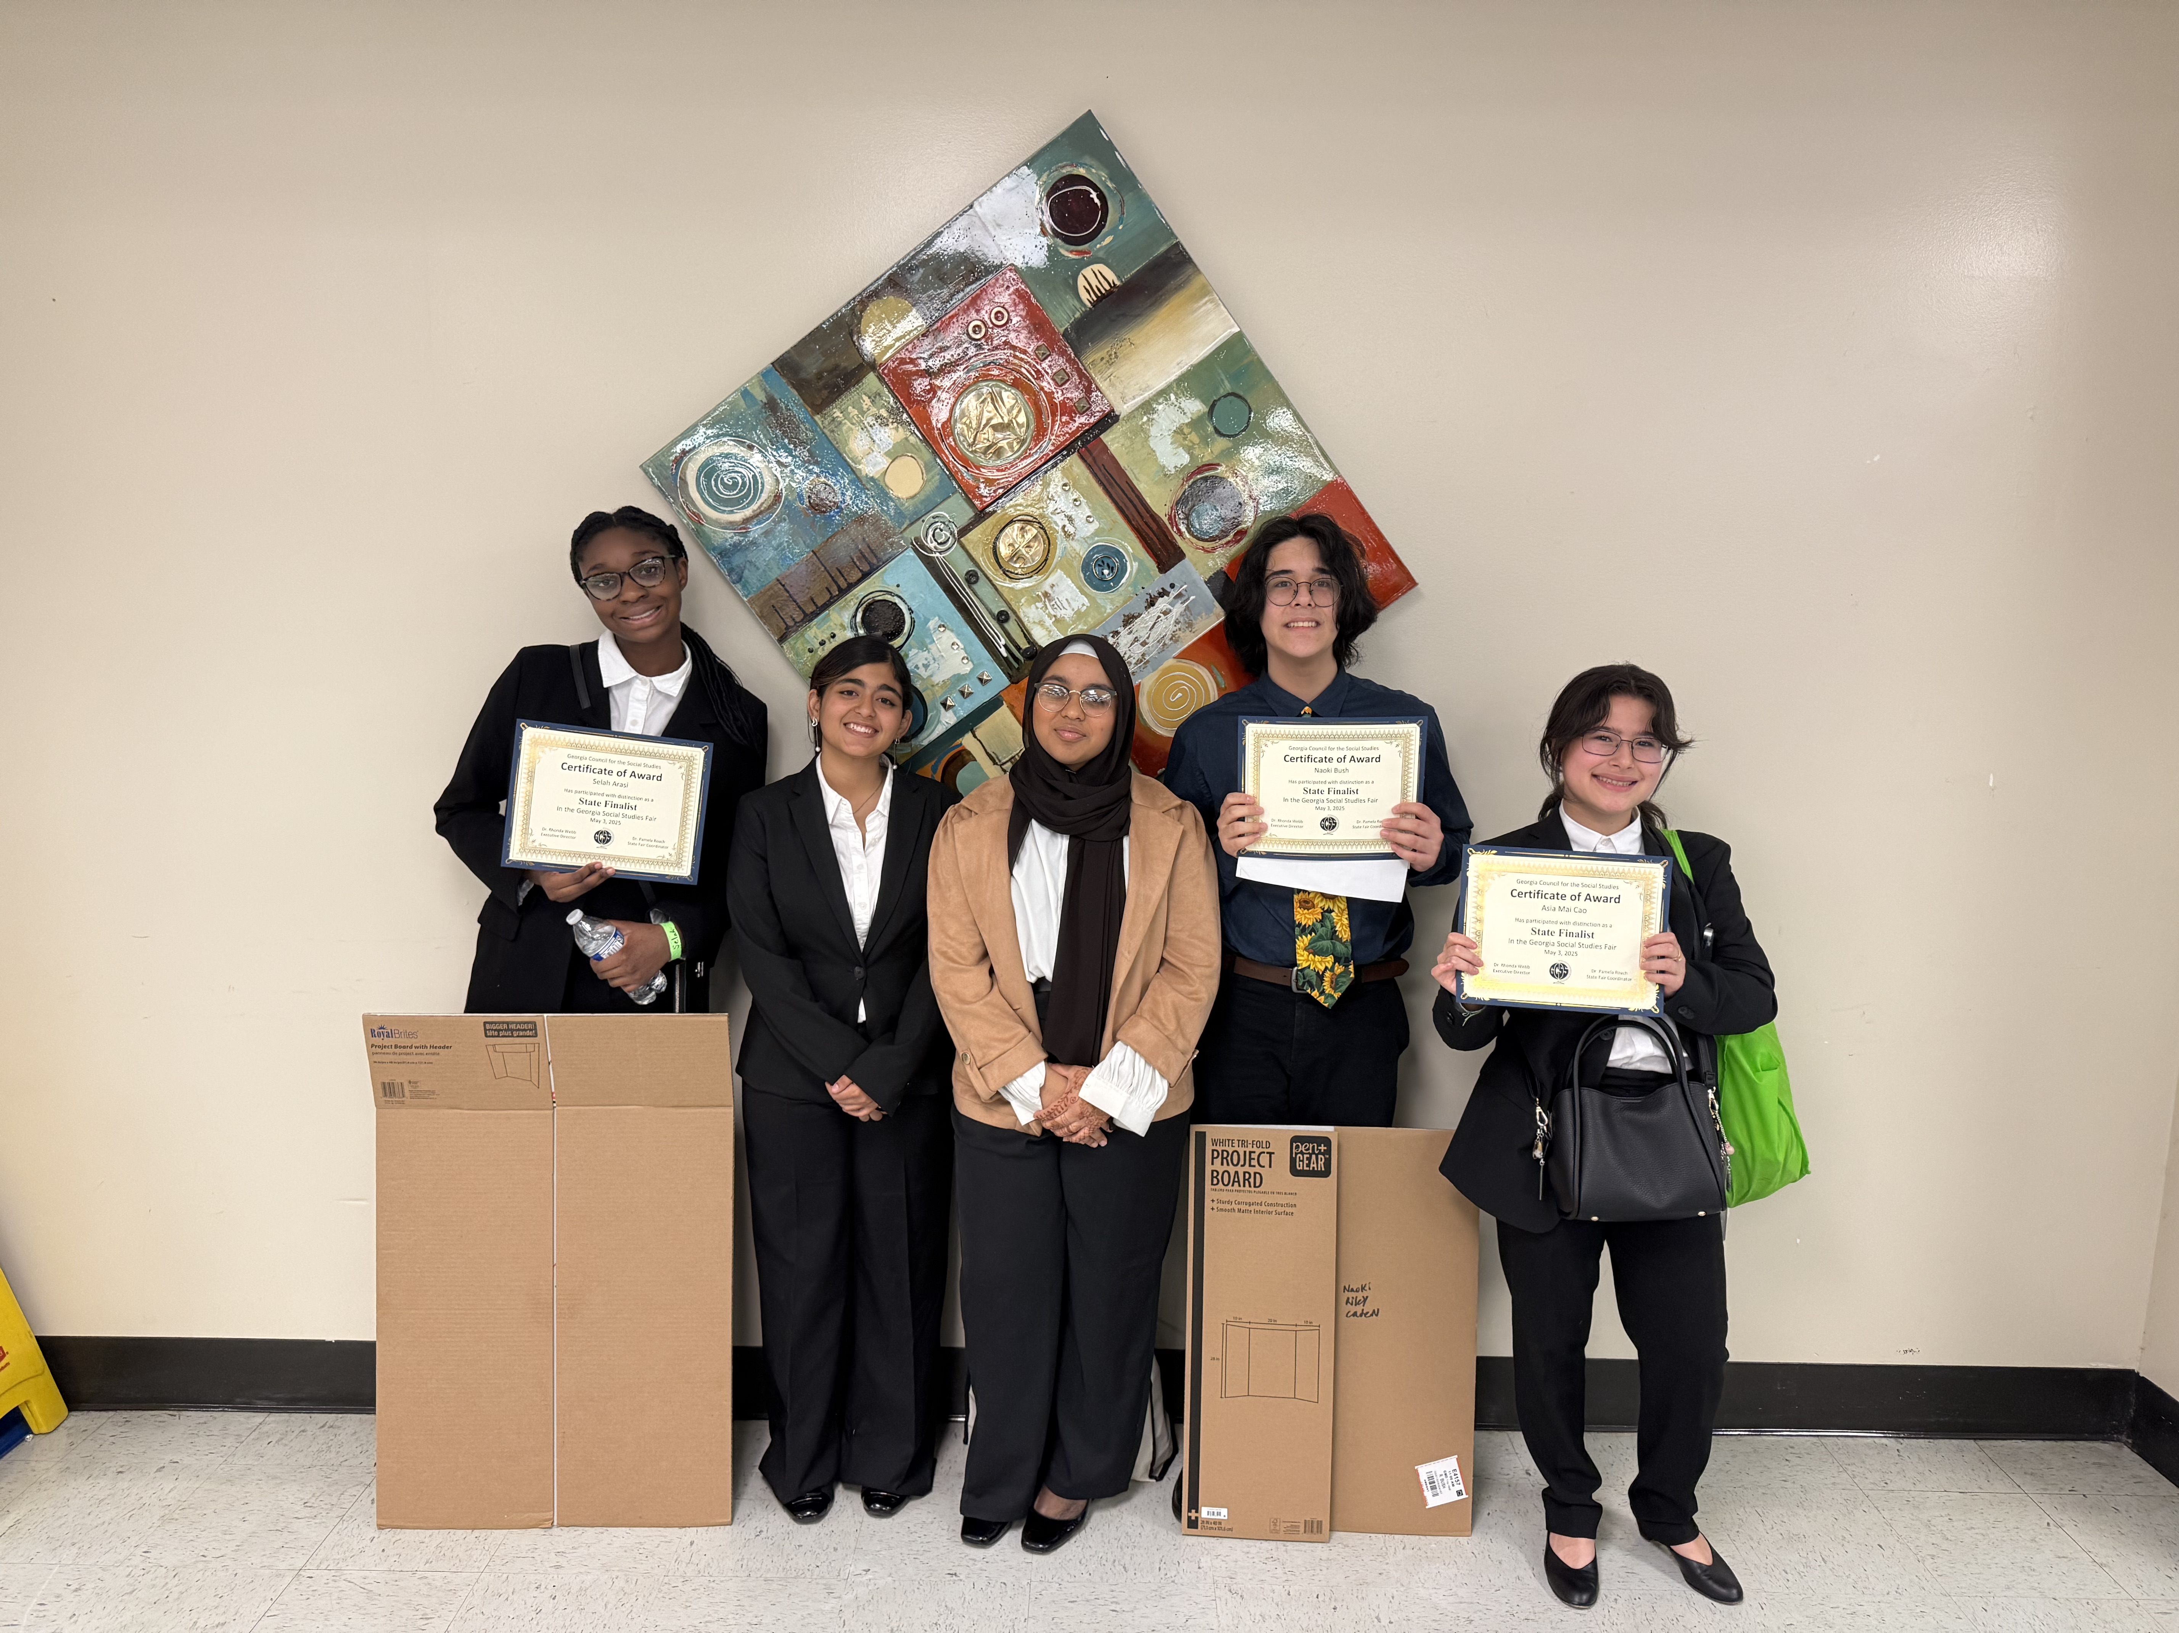
Capstone Projects
Fall Semester Projects
  Community Issues Podcast
  Social Studies Fair Research
Spring Semester Projects
  March Madness Debate Series
  Daniell Court

Slide 13
Daniell Academies
  Thanks for watching
  On Thursday you will have the opportunity to visit the theater to ask the current Academy students and teachers questions about the academies.

