Slide 1



Back-to-School
Information

Slide 2
Back-to-School Information
ARRIVAL
CLASSROOMS
LUNCH
BUSSES
LOCKERS
LEARNING COMMONS
DISMISSAL
CLUBS
INTRAMURALS
HELP SESSIONS
FIELD TRIPS/ASSEMBLIES
HALLWAYS/TRANSITIONS
HELPFUL LINKS
CCSD Website
PMMS Website

Slide 3
Helpful Links
DISCIPLINE POLICIES
Click our link to learn more about CCSD’s discipline policies.
CLIMB BEHAVIOR EXPECTATIONS
Click our link to learn more about PMMS’s Positive Behavior System.
PMMS FAMILY HANDBOOK
Click our link to learn more about PMMS’s school policies.
HOME

Slide 4
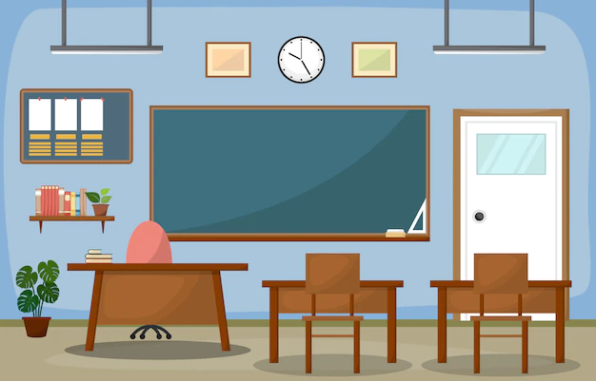
Help Sessions
Help sessions will be offered throughout the year. Help sessions are provided before school. Teachers will announce the days and times that they will be offered, and the information will be posted on the website for your convenience.
HOME

Slide 5
Clubs
Club meetings and before/after school activities will be available for students to participate throughout the school year.
Opportunities to join and meeting reminders will be shared during announcements and on our website.
HOME

Slide 6
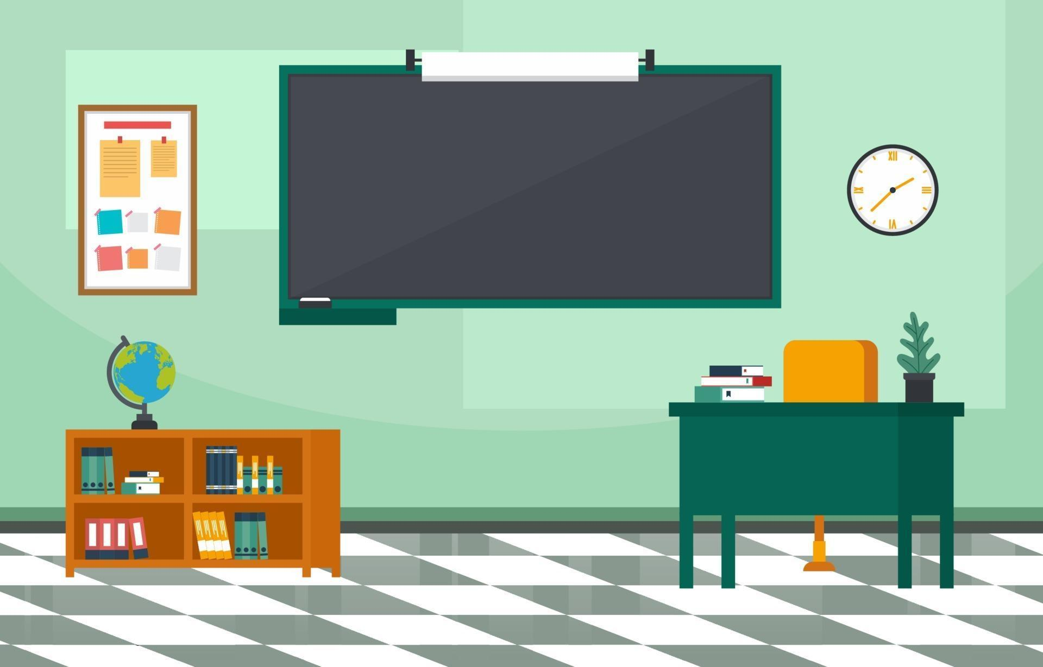
Intramurals
Intramurals occur before school between 8:15 until 8:45 in the main gym and will begin on September 2. Basketball will be first, then football, and finally soccer. They will run through April 30, 2026.
HOME

Slide 7
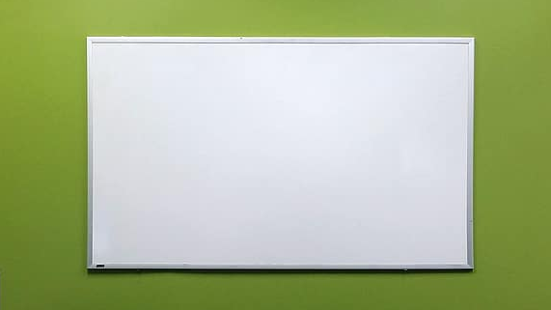

Field Trips/Assemblies
Field trips and student assemblies may occur during the year. From mining for gems to touring the Mercedes-Benz Stadium, teachers may enhance a lesson being learned by either taking students off campus or bringing an experience to them. There is usually a fee to attend field trips to help cover costs.
Assemblies may also occur. From guest speakers to performing arts concerts, assemblies will be another part of a student's learning experience.
HOME

Slide 8
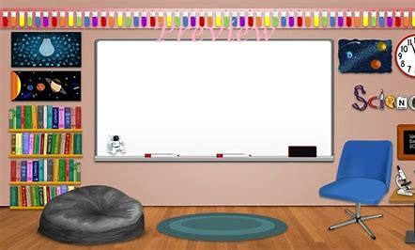
Learning Commons
The Learning Commons is available for student and teacher use throughout the school day and is open before school.
Students will also have an opportunity to participate in the Mustang Media Program which creates the schoolwide news broadcast.
HOME

Slide 9


Bus Information
For students who ride the bus, the same school rules still apply. Buses load and unload at the bus port area. Click here for more information about bus routes, and bus numbers.
Throughout the first week of school, staff will work with students to help ensure they know exactly what bus to ride.
HOME

Slide 10

Dismissal
Students will be dismissed at 4:15 pm each day. Please be aware that car rider lines are long. So, please be patient if you pick up your child. For safety reasons, car riders will only be able to be picked up from the front porch of the school. Be sure to download the Here Comes the Bus app to always know where your student's bus is located.
Bus Tracking App
Bus Number Information
HOME

Slide 11
Lunch
Students will attend lunch with their 3rd-period or 4th-period class.
Students will be assigned a seat at the lunch table during lunch. Food delivery services are not allowed. Don’t forget, at the middle level, families cannot eat lunch with students in the cafeteria.
Family Meal Application
Meal Prices
HOME

Slide 12

Hallways/Transitions
Each grade level is color coded. Each grade level has their own area. Students are considered "out of area" if they go into another grade level area without permission. Hall passes are used if a student needs to be in a hallway during instructional time. Students will follow a one-way flow of traffic within hallways and grade level commons. Each grade level has their own restroom.
HOME

Slide 13

Classroom Time
Each teacher will use CTLS to announce, share, and communicate with families and students about instructional and curricular information.
All students have an opportunity to receive a student laptop for school use as well. Sixth graders and new students will be able to receive laptops during Sneak-A-Peek (August 1) if guardians have opted in through ParentVue.
Students will not be called out of class to receive phone calls, meet visitors, or receive announcements. Classroom behavior expectations will also be communicated by each teacher.
HOME

Slide 14

Arrival
School starts at 9:15. Students arriving between 8:50 and 9:15 will report to homeroom. Students arriving between 8:30 –8:50 will go to the cafeteria for morning study hall.
Students should not be dropped off before 8:30. Supervision of students will begin at 8:30. All students entering the school will come in through the doors at the front porch. Breakfast will be served in the cafeteria from 8:50 – 9:10.
Breakfast prices
ARRIVAL 2

Slide 15

Arrival
Students arriving with musical instruments will report to their homeroom teacher to notify them that they are going to the music department to store their instruments.
HOME

Slide 16

Lockers
Students will be assigned a locker. Don't worry about needing to purchase a combination lock, as all lockers are equipped with a built-in lock for students. Students will receive their lockers at the start of the school year after returning their clinic cards.
Lockers will be used in the morning, before lunch, after lunch, and at the end of the school day. This allows students not to have to carry their lunch boxes or coats with them all day.
Students need to return their signed and completed clinic card to their last academic teacher of the day to receive their locker. Clinic cards will be distributed during Sneak-A-Peek or on the first day of school.
Cell phones will be kept in lockers all day and should be turned off. This reduces classroom distractions and the grade-level learning commons caused by alerts from incoming text messages and telephone calls.
HOME

Slide 17
Supply Lists
Curious about what supplies you will need to kick off the new year on a good foot? Look no further. Click below to see our grade level supply list. Don't worry about arriving on the first day with everything on the lists. The most important items to have with you on the first day of school is some paper and a pencil.
Supply Lists by Grade Level
HOME

Slide 18
Contact Us!
If you have a question concerning this coming school year, contact our Admin Team using the information below:
David Nelson, Principal
Allison Paulk, Assistant Principal
Carrie O’Connor, Assistant Principal
HOME

