Slide 1


Slide 2







Slide 3

What are pathways?
Allied Health & Medicine
Artificial Intelligence
Automotive
Aviation Maintenance
Carpentry
Clinical Lab
Cloud Computing
Cybersecurity
Electrical
EMR/EMT
Energy & Power
Flight Operations
Game Design
Heavy Equipment Operator
HVAC
Industrial Maintenance
Manufacturing
Masonry
Mechatronics
Networking
Patient Care
Pharmacy
Phlebotomy
Plumbing
Surgical Technology
Unmanned Aircraft Systems
Welding
Pathways that are listed in red will be offered at CITA at Allatoona.
Pathways that are listed in black will be offered at CITA at Osborne.

Slide 4

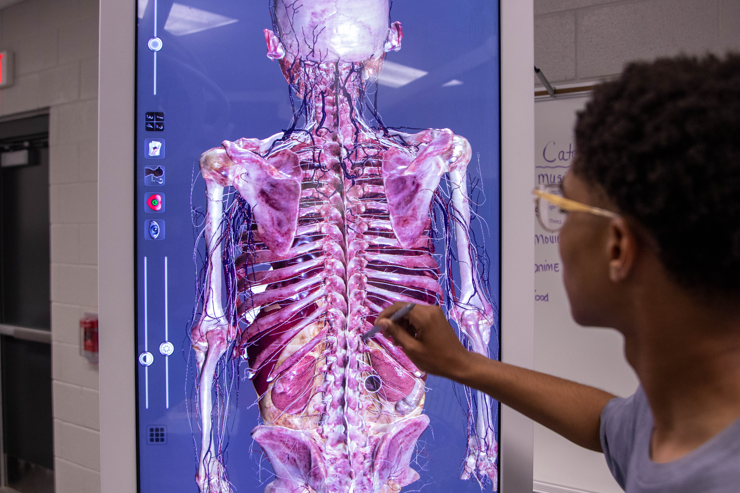
Why CITA?
Tuition Free
Industry Recognized Credentials
Dual Enrollment
Receive On-The-Job Training
Post-Secondary Options
  4 Year College
  2 Year/Tech College
  Workforce
  Military

Slide 5

Minimum Wage: $15,080
Pharmacy Tech: $41,300
Auto Mechanic: $48,859
Machinist: $52,500
Welder: $52,640
Surgical Tech: $62,250
Cyber Security: $66,450
Lineman $71,469
Avionics Technician: $79,061
Where do you see yourself in four years?

Slide 6

What could a CITA experience look like?
Mock Interviews CTSO Post-secondary visits | CTAE Pathway Completion Credential Attainment *Dual Enrollment
9th and 10th Grade
11th and 12th Grade
Work-Based Learning Dual Enrollment/ Cobb Virtual Flexible Scheduling | CTSO Post-Secondary Planning Technical Certificate of Credit Completion & Graduation
* Students at CITA can take AP, Honors, and on-level academic coursework.

Slide 7

How do you apply to CITA?
The application to attend CITA is on the magnet application website
The application has the following sections:
  Applicant Information
  Educational History
  Personal Statement

Slide 8
Transportation
Provided by CCSD
Within a 5-mile radius
Enter your address on the bus finder website this summer

Slide 9

Important Dates
Middle School Q & A Sessions
Application Opens
Open House (CITA at Osborne)
Open House (CITA at Allatoona)
Application Deadline
Magnet & CITA Decisions
Accepted Student Showcase (CITA at Osborne)
Accepted Student Showcase (CITA at Allatoona)
Student Decisions Due
August- November
October 1, 2026
September 30, 2026
October 1, 2026
December 1, 2026
January 29, 2027
February 2, 2027
February 3, 2027
February 26, 2027

Slide 10

https://web.cobbk12.org/cita
Follow us on X @cita_ccsd

