Slide 1



WELCOME CLASS OF 2026
FOLLOW US:
@Wheeler_High
@wheelerwildcats2026

Slide 2
Graduation & End of Year Info
Commencement Information Packet
Graduation Caps & Gowns – You must have a cap & gown to participate in graduation. Go to www.atlgrad.com to place your order.
Senior Final Exams –
May 11th – May 13th
Graduation Practices (mandatory) –
May 13th - 11:30 in PAC
May 18th – 8:20 am in Arena
Graduation –
May 19th – 7:30 PM KSU Convocation Center
ALL STUDENTS MUST ARRIVE BY 6PM

Slide 3

Graduation Contract
THIS CONTRACT MUST BE SIGNED AND RETURNED BY 4/30/26 TO THE COUNSELING OFFICE. STUDENTS WILL NOT BE CLEARED AND MAY NOT PARTICIPATE IN COMMENCEMENT WITHOUT A SIGNED CONTRACT.
EXTRA COPIES CAN BE PICKED UP IN THE COUSELING OFFICE

Slide 4
Graduation Contract (CONT)
The student will attend the mandatory commencement practices on May 13th (11:30 am) and May 18th (8:30 am) and will follow all rules and policies for the school activity.
All financial obligations must be cleared by May 18th, prior to graduation practice. This includes:
Return of textbooks, media center materials, CCSD-issued laptops, and school issued uniforms and fine arts equipment.
Payment for lost textbooks, parking fines, athletic and/or fine arts equipment and uniforms, as well as CCSD-issued technology.
This commencement is a formal ceremony and any disruptive behavior at the ceremony will result in the student being removed from the ceremony and will result in a delay of the receipt of the student’s diploma.
A student may be denied the opportunity to participate in the ceremony if he/she is involved in any serious discipline event during the remainder of the 2026 school year.
Students will be expected to follow the dress guidelines and all Cobb County School District policies. Any student improperly dressed for the ceremony will not be allowed to participate in the ceremony.

Slide 5
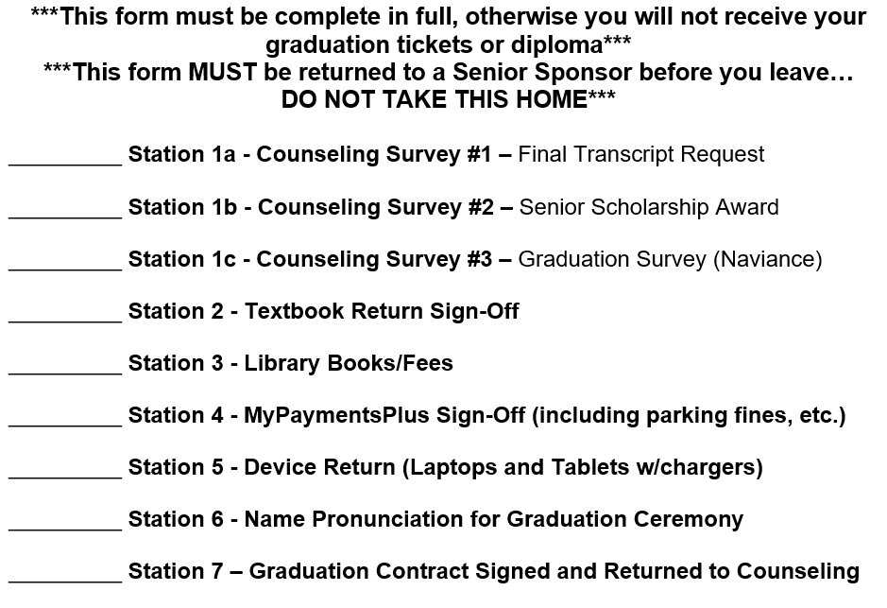
Senior Clearance

Slide 6
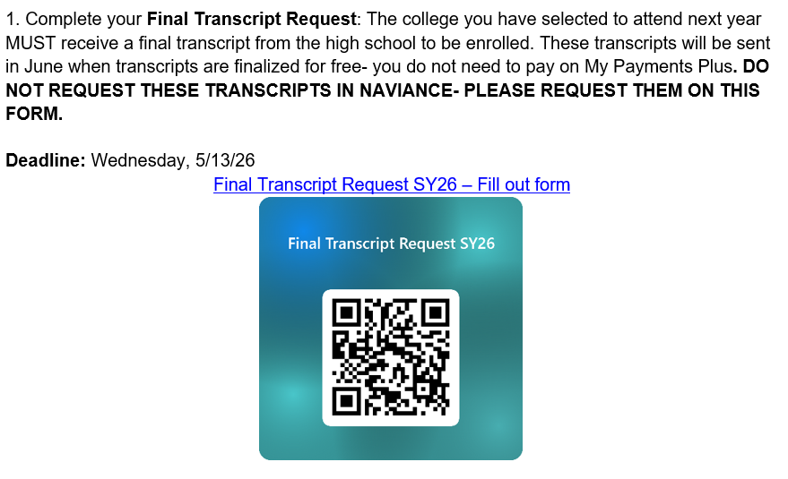
Senior Clearance – Counseling Survey 1

Slide 7
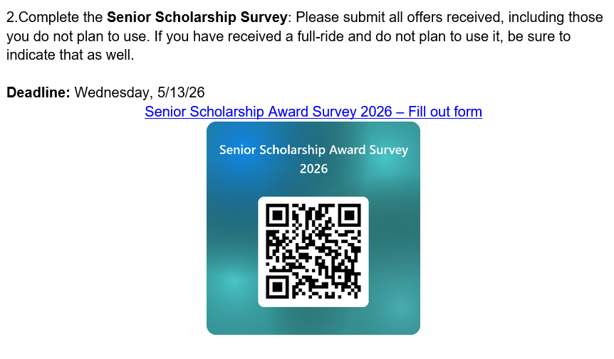
Senior Clearance – Counseling Survey 2

Slide 8
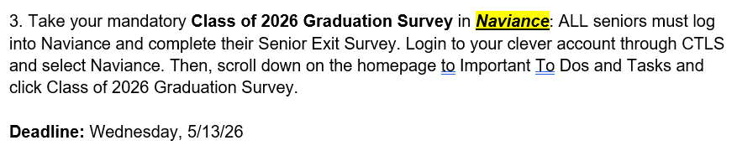
Senior Clearance – Counseling Survey 3

Slide 9
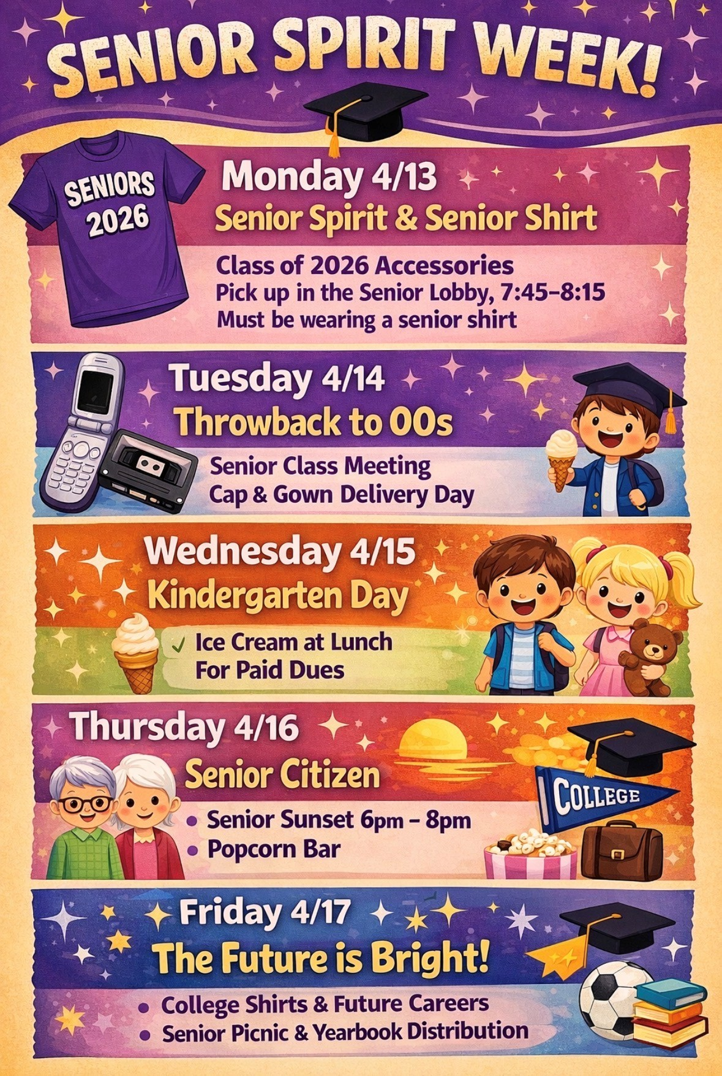
Senior Week: April 13th – 17th
Last Day to pay Senior Dues is Wednesday, April 15th by 11pm
Events
Monday 4/13 – Co2026 Accessories
Tuesday 4/14 – Senior Meeting/Cap & Gowns
Wednesday 4/15 – Ice Cream during lunch
Thursday 4/16 – Senior Sunset w/Popcorn Bar
Friday 4/17 – Senior Picnic

Slide 10
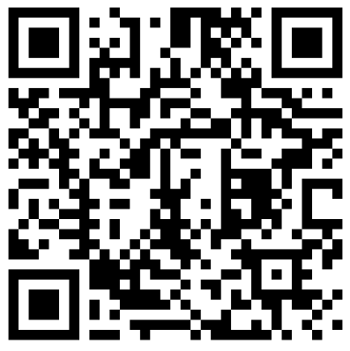
Senior Picnic & Survey
Senior Picnic: Friday, April 17th
Report to the PAC at the start of 3rd block
Yearbook distribution day
Lunch provided
King of Pops will be here for seniors who have paid their dues
COMPLETE THE SURVEY USING THE QR CODE

Slide 11

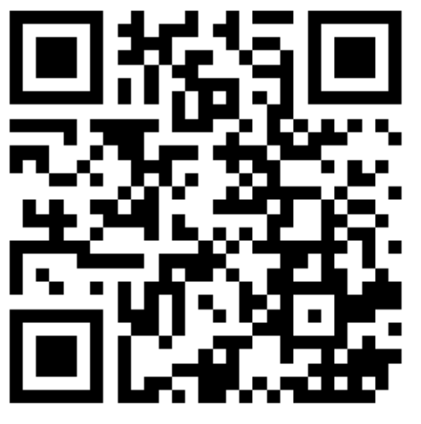

Slide 12
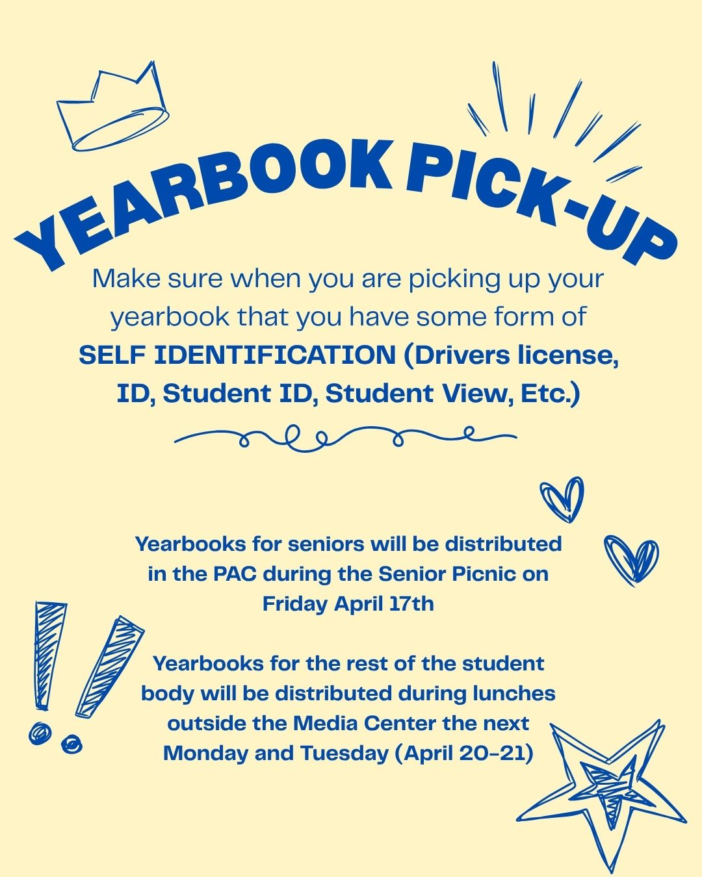
You have to present ID!!!
Show ID
If you don't pick your book up you will need to pick it up Monday or Tuesday.
You can't pick up a book for another person.
You will sign off that you received your book in good condition
Once you write in it – it's your book. No exchanges or refund.

Slide 13
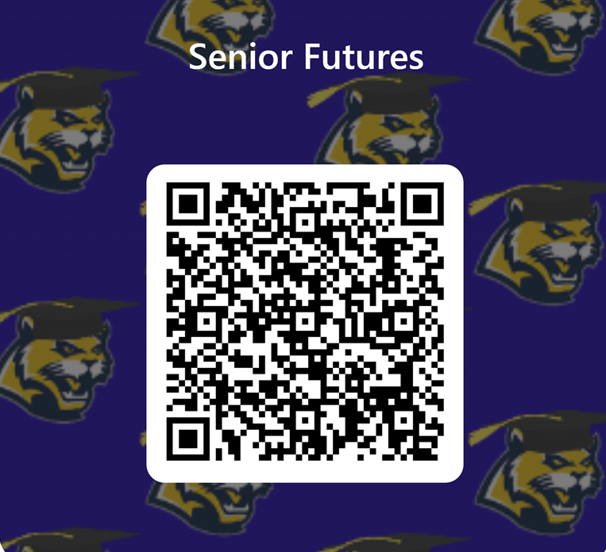
What are you doing after college?
This will be included with your name and picture (formal).
You get one shot at this

