Slide 1



WELCOME CLASS OF 2026
FOLLOW US:
@Wheeler_High

Slide 2
WHS Administration
Dr. Sara Fetterman
Principal
Ms. Marranda Edwards
(A – C)
Ms. Ann
Nemeck
(D – G)
Dr. Megan Ostrowski Ndongi
(H – K)
Dr. Amanda Shaw
(L – Q)
Ms. Tanya Robson
(R – S)
Mr. Barry Bowdre
Athletic Director
(T – Z)
Mr. Christopher Walstead
Magnet
Mr. Scott Greb
Support Services Administrator

Slide 3
Wheeler School Counseling Department
10th – 12th (including repeat 9th) Grade students with last names:
        A – Co Jackie Edwards
        Com – He Stephanie Johnson
        Hi – Me Jari Christmas
        Mi – Sa Holly Nelson
        Sc – Z Kristie Richardson
All 1st time 9th Graders: Patrick Wright
Enrollment and Records: Cory Neill
Counseling Clerk: Susan Acedo
Registrar: Megan Fanoe

Slide 4
When you get to Wheeler in the morning…
All students are to report to the café upon arrival and will be released at 8:00am. No wandering the campus.
Car riders are dropped off in front of the PAC.
If you arrive after 8:30am, you may be dropped off in front of Admin I since the PAC doors will be locked.

Slide 5
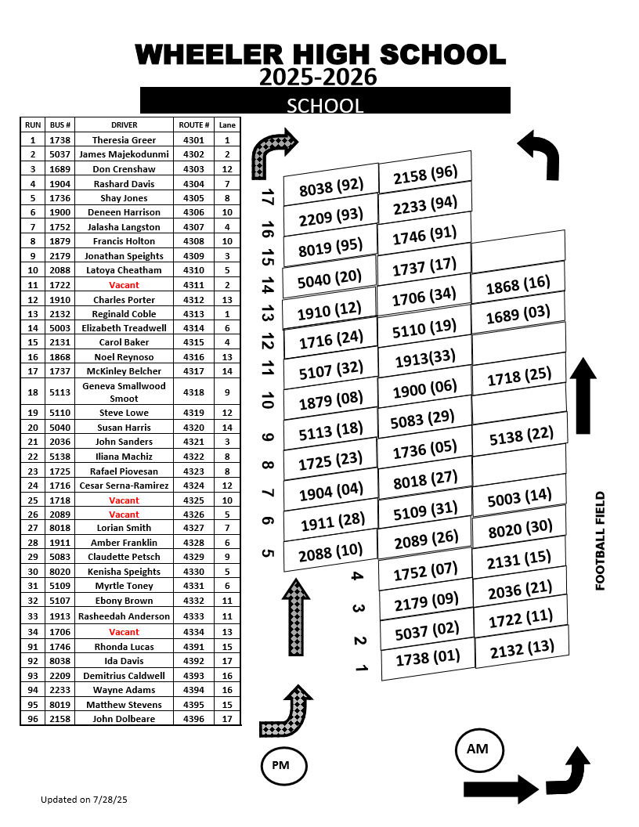
YOUR BUS LANE NEVER CHANGES!!!
When you leave Wheeler in the afternoon…

Slide 6

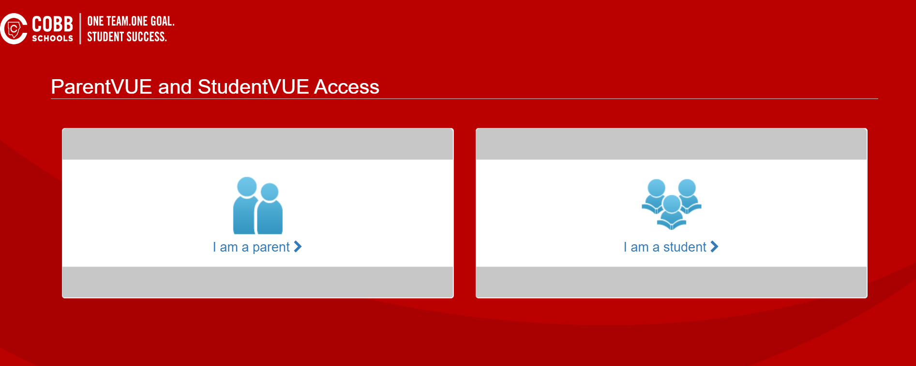
StudentVue
Issues? Ms. Davila

Slide 7
Cobb County School District
Laptop Reminders
Charge your CCSD laptop every night and leave the charger at home.
If you have an issue with your CCSD laptop, visit the media center for help before school or ask for a pass from your teacher to visit the library.
Always use the case while transporting the laptop.
CCSD policies for damaged laptops have changed.
YOU are responsible for the CCSD laptop checked out to you.

Slide 8

Visitors/Deliveries
Students ARE NOT ALLOWED to have visitors to campus
Food Deliveries ARE NOT ALLOWED on campus
Students ARE NOT ALLOWED to leave for lunch
  Any student leaving campus without permission is subject to disciplinary action.

Slide 9
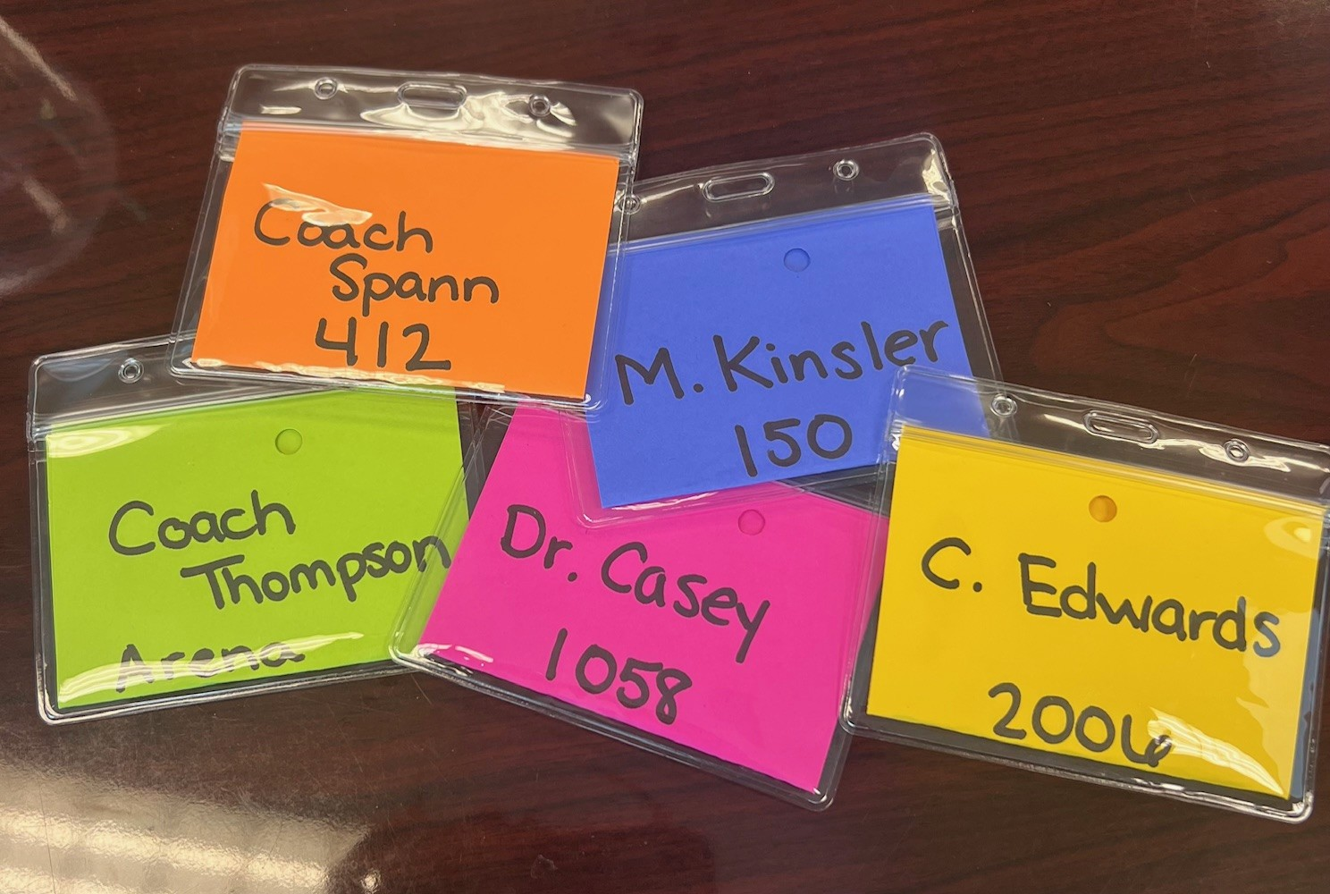
Hallway Passes/ Expectations
2000's- Yellow
400's, 500's, Fine Arts- Orange
(Science Building)
100's , 200's - Purple
(Classic Building)
1000’s, Art, Transition hall - Pink
Arena- Green
Pass must match the restroom color – if not, you are out of area

Slide 10
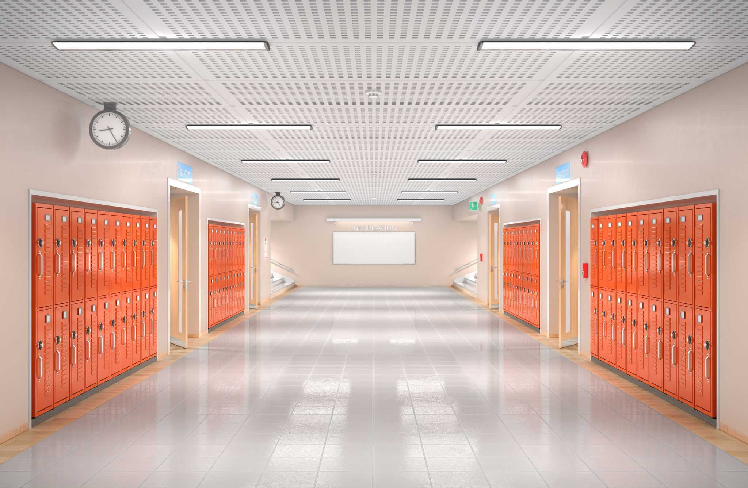
Hallway Passes/ Expectations
First 10, Last 10
No passes during instructional time; emergencies only
Hall pass is only used for the restroom & vending machines; Students you will need a written BLUE PASS for any other location.
Emergencies only during 3rd block; Students should use restroom during lunch or during transition
ALL STUDENTS WILL REPORT TO 3rd PERIOD BEFORE REPORTING TO LUNCH

Slide 11

Checking IN/OUT
All students who arrive late to school MUST check in at the attendance office.
  Unexcused tardies to school will be subject to disciplinary action based on tardy policy.
    6TH Tardy - WARNING
    9th Tardy – 1 DAY ISS
    12th Tardy – 2 DAYS ISS
    15TH Tardy – 3 DAYS ISS
    18TH + Tardy – 5 DAYS ISS
Students can be checked out by the enrolling adult and/or those individuals listed in ParentVue.
Students cannot just leave campus. they MUST be checked out or will be subject to disciplinary action.

Slide 12

LAS Machine Locations café vending
200 Hallway
400 Hallway
Attendance
2000 Hallway
In danger of being tardy?

Slide 13
Loss of Privileges
Any vaping offense = can’t attend athletic events or school events for remainder of school year
ISS or OSS = No attendance during those suspension days
10 days OSS or more = can’t attend athletic events or school events for remainder of school year
15th Tardy = lose parking for remainder of the semester
(no refunds)

Slide 14

TARDY CHALLENGE
Monday through Thursday next week!!
All students that are PRESENT and NO TARDIES will receive a freeze pop on Friday!

Slide 15
Cell phones
The limited use of personal electronic devices (PED’s) is permitted under the following guidelines between 8:20am – 3:30pm each school day:
  PED’s must be turned off at the start of each class period;
  PED’s must remain in bags or purses for the duration of each class period;
  PED’s are allowed in the cafeteria during lunch;
  PED’s are allowed in the hallways during class change;
  Students should not post to any social media outlet during the school day.
  PED’s may NOT be used to record fights or any other conduct which breaks school rules; students who use their PED’s in such a manner will be subject to discipline.
Failure to follow the guidelines above will result in an immediate discipline referral.

Slide 16
Student code of conduct
All discipline will be handled consistently and fairly.
Major offenses such as fighting, drugs, alcohol, and weapons will be an automatic 10-day OSS suspension
The second offense for the above violations is an automatic discipline hearing for alternative placement
Fighting, drugs, alcohol, and weapons are cumulative for grades 8 – 12th.

Slide 17


Slide 18
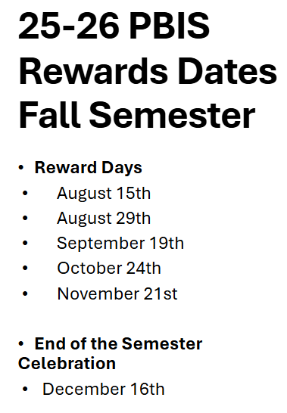


Slide 19

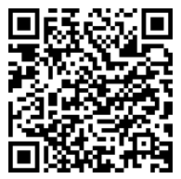

Slide 20
BACK END – FENCE AREA
Row 301-310
Faculty - Mobile Carts/Wagons. NO student parking.
Row 300 - 243 Seniors & Juniors
Row 204 - 244A Seniors & Juniors
Row 203 - 158A Seniors & Juniors
EXIT
Row 105-111
Teacher Parking. NO student parking
Row 114 - 60 Seniors & Juniors
Row 104 - 57 Seniors & Juniors: Dual Enrollment/Interns/Work -Based
Row 1 - 55 Seniors & Juniors: Dual Enrollment/Interns/Work -Based
MAIN ENTRANCE
ENTER
PAC BUILDING
WHEELER STADIUM

Slide 21

$40 - seniors
Class Dues get you a class shirt and various treats and activities throughout the year. Make sure to follow your class on Instagram!
@WheelerWildcats2026

Slide 22

Student government association
45 open spots per grade level.
Applications will be available in mid to late August. Watch wildcat morning news and Instagram for dates and timelines.
To be eligible - No OSS or ISS discipline for the last two years.
Meets once per month in the morning
Plans events like homecoming, homecoming parade, Shop with a Wildcat, Winterfest games, Winterfest court, and International Night.

Slide 23

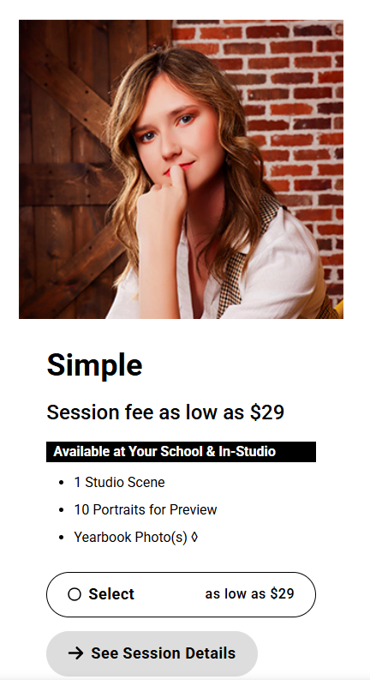
Senior Pictures
Last Day to be Pictured
November 1, 2025

Slide 24

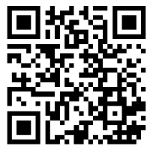
Yearbook

Slide 25

Senior Events
FALL
Monthly Treats
Cap Decorating
Homecoming
SPRING
Monthly Treats
Cap & Gown Pick Up
Senior Week: April 13-17, 2026
Senior Sunset: Tuesday, April 14th, 2026

Slide 26

Make it a great year, wildcats!

