Slide 1
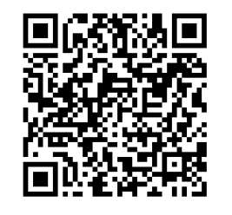
Please take this opportunity to complete the cognia parent survey

Slide 2
Class of 2028 Freshman Class Information
Educate, Inspire, Empower

Slide 3
High School Graduation Requirements
Area of Study | Total Units Required
English/Language Arts | 4 – Must include 9th Lit and American Lit
Mathematics | 4 – Must include Algebra, Geometry, Advanced Algebra and a 4th year of math
Science | 4 – Must include: Physical Science or Physics, Biology, Chemistry or Environmental Science, and a 4th year of science
Social Studies | 3 – Must include Gov/Econ, US History, World History
CTAE and/or Fine Arts and/or World Language | 3
Health and Personal Fitness | 1 – 0.5 of Health and 0.5 of Personal Fitness
Electives | 4
TOTAL Required (minimum) | 23

Slide 4
Promotion Requirements
Each class passed in a semester earns ½ unit of credit.
10th Grade Promotion Requirements:
5 Total Units (1 full math; 1 full science; 1 full English/Lang Arts)
11th Grade Promotion Requirements:
10 Total Units (2 full math; 2 full science; 2 full English/Lang Arts)
12th Grade Promotion Requirements:
16 Total Units

Slide 5
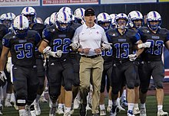
Sport Eligibility
9th grade
Fall sports = automatically eligible
Spring sports = must earn 2.5 credits fall semester
10th grade = must have 5 total credits
11th grade = must have 11 total credits
12th grade = must have 17 total credits

Slide 6
Progress Reports
Fall Semester
Spring Semester
September 18th – in ParentVue
November 6th – in ParentVue
December 20th – in ParentVue
**Posted to transcript
Feb 19th – in ParentVue
April 9th – in ParentVue
May 23rd – in ParentVue AND mailed home
**Posted to transcript

Slide 7
9th Grade – Class Schedules
For second semester
Drop/Add in October
Teachers recommend core classes
Cannot change yearlong electives
Chorus, band, and orchestra are yearlong
Elective registration takes place on 10/18
Waiver Deadline is Nov 1st
*All new schedule in January!
For sophomore year
March
9th Grade Advisement
Waiver deadline is Apr 1st
Course selections are binding; summer changes cannot be accommodated

Slide 8
What should your teenager do if they need help?
Spend approximately one and half hours on homework and study each evening
Review class notes
Re-read or read ahead
Form a study group with classmates
Do all makeup work
Seek extra help/tutoring from the teacher
Peer tutoring with Honor Society students
Walton policy – no extra credit/no re-tests

Slide 9
What should I do as a parent or guardian?
Monitor student studying and homework
Provide a time and place away from distractions for student to study and complete homework
Email the teacher
Teacher directory on Walton website
Contact the counselor
Arrange parent/teacher conference
Family support
Crisis

Slide 10
Walton Website>> Students>> Student tutoring program
Academic tutoring

Slide 11
Academic Incentive for Final Exams
Final exams are scheduled 12/17 (Tu) – 12/20 (F) with zero period final exam on 12/16.
Students who have an A prior to the final exam, regardless of absences, may exempt their final exam for that class. Students may exempt a maximum of 2 exams per semester.
Restrictions fall semester – cannot exempt EOC courses (Algebra and Biology) or AP courses (AP Human Geography and/or STEM APES)

Slide 12
9th
Grade​ELA ​

Slide 13
Honor Code
Academic integrity is expected on ALL assignments
Do your own work unless told to work together
Turn It In – plagiarism software
Use of Artificial Intelligence (AI)
Minor infraction = copying homework/classwork
Zero on assignment
N in conduct
Major infraction = 2nd minor or any other violation (assessment, essay, project, etc.)
Zero on assignment
U in conduct
Loss of final exam exemption

Slide 14
9th Grade Math
Many course options for 9th grade math
Enhanced Honors Geometry, Honors Geometry, Geometry, Honors Algebra, Algebra, Support, Foundations
Different category weights; see course syllabus on CTLS
80% - 90% of course grade is based on items graded for accuracy
No assessment re-takes
Homework expectation
Calculator usage
All math teachers are available for extra help before/after school and during WEBs. See the course syllabus for posted times. Students can see other teachers who teach their course.
Online resources via CTLS

Slide 15
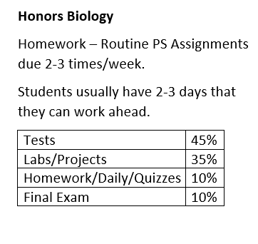
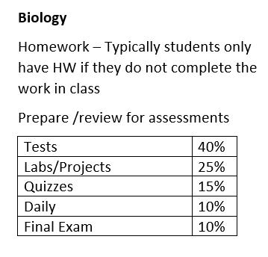
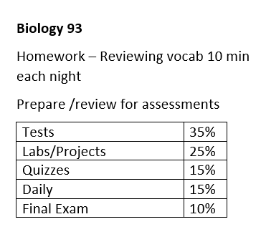
9th Grade Science
3 levels of 9th grade Bio – Honors Biology, Biology, Biology 93

Slide 16
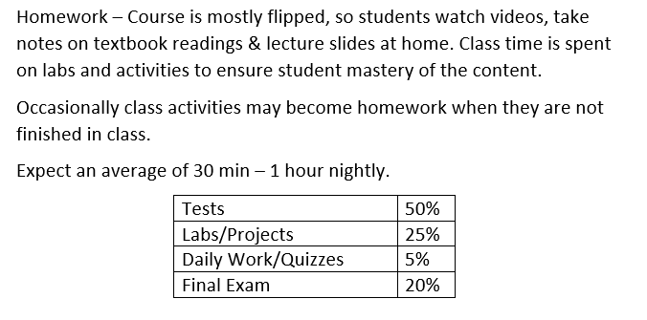
9th Grade Science
STEM AP Environmental Science

Slide 17
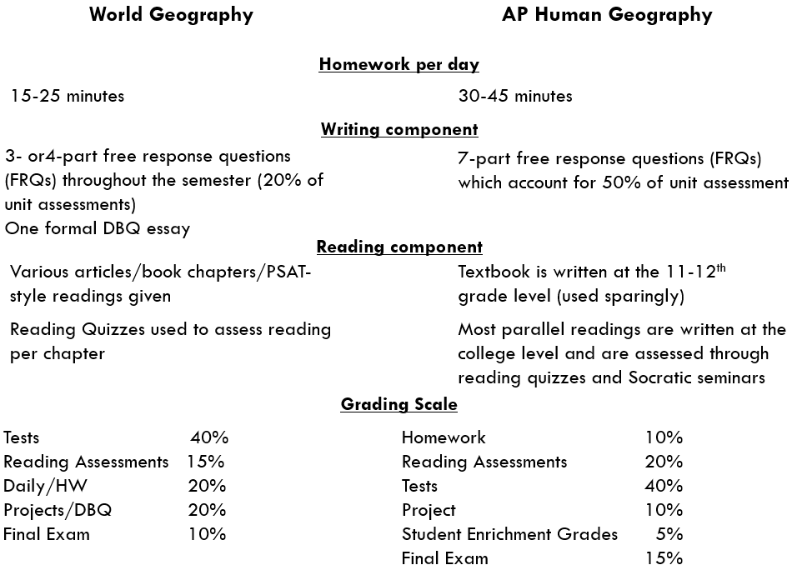
9th Grade Social Studies

Slide 18
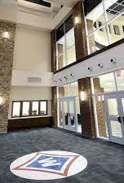
High School Curriculum
Students register for next year’s courses in the spring
Classroom teacher will make recommendations for academic course placement
Honors and AP level courses focus on application and critical reading
Colleges ALWAYS favor higher level courses
Students/parents may choose to waive up or down one level
Reach for the maximum level of coursework that is APPROPRIATE based on teacher recommendation, student ability, student motivation, and extracurricular commitments
BALANCE!

Slide 19
9th Grade Advisement
Spring semester
Students and parents attend small group presentation
Individual 1:1 meeting with a counselor
Utilize Naviance to create a four year “road map” for high school
Review academic placement, select electives, sign waivers

Slide 20
PSAT – October 9th
9th grade PSAT
Cost is covered by Walton High School
Any 9th grade student in attendance on 10/9 will sit for the PSAT.
Great experience sitting for a high-stakes standardized test
Baseline for future planning
PSAT scores can be linked to Khan Academy for individualized practice

Slide 21
College Applications – What to do now?
Focus on coursework
Naviance
GPA - transcript
PSAT as prep for SAT

Slide 22
Walton Grade Point Average (GPA)
GPA determined by grades earned and quality points
A = 4 B = 3 C = 2 D = 1 F=0
Average
Honors classes earn extra .5 quality point
B in Honors Biology = 3.5
A in Honors 9th Lit = 4.5
AP courses and World Languages 4 and higher earn extra 1.0 quality point
A in AP Human Geography = 5
C in AP Human Geography = 3
Walton Honors Graduate = cumulative 3.5 weighted GPA

Slide 23
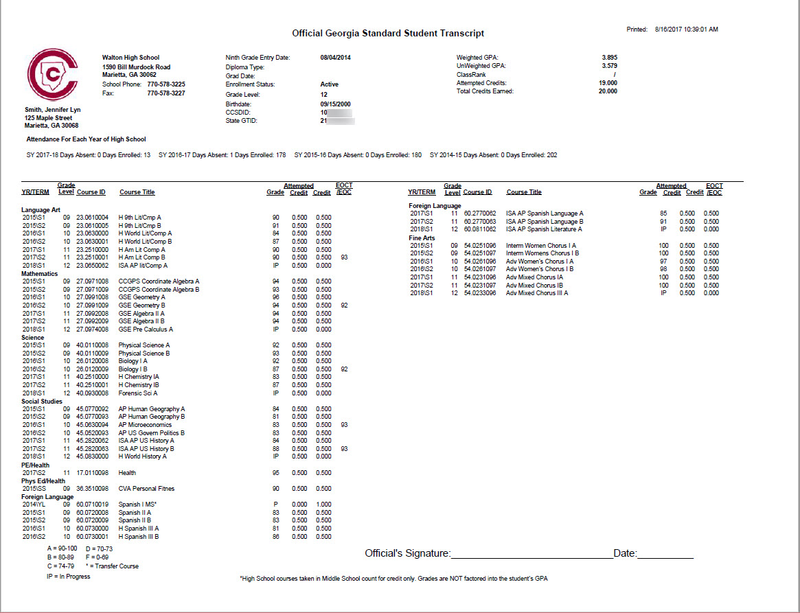
WGPA=3.895
Unweighted GPA = 3.579
HOPE GPA = 3.583

Slide 24
HOPE Scholarship
GPA = only core classes
All English/Language Arts
All Math
All Science
All Social Studies
All World Languages & Latin
All electives taken in core areas
0.5 for AP and dual enrollment courses; no weight for honors
Course rigor requirements
www.gafutures.org

Slide 25
Naviance and service hours
Naviance is a delivery system and college/career search engine used throughout the year for various activities
To access Naviance, go to www.waltonhigh.org and click the diploma icon in the top right-hand corner and then use Office 365 credentials to login.
Service Hours
NOT required for graduation but students receive a service cord if they earn 180 hours
All service hours must be logged through MobileServe (directions on school counseling website)
Service hours must be logged the same year they are received. Hours for 9th graders began on 8/1 and 5/15 is the deadline for submissions this school year.

Slide 26
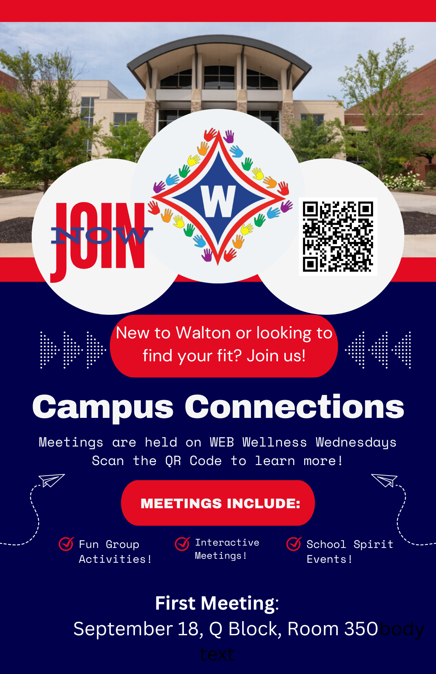

Slide 28
Stay informed
Walton website: www.waltonhigh.org
Counseling website: www.waltonhighcounseling.com
ParentVue – review your settings!
Principal CTLS emails
PTSA eblasts
Walton Foundation 411
Social media

Slide 29
But for now…enjoy the ride!

