Slide 1
Welcome Allatoona families Dual Enrollment Information Night
Please mute your microphones!

Slide 2
Purpose of Dual Enrollment
EARN COLLEGE CREDIT WHILE STILL IN HIGH SCHOOL
Students can take specific college classes and receive both high school and college credit simultaneously.
---------------------------------------
High achieving 10th graders
10th grade students with a SAT score of 1200 or an ACT score of 26 prior to the term may enroll.
11th and 12th graders
Eligible 11th & 12th grade students may take any approved dual enrollment courses at an eligible participating postsecondary institution.
WHO IS ELIGIBLE?

Slide 3
Eligible courses?
Core Academic Areas (Includes English, math, science, social studies & World/Foreign Languages). Examples: ENGL 1101, POLS 1101,
PSYCH 1101, SOCI 1101, ECON 2106, MATH 1111, HIST 2112
Career, Technical And Agricultural Education (CTAE) courses aligned with the GADOE Career Pathways. Examples: Computer Science, Cyber Security, Welding, Auto, Communications, Criminal Justice, etc.
The Course Directory Is In The Dual Enrollment Section On GAFutures
Note: Course Categories Such As Fine Arts, Health And Physical Education Courses Are Not Eligible For Dual Enrollment Funding.

Slide 4
ELIGIBLE DUAL ENROLLMENT COURSES
Go To www.gafutures.org
HOPE and State
HOPE and State Aid Programs or Search “Dual Enrollment” at the top of the page.
State Scholarships
Scroll down to “State Scholarships and Grants”
DE Enrollment
You will be in the “Dual Enrollment” tab
Choose
Choose “Course Directory”
Choose
Then choose “Dual Enrollment Course Directory”
Select
Select the “Participating College” & “Category”
All approved DE courses have a High School Equivalent
NOTE:
Not all courses required for HS graduation are available through DE
Not all college courses are available through DE

Slide 5
Do DE classes transfer to other colleges?
The state has identified courses which will transfer between the University System of Georgia Colleges
Students can check the transferability of courses through GAtracs located at www.GAfutures.org
Students will need to verify transferability to private and out of state colleges with those schools.

Slide 6
Local DE Opportunities
Most Allatoona students attend :
---------------------------------------
Chattahoochee Technical College
Can take Core & CTAE classes
Kennesaw State University
Can take Core classes & Academic Electives

Slide 7
ENROLLMENT OPTIONS
Full-Time Student
A full time DE student takes at least 12 hours of credit at the college (4 classes at the college)
No classes are taken at the high school or through CVA or GAVS
MUCH easier to schedule – no conflicts with the high school classes
More challenging to get high school information and be involved with high school events
Part-Time Student
Students must take enough courses to total at least 4.0 units of HS credit each semester
Absences and tardies ARE NOT EXCUSED! You MUST factor in extra time for parking, walking to/from class, etc.
Schedules may conflict, despite your best efforts – you may need to adjust your schedule. MUST BE FLEXIBLE!
Your high school classes come first when it comes to scheduling.
7

Slide 8
EXTRACURRICULAR
PARTICIPATION
DE Students are still eligible to participate in high school sports, extracurricular activities, clubs, prom, graduation, etc.
It is the student’s responsibility to ensure extracurricular activities don’t interfere with college course requirements and/or attendance.
Professors are NOT required to give makeups or alternate assignments.
8

Slide 9
How Much does it Cost? What is covered?
Dual Enrollment is FREE to ALL eligible high school students
*Includes REQUIRED Books and Fees
*Students may incur expenses for course related fees and supplies required for a particular course or optional fee charged by the postsecondary institution. (sometimes tools and foreign language computer programs are not covered)
If the postsecondary institution provided the textbooks through a lending program, the student may be charged a lost or damaged book fee, up to $75 or the cost of the book , whichever is less, if the book is not returned in the required condition.
Funding up to 30 semester/45 quarter hours (about 10 college classes)
Does not count against HOPE Cap Hours
Student will still be eligible for undergraduate semester hours upon graduation from high school

Slide 10
Reached the Funding Cap?
Self-Pay Option:
The college will charge the student tuition, fees and books based on credit hours of enrollment not covered by Dual Enrollment funding.
Must complete the Self Pay Approval form provided by your counselor.
ALL classes will be posted to both your high school and college transcripts.
10

Slide 11
AWARDING CREDIT—HIGH SCHOOL TRANSCRIPT
The college sends a copy of the transcript to the high school using letter grades.
The high school converts the letter grades into a numerical grade to post to the CCSD transcript: A=95, B=85, C=76, D=72, F=69
The high school and college grading scales may not be the same.
Per CCSD policy, quality points are only added if the student has taken the highest level of a subject offered at the local school prior to taking the DE course.
Ex. Student took AP US History at the high school, then takes HIST 2111/2112 at the college; they would earn extra quality points.
College courses which appear on high school transcript do satisfy NCAA core-curriculum requirements.
11

Slide 12
GRADES & GPA
ALL Final grades will factor into your CCSD, High School HOPE & your College GPA’s (DE Students are starting their college transcript in HS)
High schools require a grade of a “D” or higher to earn HS credit
IMPORTANT: Many colleges require at least a grade of a “C” or better to take the next course &/or transfer the credit.
Students are also required to meet SAP (Satisfactory Academic Progress)
Failure to maintain will impact future funding beyond high school. Students that fall below the SAP requirement will not be eligible to receive Federal Funding (i.e. Pell Grant) or State Funding (i.e. HOPE)

Slide 13
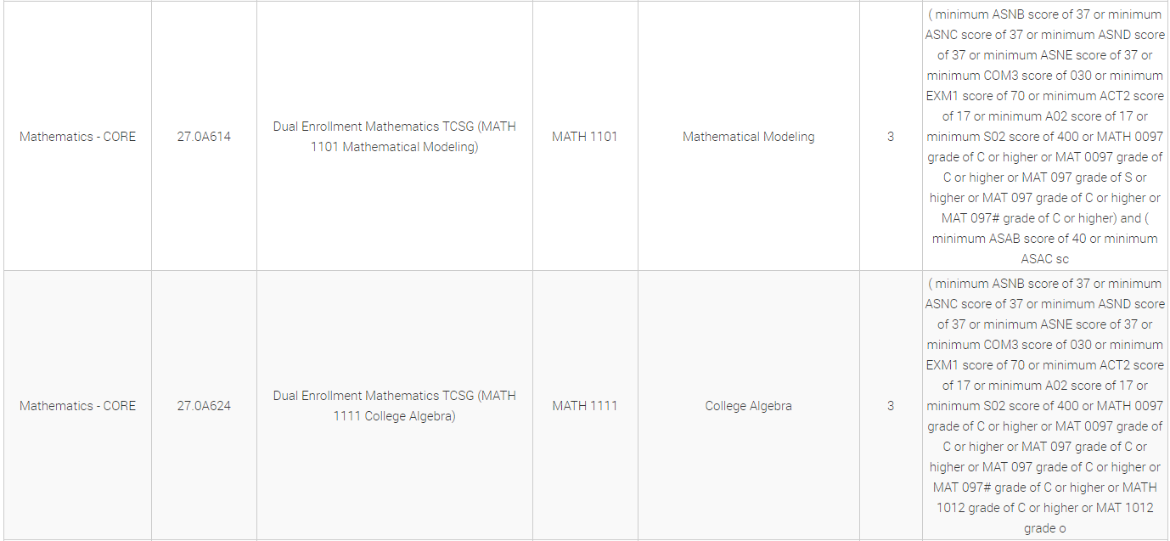
Example
ENGL 1101 will go on the High School Transcript as Advanced Composition
Fulfills your 4th English required for HS graduation.
MATH 1101 will post as Mathematical Modeling
MATH 1111 will post as College Algebra
Both will qualify as a 4th Math option & fulfill your 4th math requirement.
Colleges typically use test scores to determine your entry level into Math.

Slide 14
What is Satisfactory Academic Progress (SAP)?
Your SAP status is based on your entire academic record, at all colleges attended (includes all transferrable hours), regardless of whether you received financial aid.
SAP is reviewed at the end of each term.
Financial Aid Warning: allows the student to receive financial aid for one additional semester.
Financial Aid Suspension: no longer eligible to receive financial aid
Must meet SAP requirement before you can requalify for financial aid-will need to pay for school via self-pay, private loans and private scholarships.
Check the individual colleges financial aid page for more information about their specific criteria.
Bottom Line: Low or Failing DE grades can impact you beyond high school!!
14

Slide 15
CAN A STUDENT WITHDRAW FROM A
DE COURSE?
Students CAN withdraw from college courses by the college deadline; however, it is STRONGLY DISCOURGED for the following reasons:
1. Cobb County’s policy on dropping DE courses states:
If a student withdraws after the first 10 days of the high school term (summer, fall or spring); a grade of 10% will be recorded as the course grade and remain on the student's cumulative record. That failing grade is also calculated into the CCSD GPA.
2. Students must maintain a full-time status (this includes high school classes)
3. If a student decides to withdraw from a class, they will only be able to do this with two courses over their time as a DE student. After that, they can no longer participate in dual enrollment. This also impacts your SAP.

Slide 16
HOPE & DE
HOPE will award .5 quality points for DE degree level courses up to a 4.0.
Academic Degree-level DE courses are counted for the HOPE “rigor requirement.”
(English, math, science, social sciences & World/Foreign Languages)
Regular DE courses DO NOT count against your HOPE SCHOLARSHIP/ZELL MILLER cap hours (127 semester hours) for those planning to attend a 4-year Georgia college upon graduation.

Slide 17
PAY CLOSE ATTENTION TO
DEADLINES AND REQUIREMENTS!
Make sure you meet the requirements to apply. i.e. GPA, test scores, grade level.
Complete the DE Application for the specific college on the college’s website.
Ask your school counselor to send your transcript, if applicable.
Student will take and send qualifying test scores to the college if needed. (SAT, ACT, or PSAT)
Request Advisement meeting with your counselor prior to school deadline.
HOW TO
APPLY
17

Slide 18
Completed once a year through GA Futures
Student will create an account on GAFutures at
www.gafutures.org
Student must complete their portion
Parent will receive an email to complete their portion
Counselor will approve funding once the student has registered for classes.
Watch the video on GAFutures to walk you through the process.
DUAL ENROLLMENT
FUNDING
APPLICATION

Slide 19
Allatoona Deadlines!
It is in your BEST INTEREST to be admitted well before course registration opens to have first shot at classes.
Most colleges require you to attend orientation before you can register. This takes TIME!!!
CHATTAHOOCHEE TECH Summer 2024: March 1, 2024 Fall 2024: March 15, 2024 Spring 2025: TBA
KENNESAW STATE UNIVERSITY Summer 2024: March 15, 2024 Fall 2024: March 15, 2024 Spring 2025: TBA

Slide 20
Things to Consider
Most credits are NOT given quality points/weight for the Cobb County GPA
Students are taking challenging classes taught by college professors. AHS students can and HAVE failed DE classes and been academically dismissed from KSU resulting in college GPAs below a 2.0.
Students MUST take the American Lit EOC test at AHS
Professors DO NOT/WILL NOT communicate with parents.
College grades DO NOT appear in CTLS or ParentVue
Students are treated as college students & will be in class with older college students
Must maintain Satisfactory Academic Progress (SAP)

Slide 21
Things to Consider
College and high school calendars (breaks) often DO NOT align.
Some competitive colleges may consider AP to be more rigorous than DE classes
Some credits do not always transfer. Check out of state and private colleges.
MUST provide your own transportation.
Must factor in travel time, traffic, changing bell schedules, etc.
Students MUST be on-time and attend ALL classes regularly; this includes both high school classes and DE classes.

Slide 22
Things to Consider
Lack of daily interaction with HS friends may impact relationships, school involvement, etc.
The student may miss high school announcements and information distributed in homeroom. Students are responsible to find out info that they miss when they are not on campus.
DE students are not allowed to be on the high school campus during the school day if not in AHS class.
This includes athletic fields, the media center, gym, cafeteria, classrooms, etc.
Exceptions to this rule include before/after school for extracurricular activities, to attend a scheduled high school class or to meet with a counselor.

Slide 23
Keep in Mind…
It is the student/parent's responsibility to review all of the dual enrollment
information and understand the expectations and requirements.
DE is Recommended for 11th and 12th graders
Colleges have set their own grade and/or age requirements
Admissions requirements vary by college
Full-Time and Part-Time opportunities
Available during Fall, Spring and Summer semesters at some colleges
No residency or citizenship requirement
Allatoona students must apply by the Allatoona deadline, not the college deadline.
Apply early to make sure all of your documents have been submitted.
23

Slide 24
What does it take to be a SUCCESSFUL DE student?
ARE YOU…
Organized | Or | Disorganized
Proactive | Or | Reactive
Flexible | Or | Rigid
Able to Handle Stress | Or | Easily Overwhelmed
Assertive | Or | Unassertive
Good Self-Advocate | Or | Unable/Unwilling to ask for help
On Top of Things | Or | Procrastinator
Independent | Or | Highly dependent
Check and Respond Immediately to emails | Or | Ignore/Don’t Read Emails
Able to handle mature content/discussions | Or | Distracted by/Unable to handle mature content/discussions

Slide 25
Follow your school's dual enrollment steps
to determine when you should meet with your
school counselor for your Advisement meeting to:
Review courses needed for graduation.
Create a plan to meet graduation requirements and accomplish post-secondary goals.
Review required documents
25

Slide 26
Resources
GAFutures: www.gafutures.org
GA Dept of Education: www.gadoe.org
GATracs: www.gatracs.org
University System of GA:
www.usg.edu > Students > Prospective Students > Dual Enrollment
Technical College Systems of GA:
www.tcsg.edu > For Students > Dual Enrollment

Slide 27
Thank You

