Slide 1
Rising 6th Grade Parent Night
Notes:
Waltz

Slide 2
Our Mission:
Prepare all students for academic success
Notes:
Waltz

Slide 3
School Profile
Current Enrollment: 921
Student Groups:
31% Black
29% Hispanic
26% White
9% Asian
5% Multiracial
Teacher Profiles
70% Gifted Certified
50% Advanced degrees
Notes:
Waltz
Update-add teacher profiles (percentage that's gifted certified (70%), ESOL certified, advanced degrees)

Slide 4
Communication
Sunday Night Call Out
Weekly Newsletters
CTLS
ParentVue
All progress reports are posted electronically – no paper copies
Notes:
Waltz

Slide 5
Multiple Teacher Expectations
Your student will have 7 different teachers
Please include students full name when contacting teachers
Please allow up to 24 hours for reply
Student Accountability
StudentVue
Homework – Nightly studying
Due dates
Organization
Binders, folders, supplies, instruments
Agendas
Notes:
Waltz

Slide 6
6th Grade Schedule
2021-2022 Daily Bell Schedule
Homeroom/Breakfast | 8:50-9:11
1st Period | 9:15-10:05
2nd Period | 10:09-10:59
3rd Period / Lunch | 11:03-12:40
4th Period | 12:44-1:34
5th Period | 1:38-2:28
6th Period | 2:32-3:22
7th Period | 3:26-4:15
Notes:
McAfee

Slide 7
Connections Classes
Two periods/Day
Year-long
Band
Chorus
Orchestra
Math Support
9 Weeks
PE
Art
Technology
Family & Consumer Science (FACS)
Notes:
McAfee

Slide 8
Daniell Performing Arts
Band, Chorus, and Orchestra
Classes are part of the school day leaving time for students to participate in sports and clubs
Year-long commitment
No prior knowledge needed
Concerned about the financial aspect? We are always more than willing to assist.
To learn more or to sign up for a Performing Arts Class visit:
Be Part of the Band & Orchestra (bepartofthemusic.org)
Notes:
Waltz

Slide 9
Core Academic Classes
English Language Arts
Math
Science
Social Studies
Enrichment
Placement is data driven
Math
Writing
Reading
Science PBL
Notes:
Waltz

Slide 10
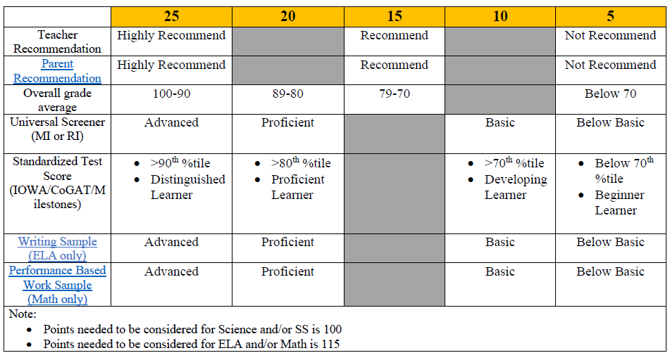
AC Classes
Notes:
https://cobbk12org-my.sharepoint.com/:b:/g/personal/jennifer_anthony_cobbk12_org/ER-6NZDmwXtJo3mOcMjFDEEBItEvDoZcihL9S4VWYhdKUw?e=KAbybK
Waltz

Slide 11
Pathways Towards HS Credit
HS Algebra
Math 7/8
Math 6/7
HS Physical Science
AC Science
HS Visual Art
Teacher Recommendation
HS Spanish
Spanish Academy
Data Driven
HS LAS
Leadership, Law, and Public Service Academy
Teacher Recommendation
Notes:
Waltz

Slide 12
PBIS
SWARM –SWARM is the model for behavior expectations
S – Show Positive Leadership
W – Work Hard
A – Accept Accountability
R – Respect Others
M – Make Good Choices
Student Recognition:
SWARM Points
Hot Spot
J.J. Days
Student of the Month
Honors Days
Notes:
Waltz

Slide 13
Lockers
Students are assigned lockers around 2nd week of school
Gym lockers are also provided, if students are dressing out
Need Practice?
Apps
Combo Lock 101 ($.99)
School Lock ($.99)
Master Lock
Notes:
McAfee

Slide 14
Transportation
Here Comes the Bus – Bus Tracking
Bus routes will be updated in late July 2022
Bus Notes
Needed when riding a different bus home
May be denied because other bus is full
Not needed when riding home via car
Car riders are not given placards
Notes:
McAfee

Slide 15
The Logistics of Being a Middle Schooler
Middle School Hours (9:15 – 4:15)
There is NO ASP
Have a plan if your student:
Misses the bus
Loses their key
Feels unsafe
Hygiene – MS Bodies are different
Practice good hygiene
Emergency Contacts
Make sure your student knows phone numbers & home address
Notes:
McAfee

Slide 16
School Logistics Continued...
School Supply Lists
Available on the Daniell Website
Don’t need to bring them all the first day
Technology
Cobb provided laptops
Students are expected to bring their laptop every day
Sneak-a-Peek
Notes:
McAfee
When assigned

Slide 17
Supports for your Students
Student Support Team: 2 Counselors and a School Social Worker
How do we support your student?
Individual meetings, mediation, small group sessions, classroom lessons
What do we talk about?
School Issues: study skills, goal setting, test anxiety, grades, discipline
Home Life: divorce (parents), siblings, living situation
Personal Issues: self-esteem, body image, self-harm, suicidal thoughts
Social Issues: drama, teasing/bullying, relationships
Grief/Loss
Your Future!
Notes:
McAfee
What do we do?
School counselors help students reach their maximum potential by providing academic, social/emotional, and career support
School Social Workers help parents, students, and school staff identify needs that interfere with learning and work with students to get the services they need

Slide 18
Extracurricular Opportunities
Clubs – Over 25 at Daniell
DNN (Daniell News Network)
Run Girl Run
Anime club
Art club
Garden Club
National Junior Honor Society
Lego Robotics
Academic Bowl
Spanish Club
Intramurals
SHS Junior Jacket Athletics
Baseball
Basketball
Cheerleading
Cross Country
Football
Lacrosse
Softball
Notes:
Waltz

Slide 19
PTSA
J.J. Daniell Middle School staff and students are fortunate to enjoy the support of many families and community members.
Support and encourage the Daniell faculty, staff, and students throughout the school year.
For more information on the PTSA and their activity, please visit their Facebook page – Junior Jackets PTSA
Notes:
Waltz

Slide 20
Why Daniell?
Top 1% most diverse public middle schools in America
Top 10% Best public middle schools in America
4 Consecutive 5-star climate rating
AdvancED Accredited School
2018 ASCA RAMP award counseling program
Georgia School of Excellence
MIE certified school
Ability to earn up to 5 HS credits
30% increase in gifted enrollment
8th Grade Academies
PBIS Operational School
½ staff have earned advanced degrees
70% of the staff is gifted endorsed
Notes:
Waltz

Slide 21
Thank You
Mr. James Rawls, Principal
James.Rawls@cobbk12.org
Mr. Nicholas Waltz, 6th Grade Administrator
Nicholas.Waltz@cobbk12.org
Ms. Cayce Pope, 6th Grade Counselor
Cayce.Pope@cobbk12.org
For more information and to watch a recording of this session please visit www.cobbk12.org/daniell

