Slide 1


Fact Fluency with K-2

Slide 2
7+7

Slide 3
2+1

Slide 4
How many?

Slide 5
5+5

Slide 6
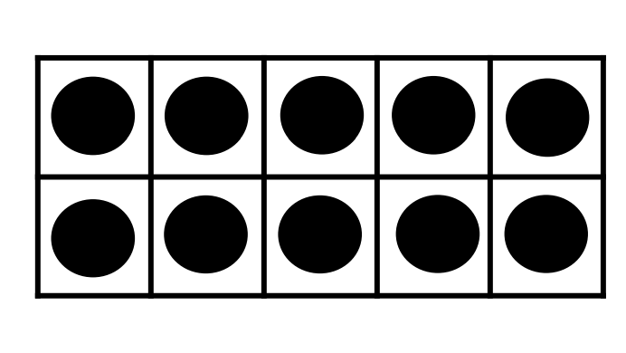
How many?

Slide 7
10+3

Slide 8
How many?

Slide 9
4+1

Slide 10
15+5

Slide 11
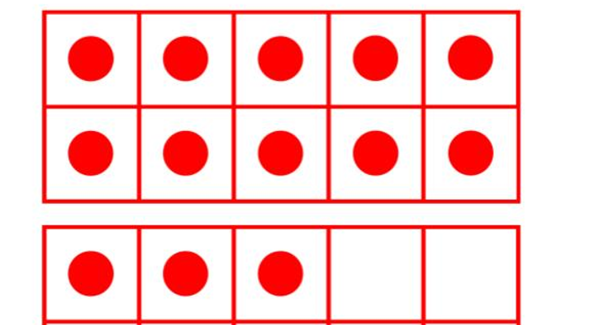
How many?

Slide 12
3+6

Slide 13
5+6

Slide 14
How many?

Slide 15
0+1

Slide 16
2+2

Slide 17
6+6

Slide 18
How many?

Slide 19
5+2

Slide 20
8+8

Slide 21
3+1

Slide 22
How many?

Slide 23
1+1

Slide 24
2+3

Slide 25
How many?

