Slide 1
Welcome to
FIRST GRADE
Mountain View Elementary School
2023 – 2024

Slide 2
THE FIRST GRADE TEAM
Mrs. Bass
Mrs. Beese
Miss Garrett
Mrs. Kopriva
Mrs. Landes
Mrs. Lieber
Mrs. Sloan
Mrs. Wallin

Slide 3
DAILY SCHEDULE
Unpacking & Morning Work
Attendance & Morning Announcements
WIN Time
Science/Social Studies/Health
Specials (PE, Music, Art, Technology or STEM)
Read Aloud
Lunch
Recess
ELA: Phonics, Grammar, Reading & Writing
Math
Snack Time
Dismissal
Each teacher will post their class schedule on CTLS. The schedules will include lunch and recess times that are specific to each classroom.

Slide 4
DAILY REMINDERS
Children may enter the building each morning at 7:20 a.m.. This is a great time for students to unpack their belongings, socialize with friends, and get started on morning activities. Our 1st grade friends enjoy having this time to get settled in for the day!
Students need a refillable water bottle each day. Please send a daily snack that is nutritious and easy to open.
Make sure your child wears comfortable shoes that are safe for the playground, gym & field. Sneakers are best. If your child cannot yet tie their shoes, please consider Velcro closures.
Start each day
with a smile!

Slide 5
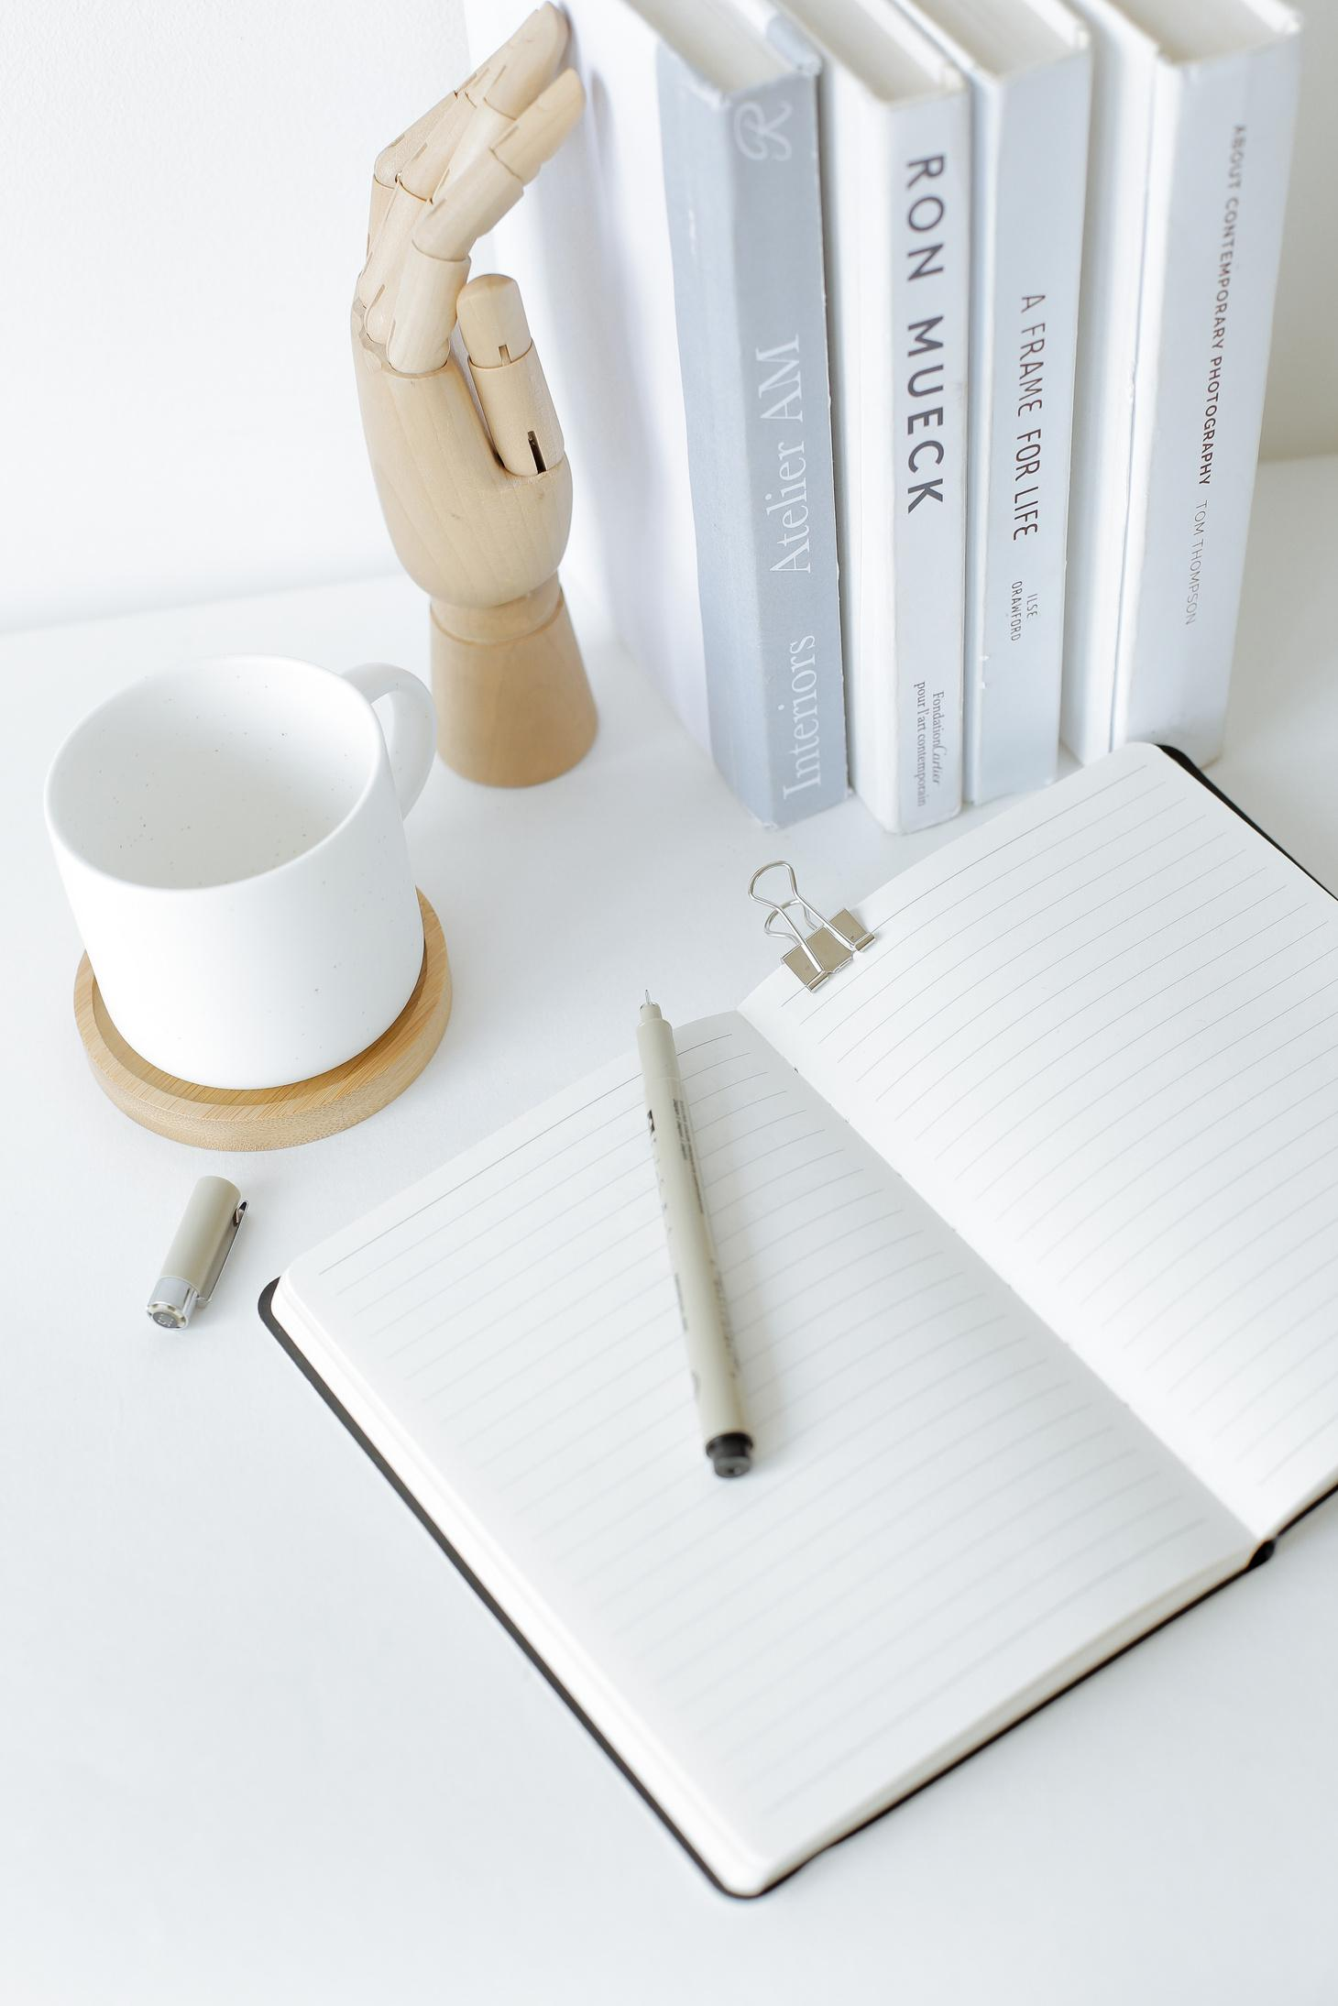
HELPFUL INFORMATION
If your child brings a lunch from home, please make sure that food and drink packaging is easy to open.
"Extras" may be purchased from the cafeteria, but we will need your permission for students to purchase these items. You will receive a form to complete from your child's teacher.
Teachers will make an announcement when guests can join children for lunch in the cafeteria. We have a special table in the lunchroom that is designated for children and their guests.
LUNCH

Slide 6
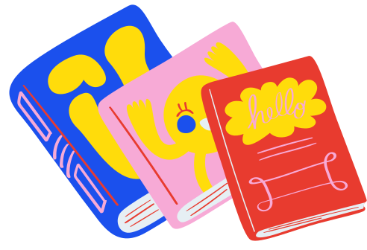
LEARNING SKILLS & BEHAVIORS
In first grade we promote academic productivity and growth
while encouraging positive social skills.
Our students know the rules and expectations,
and they are rewarded for making positive choices.
CLASSROOM RULES
Follow directions
Listen when others are talking
Stay on task and complete work
Keep hands and feet to self
Cooperate with others

Slide 7
COMMUNICATION
Your child will bring home a folder each day. Inside will be graded papers, school information and weekly homework.
Please check your child's folder daily. You will also see their monthly behavior chart in the take home folder.
We ask that you check this calendar each day,
and initial that you have reviewed it.
Every Friday we will post a grade-level curriculum
update on CTLS Parent. This is also where we post classroom updates, and information about special activities happening in our 1st grade classrooms!

Slide 8
What is CTLS?
CTLS is Cobb's digital platform where families and students receive announcements, assignments, and various links to student websites such as:
Dreambox, Georgia Studies Weekly, and Cobb's Digital Library.
All parent-teacher communication needs to be through CTLS Parent
via the messaging feature. Let us know if you are having difficulty gaining access to CTLS. This is a critical communication tool for parents, teachers, and the school. We need to make sure everyone has access as soon as possible.
During the day we get quite busy in our classrooms with teaching, learning, and all our first grade friends. Please know that we try our best to reply to messages as soon as possible, but it may take up to 24 hours
for you to receive a response from us.

Slide 9
Parent Vue
Parent Vue is an important site where you will access
your child's report card throughout the year.
If you have older students,
Parent Vue is where you can view their grades.
If you have not set up your Parent Vue account,
you'll need to stop by the front office to obtain login credentials. To receive this secure information, you'll need to provide proof of identification.

Slide 10
Go Safe
We will be using a new CCSD transportation dismissal
program this year called GoSafe.
Please make sure you have completed your child's transportation in GoSafe by Monday. If you have problems accessing GoSafe or need any questions answered regarding this process, please stop by the front office before you leave today and one of our clerks will assist you.
Important Note:
GoSafe is the program that parents will use to change daily transportation. Changes must take place prior to 1:35 PM each day.
We can no longer accept notes or phone calls
to change a child’s transportation.

Slide 11
Car Pool
In order to streamline and ensure safety during carpool, please…
Display your car tag visibly in the front window of the car
If no car tag is present, you will be asked to park and show ID in the front office
Reuse car tags from last year, if possible, by changing the grade level(s)
If you need a car tag, the enrolling adult can visit the table in the mezzanine, and ONE tag will be made, per family, at this time.
We appreciate your understanding and flexibility in all carpool matters, and please remember that it will take a little time to work through the efficiency due to the volume expected.

Slide 12
HOMEWORK
In first grade we want you to read, read, and read some more!
Reading aloud to your children is a great way to build vocabulary. Listening to your children read to you
helps to strengthen accuracy and fluency.
Math fact practice is another way to build fluency.
It's great to work with addition and subtraction
flashcards and you can do this orally, as well.
A formal homework routine will begin later this fall.

Slide 13
CELEBRATING BIRTHDAYS
We love to celebrate first grade birthdays!
If you would like to send in a birthday treat to share with the class,
they must be store-bought. If you would like to have lunch with your child on their birthday, you can bring the treats to the cafeteria and help your child pass them out at the end of the lunch period.
Treats may be arranged through our cafeteria manager,
Stacey Deremer at stacey.deremer@cobbk12.org.
Please contact your child's teacher ahead of their birthday.
We can provide a count and make you aware of any allergies.

Slide 14
MONEY
If you need to send any payments to school,
please be sure to send money in a sealed envelope that is labeled with the following information:
Student's Name
Grade
Homeroom Teacher
ASP, Lunch, Bookfair, or Fieldtrip

Slide 15
WAYS TO GET INVOLVED
Chaperone a fieldtrip
Sign up to be a Mystery Reader
Attend class parties in December & May
Join the PTA
Join the Foundation
*Parent volunteers who interact with students will need to watch a 3-minute video and sign a form that covers the Family Educational Rights and Privacy Act (FERPA). Here is a link to the video: Volunteer Video.
We are sending home the form today.

Slide 16
VISITORS
All visitors to the building will need to show identification at the front entrance, then check-in at the front office.
Visitors will receive a sticker
that needs to be worn while you are in the building.

Slide 17
AND LAST . . .
Please join us downstairs in our individual classrooms.
You will be able to:
Check on supplies
Complete forms
Verify Bus/Run #s
Make us aware of allergies
We look forward to meeting each of you.
Your child's teacher will be happy to answer
any questions you might have!

Slide 18
We are glad you are here!
The Sky's the Limit!

