Slide 1
Walton High School Class of 2028
Freshman Class Meeting
Ms. LaVangie
Mr. Pirkle
Notes:
Pam

Slide 2
Freshman Year – New Beginnings!
Important Year!
More independence – higher expectations
Focus on academics
Developing high school habits – strong study skills, getting involved, starting your transcript
Keep it between the lines – focus on academics, avoid discipline issues
Notes:
Troy – All but last; Pam – Last Bullet Point

Slide 3
Freshman Sponsors​
Ms. Duncan – SGA Sponsor​
Karen.Duncan@cobbk12.org
Ms. Kinzler – Freshman Class Sponsor​
Charlotte.Kinzler@cobbk12.org
Ms. LaVangie and Mr. Pirkle – Freshman Administrators ​
Dr. Santoro – Principal​
Notes:
Pam

Slide 4
Where to go for help?
Academic Support – Classroom Teacher – Make good use of WEB time!
Social/Emotional Health – Walton School Counseling Department
NOT SURE what to do or where to go for help? Ask US!
Ms. LaVangie’s Office: 2nd floor (235)
Email: pamela.lavangie@cobbk12.org
Mr. Pirkle’s Office: 4th floor (423)
Email: troy.pirkle@cobbk12.org
Notes:
Pam

Slide 5
CCSD Email Address
Primary method of communication from school
Check daily to ensure up to date information
School will no longer communicate with personal email
First.Last@students.cobbk12.org
Notes:
Troy

Slide 6
Notes:
SGA

Slide 7
Notes:
SGA

Slide 8
CLASS OF 2028
T-SHIRT DESIGN
CLASS DUES
PAY CLASS DUES THROUGH
MY PAYMENTS PLUS
Notes:
Troy

Slide 9
BEHAVIOR EXPECTATIONS
Walton Pride!
Tardies to School and Class
Leaving School without Permission
Bullying/Harassment (Stalking)
Vaping – 3 Days OSS
Multiple People in a stall
Fighting – 10 Days OSS
NO Food Deliveries – No Uber Eats, Door Dash, etc.
Pay Attention to Rules and Deadlines – It is your responsibility to know the rules and follow all deadlines!
Notes:
Pam

Slide 10
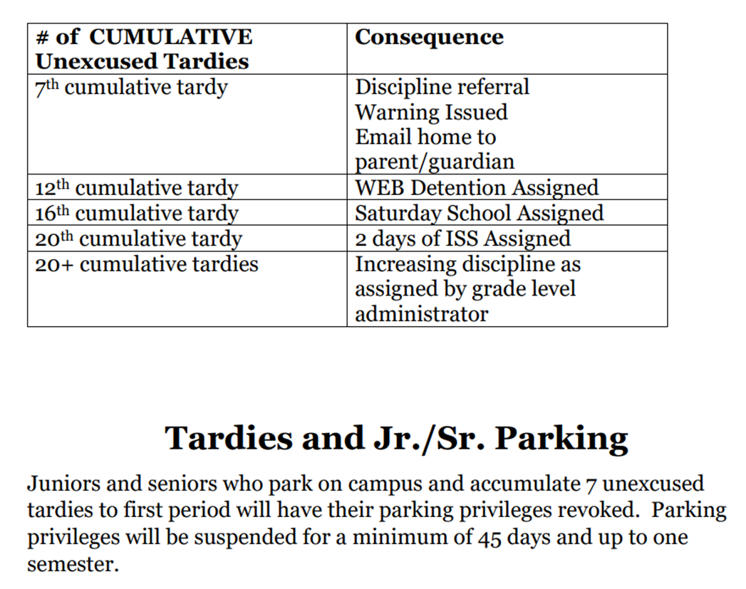
Tardy Policy
**Tardies are cumulative over ALL classes!
Notes:
Troy

Slide 11
Cyber Bullying
24 hours a day/7 days a week
THINK before you post on social media
Administrators can and will enforce CCSD code of conduct for students who violate policy
GHSA has additional consequences for athletes —including loss of game time.
Notes:
Troy

Slide 12
Dress Code
Walton Wear vs Weekend Wear
Head coverings – Hats & hoodies
Length of shorts/skirts
Length of shirts- no midriffs
Undergarments should be worn under other clothing and should not be visible!
Notes:
Pam

Slide 13
Honor Code
Academic Dishonesty
We believe that every student has the right to learn in an environment free from academic dishonesty. Each individual has the duty to display honesty, integrity, respect, and responsibility. Academic integrity is expected on classroom assignments as well as on summer or supplemental assignments.
Student Agenda
Description and Consequences
Failure to understand the honor code does not excuse infractions.
Notes:
Pam

Slide 14
Other Reminders
Exterior Doors
Elevator Passes
Lunch Areas
Food Deliveries
Walking from Parking Lot
Notes:
Pam

Slide 15
Zero Period
7:10 - 8:12 (62 min)
1st Period
8:20 - 8:50 (30 min.)
Homeroom
8:56 - 9:05 (9 min.)
2nd Period
9:11 - 9:40 (29 min.)
3rd Period
9:46 - 10:15 (29 min.)
4th Period
10:21 - 10:50 (29 min.)
5th Period
10:56 - 11:25 (29 min.)
6th Period
11:31 - 12:00 (29 min.)
7th Period
12:06 - 12:35 (29 min.
Q Block
12:35 -12:55 (20 min.)
A Block
1:00 - 1:25 (25min.)
B Block
1:30 – 1:55 (25 min.)
C Block
2:00 - 2:25 (25 min.)
D Block
2:30 – 2:55 (25 min.)
All students to Dining Hall (unless leaving)
3:00 - 3:30 (30 min.)
Walton Enrichment Block (WEB)
Notes:
Pam

Slide 16
Walton Enrichment Block (WEB)
Four 25-minute blocks--tutoring with teachers, research in the Information Center, make-up work, sat prep, guest speakers, etc.
Must stay/May leave—Parent WEB Permission Form
If on Must Stay List – will receive Accountability Form in HR; must complete with signatures and turn in before dismissal; discipline consequences
Sign in procedures. Check out procedures if on Must Stay
Notes:
Pam

Slide 17
Freshman Kickoff, Homecoming & Spring 2025
Freshman Football Game vs. North Cobb on Thursday, August 29
Freshman Celebration
Make it your night!
Homecoming Game vs. Etowah on Friday, October 18
Spirit Week – 10/14 – 10/18
Homecoming Parade – 10/18
Winterfest
January 17, 2025
Freshman Advisement
Spring 2025
Notes:
Troy

Slide 18
Athletics & Extracurricular Information
Attend events – Get Connected
How to Purchas Tickets – gofan.co
All Sports Pass
$95
Notes:
Williams

Slide 19
Athletics and Sportsmanship
Expected Behavior
Cheer for our teams/students
Do not yell disparaging remarks at opponents/officials.
Ejection from event. Suspension from future events!
Notes:
Williams

Slide 20
HAVE A GREAT YEAR!!!
Notes:
Pam

