Slide 1
Graduation Tickets

Slide 2
Graduation Ticket Request

Slide 3
PBIS Points will be given if you complete before the DEADLINE

Slide 4
MAY 2025
Monday 12 | Tuesday 13 | Wednesday 14 | Thursday 15 | Friday 16
A/B Day Finals | Block 3rd & 4th Finals | Block 1st & 2nd Finals PICNIC |  | ALL Elementary Senior Walks
Monday 19 | Tuesday 20 | Wednesday 21 | Thursday 22 | Friday 23 | Saturday 24
Counselors will graduate students | Mandatory Graduation Rehearsal | Mandatory Graduation Rehearsal Ticket distribution |  |  | Graduation 2:30PM Report time 12:30PM

Slide 5
NEW SENIORS (enrolled in January or mid-year promotion)

Slide 6
Graduation Information Form
Provides the following information:
Name verification
Do you plan to participate in commencement?
Cell phone number
Personal email address

Slide 7
December Graduates ONLY
Commencement Ticket Request is available to you.
Sign in to Student Portal
Choose Graduation Tickets or Ticket Icon (under apps)
Please read ALL information on the screen before you enter information.
Deadline is December 4th.
Click Submit request.
Be sure to logout

Slide 8
REVIEW information
Review data to determine if it is accurate in the database.
Students refrain from using autofill/autocomplete feature when completing your form, specifically when entering the telephone number and/or email address, your name could change, often supplicating the first name as the middle name and /or the last name as a suffix.
Miller, Jordan HayesMiller (example)

Slide 9
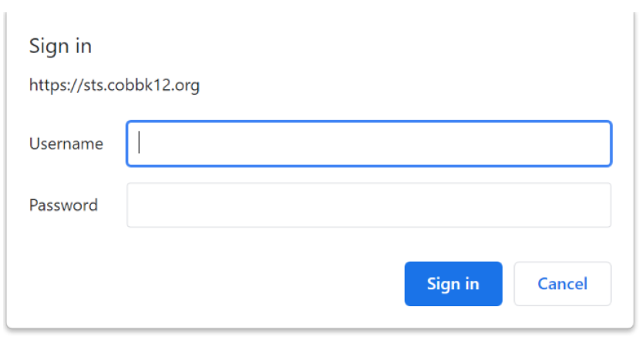
Student Portal https://studentportal.cobbk12.org
Students will sign in using their CCSD student email address.
If you are in Office 365 you will be logged in to the Student Portal. If you are not logged in to Office 365, you will be asked to sign in with your username and password.

Slide 10
Choose Graduation Form from the list of Apps.

Slide 11
Name Verification
Name
o If the student's name is correct as listed, do not make any changes.
o If the student's name as listed does not match the birth certificate, make changes in the appropriate field (first name, middle name, or last name) by deleting the incorrect name and typing in the correct name.
o Add a suffix if a part of the legal name (Jr, II, III, IV, etc.) Do not use periods.
Name Note
o If the student's name has any accents or special characters, please supply the information clearly in the text box. (accent over the e in Jared)
Pronunciation
o If the student's name has unusual pronunciation, please explain clearly in the text box. (Aarons is pronounced Air Runs)

Slide 12
Name Verification

Slide 13
Graduation Plans
Indicate when you plan to graduate. You must choose Spring Term.

Slide 14
Commencement Plans
You must choose whether you plan to participate in commencement or not. Students who participate must wear proper attire. Information about commencement gowns will be communicated by the school. The default is set to PARTICIPATE until the form is completed and submitted.

Slide 15
Contact Information
Enter the student’s cell phone number.
Enter the student’s personal email address. DO NOT USE a CCSD (@cobbk12.org) email address.

Slide 16
Click Submit
Once you have completed all fields in the Graduation Information Form, please review for accuracy. When you are satisfied that you have completed the form accurately, CLICK SUBMIT.

