Slide 1
School Improvement Forum
Brumby Elementary

Slide 2
AGENDA
Brumby Elementary
School
Welcome Parents, School Staff and Community Members
Purpose of the Meeting
Title I, Part A, School Improvement Plan (Overview)
School-Family & Community Engagement Policy
School-Parent Compact
Building School Staff Capacity
Family Engagement Budget
5. Recommendations for Revisions/Updates
April 29th, 2021
Notes:
Create a QR code and post the picture on this slide. Ask participants to sign-in using the QR code. You may want to put some QR codes on the tables, too.
2

Slide 3
School Improvement Plan
The Title I School Improvement Plan is developed through the comprehensive needs assessment and decision-making process to identify evidence-based strategies designed to increase student achievement. Identified strategies are carried out through action steps our school will take to intentionally increase learning outcomes.
School Improvement Plan Goals:
By the end of the 2020-2021 school year, increase the percentage of students in the proficient and advanced band combined on the MI assessment by 30%.
By the end of the 2020-2021 school year, increase the percentage of students in the proficient and advanced by 30% when compared to fall '20 RI scores.
By the end of the 2020-2021school year, increase the percentage of students from non-proficient to proficient by 3%
Notes:
We encourage you to ask questions throughout the meeting. We value your input. We want to make sure you leave the meeting informed about the Title I program, as well as the opportunity
to provide feedback.
3

Slide 4
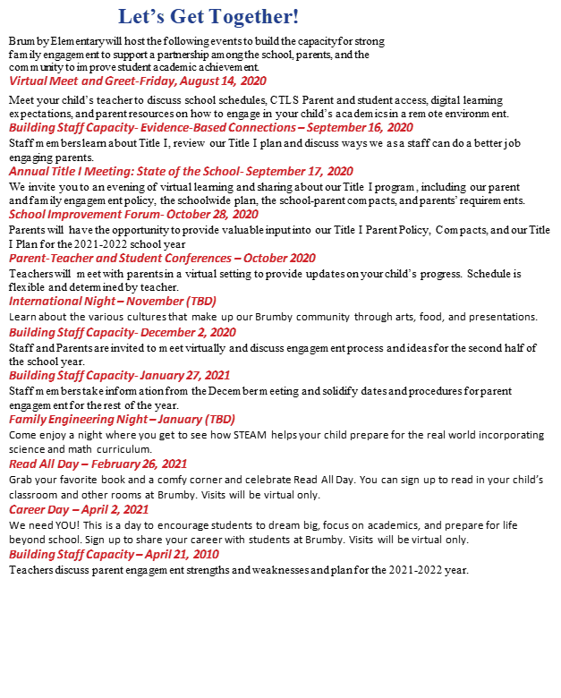
School and district Parent and family engagement policy
This plan describes how we will carry out its obligation to conduct outreach and provide activities, programs, and procedures for all families with students enrolled in a school with a Title I Program.
Let’s take a look at the plan.
Notes:
We encourage you to ask questions throughout the meeting. We value your input. We want to make sure you leave the meeting informed about the Title I program, as well as the opportunity
to provide feedback.
(Share and review your policy/plan. Discuss the 8 components of the policy/plan.)
4

Slide 5
Teachers, Parents, Students- Working together for Success
The third-grade teachers, specialists and support staff will work students and their families to develop students’ Mathematical and Reading competency according to grade level standards. The focus of our key connections with families will be:
Provide parents with a variety of math and reading strategies that meet the Georgia Standards of Excellence. Examples of each will be provided through CTLS Parent, classroom parent meetings or conferences.
Provide individualized and personalized mathematics support using Dreambox Learning software.
Provide individualized and adaptive reading support using Headsprout online reading program.
Families can support student’s math and Reading understanding by:
Utilize strategies provided by school in both reading and math to explore books and literacy skills as well as mathematical concepts with your child.
Help your child develop a love of reading by reading the materials provided with them at home.
Ensure your child frequently logs into Dreambox software to build conceptual understanding and procedural fluency.
School-parent compact
The compact was developed in partnership with teachers, parents, and students. The compact outlines shared responsibilities between schools/teachers, parents/families, and students that are focused on supporting student academic success.
Brumby students can succeed in school and meet our school goals in both Math and Reading. As a student, I can:
Use a variety of mathematical strategies to solve math problems both in and out of school and use a variety of reading strategies to read and understand what I am reading both in and out of school.
Read at least 20 minute each night
Log in to Dreambox and practice math facts and concepts.
Notes:
We encourage you to ask questions throughout the meeting. We value your input. We want to make sure you leave the meeting informed about the Title I program, as well as the opportunity
to provide feedback.
(Review the 5 components of the School-Parent Compact)
5

Slide 6
Building school staff capacity
Family engagement budget
Federal law also requires that Title I schools are to educate and train teachers, specialized instructional support staff, principals, other school leaders, and staff in how to best develop partnerships with families. This training and education are to be done in consultation with parents. For this school year our staff capacity building plan includes a 4-part course to increase our understanding of effective ways to communicate with our families. We want your suggestions on topics you think teachers, administrators, and other school staff need to discuss or learn more about to support your child and family.
Our school district received more than $500,000 for this school year from Title I, Part A. Part of that amount has been set aside for family and community engagement. Specifically, $4,525 for the District Set-Aside.
Notes:
We encourage you to ask questions throughout the meeting. We value your input. We want to make sure you leave the meeting informed about the Title I program, as well as the opportunity
to provide feedback.
6

Slide 7
Large Photo Slide
Recommendations for Revisions/Updates
We appreciate and value your input and want to give you the opportunity to provide recommendations for revisions to our School Improvement Plan and Family & Community Policy for the upcoming school year. The revisions/updates that you recommend will be incorporated into our School Improvement Plan and Family & Community Policy for the upcoming school year based on the identified needs. A final draft will be available on the school’s Title I webpage in the Fall.
Please visit the attached link to provide your feedback to this presentation and offer your recommendations for revisions. https://forms.office.com/Pages/ResponsePage.aspx?id=-x3OL5-ROEmquMR_D8kYLdJo7SohX6tCveLg_1FaJhdUN0RWR0szWjU4WVNTNVAwR0dBVUdDNk9LWC4u
Notes:
7

Slide 8
THANK YOU FOR COMING!
We hope to see you again very soon!
Brumby Elementary
Principal Dr. Amanda K. Richie
815 Terrell Mill Road, Marietta, GA
770-916-7070
Notes:
8

