Slide 1
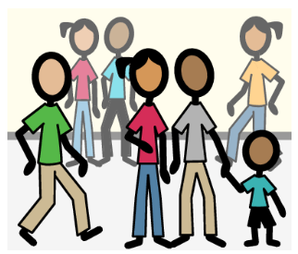
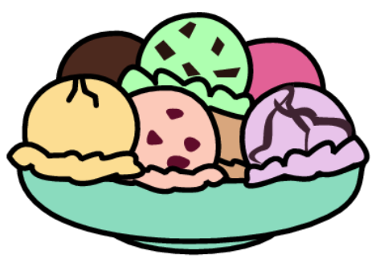
The Ice Cream Social

Slide 2
The ice cream social is an event that happens at my school. I can eat ice cream and play on the playground.

Slide 3
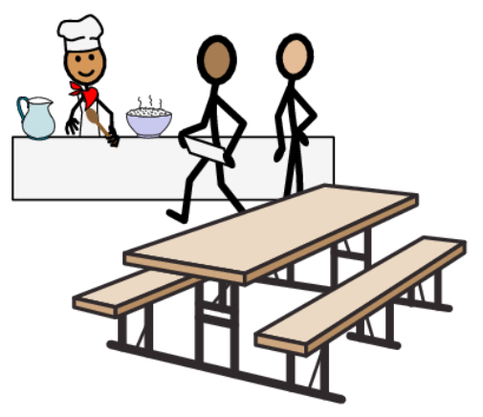
First, I will go the cafeteria and get ice cream. I will wait in line to get ice cream.

Slide 4
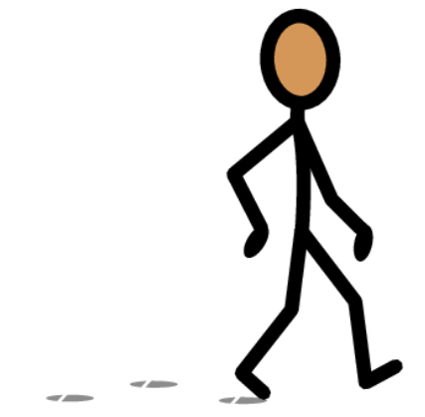

When I am in the cafeteria, it is important to be safe. I can be safe by using walking feet, waiting in line, and staying close to a grown up I know.

Slide 5
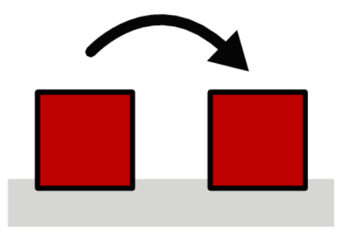
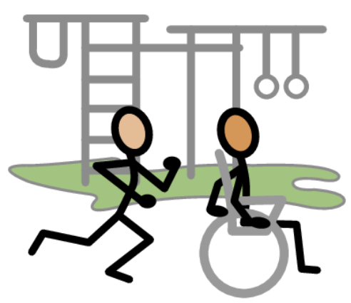
After I eat my ice cream, I can go to the playground.

Slide 6
There will be a lot of students on the playground. It is important for me to stay inside the playground, take turns with the other students, and keep my feet on the ground or the structure.

Slide 7


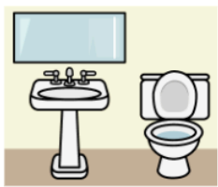
I might get hungry, thirsty, or need to go to the bathroom. When I need to eat, drink, or use the bathroom, I can tell an adult with my words, communication board, or device!

Slide 8

There will be a lot of people at the Ice Cream Social. It might be loud, and there will be a lot of things moving around.

Slide 9

If I feel upset, I can go to the Inclusion Table. I can borrow headphones, a fidget, and other things to make me feel more comfortable.

Slide 10

The Inclusion Table is here to help keep me safe and make sure I have fun at the Ice Cream Social.

Slide 11

I am excited for the Ice Cream Social!

