Slide 1


Walton
High School
Class of
2026
Junior Class Meeting
Dr. Brown

Slide 2
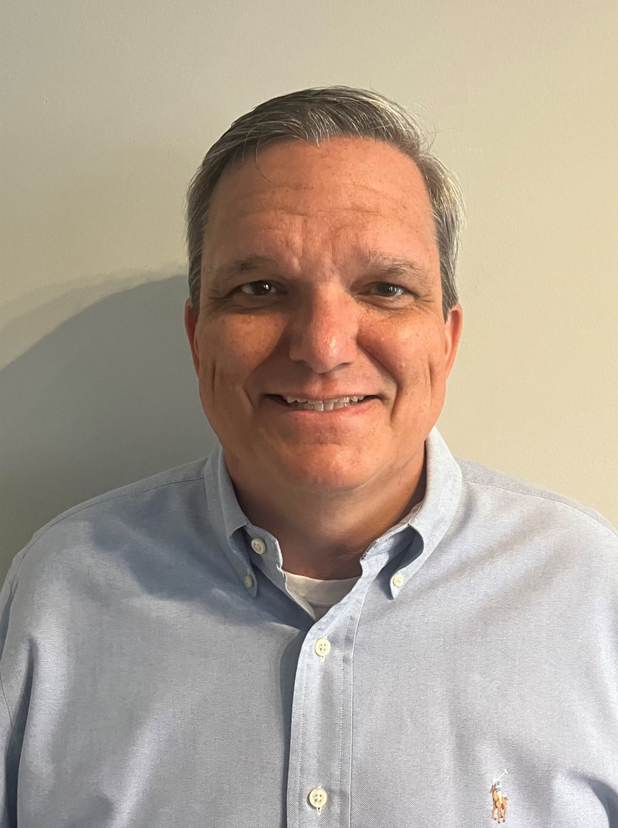
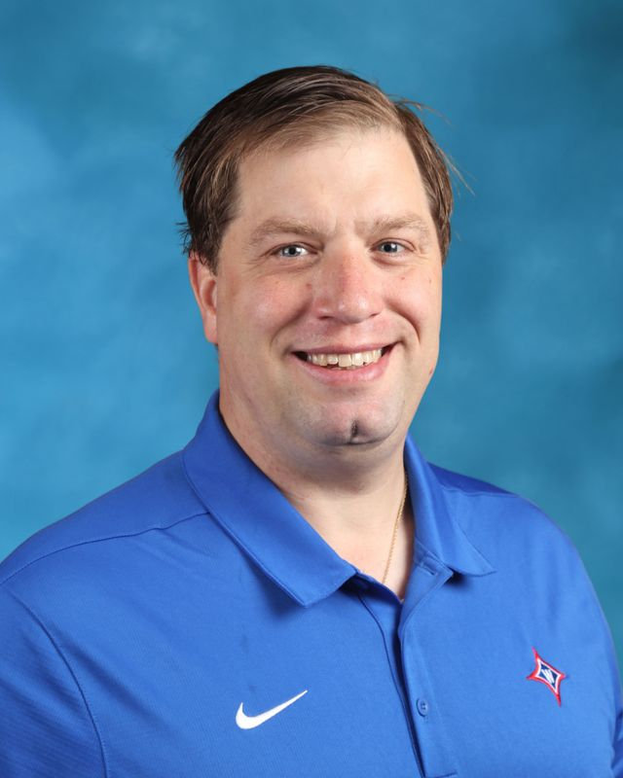
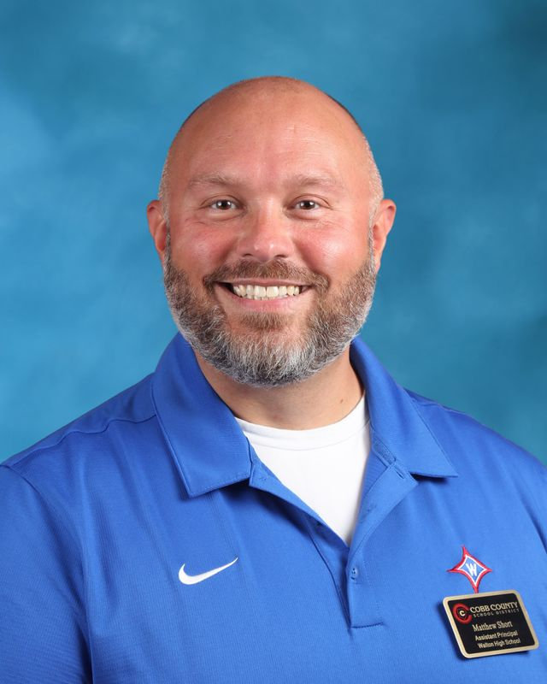
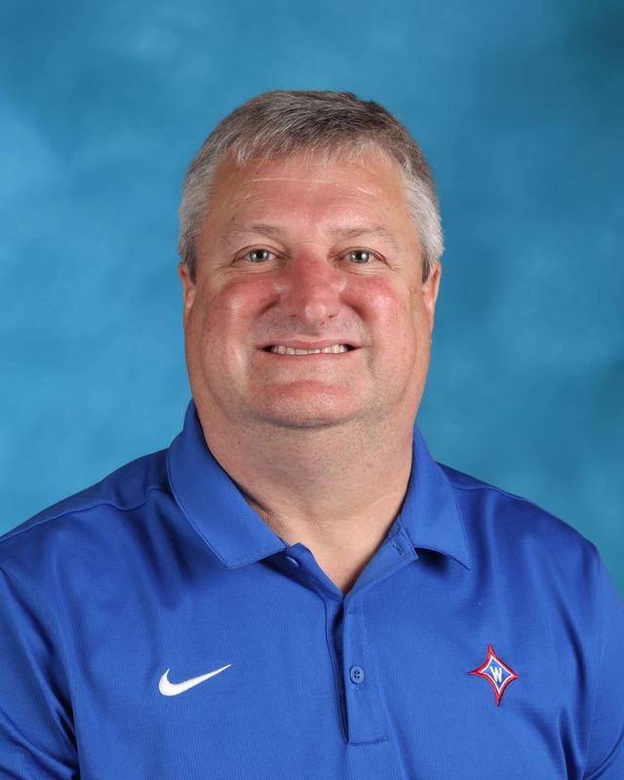
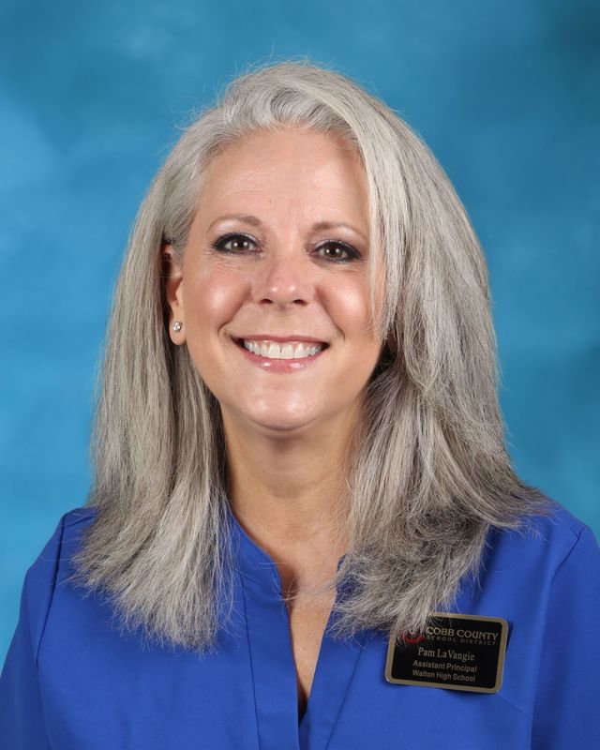
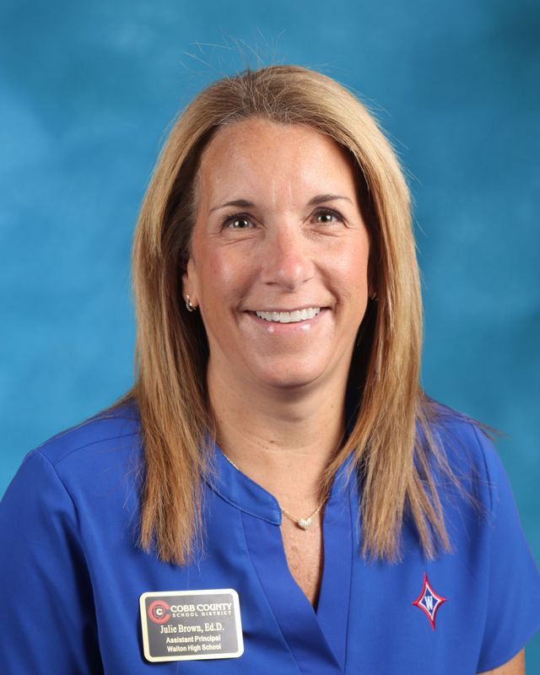

Administration
Mr. Pirkle
9th grade
Dr. Jones
10th grade
Mr. Short
12th grade
Dr. Williams
10th grade
Ms.LaVangie
9th grade
Dr. Brown
11th grade

Slide 3

Junior Sponsors​
Ms. Duncan – SGA Sponsor​
Ms. Ebbert & Mrs. Turner – Junior Class Sponsors​
Dr. Brown– Junior Administrator ​
Dr. Santoro – Principal​

Slide 4

Junior Class Officers
Jr. Class President- Evan Kambies
Jr. Class VP – Brody Alterman
Jr. Class Secretary – Shivum Patel
Jr. Class Treasurer – Om Patel

Slide 5


Slide 6
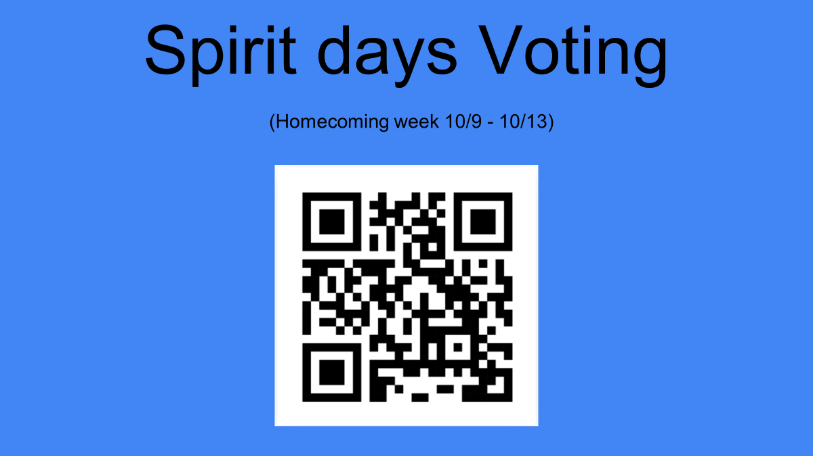

Slide 7

CCSD Email Address
Primary method of communication from school
Check daily to ensure up to date information
School will no longer communicate with personal email

Slide 8

BEHAVIOR EXPECTATIONS
Leaders of the School!
Tardies to School and Class – Be on time!
Leaving School without Permission
    Lose parking 45 days
Bullying/Harassment
Vaping – 3 Days OSS (1st Offense)
Multiple People in a stall
Fighting – 10 Days OSS
NO Food Deliveries
Pay Attention to Deadlines - Take responsibility (ex: NHS application deadline, sports physicals, AP registration and payment, etc.)

Slide 9
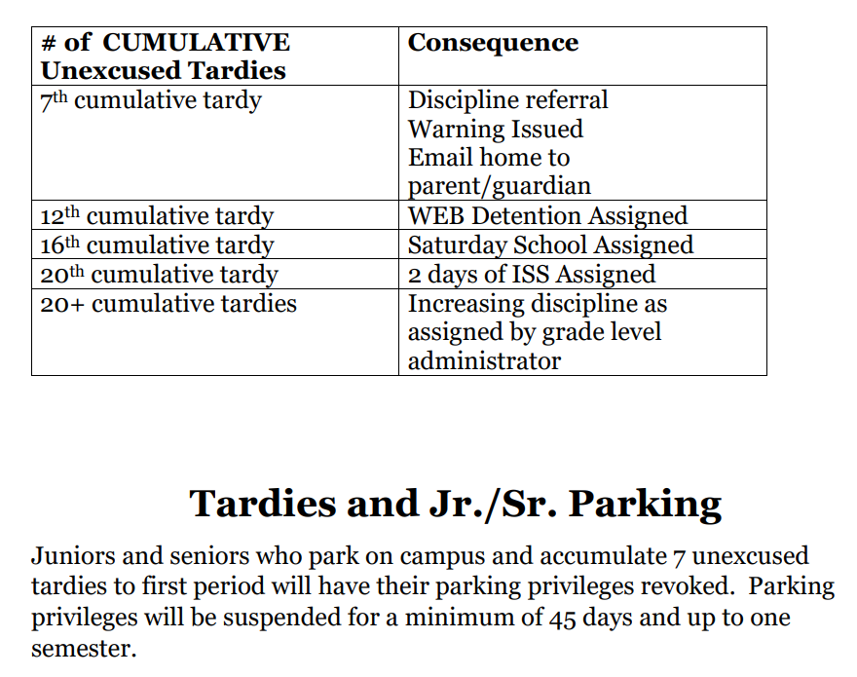

Tardies
Tardies are cumulative over ALL classes!

Slide 10

Appropriate Behavior
24 hours a day/7 days a week
THINK before you post on social media
Administrators can and will enforce CCSD code of conduct for students who violate policy
GHSA has additional consequences for athletes —including loss of game time.

Slide 11
Dress Code
Walton Wear vs Weekend Wear
No hats & hoodies
Length of shorts/skirts
Length of shirts – No midriffs
Undergarments should be worn under other clothing and should not be visible!

Slide 12
Honor Code
Academic Dishonesty
We believe that every student has the right to learn in an environment free from academic dishonesty. Each individual has the duty to display honesty, integrity, respect, and responsibility. Academic integrity is expected on classroom assignments as well as on summer or supplemental assignments.
Student Agenda
  Description and Consequences
  Failure to understand the honor code does not excuse infractions.
Notes:
Pam

Slide 13
Walton Enrichment Block (WEB)
Four 25-minute blocks - Tutoring with teachers, research in the Information Center, make-up work, SAT prep, guest speakers, etc.
Must Stay/May Leave – Parent WEB Permission Form – If on Must Stay List, will receive a WEB Accountability Form in HR; must complete with signatures and turn in before dismissal; discipline consequences!
If leaving early, Must Stay students need to check out with the Attendance Office – Skipping!

Slide 14

WEB Day Schedule
Zero Period
7:10 - 8:12 (62 min.)
1st Period
8:20 - 8:50 (30 min.)
Homeroom
8:56 - 9:05 (9 min.)
2nd Period
9:11 - 9:40 (29 min.)
3rd Period
9:46 - 10:15 (29 min.)
4th Period
10:21 - 10:50 (29 min.)
5th Period
10:56 - 11:25 (29 min.)
6th Period
11:31 - 12:00 (29 min.)
7th Period
12:06 - 12:35 (29 min.)
Q Block/WEB
12:35 -12:55 (20 min.)
A Block
1:00 - 1:25 (25 min.)
B Block
1:30 - 1:55 (25 min.)
C Block
2:00 - 2:25 (25 min.)
D Block
2:30 - 2:55 (25 min.)
All Students to Dining Hall
3:00 - 3:30 (30 min.)
Walton Enrichment Block (WEB)
Notes:
Pam

Slide 15

Importance of 11th Grade
COUNSELING

Slide 16
Junior Year
Important Year!
More independence—more responsibilities
Demonstrate your academic success and readiness for college

Slide 17
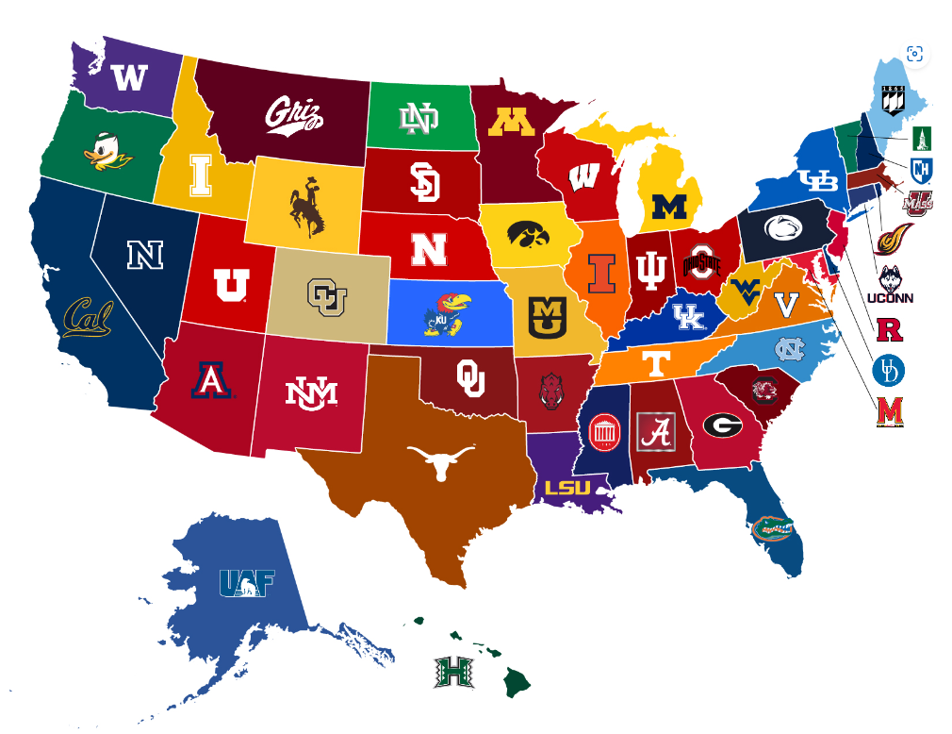
College Visits
Will start mid-August
Sign-up in Naviance 25 hours before the visit
Will need a pass to be excused from class ( signed by teacher)
Add colleges to Naviance "colleges I'm thinking about" to get more info
Juniors have 1 excused off campus college visit.
  Provide documentation on college letterhead.

Slide 18




11th Grade PSAT Oct 23rd
YOU NEED TO REGISTER THIS YEAR THROUGH MYPAYMENTS PLUS FOR $18
Deadline is Friday, August 30th
Aug 24*
Oct 5
Nov 2*
Dec 7*
Mar 8
May 3*
Jun 7
Sept 14 *
Oct 26 *
Dec 14 *
Feb 8 *
Apr 5
June 10
Jul 12
* Testing offered at Walton

Slide 19

Volunteer Service Recognition
Graduation Honor Cord
Students need 180 hours of verified and approved service hours
Deadline to submit service hours for this school year is May 15, 2025
Student's responsibility to get hours verified
More info on Walton website - Students > Community Service Hours

Slide 20



Athletics & Extracurricular Information
Attend events – Get Connected
How to Purchas Tickets – gofan.co
All Sports Pass
  $95

Slide 21
Athletics and Sportsmanship
Expected Behavior:
  Cheer for our teams/students
  Do not yell disparaging remarks at opponents/officials.
  Ejection from event. Suspension from future events!

Slide 22

Where to go for help?
Academic Support – Classroom Teacher
  Make good use of WEB time!
Social/Emotional Health – Walton School Counseling Department
NOT SURE what to do or where to go for help? Just ask!
Dr. Brown’s Office: 2nd Floor (connected to counseling suite)
Email: Julie.Brown@cobbk12.org

Slide 23
HAVE AN AMAZING JUNIOR YEAR!!!

