Slide 1
Welcome to {Kindergarten} 2023-2024

Slide 2
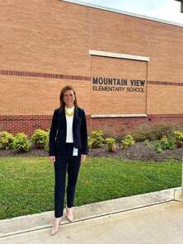
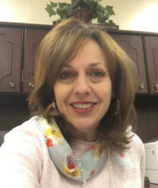
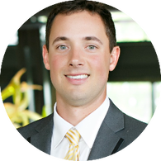
MVES Administration
Principal - Dr. Katie Derman
K-2 Assistant Principal – Ms. Sherry Green
3-5 Assistant Principal – Mr. Kevin Johnson

Slide 3
Kindergarten Teachers
Ms. Cook
Ms. Fennell
Ms. Gunter
Ms. Roman
Ms. Russell
Ms. Smith

Slide 7
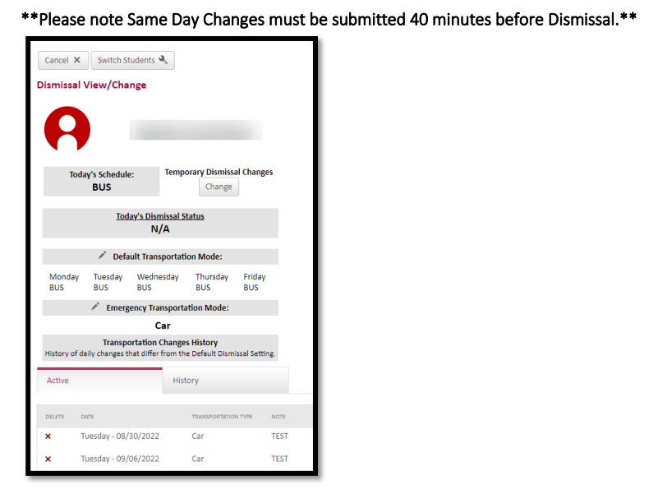
Go Safe
Online Daily Dismissal System
You will access GoSafe through your ParentVue account. - GoSafe will replace any other method of changing your child’s transportation. Because you will have the ability to directly select and change transportation, our school will no longer accept transportation changes by phone or note to your child’s teacher.
“Parents – please make sure you have completed your child’s transportation in GoSafe by Monday. If you have problems accessing GoSafe or need any questions answered regarding this process, please stop by the front office before you leave today and one of our clerks will assist you.”
**Reminder - only the enrolling adult can make changes.

Slide 8
CTLS Parent
Teachers will post announcements and send messages VIA CTLS. Please allow up to 24 hours for a response, as it is not set up like a text message. If you need to contact the teacher immediately, call the front office.

Slide 9
Volunteers
Anyone who volunteers in a school is required to watch a training video and complete a form stating they have been trained.
Information about the video and form can be found on the school website and in the front office. Teachers will also be handing out PINK forms in their classrooms.
Volunteers should visit the training link found in the brochure prior to signing the Acknowledgement of Volunteer Responsibilities under FERPA.

Slide 10
Morning Drop-off
Students may not enter the building any earlier than 7:20.
Afternoon Checkout
Late afternoon check out needs to occur prior to 1:45.

Slide 11
Afternoon Carpool Line
In order to streamline and ensure safety during carpool, please…
Display your car tag visibly in the front window of the car
If no car tag is present, you will be asked to park and show ID in the front office
Reuse car tags from last year, if possible, by changing the grade level(s)
If you need a car tag, the enrolling adult can visit the table in the mezzanine, and ONE tag will be made, per family, at this time.
We appreciate your understanding and flexibility in all carpool matters, and please remember that it will take a little time to work through the efficiency due to
the volume expected.

Slide 12
Homework
Read with your child 20 minutes every night.

Slide 13
Attendance Policy
Regular and consistent attendance is important for students and their academic progress. Mountain View follows the county’s attendance policy with the following procedures:
· Three (3) unexcused absences: Teachers will communicate with parents regarding student attendance via e-mail, phone, parent conference or postcard
· Five (5) unexcused absences: A letter to parents will be sent from administration.
· Seven (7) unexcused absences: A School Social Work referral will be generated.

Slide 14
Lunch Accounts
If your child will be eating in the cafeteria, be sure to put money on their accounts. This can be done on mypaymentsplus via CTLS Parent. Be sure to fill out the form in your child’s classroom if they are able to get extras at lunch, i.e. ice cream.
Specials
6 special rotation – PE, STEM, Tech, PE, Art, Music
Students must wear tennis shoes on PE days!

Slide 15
Kinder Tidbits
Label, Label, Label – jackets, water bottles, lunch boxes, etc.
Snacks – please send in 1 healthy snack a day. Do NOT put this in your child’s lunchbox, but rather in a front pocket so it’s easily accessed.
Water Bottle – Be sure to send in a water bottle every day – WATER ONLY.
Take Home Folder – please clean out folders every night and return the next day. Students will be responsible for getting their folders out of their bookbags and turning them in everyday.
Extra set of clothes – Accidents happen, so for this reason, please put an extra set of clothes in a Ziploc bag and put in your child’s bookbag. These will stay there unless needed. Be mindful of the weather and change the clothes out throughout the year.

Slide 16
Kinder Tidbits
First week name tags – be sure to send your child in with their name tag every morning the first week of school. This will ensure they get to where they are going. ☺

