Slide 1
Meet Sora
© Copyright 2024, OverDrive, Inc.

Slide 2
What is Sora?
Sora is a student reading app.
With Sora, you can read ebooks, listen to audiobooks, and more!
Students can log in to Sora any time, 24 hours a day – at school and at home.
© Copyright 2024, OverDrive, Inc.

Slide 3
Digital books are available to students 24/7, whether they are in school or at home.

Slide 4
Sora serves students
Sign in easily with existing school credentials
Borrow ebooks and audiobooks quickly
Interact with text while reading or listening to titles
Improve student equity with a customizable reading experience
Add a public library to expand your access to digital books
© Copyright 2024, OverDrive, Inc.

Slide 5
Access Sora
© Copyright 2024, OverDrive, Inc.

Slide 6
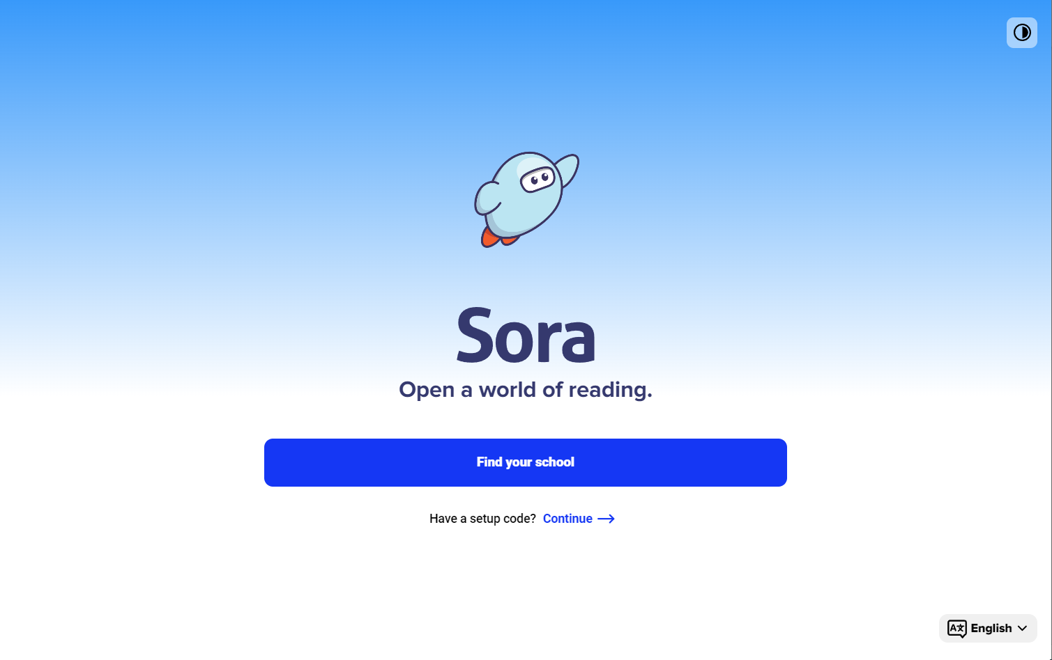
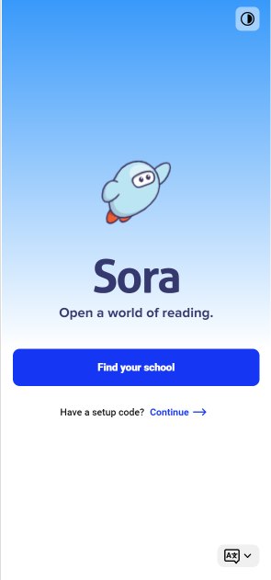
Get started
Option 1: Download the Sora app
Option 2: Use Sora in your web browser
soraapp.com
© Copyright 2024, OverDrive, Inc.

Slide 7
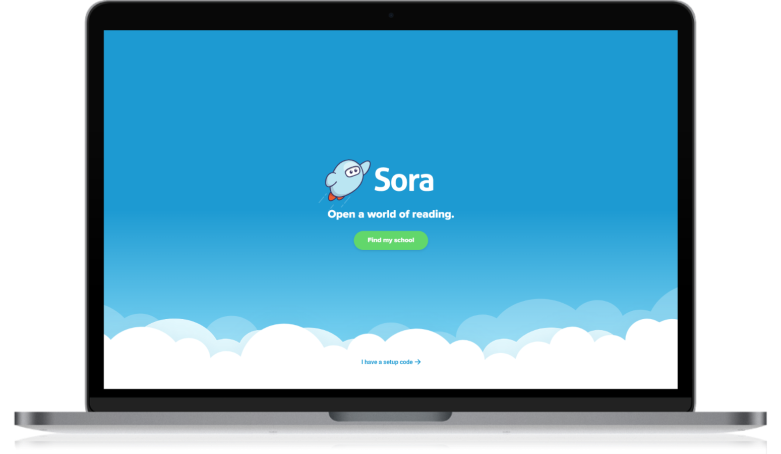
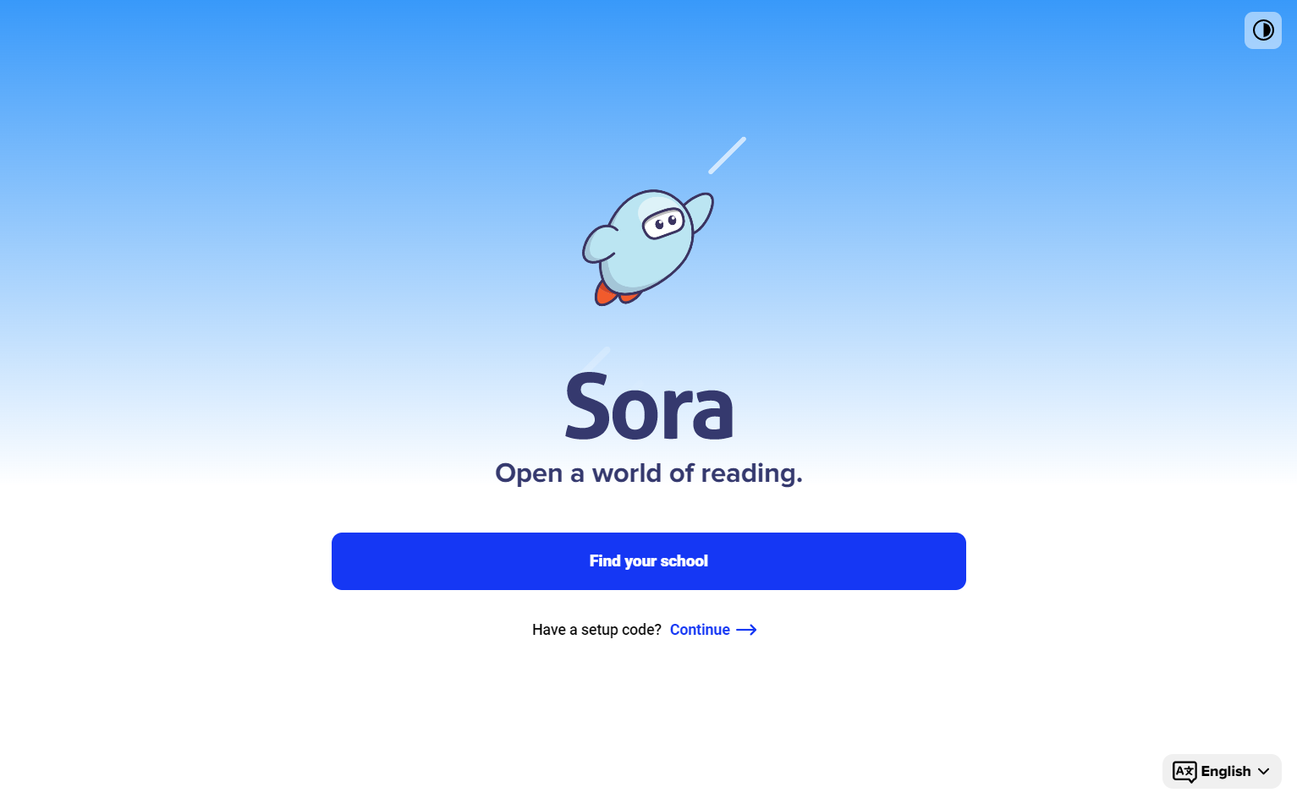
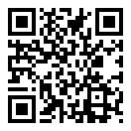
Signing into Sora
Sign into Sora in 3 easy steps!
Access Sora: School Specific URL
Sign in with your school credentials
Browse, borrow, enjoy!
Scan this QR code to start exploring Sora!
© Copyright 2024, OverDrive, Inc.

Slide 8
Feature Overview
© Copyright 2024, OverDrive, Inc.

Slide 9
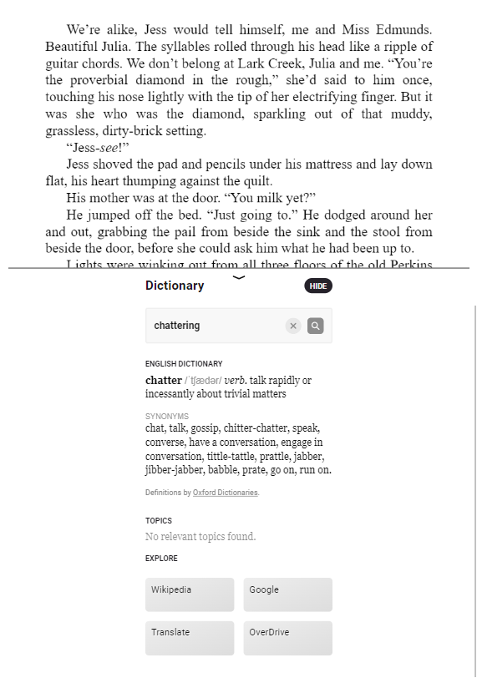
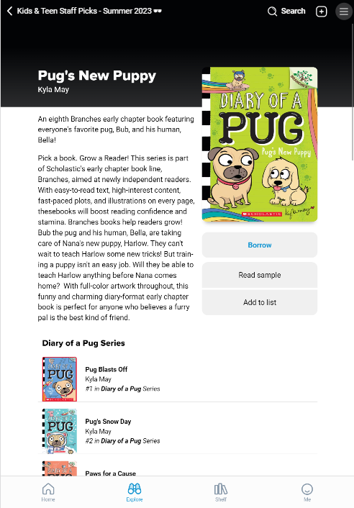
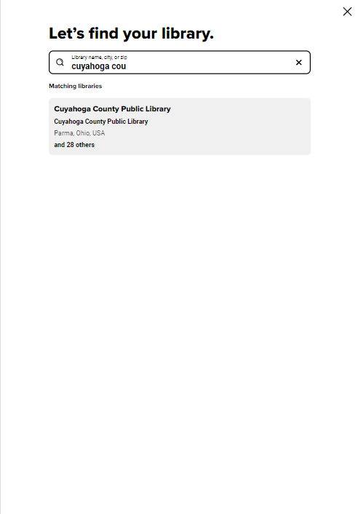
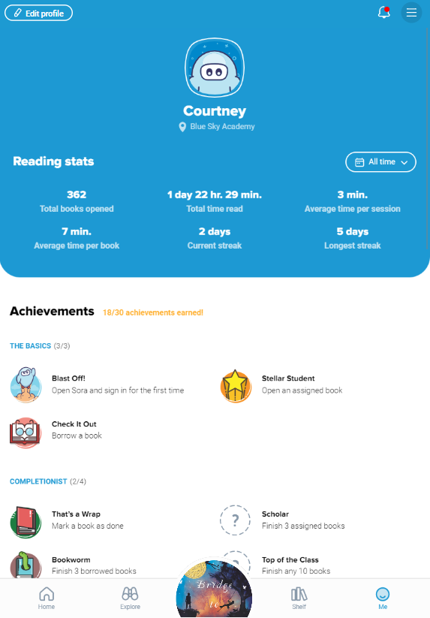
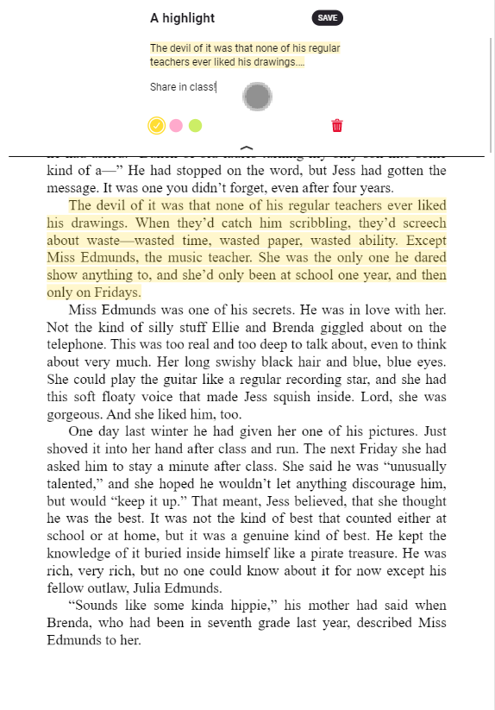
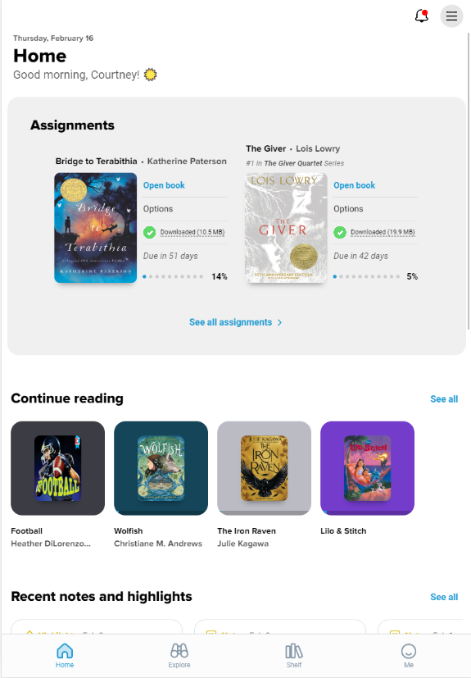
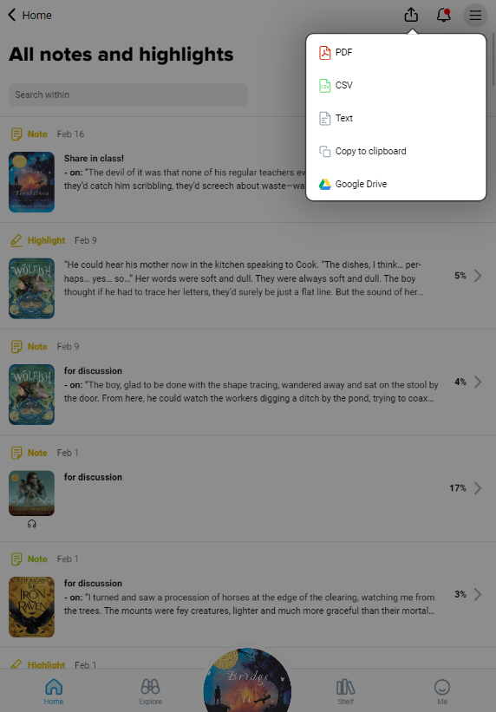
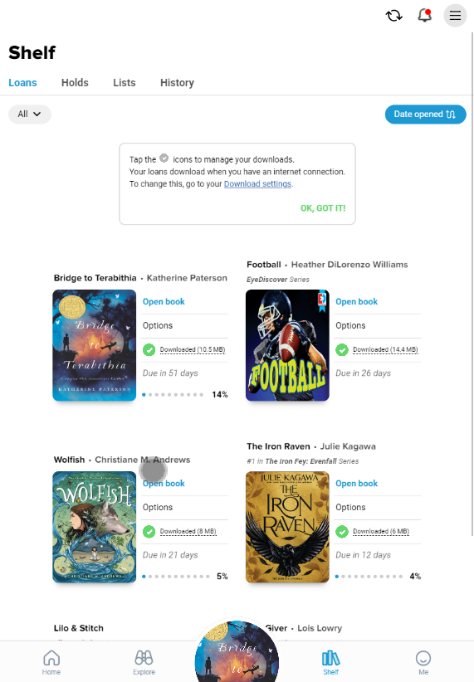
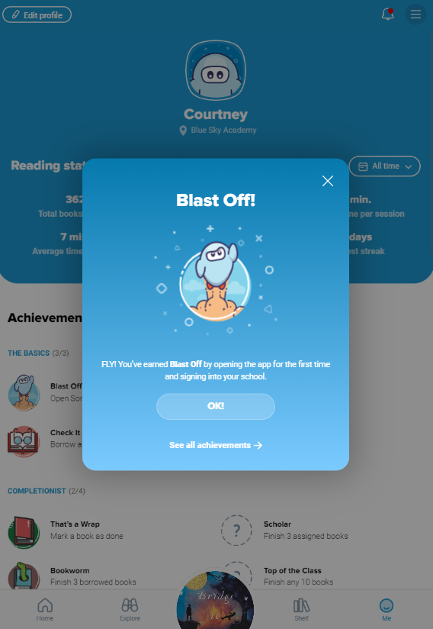
Sora features
Access assigned titles
Add notes and highlights
Define words and access Google Translate
Export your great annotations
Read or listen offline
Earn achievement badges
Add a public library’s digital collection
View individual reading statistics
Read with a tap

Slide 10
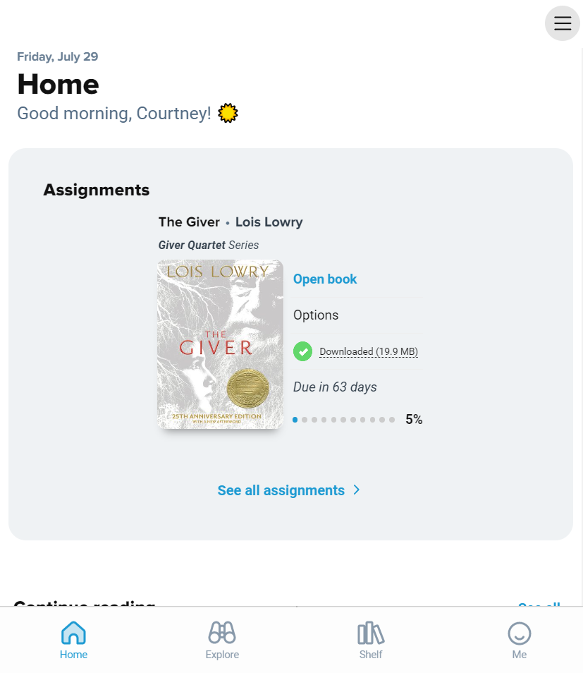
Assigned titles
Appear on the Home tab
Students always have access to their assigned reading via their devices
Ensures that the right book is in the hands of the right student – 24/7
Protects privacy for students reading at varying levels
© Copyright 2024, OverDrive, Inc.

Slide 11
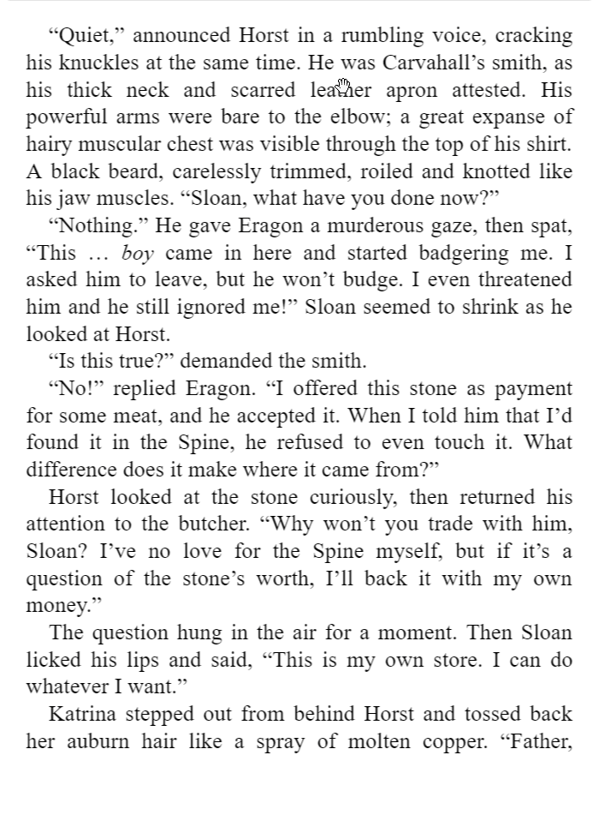
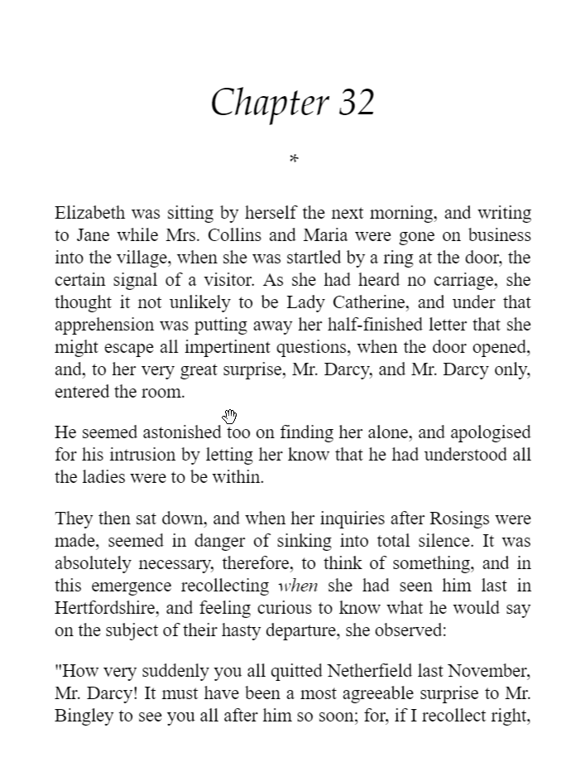
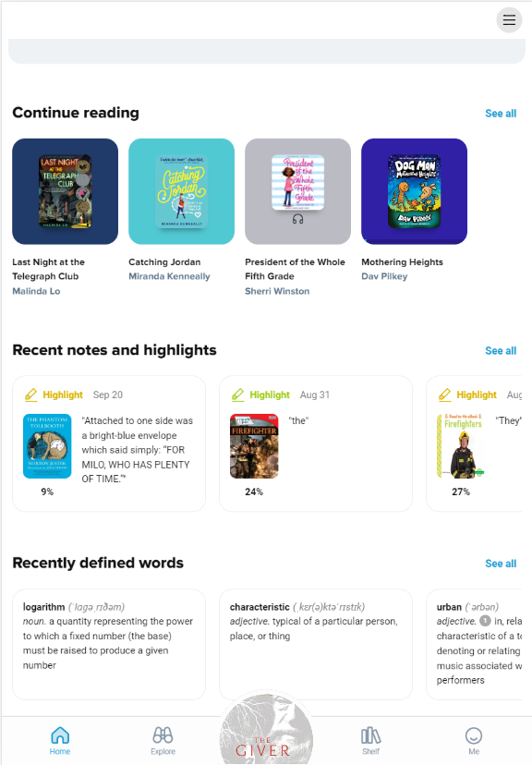
Define new words
Define while reading
View synonyms and related definitions
Use Google Translate for pronunciation or language translation
© Copyright 2024, OverDrive, Inc.

Slide 12
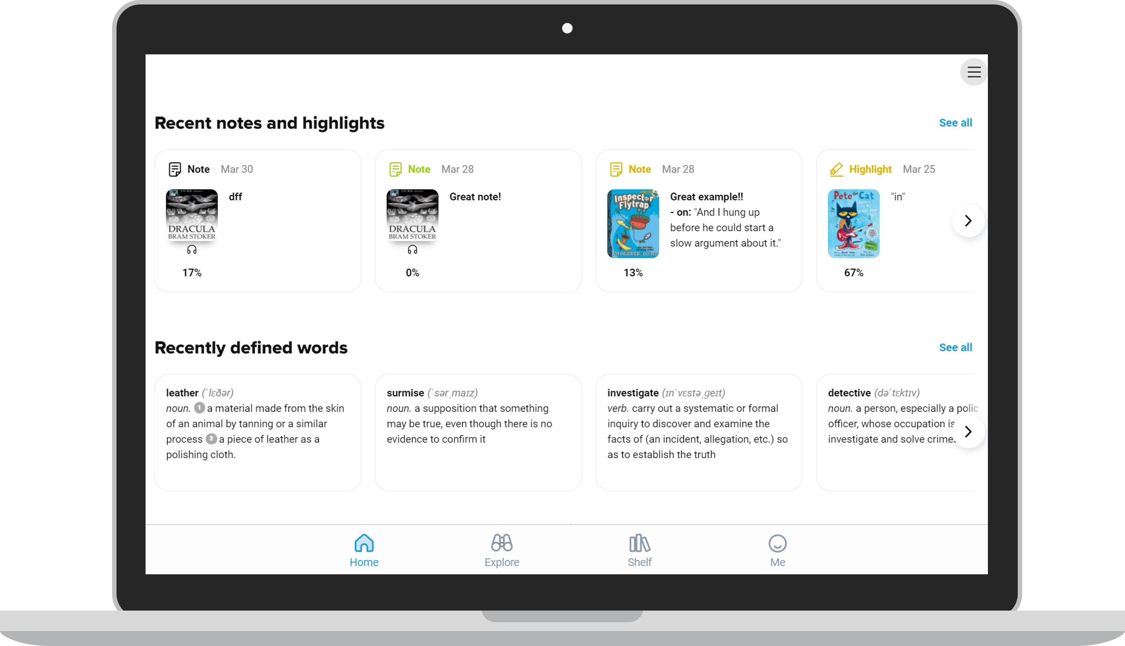
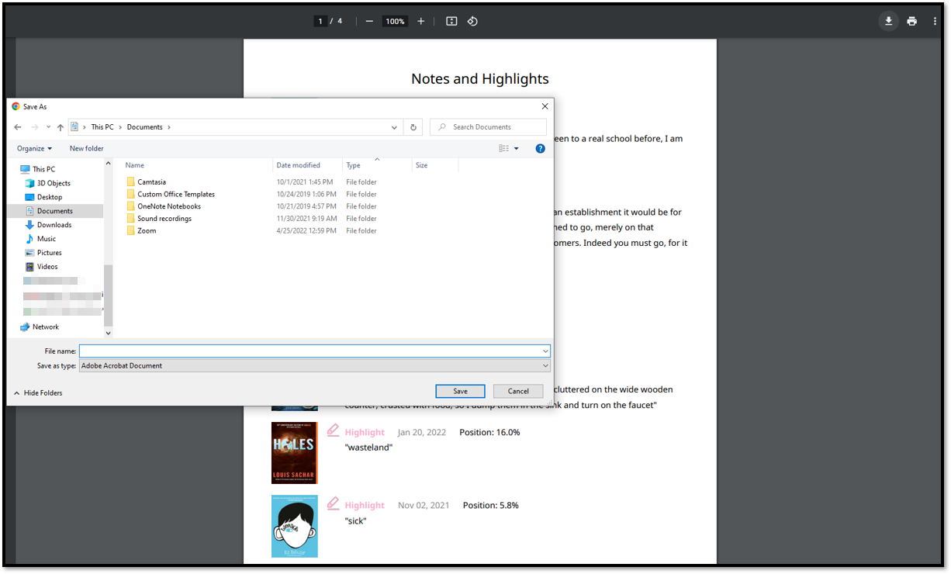
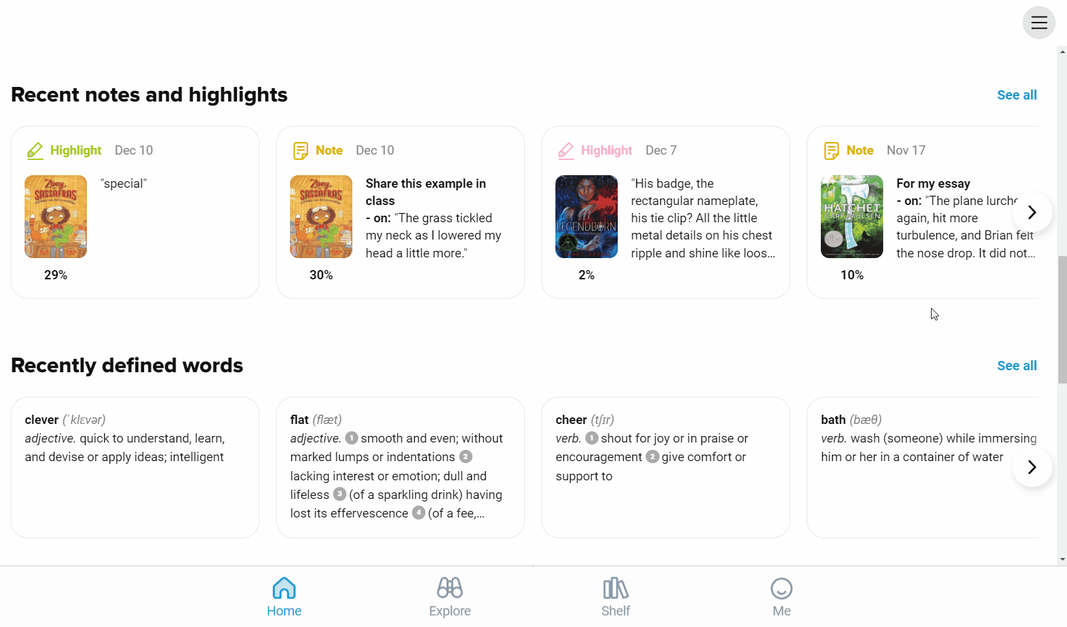
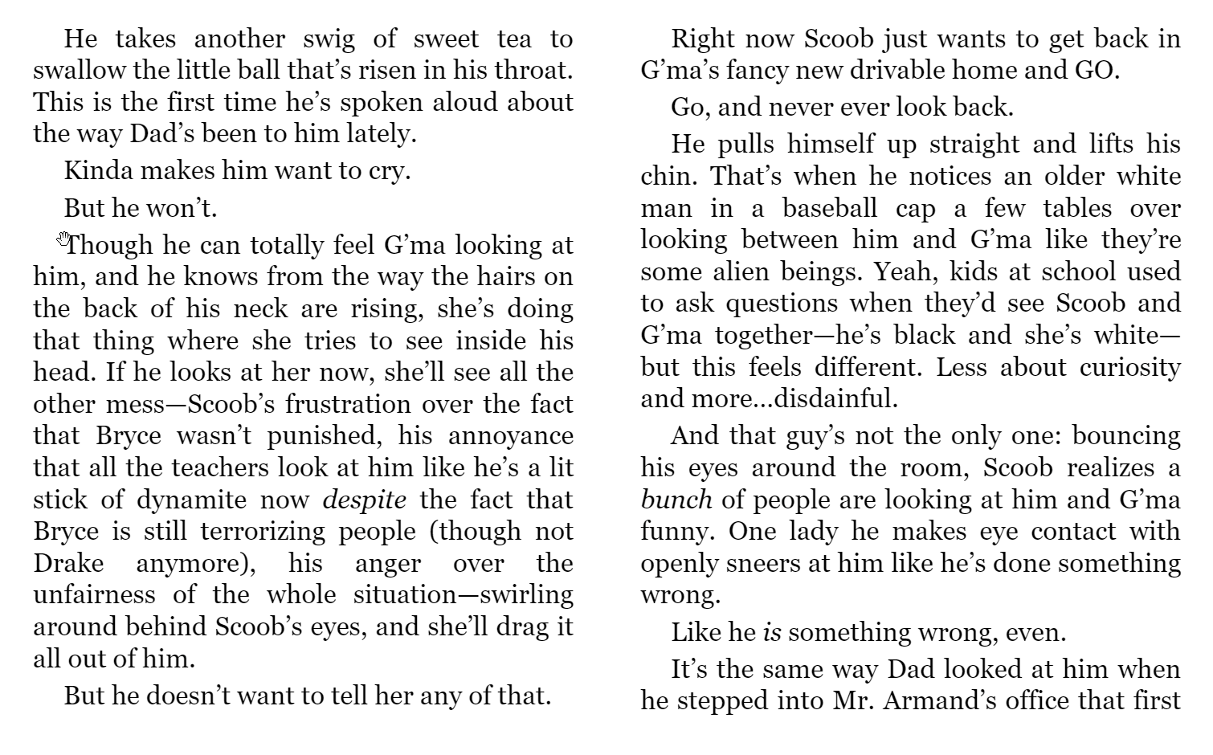
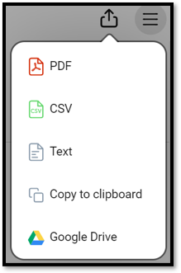
Export notes & highlights
Create annotations while reading
Annotations are saved even after the book is returned
Access Recent notes & highlights on the Home tab
Filter, sort, & export
Save, print, or share as needed
© Copyright 2024, OverDrive, Inc.

Slide 13
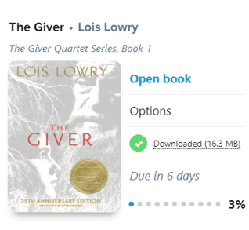
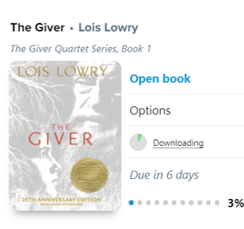
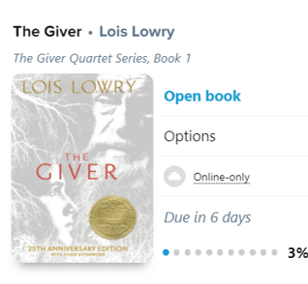
Offline access
Title has fully downloaded for offline use.
Once a title has been downloaded, you can disconnect from the internet and read or listen on the go.
On Shelf > Loans:
A green checkmark means the title was successfully downloaded.
A green circle filling in like a piece chart means the title has begun downloading.
A cloud icon means the title has not yet begun to download. Tap cloud to begin.
Change download preferences under the Main Menu in Sora.
Title is in the process of downloading.
Title has not downloaded.
It is only available to stream online.
© Copyright 2024, OverDrive, Inc.

Slide 14
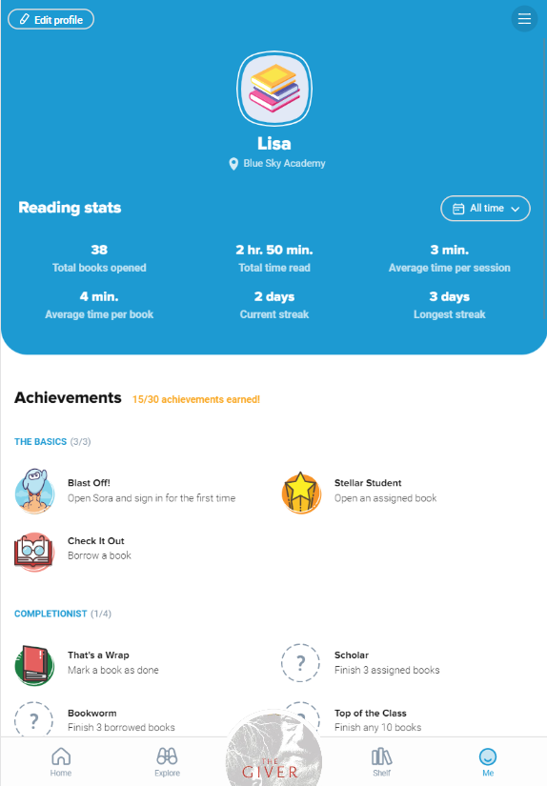
Gamification: Achievement badges
Subject-based achievements:
Fiction
Nonfiction
Animals & Pets
Biography & Autobiography
Health & Fitness
History
Music
Mystery
Science
Science Fiction & Fantasy
© Copyright 2024, OverDrive, Inc.

Slide 15
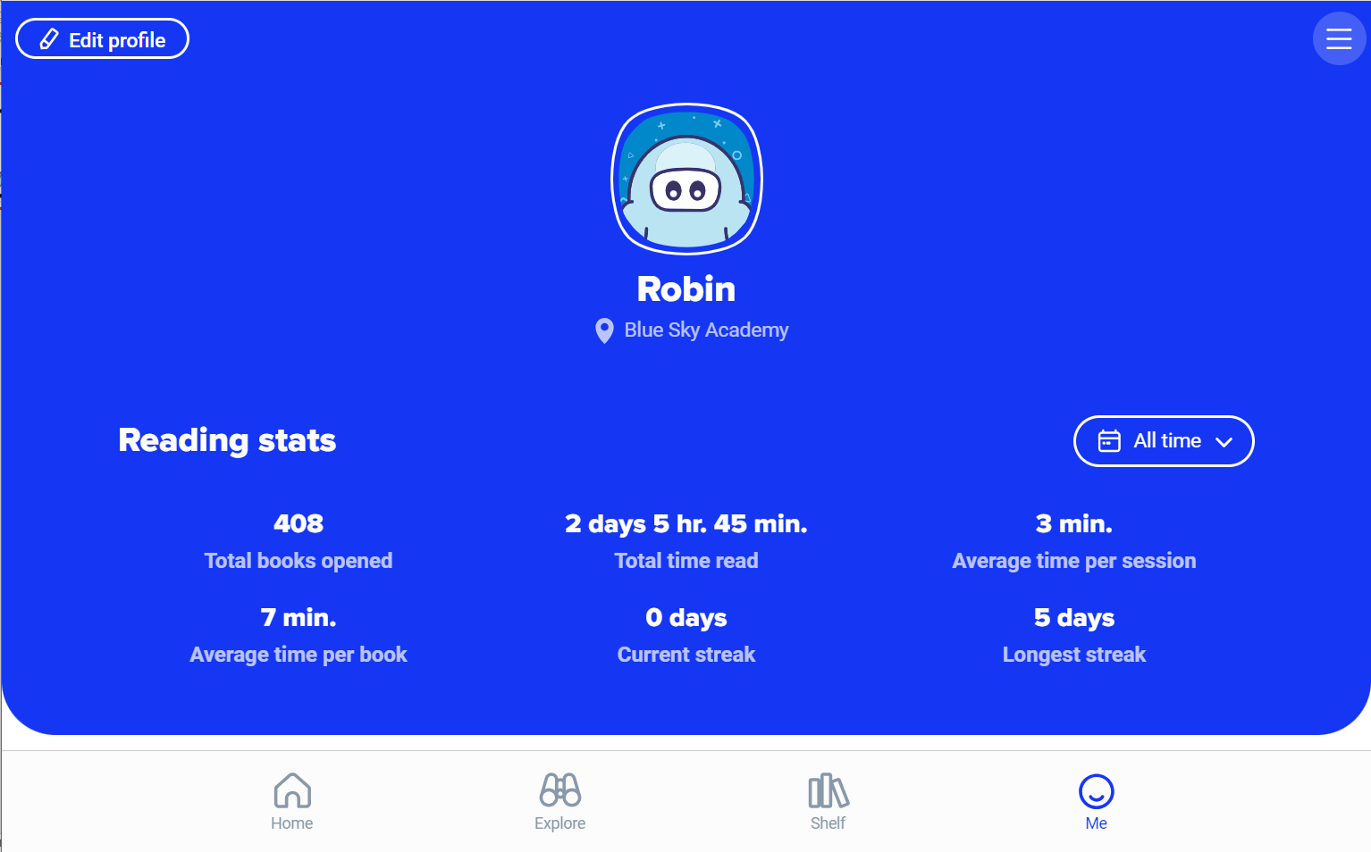
Individual reading stats
Private to each reader’s account. Users can share with a screenshot.
Filter to show stats for All time, Today, or a Custom date range.
Available on the Me tab.
© Copyright 2024, OverDrive, Inc.

Slide 16
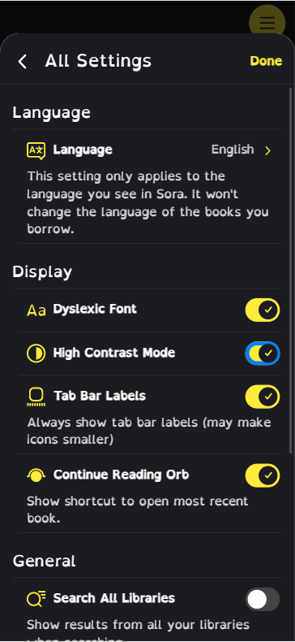
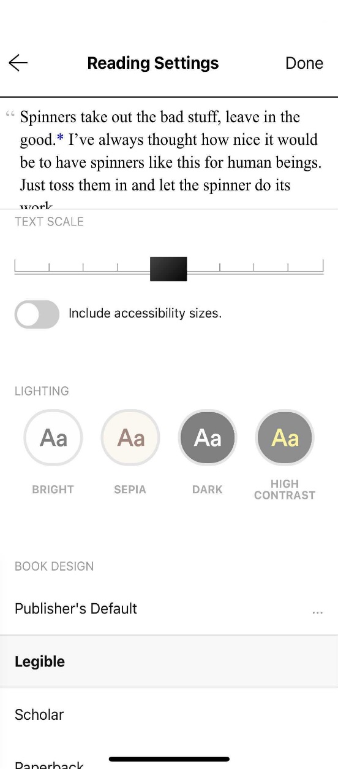
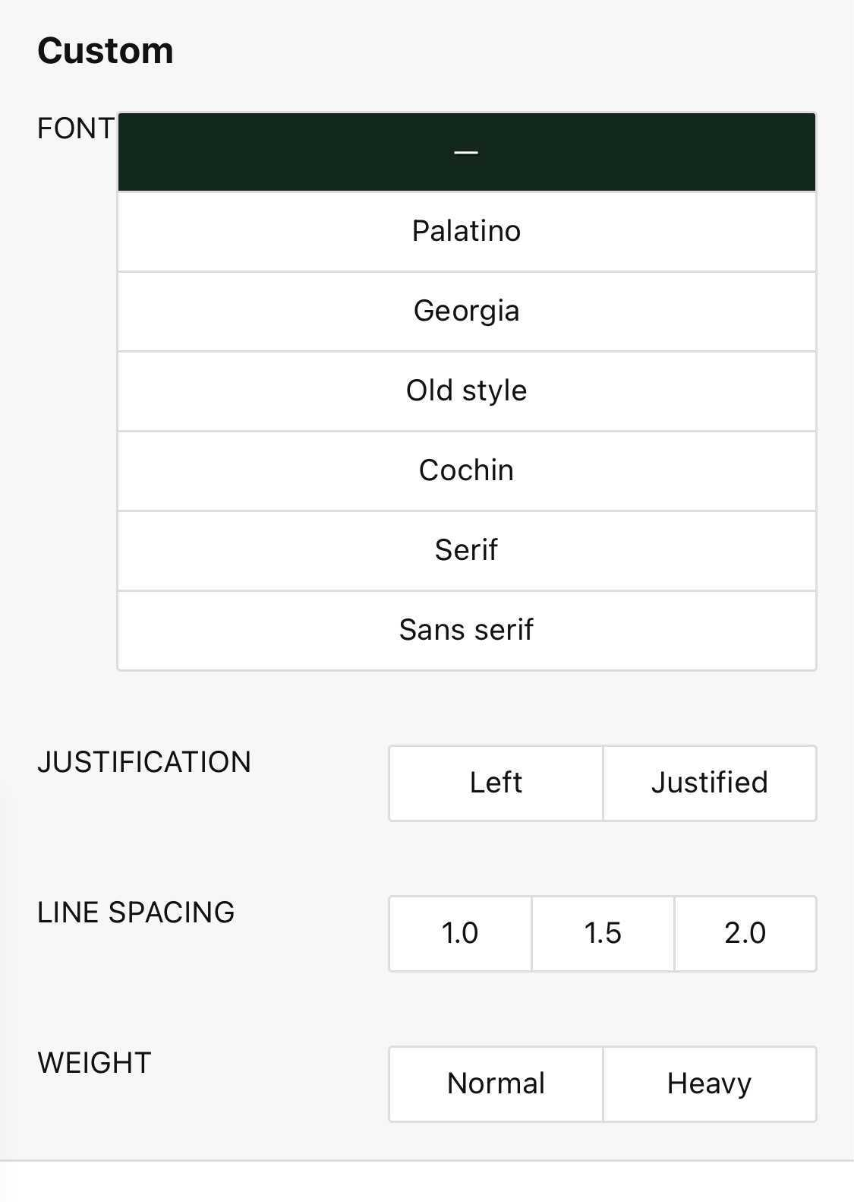
Personalization features make reading more accessible and enjoyable
Adjustable fonts, text sizes and screen lighting
High-contrast mode

Slide 17
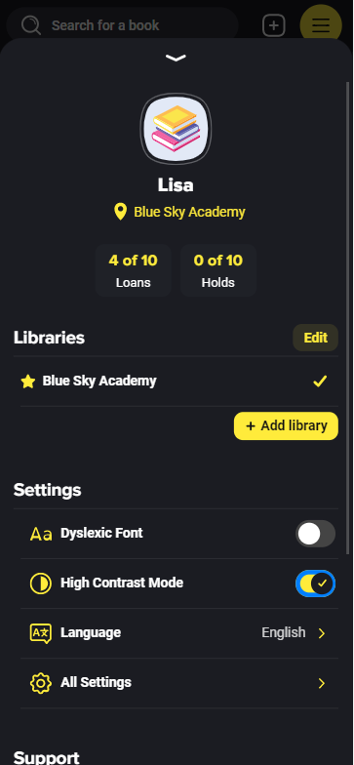
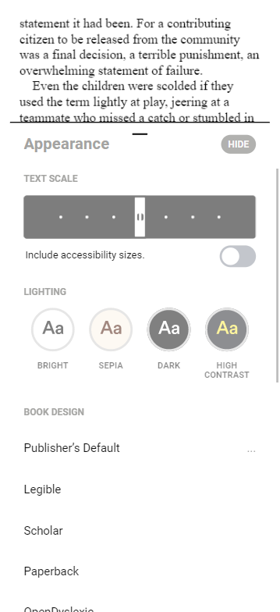
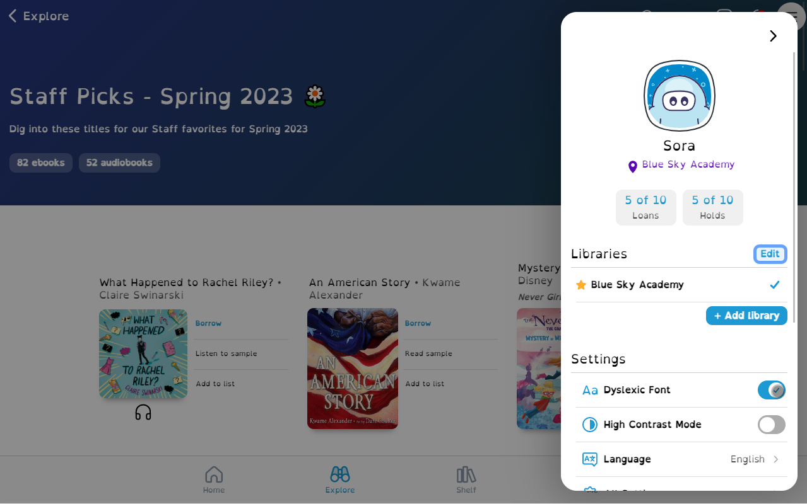
Personalization settings
High-contrast mode
Adjustable fonts, text sizes and screen lighting
Dyslexic font

Slide 18
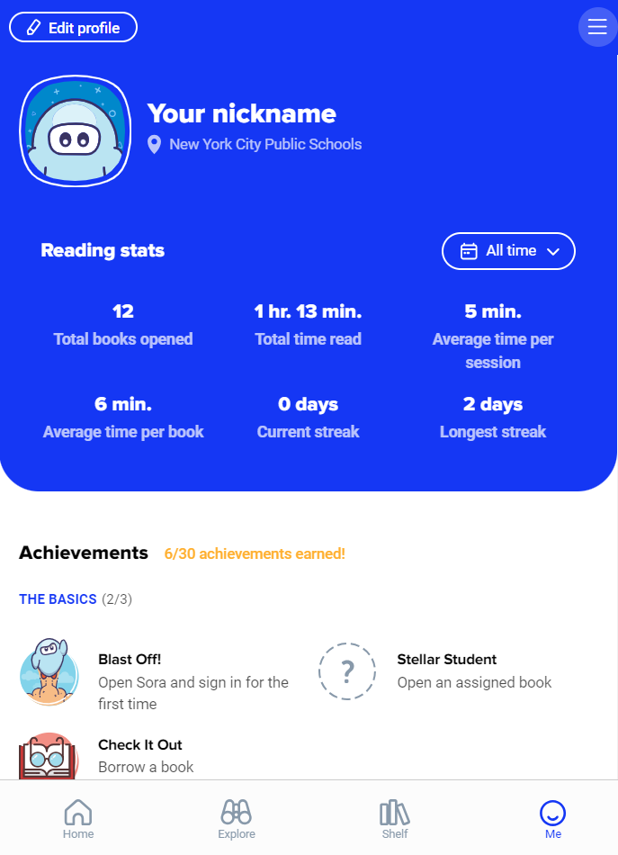
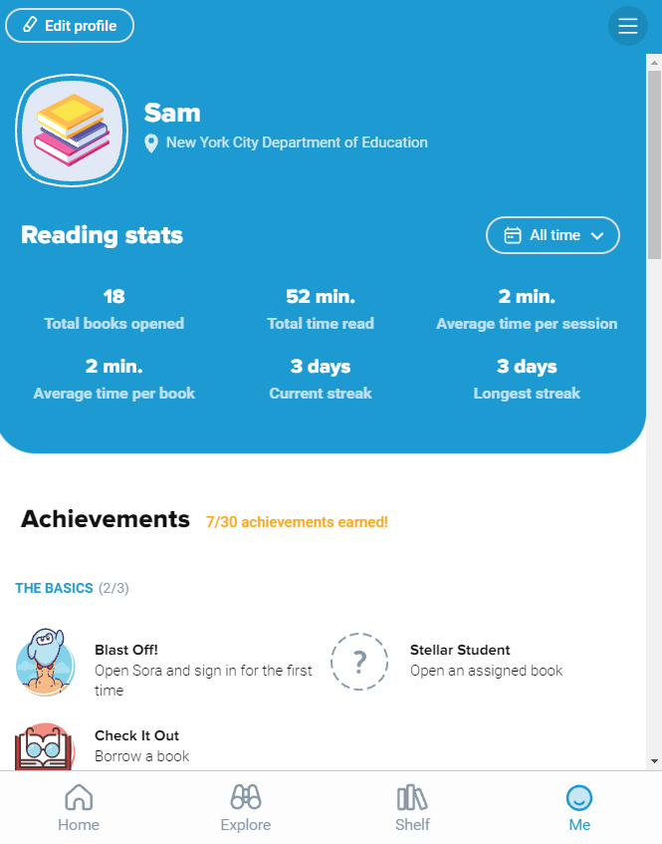
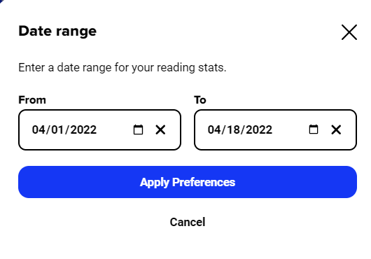
Reading logs & self-assessment
Students can track their reading data in Sora​
Flexible date range with key factors like:​
Total time read​
Average time per session​
Average time per book​
Streaks (days in a row)​​
© Copyright 2024, OverDrive, Inc.

Slide 19
Additional Formats & Features
© Copyright 2024, OverDrive, Inc.

Slide 20
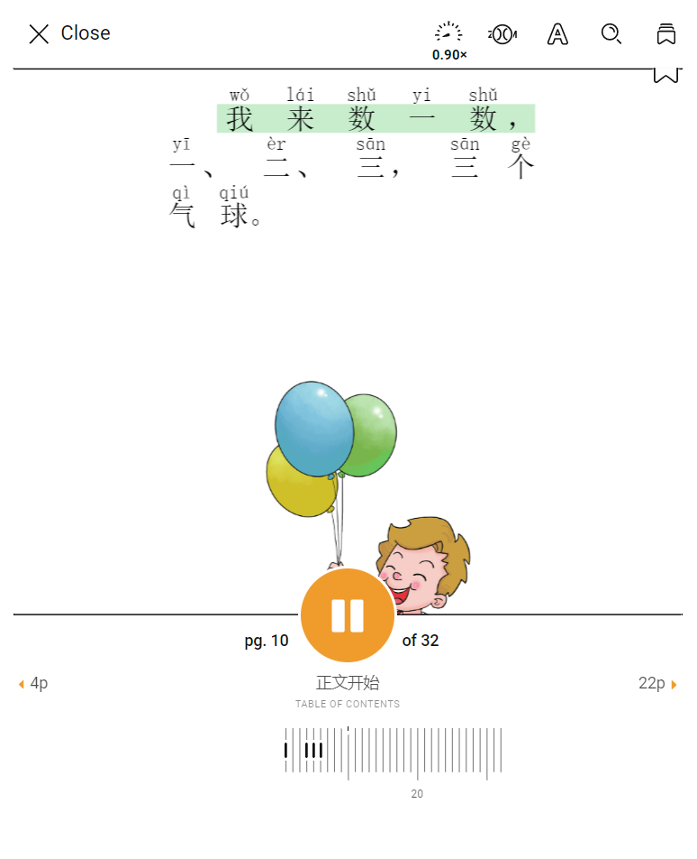
Read-alongs
Professional narration & words spotlighted
Associate words with sounds
Build confidence & decrease anxiety
Grow vocabulary & aid comprehension
Zoom in & customize playback speed
Share titles using filters & direct links.
Tip: Curate collections to help with discovery!
© Copyright 2024, OverDrive, Inc.

Slide 21
Audiobooks
Professional narration & engaging dialogue
Model fluency, pronunciation, & pacing
Keep students on grade level with heritage language
Privacy & equity for students
Support mastery for language learners
Customize playback speed & sleep timer
© Copyright 2024, OverDrive, Inc.

Slide 22
Comics and graphic books
Sequential art that tells a story, often formatted in a panel layout
ZOOM in on pictures and text with Sora
Promotes interest & engagement; great for emerging readers
© Copyright 2024, OverDrive, Inc.

Slide 23
Magazines
Popular titles for kids & teens
Supports literacy
Engaging, short text
Browse back issues
New issues added automatically
Pro-tip: Magazines don’t count towards checkout limits!
© Copyright 2022, OverDrive, Inc.

Slide 24
Personalize your Sora profile
Edit your nickname
Choose your avatar
Save your changes
© Copyright 2024, OverDrive, Inc.

Slide 25
Multilingual interface
Display the Sora app in one of 13 languages
Access multilingual tools at sign in or anytime under the Main Menu
Note: This does not change the text within the titles. Use filters to find titles in other languages!
© Copyright 2024, OverDrive, Inc.

Slide 26
Read to Me
Read to Me is a text-to-speech feature that gives students the power to select a word, phrase, sentence, or paragraph in an ebook and have the text read aloud.
Furthermore, readers can use customization tools like reading speed and volume controls to tailor their experience to meet their unique needs and preferences.
© Copyright 2024, OverDrive, Inc.

Slide 28
Learn More
© Copyright 2024, OverDrive, Inc.

Slide 29
Sora Help
Detailed, step-by-step articles to help you:
Get started
Use Sora
Troubleshoot
© Copyright 2024, OverDrive, Inc.

Slide 30
How-to Videos
Short, visual overviews to help you:
Explore Sora
Learn how to use tools and features
Customize the app
© Copyright 2024, OverDrive, Inc.

Slide 31
Thank You!
© Copyright 2024, OverDrive, Inc.

