Slide 1


Meet the New Staff at Daniell

Slide 2
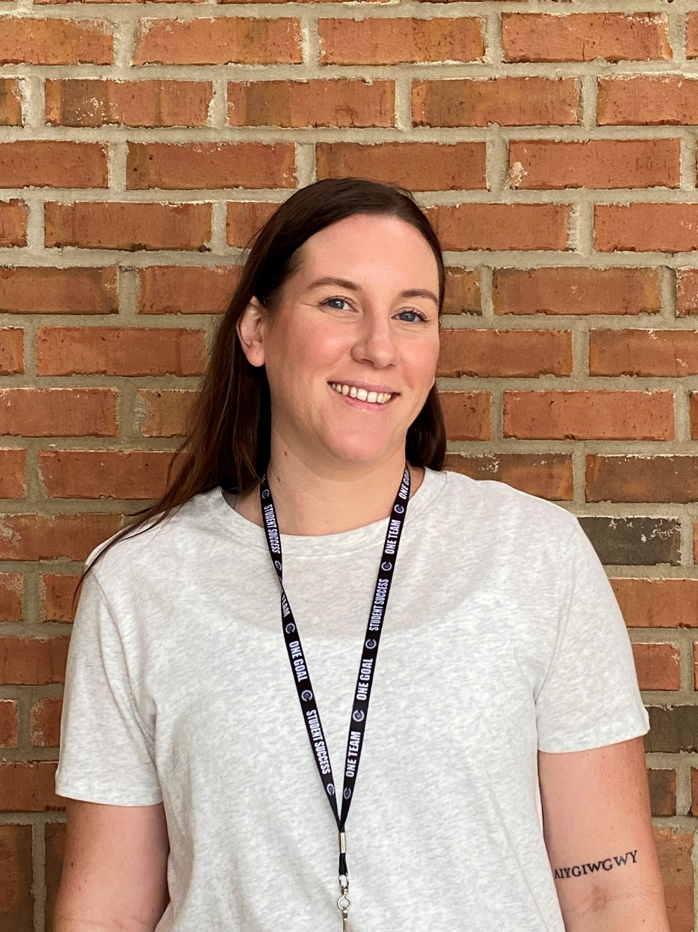
Lacey Edwards
6th Science
“I'm excited about returning back to Daniell and getting to teach 6th grade science this year!”
WELCOME TO J.J. DANIELL!

Slide 3
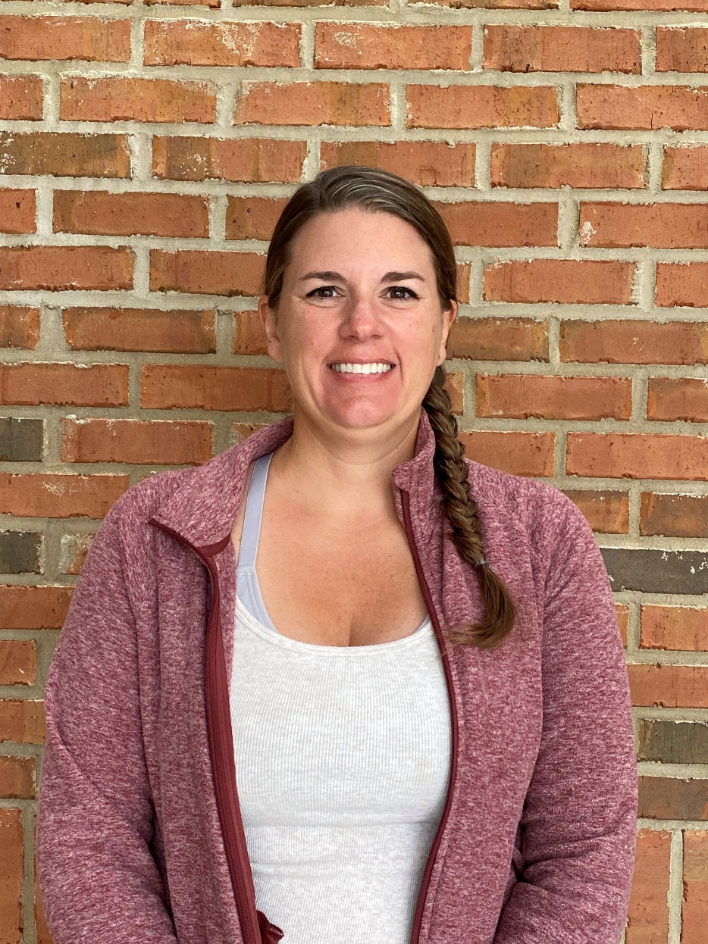
Amy Klemm
7th ELA
“This year, I’m pumped to watch my 7th graders get creative, crack open stories that actually mean something to them, and grow into confident, curious thinkers—one meme, metaphor, and messy draft at a time.”
WELCOME TO J.J. DANIELL!

Slide 4
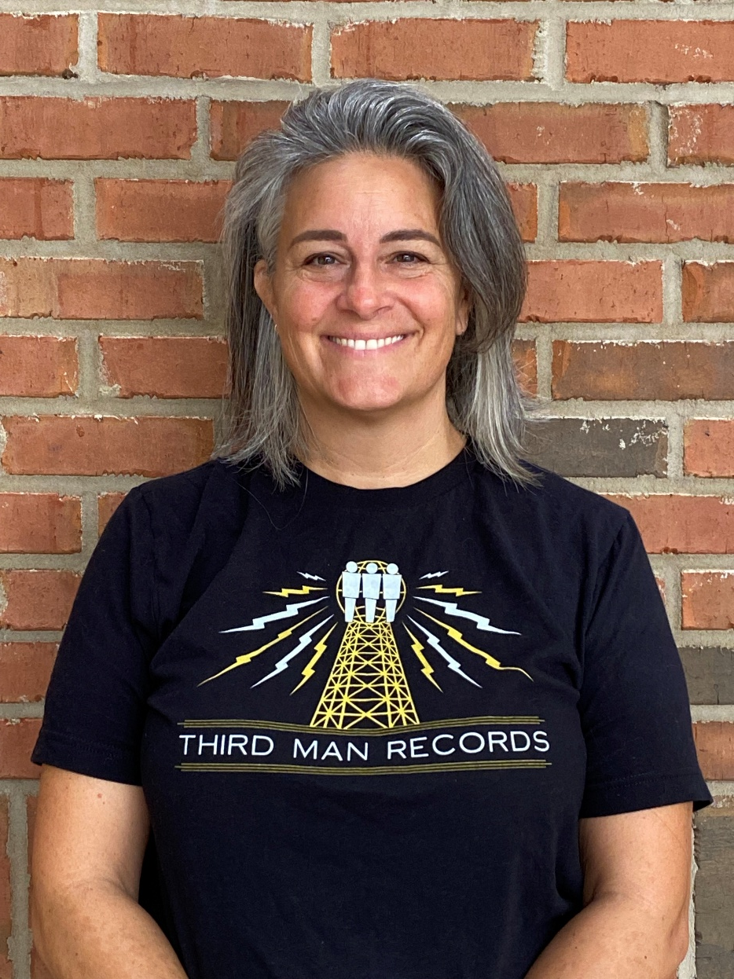
Jessica Hood
ART
“I can't wait for all you AWESOME Daniell students to experience what my art class is all about. It's more than meets the eye!”
WELCOME TO J.J. DANIELL!

Slide 5
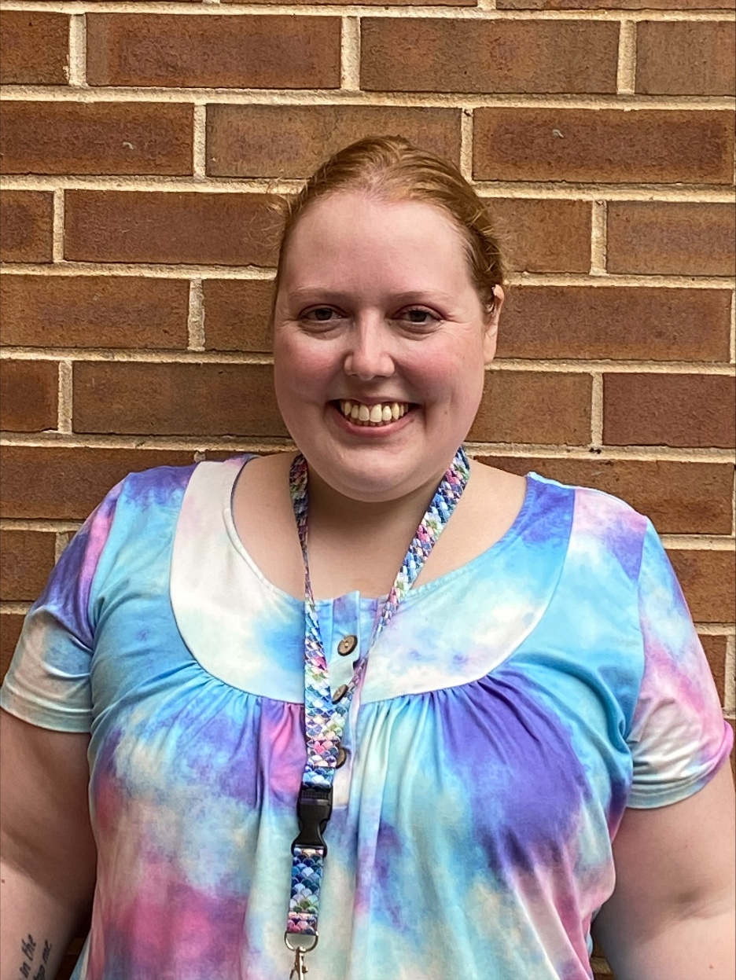
Tyler Shuman
Paraprofessional
"I am excited to meet new friends and help them learn!"
WELCOME TO J.J. DANIELL!

Slide 6
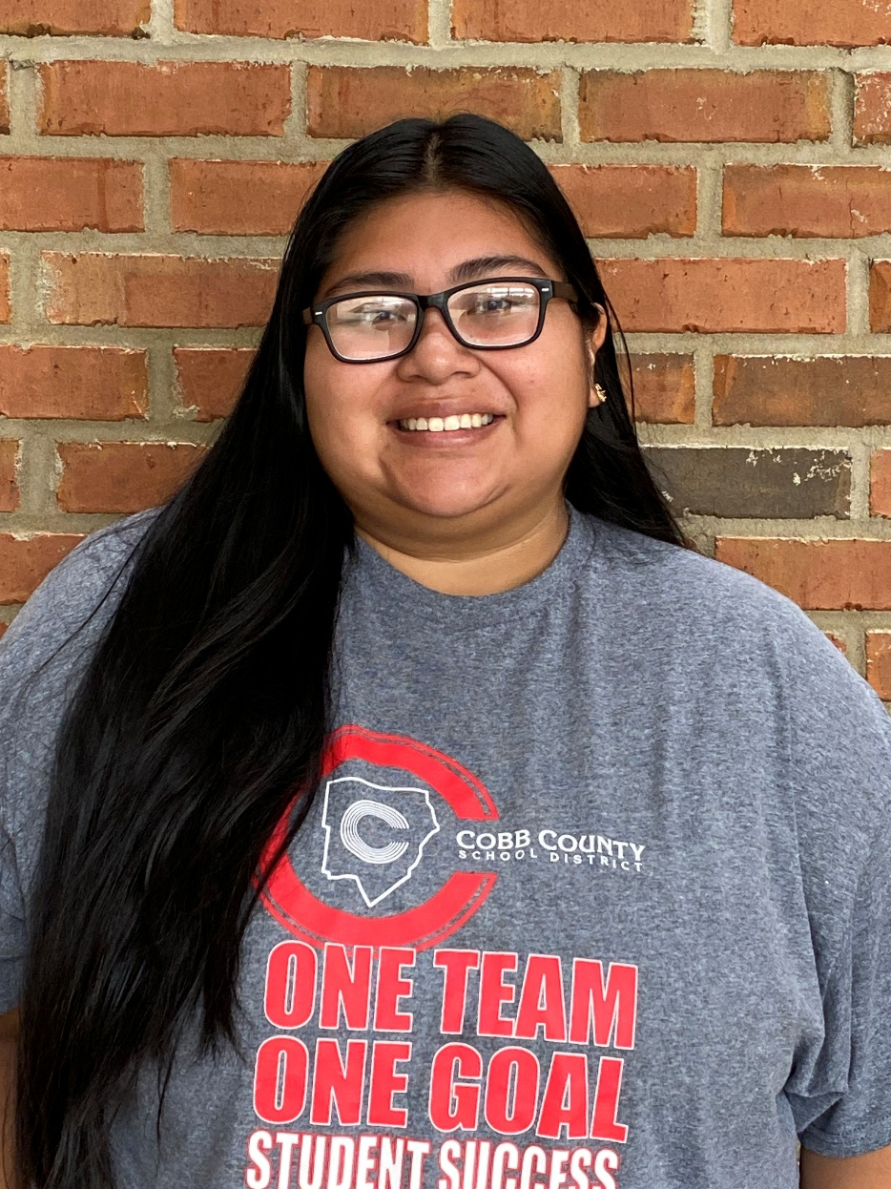
Janelle Morales
ISS Paraprofessional
“This school year, I'm excited to build strong relationships and create a supportive space for students. I'm ready to help them grow both in and out of the classroom.”
WELCOME TO J.J. DANIELL!

Slide 7
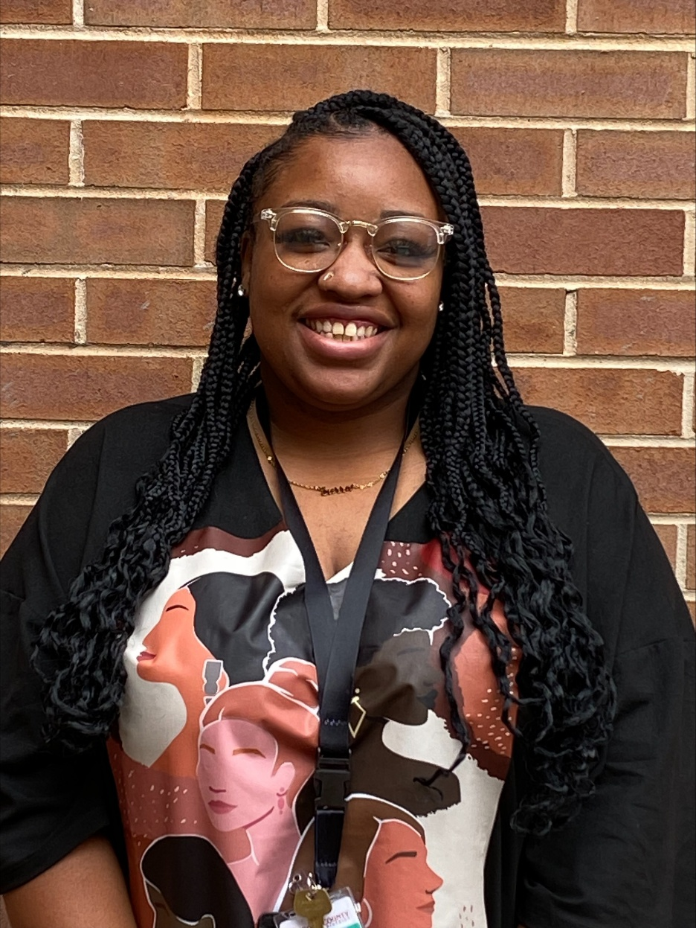
sIERRA HARRIS
Paraprofessional
"I’m excited about the opportunities ahead to grow, learn, and connect with others. I’m looking forward to all the new experiences and challenges that will help shape a successful year."
WELCOME TO J.J. DANIELL!

