Slide 1

Open House/Academic Night
February 9, 2023

Slide 2
Tonight’s Purpose
Provide specific information to you regarding academics & testing
Provide information about upcoming tests – what they are used for
Information about daily homeroom
Learn the focus of our school counselors for each grade level
Share some great things from Aug to now
Share upcoming events
Visit our Book Fair; purchase a candy gram; visit our school store for spirit wear
Let you know that we are here for you!

Slide 3

Topics Covered when you visit your student’s classroom
Math – detail about the Math Inventory (MI), purpose, what it is used for
ELA - detail about the Reading Inventory (RI), purpose, how you can support reading at home at the MS level
Reading – Reading Plus
Science – Milestone Exams
Social Studies – Interim Exams
Connections – Connections overview & supporting our school goals

Slide 4
Homeroom Every Day -
Monday – Wildcat Way – reviewing grades, making a weekly to-do list, tracking progress on academic tracker
Tuesday – Math; Freckle/Dreambox/Khan Academy
Wednesday – Sci/SS
Thursday – ELA/Reading; Reading Plus, Read 180, System 44
Friday – Reflect/Complete/Incentive Activity

Slide 5
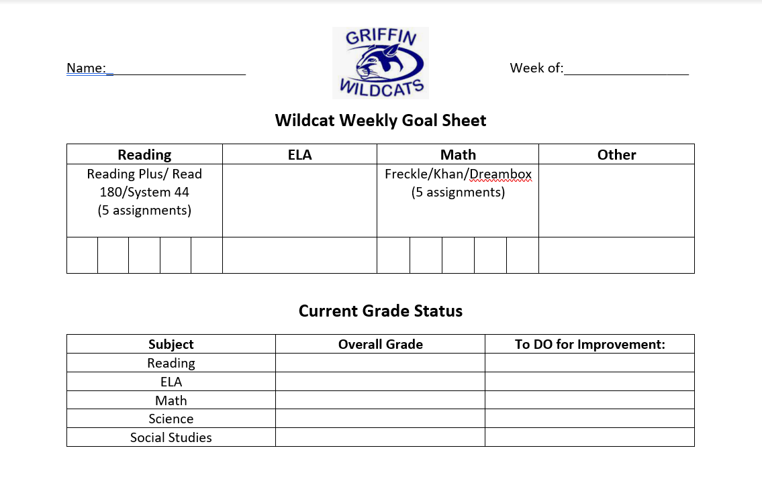
Students fill this out every Monday during Homeroom

Slide 6

Griffin’s 2022-23 School Goals, Mission & Vision
Have a 15% or more increase in students moving a band level in each grade for Reading and Math proficiency.
Our School Mission matches that of the district: One Team. One Goal. Student Success.
Our Vision: To Advocate For and Empower The Learning Of All Students
We are preparing our students to be successful while here, at high school, and beyond. The ultimate goal is for them to receive a diploma! We are also developing the next generation of leaders.

Slide 7
Reading Inventory – Where Should Your Student Be Performing?
Levels: | Below Basic | Below Proficiency | Proficient | Advanced
6th | < 729 | 730 - 924 | 925 - 1070 | 1071 – 1700+
7th | < 769 | 770 - 969 | 970 - 1120 | 1121 – 1700+
8th | < 789 | 790 – 1009 | 1010-1185 | 1186 – 1700+

Slide 8
Math Inventory – Where Should Your Student Be Performing?
Levels: | Below Basic | Below Proficiency | Proficient | Advanced
6th | 125 - 659 | 660 - 784 | 785 - 890 | 891 – 1138+
7th | 393 - 752 | 753 - 880 | 881 - 970 | 971 - 1141+
8th | 422 - 845 | 846 - 1000 | 1001-1089 | 1090 – 1296+

Slide 9
G.R.O.W.L.
Giving Recognition of Wonderful Learning
Students will be recognized for:
  All A’s and B’s at 4 ½ weeks
  Growth on MI & RI
  Raising grades in 2 classes by a letter grade F to D or better, D to C or better, C to B if better; comparing grades on progress reports to Q4 grades :
    ELA & Math,
    ELA & one other content class
    Math & one other content
  Students will be given a choice board to choose which incentive they are working towards
  Students can provide ideas for incentives for Q4 G.R.O.W.L
  If you have ideas or would like to make a donation of items, gift cards, etc., please let us know.

Slide 10
Milestones – ALL online with student laptops
We have approximately 95% of our students who have been issued district laptops at Griffin.
Our testing plan for Milestones depends on our students bringing their fully charged laptops to school each day during testing. We will not be able to have AM testing followed by academic classes in the afternoon if this does not occur.
We do not have enough laptops/desktops in school in order to complete grade level testing without students bringing their laptops. If this occurs we will have to run both AM and PM testing schedules which will result in silent transitions, study halls in the AM for those testing in the PM. This makes for a VERY long day for everyone.
Please help us make our testing administration go as smooth as possible by having your student bring their fully charged laptops to school each day. They should already be doing this now, but it is IMPERATIVE during testing.

Slide 11


School Counseling &
High School Programs

Slide 12
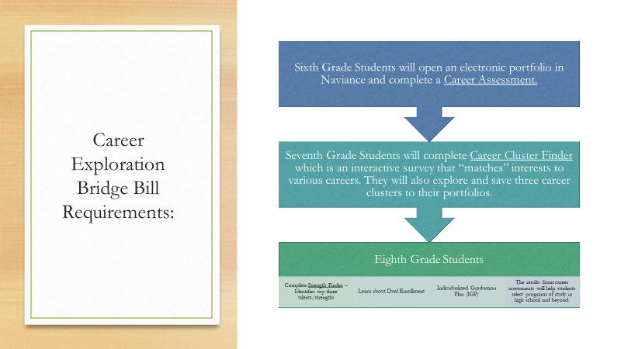

Slide 13
Attendance – 5 or more unexcused absences
6th & 8th Grade
Monthly Large Group Sessions
7th Grade
Classroom Lessons in the fall
Small Group
Individual Sessions

Slide 14
Application Programs
AVID
  Prepares students for college and Advanced Learning opportunities
  AVID is a class
  Application due February 26
EPIC Entrepreneurship Program
  Earn Honors Literature credits and Marketing credits in year- long courses
  Students will launch their own business
  Teacher Recommendation and Application
  Deadline March 3
Applications: Campbell High School Website
Curricular
Course Offerings and Registration
AVID and EPIC information

Slide 15
Application Program
3DE
Connects real world to classroom
Students will study real business case challenges
Juniors will start their own Pop- up businesses.
Seniors will receive real-world experience by serving as student consultants for Atlanta Metro companies
School within a school – all classes are taken in a separate wing of OHS
3DE Application - Osborne Website/curricular/academics

Slide 16
Sharing Great Things
Reality U – for our 8th Grade Students (Foundation Funded)
6th Grade Field Trip – visited Fernback Science Center in the fall (Foundation funded)
7th Grade Field Trip – upcoming visit to Smith Gilbert Gardens (Foundation funded)
8th Grade Field Trip – headed to Savannah next week! (Foundation funded)
Successful Talent Show held in the fall (PTSA sponsored)
Musical Rehearsals are underway for School House Rock – 4/21 & 4/22 (PTSA sponsored)

Slide 17


Slide 18
Great things from August 2022 until now…
Reflections Winners – 4 students headed to National PTA Reflections Art Contest at the State level
FBLA – 31 students attended Regional Leadership Conference & many have tested for State level
Honors Orch, Chorus, and Band
Auburn University and UGA trips
Friday “Recess” bi-weekly in Connections - very successful
Helen Ruffin Reading Bowl – 8 students competed

Slide 19
Upcoming Events
GSPN Live 2/13 10 AM; 3/20 5 PM; 4/17 10 AM; 5/15 5 PM
Campus Tours –10 AM on 2/27, 3/27, 4/10, 5/15
7th Grade Social – March 17th
Lots of LGPE Concerts
String Jamboree @ CMS – 6th Grade Orchestra
Band Jamboree @ CMS April 27th
Night of the Arts & Art Show – April 13th
Beta Club Induction – April 25th
8th Grade Dance – May 12th
Teacher/Staff Appreciation Week – May 1st – 5th
Field Days – May 11th, 18th, 19th
8th Grade Drive By Parade – May 24th 3:30 – 4:45
6th Grade Spring Field Trip – Kennesaw Mountain – May 17th

Slide 20
Faith in Action (FIA) Project – sponsored by Cumberland Community Church
2 day community event to complete many beautification and makeover projects inside and outside of Griffin.
March 25th & March 26th 9 AM – 1 PM
We will also have a campus cleanup on March 25th
We would love to have you join us.

Slide 21
Rising 6th Grade Activities
Welcoming the Class of 2030!!!
Rising 6th Grade Parent Night- March 9th
5th Grade visits Griffin
6th Grade Summer Camp
  2 half days to learn all about being a Wildcat
  Easing the transition to middle school for our students & parents
  Date TBD

Slide 22

Resources from tonight
In addition to this powerpoint, information will be shared by each content area teacher in all grades
All powerpoints will be posted online & can also be found:
  Each content area powerpoint will be placed on that teacher’s CTLS Digital Classroom as an announcement
  This powerpoint will be placed on the website
As always, please reach out to our teachers, counselors, admin, or any support staff as appropriate with questions. We are here to support you so your student is successful

Slide 23
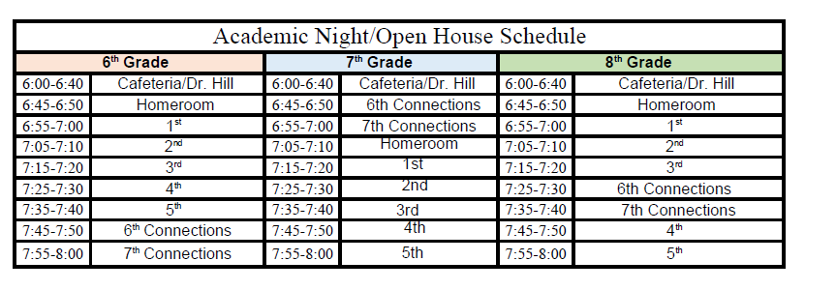
Tonight’s Schedule

Slide 24
What to do if…
Your student’s teacher is not here today, please go to the learning commons to see Ms. Beasley & Dr. Langston
You do not have access to your student’s schedule – please see a counselor at a table right outside the cafeteria
You do not know your student’s homeroom teacher – please see a counselor or someone in the learning commons
THANKS FOR COMING TONIGHT!

