Slide 1






Class Of 2025
SENIOR PARENT
INFO NIGHT
27 August 2024

Slide 2






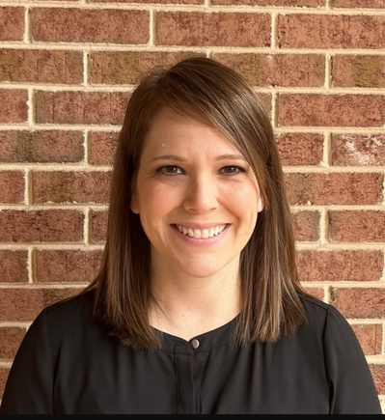
ALLATOONA COUNSELORS
ANGIE WEEKS
ROBIN ROHRBACH
KRISTI TURNER
A-D
ANGIE.WEEKS@COBBK12.ORG
E-K
ROBIN.ROHRBACH@COBBK12.ORG
L-RE
KRISTI.TURNER@COBBK12.ORG
OLIVIA MASTRANGELO
RF-Z
OLIVIA.MASTRANGELO@COBBK12.ORG
HALEY WELCH
504/Academic/Personal Social
Haley.Welch@cobbk12.org
JENNIFER MICHAEL
504/Academic/Personal Social
Jennifer.Michael@cobbk12.org

Slide 3

Notes:
Introduce PTSA members

Slide 4
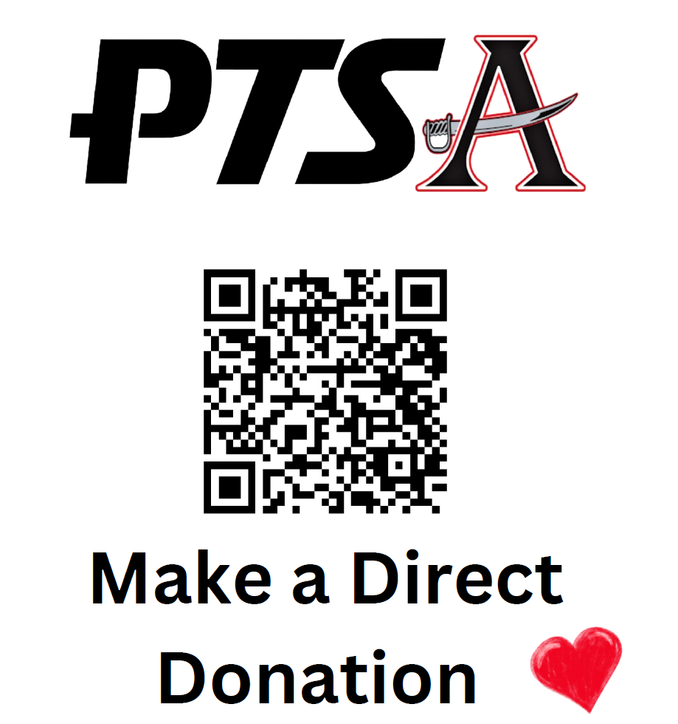

Slide 5


Stay Connected
Email: Make sure you are checking your CCSD email regularly
Allatoona High School Website: https://www.cobbk12.org/Allatoona
CTLS: Check the Senior Class of 2025 tile in CTLS
@buc_counselors
@allatoonahighschool
@allatoona2025

Slide 6



Slide 7


TONIGHTS AGENDA
MEETING GRADUATION REQUIREMENTS
NAVIANCE
FUTURE PLANNING
THE COLLEGE APPLICATION PROCESS

Slide 8
Graduation requirements
Subject | Credits Required | Courses Required
English | 4 Units | 9th Literature | American Literature |two additional courses
Mathematics | 4 Units | Algebra I | Geometry | Algebra II or ACC Math | plus one additional Senior math course. (Foundations of Algebra may be used as a fourth math course for graduation. However, four-year colleges/universities will require a Senior level math course.)
Science | 4 Units | Biology | Physics or Physical Science | Chemistry Earth Science, or Environmental Science plus one additional course
Social Studies | 3 Units | World History | US History | Economics\Government
Health | Personal Fitness | 1/2 Unit of Each
Foreign Language | Fine Arts | Career & Technical | 3 Units | Recommendation is to take 3 courses from a single area. (Two foreign language courses are required to enter four-year colleges/universities.)
Local Electives | 4 Units
Total | 23 Units

Slide 9

Explore interests and research careers
1
Introducing Naviance
  Build a Resume
  2
  Research colleges and scholarships
  3
Naviance is a college and career preparation tool to support your student through their senior year
  Complete surveys that will help your counselors and teachers write recommendations.
  4
  Have important documents sent to the colleges of your choice
  5

Slide 10


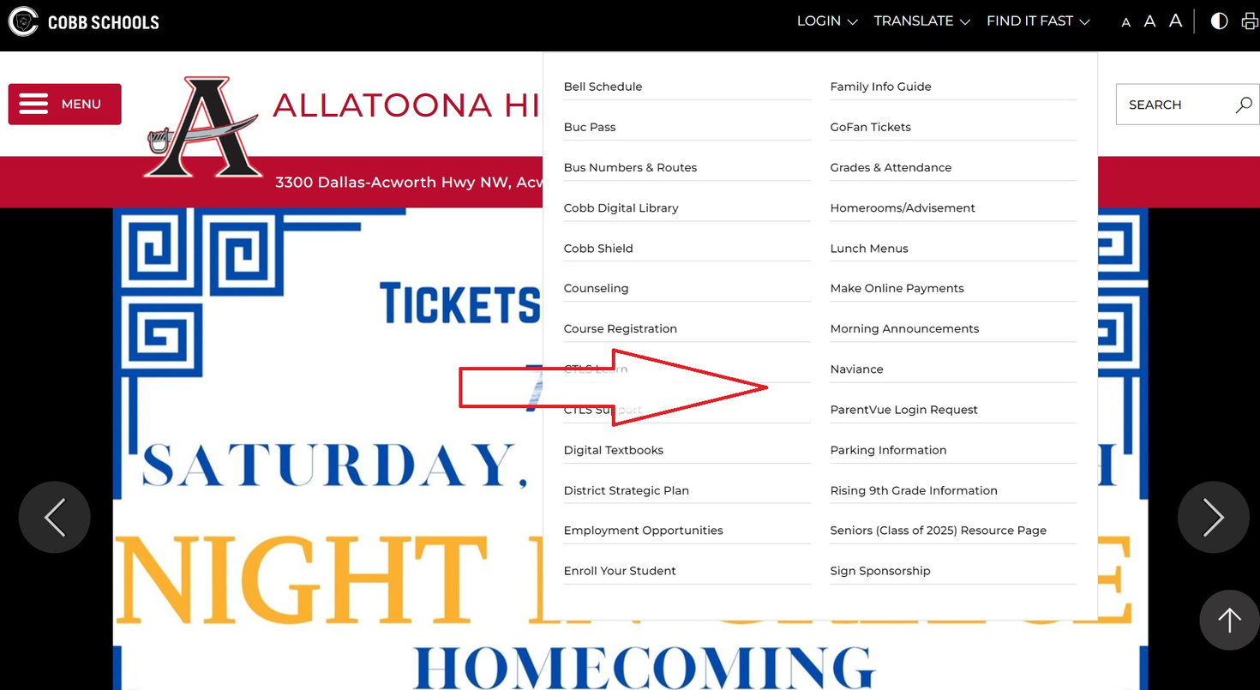
STUDENTS LOGGING INTO NAVIANCE
  Log into Office 365/CTLS on your computer at home or log into the network if you are at school.
  Go to the AHS website
  Click Find it Fast in the Upper Right Corner
  Click Naviance

Slide 11
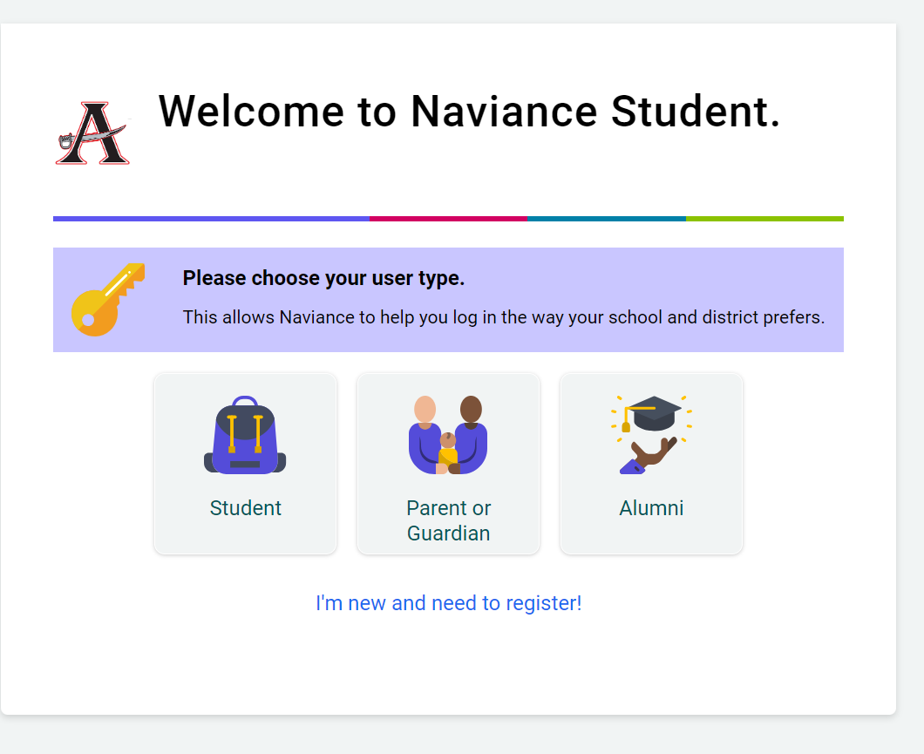
PARENTS LOGGING INTO NAVIANCE
  Go to https://student.Naviance.com/allatoonahs
  Select Allatoona High School
  Once on the log in page, click the button for parent/guardian
  If you have been on the site before, you can log in here. If you have forgotten your password click “forgot my password” and you can reset it.

Slide 12



WHAT IS YOUR CHILD’S POST SECONDARY PLAN
  Military service
  Workforce
  Specialty school
  Technical school
  Two year college
  Four year college
  Other (Mission Field, gap year, etc)

Slide 13
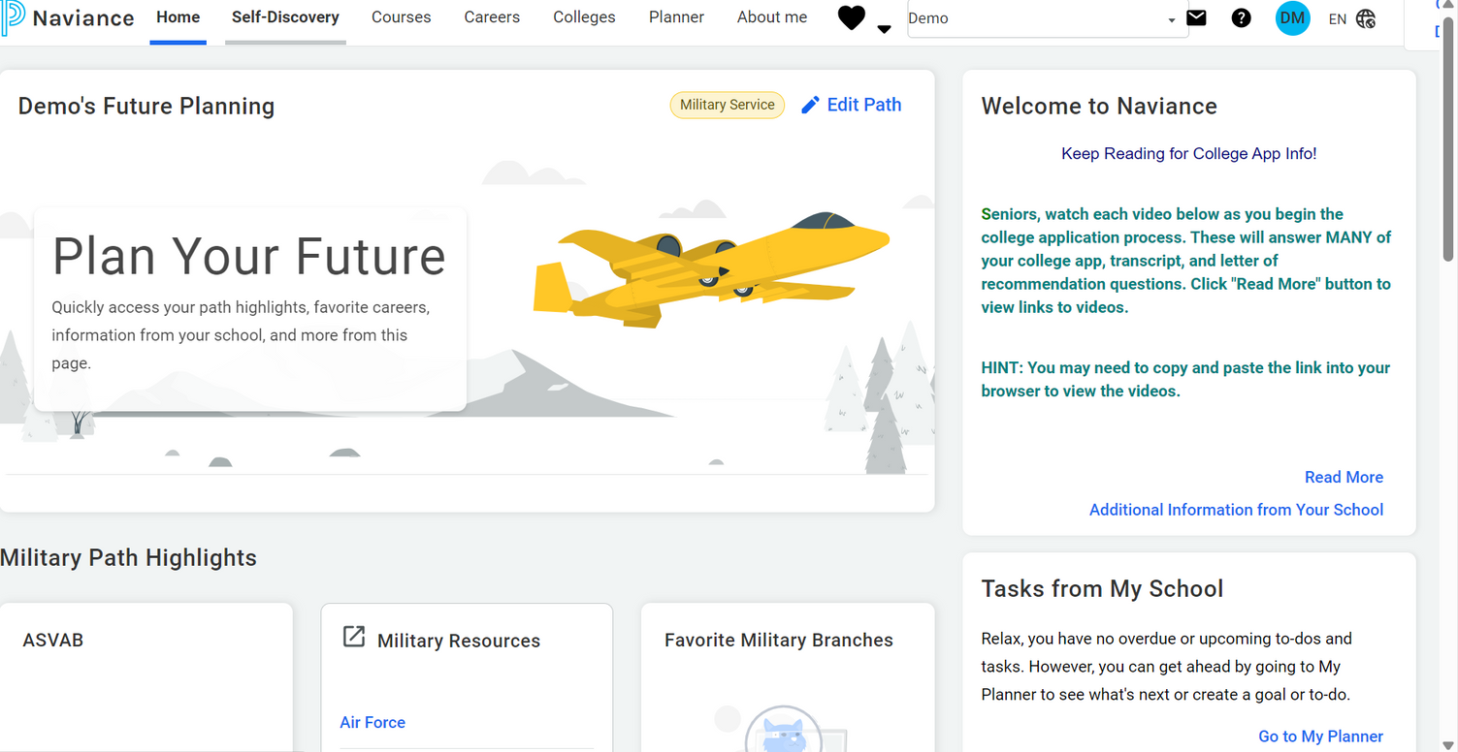

MILITARY/ARMED FORCES
  Do some research at https://www.todays military.com
  High School Diploma is preferred/required
  Take the ASVAB test at AHS or MEPS
  Make contact with branch recruiter
  Request your final transcript in May.

Slide 14
ON THE JOB TRAINING VERSUS APPRENTICESHIPS
On the Job Training | Apprenticeship
Short Period of Time | Takes 1-6 years to learn the job from someone in the field
Strutured hands on training | Most skilled trades: HVAC, Electrician, cosmetology
Trained by a peer or supervisor | Often requires formal licensure
Typically don’t require tests for certification/licensure | May also require formal classes to learn the job
Notes:
An apprenticeship is a structured program that combines on-the-job learning with related classroom instruction. It involves a long-term commitment, typically ranging from one to six years, wherein an apprentice works under the close supervision of a skilled mentor in the chosen trade or profession. The apprentice is a worker earning a wage and a learner engaged in formal, on- and off-the-job training.
On the other hand, on-the-job training (OJT) is a more informal and often short-term process. It happens directly in the workplace as employees learn by doing under the guidance of experienced colleagues or managers. It's a hands-on method that equips employees with specific skills necessary for their current jobs, with the training period varying depending on the job's complexity.

Slide 15



Two Year Colleges
& Technical Colleges
Chattahoochee Tech
Georgia Highlands College
Technical Colleges with housing: North Georgia Tech and South Georgia Tech
www.reallygreatsite.com
Notes:
Technical schools (aka tech schools) offer specialized training programs for specific careers or industries.
If you're someone who prefers hands-on learning to acquire practical skills rather than sitting through lectures, then tech schools might be a good option.
Pros of tech school
Career-focused training. Tech schools offer specialized training programs to prepare you for specific careers or industries, providing hands-on experience and practical skills directly relevant to the job market.
Short program durations. Compared to traditional four-year colleges, tech school programs often have shorter durations, allowing you to enter the workforce sooner and start earning a salary.
Lower costs. Tech school tuition is typically more affordable than four-year colleges, helping you avoid significant student loan debt and providing a quicker return on investment.
In-demand skills. Many tech school programs focus on teaching skills in high demand in the job market, increasing your chances of finding employment after graduation.

Slide 16
Two year school requirements:
2.0 Core GPA, plus all GA requirements
1
2 Year Colleges and Technical Colleges
  Technical college requirements: High School Diploma or GPA
  2
  See if the ACT/ACT, Accuplacer Exam, or a placement test is required. Check with each school
  3
  4
Accuplacer preparatory material:
  https://accuplacer.collegeboard.org/

Slide 17

I PLAN TO GO TO A 4 YEAR COLLEGE!
WHAT DO I DO NOW?!

Slide 18
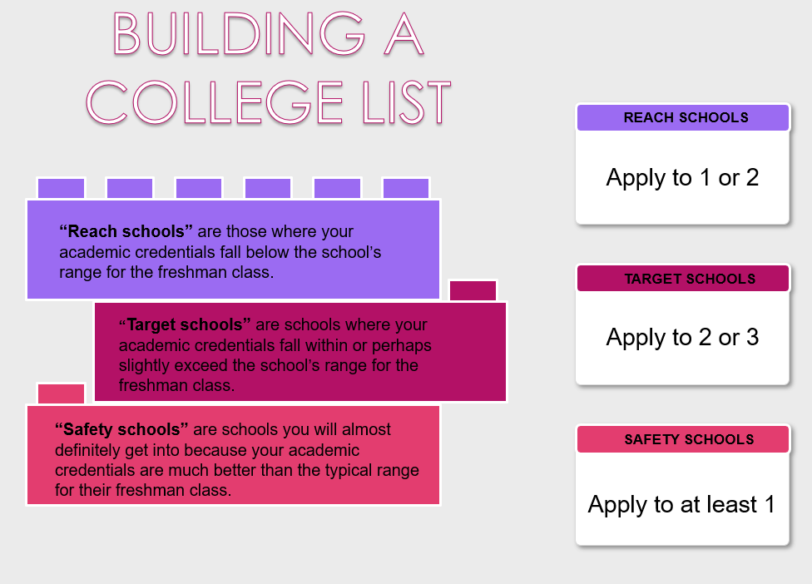
Reach, Match, and Safety

Slide 19


GEORGIA STATE, AUGUSTA STATE, GEORGIA TECH AND UNIVERSITY OF GEORGIA
VIRTUAL
WEDNESDAY, AUGUST 28: 6:00-7:00 P.M.
WEDNESDAY, SEPTEMBER 4: 6:00-7:00 P.M.
WEDNESDAY, SEPTEMBER 11: 6:00-7:00 P.M.
IN PERSON
THURSDAY, SEPTEMBER 5: 6:00-8:00 P.M.
ATLANTA
https://www.peachstatetour.org/
Notes:
Also, plenty of college fairs to attend and learn more about college/univiersities.

Slide 20

•SEPTEMBER 9
CHEROKEE HS
•SEPTEMBER 11
MARIETTA HS
•OCTOBER 30
LASSITER HS
HTTPS://WWW.GAPROBE.ORG/STUDENTS/#LOCAL

Slide 21
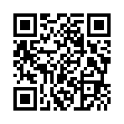
COLLEGE CASE STUDY AND COLLEGE FAIR
MONDAY, SEPTEMBER 9TH FROM 5PM TO 8PM
AT WALTON HIGH SCHOOL
https://www.scholartrek.com/cobb
Notes:
What is a Case Study?
During the Case Study, students and their family members will get the opportunity to review college applications alongside admissions counselors from across the nation. You will get to experience firsthand what does and doesn’t matter in the application review process.
What is a College Fair?
College Fairs allow for college admissions representatives from across the nation to speak one-on-one with interested students and family members. This is a great opportunity to learn more about the academic and social opportunities at different institutions, get questions about the admissions, scholarship, and financial aid process answered, and show demonstrated interest!

Slide 22
THE APPLICATION PROCESS

Slide 23
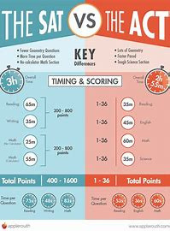
COLLEGE ADMISSION TESTS
SAT & ACT:
SOME SCHOOLS REQUIRE THIS. SOME ARE TEST OPTIONAL WITH ADDITIONAL REQUIRESMENTS. SOME ARE TEST OPTIONAL WITH NO ADDITIONAL REQUIREMENTS. CHECK THE COLLEGE’S WEBSITE TO SEE THIER POLICY ON SAT/ACT.
STUDENTS ARE RESPONSIBLE FOR SENDING SCORES TO THE COLLEGES/UNIVERSITIES

Slide 24


COMMON APP

Slide 25
STEP BY STEP PROCESS
  Select what colleges you’re applying to ​
  Determine application types: Common App, Direct to Institution​
  Submit your college applications – your “package” (may include essays and/or a resume)​
  Send your test scores via College Board/ACT ​
  Request recommendations (if needed)​
  Use Naviance – our “delivery” system. Students must:​
    Add colleges​
    Match your Common App (if using the Common App system)​
    Invite teacher recommenders (if recommendations are needed)​
    Complete Senior Survey and Parent Survey (if recommendations or school report are needed)​
  Request initial transcripts through the Counseling Office​
  Track your package​
  ​

Slide 26
TYPES OF APPLICATION DEADLINES
  Regular Decision-Receive a deadline at the standard response rate
  Early Action-receive a decision earlier than the standard response date BUT are NOT required to accept the decision
  Early Decision (Binding)-Commit to enroll at a college if admitted and offered satisfactory financial aid packet. You can only apply ED to one school.
  Rolling-Admission decisions are usually made within 6 weeks of submitting the application
  Priority Deadline-mostly associated with getting into insitutional scholarship poos.

Slide 27
WAIVING FERPA
WAIVING YOUR RIGHT LETS COLLEGES KNOW THAT YOU DO NOT INTEND TO READ YOUR RECOMMENDATIONS, WHICH HELPS REASSURE COLLEGES THAT THE LETTERS ARE CANDID AND TRUTHFUL.
SOME RECOMMENDERS MAY DECLINE TO WRITE A LETTER FOR YOU IF YOU DO NOT WAIVE YOUR RIGHTS. CHECK WITH YOUR COUNSELOR OR TEACHERS TO SEE IF ANY OF THEM FOLLOW SUCH A POLICY.

Slide 28
Requesting Transcripts
2 Step Process
STEP 1
Request your official high school transcript through Naviance. ​
  Log onto your Naviance student account​
  Select the COLLEGES tab​
  Under COLLEGES select “Colleges I’m Applying To”​
  Click on “+”, add each college/university, including application information​
  Click “Add Application” ​
STEP 2
  YOU MUST SIGN & PAY $2 PER TRANSCRIPT, IN THE COUNSELING OFFICE​
  FOR COMMON APP DOCUMENTS, YOU MUST LINK YOUR COMMON APP​
BOTH PARTS OF THE ABOVE PROCESS MUST BE COMPLETED OR TRANSCRIPTS WILL NOT BE SENT. ​

Slide 29
Teacher
Recommendations
  Allow at least 2 weeks for teachers to complete their recommendation portion of your application.
  Ask the teacher you would like to write the recommendations BEFORE you submit the request in Naviance
  Students invite their teachers to upload and send letters of recommendation in Naviance.
    Add the request digitally under your “Colleges I am applying To” tab.
    Important: Assign your teachers to specific schools, not all applications
    Remember to WORK BACKWARDS! If a deadline is 10/15 then make sure you request a recommendation before October 1st!

Slide 30
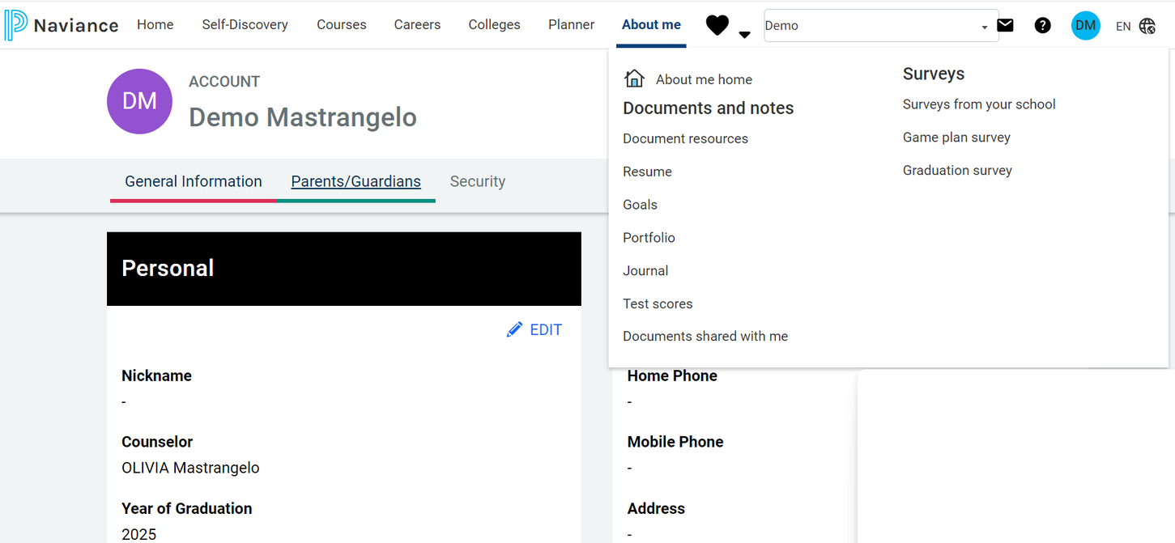
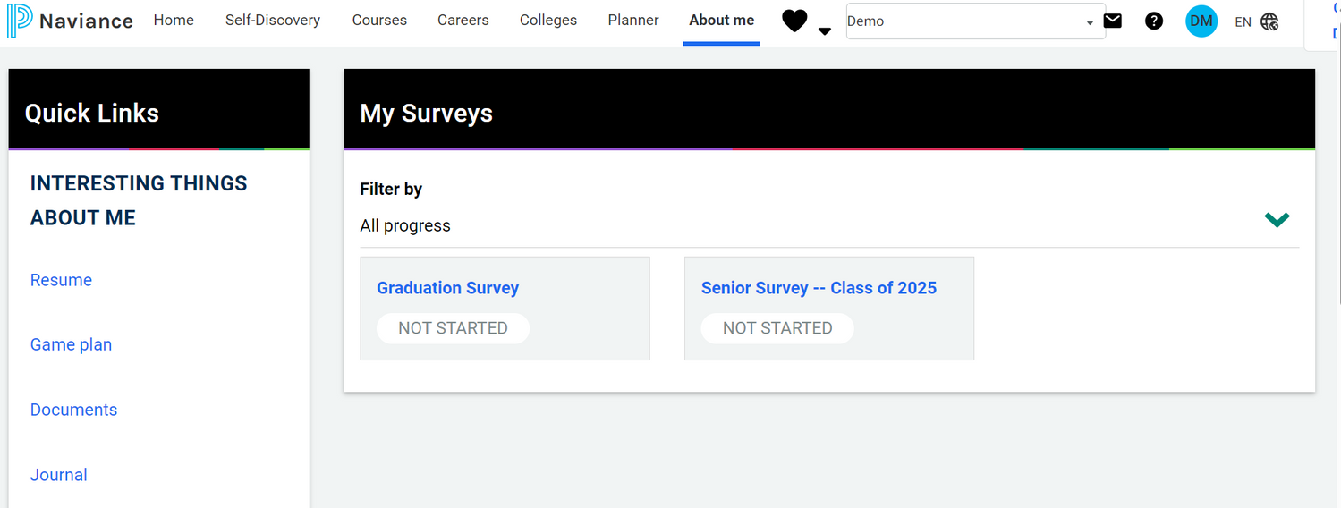
Notes:
Tell students and families this is where they will find surveys to complete for recommendations. Helps us give a complete picture of the student.

Slide 31
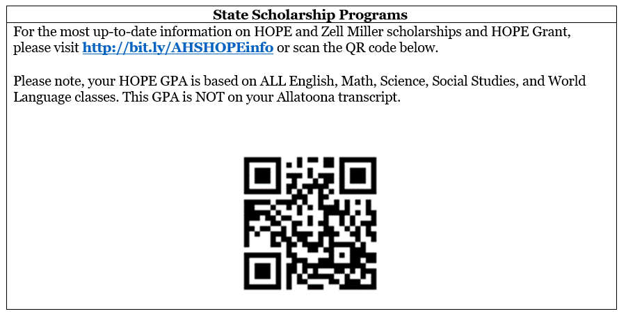
SCHOLARSHIPS
  HOPE GPA is calculated using core courses only (English, Math, Science, Social Studies and World Languages.
  3.0 GPA, 80-90% of Tuition
  Check HOPE GPA through GA Futures
HOPE GRANT CAN BE USED AT TECHNICAL SCHOOLS
ZELL MILLER
3.7 GPA 1200 SAT OR 25 ACT
FULL TUITION

Slide 32

Free Application for Federal Student Aid
https://studentaid.gov
APPLICATION WILL AVAILABLE
IN
EARLY DECEMBER!

Slide 33
WHAT’S NEXT?
  Stay tuned for a Financial Aid night presented by the Georgia Student Financial Commission!
  Watch your Graduation Credits-23 to Graduate
  Counselors are meeting with Seniors now through the end of September!
  REACH OUT TO YOUR COUNSELOR IF YOU HAVE ANY QUESTIONS!!

