Slide 1
AP Human Geography Summer Assignment Part I - Map Practice Walton High School

Slide 2
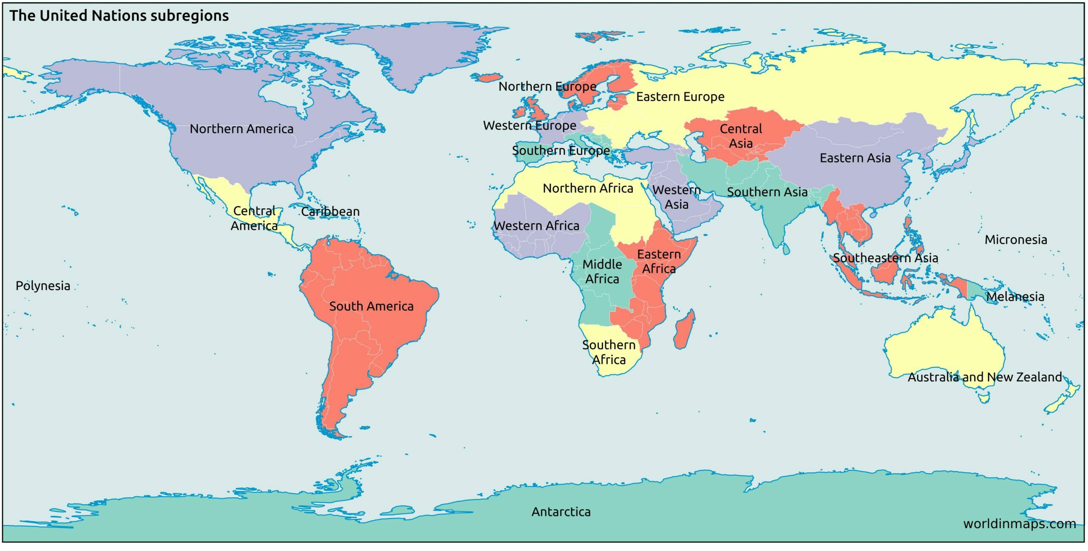
Know the major world regions detailed below. This is a map scale and scale of analysis you will use and interpret in class.
Sub-Saharan Africa
Latin
America

Slide 3
Countries you should recognize
For each of the countries listed on the following slides you should recognize:
What continent is the country in?
What countries does that country border?
Is it land locked (does it border an ocean)
Is it an island?
Finally, what is its location compared to Georgia (our state)?

Slide 4
NORTH AMERICA

Slide 5
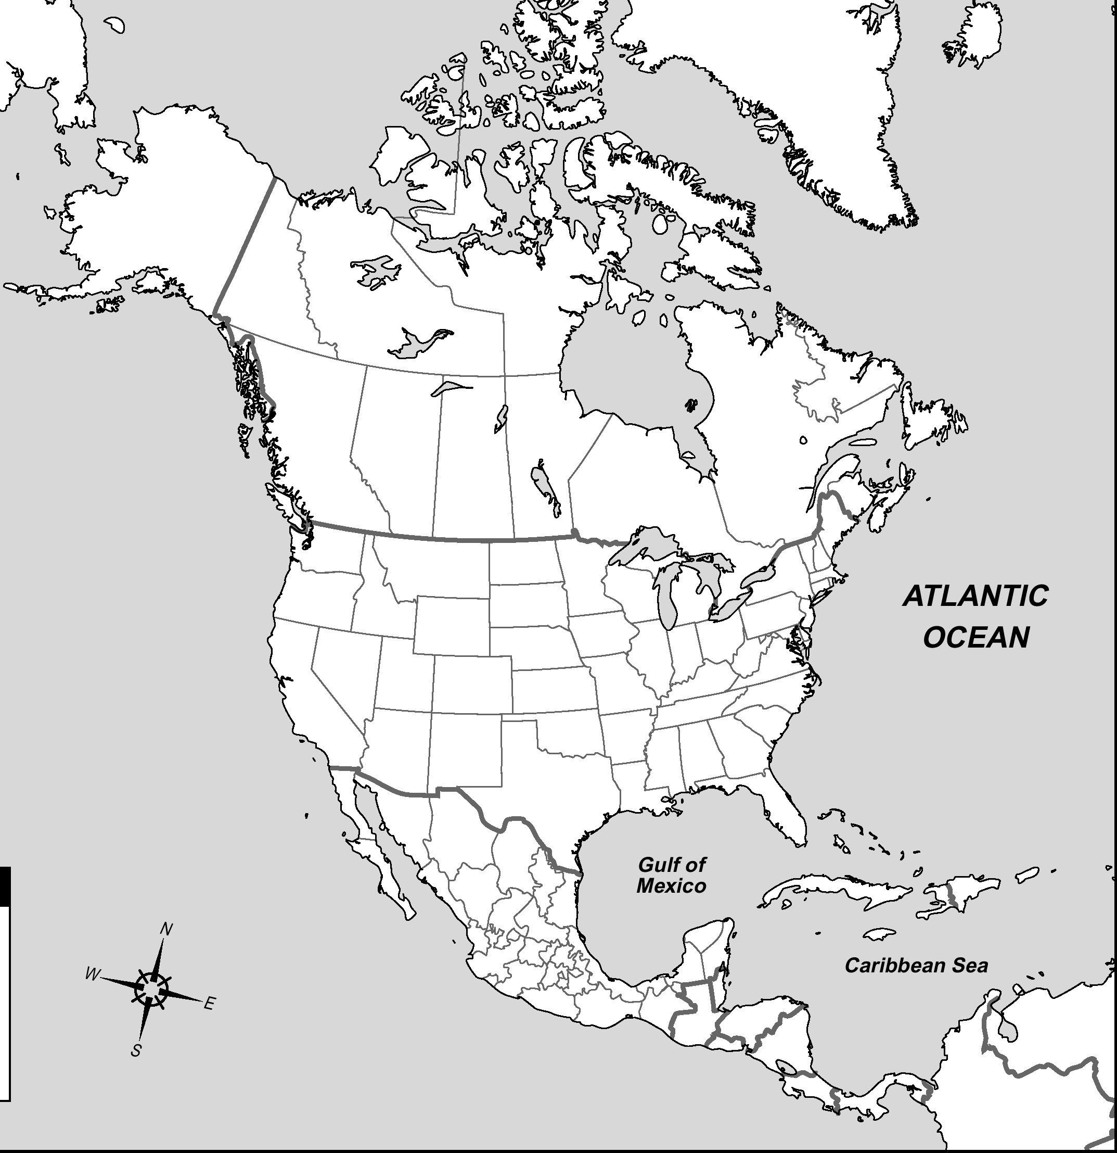
Canada

Slide 6
Costa Rica

Slide 7
Cuba

Slide 8
Dominican Republic

Slide 9
Guatemala

Slide 10
Haiti

Slide 11
Honduras

Slide 12
Jamaica

Slide 13
Mexico

Slide 14
Nicaragua

Slide 15
Panama

Slide 16
United States of America

Slide 17
SOUTH AMERICA

Slide 18
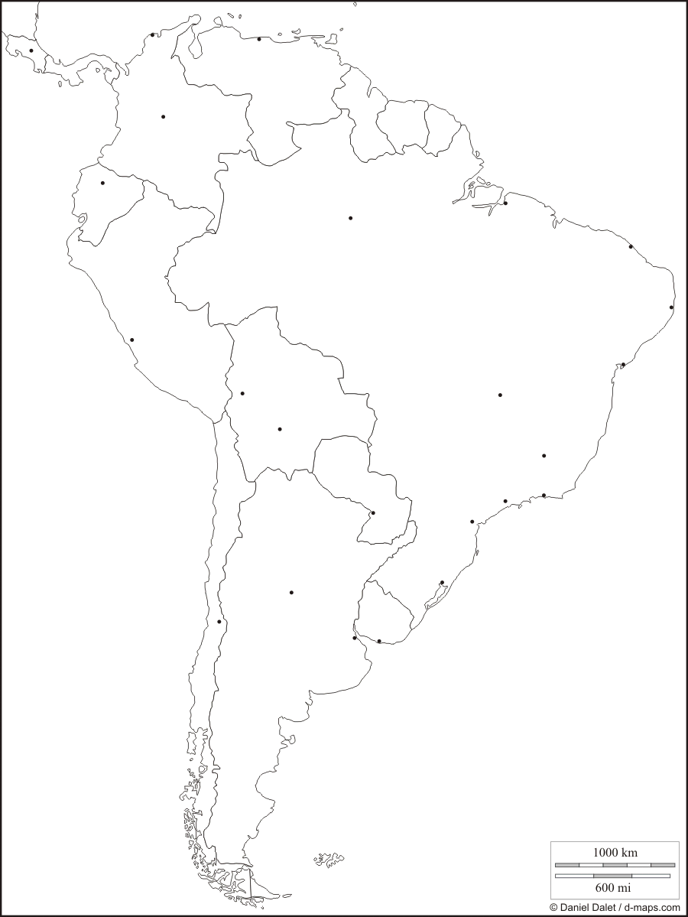
Argentina

Slide 19
Bolivia

Slide 20
Brazil

Slide 21
Chile

Slide 22
Colombia

Slide 23
Ecuador

Slide 24
Paraguay

Slide 25
Peru

Slide 26
Uruguay

Slide 27
Venezuela

Slide 28
EUROPE Each of the following countries will be in important topics covered. You should know location

Slide 29
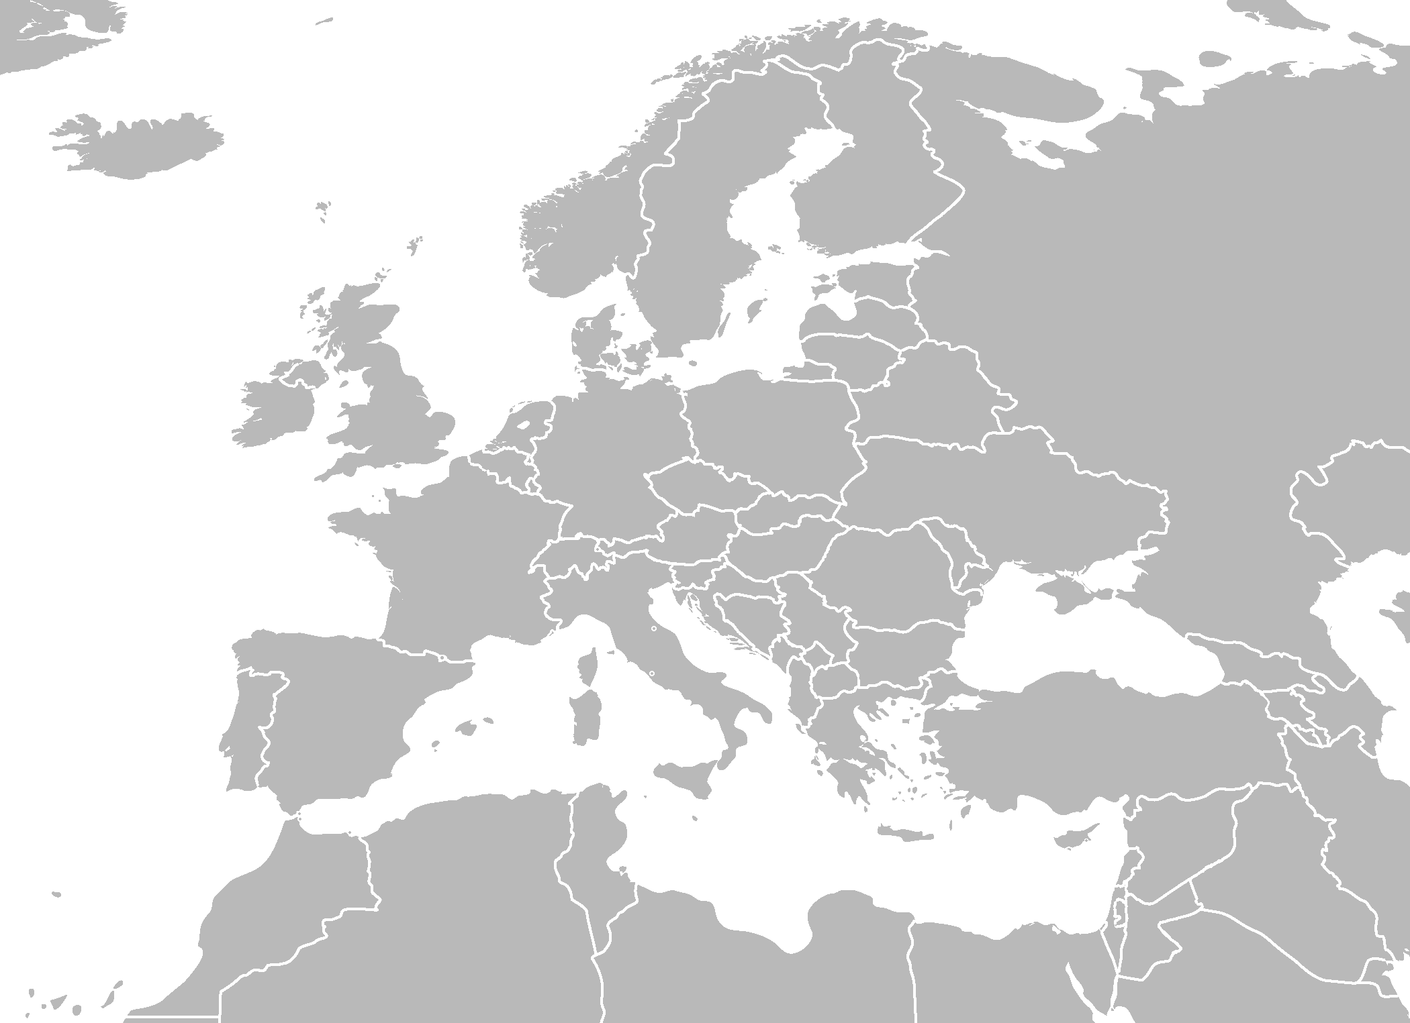
Bosnia & Herzegovina

Slide 30
Croatia

Slide 31
Czech Republic

Slide 32
Estonia

Slide 33
Latvia

Slide 34
Lithuania

Slide 35
Finland

Slide 36
Germany

Slide 37
Ireland

Slide 38
Italy

Slide 39
Montenegro

Slide 40
Norway
A hint for the countries of Scandanavia →
Not (Norway)
So (Sweden)
Fine (Finland)

Slide 41
Russia

Slide 42
Serbia

Slide 43
Spain

Slide 44
Sweden

Slide 45
Ukraine

Slide 46
United Kingdom

Slide 47
AFRICA

Slide 48
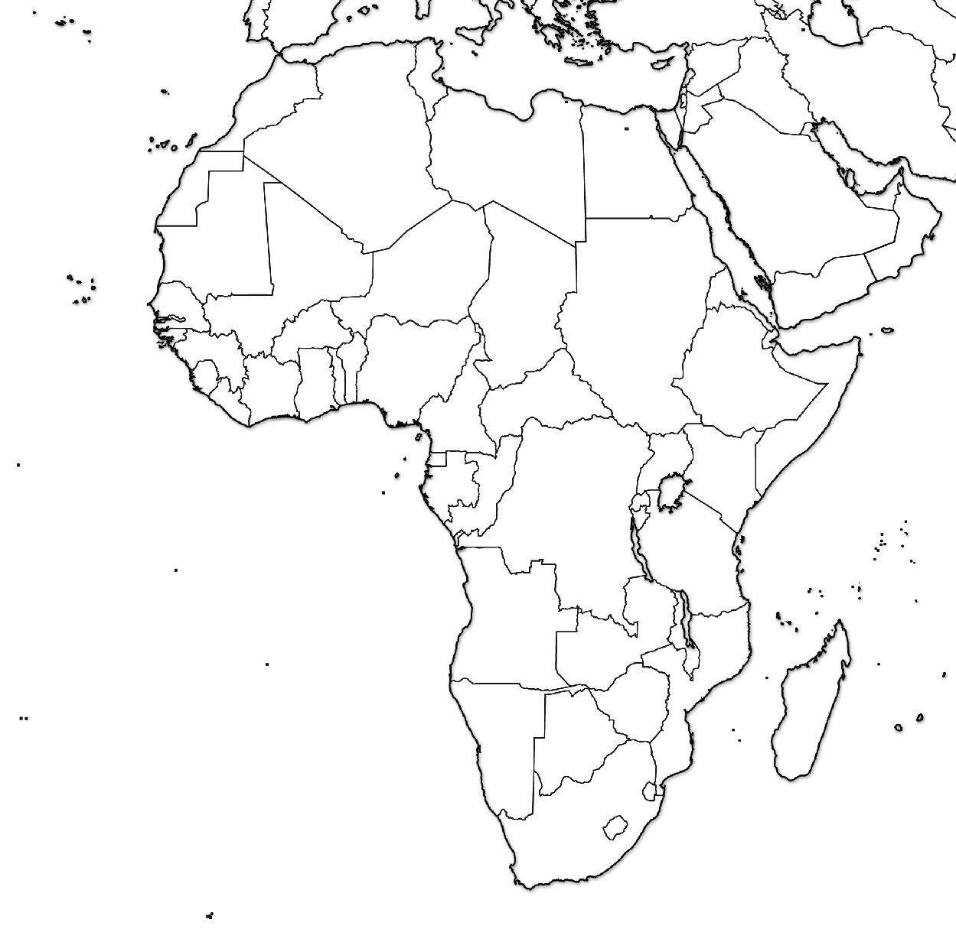
Angola

Slide 49
Democratic Republic of the Congo (D.R.C.)

Slide 50
Egypt

Slide 51
Ethiopia

Slide 52
Ghana

Slide 53
Kenya

Slide 54
Lesotho

Slide 55
Madagascar

Slide 56
Morocco

Slide 57
Mozambique

Slide 58
Nigeria

Slide 59
Rwanda

Slide 60
Somalia

Slide 61
South Africa

Slide 62
South Sudan

Slide 63
Sudan

Slide 64
Uganda

Slide 65
ASIA

Slide 66
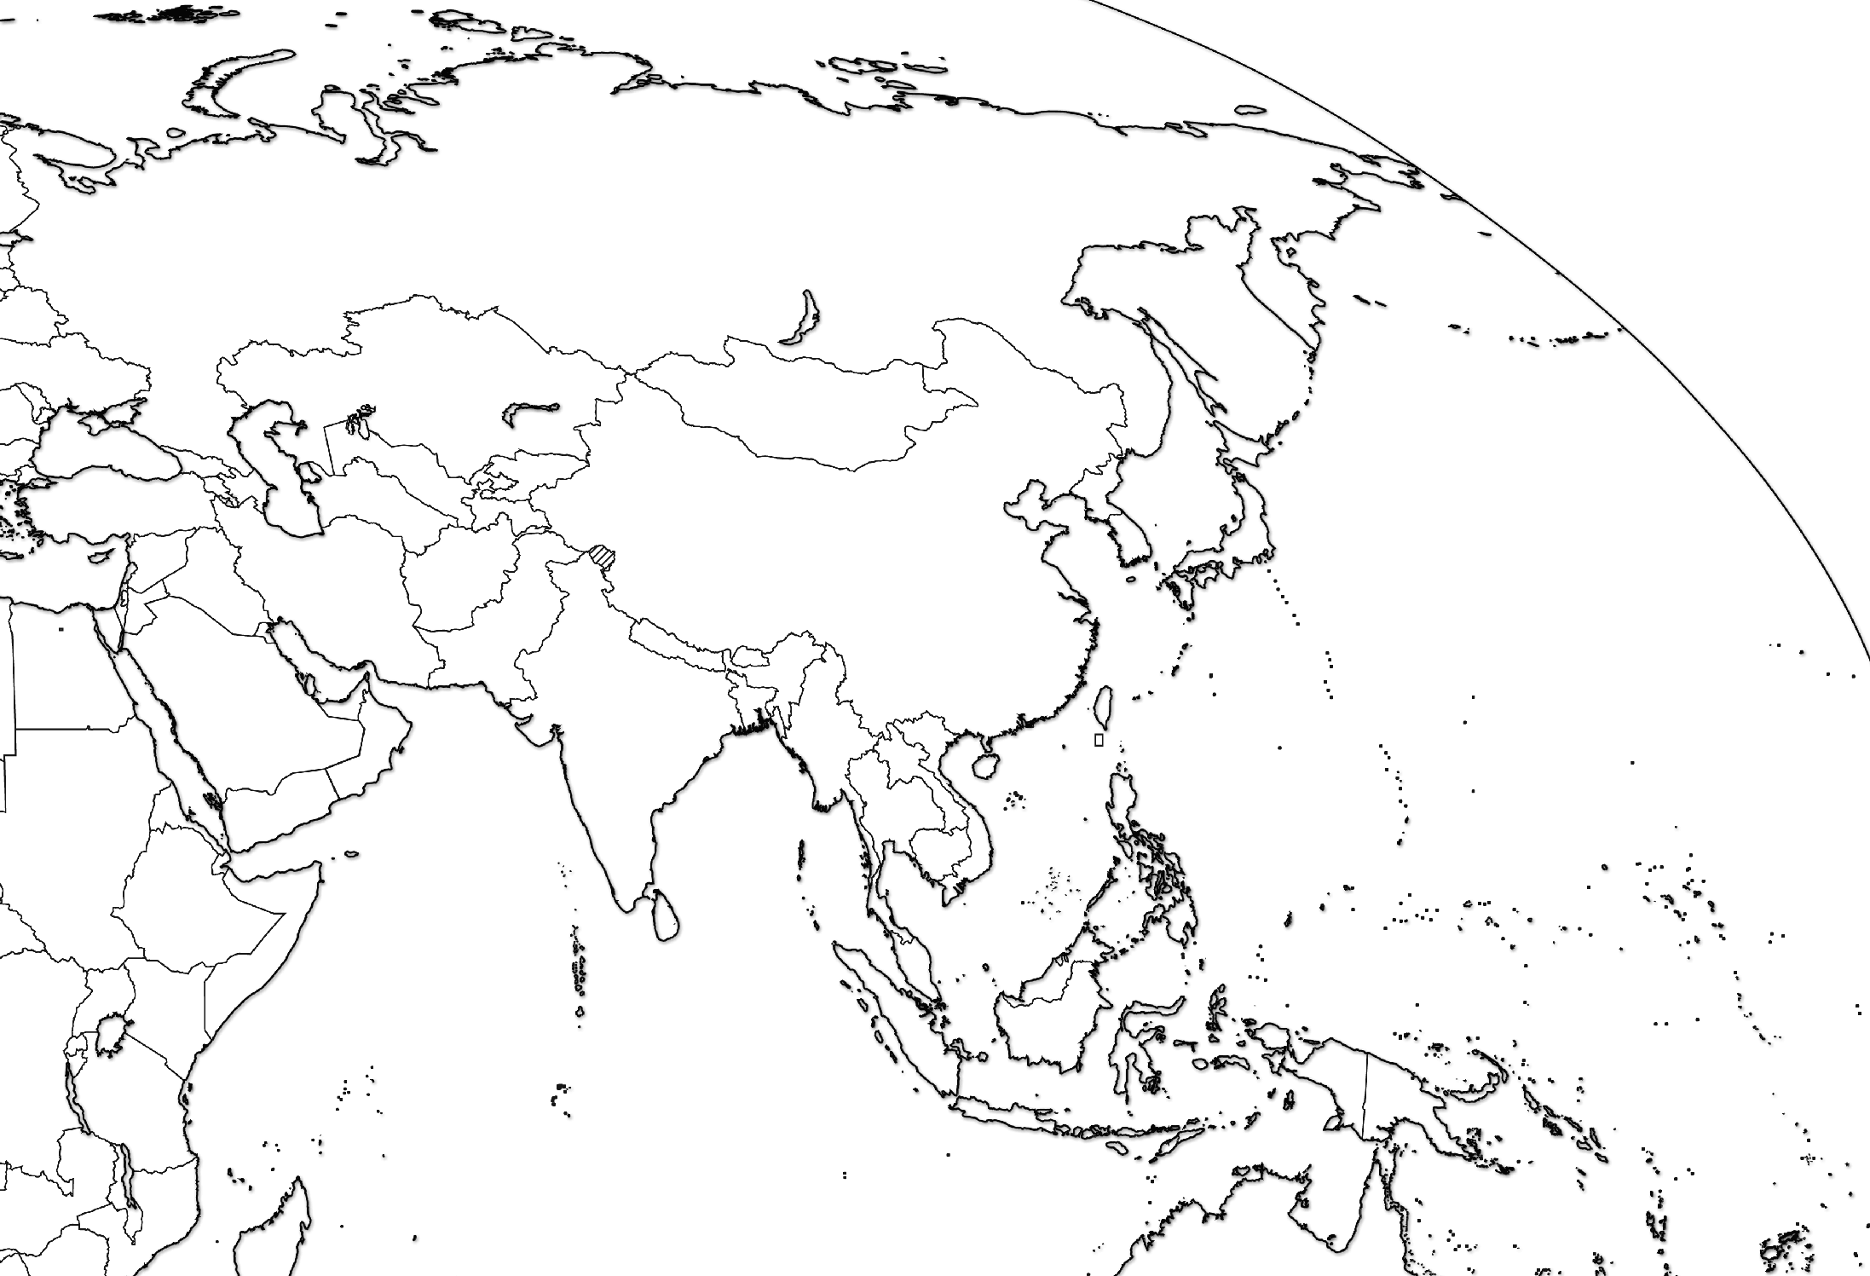
Afghanistan

Slide 67
Armenia

Slide 68
Bangladesh

Slide 69
China

Slide 70
India

Slide 71
Indonesia

Slide 72
Iran

Slide 73
Iraq

Slide 74
Israel

Slide 75
Japan

Slide 76
Myanmar (Burma)

Slide 77
North Korea

Slide 78
Pakistan

Slide 79
Russia

Slide 80
Saudi Arabia

Slide 81
South Korea

Slide 82
Turkey

Slide 83
Vietnam

Slide 84
AUSTRALIA & OCEANIA

Slide 85
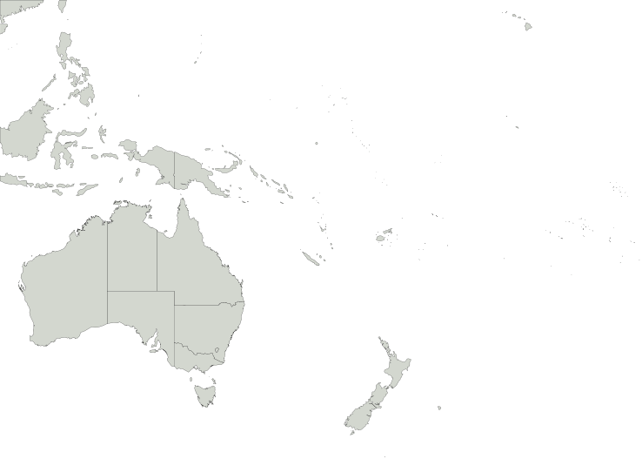
Australia

Slide 86
New Zealand

Slide 87
Test Yourself
- Under “geography”
- Search for “parisaday”
http://www.sporcle.com/
http://www.purposegames.com/
http://www.lizardpoint.com/fun/geoquiz/
http://www.travelpod.com/traveler-iq
http://www.ilike2learn.com/ilike2learn/geography.asp
http://www.maps.com/funfacts.aspx
http://www.sheppardsoftware.com/Geography.htm
http://www.funbrain.com/where/
http://www.jetpunk.com/quizzes/map-quiz-europe.php
http://www.yourchildlearns.com/map-puzzles.htm
http://sites.google.com/site/geogeomania/geographygames
Tap Quiz Apps (for your smart phone)
or print one of these regional maps and try to label it

Slide 88
Global & Local Regions or Areas of Interest

Slide 89
Kurdistan

Slide 90
Basque

Slide 91
Catalonia

Slide 92
West Bank

Slide 93
Gaza Strip

Slide 94
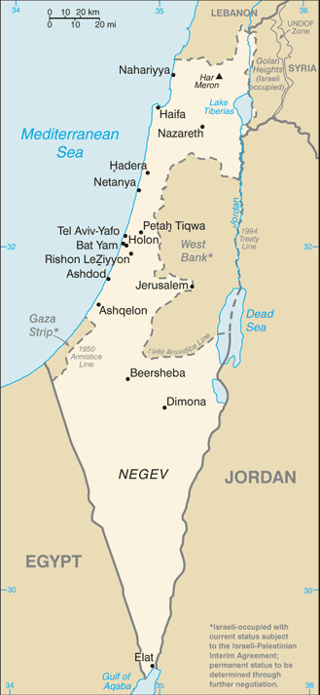
West Bank
Gaza Strip

Slide 95
Kashmir

Slide 96
Quebec

Slide 97
Darfur

Slide 98
TYPES OF MAPS
There are two major categories of maps:
Reference: designed to give people general info about places. Tell us where things are.
Political Maps, Physical Maps, & Road Maps
2. Thematic: show spatial aspects of information &
data. Tells us characteristics about a place.
Choropleth Maps, Dot Density Maps,
Graduated Symbol Maps, Cartogram Maps &
Isoline Maps

Slide 99
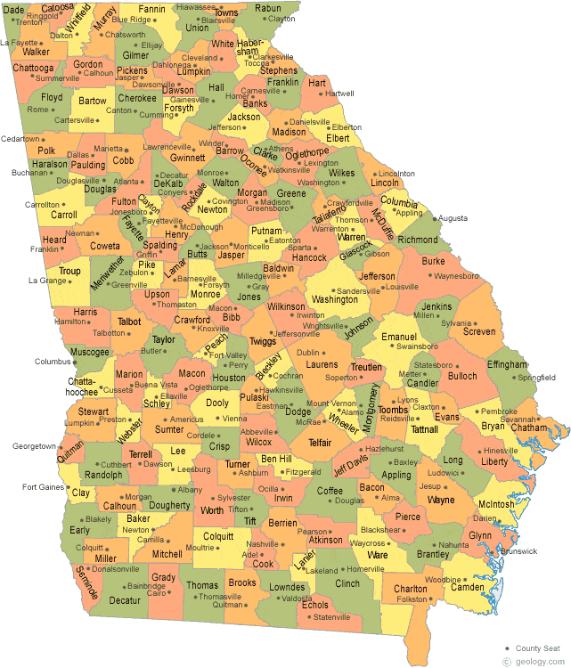
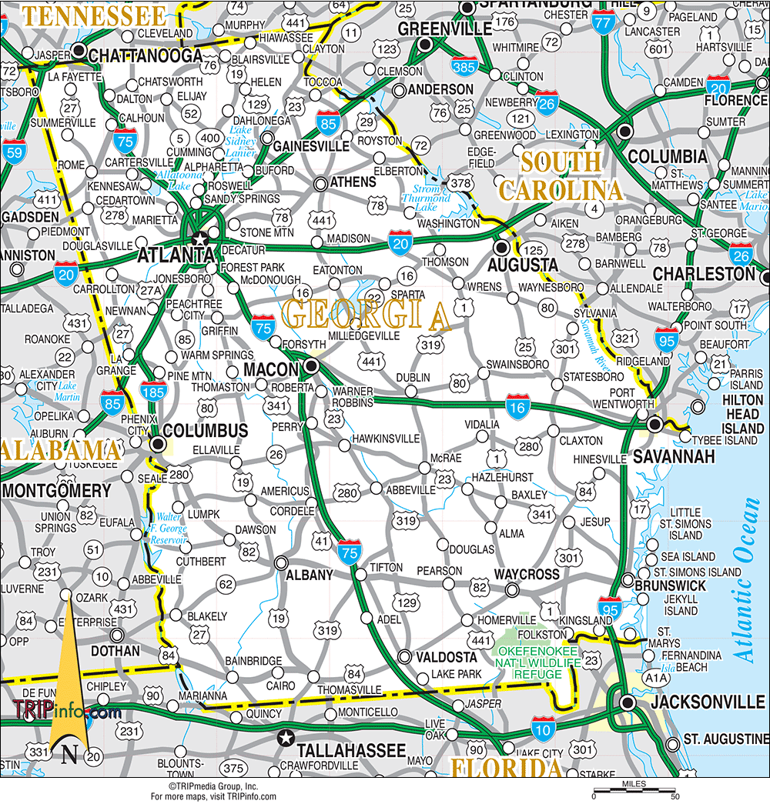
TYPES OF REFERENCE MAPS
Political Map
Road Map

Slide 100
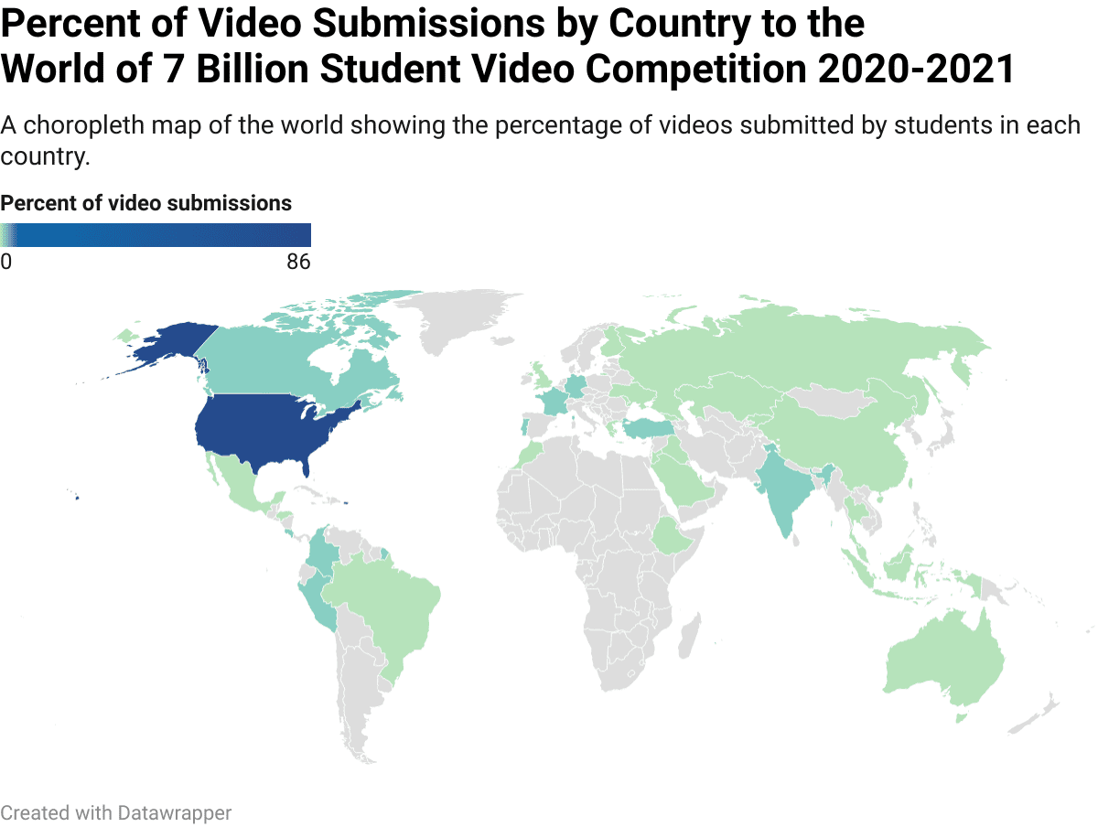
TYPES OF THEMATIC MAPS: Choropleth
Uses color to show different values of data.

Slide 101
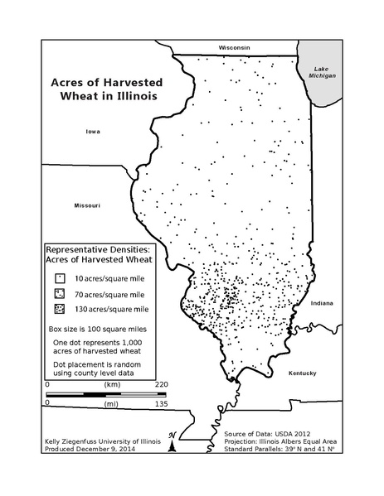
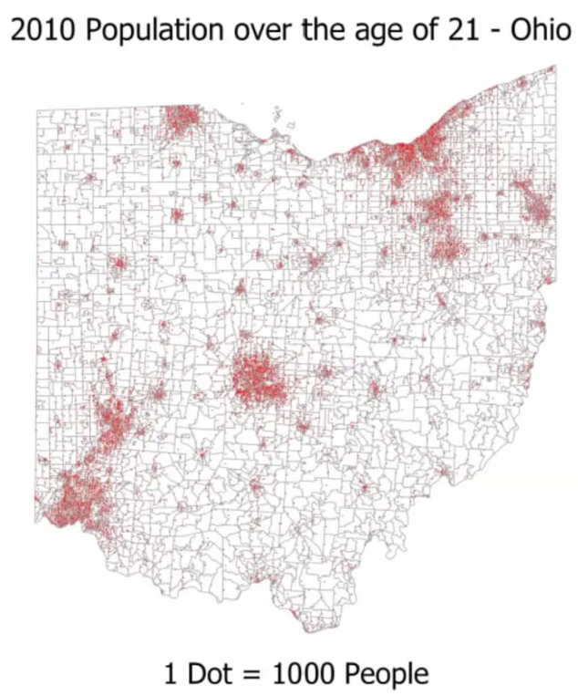
TYPES OF THEMATIC MAPS: Dot Density
Uses dots of the same size to show density & distribution of data.

Slide 102
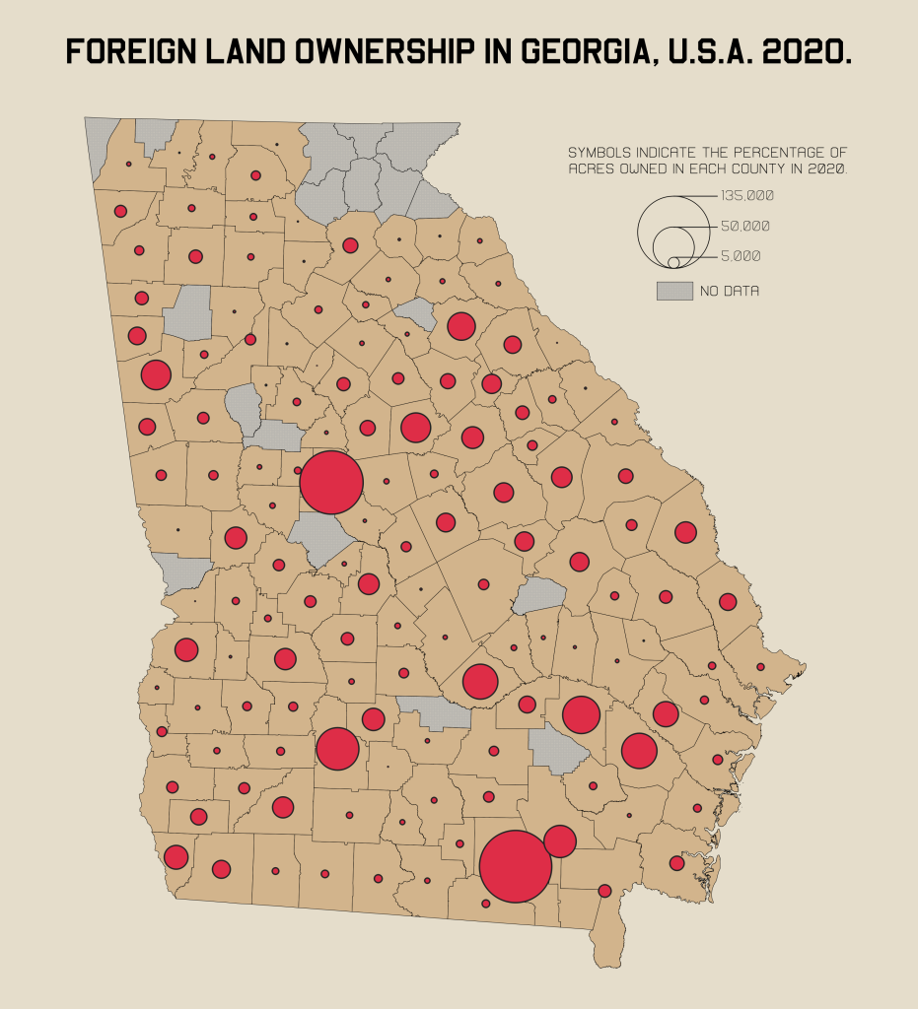
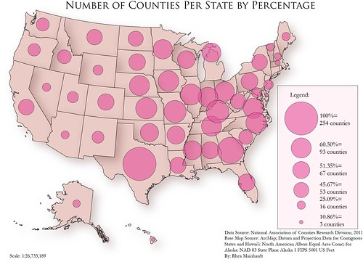
TYPES OF THEMATIC MAPS: Graduated Symbol
Uses shapes of different sizes (usually a circle) to show values of data. AKA Proportional Symbol Map

Slide 103
TYPES OF THEMATIC MAPS: Cartogram
The size of a place (state, county, province) is shown according to a specific data point.
Cartogram Map
Size of GA counties distorted to show population
Choropleth Maps

Slide 104
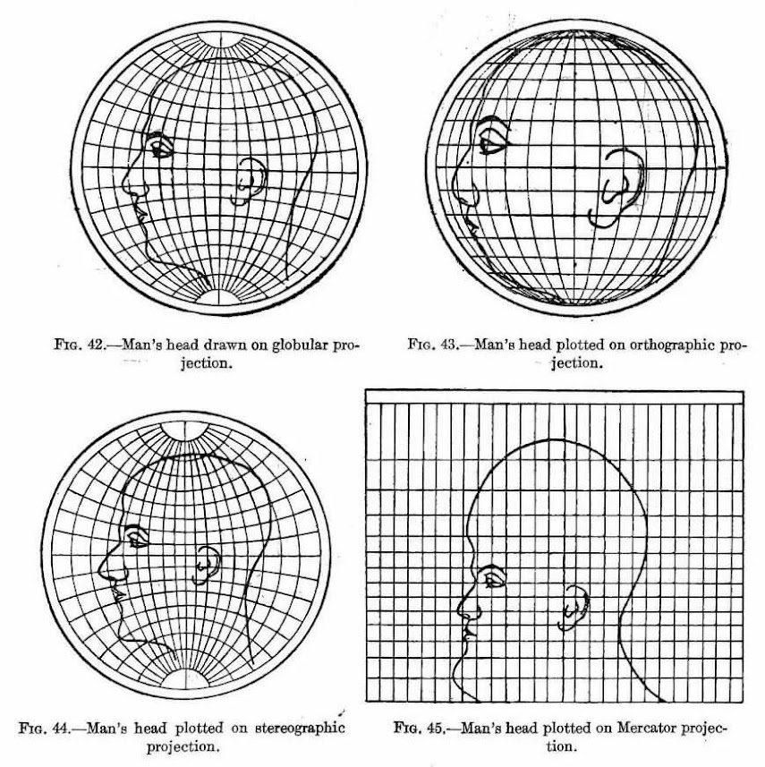
MAP PROJECTIONS: a projection is when a curved surface is shown on a flat surface. Because the Earth is a sphere and maps are flat, all maps distort some aspect of reality. All maps are SADD.
Shape can be distorted.
Area or size can be distorted.
Distance can be distorted.
Direction can be distorted.
The most accurate part of
a projection is the center.
This guys ear.

Slide 105
MAP PROJECTIONS TO KNOW: MERCATOR
Purpose: Navigation
Strengths: Directions are constant & accurate.
Distortion: Area of places near poles appear much larger than reality.

Slide 106
MAP PROJECTIONS TO KNOW: ROBINSON
Purpose: General use, like in classrooms.
Strengths: No major distortion.
Distortion: Area, shape, size, and direction are all slightly distorted.

Slide 107
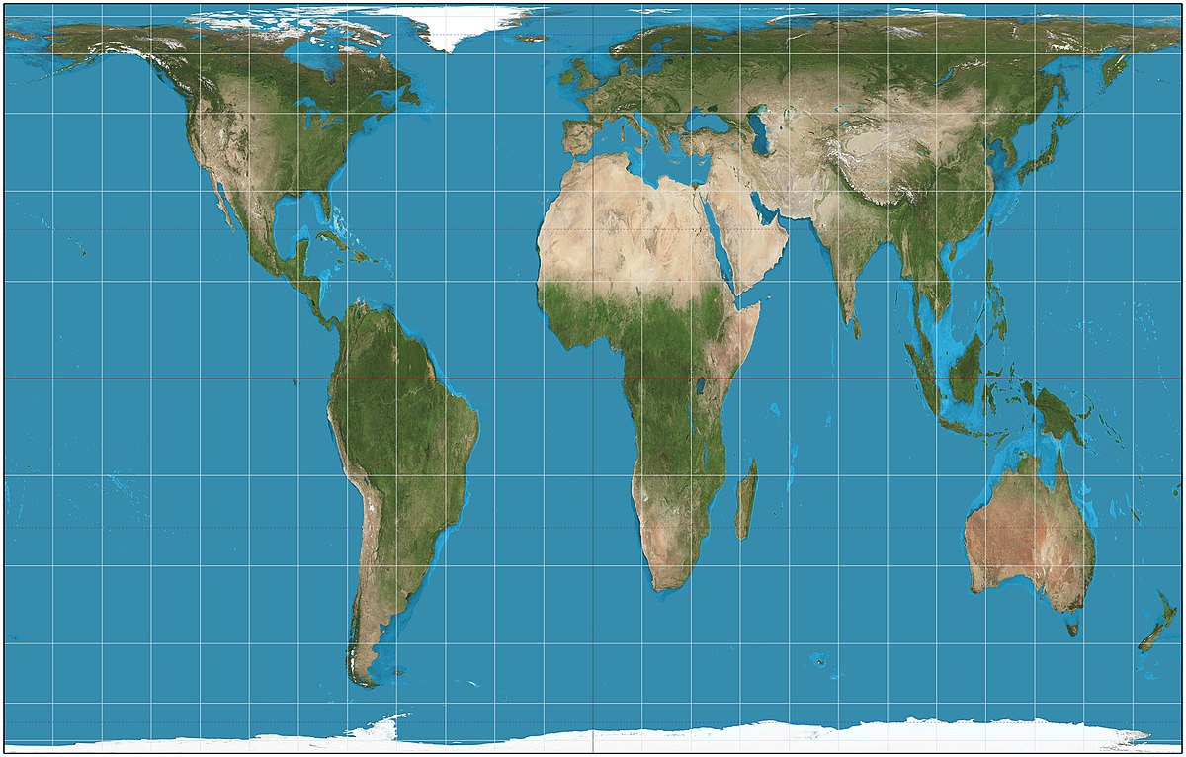
MAP PROJECTIONS TO KNOW: PETERS
Purpose: Spatial distributions related to area.
Strengths: Size of places are shown accurately.
Distortion: Shapes are inaccurate, especially near the poles.

Slide 108
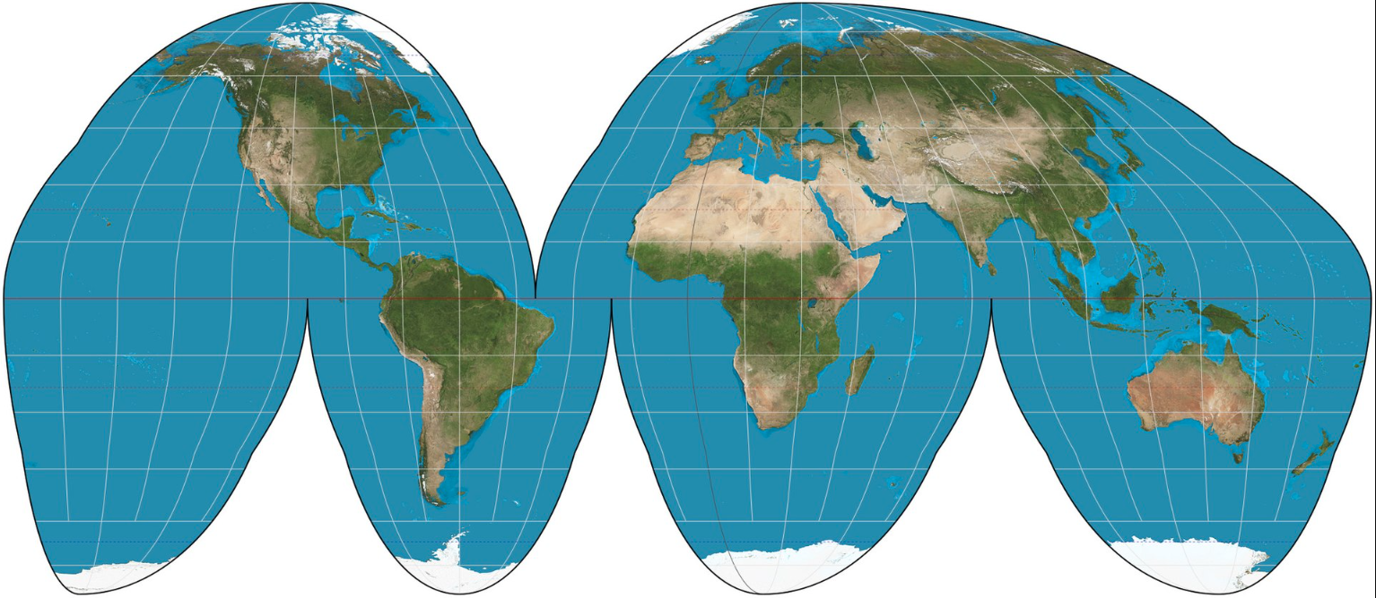
MAP PROJECTIONS TO KNOW: EQUAL-AREA
Purpose: General use & for data distributions.
Strengths: Size very close to reality.
Distortion: Shape & Distance are distorted. AKA Orange-Peel Projection

