Slide 1
CAMPBELL MIDDLE SCHOOL Principal’s Advisory Council
January 29, 2023

Slide 2
Where do we start?
INTRODUCTIONS
2022-2023
TITLE 1 REQUIREMENTS

Slide 3
INTRODUCTIONS
2 Staff – Kiersten Martin (TOTY) and Jessica Richardson (Title 1 Academic Coach)
2 Parents - Latoya Palmer-Addy (PTSA President) and Beth Seelinger (7th & 8th Parent)
2 Community - Tim Gould (Smyrna City Councilman) & Shawn Freeman (6th Parent)
1 Counselor - Alex Gorrell (Counselor)
1 Rep from Title 1 - Dalia Saldierna (Parent Facilitator)

Slide 4
PURPOSE
The Council will function as an advisory body, offering input to the local school principal on matters relating to student achievement and school improvement. The principal may seek input from the Council on a variety of topics which may include, but are not limited to, student achievement goals, student attendance, school improvement plans, curriculum, school budget priorities, community use of school facilities, and early intervention services.

Slide 5
Campbell Middle Demographics We are up 40 students from last year.
1230 Students
52% Black
23% Hispanic
13% White
6% Asian
4% Multiracial
2% Other

Slide 6
Q2 GRADES
All “A” Honor Roll
66 – 6th grade
81 – 7th grade
49 – 8th grade
All “A/B” Honor Roll
131 – 6th grade
93 – 7th grade
108 – 8th grade

Slide 7
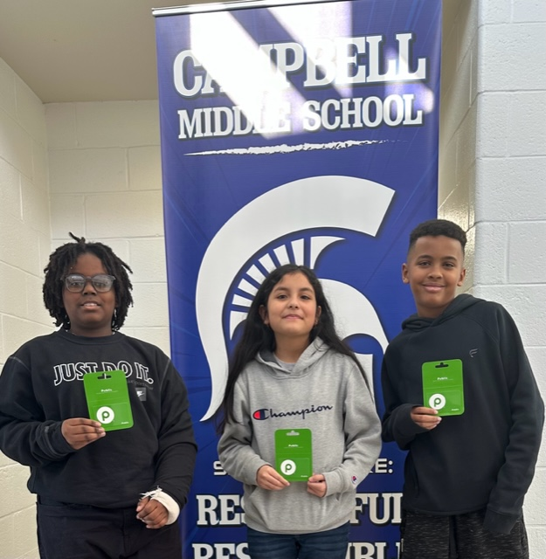
6th Grade VIPs $20 Publix Gift Card
Jair Kemp
(nominated by Ms. Laney)
Jordan John
(nominated by Ms. Forbes)
Amanda Martinez-Alves
(nominated by Ms. Robinson)

Slide 8
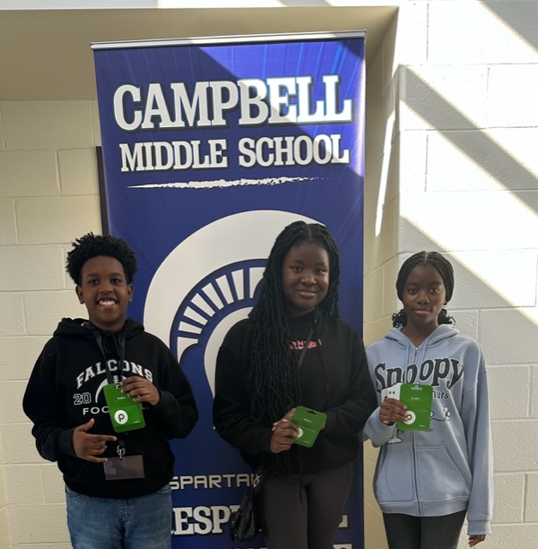
7th Grade VIPs $20 Publix Gift Card
Brittany Akporj
(nominated by Ms. Moyer)
Jeremy Irungu
(nominated by Ms. Purvis)
Loryn Beckford
(nominated by Ms. Groebner)

Slide 9
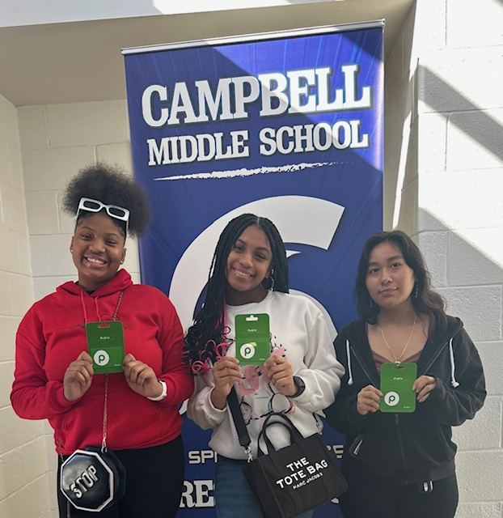
8th Grade VIPs $20 Publix Gift Card
Autmyn Lightfoot
(nominated by Ms. Henderson)
Diana Salgado
(nominated by Ms. Johnson)
Trinity Hanson
(nominated by Dr. Evans)

Slide 10
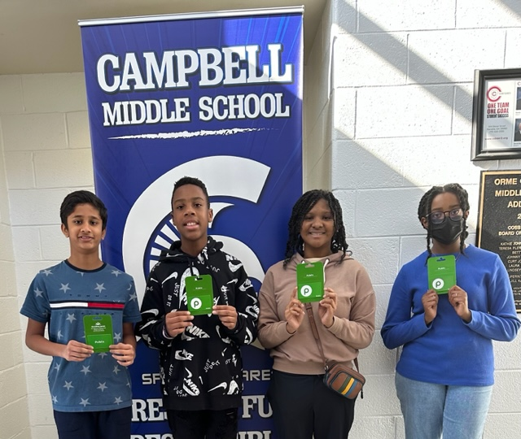
Connections VIPs $20 Publix Gift Card
Cori Parker
(nominated by Mr. Connolly)
Kayla Harvey
(nominated by Ms. Sheppard)
Rajveer Gaikwad
(nominated by Dr. Smith)
Tyson Parks
(nominated by Ms. Grant)

Slide 11
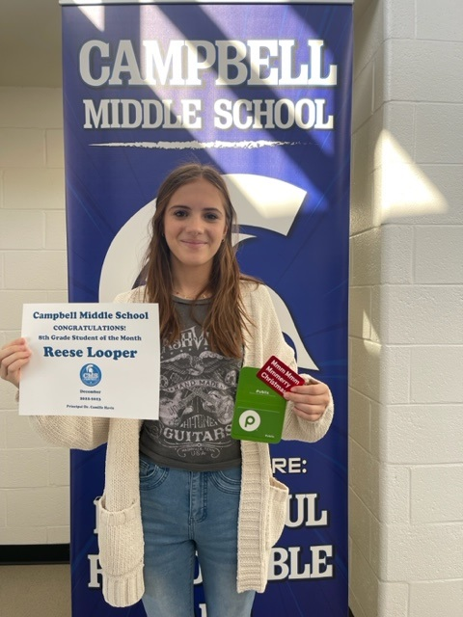
8th Grade Student of the Month
Reese Looper
$10 Chick Fil A Card
$20 Publix Gift Card

Slide 12
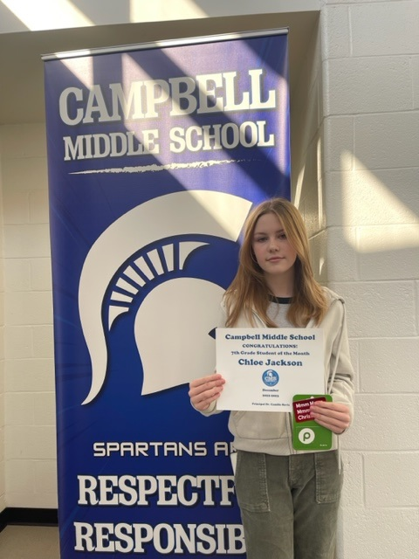
7th Grade Student of the Month
Chloe Jackson
$10 Chick Fil A Card
$20 Publix Gift Card

Slide 13
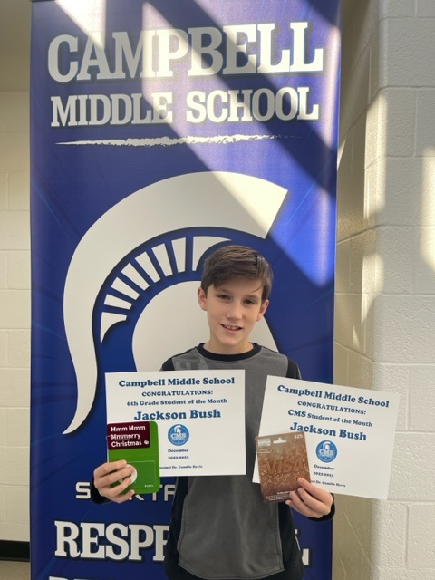
6th Grade Student of the Month & CMS Student of the Month
Jackson Bush
$10 Chick Fil A Card
$20 Publix Gift Card
$25 VISA Gift Card

Slide 14
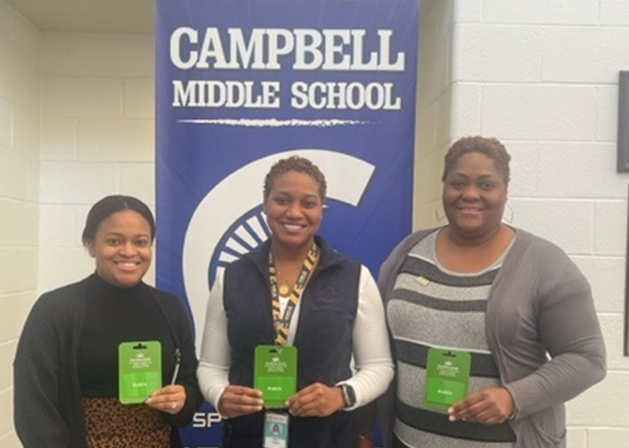
TEACHER VIPs $20 Publix Gift Card
Ms. Forbes
(6th grade math)
Ms. Walker
(7th grade science)
Ms. Stewart
(8th grade ELA)

Slide 15
RI / MI GROWTH

Slide 16
Top 5 Highest MI Growth
Gabriella Milligan (6th grade) 547
Zayin Dominguez (8th grade) 493
Cortez Stephens (8th grade) 472
Gerson Lara Portillo (8th grade) 457
Jai Pallaprolou (7th grade) 452

Slide 17
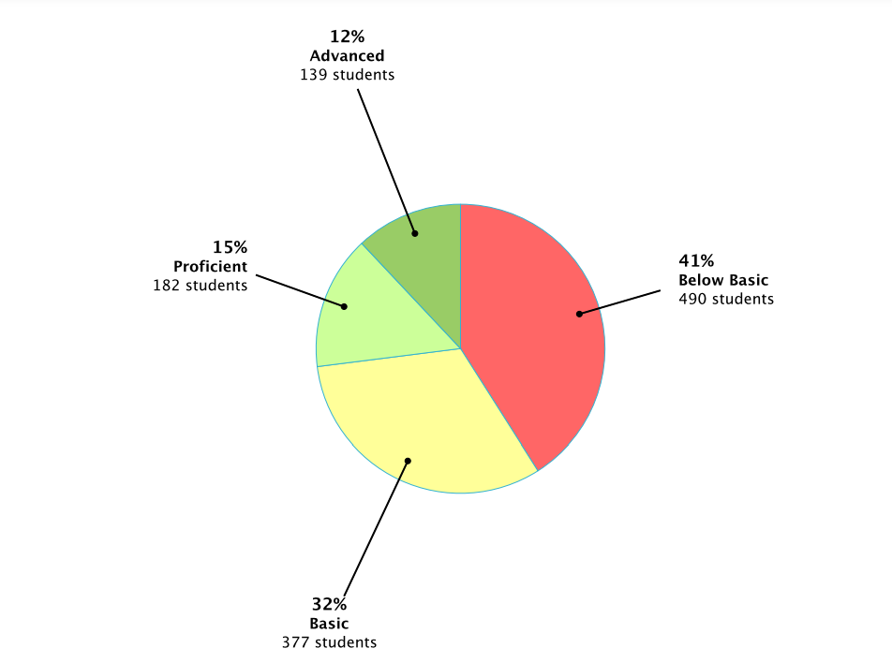
TOTAL SCHOOL MI GROWTH
Beginning of the Year 2022-2023
Middle of the Year 2022-2023

Slide 18
Top 5 Highest RI Growth
Christian Wilson (8th grade) 520
Kayd'n Benson (8th grade) 471
Miguel Andrade (8th grade) 430
Asher Bryant (6th grade) 382
Kamay Haynes (7th grade) 360

Slide 19
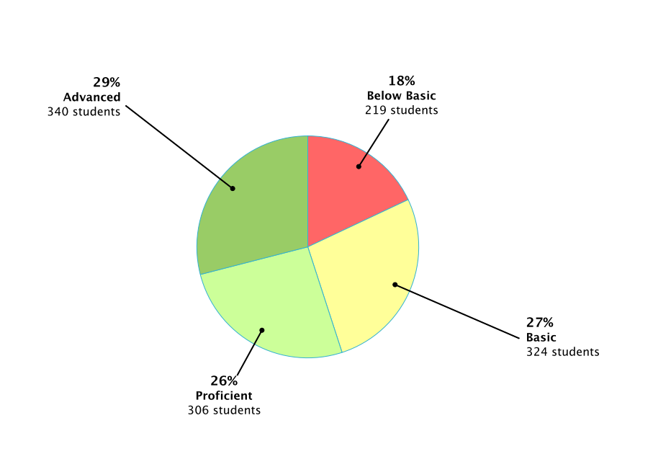
TOTAL SCHOOL RI GROWTH
Beginning of the Year 2022-2023
Middle of the Year 2022-2023

Slide 20
RI & MI - REWARDS
101+ growth on RI or MI: 588 students (Zaxby’s Gift Cards) $$$$
75-100 growth on RI or MI: 162 students (Café Slushies) $$$
51-74 growth on RI or MI: 106 students (Café Ice Cream) $$$
26-50 growth on RI or MI: 105 students (Chips) $$
1-25 growth on RI or MI: 71 students (Pencils & Jolly Rancher) $

Slide 21
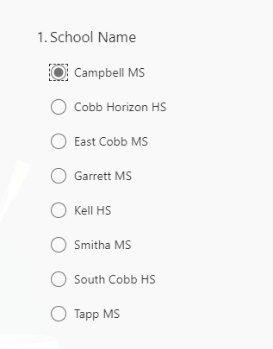
UI Tutors
We have 6
Two per grade level
One ELA / One Math
They work with 3 students per class for additional tutoring support

Slide 22
RAMP CERTIFICATION
We will be officially recognized by the CCSD BOE … I will let you know the date.
We will be recognized on July 17th by ASCA at the GA World Congress Center ☺

Slide 23
STEAM CERTIFICATION
We have begun the process for STEAM (It is a 3-year process). First teacher meeting is Tuesday January 24th at KSU and 2nd meeting is in March at KSU. Then we start this summer with training.
We will roll it out via 6th grade, and it will move up each year. Certification should be in 2026!
The Team
Candace Ellis (Academic Coach)
Alicia Farrar (Science Teacher)
Ms. Robinson (Math Teacher)
Ceilidh Hoadley (Art Teacher)
Michael Glenn (Technology Teacher)
Tanika Parrish (Assistant Principal – Former English Teacher)

Slide 24
IB REAUTHORIZATION
The process might begin in August 2023 with the study which lasts one year.
But it may be put off until August 2024 when our original reauthorization which was put on hold due to pandemic.

Slide 25
DISCIPLINE is DOWN ☺
TOP 3 INCIDENTS 2019
Skipping 181 offenses
Class Disruption 73 offenses
Insubordination 72 offenses
TOP 3 INCIDENTS 2021
Horseplay 62 offenses
Insubordination 61 offenses
Class Disruption 57 offenses
TOP 3 INCIDENTS 2021
Horseplay 58 offenses
Insubordination 51 offenses
Class Disruption 26 offenses

Slide 26
WHAT CONTRIBUTES TO DOWNWARD TREND FOR DISCIPLINE?
RESTORATIVE
CIRCLES
CRYPTO CURRENCY via PBIS
ASSIGNED TEACHER MENTORS
Monthly admin grade level talks
Grade level field trips
MONTHLY STUDENT INCENTIVES
MORE GRADE LEVEL RECOGNITON
MORE INDIVIDUAL CLASSROOM RECOGNITION

Slide 27
MY BUDGET – LOCAL SCHOOL (Facility & Vending)
Date | Event | For Whom? | Ordering From? | Ordering What? | # of people | Cost?
1/24 | DLI 1st Semester Celebration | DLI Students | Bella’s Pizza | 6 cheese 6 pepperoni 3 sausage |  | $300
3/1 & 3/5 | Rising 6th Grade Visit | 5th graders | UA Printing | 35 small shirts 35 medium shirts 30 large shirts | 144 | $600
3/10 | Ice Cream Truck | Students & CMS Staff | ATL Ice Cream | Ice Cream Variety | 1300 | $2000
4/28 | 6th Grade Field Day | 6th Students & Staff | Kona Ice 2 to 4pm | Variety | 450 | $1100
5/2 | Teacher Appreciation | CMS Staff | Doc Greens | Thai Chicken Wraps Ranchero Chicken Wraps Caesar Chicken Wraps | 120 | $1600
5/5 | Teacher Appreciation | CMS Staff | Willys | Nacho Bar (Chicken / Steak / Cheese / Guac) | 120 | 1200
5/5 | 8th Grade Field Day | 8th Students & Staff | Kona Ice 2 to 4pm | Variety | 450 | $1100
5/12 | 7th Grade Field Day | 7th Students & Staff | Kona Ice 11:30 to 1:30 | Variety | 450 | $1100
5/19 | 8th Grade Dance | 8th Students & Staff | Carrabba’s | Less than we did last year ☺ | 275 | $1500
5/22 | 8th Grade Fun Day (Kids may order Chick Fil A for breakfast via mypayments plus for breakfast) | 8th Students & Staff | Vendor Vendor Vendor Costco or Sam’s | Obstacle Course Game Truck Hotdogs Chips & Water | 450 | $500 $700 $1000 $600
5/23 | 8th Grade Yearbook Signing (kids may order Zaxbys via mypayments plus for lunch) | 8th Students & Staff | Zaxby’s | Boxed Lunch | TBD | N/A

Slide 28
NOW THAT YOU HAVE THE BACKGROUND
TITLE 1
JANUARY = THE BUDGET PLAN
FEBURARY = PRIORITIZED NEEDS
MARCH = 3 GOALS (ELA / MATH / BEHAVIORAL)
APRIL = THE TITLE 1 PLAN

Slide 29
23-24 TITLE 1 BUDGET PRIORITES
$515,00
Personnel $350,000
Math Support Teacher
ELA Academic Coach (DLI Coordinator)
Math Coach (IB Coordinator)
Parent Facilitator
Software $33,000
Moby Max
Flocabulary
IXL Math
IXL English
IXL Social Studies
IXL Science

Slide 30
23-24 TITLE 1 BUDGET PRIORITES
$515,00
Supplies $18,000
Copy Paper / Copier Ink
Printer Ink
PBIS APP
Student Agendas
Performance Contracts $13,000
Science 4 Everyone
Diamond Del Mining
Parent Nights $1,000
Multicultural Night Decorations
IB Showcase Decorations

Slide 31
23-24 TITLE 1 BUDGET PRIORITES
$515,00
Workshops & Conferences $18,000
Title 1
IB
GATESOL
GA ELA
GA SOCIAL STUDIES
GA MATH
GA SCIENCE
Conferences / Workshops include
*Registration
*Hotel
*Food Per Diem
*Travel

Slide 32
23-24 TITLE 1 BUDGET PRIORITES
$515,00
$350,000
$33,000
$18,000
$13,000
$1,000
$18,000
__________
$433,000
$82,000 Left to Budget

Slide 33
Wish List for Improvements 22-24
2 Cameras in both gyms &
2 additional outside cameras
Glass Security wall
near media center

Slide 34
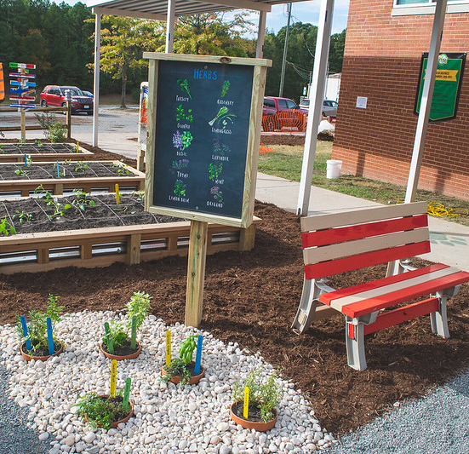
Wish List for Improvements – 22-24
Out Teach which would assist the Foundation with an Outdoor STEM Station:
Cost: $25,000 (Includes below + professional learning sessions)
Whiteboard/Weatherboard
Bench Seating (for 25-30)
Earth Science Station w/ Sand & Rock Bins
Maker Space Bin
Measuring Poles
Veggie Bed w/ SQ FT
Sample Elementary

Slide 35
SIDE NOTE (this came today!!)
I just received notice that I have an extra $70,000 to spend in carry over
We would like to do a Welcome to Your CMS Homeroom Supply Bag for August 1, 2023
I must submit the plan by Monday 😲

Slide 36
SO, NOW WHAT?
I will send the PPT as soon as this meeting is over
Read through it again
Send me suggestions on the budget AND the $82,000
We will discuss the goals for student achievement in the Title 1 Plan next meeting on February 27th

