Slide 1
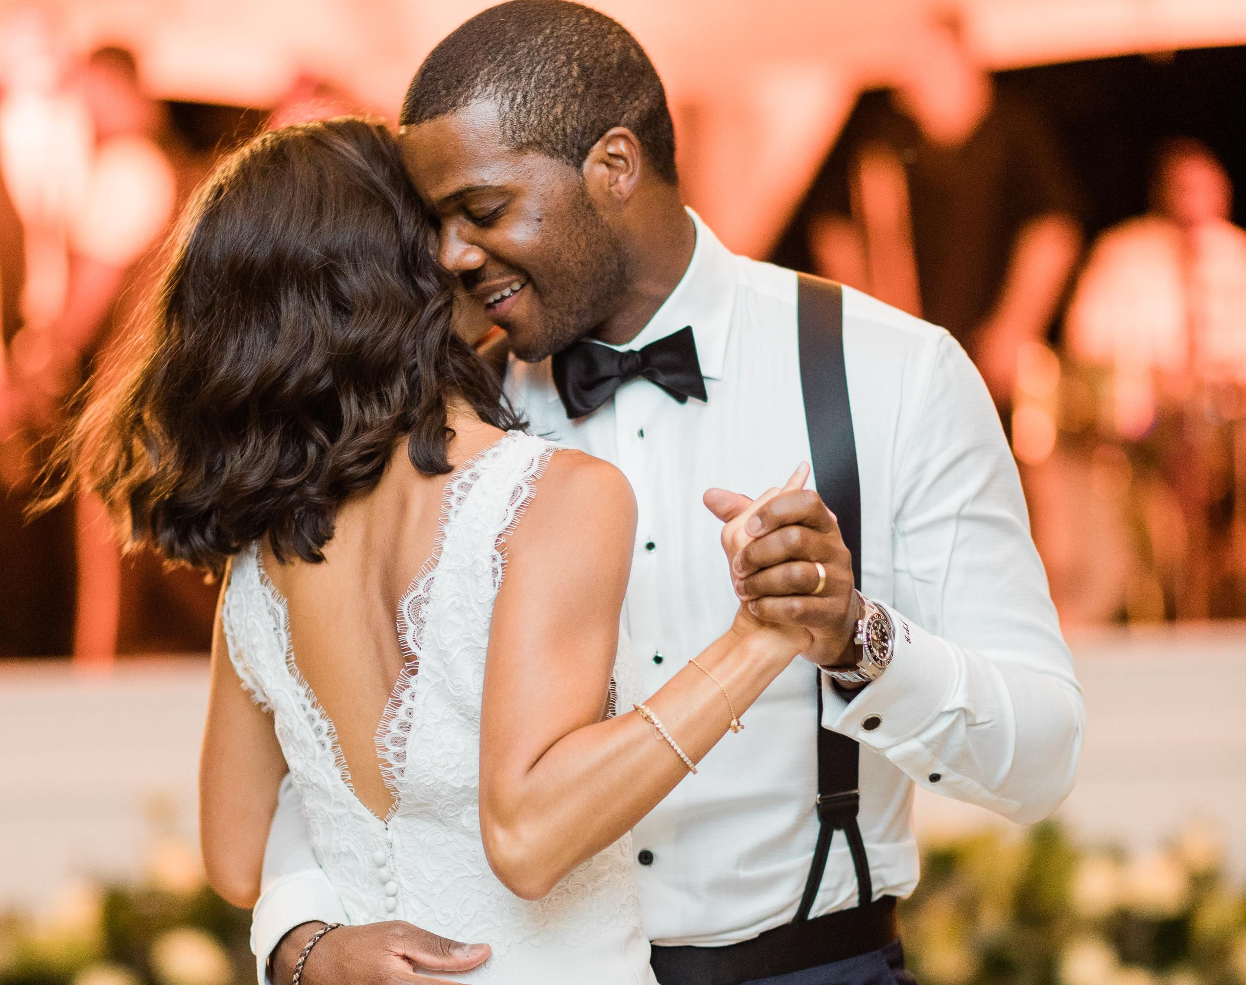
Campbell High School PROM DRESS CODE 2022

Slide 2
Rule of thumb…
Keep modesty in mind when shopping for dresses and tuxes for this year’s prom.
The dress code DOES NOT limit your ability to show your style and creativity. Though these rules are parameters to work within because this is a school event, they are not final statements about ALL acceptable prom fashions.

Slide 3
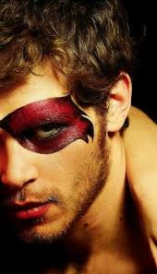
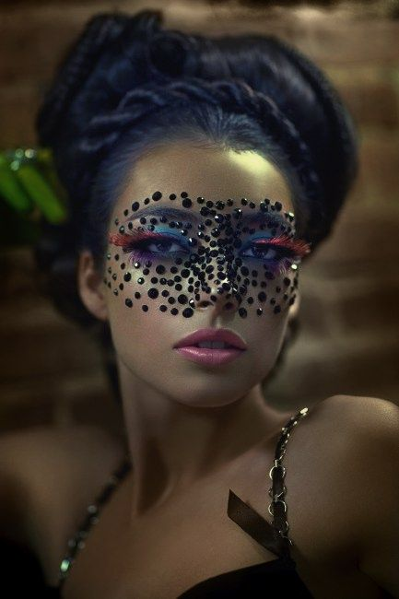
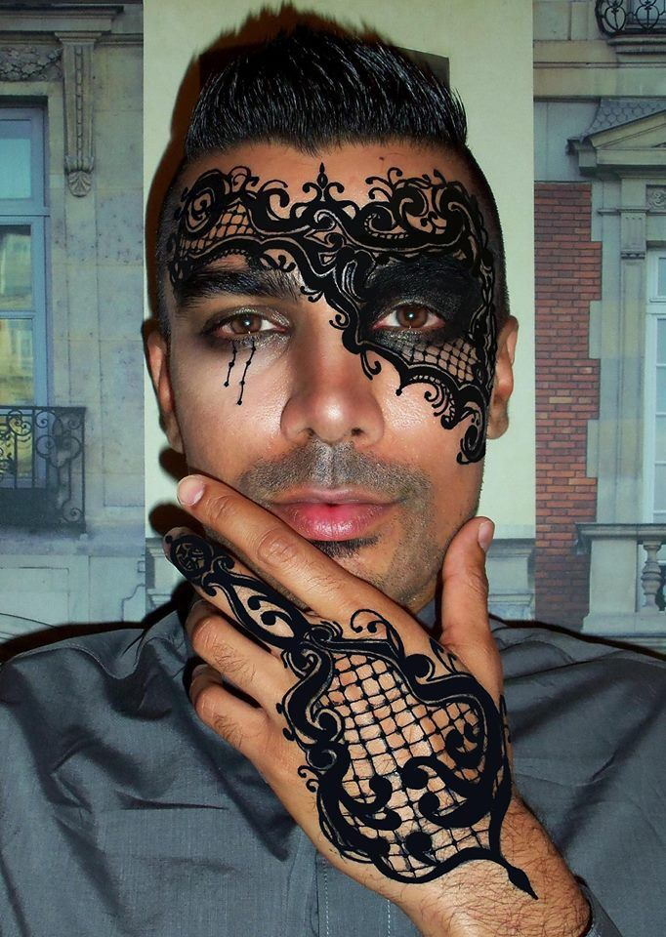
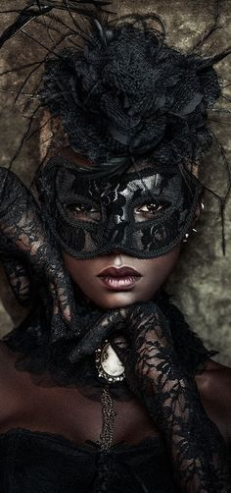
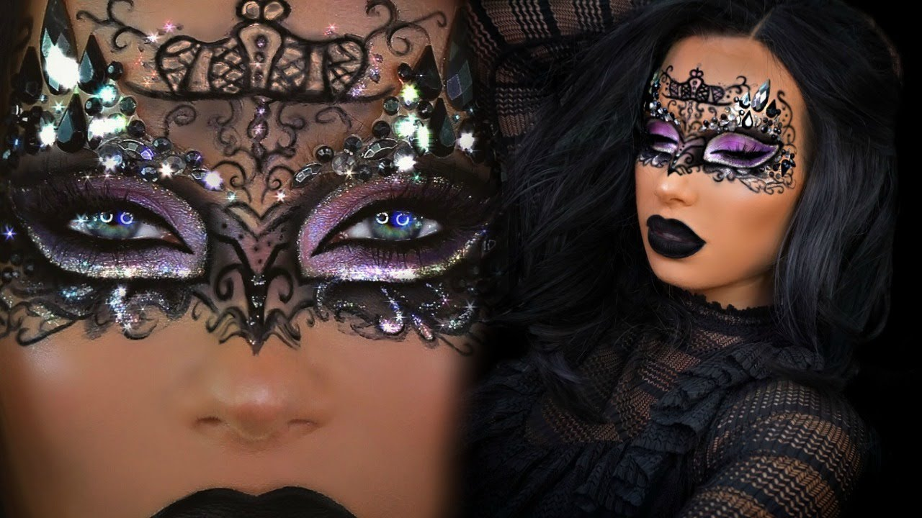
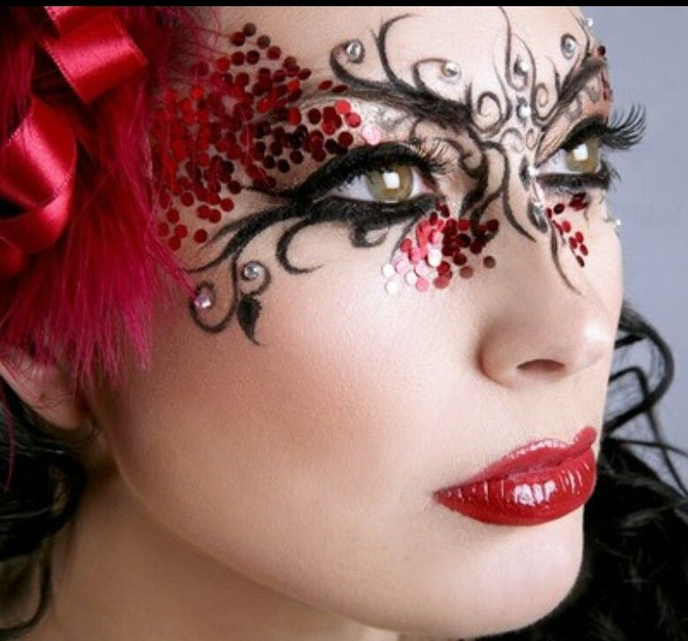
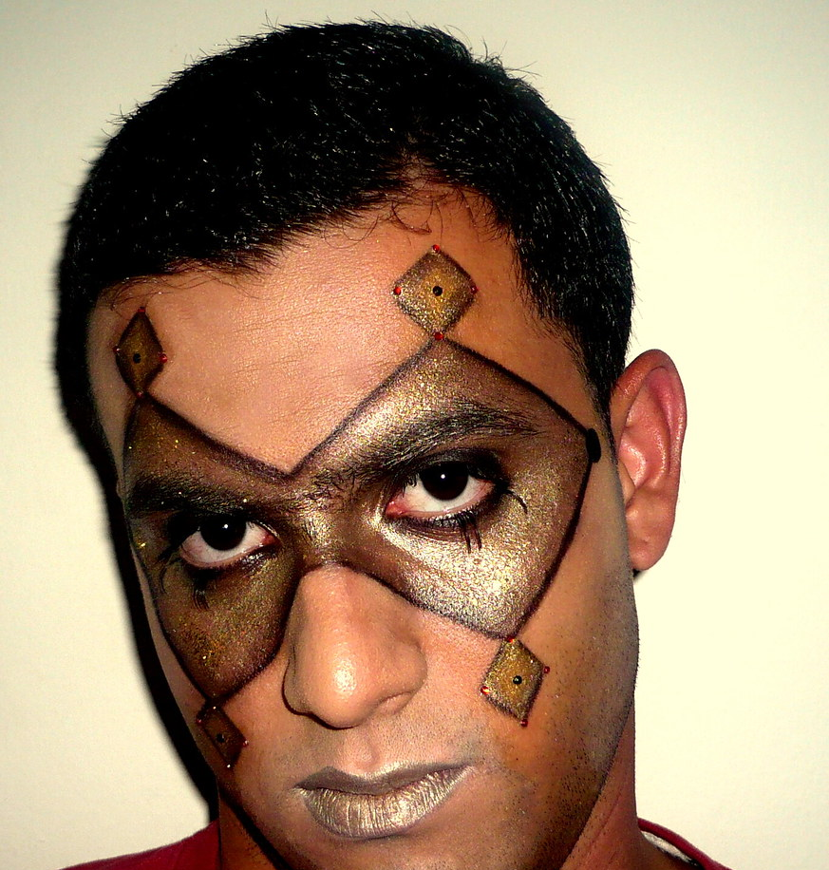
Since our Prom will be a Masquerade Ball, there are some parameters we must meet.
You may wear masks which only cover your eyes or use mask make up. Full face masks will not be allowed.

Slide 4
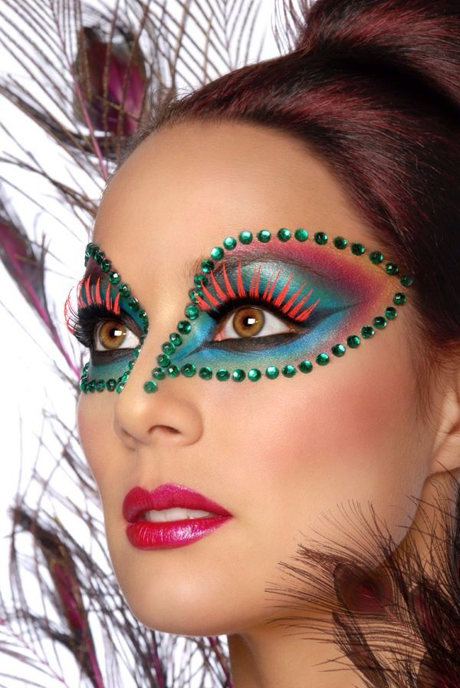
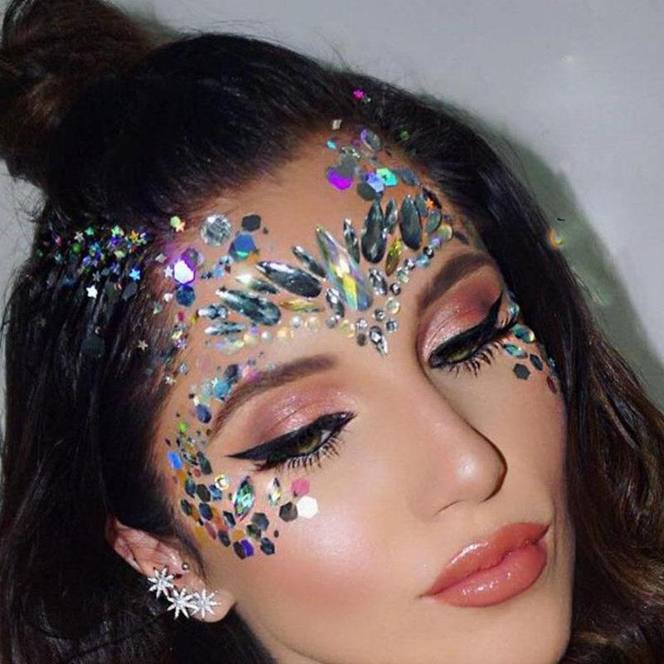
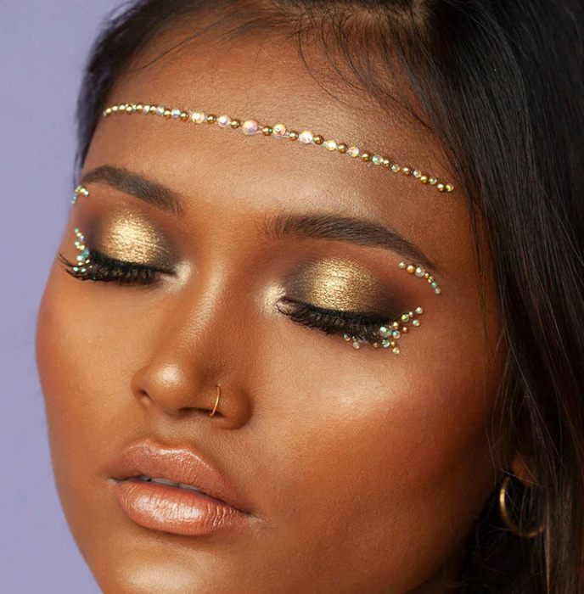
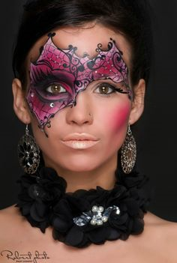
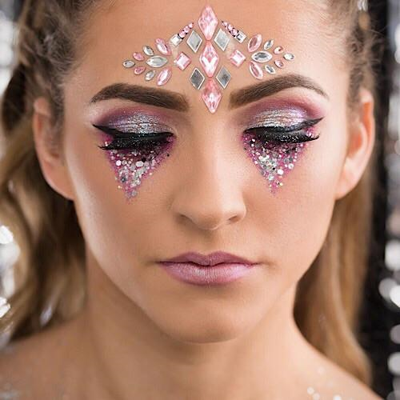
More Alternatives!!

Slide 5
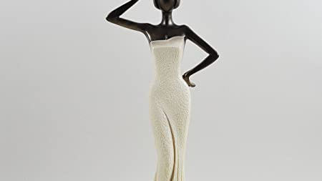
Ladies…

Slide 6
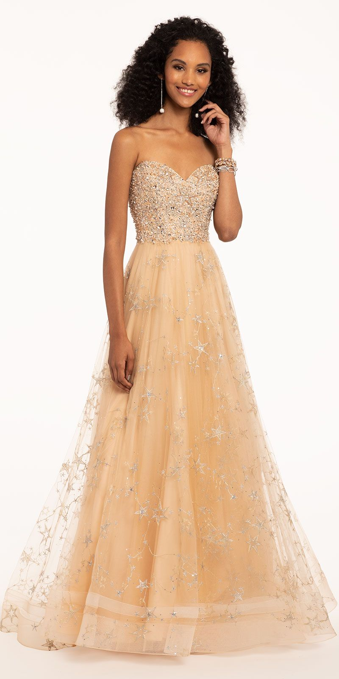
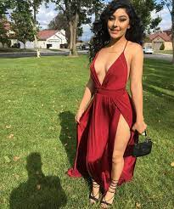
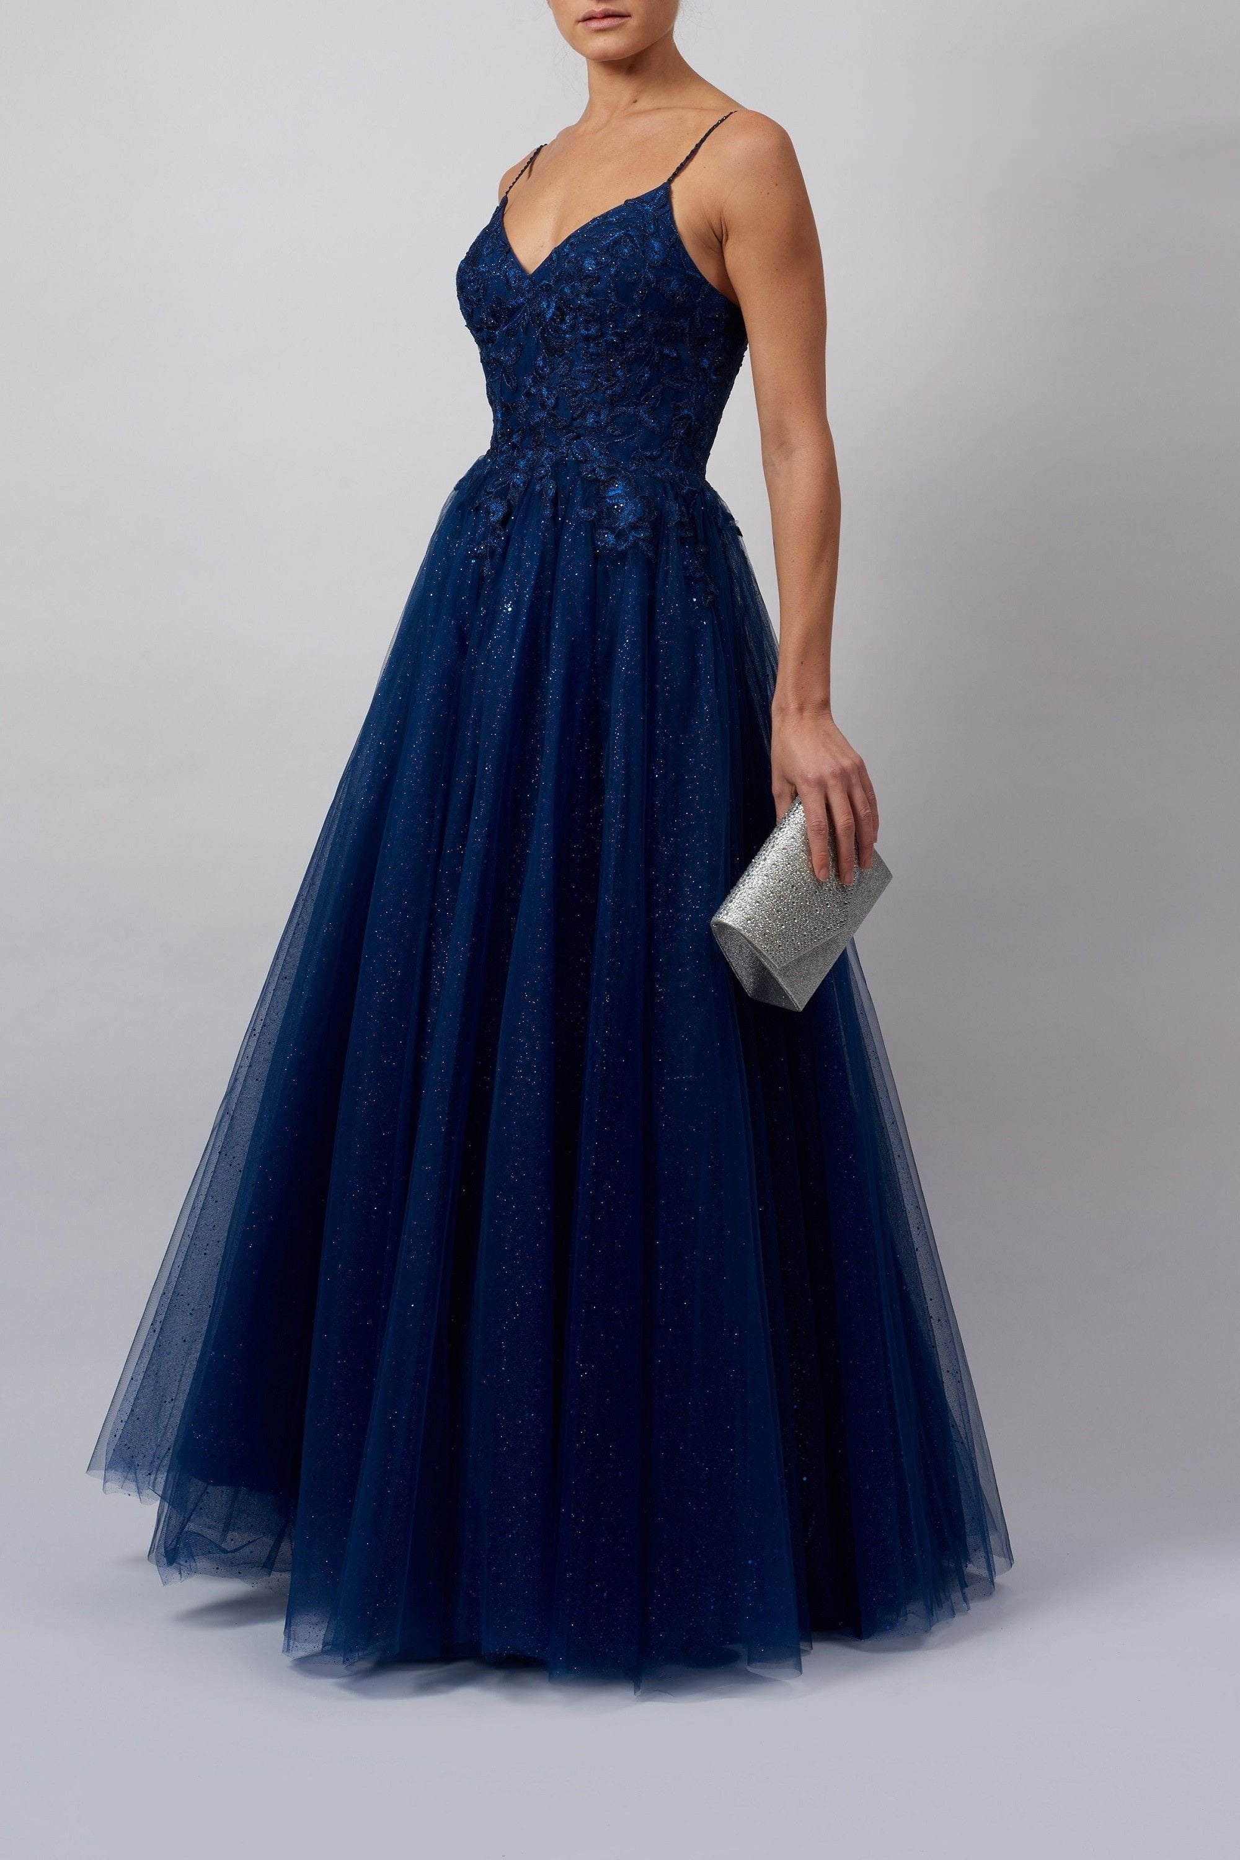
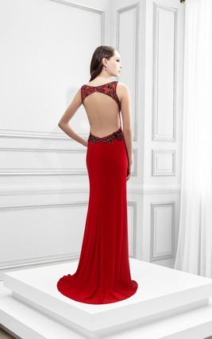
Rule # 1: Class not Crass
YES!
YES!
YES!
NOOOOOOOOOOO
Nope
NO
NO
NO

Slide 7
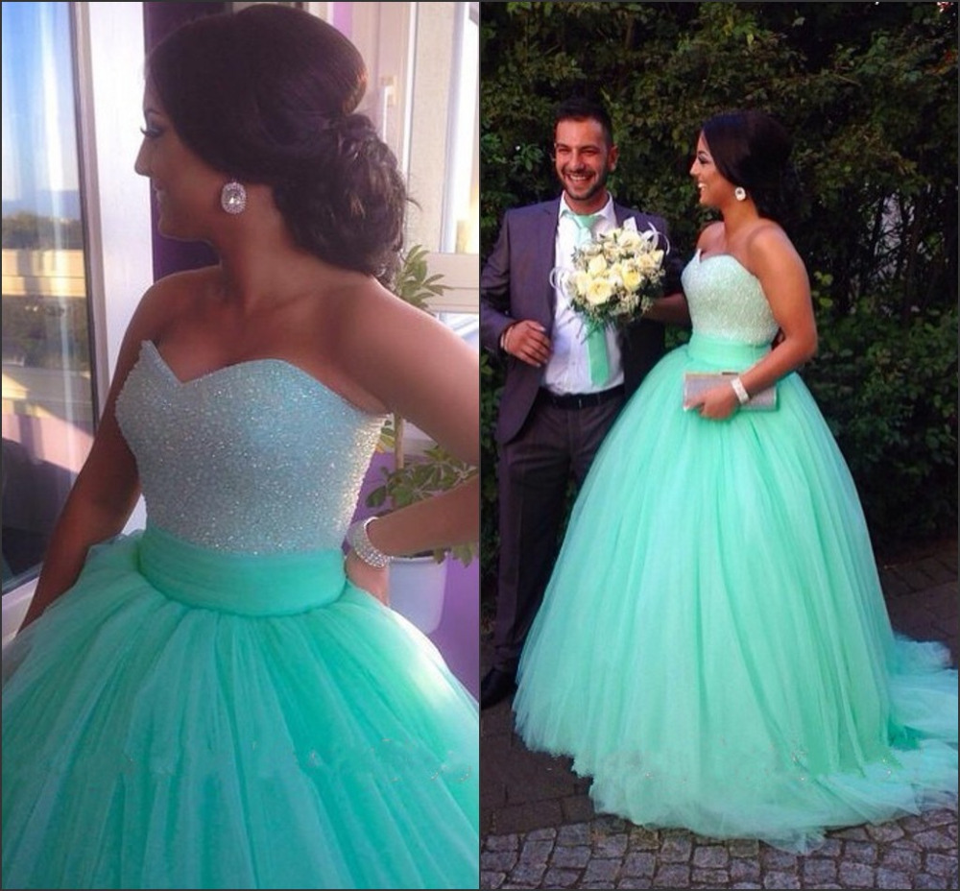
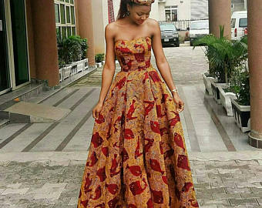
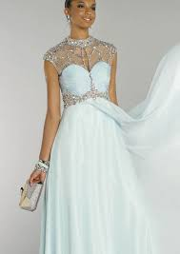
ACCEPTABLE Necklines for Prom
No exposed cleavage! Imagination is more exciting!

Slide 8
UNACCEPTABLE Necklines for Prom
Oh Heck No!!!
The bust is excessively exposed in all of these pictures.

Slide 9
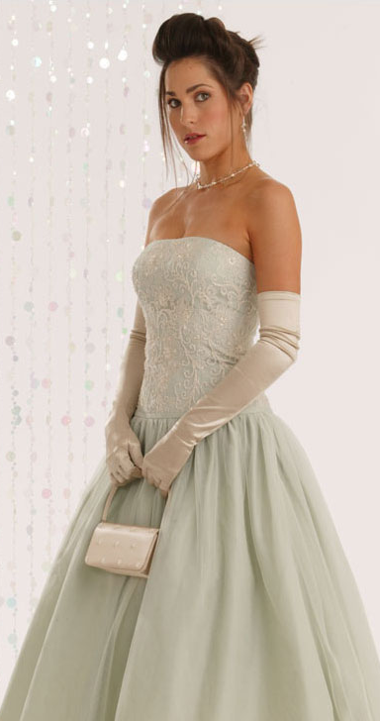
Rule # 2: NO EXCESSIVE BARE MIDRIFFS
Midriffs must not be overly exposed in dresses.
Two-piece dresses ARE permitted so long as the gap does not exceed 2”.
Cutouts on the side must have side paneling to cover skin.

Slide 10
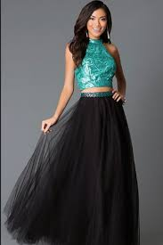
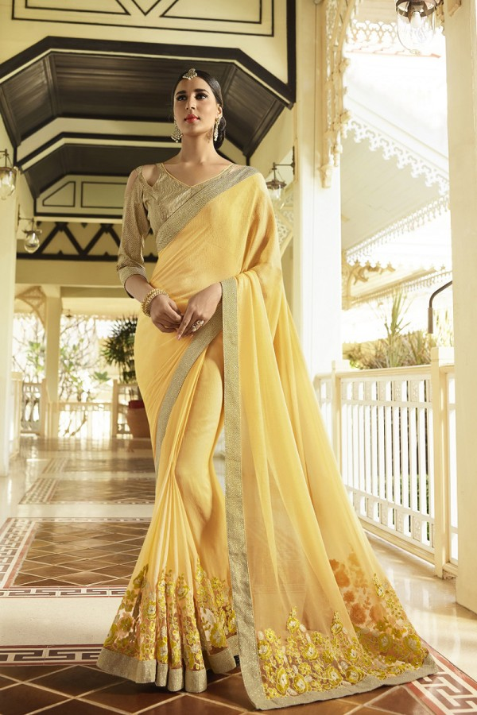
ACCEPTABLE midriffs for Prom
Midriffs are completely covered, have paneling, or meet the 2” gap requirement

Slide 11
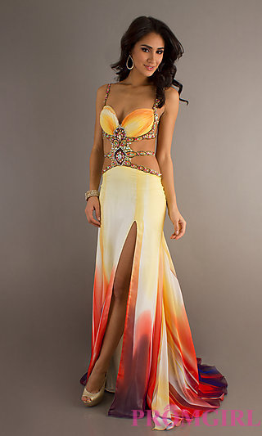
UNNACCEPTABLE midriffs for Prom
Skin at midriff inappropriately exposed.
YIKES!!!

Slide 12
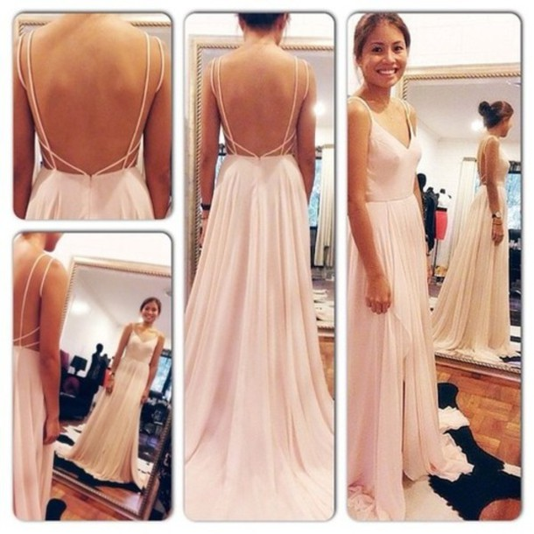
Rule # 3: NO BAREBACKS BELOW THE WAIST
Dresses may be backless so long as they are NOT below the waist.

Slide 13
ACCEPTABLE backless dresses
Backs are bared at or above the waist

Slide 14
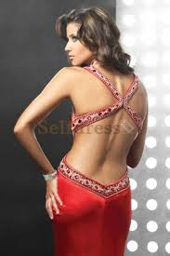
UNNACCEPTABLE backless dresses
Bare backs hit below the waist. You’re at a dance…not a honeymoon!

Slide 15
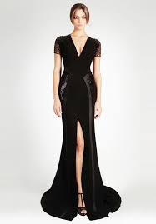
Rule # 4: Dresses can be no shorter than fingertip length.
Make sure the tips of your fingers reach the hem of your dress.
No pulling to make it work!
Same goes for slits. They should be no higher than the length of your fingertips.

Slide 16
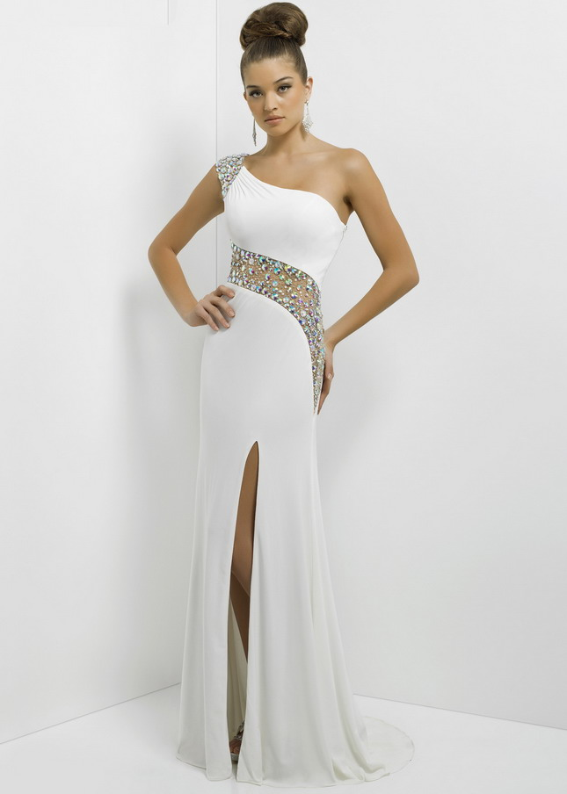
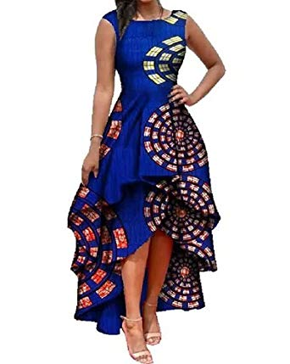
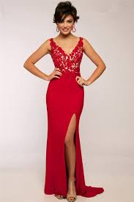
ACCEPTABLE dress and slit lengths
Dress length/slit height do not go past the fingertips

Slide 17
UNNACCEPTABLE dress and slit lengths
Dress length/slit height go past the fingertips

Slide 18
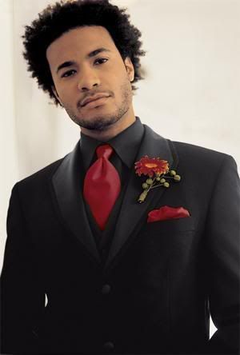
Gentlemen…

Slide 19
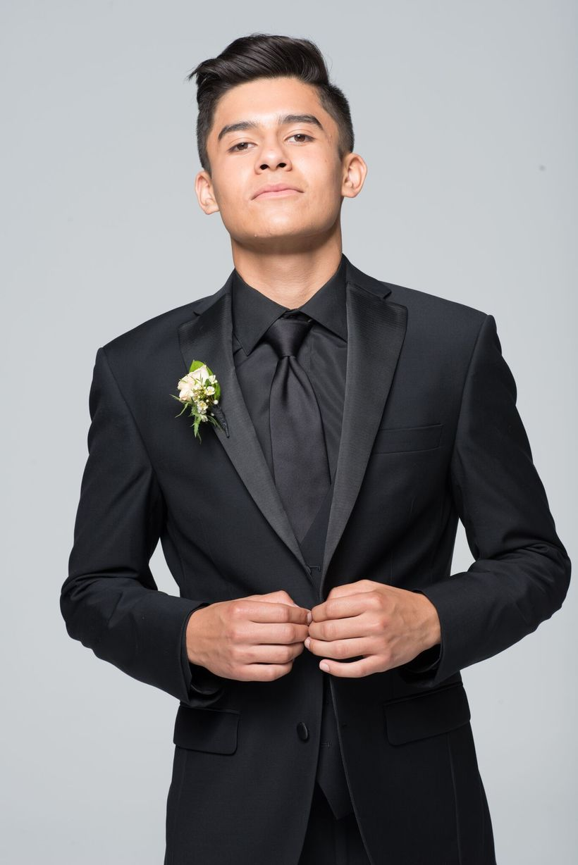
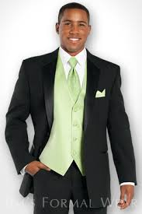
Rule # 1: Formal attire required
No Jeans.
No sagging pants.
No casual T-shirts

Slide 20
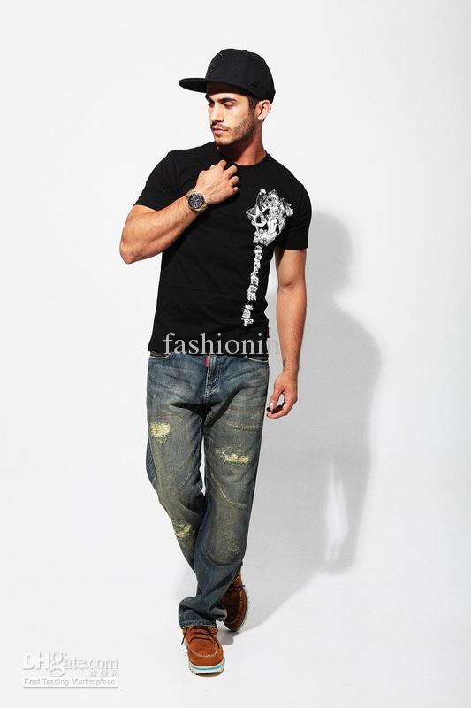
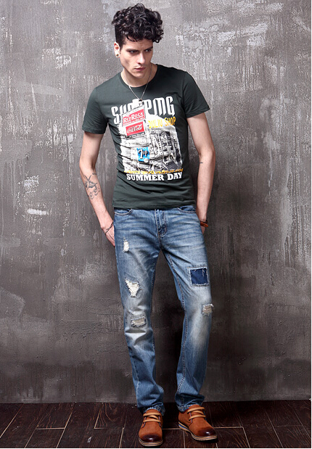
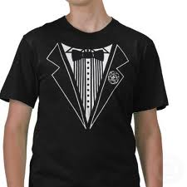
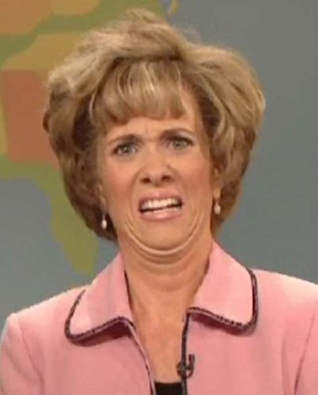
UNNACCEPTABLE attire
Attire is too casual

Slide 22
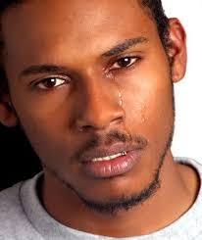
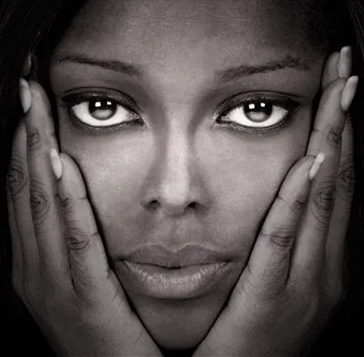
Your teachers and administrators will be reasonable in our interpretation of these guidelines. But any student not meeting dress code will be asked to cover themselves or to leave.
There will be NO REFUND given to students asked to leave due to dress code violation.

Slide 23
Final Reminders…
Before you buy, ASK! If you are uncertain about whether your prom attire meets dress code, ask an administrator or Ms. Efaw (705).
We look forward to celebrating and collaborating with students in preparation for this event!

Slide 24
What Mystery Will You Unmask?

