Slide 1

CAMPBELL MIDDLE SCHOOL
Rising 6th Grade
Parent Night

Slide 2
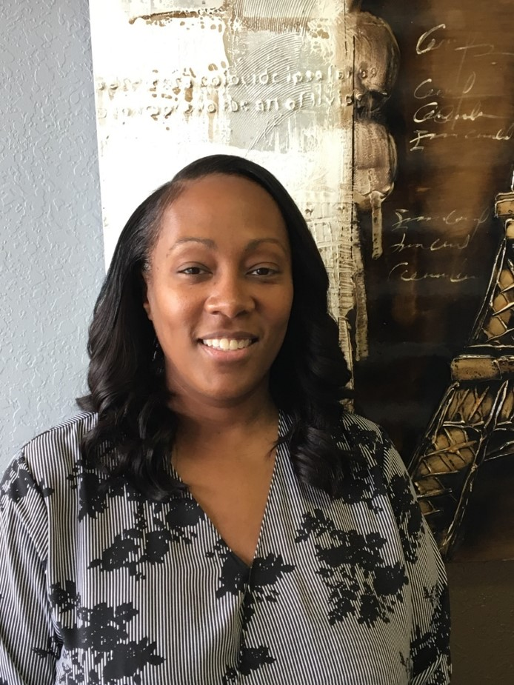
WELCOME
BIENVENIDO
BIENVENUE
Dr. Camille Havis, Principal
  About Us
  Basic School Info
Ms. Erin Thaler, 6th AP
  Course Handbook
Ms. Molly Groebner – AC Coordinator
Ms. Stephanie Burress – Students With Disabilities Lead Teacher
Ms. Candace Ellis – IB Coordinator / Academic Coach
Ms. Jessica Richardson – DLI / Academic Coach
Sixth Grade Lead Teachers
Brittani Clark – Connections Lead Teacher
Ms. Erica Lester, Counselor

Slide 3

President:
Mrs. Latoya Palmer-Addy
www.campbellmiddleschoolptsa.com

Slide 4



JOIN US ON SATURDAY MARCH 11th

Slide 5
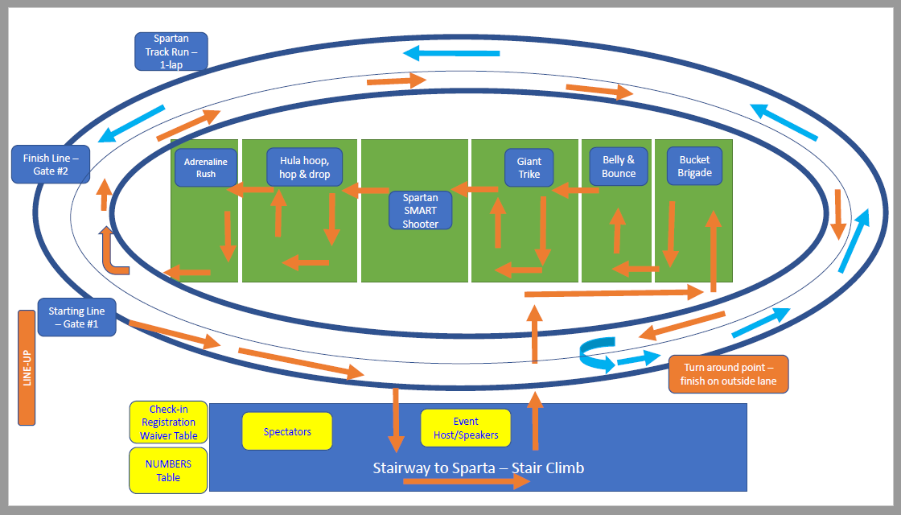
THE COURSE

Slide 6
We are a Title 1 School
Title 1
  Annual Budget of $443,000
    Personnel
      2 - Academic Coaches
      1 - Math Support Teacher
      1 - Parent Facilitator
    Instructional Materials
      IXL Math & ELA & SS & SCI
      Moby Max
    Professional Development
      IB Conferences
      GA Subject Area Conferences

Slide 7
We are a PBIS
School
Positive Behavior Interventions and Supports
An appropriate evidence-based method that creates an effective school-wide set of ideas and tools to improve the behavior of students for a more positive learning environment that includes improved academic and social outcomes for all students.

Slide 8
We are a Restorative Practices School
Restorative Circles are proactive discussions that we use as a school to establish relationships and address underlying issues that intrude into the classroom and disrupt the learning environment.
Restorative Conferences are a systemic approach for supporting students in conflict. The parties are brought together to discuss how the conflict has impacted each party and the larger school community. This practice invites shared power, mutual understanding, self-responsibility and agreed actions that repair harm, restore relationships and reintegrate the school community.

Slide 9
We are the only IB Middle School in CCSD
In addition to Math, English, Science, & Social Studies
  IB expects students to take a foreign language (French / Spanish)
  IB expects students to take a fine arts class
  (Band, Chorus, Orchestra, Art or Drama)
  IB expects students to take a computer-based class (Business or Technology)
  IB expects students to take physical education class
  IB expects students to have a culminating project at the end of the 8th grade year

Slide 10
We are the only DLI Middle School in CCSD
Dual Language Immersion
  Smyrna Elementary
  Nickajack Elementary
  Others by school choice
Spanish Language & Literature
  High School Spanish 1 / 2 / 3
Social Studies in Spanish
  All 3 years

Slide 11

Operations
School Opens 8:10
  Report to Theater for silent study hall
  Report to Before School Tutoring
School Begins 9:10
  9:15 to 9:20 are the morning announcements
  9:20 begins our daily advisement period
  60-minute core class periods
  50-minute connection class periods

Slide 12

Operations
Class Transition
  Line up to enter the next class
  Literally walking across the hall
Hallways are separate
  6th basically on two hallways
    500 Hall and 600 Hall
  Lunch and Connections are separate from the other grade levels
  Bus is the only time they will see 7th and 8th grade students

Slide 13

Operations
Afternoon Announcement 4:10
  We dismiss by grade & mode of transportation
    Walkers & Bike Riders
    Car Riders
    Bus Dismissal
  Buses
School Closes 5:00
  All students should be off campus
  The front office is closed
  Only exception is for those staying after for a club or tutor

Slide 14













AFTER SCHOOL ACTIVITIES

Slide 15
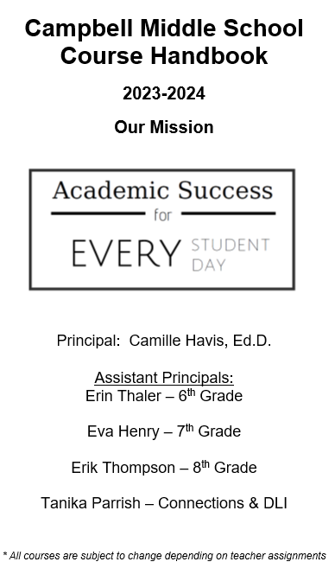
Ms. Erin Thaler, Assistant Principal
Course Handbook
Who are we?
CMS Bell Schedule
6th Grade At a Glance
Sample 6th Grade Events

Slide 16

Ms. Molly Groebner
Delivery Models
  Advanced Content Classes
  Math 6/7 & Math 7/8
  High School Classes
    Honors Algebra
    Spanish 1 / French 1
    Physical Science
    Art

Slide 17
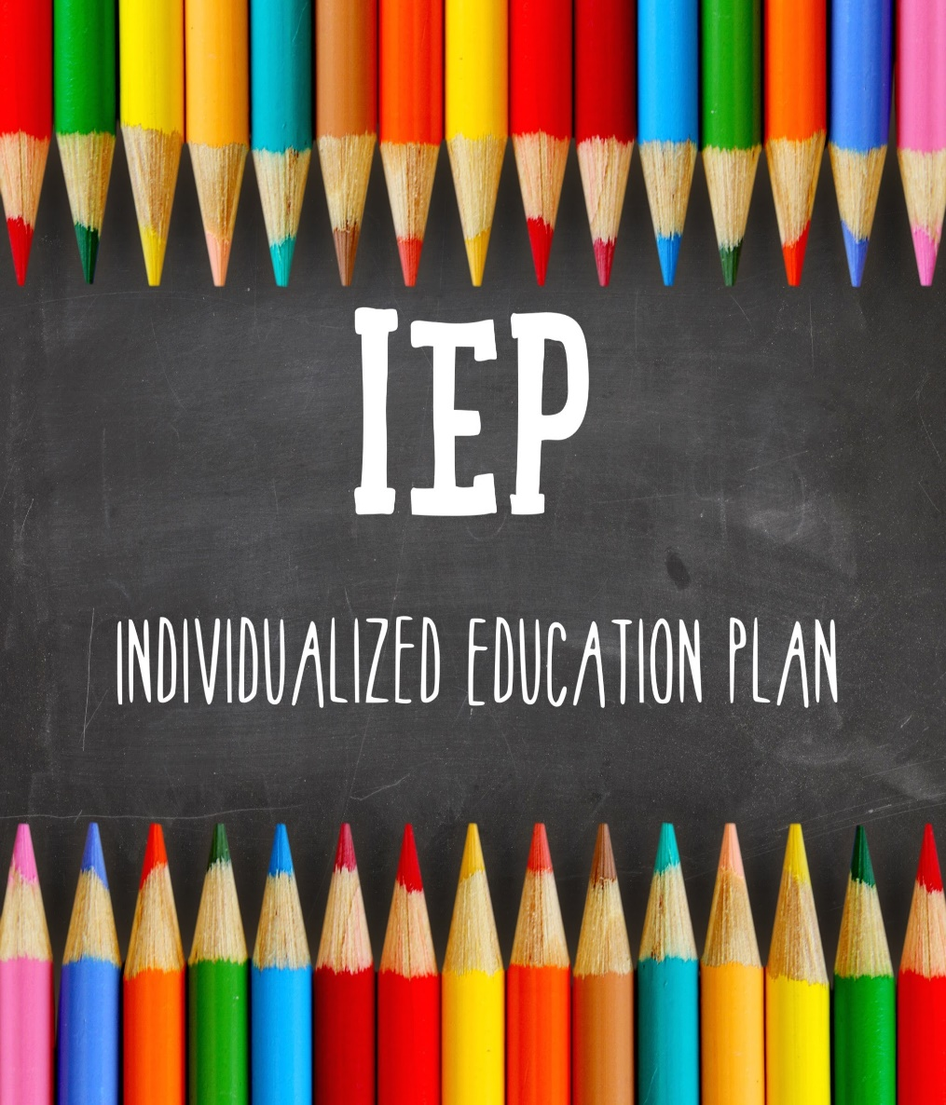
Ms. Stephanie Burress
Support & Specialized Services
  Co-Taught Classes
    ELA Social Studies
    Math Science
  Small Group Classes
    ELA - Math – Reading Support
  Programs
    AU / MID / MOID

Slide 18

IB Coordinator
Candace Ellis
IB at CMS
The International Baccalaureate® (IB) Middle Years Programme (MYP) emphasizes intellectual challenge.
It encourages students to make practical connections between their studies and the real world, preparing them for success in further study and in life.
Grades 6-8 are IB learners-inclusive program.

Slide 19
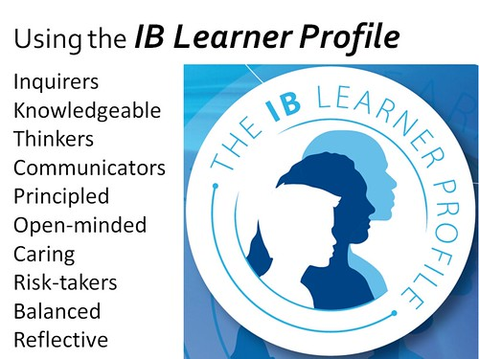
IB Learner Profile Traits

Slide 21

Ms. Jessica Richardson
DLI
  Spanish Language (High School)
  Social Studies in Spanish
The dual language immersion experience incorporates two languages into instruction.
Typically, DLI is taught in a 50/50 model where half the day is spent in the target language.
Students from either native language basically acquire the target language after success in the program.
GADOE DLI

Slide 22
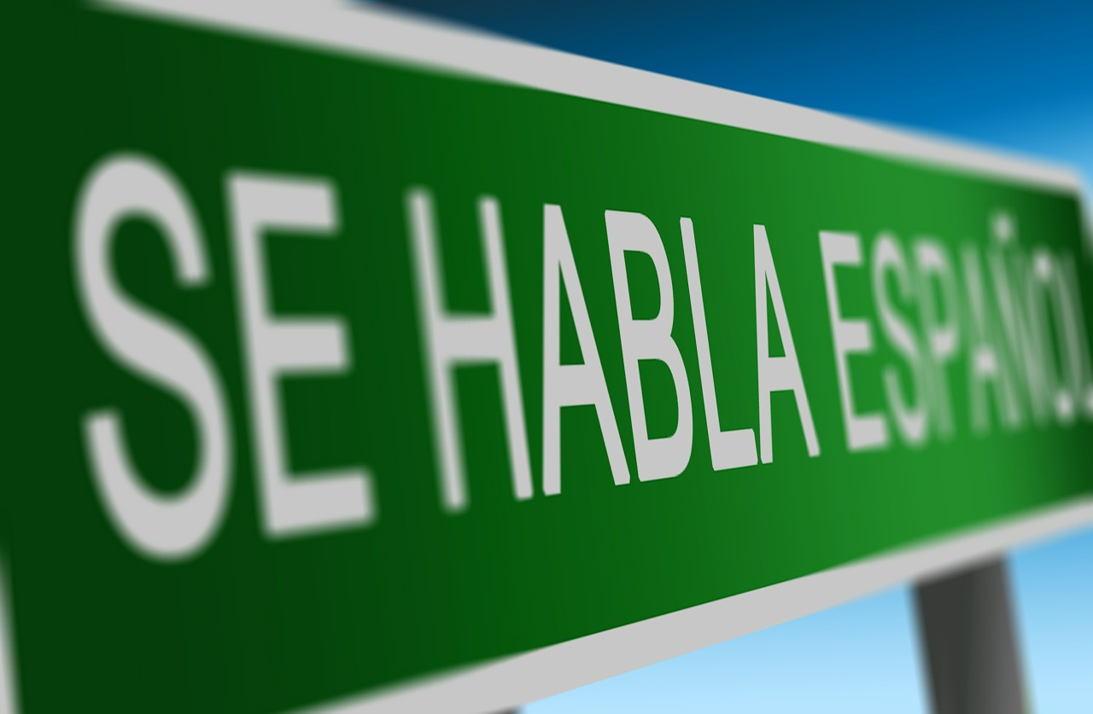
What does DLI look like at CMS?
One teacher will have the DLI students for ELA. Many DLI students are AC and/or ESOL.
We have approximately 85 students enrolled this coming year.
We are the ONLY middle school in Cobb with DLI in Social Studies & High School Spanish
*To learn more about this program, please contact Jessica Richardson

Slide 23

Ms. Annette Foreman
English Language Arts
  Course Overview
  Class Expectations
  Springboard
  Other Supplies

Slide 24
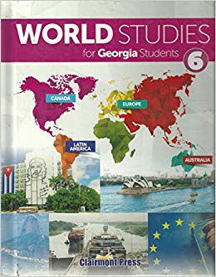
Mr. Addison Daniel
Individuals & Societies
  Course Overview
  Class Expectations
  Clairmont Press
  Other Supplies

Slide 25

Mr. Vircher Floyd
Science
  Course Overview
  Class Expectations
  Houghton Mifflin Harcourt
  Other Supplies

Slide 26
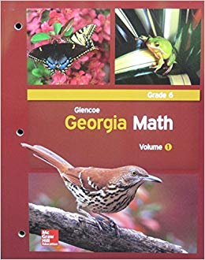
Ms. Teresa Bunch
MATH
  Course Overview
  Class Expectations
  McGraw-Hill
  Other Supplies

Slide 27
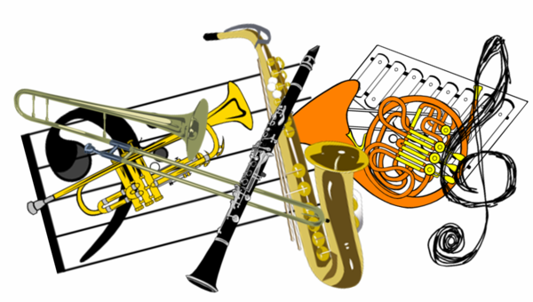
Ms. Brittani Clark
Performing Arts
  Band
  Orchestra
  Chorus
  Other Supplies

Slide 28



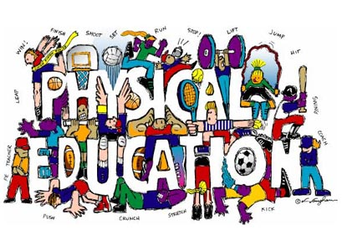


Slide 29
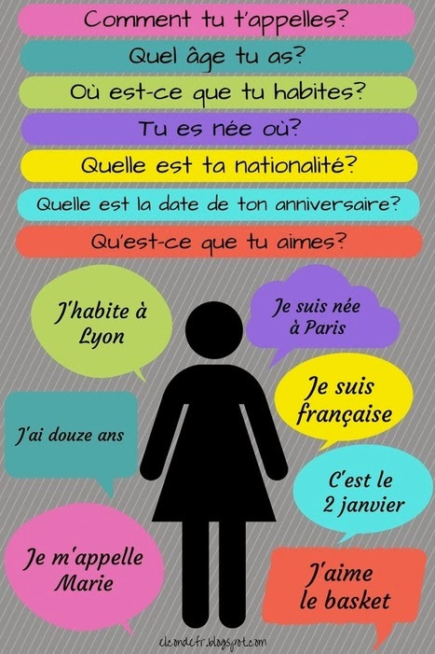
World Languages
  Spanish for Heritage Speakers
  Semester of French and Spanish, Each lasting 9 weeks
    Greetings, Salutations, Leave-taking
    Alphabet, Phonemes of Language
    Numbers, Dates, Birthdays, Age; Seasons, Months
    Weather and Associated Activities
    Colors and Clothes, Likes and Dislikes
    Origins, nationalities, simple descriptions of self
This Photo by Unknown author is licensed under CC BY.

Slide 30
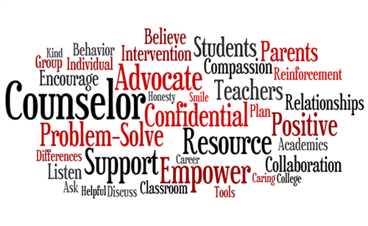
Ms. Erica Lester, 6th Grade Counselor
Emotional Knowledge
  Self-Management
  Self-Awareness
  Relationship Skills
  Responsible Decision Making
School-wide Services
  Individual counseling
  Classroom lessons
  Affective Statements
  Conflict Resolution 3-part series
  Chill Spot
Partner with your teacher:
The level of collaboration between families and educators is an important predictor of student academic achievement.
Parents and family members who establish strong, positive relationships with school staff have more opportunities to learn about the education system and become better education advocates.
Successful school-family partnerships are built on mutual respect, trust, equality, and a joint vision for student achievement.

Slide 31


July 17th & 18th

Slide 32

July 28th – FRIDAY
By Last Name (1pm to 4pm)

Slide 33

Contact us with questions camille.havis@cobbk12.org / erin.thaler@cobbk12.org / erica.lester@cobbk12.org / jessica.Richardson@cobbk12.org (DLI)

