Slide 1

Welcome to GrifFin's Rising 6th grade Parent Night…
we’re SO glad you’re here!

Slide 2

Griffin Middle School
Administrative Team
Dr. Loralee Hill, Principal
Mrs. Lynzee Courtney,
6th Grade AP
Mrs. Nneka Butler,
7th Grade AP
Mr. Donald Holmes
8th Grade AP
Dr. Roderick Langston, Scheduling AP
Mr. Marcus Griffin, SSA
Mia Beasley, Instructional Coach

Slide 3
Key Support Team Members
Counselors:
  Ms. Stella Mejia, 6th Grade
  Ms. Cheryl McFadden, 7th Grade
  Dr. Julia Richardson, 8th Grade
  Mr. William “Brady” McCaffrey – all students
  Support Personnel:
  School Secretary – Mrs. Shannon Campbell
  Attendance Clerk – Maria Galvez-Munoz
  Registrar – Mrs. Tomeca Secrease-Brown

Slide 4
AND OUR FABULOUS TEACHERS and support personnel here tonight.
We choose the very best 6th teachers to help our students transition to Middle School, and we can’t wait for you to meet them tonight!!!!
We hope you feel a big, warm welcome to Griffin. ☺

Slide 5
THANKS for all you do to support our district, our community, and our school!
We are excited about the Class of 2030 of Griffin Wildcats

Slide 6


Slide 7
Griffin’s Mission and Vision
Mission – One Team, One Goal, Student Success
Vision – To Advocate For And Empower The Learning Of ALL Students

Slide 8


BE GREAT…BE GRIFFIN…
PBIS SCHOOL-WIDE
EXPECTATIONS:
BE HERE
BE READY
BE RESPECTFUL

Slide 9

Notes:
Hello! It’s wonderful to see so many familiar faces in the room! My name is Amy Stafford and I have two boys here at Griffin, one in 6th and one in 8th. So, I was just where you are last year with my youngest, and this year we had the fun of applying for all the incredible Magnet High School Programs available to us through Cobb County Schools.

Slide 10

Our school will THRIVE with your help!
Griffin PTSA
Notes:
We want to welcome you to Griffin, on behalf of our school’s PTSA. You may be wondering… why is there an S in the PTA? It’s for our STUDENTS! Middle school is different than elementary school, and our students get to be a part of what happens here at Griffin. They get to weigh in on things like what they’d like to have at their grade level socials, put in DJ song requests. One thing that is NOT different than elementary school is that our school still needs US…the parents!
At Griffin, the PTSA is asking family to “Go In for Ten.” You’ll hear more about that when we start our next school year. But, I can tell you that our goal for last year was to have more parent involvement than ever before and we were thrilled to meet that goal! Our kids can feel it, our teachers can definitely feel it, and we are really excited to keep this momentum going next year.

Slide 11
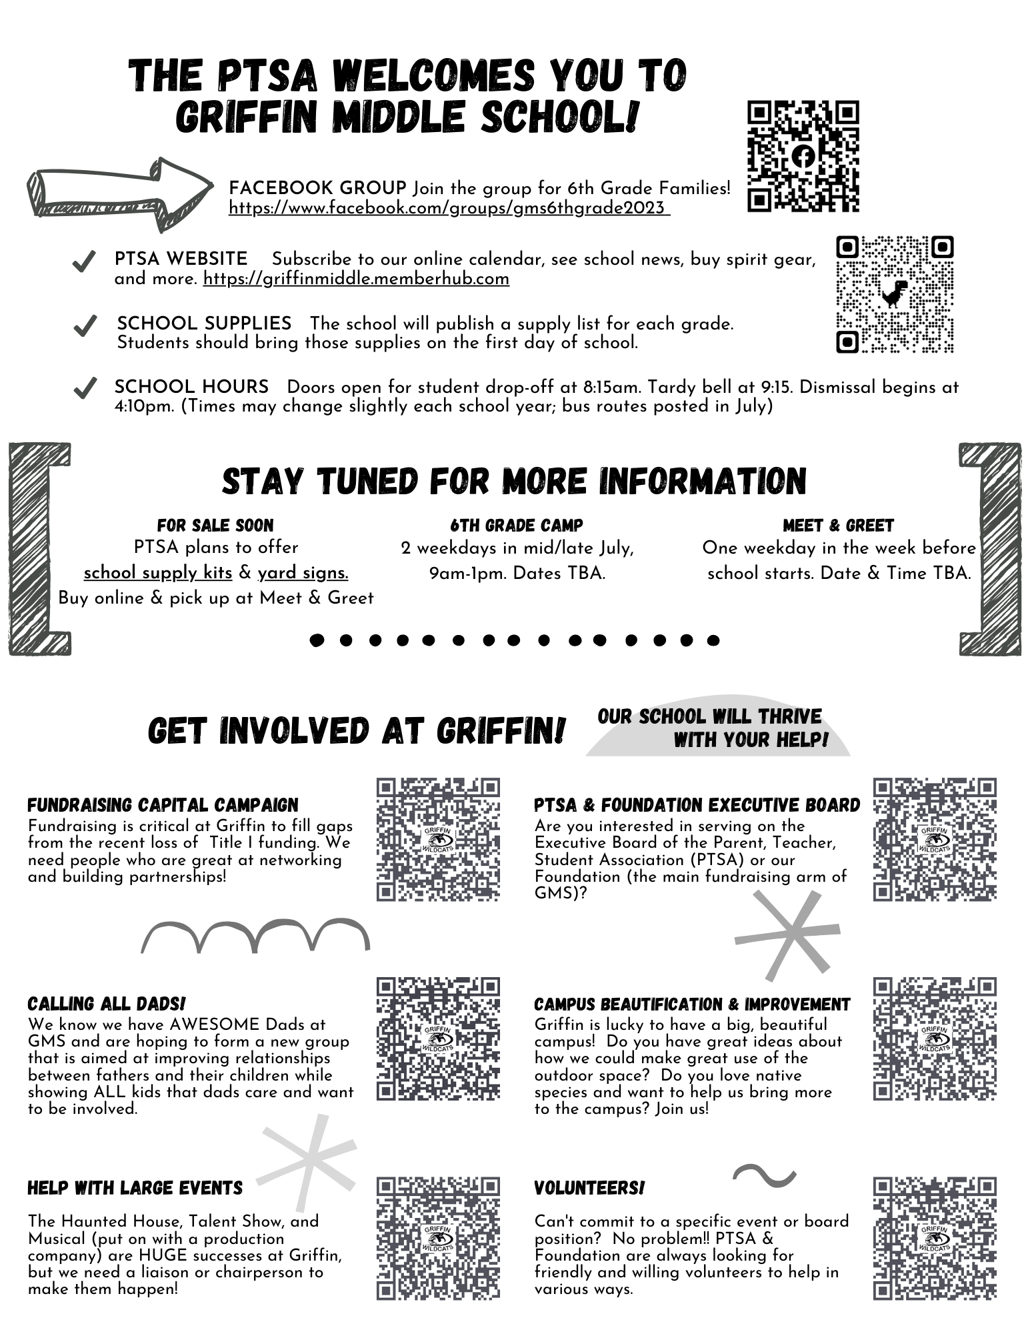
Grab a flyer!
What to expect between now & the first day of school.
Links to sign up to volunteer for PTSA & Foundation.
Notes:
Hopefully, you’ve already got one of these flyers in your hand. As a Parent, one of the most important things for me is to feel like I know what’s going on here at Griffin. Communication is VITAL. And, not sure about you, but I’m not getting a whole lot of information from my teen boys. So… the PTSA made that our other major goal last year… to increase the communication as much as we could to help every member of the Griffin Community feel up-to-date on what’s going on. I just want to highlight a few ways we did that: 1st, we started partnering with the School to put out an incredibly thorough and informative weekly newsletter that comes out each Friday night via CTLS. Our communications chair, Liz Li spends hours each week making sure that newsletter has everything you need to know! So, be sure to watch for that. 2nd, we started FB groups for each grade level. Many of you have already found our Rising 6th Grade FB page, but if you haven’t… just scan the QR code on that flyer. 3rd, we wanted to make sure that EVERYONE here is invited and encouraged to get involved. And, to make it even easier for you to get involved in the kind of things you enjoy… we’ve given you six categories of ways to help. Simply scan the QR code, fill out the contact information on the page it takes you to, and we’ll get back to you about how you can help with that area! Specifically, a big call for DADS!!! I see Many Dad’s Club Dads that were instrumental in Dad’s Club at the elementary level… and we’re hoping you’ll step up and get involved BIG TIME here at Griffin. You won’t need to go to classrooms to read stories anymore, but we think we have some ideas for how you can make a HUGE impact here.

Slide 12
activities!
Soccer
Art
Yearbook
STEAM
Beta Club
Girls Empowerment
Peer Helpers
Unified Club
Inclusivity Club
Disc Golf
Comic Book & Manga
Reading Bowl
Future Business Leaders
Family, Career & Community Leaders
Cobb Student Leadership Academy
School
Sponsored
Notes:
Think back to your middle school years. It was a time when you grew in your independence, started to figure out your own interests, and develop deeper friendships. Here at Griffin, there are a ton of opportunities for kids to get involved in activities they enjoy. Griffin has dozens of clubs that meet in the mornings before school, or in the afternoon after dismissal. School-sponsored clubs are open to all students. Most of them are free, but some clubs ask members to pay a small amount for dues.

Slide 13
activities!
PTSA Sponsored
Enrichment Clubs
Jr. Spartan Sports
Griffin, Campbell & Pearson MS
Chess
Robotics & Coding
*More to come next year!
Wrestling
Basketball
Cheer
Football
Swim & Dive
Baseball
Notes:
We also have Enrichment Clubs. These are new this year and sponsored by the PTSA, and students need to register to attend. Since this was our first semester adding these enrichment clubs, we started with two. But, our plan is to add more beginning in the Fall. And, then there are the Junior Spartans Sports Teams. These are tied to the Campbell High School varsity teams, and they are open to kids at Griffin, Campbell, and Pearson middle schools.

Slide 14
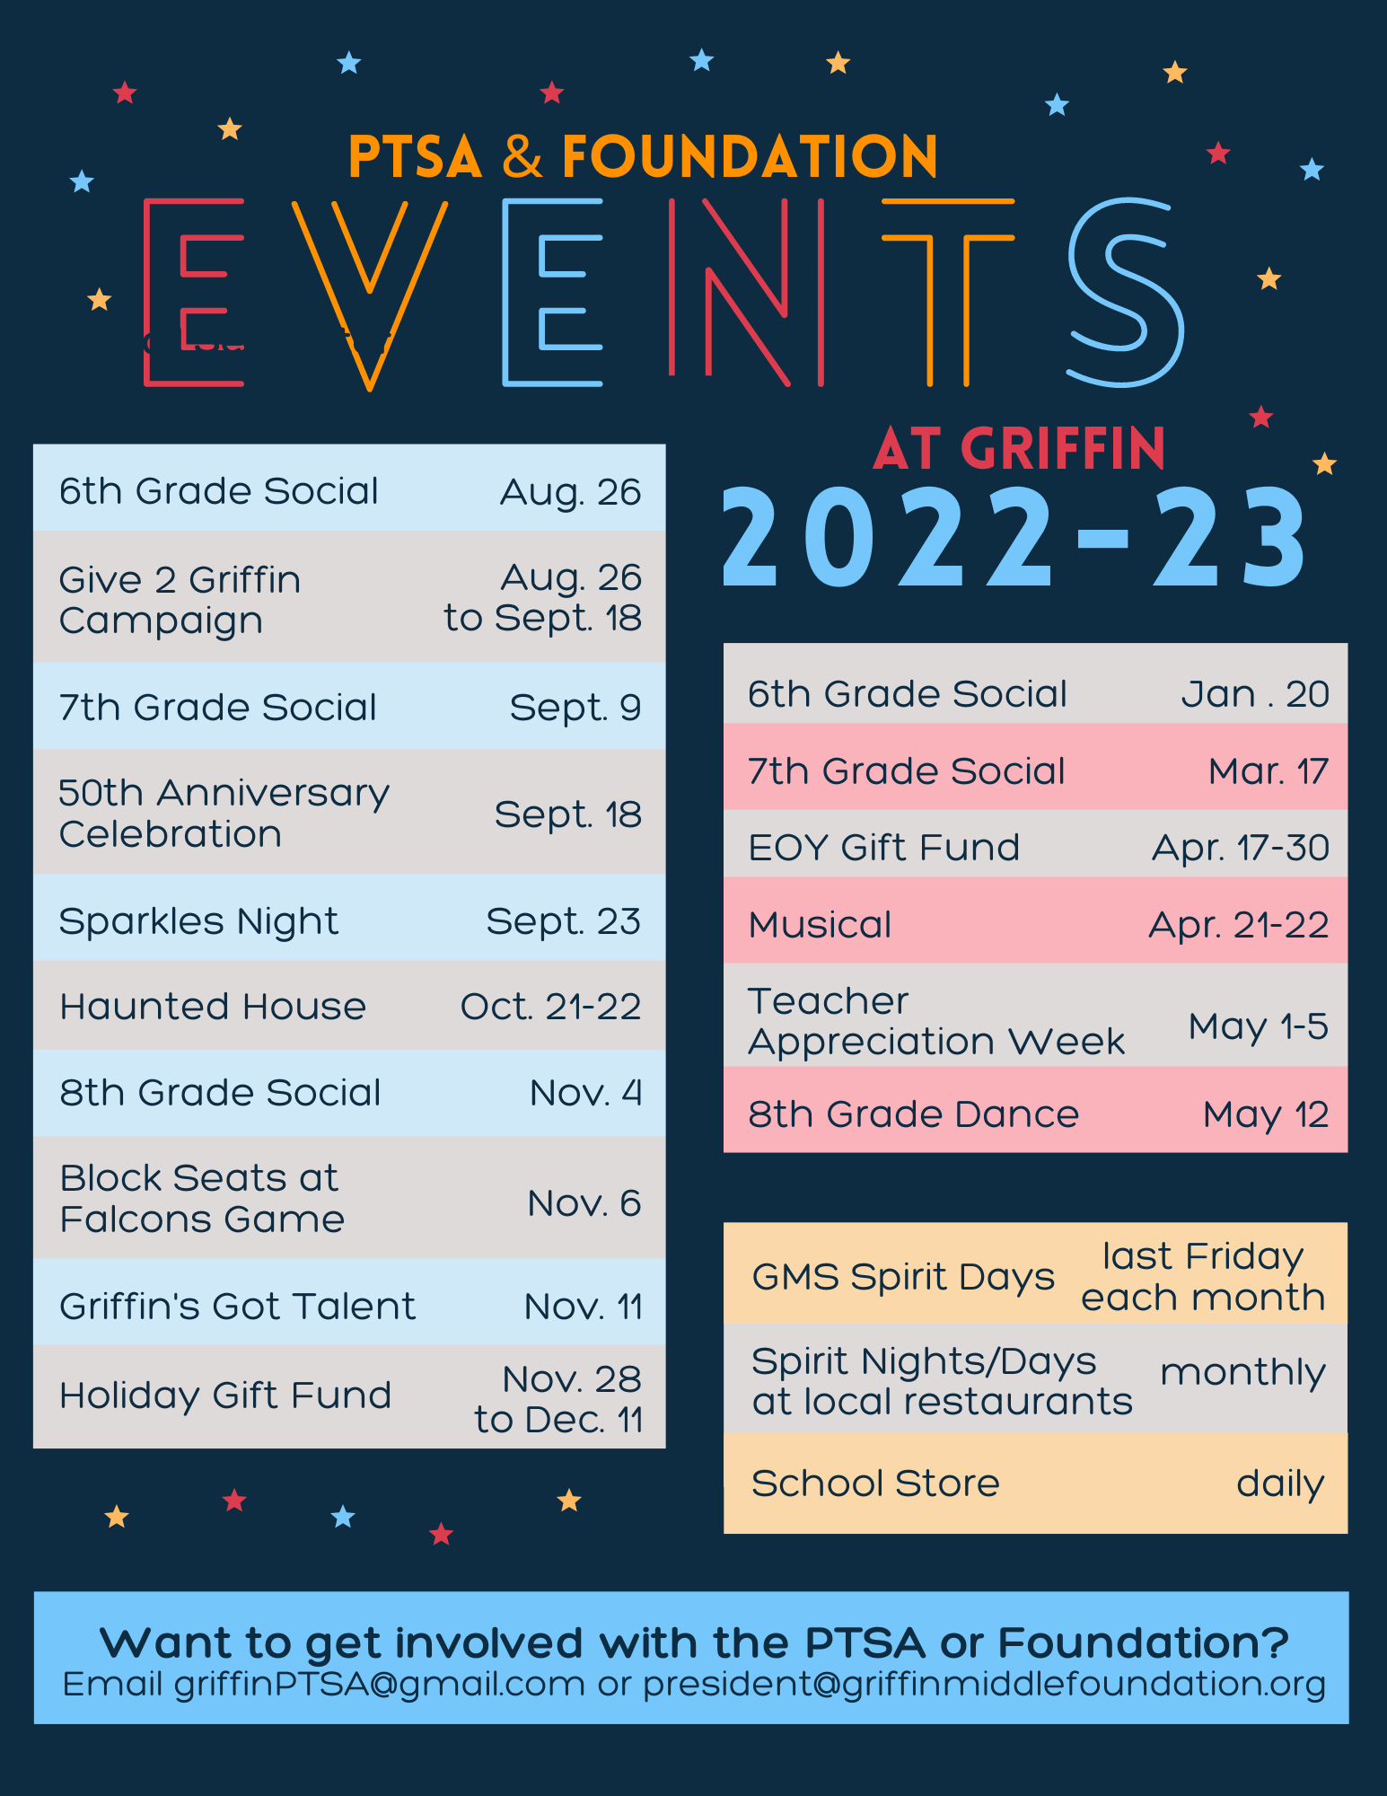
How to Keep Up?
Posts on Facebook & Instagram
Facebook groups for each grade - join now! (QR code on flyer)
Weekly Newsletter sent by CTLS
Online calendar – subscribe now!
PTSA website (QR code on flyer)
Notes:
Finally, the PTSA and Foundation host a ton of events throughout the year. PTSA has socials for each grade level, plus the Talent Show and Musical. And Foundation hosts their annual Haunted House. So How can you keep up with all of these events? Here you go!

Slide 15

We are a neighborhood school that is supported by local businesses!
New sponsors are always welcome.
Notes:
We’d love to ask you to join us in frequenting these awesome local businesses that support our school. AND… if you know any businesses, or maybe even your own business, that might like to sponsor our school, please feel free to see any of us at the PTSA table tonight for more information!

Slide 16

2023-24 executive Board Members:
President - Trudi Salowitz
Vice President - Nicole Adams
Treasure -Eboni Lewis
Secretary - Ashaki Whatley
Haunted House Producer -
Member at Large:
Christina Million
Social Media -
Sponsorship

Slide 17
Mission & Purpose
Established in 2014
Non-profit organization formed to raise funds beyond those currently provided by Cobb County School District and the PTSA
Aims to financially support elements of education such as technology enhancements, supplemental enriched curriculum, student services, additional faculty, and capital improvements.

Slide 18
2022 – 2023 Accomplishments
Give 2 Griffin Annual Fund Campaign
Monthly Spirit Nights
Purchased many items requested by teachers via classroom grants which benefit ALL students as well as campus enhancements
Will award Barbara Quarles STEAM Scholarship to GMS alumni
Present the Legacy Award (chromebook) to 2 8th grade students annually

Slide 19
2022-23 Fundraising
Give 2 Griffin Annual Capital Campaign
Fundraising Events:
Haunted House
Sponsorships & Spirit Nights
The Foundation executes its mission to raise funds for the school in four ways:

Slide 20
Lots of opportunities to be involved in the Foundation
We have some spots open for the 2023-24 school year on our Foundation Executive Board.
Please pick up a brochure at the Foundation table and let us know if you are interested in being involved in the Foundation.

Slide 21







Nothing Bundt Cakes
KING SPRINGS BAPTIST CHURCH

Slide 22
Highlights of Griffin
Lots of ways for your student and you to be involved
Performing Arts/Visual Arts/ Talent Shows, Musical, A Night of the arts
Academically – we have many students who are accepted into CCSD Magnet schools and Cobb Informational Technology Academy (CITA)
Literacy Week, Hispanic Heritage Month, Black History Month
Many spirit weeks throughout the year, academic field trips, and We were awarded one of the healthiest middle schools in the state and nation

Slide 23
Supports Available To Students – school counseling
3 grade level and 1 special projects
  Academic, college/career, social/emotional
  3 delivery methods
    Classroom, small groups, individual
6th Grade
    Peer relationships, self-regulation, interest inventory
    Introduce to Naviance
    Academics- 7 different teachers, class and homework expectations

Slide 24
How To Prepare For Middle School
Academics: 7 different teachers, class and homework expectations, Organization, time management
Personal: social media, peer relationships, dress code.
Additional tips: stay involved (parentvue), Hygiene, Teachers extra help sessions, student laptops
Weekly Lessons: school wide delivery in homeroom
Homeroom meets every day

Slide 25
Connections Classes
Band
Chorus
Orchestra
Technology
Business
Art
Family & Consumer Science (FACS)
Physical Education
Health
Reading Connections
Math Connections

Slide 26
Advanced Content in Middle School
For 6th grade, offered in Reading, Social Studies, Science, Math, and Language Arts
Placement is determined by a placement matrix (found on the website)
5th grade IOWA, Milestones, RI/MI, academic grades, and prior AC placement are components of the matrix
Continuation criteria to remain in AC

Slide 27
Our Weekly Griffin Wildcat Newsletter
Sent out Friday at 5 PM
Main way for us to communicate
Griffin Website
CTLS Parent
Also check us out on twitter
@GMS_ Wildcats
@DrLoraleeHill
Notes:
Hill

Slide 28
WE Want you to feel welcome and be involved…
Open Door Policy
GSPN Live (Virtual) once a month on Mondays (8:00 – 8:45 AM OR 5:00 – 5:45 PM)
School Tours with the Principal – offered once a month on Mondays 10:00 – 11:00 AM
We know middle school is a big transition for all, so we want you to be informed and be able to keep up with what is going on at Griffin!
Notes:
Hill

Slide 29
Building Maps
Yes, we know our building is a MAZE!!!!
We have lots of people here to assist you so you can find your way to specific locations.
If you have questions, just ASK. We are here for you!!!

Slide 30
THANKS FOR JOINING US GRIFFIN FAMILIES… we’re so glad you’re here!

