Slide 1

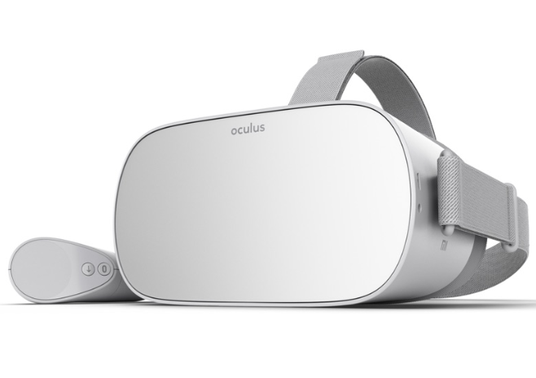
With Summer Reading

Slide 2
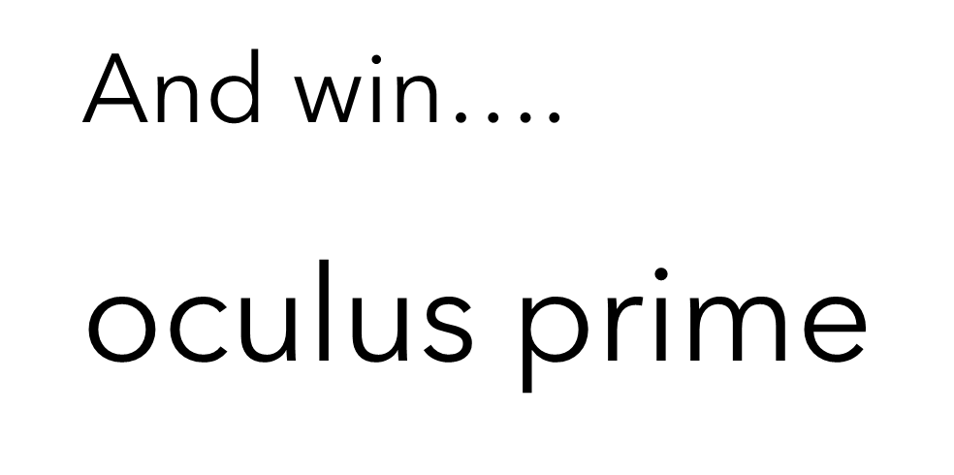
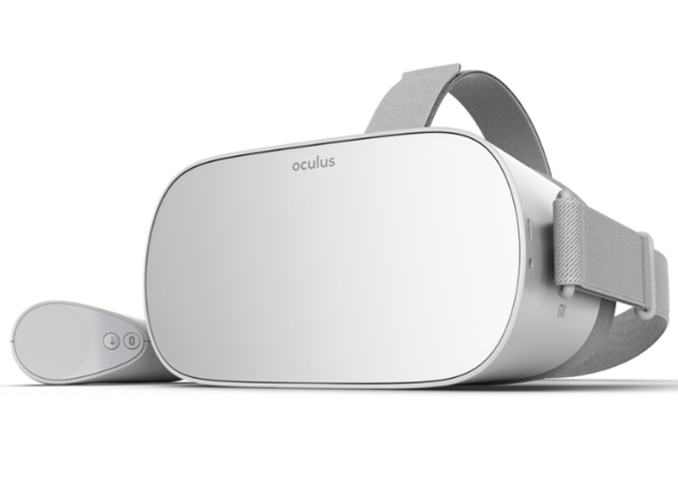

Slide 3


Slide 4

SUMMER READING using…..

Slide 5

LOG INTO….
STUDENT ID
4 Digit Bday
(monthday, i.e 1015 is October 15th)

Slide 6

WHERE do I find
Beanstack has a single sign on with CLEVER.
OR…..
www.beanstack.com/cobb
SCROLL DOWN
FIND OUR SCHOOL
LOG IN

Slide 7
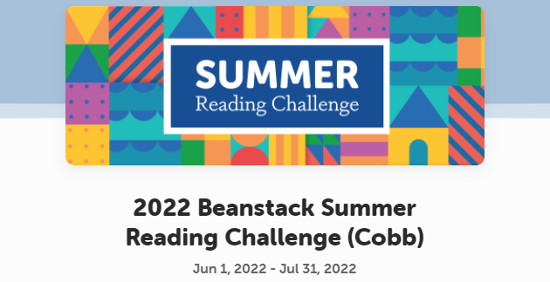

Slide 8

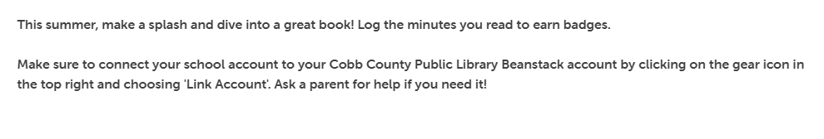

Slide 9
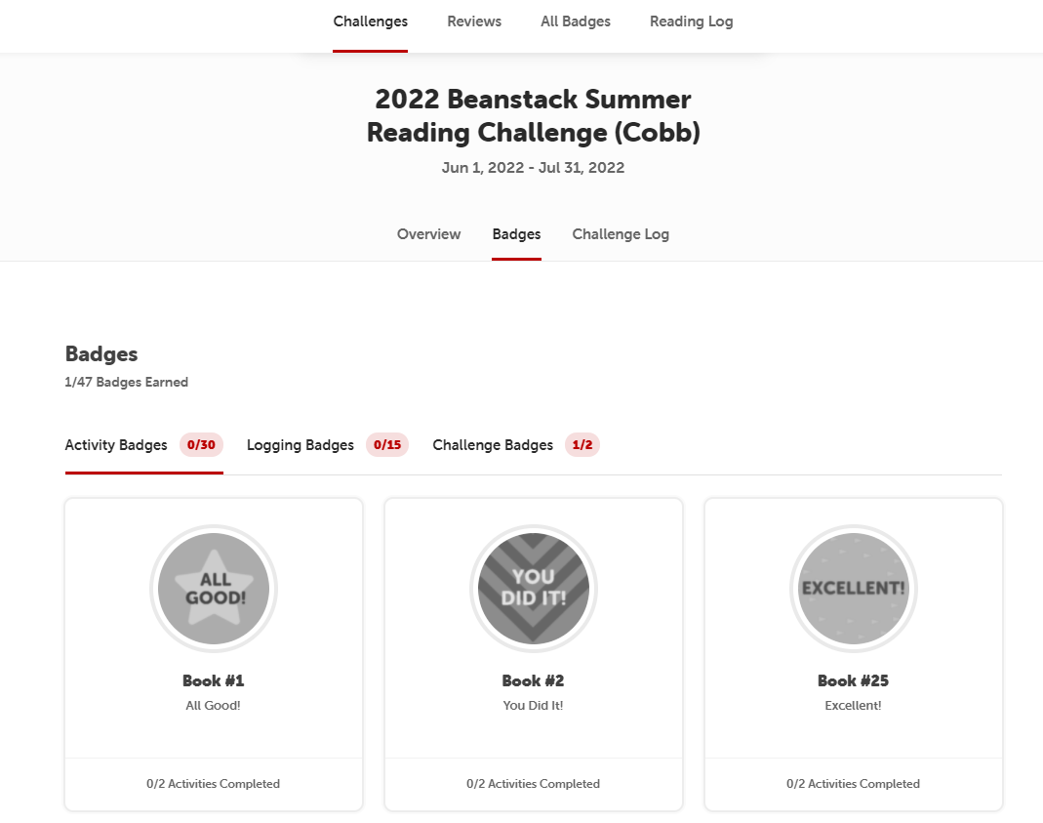
For every BADGE completed….
A ticket in your name will be entered into the drawing.

Slide 10
Complete the steps below.
For each book completed, you get a ticket entered into the Oculus Prime contest!
For each book read, you must enter the Title and Author.
1
Complete your Badge.
2
Write a review.
3
Log your minutes
4

