Slide 1
Walton High School Class of 2025
Senior Class Meeting
Mr. Short

Slide 2
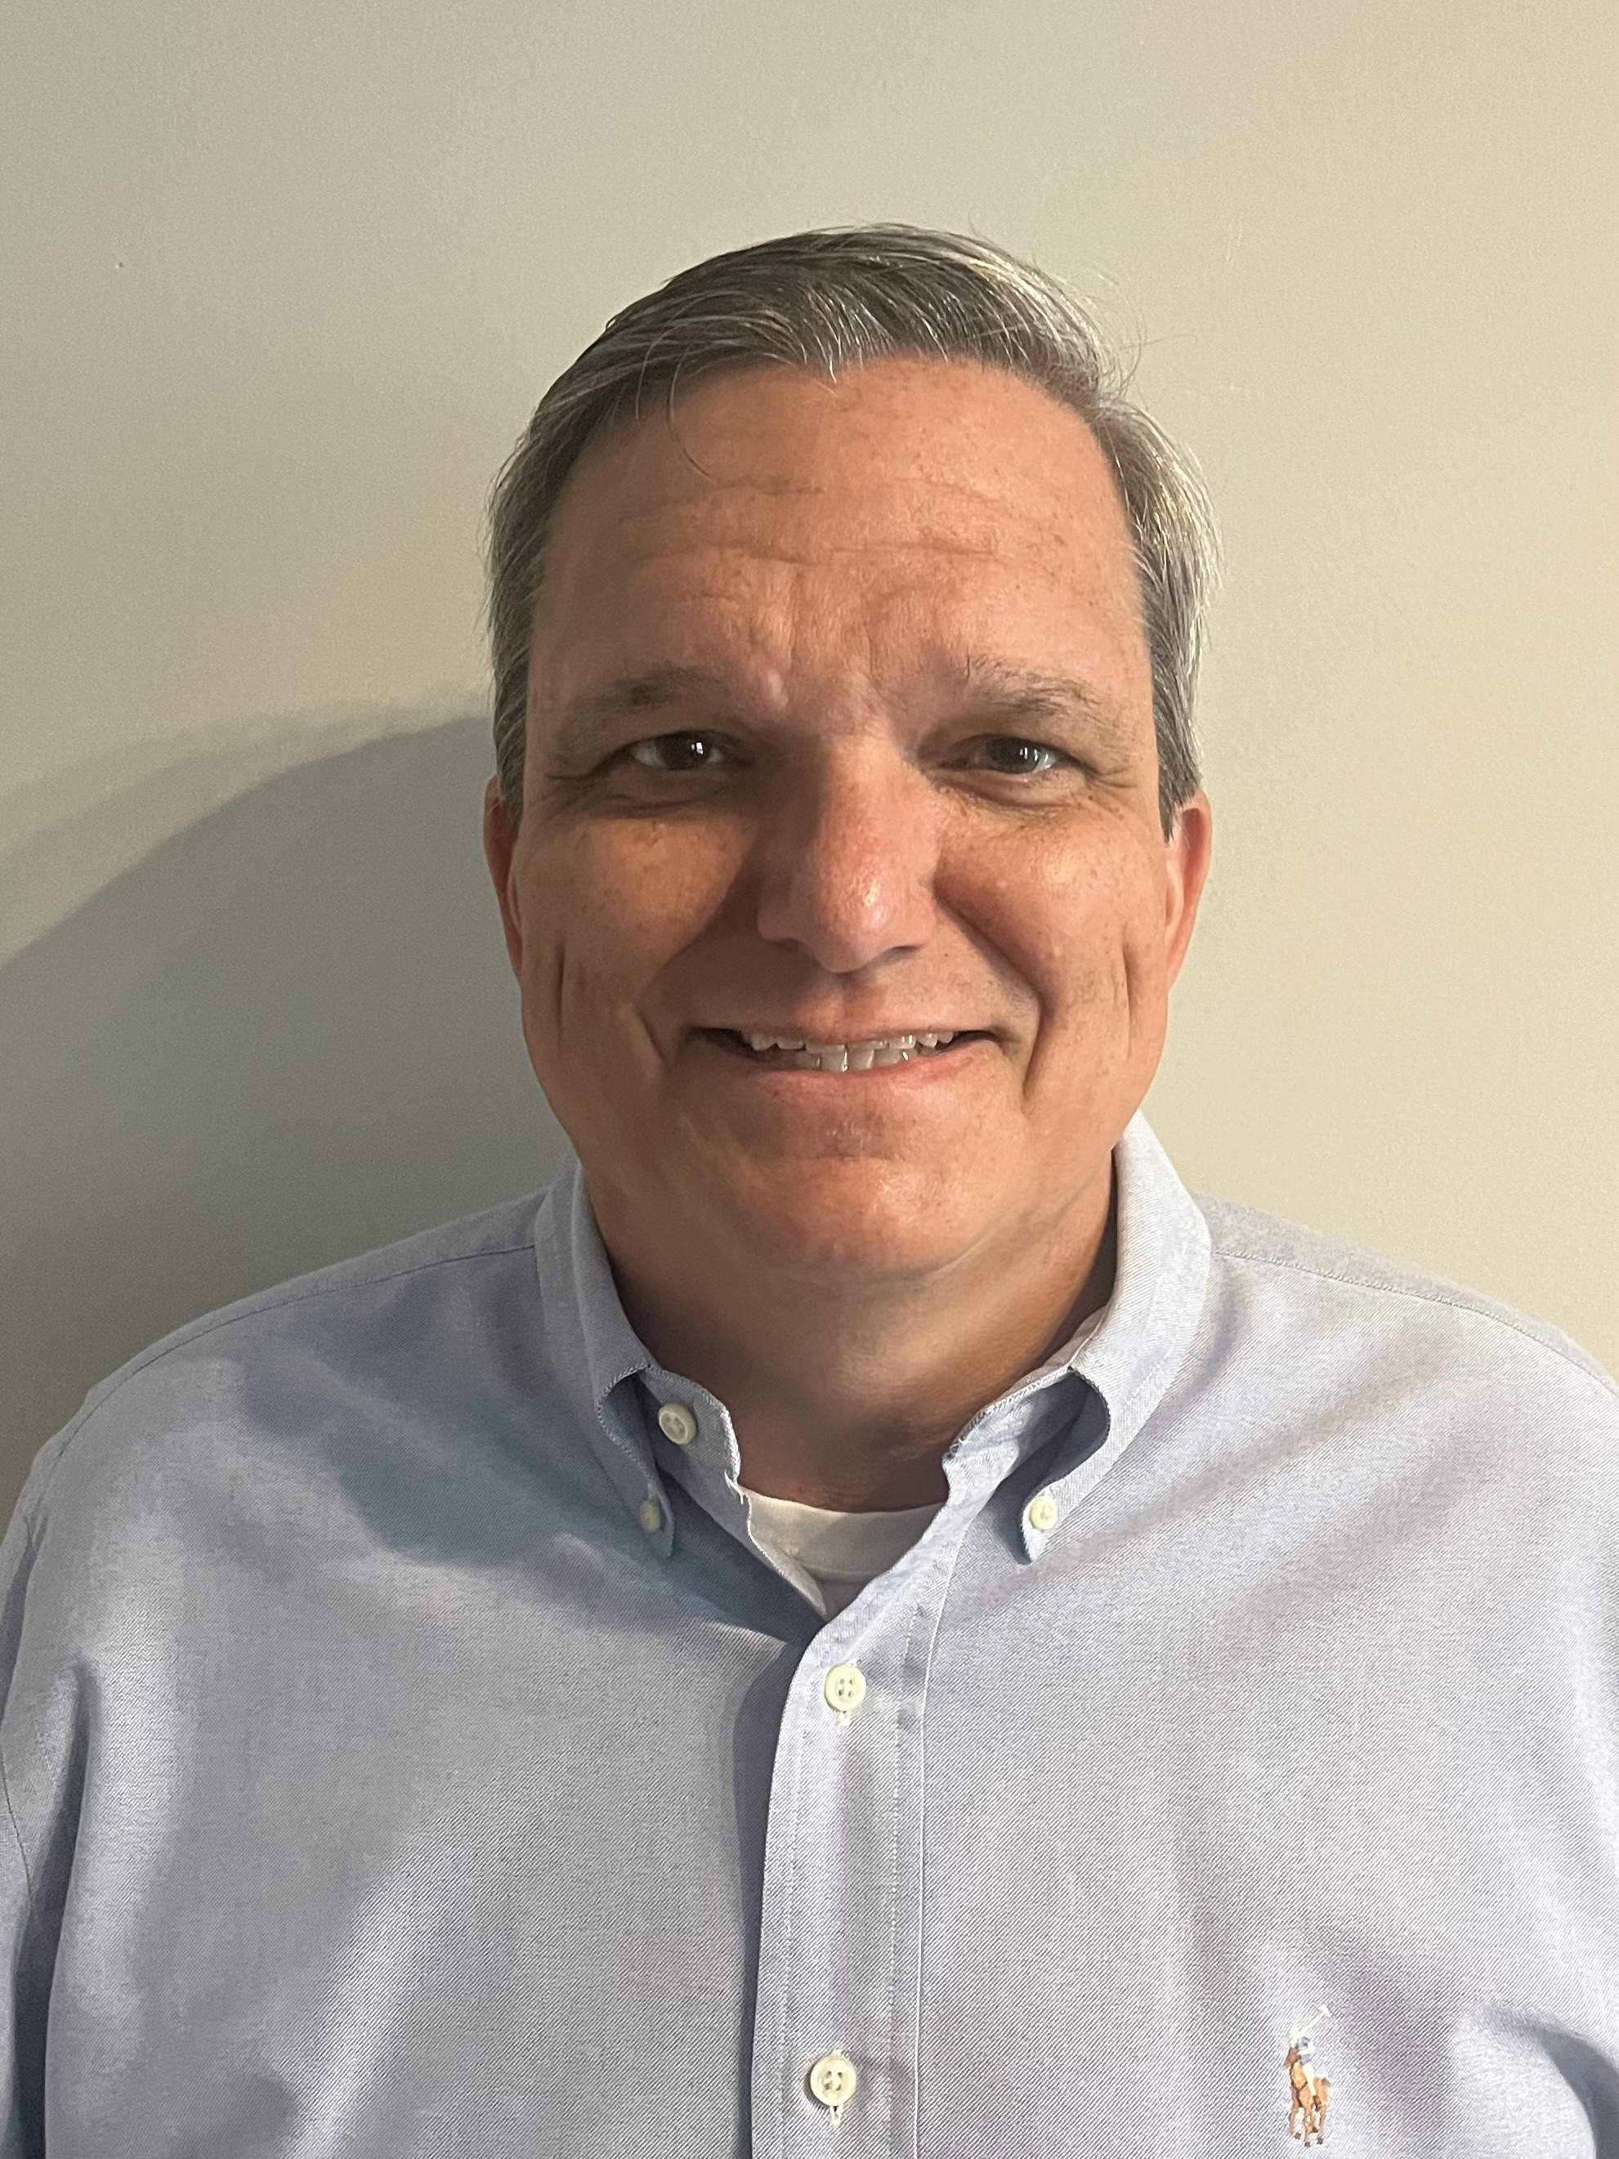
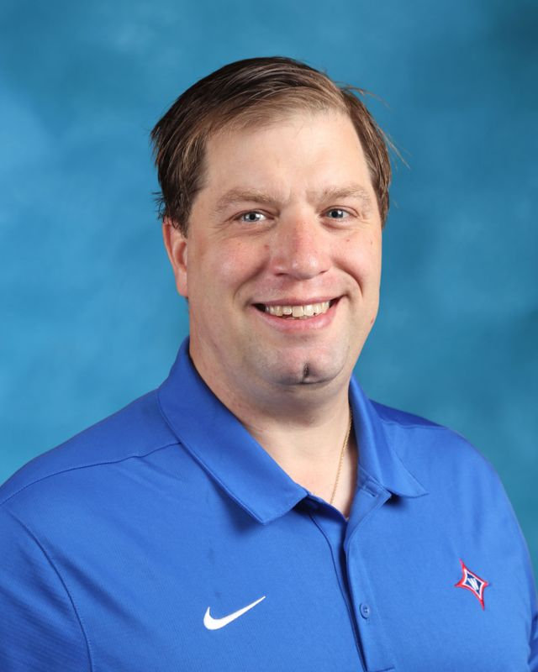
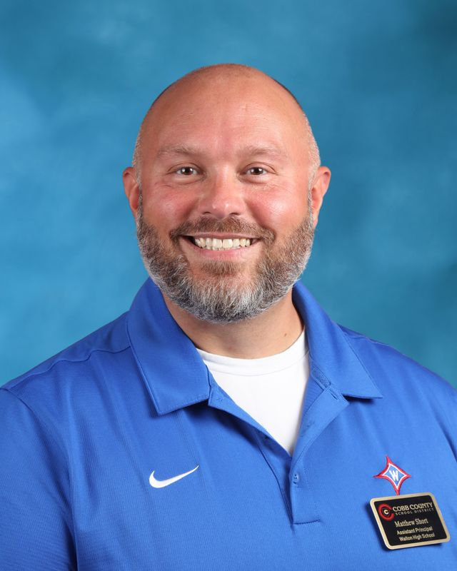
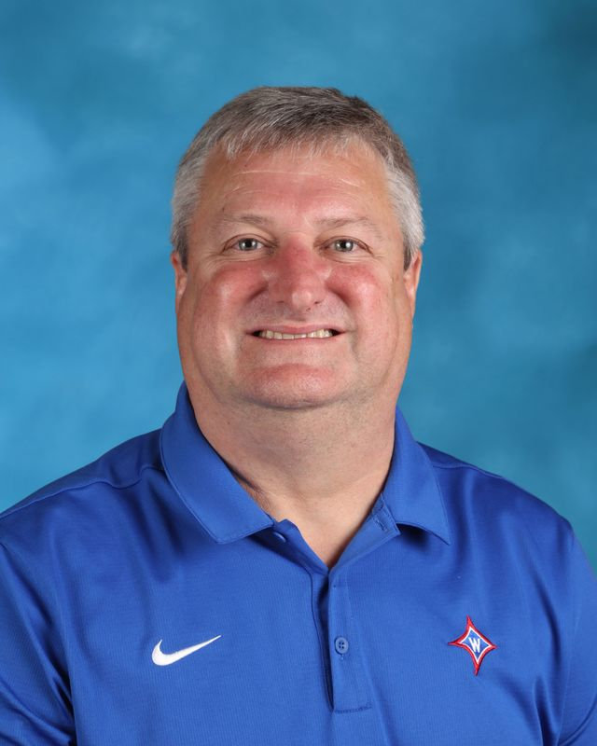
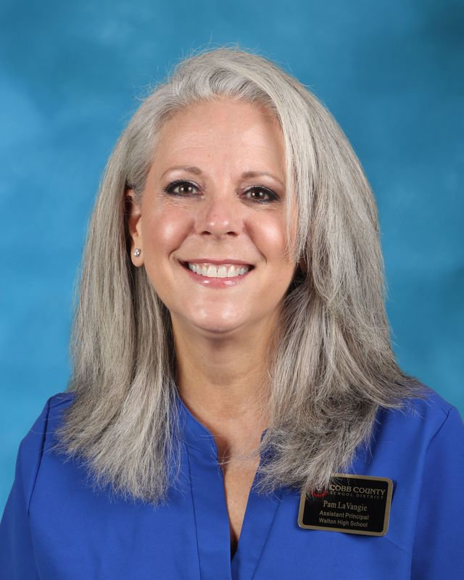
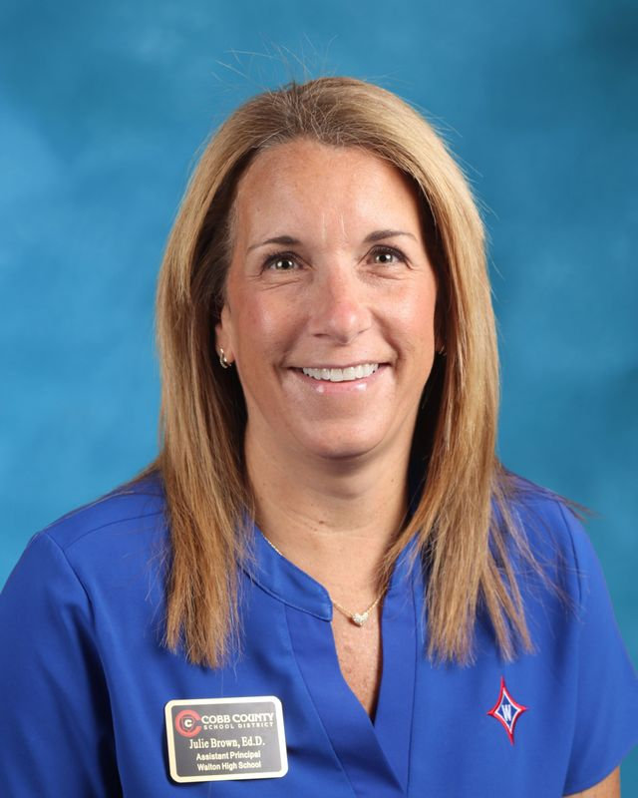
Administration
Mr. Pirkle
9th grade
Dr. Jones
10th grade
Mr. Short
12th grade
Dr. Williams
10th grade
Ms.LaVangie
9th grade
Dr. Brown
11th grade

Slide 3
Senior Sponsors​
Ms. Duncan – SGA Sponsor​
Ms. Bell, Ms. Hart – Senior Class Sponsor​
Ms. Skeean, Ms. Tatman – Super Senior Spirit Club Sponsors​
Ms. MacDonald, Dr. Mull, Ms. Skeean – Graduation​
Mr. Short – Senior Administrator ​
Dr. Santoro – Principal​

Slide 4
SGA Information
Class-wide Meeting for Homecoming float building is on August 23rd at 7:45 AM in room 403
The class-wide float building day will be October 2nd with more details announced later
Follow @waltonclass2025 on Instagram so you don’t miss out on any announcements!
Homecoming week is October 14-18, and the spirit days will be voted on in the next slide
Senior Class T-Shirts will also be voted on in the next slides

Slide 5
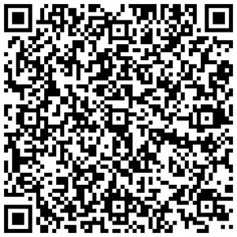
Senior Class T-Shirt Voting
Shirt 1
Shirt 2
Shirt 3
Use this QR Code to vote for Senior Class T-Shirts →

Slide 6
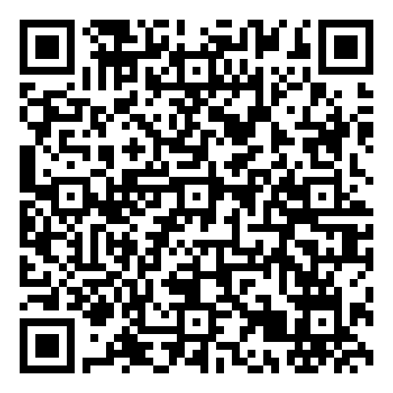
Senior Spirit Days Voting
Pick your two favorite Homecoming Spirit Days using the QR Code for Tuesday and Wednesday of that week!
Monday is a digital learning day, while Thursday is our class season (Summer), and Friday is Walton Out
→→→

Slide 7
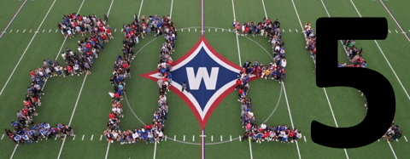
Senior Class Photo
Tuesday, August 6
During Homeroom
Wear Black Shirt/Top
Leave Bags in Homeroom

Slide 8
CCSD Email Address
Primary method of communication from school
Check daily to ensure up to date information
School will no longer communicate with personal email

Slide 9
BEHAVIOR EXPECTATIONS
Leaders of the School!
Tardies to School and Class – Be on time!
Leaving School without Permission
Lose parking 45 days
Bullying/Harassment
Vaping – 3 Days OSS (1st Offense)
Multiple People in a stall
Fighting – 10 Days OSS
NO Food Deliveries
Pay Attention to Deadlines - Take responsibility (ex: NHS application deadline, sports physicals, graduation deadlines, AP registration and payment, etc.)

Slide 10
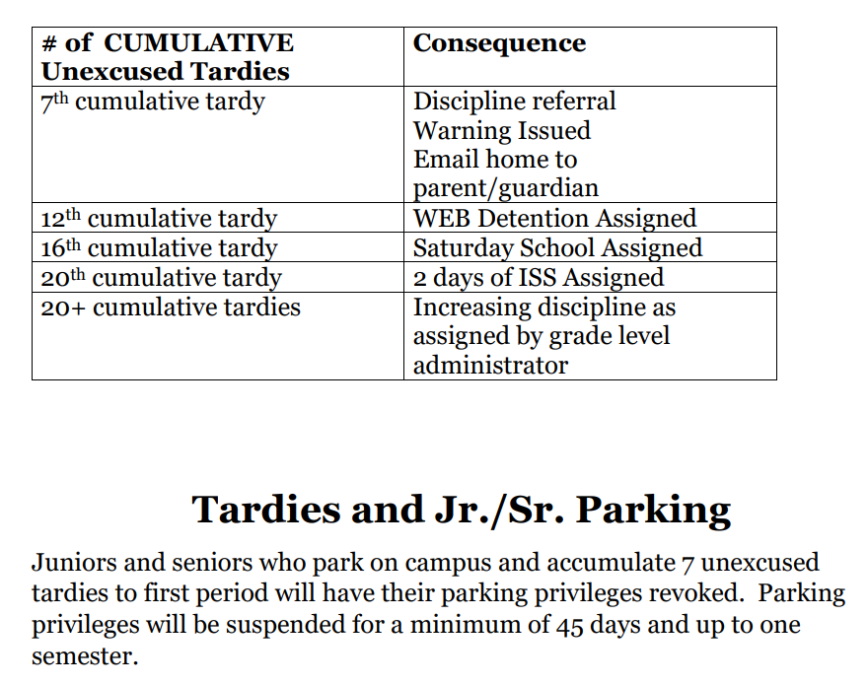
Tardies
Tardies are cumulative over ALL classes!

Slide 11
Appropriate Behavior
24 hours a day/7 days a week
THINK before you post on social media
Administrators can and will enforce CCSD code of conduct for students who violate policy
GHSA has additional consequences for athletes —including loss of game time.

Slide 12
Dress Code
Walton Wear vs Weekend Wear
No hats & hoodies
Length of shorts/skirts
Length of shirts – No midriffs
Undergarments should be worn under other clothing and should not be visible!

Slide 13
Honor Code
Academic Dishonesty
We believe that every student has the right to learn in an environment free from academic dishonesty. Each individual has the duty to display honesty, integrity, respect, and responsibility. Academic integrity is expected on classroom assignments as well as on summer or supplemental assignments.
Student Agenda
Description and Consequences
Failure to understand the honor code does not excuse infractions.
Notes:
Pam

Slide 14
Walton Enrichment Block (WEB)
Four 25-minute blocks - Tutoring with teachers, research in the Information Center, make-up work, SAT prep, guest speakers, etc.
Must Stay/May Leave – Parent WEB Permission Form – If on Must Stay List, will receive a WEB Accountability Form in HR; must complete with signatures and turn in before dismissal; discipline consequences!
If leaving early, Must Stay students need to check out with the Attendance Office – Skipping!

Slide 15
WEB Day Schedule
Zero Period
7:10 - 8:12 (62 min.)
1st Period
8:20 - 8:50 (30 min.)
Homeroom
8:56 - 9:05 (9 min.)
2nd Period
9:11 - 9:40 (29 min.)
3rd Period
9:46 - 10:15 (29 min.)
4th Period
10:21 - 10:50 (29 min.)
5th Period
10:56 - 11:25 (29 min.)
6th Period
11:31 - 12:00 (29 min.)
7th Period
12:06 - 12:35 (29 min.)
Q Block/WEB
12:35 -12:55 (20 min.)
A Block
1:00 - 1:25 (25 min.)
B Block
1:30 - 1:55 (25 min.)
C Block
2:00 - 2:25 (25 min.)
D Block
2:30 - 2:55 (25 min.)
All Students to Dining Hall
3:00 - 3:30 (30 min.)
Walton Enrichment Block (WEB)
Notes:
Pam

Slide 16
Importance of 12th Grade
Counselor: Ms. Fay
College Corner-Dr.ENGLANd

Slide 17
Counseling
Counselors will visit your English classes on August 12th to review the college application process.
If you do not have an English class, please plan to attend a presentation in the lecture hall on August 13th during 1st or 6th period.
Step-by-step overview of the admissions process.

Slide 18
To-Do Items
NOW
Complete the Senior Post-Secondary Options Packet
Email a copy to your counselor.
MID-AUGUST
Update "colleges I'm applying to" list in Naviance
Feature will be active in Naviance after senior classroom presentation
Transcript requests will start in the records room on Wednesday, August 21st.

Slide 19
College Admissions: Get Organized
Go to college website for updates and application information.
Pay attention to deadlines.
Know what is needed.
Check (READ) your email!

Slide 20
College Visits
Will start mid-August
Sign-up in Naviance 25 hours before the visit
Will need a pass to be excused from class ( signed by teacher)
More info in senior classroom visits

Slide 21
Volunteer Service Recognition Graduation Honor Cord
Students need 180 hours of verified and approved service hours
Deadline to submit service hours for this school year is April 15, 2025
Student's responsibility to get hours verified
More info on Walton website - Students > Community Service Hours

Slide 22
Athletics & Extracurricular Information
Attend events – Get Connected
How to Purchas Tickets – gofan.co
All Sports Pass
$95

Slide 23
Athletics and Sportsmanship
Expected Behavior:
Cheer for our teams/students
Do not yell disparaging remarks at opponents/officials.
Ejection from event. Suspension from future events!

Slide 24
Where to go for help?
Academic Support – Classroom Teacher
Make good use of WEB time!
Social/Emotional Health – Walton School Counseling Department
NOT SURE what to do or where to go for help? Just ask!
Mr. Short’s Office: 1st Floor (Room 100)
Email: matthew.short@cobbk12.org

Slide 25
HAVE AN AMAZING SENIOR YEAR!!!

