Slide 1
Welcome Class of 2027

Slide 2
10th Grade Administrators
Dr. Jones
Christopher.Jones@cobbk12.org
Dr. Williams
Chris.Williams@cobbk12.org

Slide 3
10th Grade Resources
Ms. Duncan – SGA (Student Government Association) Sponsor
Karen.Duncan@cobbk12.org
Ms. Wright – Sophomore Class Sponsor
Emma.Wright@cobbk12.org

Slide 4
CLASS MEETING DATE:
August 16th
Time: 7:45 am Where: Room #211

Slide 5
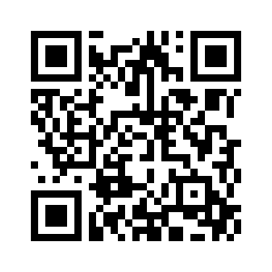
SPIRIT DAY VOTING
https://forms.gle/UTtkHygHiYFpKy6K6
Pool/beach day
Anything but backpack (with rules)
Dynamic duo
BBQ dad vs soccer mom
Country club vs country
Sports team/sports jerseys

Slide 6
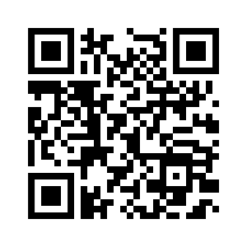
T-SHirt VOTING
https://forms.gle/vom6xCaNaZghuo6d8

Slide 7
CCSD Email Address first.last@students.cobbk12.org
Primary method of communication from the school
Check DAILY to ensure up-to-date information

Slide 8
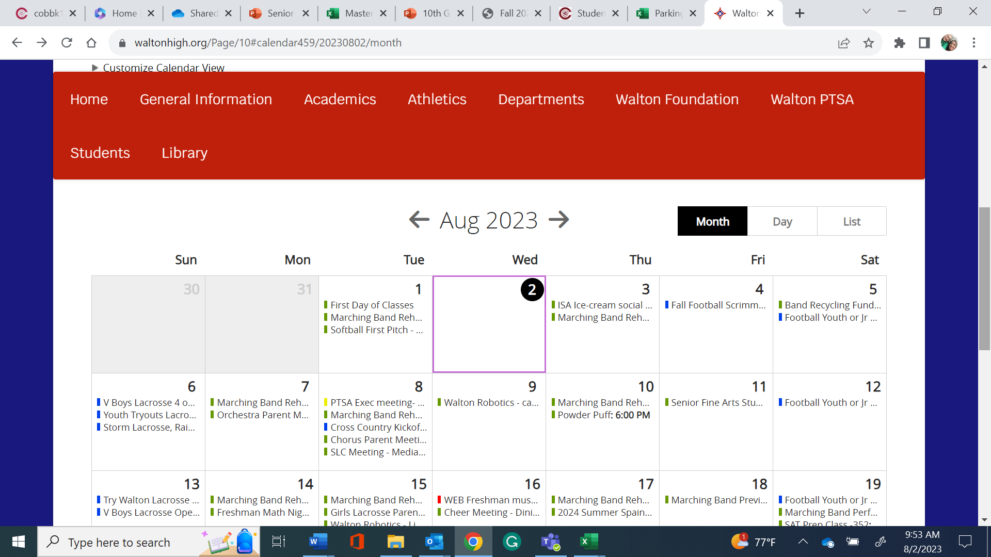
Walton HS School calendar www.waltonhigh.org

Slide 9
Behavior Expectations
Get to school and class on time
You may not leave the school campus without permission
Bullying/harassment will not be tolerated
Vaping – 3 days OSS
Fighting – 10 days OSS
No more than 1 person in a bathroom stall
NO food deliveries from outside companies (UberEATS, Door Dash, etc.)
10th graders – NOT allowed to park on campus

Slide 10
Tardy Policy

Slide 11
Social Media
Is it true?
Is it kind?
Is it necessary?
Consequences for actions: Cyberbullying 24/7
THINK BEFORE YOU POST!!

Slide 12
Dress Code
No hats or head coverings in the building (this includes baseball hats, hoodies, etc.)
No hoods worn inside the building.
Check the length of your shorts and your shirts (no midriffs)
Pants and shorts must be worn around the waist and no undergarments shown.

Slide 13
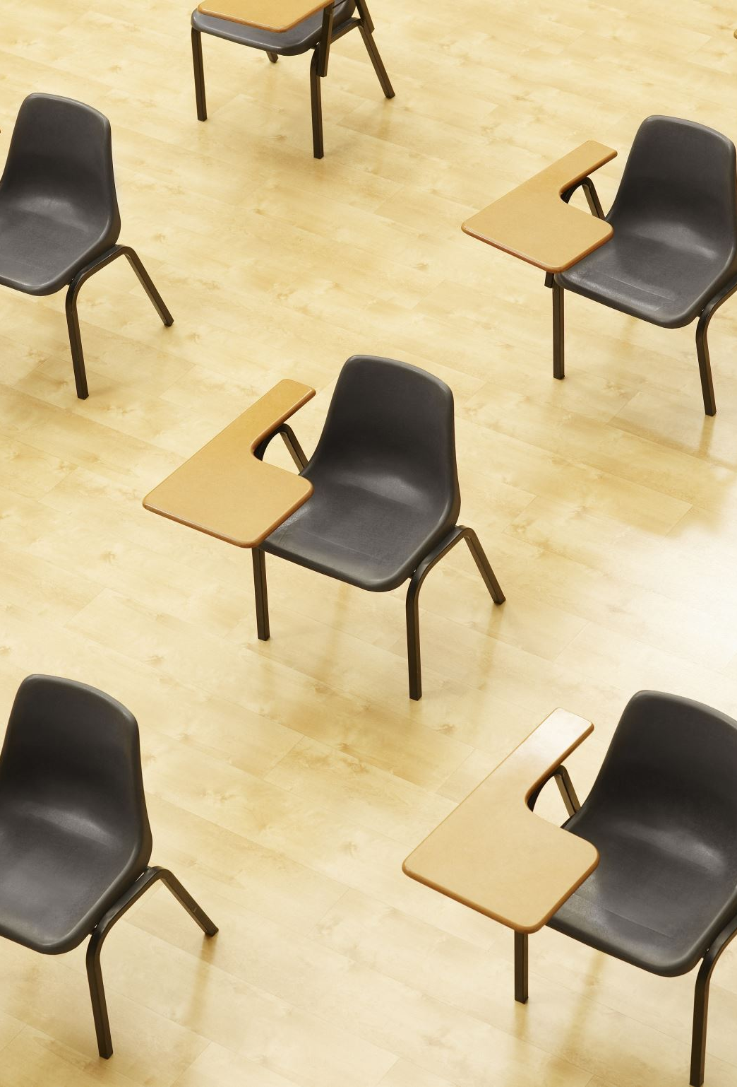
Honor Code
The faculty and students at Walton High School honor academic and personal integrity. We believe that every student has the right to learn in an environment free from academic dishonesty. Everyone has the duty to display honesty, integrity, respect, and responsibility, as these characteristics are essential in achieving and sustaining academic excellence. Academic integrity is expected on classroom assignments as well as on summer or supplemental assignments.
Student agenda – consequences for violations of the Honor Code on pages 2-4

Slide 14
WEB (Wednesday Enrichment Block)
Zero Period
7:10 - 8:12 (62 min)
1st Period
8:20 - 8:50 (30 min.)
Homeroom
8:56 - 9:05 (9 min.)
2nd Period
9:11 - 9:40 (29 min.)
3rd Period
9:46 - 10:15 (29 min.)
4th Period
10:21 - 10:50 (29 min.)
5th Period
10:56 - 11:25 (29 min.)
6th Period
11:31 - 12:00 (29 min.)
7th Period
12:06 - 12:35 (29 min.
Q Block
12:35 -12:55 (20 min.)
A Block
1:00 - 1:25 (25 min.)
B Block
1:30 - 1:55 (25 min.)
C Block
2:00 - 2:25 (25 min.)
D Block
2:30 - 3:00 (25 min.)

Slide 15
Importance of 10th Grade
Dr. Alpert – School Counselor

Slide 16
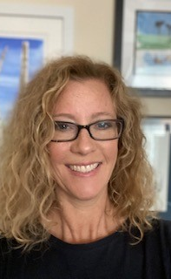
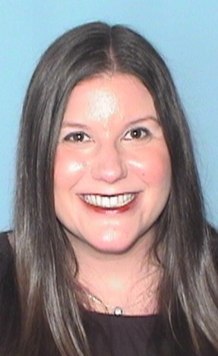
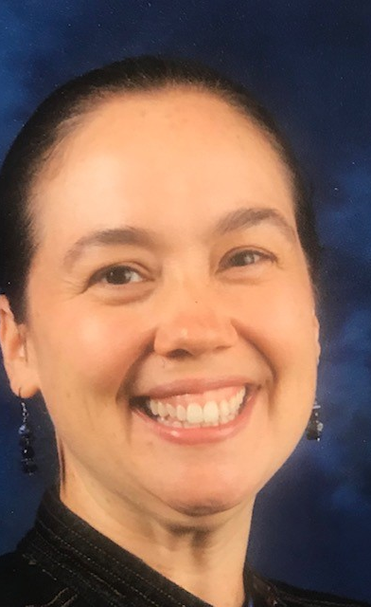
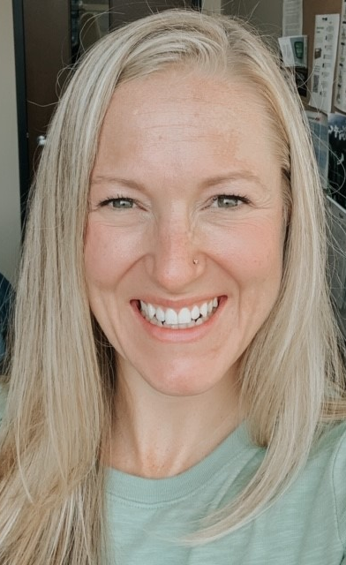
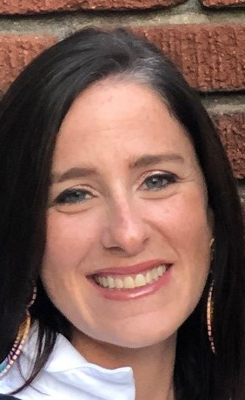
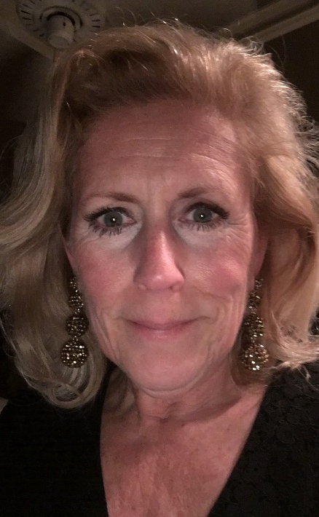
Mrs. Clary
A - Ch
Mrs. Alpert
Ci - G
Mrs. Dunham
H - K
Mrs. Watford
L - N
Mrs. Harwood
O - Si
Mrs. Fay
Sm - Z
Who are your school counselors?

Slide 17
10th Grade Year
PSAT Day –
Wednesday, October 9th (9th and 10th graders)
Wednesday, October 27 (11th graders)
Dual Enrollment for next school year
HOPE GPA & rigor courses
Ask for help when needed
Get involved!
Notes:
`

Slide 18
10th Grade Year
Wed, Nov 13, at 6:30 pm
College Admissions Meeting

Slide 20
Athletics and Sportsmanship
Expected Behavior
Cheer for our teams/students
Do not yell disparaging remarks at opponents/officials.
Ejection from the event. Suspension from future events

Slide 21
Athletics and Extracurricular Information
Attend events - get connected
How to purchase tickets- GoFan.com
All sports pass (www.mypaymentsplus.com)
Clubs/Organizations
www.waltonhigh.org > students > clubs and organizations

Slide 22
Have a great school year!

