Slide 1
PTSA SPRING 2022-2023 OPEN HOUSE WELCOME

Slide 2
ADMINISTRATION
Dr. Vanessa Watkins, Principal
Assistant Principals
Ms. Valencia Andrews
Dr. Jennifer Dorrough
Dr. Dannette Estes
Mr. Joshua Ford
Dr. Antwane Nelson
Dr. Lisa Moore Sparks
Mr. James Thigpen, AD
Ms. Jessica Tibbetts
Dr. Kristin Willis, SSA
Ms. Lisha Wood, IB

Slide 3
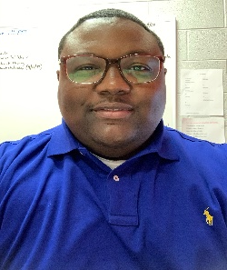
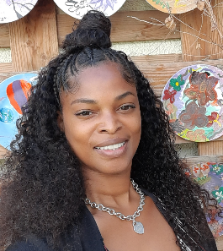
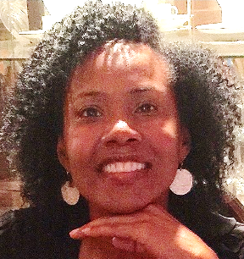
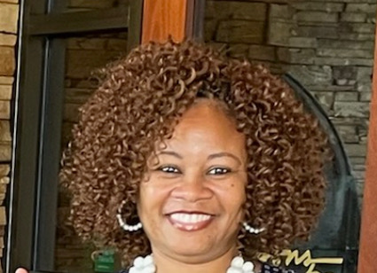
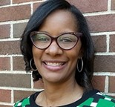
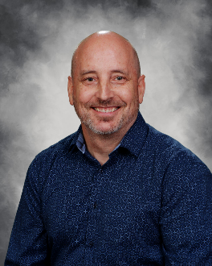
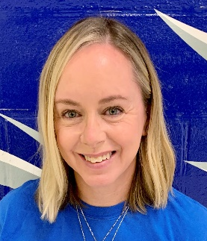
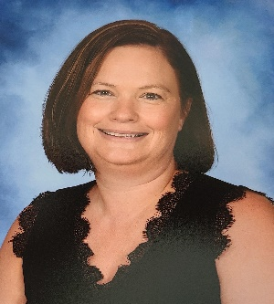
Campbell High School Counselors
Mr. Cole
A-Dan
Mrs. Burke-Collins
Dar-Ga
Dr. Amand
Ge-Man
Mrs. Wright
Mar-Rom
Mrs. Jackson
Roo-Z
Mr. Radecki
AVID, STEM &
Active ESL/IEL
Mrs. Loftin
Dual Enrollment
Mrs. Holmgren
Department Chair
www.campbellhscounseling.com

Slide 4
Mission One School, One Team, One Goal Student Success Vision Every Student, Every Day
Notes:
This is a reminder to the presenter to push the “start recording” button. See slide 5 for directions.

Slide 5
Goals for the Year
CCRPI Goal- 81
Baseline year for CCRPI. Last CCRPI score 2019-77.1
Graduation Rate- 90
2019- 87.0, 2020- 88.6, 2021-87.3, 2022-86.9
Create a Consistent Reward and Recognition Program for CHS Students
Create a School Operations Team
Create CHS Core Values

Slide 6
Advanced Learning
Advanced Placement (AP®) courses provide high school students a college-level academic experience. The College Board partners with colleges and universities to develop an appropriately challenging curriculum, to create college-level assessments, and to train teachers to deliver instruction that meets college-level standards.
AP Capstone:
AP Seminar and AP Research
Arts:
Studio Art 2D/3D/Drawing
Music Theory
English:
English Language and English Literature
World Languages:
French and Spanish Language, Spanish Literature and Japanese
STEM Related Courses:
Math: Calculus AB, Statistics and Computer Science
Science: Biology, Environmental Science and Physics
History and Social Sciences:
US and Comparative Government and Politics
World and European History
Human Geography
Microeconomics
Psychology
Honors-allows students to participate in higher level coursework
Advancement Via Individual Determination-skills-based coursework that prepares students to enter higher level coursework.
Dual Enrollment-(DE) is a program that allows high school students in the state of Georgia to take college courses that can count for credit towards both high school graduation requirements and some college requirements.

Slide 7
Career Technology Agriculture Education (CTAE)
Career Pathway Offerings
Supervisor - Mr. Joshua Ford
Audio Video Technology & Film (AVTF)
(Mr. North)
Financial Literacy, Game Design, & Web and Digital Design
(Ms. Flemming)
Law Enforcement Services
(Mr. Kimball & Mr. Chalfant)
Culinary Arts
(Chef Alentyev & Chef Gonzalez)
Computer Science
(Ms. Flemming & Dr. Winthrop)
Marketing & Management
(Ms. Lewis & Mr. Wright)
Interiors, Fashion & Textiles & Early Childhood Ed.
(Ms. Jones)
Graphic Communications & Design
(Ms. Di Natale)
Plant & Landscape Systems
(Ms. Owens)
Engineering & Technology
(Mr. W. Smith)
Army JROTC LTC. Michael Hulsey, SGM. McCabe, SGM. Martin Smith, & 1SG. Gerard Brown
Work-Based Learning
(Mr. Wright)
Notes:
This is a reminder to the presenter to push the “start recording” button. See slide 5 for directions.
Note: Potential to earn a cord and diploma seal at graduation for successfully completing the CTAE pathway and passing the EOPA.

Slide 8
Campbell High School Educational Foundation (CHSEF)

Slide 9
Campbell High School Educational Foundation (CHSEF)
CHSEF is a non-profit, tax- deductible organization formed in 1995 by concerned parents who saw a need to bring the school and community together for the benefit of our students.
The purpose of the Foundation is to provide supplemental funds to enhance the educational programs and student academic experience at Campbell. A major initiative is funding the College & Career Center programs and staff.
The Foundation’s budget is funded through the annual Susan T. Pearson Memorial Golf Tournament, the Jonquil City Jog, board member contributions, and contributions by CHS parents and alumni.

Slide 11
CHS College & Career Center
Students can make individual advisement appointment to discuss their Post-HS plan.
Students can also drop in during lunch without an appointment for time-sensitive questions.
We have two big events coming up:
Career Coaching Week – February 13 – 17
College & Career Fair – March 10 (all Juniors will attend; other students can request passes).
Encourage your student to SIGN UP or drop by the College & Career Center.
We’re down the hall from the cafeteria, across from the main Counseling office.
Questions?
Email kathy.young@cobbk12.org or shirley.diazbrown@cobbk12.org
Check the Counseling website: campbellhscounseling.com
Follow us online @campbellhscounseling (Instagram & Facebook)

Slide 12
PTSA 2022-2023 SPRING BUSINESS MEETING

Slide 14
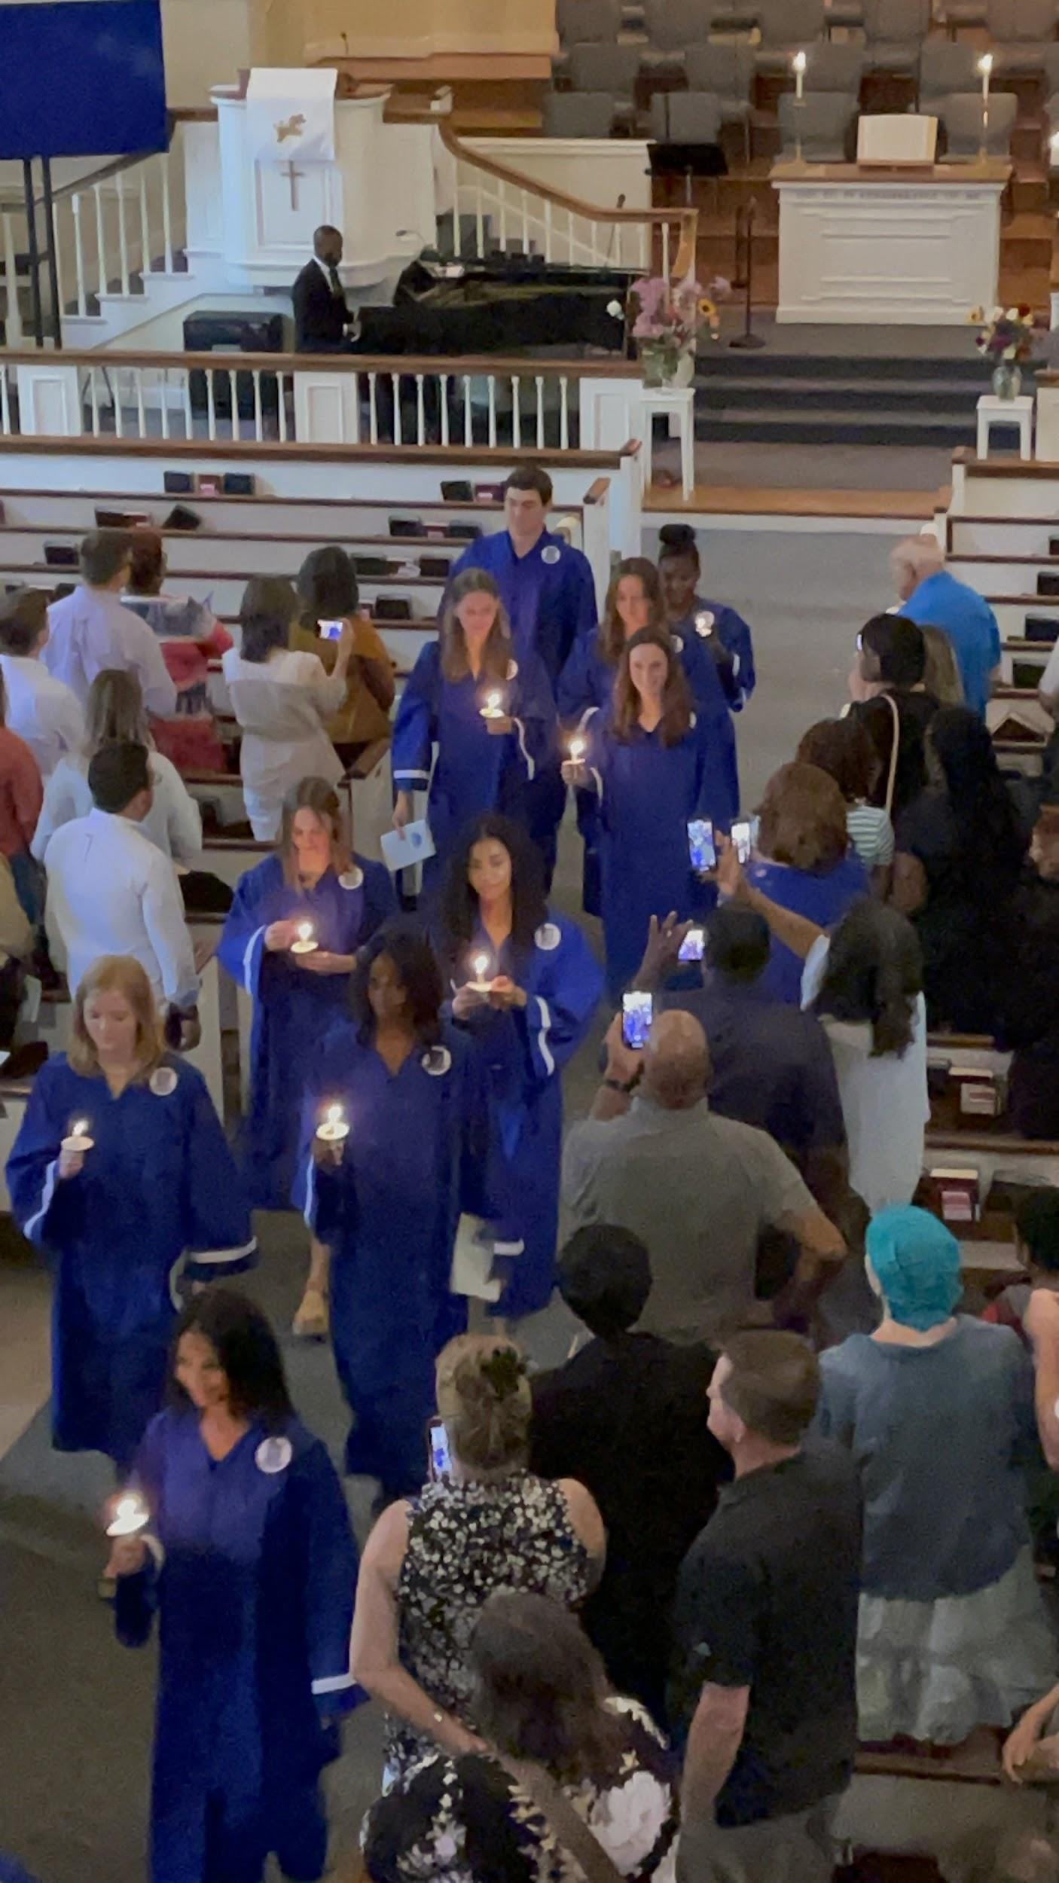
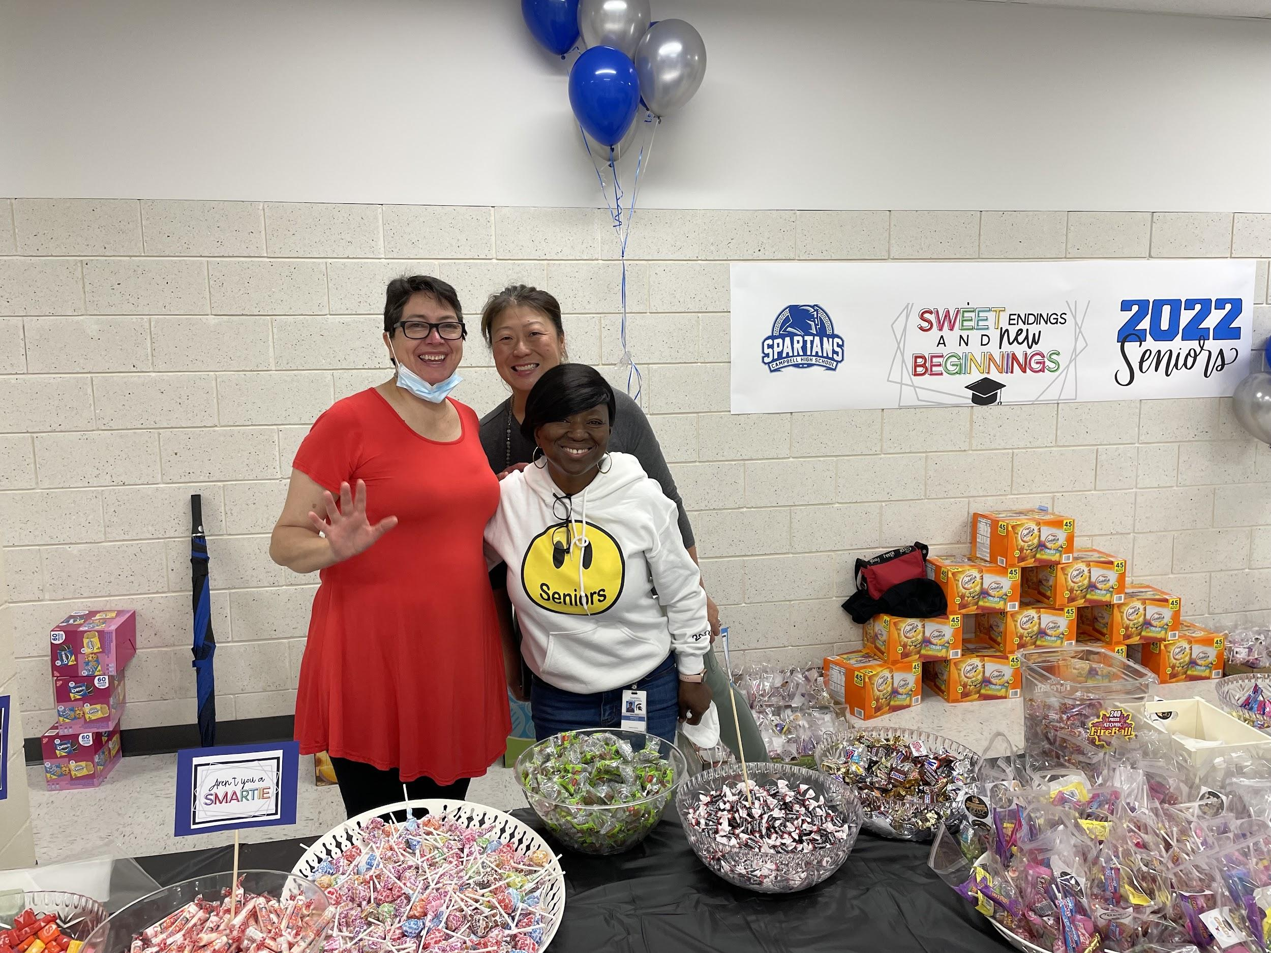
Senior Celebrations

Slide 15
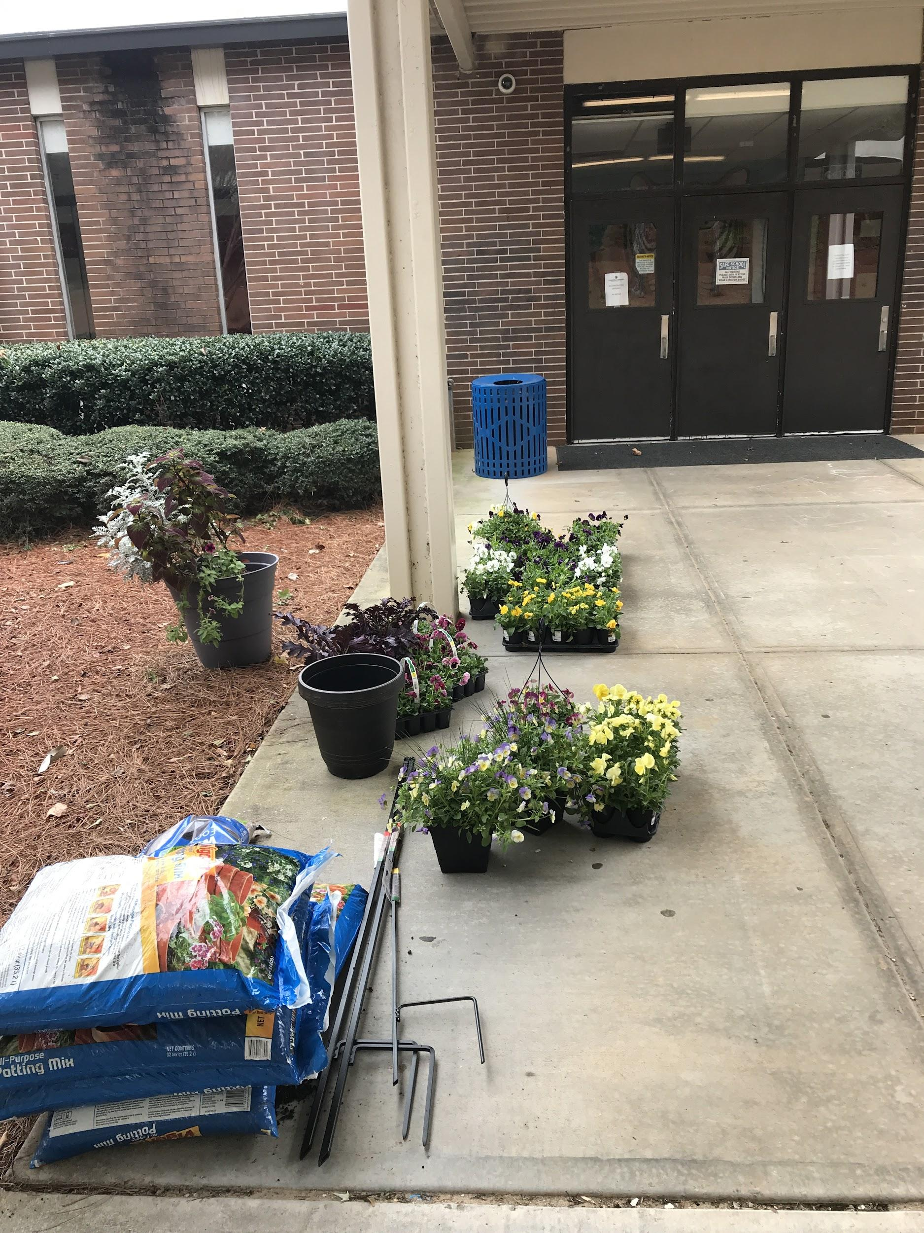
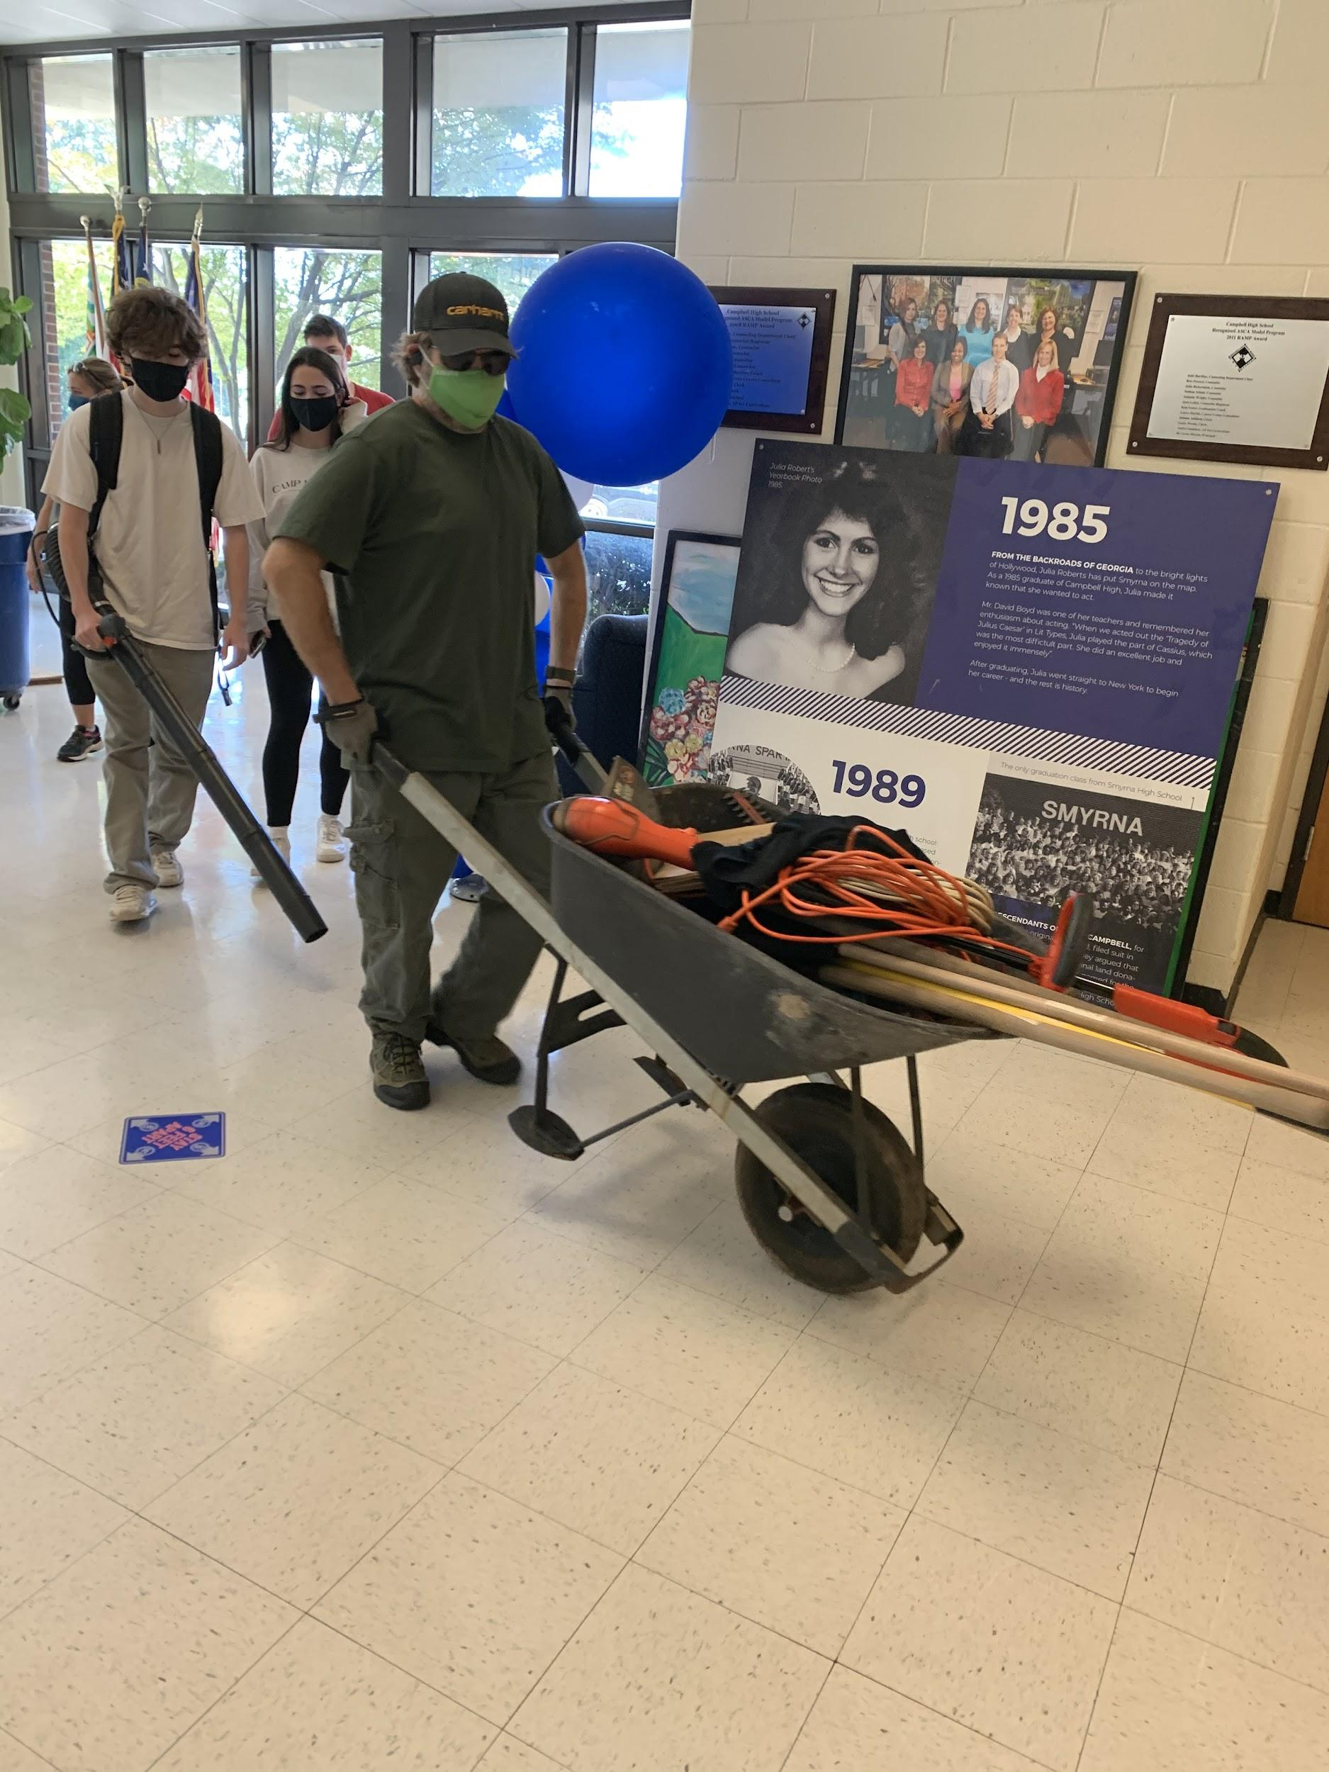
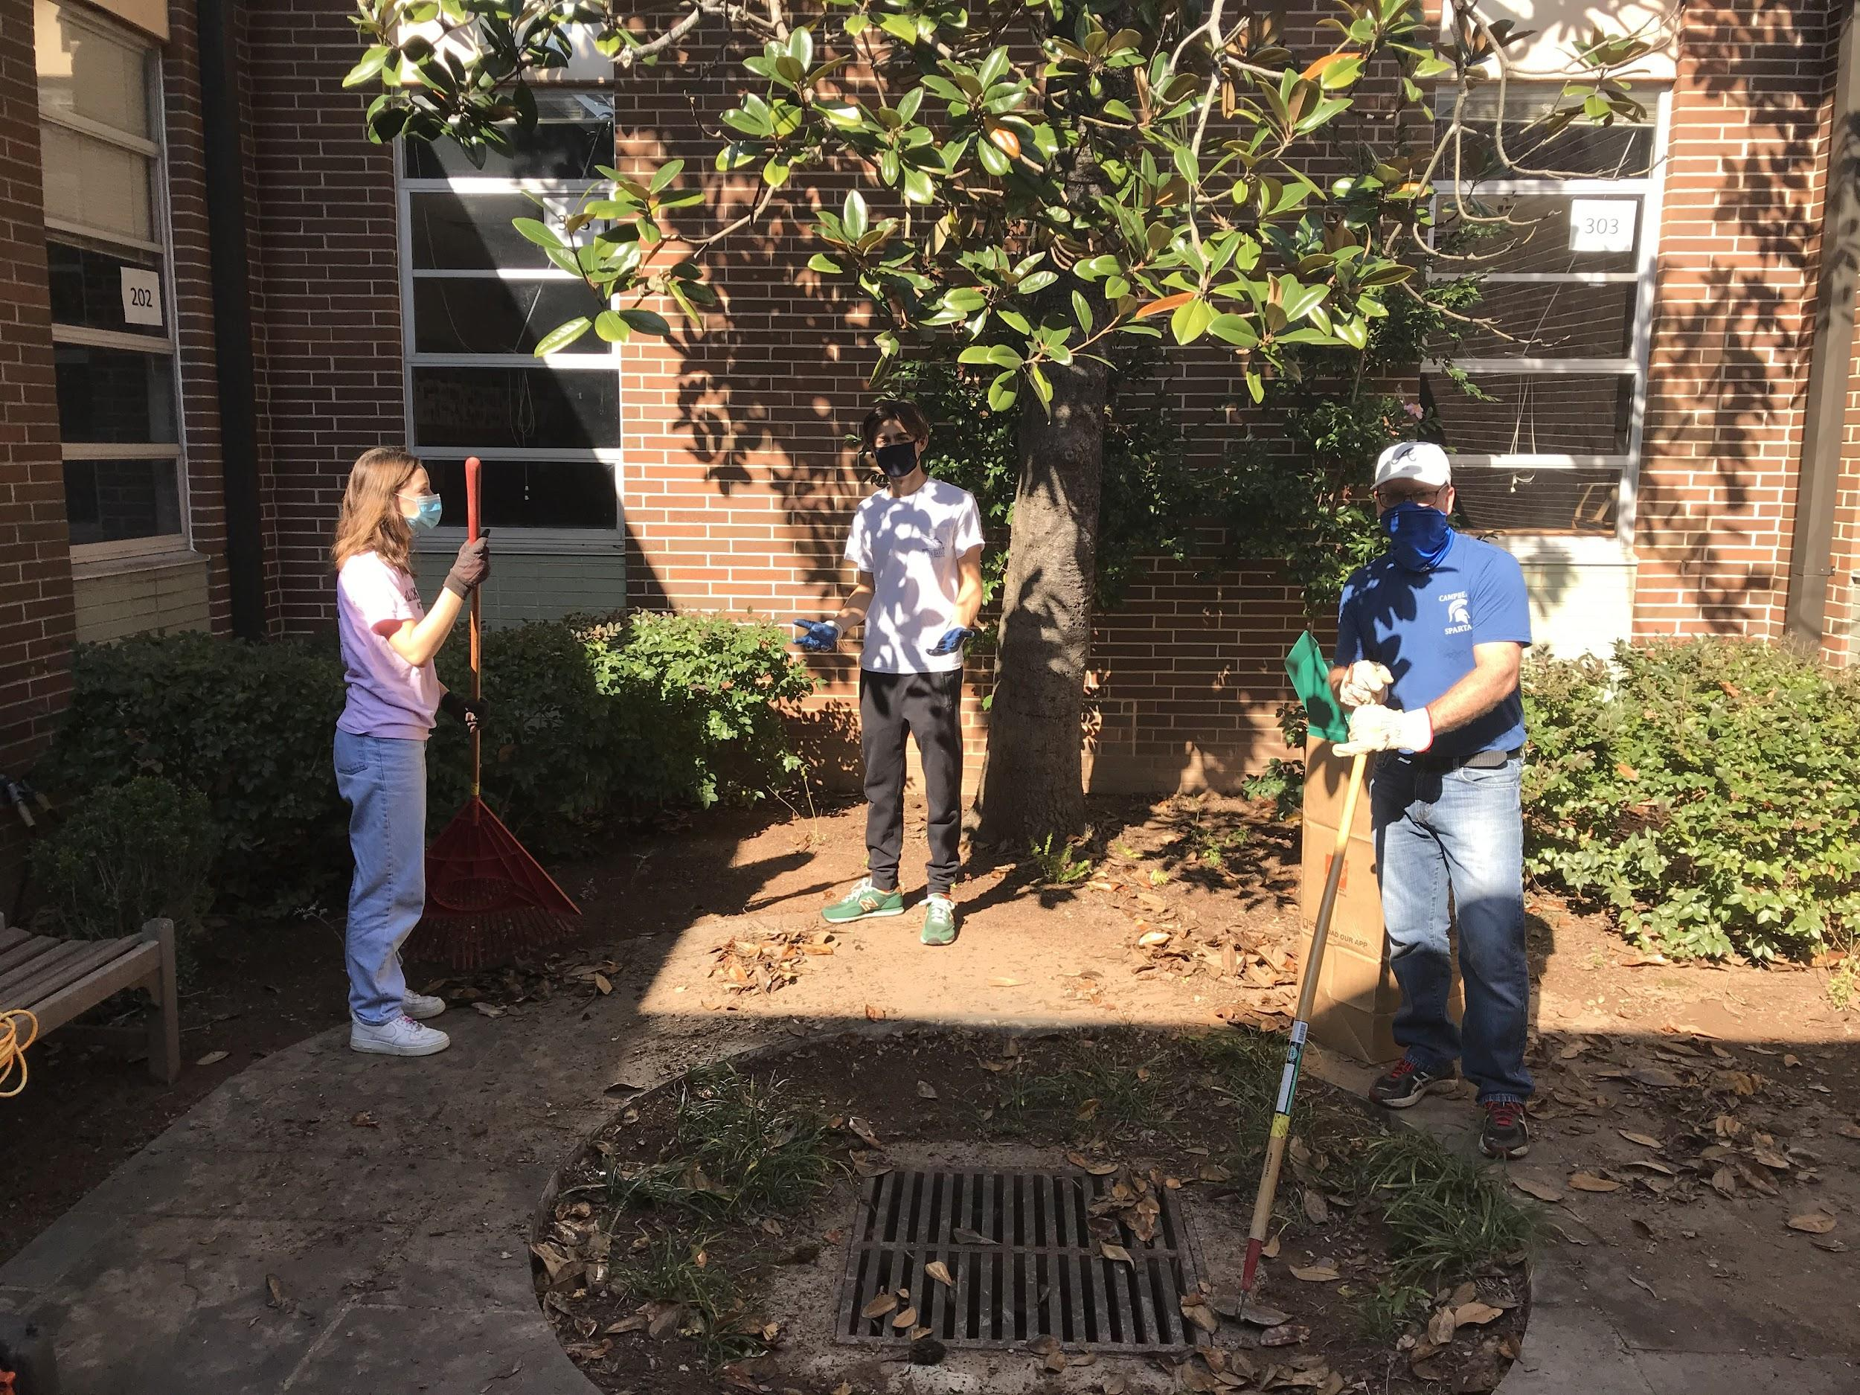
Campus Beautification

Slide 16
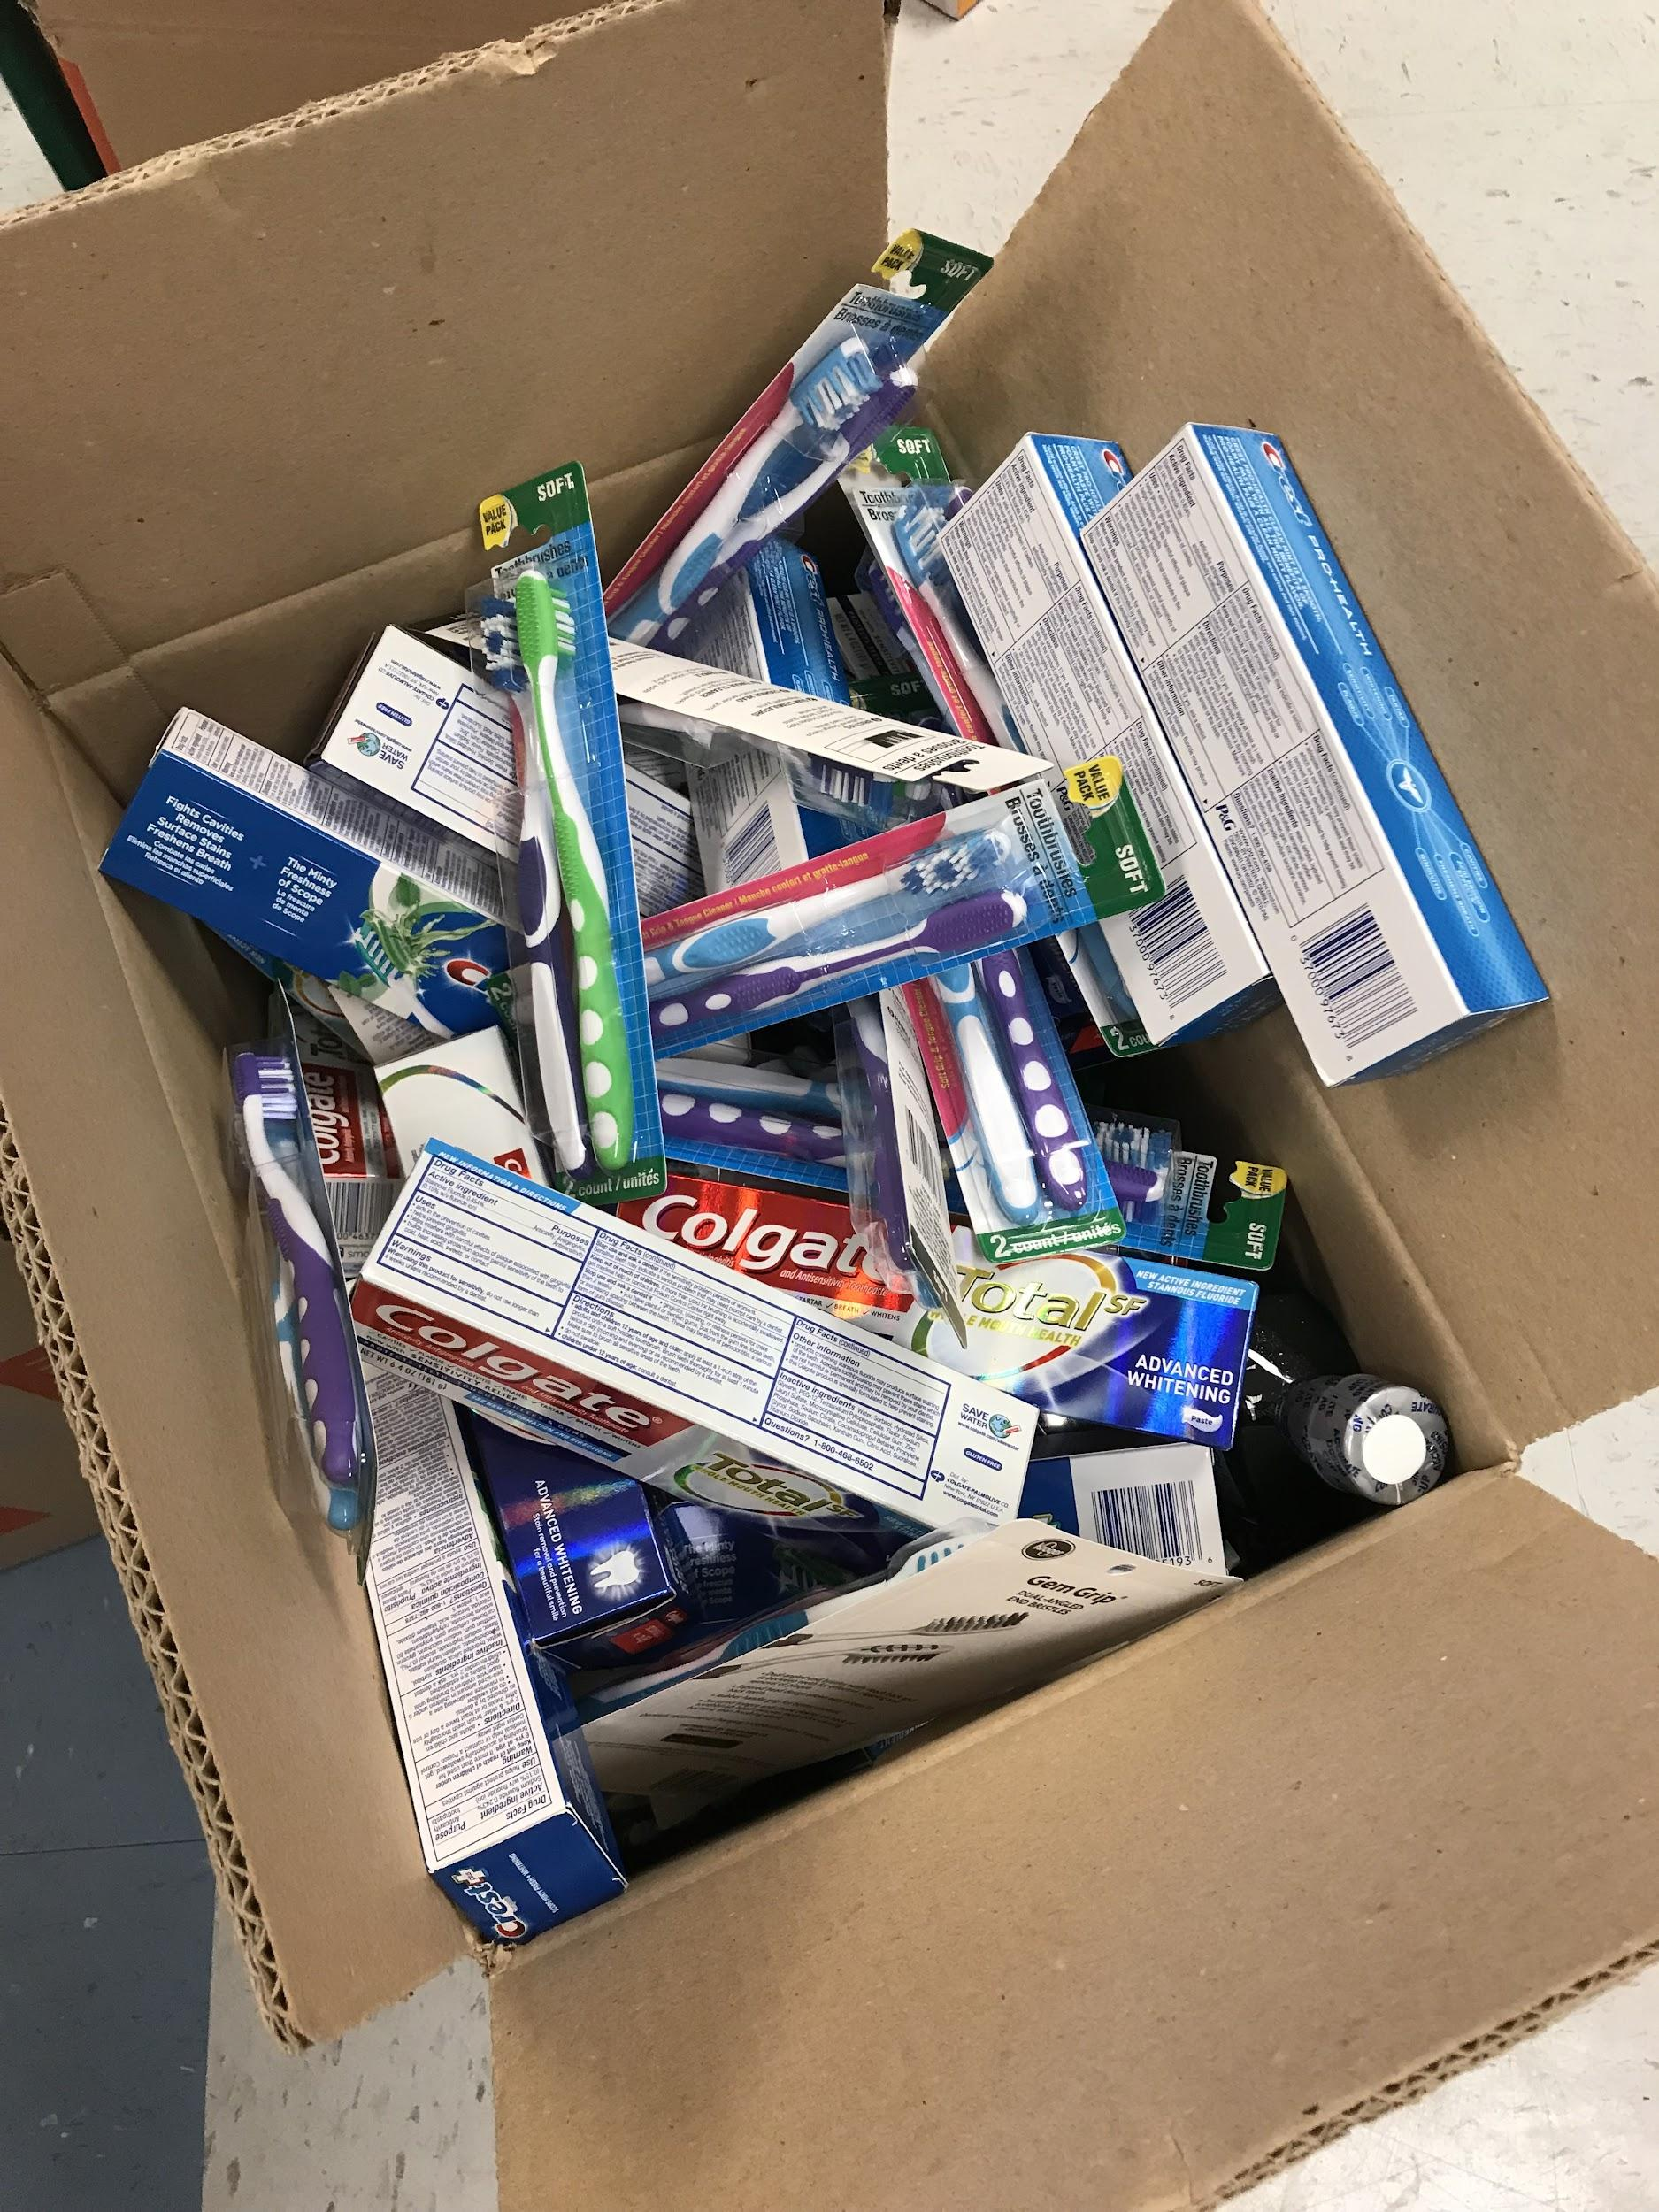
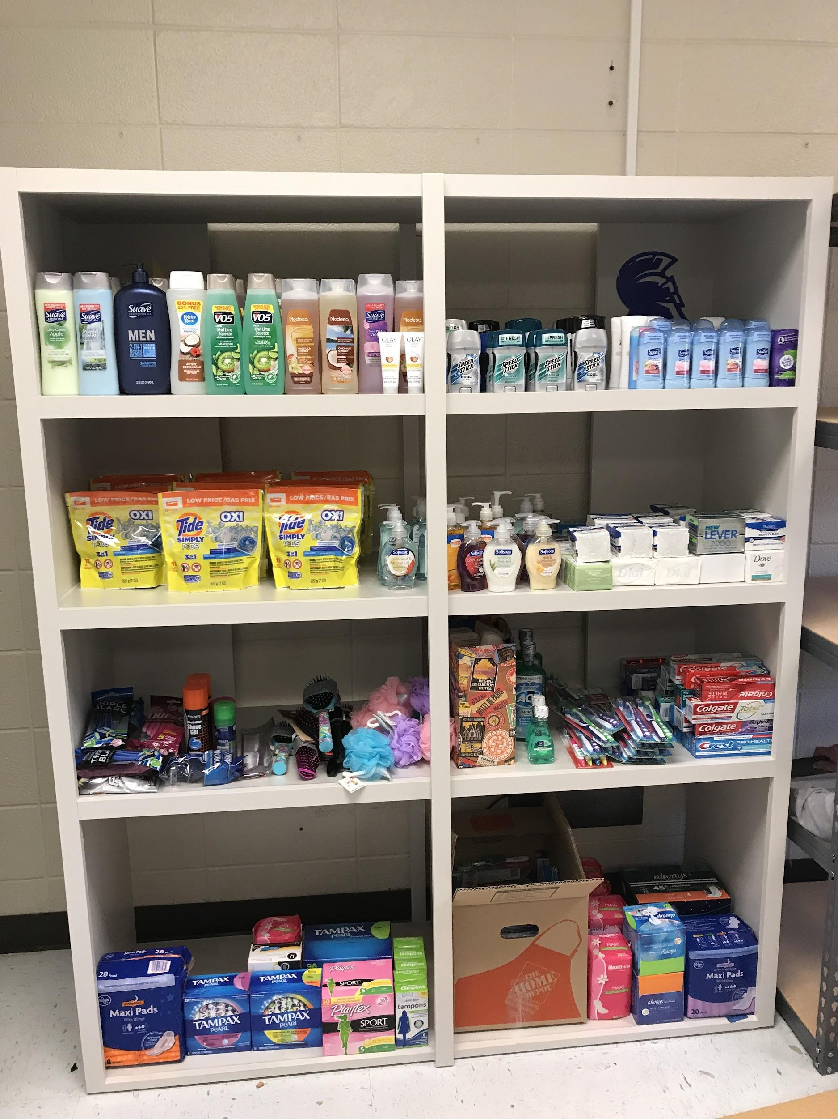
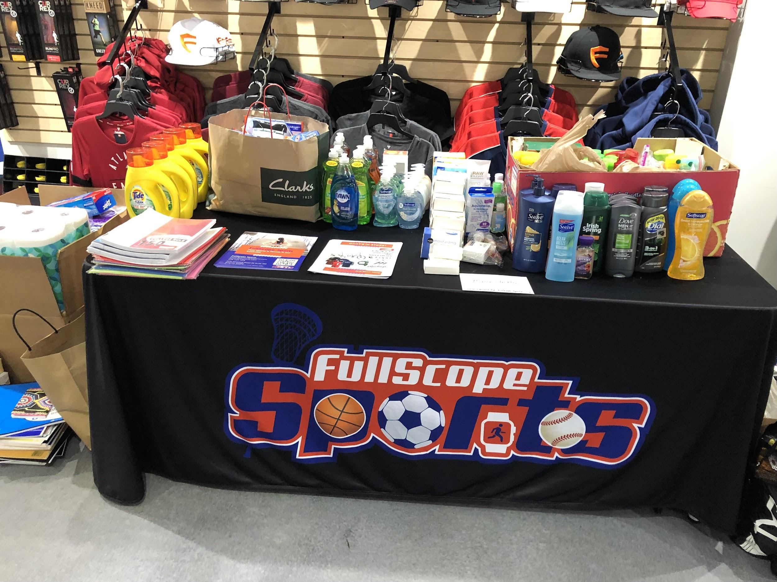
Comfort Closet

Slide 17
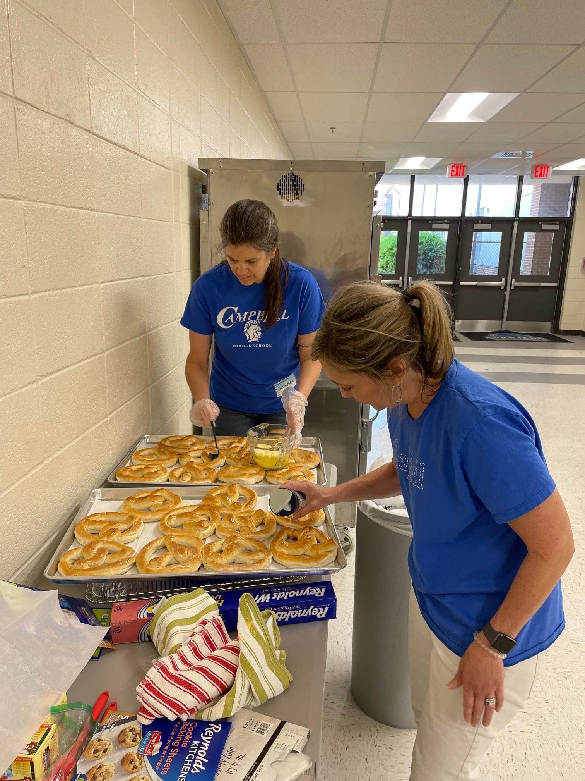
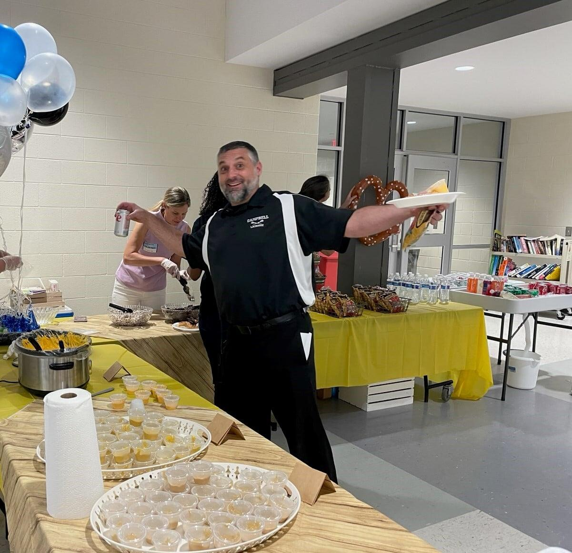
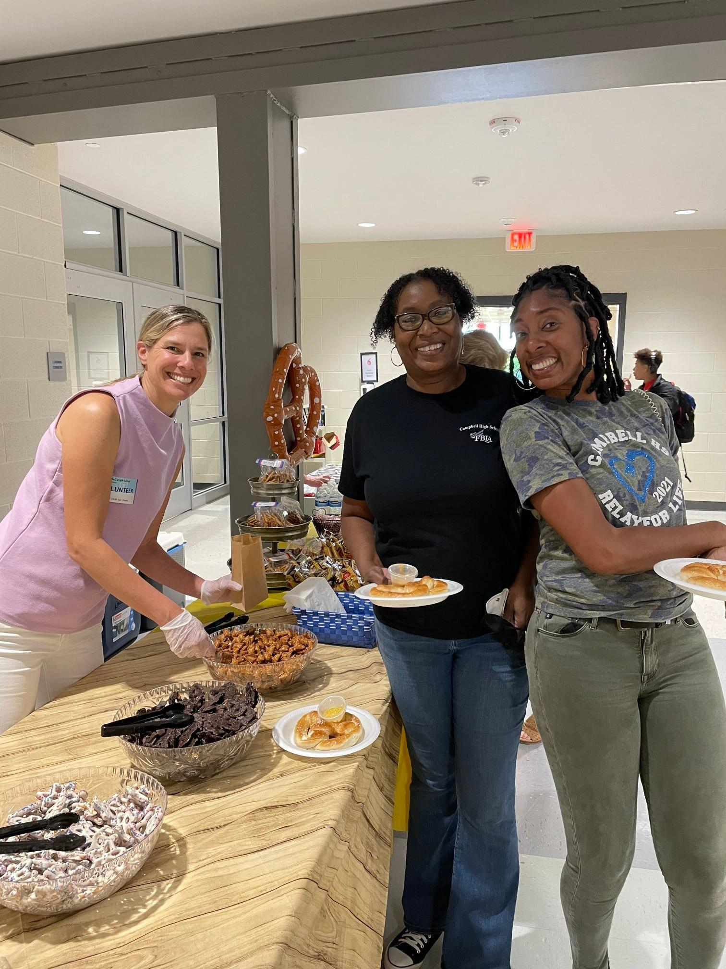
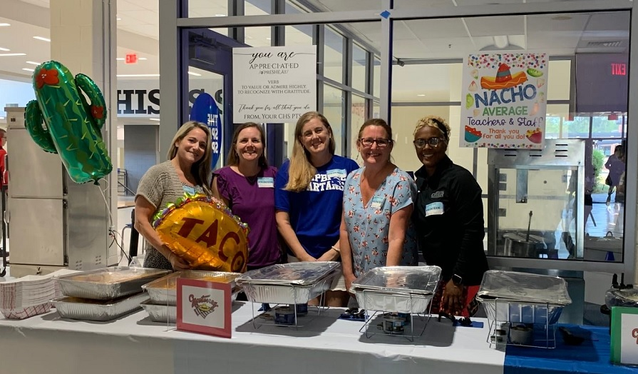
Staff Recognition

Slide 18
Email:
CampbellPTSAPresident@gmail.com
Facebook: Campbell High School PTSA
Website: www.CampbellPTSA.com

Slide 19
We have Volunteer Openings for these Committee Chairs:
Hospitality
Senior Recognition
Spirit Wear
Partners/Sponsorships

Slide 20
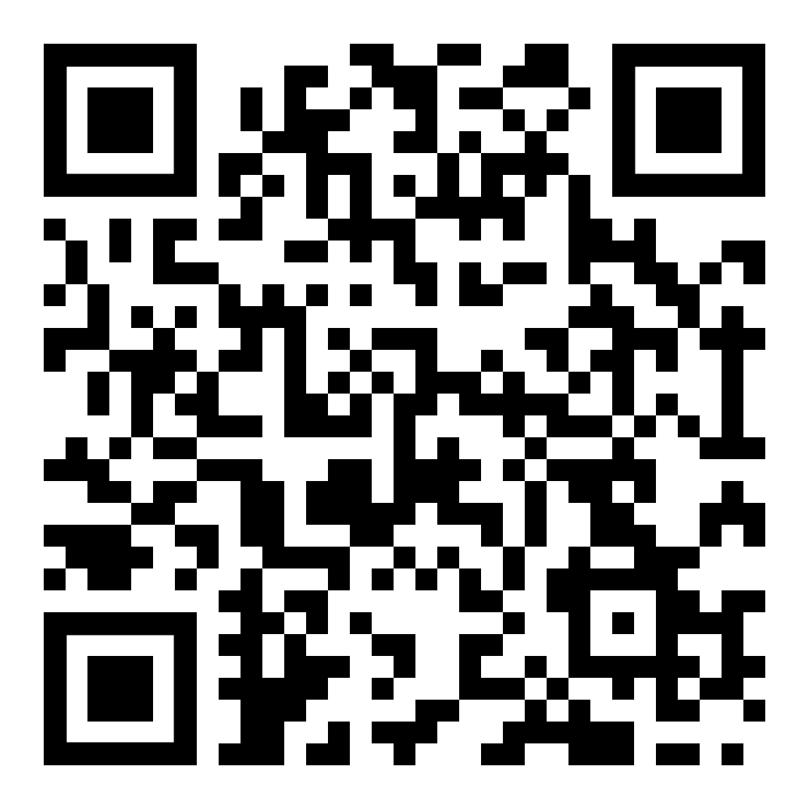
Go to the PTSA Website to:
Join PTSA!
Buy Spirit Wear!
Donate!

Slide 21
SCHEDULE
6:00-6:20 | Opening Session in the PAC
Block 1 6:30-6:40 PM | Block 1 A Day 6:30-6:36 Block 1 B Day 6:39-6:45
Block 2 6:48-6:58 PM | Block 2 A Day 6:48-6:54 Block 2 B Day 6:57-7:03
Block 3 7:06-7:16 PM | Block 3 A Day 7:06-7:12 Block 3 B Day 7:15-7:21
Block 4 7:24-7:34 PM | Block 4 A Day 7:24-7:30 Block 4 B Day 7:33-7:40
Bells will ring to change blocks only.

Slide 22
THANK YOU FOR COMING!

